Slide 1
CS2105
Introduction to Computer Networks Tutorial 4

Slide 2
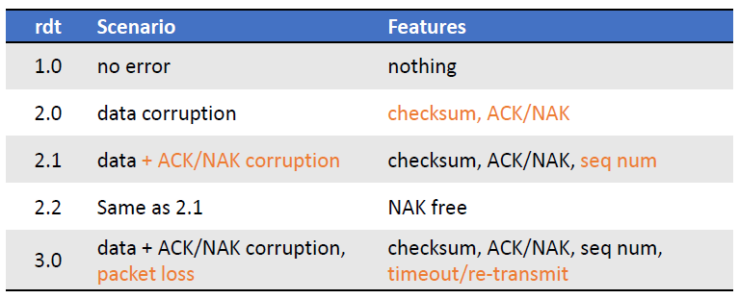
Recap
All still assume packets cannot be reordered!
Because all these are Stop-and-wait protocols

Slide 3
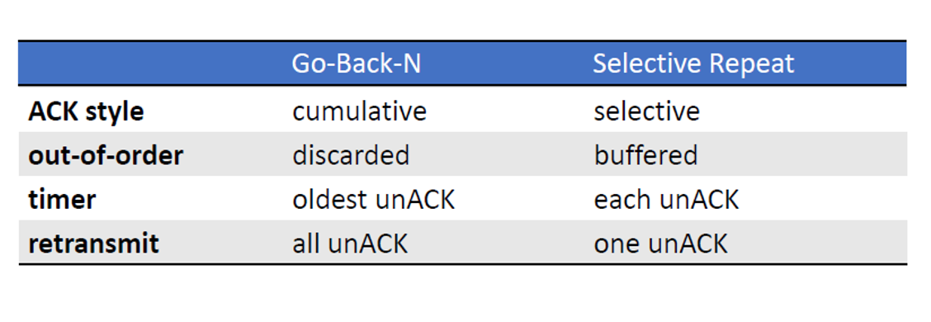
Pipelined Protocols
Same channel assumptions as rdt 3.0
Aim to increase utilization of link
Range of seq # needs to be increased

Slide 4
Pipelined Protocols
Stop-and-wait
pkt 0
ACK 0
pkt 1
Same channel assumptions as rdt 3.0
Aim to increase utilization of link
Range of seq # needs to be increased
ACK 1
pkt 0

Slide 5
Pipelined Protocols
Pipelining
pkt 0
pkt 1
pkt 0
pkt 1
Same channel assumptions as rdt 3.0
Aim to increase utilization of link
Range of seq # needs to be increased
???

Slide 6
Pipelined Protocols
Pipelining
pkt 0
pkt 1
Pkt 2
pkt 3
Same channel assumptions as rdt 3.0
Aim to increase utilization of link
Range of seq # needs to be increased

Slide 7
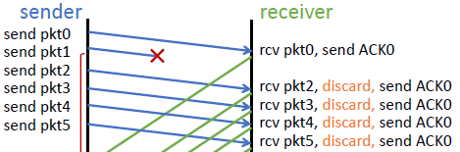
Go-Back-N
Sender sends n packets at one go
Cumulative ACK
ACK with seq # x means all packets ≤ x have been received
If receiver receives out of order packet, packet discarded and last cumulative ACK sent

Slide 8
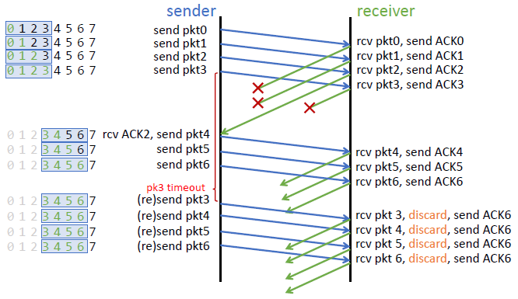
Go-Back-N
ACK with seq # x means all packets ≤ x have been received
If receiver receives out of order packet, packet discarded and last cumulative ACK sent
Sender keeps a timeout for last unACKed packet
On timeout, resends packet and other packets in window
Sequence: 0-7
window: 4 pkts

Slide 9
Go-Back-N
ACK with seq # x means all packets ≤ x have been received
If receiver receives out of order packet, packet discarded and last cumulative ACK sent
Sender keeps a timeout for last unACKed packet
On timeout, resends packet and other packets in window
Sequence: 0-7
window: 4 pkts

Slide 10
Go-Back-N
ACK with seq # x means all packets ≤ x have been received
If receiver receives out of order packet, packet discarded and last cumulative ACK sent
Sender keeps a timeout for last unACKed packet
On timeout, resends packet and other packets in window
Sequence: 0-7
window: 4 pkts

Slide 11
Go-Back-N
ACK with seq # x means all packets ≤ x have been received
If receiver receives out of order packet, packet discarded and last cumulative ACK sent
Sender keeps a timeout for last unACKed packet
On timeout, resends packet and other packets in window
Sequence: 0-7
window: 4 pkts

Slide 12

Go-Back-N
ACK with seq # x means all packets ≤ x have been received
If receiver receives out of order packet, packet discarded and last cumulative ACK sent
Sender keeps a timeout for last unACKed packet
On timeout, resends packet and other packets in window
Sequence: 0-7
window: 4 pkts
What if ACK4 reach earlier?

Slide 13
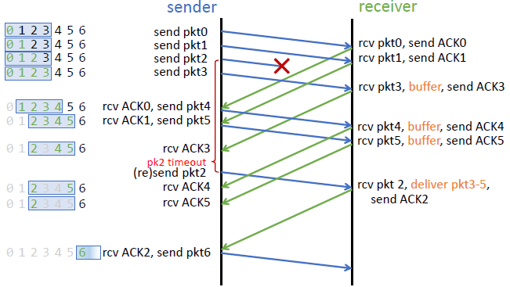
Selective Repeat
Receiver buffers out of order packets and ACKs each packet individually
Move window to last unACKed packet
Sender keeps a timer for each unACKed packet
On timeout, retransmit only that packet

Slide 14
Question 1
Is it possible for an application to enjoy reliable data transfer even
when the application runs over UDP? If so, how?
One would have to implement reliability checking and recovery mechanisms (ACK, seq#, checksum, timeout, re-transmission, etc.) at application layer. For example, sender needs to include relevant header/trailer fields in every packet

Slide 15
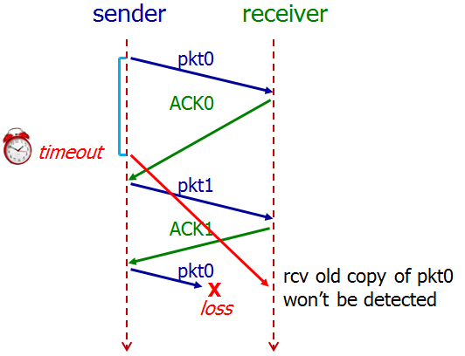
Question 2
Show an example that if the communication channel between the sender and receiver can reorder messages (i.e., two messages are received in different order they are sent), then protocol rdt3.0 will not work correctly.
Sender send pkt0 and receiver receives it and sends ACK0
ACK0 gets received by sender after pkt0’s timeout happens and sender retransmits pkt0.
After timeout, ACK0 reaches sender and it sends next packet pkt1 and receiver sends back ACK1.
Now receiver is waiting for new pkt0.
Sender sends new pkt0 but it get lost and older pkt0 (out of order) reaches receiver and it will be accepted.
Receiver cannot differentiate between old pkt0 and new pkt0.

Slide 16
Question 3
It is generally a reasonable assumption, when sender and receiver are connected by a single wire, that packets cannot be reordered within the channel between the sender and receiver. However, when the “channel’ connecting the two is a network, packet reordering may occur.
One manifestation of packet reordering is that old copies of a packet with a sequence or acknowledgement number of x can appear, even though neither sender’s nor receiver’s window contains x. With packet reordering, the channel can be thought of as essentially buffering packets and spontaneously emitting these packets at any point in the future.
What is the approach taken in practice to guard against such duplicate packets?

Slide 17
Question 3
The approach taken in practice is to ensure that a sequence number is not reused until the sender is “sure” that any previously sent packets with the same sequence number are no longer in the network.
Firstly, TCP use large sequence number field (32-bit) to lower the chance a sequence number is to be reused.
Secondly, a packet cannot “live” in the network forever. For example, IP protocol specifies TTL (Time To Live) in packet header to ensure that datagrams do not circulate infinitely in the network. This field is decreased by one each time the datagram arrives at a router along the end-to-end path. If TTL field reaches 0, router will discard this datagram. In practice, a maximum packet lifetime of approximately three minutes is assumed in the TCP extensions for high-speed networks.

Slide 18
Question 4
A
GBN
B
Pkt1
Pkt2
ACK1
Pkt3
Host A is sending data segments to Host B using a reliable transport protocol (either GBN or SR). Assume timeout values are sufficiently large such that all data segments and their corresponding ACKs can be received (if not lost in the channel) by Host B and the Host A respectively.
Suppose Host A sends 5 data segments to Host B and the 2nd data segment is lost. Further suppose retransmission is always successful. In the end, all 5 data segments have been correctly received by Host B.
How many segments has Host A sent in total and how many ACKs has Host B sent in total if either GBN or SR protocol is used? What are their sequence numbers? Answer this question for both protocols.
GBN: Host A sends 9 segment. They are initially sent segments 1, 2, 3, 4, 5 and later
resent segments 2, 3, 4 and 5. Host B sends 8 ACKs. They are 4 ACKs with seq # 1 and 4
ACKs with seq # 2, 3, 4 and 5.
SR: Host A sends 6 segment. They are initially sent segments 1, 2, 3, 4, 5 and later
resent segment 2. Host B sends 5 ACKs. They are 4 ACKs with seq # 1, 3, 4, 5 and 1 ACK
with seq # 2 (for resent segment).
Timeout/
retransmission
Pkt4
ACK1
Pkt5
ACK1
Pkt2
ACK1
Pkt3
ACK2
Pkt4
ACK3
Pkt5
ACK4
ACK5
A
SR
B
Pkt1
Pkt2
ACK1
Pkt3
Timeout/
retransmission
Pkt4
ACK3
Pkt5
ACK4
Pkt2
ACK5
ACK2

Slide 19
Question 5
TCP ACK Number
Seq# of the next byte of data expected by the receiver
Suppose Host A sends two TCP segments back to back to Host B over a TCP connection. The first segment has sequence number 65; the second has sequence number 92.
a) How much data is in the first segment?
92 – 65 = 27 bytes // TCP sequence number: byte number of the first byte of data in a segment.
b) Suppose that the first segment is lost but the second segment arrives at B. In the
acknowledgment that Host B sends to Host A, what will be the acknowledgment
number?
65. Note that TCP acknowledgment is cumulative and states the expected in-order sequence number.
(Acknowledgement number: seq # of the next byte of data expected by receiver. TCP ACKs up to the first missing byte in the stream (cumulative ACK).)

Slide 20
Question 6
Consider transferring an enormous file of L bytes from Host A to Host B. Assume an MSS of 512 bytes. (MSS: Maximum Segment Size)
a) What is the maximum value of L such that TCP sequence numbers are not
exhausted? Recall that the TCP sequence number field is 32 bits.
TCP sequence number doesn’t increase by one with each TCP segment. Rather, it increases by the number of bytes of data sent. Therefore the size of the MSS is irrelevant here -- the maximum size file that can be sent from A to B without exhausting TCP sequence number is simply 2³² bytes.

Slide 21
Question 6
For the L you obtain in (a), find how long it takes to transmit this file. Assume that a
total of 64 bytes of transport, network, and data-link header are added to each
packet before the resulting packet is sent out over a 155 Mbps link. Ignore flow
control, congestion control and assume Host A can pump out all segments back to
back and continuously.
Number of packets = L / MSS = 2³² / 512 = 8,388,608
64 bytes of headers will be added to each packet. Therefore,
Total bytes sent = Data + number of packet * header bytes
2³² + 8388608 * 64 = 4,831,838,208 bytes
Transmission delay = 4831838208 * 8 / (155 * 10⁶) ≈ 249 seconds

Slide 22
Wireshark: TCP
Start up your web browser. Go the http://gaia.cs.umass.edu/wiresharklabs/alice.txt and retrieve an ASCII copy of Alice in Wonderland. Store this file somewhere on your computer.
Next, go to http://gaia.cs.umass.edu/wireshark-labs/TCP-wireshark-file1.html
Use the Browse button to enter the full path name on your computer containing Alice in Wonderland. Don’t yet press the “Upload alice.txt file” button.
Startup Wireshark and begin packet capture.
Returning to your browser, press the “Upload alice.txt file” button. Once the file has been uploaded, a short congratulations message will be displayed in your browser window.
Stop Wireshark packet capture.

Slide 23
Question 7
Answer the following questions:
1. What is the IP address and TCP port number used by the client computer (source) that is transferring the file to gaia.cs.umass.edu?
Select an HTTP message sent from your computer to gaia.cs.umass.edu and explore the details (src-ip & src-port) of the TCP packet used to carry this HTTP message.
2. What is the IP address of gaia.cs.umass.edu? On what port number is it sending and receiving TCP segments for this connection?
ip: select an HTTP message explore the details of the TCP packet used to carry this HTTP message. port: 80.

Slide 24
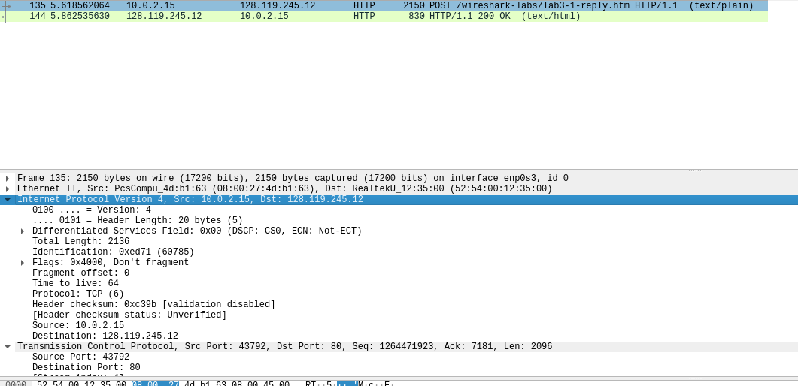

Slide 25
End of Tutorial

Slide 26
A Go-Back-N sender just receives an ACK packet with sequence number 14. This ACK number falls within sender’s window. Sender’s window size is 6. Every packet embeds a 𝑘-bit sequence number field. Which of the following definitely CANNOT be the sequence number of the next packet transmitted by the sender?
A. 9
B. 4
C. 15
D. 19
E. 20

Slide 27
A Go-Back-N sender just receives an ACK packet with sequence number 14. This ACK number falls within sender’s window. Sender’s window size is 6. Every packet embeds a 𝑘-bit sequence number field. Which of the following definitely CANNOT be the sequence number of the next packet transmitted by the sender?
A. 9
B. 4
C. 15
D. 19
E. 20
sequence# is bounded by the number of bits reserved for the sequence
If you have 1 bit, you can only have sequence number 0,1
If you have 2 bits, you can have sequence numbers from 0-3
If 3 bits -> seq# 0-7
4 bits -> seq# 0-15
…

Slide 28
A Go-Back-N sender just receives an ACK packet with sequence number 14. This ACK number falls within sender’s window. Sender’s window size is 6. Every packet embeds a 𝑘-bit sequence number field. Which of the following definitely CANNOT be the sequence number of the next packet transmitted by the sender?
A. 9
B. 4
C. 15
D. 19
E. 20
0 | 1 | 2 | 3 | 4 | 14 | 15
Third sequence number within the window | Fourth sequence number within the window | Fifth sequence number within the window | Sixth sequence number within the window | Next Packet to Transmit | ACK RCV, First sequence number within the window | Second sequence number within the window
ANS: 2⁴, so loopback

Slide 29
A Go-Back-N sender just receives an ACK packet with sequence number 14. This ACK number falls within sender’s window. Sender’s window size is 6. Every packet embeds a 𝑘-bit sequence number field. Which of the following definitely CANNOT be the sequence number of the next packet transmitted by the sender?
A. 9
B. 4
C. 15
D. 19
E. 20
9 | 10 | 11 | 12 | 13 | 14 | 15
ACK Lost, First sequence number within the window | ACK Lost, Second sequence number within the window | ACK Lost, Third sequence number within the window | ACK Lost, Fourth sequence number within the window | ACK Lost, Fifth sequence number within the window | ACK RCV, Sixth sequence number within the window | Next Packet to Transmit

Slide 30
A Go-Back-N sender just receives an ACK packet with sequence number 14. This ACK number falls within sender’s window. Sender’s window size is 6. Every packet embeds a 𝑘-bit sequence number field. Which of the following definitely CANNOT be the sequence number of the next packet transmitted by the sender?
A. 9
B. 4
C. 15
D. 19
E. 20
13 | 14 | 15 | 16 | 17 | 18 | 19
ACK Lost, First sequence number within the window | ACK RCV, Second sequence number within the window | Third sequence number within the window | Fourth sequence number within the window | Fifth sequence number within the window | Sixth sequence number within the window | Next Packet to Transmit
5 bits -> 2^5 sequence numbers -> seq# 0 to 31

Slide 31
A Go-Back-N sender just receives an ACK packet with sequence number 14. This ACK number falls within sender’s window. Sender’s window size is 6. Every packet embeds a 𝑘-bit sequence number field. Which of the following definitely CANNOT be the sequence number of the next packet transmitted by the sender?
A. 9
B. 4
C. 15
D. 19
E. 20
14 | 15 | 16 | 17 | 18 | 19 | 20
ACK RCV, First sequence number within the window | Second sequence number within the window | Third sequence number within the window | Fourth sequence number within the window | Fifth sequence number within the window | Sixth sequence number within the window | Next Packet to Transmit

