Slide 1
CS2105 Introduction to Computer Networks Tutorial 5

Slide 2
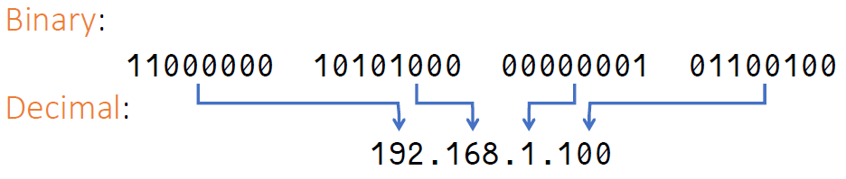
Recap
IPv4 addresses
32 bit addresses, expressed in dot-decimal notation (4 * 8 bits)
E.g.
Special IP addresses exist that are reserved
127.0.0.1/8 (localhost)
255.255.255.255/32 (Broadcast address)
0.0.0.0/8 (private addresses)
…
One IP address for one network interface (WiFi, Ethernet…)

Slide 3
Recap
23 bits wide
IP addresses starting with same prefix belong in same subnet:
From: 11001000 00010111 00010000 00000000 = 200.23.16.0
To: 11001000 00010111 00010001 11111111 = 200.23.17.255
How many IP addresses in subnet?
2³²⁻²³ = 2⁹ addresses
Subnet Mask
E.g. /23 = 11111111 11111111 11111110 00000000 = 255.255.254.0

Slide 4
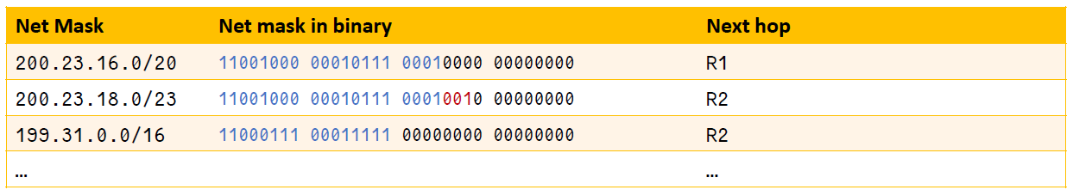
Recap
Longest Prefix Match
Algo for router to decide where to send packets
E.g. For packet with destination IP 200.23.19.0
Sent to R2 by the longest prefix that matched

Slide 5
Recap
Dynamic Host Configuration Protocol (DHCP)
Used to obtain IP address when a host joins a network
New host broadcasts Discover message:
Source IP: 0.0.0.0:68
Dest IP: 255.255.255.255:67
yiaddr: 0.0.0.0
ID: 123
Host sends Request:
Source IP: 0.0.0.0:68
Dest IP: 255.255.255.255:67
yiaddr: New IP address
ID: 124
DHCP server replies with Offer:
Source IP: Server IP
Dest IP: 255.255.255.255:68
yiaddr: New IP address
ID: 123
DHCP server replies with Ack:
Source IP: Server IP
Dest IP: 255.255.255.255:68
yiaddr: New IP address
ID: 124

Slide 6
Question 1
What is the 32-bit binary equivalent of the IP address 202.3.14.25?
11001010 00000011 00001110 00011001
2⁷ | 2⁶ | 2⁵ | 2⁴ | 2³ | 2² | 2¹ | 2⁰
128 | 64 | 32 | 16 | 8 | 4 | 2 | 1

Slide 7
Question 2
Suppose an application generates chunks of 40 bytes of data every 20 msec, and each chunk gets encapsulated in a TCP segment and then an IP datagram. Assume TCP header is 20 bytes and IP header is another 20 bytes, what percentage of each datagram will be overhead, and what percentage will be application data?
IP datagram size is 80 bytes which consists of 40 bytes of header and 40 bytes of data. Thus percentage of overhead and data is each 50%.

Slide 8
Question 3
Combine the following three blocks of IP addresses into a single block:
a) 16.27.24.0/26
b) 16.27.24.64/26
c) 16.27.24.128/25
Host bit = 32-26 = 6
Number of IP addresses in a) = 2⁶
First addr: 16.27.24.0 Last addr : 16.27.24.63
Number of IP addresses in b) = 2⁶
First addr: 16.27.24.64 Last addr : 16.27.24.127
Host bit = 32-25 = 7
Number of IP addresses in c) = 2⁷
First addr: 16.27.24.128 Last addr : 16.27.24.255
2⁸ = 256 IP addresses
Combine: 16.27.24.0 to 16.27.24.255 : 16.27.24.0/24
Additional Information
a) 16.27.24.0/26
Address (16.27.24.0) :00010000.00011011.00011000.00000000
Netmask : 11111111 11111111 11111111 11000000 (26 1’s)
First IP address in this subnet
00010000.00011011.00011000.00000000 (Address)
11111111 11111111 11111111 11000000 (Netmask) Logical AND
00010000.00011011.00011000.00000000 = 16.27.24.0 (First IP Address)
Last IP address in this subnet
00010000.00011011.00011000.00000000 (Address)
00000000 00000000 00000000 00111111 (Netmask 1’s complement) OR
00010000.00011011.00011000.00111111 = 16.27.24.63 (Last IP Address)

Slide 9
Question 4
Consider a subnet with network prefix 192.168.56.128/26. Give an example IP address (of form xxx.xxx.xxx.xxx) that belongs to this network.
Host bit = 32 – 26 = 6
2⁶ = 64
11000000 10101000 00111000 10000000
11000000 10101000 00111000 10111111
Any IP address in the range 192.168.56.128 to 192.168.56.191

Slide 10
Question 4
b) Suppose an ISP owns the block of addresses of the form 192.168.56.128/26. Suppose it wants to create four subnets from this block, with each block having the same number of IP addresses. What are the network prefixes (of form a.b.c.d/x) for the four subnets?
(Hint: 4 subnet: 2 bits to represent each subnet after 26 bits)

Slide 11
Question 4

Slide 12
Additional Question
Address Block: 192.168.56.128/26
Split into 16 equal subnets.
How many IP addresses in each subnet.
A. 4
B. 2
C. 64
D. 32

Slide 13
Additional Question
Address Block: 192.168.56.128/26
Split into 16 equal subnets.
How many IP addresses in each subnet.
A. 4
B. 2
C. 64
D. 32
4 bits needed for splitting into 16 subnets (2⁴)
Number of host bits left for each subnet = 32 – 30 = 2
Number of IP address in each subnet = 2²

Slide 14
Question 5
Consider a datagram network using 8-bit addresses. Suppose a router has the following forwarding table:
Prefix Match | Interface
11 | 0
101 | 1
100 | 2
otherwise | 3

Slide 15
Question 5
For each of the four interfaces, give the associated range of destination host addresses and the number of addresses in the range.
Prefix Match | Interface | IP Range | No. of IP
11 | 0 | 1100 0000 – 1111 1111 | 64
101 | 1 | 1010 0000 – 1011 1111 | 32
100 | 2 | 1000 0000 – 1001 1111 | 32
otherwise | 3 | 0000 0000 – 0111 1111 | 128

Slide 16
Question 6
What is private IP address? Does LumiNUS use private or public IP? When your laptop is connected to NUS network, does it receive a private or public IP?
https://tools.ietf.org/html/rfc1918
The Internet Assigned Numbers Authority (IANA) has reserved the following three blocks of IP address space for private networks:
10.0.0.0 - 10.255.255.255 (10/8 prefix)
172.16.0.0 - 172.31.255.255 (172.16/12 prefix)
192.168.0.0 - 192.168.255.255 (192.168/16 prefix)
LumiNUS use public IP address (137.132.10.10). Students may use ping command to check it. Laptops of students are assigned private IP addresses (e.g., 172.26.184.76).

Slide 17
End of Tutorial

Slide 18
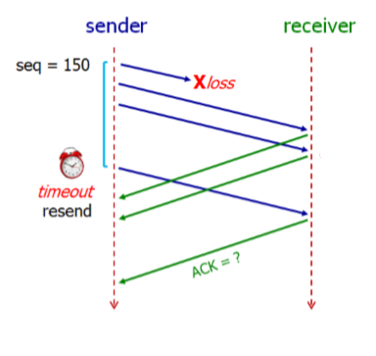
Consider the following diagram in which sender sends 3 TCP segments to receiver. MSS is 100 bytes. The first segment is lost and retransmitted when timer expires. Receiver buffers out-of-order segments for eventual in-order delivery to application.
What is the smallest and largest possible ACK numbers in the last acknowledgement packet?
Remember: ACK number is the packet number that it expects to receive next
A. 350; 450
B. 150; 450
C. 50; 350
D. 150; 350
E. None of the above

Slide 19
Consider the following diagram in which sender sends 3 TCP segments to receiver. MSS is 100 bytes. The first segment is lost and retransmitted when timer expires. Receiver buffers out-of-order segments for eventual in-order delivery to application.
What is the smallest and largest possible ACK numbers in the last acknowledgement packet?
A. 350; 450
B. 150; 450
C. 50; 350
D. 150; 350
E. None of the above
250
350
150
ACK150 if packet retransmitted is corrupted
If retransmitted packet is not corrupted then ACK450

