Slide 1
CS2105 Introduction to Computer Networks Tutorial 6

Slide 2
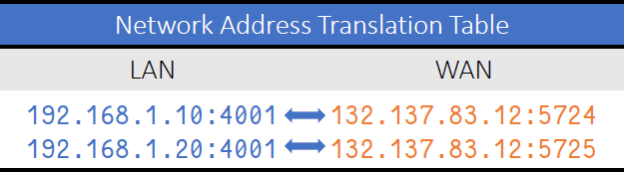
Recap
Network Address Translation (NAT)
Each interface in local network has IP address in reserved range
10.0.0.0/8 → 10.0.0.0 to 10.255.255.255
172.16.0.0/12 → 172.16.0.0 to 172.31.255.255
192.168.0.0/16 → 192.168.0 0 to 192.168.255.255
Router maintains one external IP address
Each local IP/port is mapped to an external port
Different hosts on same local network have same external IP address
Router needs to store NAT table in memory

Slide 3
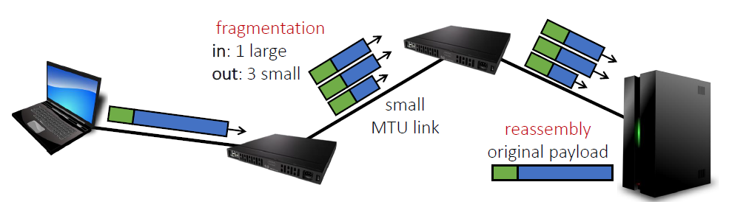
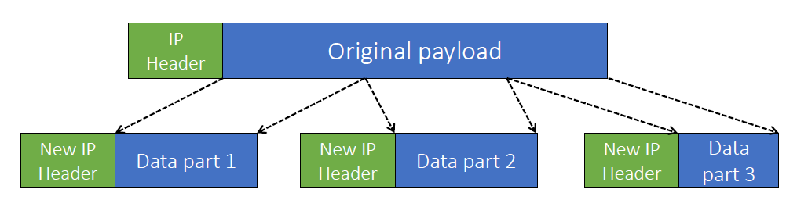
Recap
IP Datagrams:
Header + Data
Data may be split up according to MTU of links
New header added to each smaller “part”
Length includes header!

Slide 4
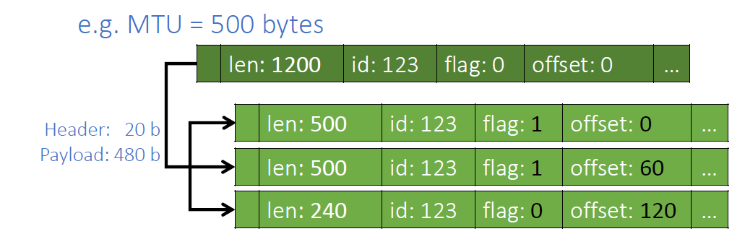
Recap
IP Datagrams:
Offset
First “byte number” of data in multiples of 8-bytes
Frag Flag
Signifies when fragment is last fragment of original IP datagram
Header: 20
Data: 1180

Slide 5
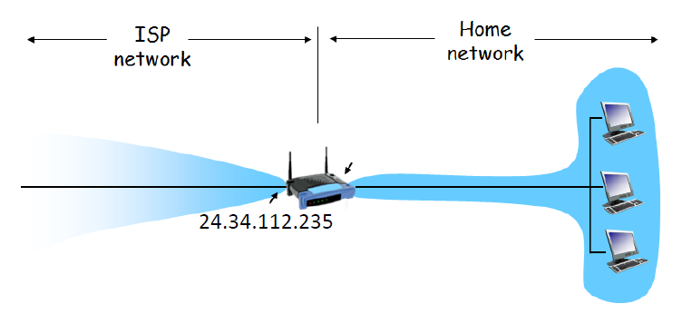
Question 1
Consider the network setup in the following figure. Suppose that the ISP assigns the router the address 24.34.112.235 and that the network address (i.e. network prefix) of this home network is 192.168.1/24.

Slide 6
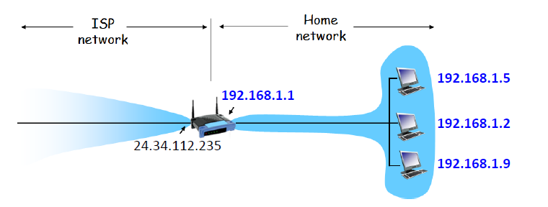
Question 1
a) Give an example IP address assignment to all interfaces in this home network.

Slide 7
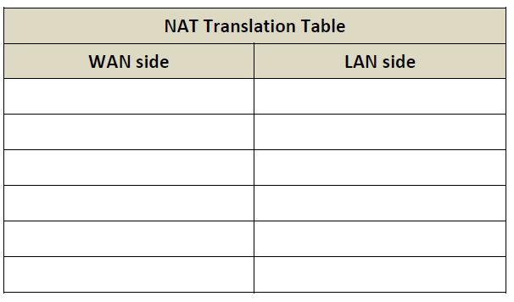
Question 1
b) Suppose each host has two ongoing TCP connections, all to port 80 of a server at 128.119.40.86. Provide example corresponding entries in the NAT translation table.

Slide 8
Question 1
Hint
NAT routers must: Replace (source IP address, port #) of every outgoing datagram to (NAT IP address, new port #).
Replace (NAT IP address, new port #) in destination fields of every incoming datagram with corresponding (source IP address, port #) stored in NAT translation table.

Slide 9
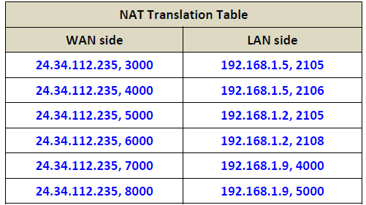
Question 1

Slide 10
Question 2
Consider sending a 1500-byte IP datagram into a link that has an MTU (Maximum Transmission Unit) of 500 bytes. Suppose the original datagram is stamped with the identification number 422. Also assume that IP header is 20 bytes long.
How many fragments will be generated?
Data (segment) length = 1500 – 20 = 1480 (due to 20 bytes IP header)
Maximum size of data in each fragment = 500 – 20 = 480
Number of fragments = ⌈1480/480⌉ = 4

Slide 11
Question 2
b) What is the length of each fragment (including IP header)?
1st – 3rd fragments have length 500. 4th fragment has length 60.
(
total data you need to send = 1480 bytes
Total data sent in the first 3 fragments = 480 * 3 = 1440 bytes
Last fragment contains 1480-1440 = 40 bytes of DATA
After adding 20 bytes of HEADER, total length of 4th fragment = 60
)

Slide 12
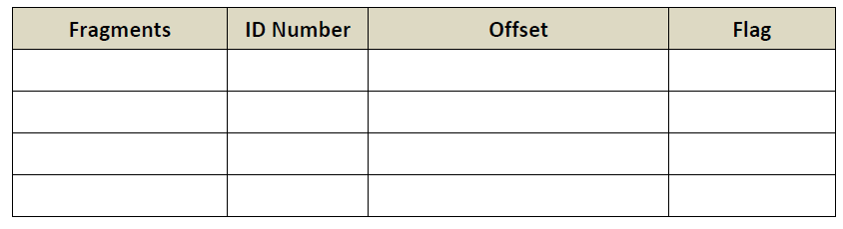
Question 2
c) What are the values of identification number, offset and flag in each fragment?

Slide 13
Question 2
Hint
ID number same for whole datagram/segment
Flag (fragment flag) is set to
1 if there is next fragment from the same segment.
0 if this is the last fragment.
Offset is in expressed in unit of 8-bytes.
Eg: Fragment 1: offset =0
Fragment 2 :offset = 60 ( 60* 8 = 480 bytes)
Fragment 3: offset = 120 ( 120 * 8 = 960)

Slide 14
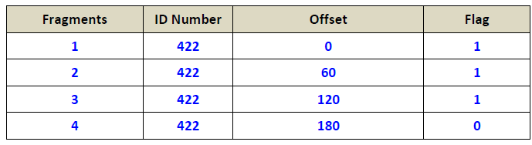
Question 2
First byte of segment
0
480
960
1440

Slide 15
Question 2
Length: 1500 (1480+20) | ID=422 | Flag=0 | Offset=0
Length: 500 (480+20) | ID=422 | Flag=1 | Offset=0
Length: 500 (480+20) | ID=422 | Flag=1 | Offset=60
Length: 500 (480+20) | ID=422 | Flag=1 | Offset=120
Length: 60 (40+20) | ID=422 | Flag=0 | Offset=180

Slide 16
Question 3
The following diagram shows a simple network topology with 4 nodes. The links in the diagram are labeled with the cost of each link. The nodes run distance vector routing protocol. The protocol has terminated, and each node knows the cost of the minimum cost path to every other node.

Slide 17
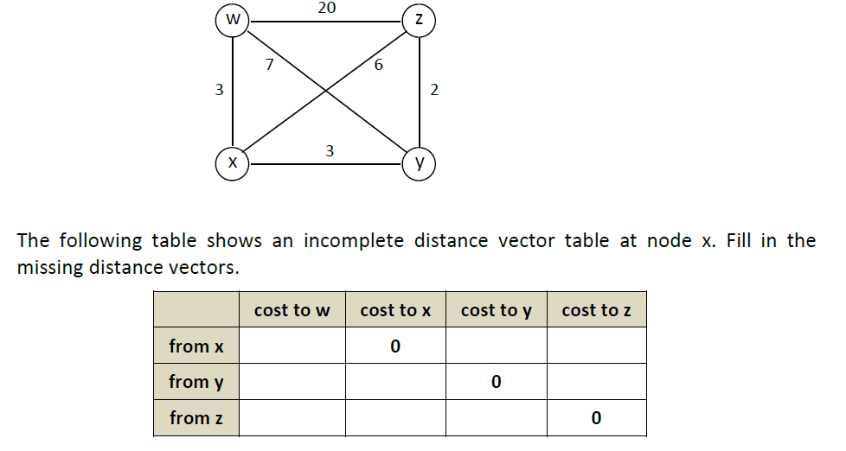
Question 3

Slide 18
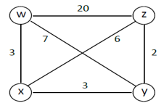
Node x before 1st iteration
 | Cost to w | Cost to x | Cost to y | Cost to z
From x | 3 | 0 | 3 | 6
From y | 7 | 3 | 0 | 2
From z | 20 | 6 | 2 | 0
From w | 0 | 3 | 7 | 20

Slide 19
Node x
 | Cost to w | Cost to x | Cost to y | Cost to z
From x | 3 | 0 | 3 | 6
From y | 7 | 3 | 0 | 2
From z | 20 | 6 | 2 | 0
From w | 0 | 3 | 7 | 20
dx(x) =0
dx(y) = min{c(x,y)+ dy(y), c(x,w)+dw(y), c(x,z)+dz(y)}
min { 3+0, 3+7,6+2} = 3
dx(w) = min{c(x,w)+ dw(w), c(x,y)+dy(w), c(x,z)+dz(w)}
min { 3+0, 3+7,6+20} = 3
dx(z) = min{c(x,z)+ dz(z), c(x,y)+dy(z), c(x,w)+dw(z)}
min { 6+0, 3+2,3+20} = 5

Slide 20
Node x after updating
 | Cost to w | Cost to x | Cost to y | Cost to z
From x | 3 | 0 | 3 | 5
From y | 7 | 3 | 0 | 2
From z | 20 | 6 | 2 | 0
From w | 0 | 3 | 7 | 20

Slide 21
Node y
 | Cost to w | Cost to x | Cost to y | Cost to z
From x | 3 | 0 | 3 | 6
From y | 7 | 3 | 0 | 2
From z | 20 | 6 | 2 | 0
From w | 0 | 3 | 7 | 20
dy(y) = 0
dy(x) = min{c(y,x)+ dx(x), c(y,w)+dw(x), c(y,z)+dz(x)}
min { 3+0, 7+3, 2+6} = 3
dy(w) = min{c(y,w)+ dw(w), c(y,x)+dx(w), c(y,z)+dz(w)}
min { 7+0, 3+3, 6+20} = 6
dy(z) = min{c(y,z)+ dz(z), c(y,x)+dx(z), c(y,w)+dw(z)}
min { 2+0, 3+6, 7+20} = 2

Slide 22
Node x table with the shortest distance
 | Cost to w | Cost to x | Cost to y | Cost to z
From x | 3 | 0 | 3 | 5
From y | 6 | 3 | 0 | 2
From z | 8 | 5 | 2 | 0
From w | 0 | 3 | 6 | 8

Slide 23
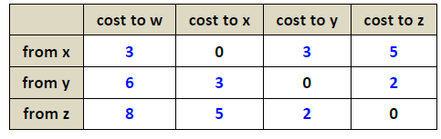
Question 3

Slide 24
Question 4
Do the following:
1. Start up Wireshark and begin packet capture.
2. Start up the Terminal and execute the following command:
ping www.google.com (Windows) OR Ping www.google.com -c 4 (Linux/mac)
3. Stop Wireshark packet capture.
4. Type in “icmp” into the display filter specification window, then select Apply

Slide 25
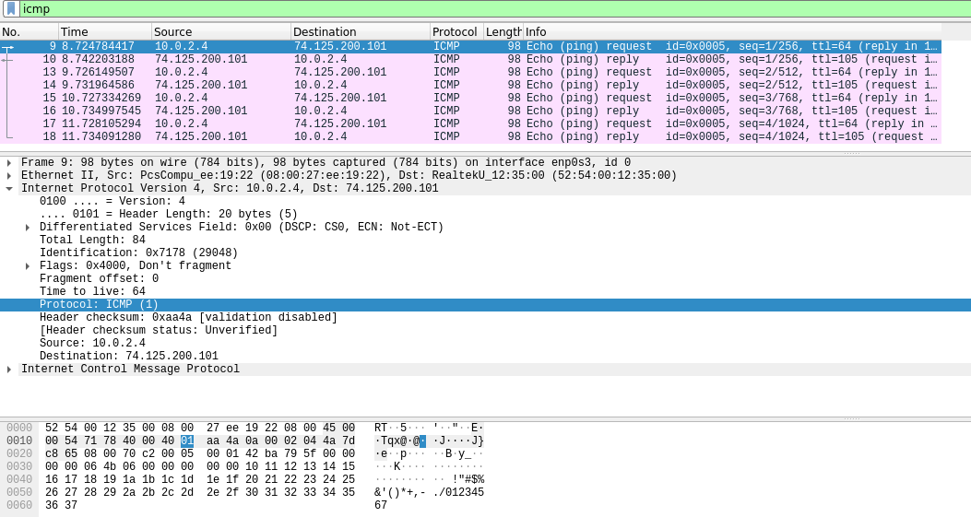
Question 4
1. Within the IP packet header, what is the value in the upper layer protocol held?
ICMP.

Slide 26
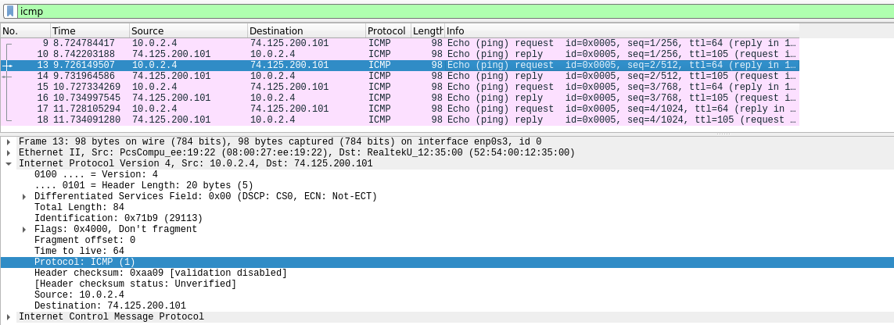
Question 4
2. Which fields in the IP datagram always change from one datagram to the next within this series of ICMP messages sent by your computer?
Identification and Checksum.

Slide 27
End of Tutorial

