Slide 1
CS2105 Introduction to Computer Networks Tutorial 7

Slide 2

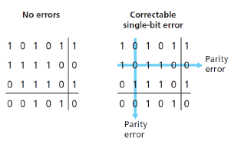
Recap
Error Detection and Correction
Parity Checking
Single Bit Parity
Detect single bit error
2D Parity
Detect and correct single bit error
Detect two bit error
1 is added to the block if it contains odd number of 1’s, and
0 is added if it contains even number of 1’s

Slide 3
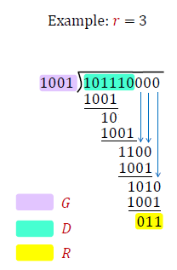
Recap
SENDER SIDE
Error Detection and Correction
Parity Checking
Cyclic Redundancy Check (CRC)
D: data to generate CRC for
G: generator (r+1 bits), agreed upon beforehand
How to calculate:
Append r zeroes to data
Do “long division”
“Divide” data by generator
Use XOR operation
CRC is final remainder

Slide 4
Recap
RECEIVER SIDE
Error Detection and Correction
Parity Checking
Cyclic Redundancy Check (CRC)
D: data to generate CRC for
G: generator (r+1 bits), agreed upon beforehand
How to check for errors:
Append CRC R to data, e.g:
Do “long division”
“Divide” data by generator
Use XOR operation
If remainder is zero, no error
If remainder is non-zero, error detected

Slide 5
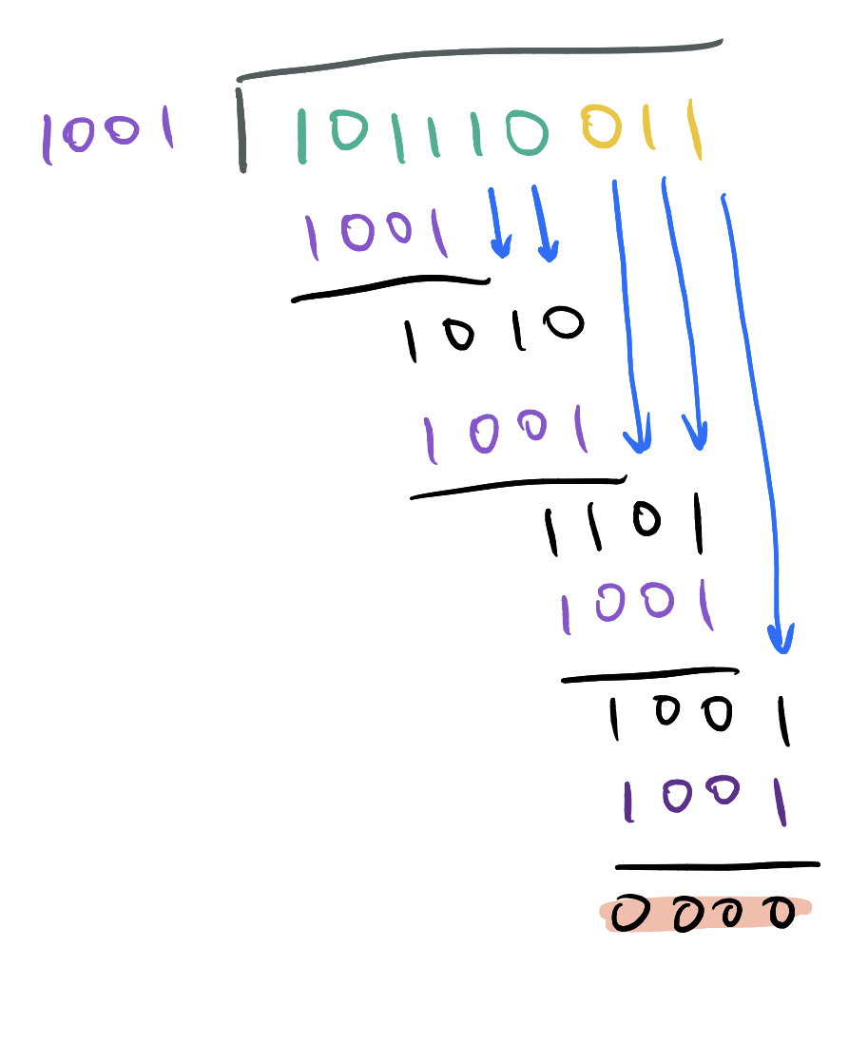
Recap
RECEIVER SIDE
Error Detection and Correction
Parity Checking
Cyclic Redundancy Check (CRC)
D: data to generate CRC for
G: generator (r+1 bits), agreed upon beforehand
How to check for errors:
Append CRC R to data, e.g:
Do “long division”
“Divide” data by generator
Use XOR operation
If remainder is zero, no error
If remainder is non-zero, error detected

Slide 6
Recap
Multiple Access Protocols
Link might be shared between multiple node
Protocols needed to ensure link can be utilized by all nodes
If two or more nodes transmit simultaneously, frames collide and will be read incorrectly
Three broad classes
Channel Partitioning
Taking Turns
Random Access

Slide 7
Recap
Channel Partitioning
Divide channel into smaller “pieces”
Allocate piece to each node for exclusive use

Slide 8

Recap
Channel Partitioning: TDMA
Time-Division Multiple Access
Access channel in “rounds”
Each node gets specific slot in round
Unused slots go idle

Slide 9
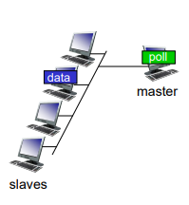
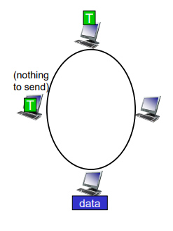
Recap
Taking Turns
Nodes take turns to transmit
Polling
Master node controls when other nodes transmit
Overhead for polling
Master node is single point of failure
Token Passing
Control token is passed sequentially between nodes
Overhead for token
Token is single point of failure

Slide 10
Recap
Random Access
Collision: two or more transmitting nodes
Protocols specify:
How to detect collisions
How to recover from collisions

Slide 11
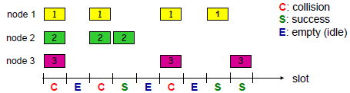
Recap
Random Access: Slotted ALOHA
Time is divided into slots of equal length (time to transmit 1 frame)
Assume frames are of equal size
Nodes only start to transmit at beginning of slot

Slide 12
Recap
Random Access: Slotted ALOHA
Listen to channel while transmitting (collision detection)
If collision happens, retransmit in next slot with fixed probability p until transmission success

Slide 13
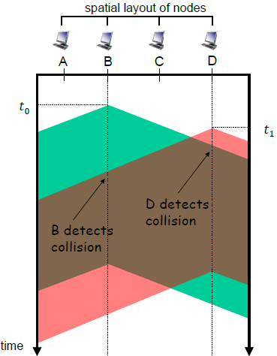
Recap
Random Access: CSMA
Carrier Sense Multiple Access
Sense channel before transmission
Channel idle: transmit frame
Channel busy: defer transmission
Collisions may still occur
Two nodes sense that channel is empty and transmit at same time
Propagation delay may cause collisions as well

Slide 14
Recap
Random Access: CSMA/CD (Collision Detection)
Stop transmission once collision is detected
Reduce channel wastage
Retransmit after random amount of time

Slide 15
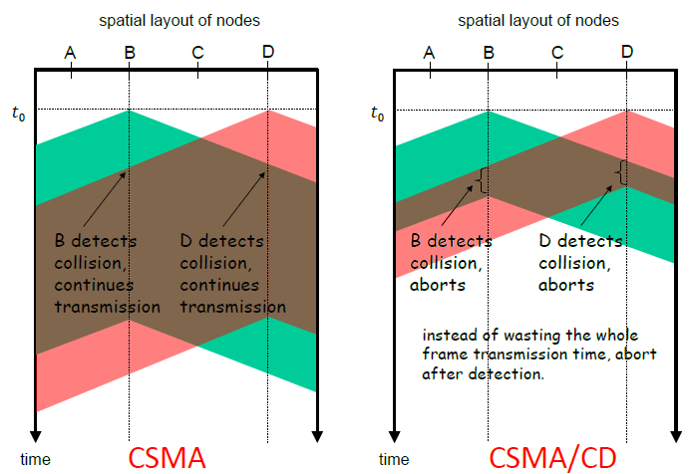
Recap

Slide 16
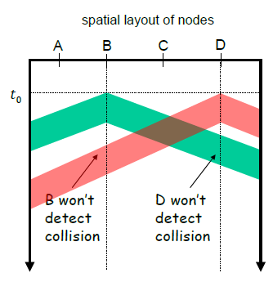
Recap
Random Access: CSMA/CD
Minimum frame size needed
Collisions may happen but are undetected by sending nodes
No retransmission!
E.g. Ethernet requires minimum frame size of 64 bytes

Slide 17
Question 1
If all the links in the Internet were to provide reliable delivery service, would the TCP reliable delivery service be redundant? Why or why not?
IP datagrams in the same TCP connection can take different routes in the network, and therefore arrive at receiving host out of order. TCP is still needed to sort out received data in the correct order before passing them to application.
Also, IP datagrams can be lost due to routing loops, equipment failures, etc. For example, if a router holding a frame crashes

Slide 18
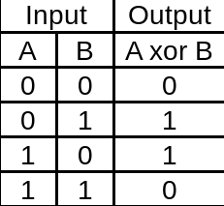
Question 2
Hint:
𝐷: data bits, viewed as a binary number.
𝐺: generator of 𝑟+1 bits, agreed by sender and receiver beforehand.
𝑅: will generate CRC of 𝑟 bits.
CRC calculation is done in bit-wise XOR operation without carry or borrow.
Consider a 4-bit generator 𝐺 with value 1001, what is the CRC checksum 𝑅 if data 𝐷 has the following value?
a) 11000111010
110
11000111010000
1001
1010
1001
1111
1001
1101
1001
1000
1001
1100
1001
1010
1001
110

Slide 19
Question 2
Consider a 4-bit generator 𝐺 with value 1001, what is the CRC checksum 𝑅 if data 𝐷 has the following value?
b) 01101010101
011
01101010101000
1001
1111
1001
1101
1001
1000
1001
1101
1001
1000
1001
1100
1001
1010
1001
011

Slide 20
Question 2
Consider a 4-bit generator 𝐺 with value 1001, what is the CRC checksum 𝑅 if data 𝐷 has the following value?
c) 11111010101
011
11111010101000
1001
1101
1001
1000
1001
1101
1001
1000
1001
1100
1001
1010
1001
011

Slide 21
Question 2
Consider a 4-bit generator 𝐺 with value 1001, what is the CRC checksum 𝑅 if data 𝐷 has the following value?
d) 10001100001
110
10001100001000
1001
1110
1001
1110
1001
1110
1001
1110
1001
1111
1001
1100
1001
1010
1001
110

Slide 22
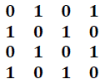
Question 3
Consider the following two-dimensional parity matrix.

Slide 23
Question 3
a) Compute row sums, column sums and parity bit.
0 | 1 | 0 | 1 | 0
1 | 0 | 1 | 0 | 0
0 | 1 | 0 | 1 | 0
1 | 0 | 1 | 0 | 0
0 | 0 | 0 | 0 | 0

Slide 24
Question 3
b) Give an example of a 1-bit error that can be detected and corrected.
0 | 1 | 0 | 1 | 0
1 | 0 | 1 | 0 | 0
0 | 1 | 0 | 1 | 0
1 | 0 | 1 | 0 | 0
0 | 0 | 0 | 0 | 0
0 | 1 | 1 | 1 | 0
1 | 0 | 1 | 0 | 0
0 | 1 | 0 | 1 | 0
1 | 0 | 1 | 0 | 0
0 | 0 | 0 | 0 | 0
Original/Correct
Detect and can correct

Slide 25
Question 3
c) Give an example of a 2-bits error that can be detected but cannot be corrected.
0 | 1 | 0 | 1 | 0
1 | 0 | 1 | 0 | 0
0 | 1 | 0 | 1 | 0
1 | 0 | 1 | 0 | 0
0 | 0 | 0 | 0 | 0
0 | 1 | 0 | 0 | 0
1 | 0 | 1 | 0 | 0
0 | 1 | 0 | 0 | 0
1 | 0 | 1 | 0 | 0
0 | 0 | 0 | 0 | 0
Original/Correct
Detect but cannot correct

Slide 26
Question 3
d) Give an example of a 4-bits error that cannot be detected.
0 | 1 | 0 | 1 | 0
1 | 0 | 1 | 0 | 0
0 | 1 | 0 | 1 | 0
1 | 0 | 1 | 0 | 0
0 | 0 | 0 | 0 | 0
0 | 1 | 0 | 1 | 0
1 | 0 | 1 | 0 | 0
1 | 1 | 0 | 0 | 0
0 | 0 | 1 | 1 | 0
0 | 0 | 0 | 0 | 0
Original/Correct
Cannot detect

Slide 27
Question 4
There are many nodes in a shared medium network and most nodes are likely to transmit frequently. Which of the following multiple access protocol(s) is (are) suitable? (1) TDMA; (2) CSMA; (3) Token passing.
TDMA and token passing are suitable because there is sufficient work to do to utilize the “fixed” resources allocated.
CSMA is not because many nodes competing for the shared channel can result in lots of collision. Utilization will be low.

Slide 28
Question 5
Nodes 𝐴 and 𝐵 are accessing a shared medium using CSMA/CD protocol, with propagation delay of 245 bit times between them (i.e., propagation delay equals to the amount of time to transmit 245 bits onto the link). Minimum frame size is 64 bytes. Suppose node 𝐴 begins transmitting a frame at 𝑡 = 0 bit time. Before 𝐴 finishes, node 𝐵 begins transmitting a frame. Assume no other nodes are active.
Write down your answers to the following 2 questions in the unit of bit time.

Slide 29
Question 5
a) When is the latest time, by which 𝐵 can begin its transmission?
If A starts at t=0, propagation delay =245 bit time.
The latest time B can begin transmission is before the signal from A reaches B, which is when 𝒕 = 244 bit time.
A
B
t=245
t=244

Slide 30
Question 5
b) Suppose 𝐵 begin its transmission at the time computed in a), can 𝐴 detects that 𝐵 has transmitted before it finishes transmission?
Suppose 𝑩 begin transmission at 𝒕 = 244 bit time. Signal propagates to 𝑨 at 𝒕 = 244 + 245 = 489 bit time. 𝑨 is able to detect collision before it finishes transmission (at 𝒕 = 512bit time).
A
B
t=512
t=245
t=244
t=489

Slide 31
End of Tutorial

Slide 32
Extra Question 1
Which of the following statement about 2-dimensional parity bits is FALSE?
It can detect any one-bit error.
B. It can correct any one-bit error.
C. It can detect any two-bit error.
D. It can correct any two-bit error.
E. It may not be able to detect a four-bit error.

Slide 33
Extra Question 1
Which of the following statement about 2-dimensional parity bits is FALSE?
It can detect any one-bit error.
B. It can correct any one-bit error.
C. It can detect any two-bit error.
D. It can correct any two-bit error.
E. It may not be able to detect a four-bit error.

Slide 34
Extra Question 2
Two hosts are communicating using CRC as an error detection scheme, with a generator of 110. Every byte sent consists of six bits of data and two bits of the CRC value. Suppose the following four bytes are received. Which bytes would pass the CRC test and considered as containing no bit error?
i. 11011000
ii. 11011101
iii. 10010110
iv. 11111100
A. (i) and (ii) only
B. (i) and (iv) only
C. (i), (iii) and (iv) only
D. (iii) and (iv) only
E. (i), (ii) and (iii) only

Slide 35
Two hosts are communicating using CRC as an error detection scheme, with a generator of 110. Every byte sent consists of six bits of data and two bits of the CRC value. Suppose the following four bytes are received. Which bytes would pass the CRC test and considered as containing no bit error?
i. 11011000
ii. 11011101
iii. 10010110
iv. 11111100
A. (i) and (ii) only
B. (i) and (iv) only
C. (i), (iii) and (iv) only
D. (iii) and (iv) only
E. (i), (ii) and (iii) only

Slide 36
Two hosts are communicating using CRC as an error detection scheme, with a generator of 110. Every byte sent consists of six bits of data and two bits of the CRC value. Suppose the following four bytes are received. Which bytes would pass the CRC test and considered as containing no bit error?
i. 11011000
ii. 11011101
iii. 10010110
iv. 11111100
A. (i) and (ii) only
B. (i) and (iv) only
C. (i), (iii) and (iv) only
D. (iii) and (iv) only
E. (i), (ii) and (iii) only
11011000
110
110
110
00
10010110
110
101
110
110
110
110
110
000
11011101
110
111
110
101
110
011
11111100
110
111
110
110
110
0

