Slide 1
CS2105 Introduction to Computer Networks Tutorial 8

Slide 2
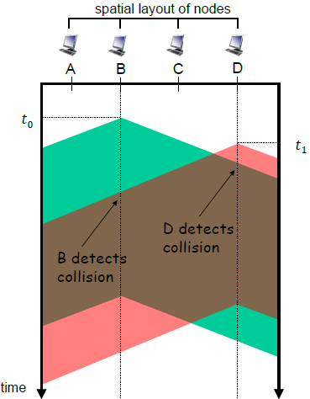
Recap
Random Access: CSMA/CD (Exponential Backoff)
After n^{th} collision, choose k randomly from {0, 1, … ,2^{n}-1}
When n ≥ 10, stop increasing range
Wait 512 * k bit-time before retransmitting
Goal: Adapt retransmission attempts to estimate current load of link
More collisions imply heavier load
Longer back-off interval with more collisions

Slide 3
Recap
Random Access: CSMA/CD (Exponential Backoff)
After n^{th} collision, choose k randomly from {0, 1, … ,2^{n}-1}
When n ≥ 10, stop increasing range
If n = 1, choose from {0,1}
If n = 2, choose from {0, 1, 2, 3}
If n = 3, choose from {0, 1, 2, 3, 4, 5, 6, 7}
…
Wait 512 * k bit-time before retransmitting
Goal: Adapt retransmission attempts to estimate current load of link
More collisions imply heavier load
Longer back-off interval with more collisions

Slide 4

Recap
MAC address
6 byte hardware address (48 bits)
Every adapter has unique MAC address
Used for link layer frames
When frame received, check MAC address
Discard if MAC address does not match adapter’s MAC address
Implemented in hardware

Slide 5
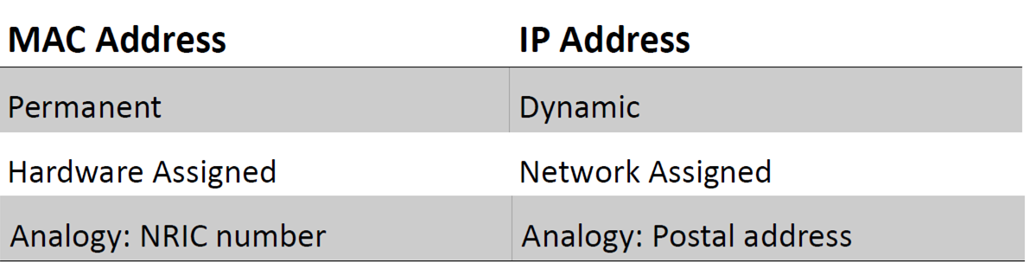
Recap

Slide 6
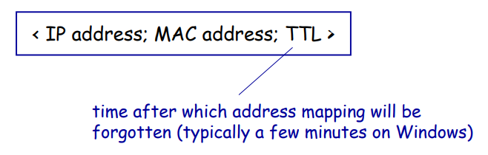
Recap
Address Resolution Protocol (ARP)
Each IP node (host, router, etc) stores an ARP table
Stores mappings of IP address and MAC address for nodes in same subnet

Slide 7
Recap
Address Resolution Protocol (ARP)
How to know the MAC address of receiving host?
Broadcast ARP query packet, with target IP address.
Destination MAC address: FF-FF-FF-FF-FF-FF (Broadcast address)
Only target host will reply to query packet
Target replies with MAC address
MAC address cached in ARP table

Slide 8
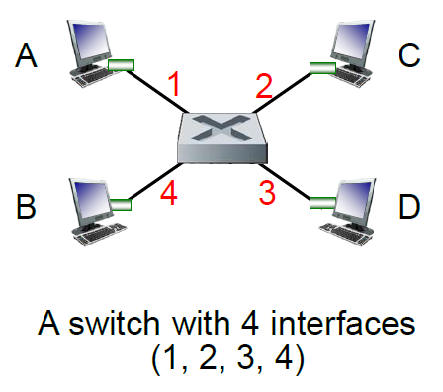
Recap
Switches
Link layer device used in LAN
Central station connecting all nodes
Helps to forward Ethernet frames to correct nodes
Examines MAC address of incoming frames
Forward to one or more outgoing links
Transparent to hosts
No IP address
Hosts unaware of presence of switch
Star topology
Each node has dedicated link to switch

Slide 9
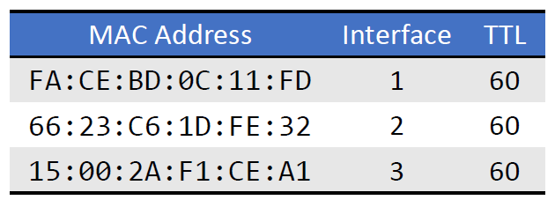
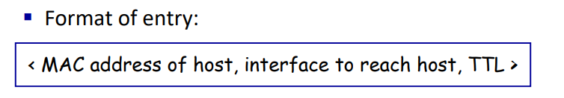
Recap
Switches
Switch stores switch table
Entries are mappings between MAC address and interfaces
May be initially empty

Slide 10
Recap
Switches
Table is filled up as hosts communicate
E.g. A sends frame to B:
When switch receives frame from A, fill in table with A’s MAC address and interface
If B’s MAC address is found in table, forward frame directly to B’s interface
If not found, broadcast to all outgoing links.

Slide 11
Question 1
In CSMA/CD, after the fifth collision, what is the probability that a node chooses 𝐾=4? The result 𝐾=4 corresponds to a delay of how many microseconds on a 10 Mbps Ethernet?
Hint: After aborting, NIC enters binary back-off: after 𝑚𝑡h collision, NIC chooses 𝐾 at random from {0, 1, 2, …, 2^{𝑚}-1}.
NIC waits 𝐾*512 bit times
After 5th collision, NIC will choose 𝑲 at random from {0, 1, 2, …, 2⁵-1}. The chance to choose 𝑲=𝟒 is 1/32.
NIC will wait for (4 * 512) / 10⁷ = 204.8 microseconds.

Slide 12
Question 2
Let’s consider the operation of a learning switch in the context of a network in which 4 nodes, labeled 𝐴 through 𝐷, are star connected into an Ethernet switch (refer to the diagram on Lecture 9 notes page 35).
Suppose that the following events happened in sequence,
i. 𝐵 sends a frame to 𝐷
ii. 𝐷 replies with a frame to 𝐵
iii. 𝐷 sends a frame to 𝐴
The switch table is initially empty. Show the state of the switch table after each of the above events (ignore TTL field). For each event, identify the link(s) on which the transmitted frame will be forwarded, and briefly justify your answers.

Slide 13
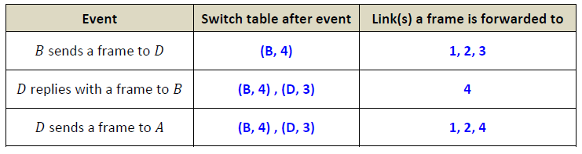
Question 2
1st: initially broadcast to all links other than 4
2nd: send directly to 4 since switch knows B is 4, switch learns D
3rd: send to all other than 3 from which it received - broadcast

Slide 14
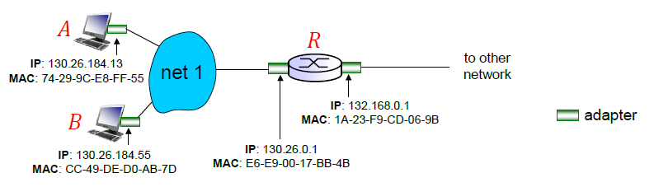
Question 3
Refer to the diagram on Lecture 9 notes page 14. Suppose nodes 𝐴, 𝐵 and 𝑅 are star connected into a switch 𝑆. 𝐴, 𝐵 and 𝑅 are aware of the IP addresses of each other.

Slide 15
Question 3
a) Consider sending an IP datagram from Host 𝐴 to Host 𝐵. Suppose all of the ARP tables and switch table are up to date. Enumerate all the steps the host and switch take to move the packet from 𝐴 to 𝐵.
1) 𝑨 creates a frame with destination MAC address CC-49-DE-D0-AB-7D (𝑩’s address is found in ARP table).
2) This frame travels to switch 𝑺 and is forwarded towards 𝑩 (interface to 𝑩 is found in switch table).

Slide 16
Question 3
b)Repeat the problem in a), assuming that ARP table in the sending host is empty, but all other tables are up to date.
1) 𝑨 broadcasts an ARP query packet, with destination MAC address FF-FF-FF-FF-FF-FF.
2) Switch 𝑺 forwards this ARP query packet to both 𝑩 and 𝑹 since destination MAC address is a broadcast address.
3) 𝑹 will ignore this ARP query packet but 𝑩 will reply to 𝑨. Switch 𝑺 forwards the reply frame towards 𝑨 (interface to 𝑨 is found in switch table).
4) Subsequently 𝑨 can send IP datagram to 𝑩 as in part a).

Slide 17
Question 3
c) Repeat the problem in a), assuming that all tables in all nodes are empty.
1) 𝑨 needs to issue an ARP query to know the MAC address of 𝑩.
2) The query packet travels to switch 𝑺 and is forwarded to both 𝑩 and 𝑹. Switch 𝑺 learns 𝑨 is reachable via the interface query packet arrives at.
3) 𝑹 will ignore this ARP query packet but 𝑩 will reply to 𝑨. Switch 𝑺 forwards the reply frame towards 𝑨 (interface to 𝑨 is found in switch table). Switch 𝑺 learns 𝑩 is reachable via the interface reply frame arrives at.
4) Subsequently 𝑨 can send IP datagram to 𝑩 as in part a).

Slide 18
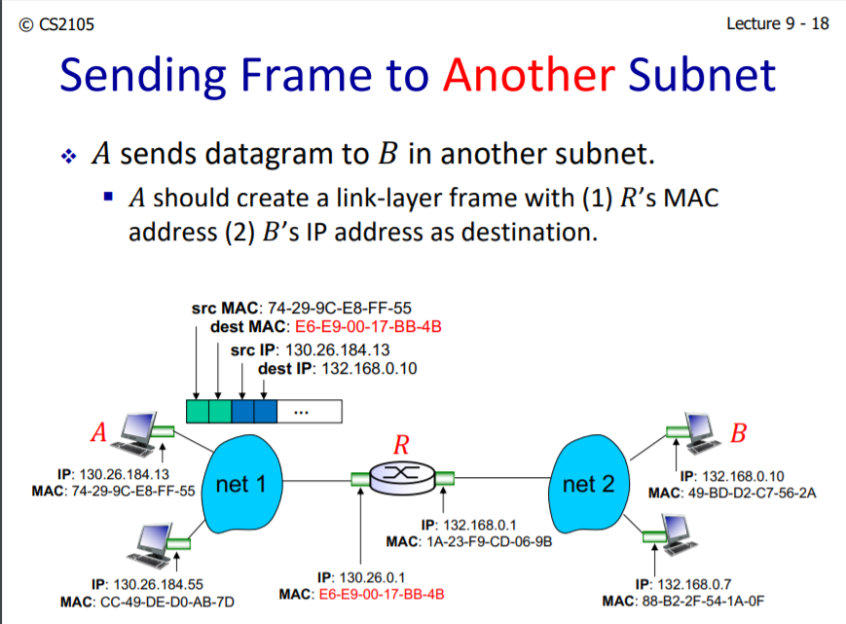
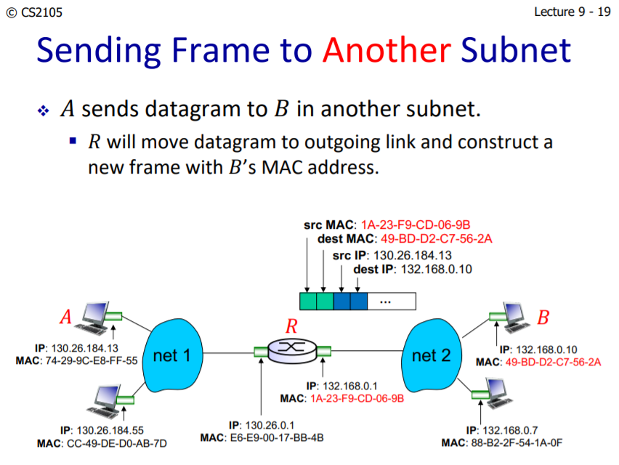
Question 3
d) Suppose 𝐴 sends an IP datagram to a host in another subnet. All of the ARP tables and switch table are up to date. Enumerate all the steps the host, switch and router take to move the packet to another subnet.
1) 𝑨 creates a frame with destination MAC address E6-E9-00-17-BB-4B (𝑹’s address is found in ARP table).
2) This frame travels to switch 𝑺 and is forwarded towards 𝑹 (interface to 𝑹 is found in switch table).
3) 𝑹 checks the destination IP of the datagram and decides to forward it towards external network. It encapsulates the IP datagram in a new frame with source MAC address 1A-23-F9-CD-06-9B (dest MAC address not mentioned in question) and sends it through the interface towards external network.

Slide 19
Question 4
Wireshark: Ethernet
Do the following:
1. Make sure your browser’s cache is empty. To do this, Clear Recent History.
2. Start up the Wireshark packet sniffer.
3. Enter the following URL into your browser http://gaia.cs.umass.edu/wireshark-labs/HTTP-ethereal-lab-file3.html
4. Stop Wireshark packet capture.

Slide 20
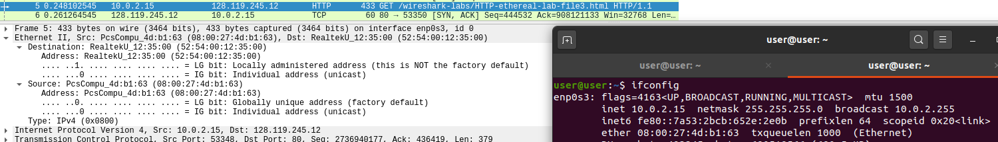
Question 4
Based on the contents of the Ethernet frame containing the HTTP GET message:
1a) What is the 48-bit Ethernet address of your computer?
select HTTP GET message and explore the ’mac-src’ header ﬁeld in the ethernet frame used to carry this HTTP GET message.

Slide 21
Question 4
Based on the contents of the Ethernet frame containing the HTTP GET message:
1b) What is the 48-bit destination address in the Ethernet frame? Is this the Ethernet address of gaia.cs.umass.edu? What device has this as its Ethernet address?
destination address: select HTTP GET message and explore the ’mac-dst’ header ﬁeld in the ethernet frame used to carry this HTTP GET message.
No, it is the gateway.

Slide 22
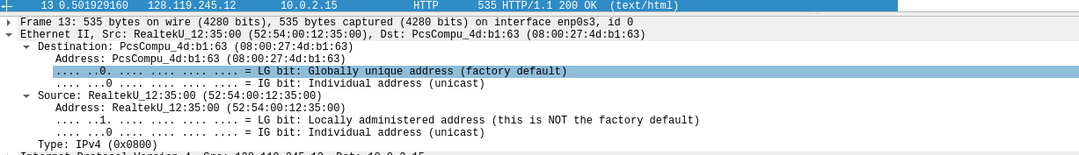
Question 4
Based on the contents of the Ethernet frame containing the first byte of the HTTP response message:
2a) What is the value of the Ethernet source address? Is this the address of your computer, or of gaia.cs.umass.edu. What device has this as its Ethernet address?
select HTTP response message and explore the ’mac-src’ header ﬁeld in the ethernet frame used to carry this HTTP response message.
Neither your computer nor gaia.cs.umass.edu.
Gateway.

Slide 23
Question 4
Based on the contents of the Ethernet frame containing the first byte of the HTTP response message:
2b) What is the destination address in the Ethernet frame? Is this the Ethernet address of your computer?
select HTTP response message and explore the ’mac-dst’ header ﬁeld in the ethernet frame used to carry this HTTP response message.
Yes.

Slide 24
End of Tutorial

Slide 25
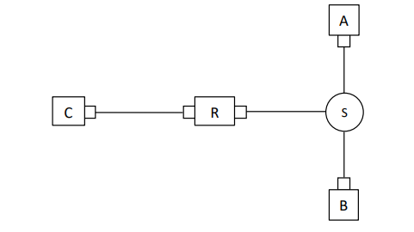
Extra Question 1a
The diagram below shows a small network with five entities: hosts A and B are connected to a router R through a switch S. Host C connects to R directly. There is no other host, switch, or router in the network. Assumed that each router interface is a subnet.
What is the maximum number of entries that could be in the ARP table of A?
a) 3
b) 1
c) 2
d) 5

Slide 26
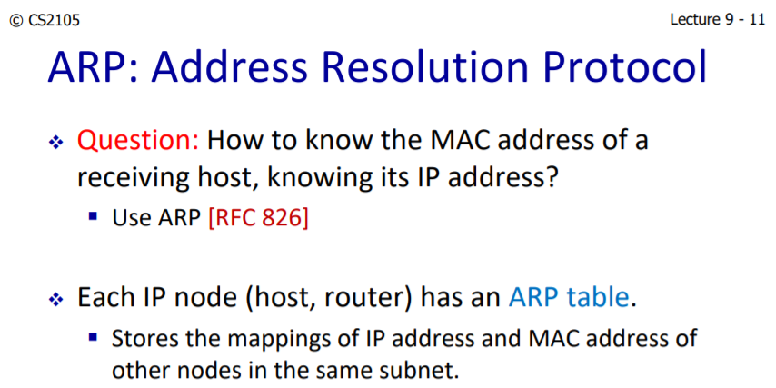
Extra Question 1a
The diagram below shows a small network with five entities: hosts A and B are connected to a router R through a switch S. Host C connects to R directly. There is no other host, switch, or router in the network. Assumed that each router interface is a subnet.
What is the maximum number of entries that could be in the ARP table of A?
a) 3
b) 1
c) 2
d) 5

Slide 27
Extra Question 1b
The diagram below shows a small network with five entities: hosts A and B are connected to a router R through a switch S. Host C connects to R directly. There is no other host, switch, or router in the network. Assumed that each router interface is a subnet.
What is the maximum number of entries that could be in the ARP table of C?
a) 3
b) 1
c) 2
d) 5

Slide 28
Extra Question 1b
The diagram below shows a small network with five entities: hosts A and B are connected to a router R through a switch S. Host C connects to R directly. There is no other host, switch, or router in the network. Assumed that each router interface is a subnet.
What is the maximum number of entries that could be in the ARP table of C?
a) 3
b) 1
c) 2
d) 5

Slide 29
Extra Question 1c
The diagram below shows a small network with five entities: hosts A and B are connected to a router R through a switch S. Host C connects to R directly. There is no other host, switch, or router in the network. Assumed that each router interface is a subnet.
How many IP addresses need to be assigned to this network?
a) 3
b) 1
c) 2
d) 5

Slide 30
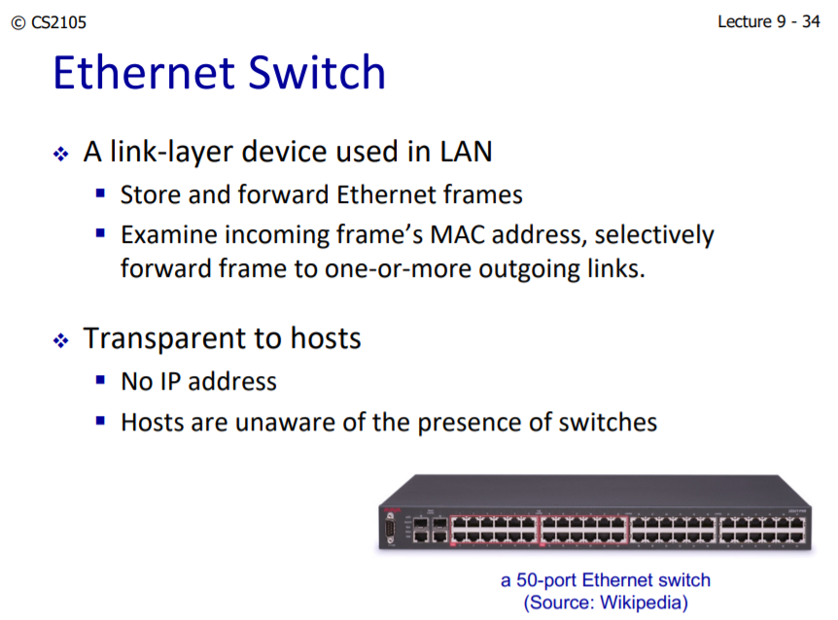
Extra Question 1c
The diagram below shows a small network with five entities: hosts A and B are connected to a router R through a switch S. Host C connects to R directly. There is no other host, switch, or router in the network. Assumed that each router interface is a subnet.
How many IP addresses need to be assigned to this network?
a) 3
b) 1
c) 2
d) 5

