Slide 1
CS2105 Introduction to Computer Networks
Tutorial 9

Slide 2
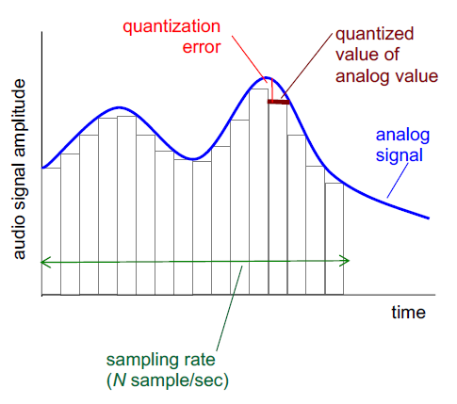
Recap
Keywords:
Quantized Values
Bit Rate of Signal
Multimedia networking
Audio
Bit rate of signal = sample rate * number of bits
256 quantized values = 2⁸ = 8 bits (0000 0000 – 1111 1111)
64,000 bps = 8,000 samples/sec * 8 bits

Slide 3
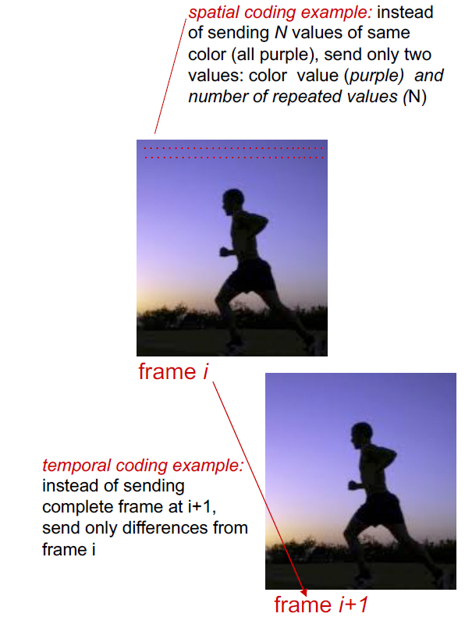
Recap
Multimedia networking
2. Video: a sequence of images displayed at constant rate
E.g. (images/sec)
Compressing videos during encoding
spatial (similar pixels within image)
temporal (only changed pixels from one image to next)

Slide 4
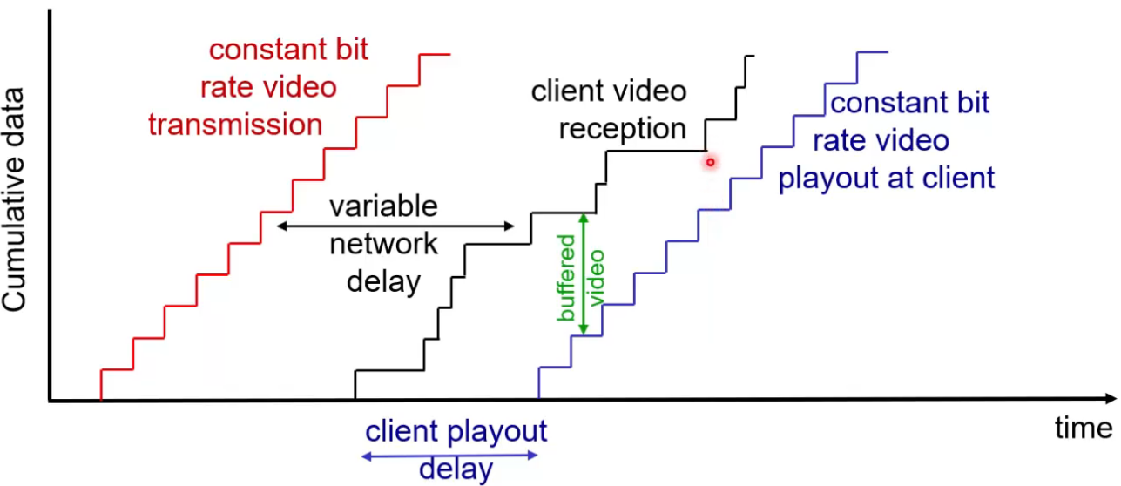
Recap
Streaming stored video
Server starts sending
client starts receiving from here

Slide 5
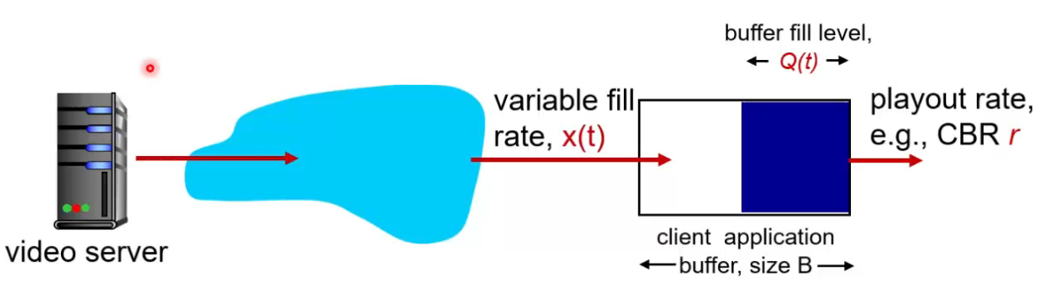
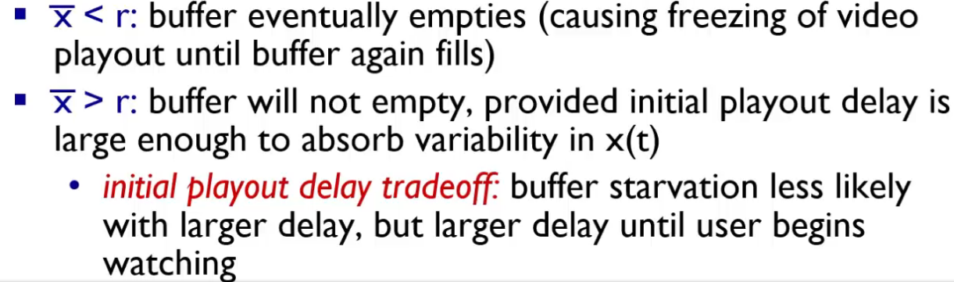
Recap
Client side buffering
In the buffer:
Video frames incoming at rate of x(t)
Playout rate outgoing at rate of r

Slide 6
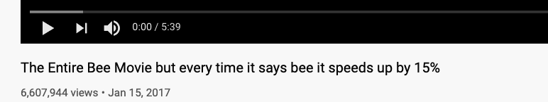

Smaller Delay – start your video faster BUT more likely to run out your buffer – jittery videos
Larger Delay – your video takes a longer time to start but you can enjoy smooth viewing

Slide 7
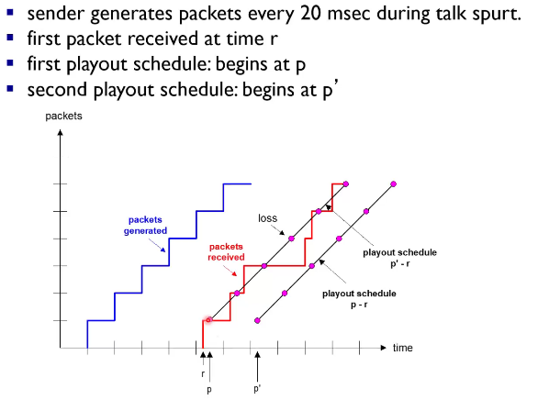
Recap
VoIP playout delay

Slide 8
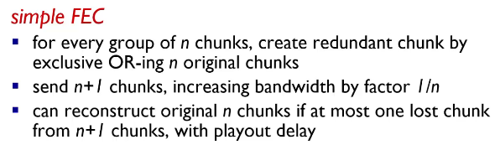
Recap
VoIP packet loss recovery (FEC)
N chunks: 1100, 1010
XORed chunk: 0110

Slide 9
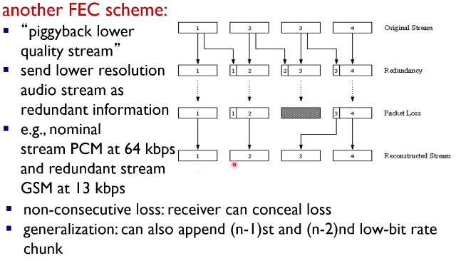
Recap
VoIP packet loss recovery (FEC)

Slide 10
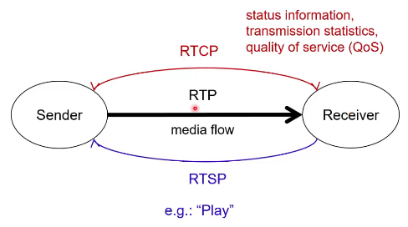
Recap
Real time control protocol, carries signalling information
RTP
Real time streaming protocol, carries commands similar to VCR

Slide 11
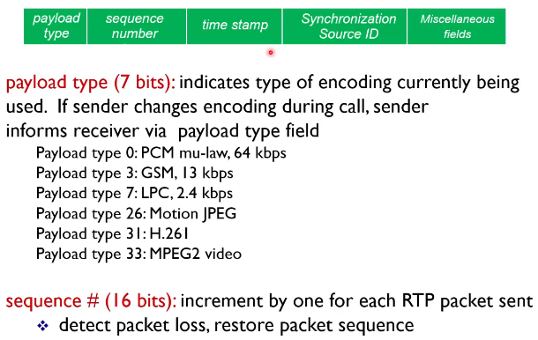
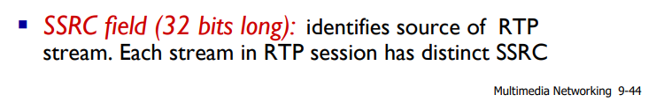
Recap
RTP Header

Slide 12
Question 1
There are two types of redundancy in video. Describe them, and discuss how they can be exploited for efficient compression.
Spatial redundancy: Redundancy within the same image, e.g. consecutive pixels with the same color. We could compress the video frame by sending just the color value and its count (instead of the color value N times).
Temporal redundancy: Redundancy between multiple images, e.g. consecutive frames that are very similar and only have a small change between them. We could compress the second video frame by sending only its difference from the original frame (instead of the full uncompressed frame).

Slide 13
Question 2
Suppose an analog audio signal is sampled 16,000 times per second, and each sample is quantized into one of 1,024 levels. What would be the resulting bit rate of the PCM digital audio signal?
Each sample would require 𝐥𝐨𝐠_{𝟐}𝟏𝟎𝟐𝟒 = 𝟏𝟎 bits encode its data. Hence, sampling at 16,000 times per second would generate a signal of 160,000 bits per second = 160 kbps.
Bit rate = sampling rate * number of bits = 16,000 * 10 = 160,000bps

Slide 14
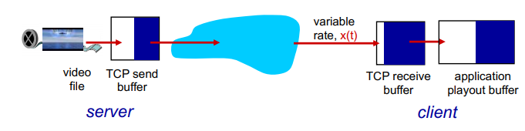
Question 3
With HTTP streaming, are the TCP receive buffer and the client’s application buffer the same thing? If not, how do they interact?
No, they are not the same. TCP and application are at different layers of the OSI model.
TCP receive buffer (at transport layer) receives the TCP packets from the network layer, which are then processed and forwarded as HTTP packets to the client’s application buffer (at the application layer). The client (e.g. Chrome browser), upon receiving these HTTP packets, then processes and renders the video playback to the user.

Slide 15
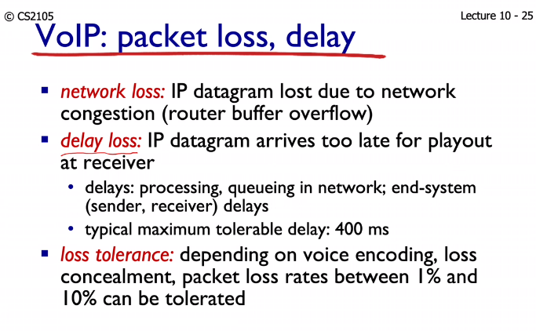
Question 4
Why is a packet that is received after its scheduled playout time considered lost?
When an application receives a packet that is late, i.e. received after its scheduled playout time, the application would not be able to play that packet anymore. Hence, from the perspective of the application, the packet has been lost.

Slide 16

Question 5
How are different RTP streams from within the same session identified by the receiver? How are RTP and RTCP packets differentiated?
RTP streams in the same session are identified using the SSRC field. RTP and RTCP packets use distinct port numbers.

Slide 17
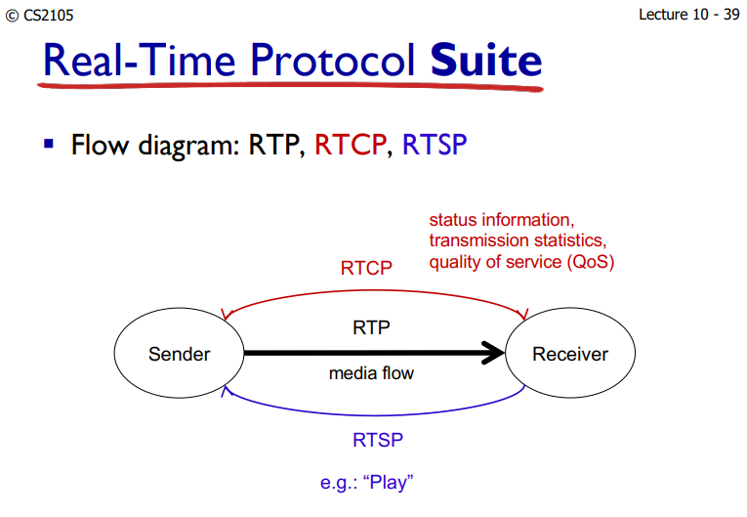
Question 6
In practice, RTP tends to be used over UDP while RTSP tends to be used over TCP. Why might this be so?
RTP sends media flow (e.g. multiple video packets) while RTSP sends playback commands (e.g. “Play” and “Pause”).
Hence, it may be preferred that RTP prioritizes speed over reliability (UDP), so that the client could playback the video with minimal delay (losing a few video packets in-between is a relatively small cost since its impact on playback experience is generally tolerable). On the other hand, it may be preferred that RTSP prioritizes reliability (TCP), so that we do not lose any of these commands requested by the client.

Slide 18
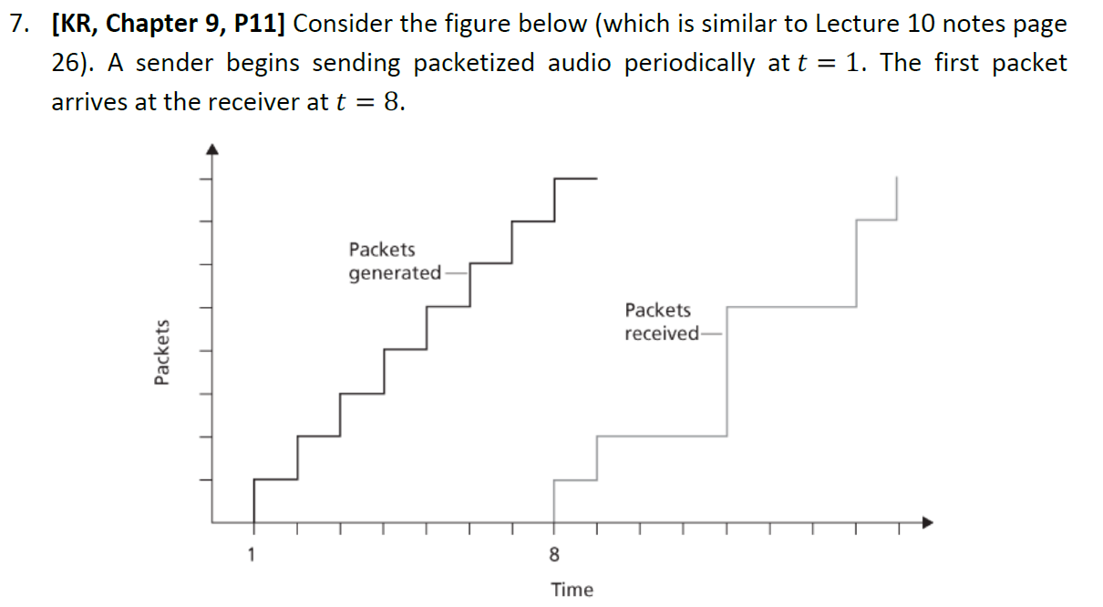
Question 7

Slide 19
Question 7
a) What are the delays (from sender to receiver, ignoring any playout delays) of packets 2 through 8? Note that each vertical and horizontal line segment in the figure has a length of 1, 2, or 3 time units.
Packet 2: 7 units, Packet 3: 9 units, Packet 4: 8 units, Packet 5: 7 units, Packet 6: 9 units, Packet 7: 8 units, Packet 8: 8 units

Slide 20

Question 7
b) If audio playout begins as soon as the first packet arrives at the receiver at 𝑡 = 8, which of the first eight packets sent will not arrive in time for playout?
Packet 3, 4, 6, 7, 8

Slide 21
Question 7
c) If audio playout begins at 𝑡 = 9, which of the first eight packets sent will not arrive in time for playout?
Packets 3, 6

Slide 22
Question 7
d) What is the minimum playout delay at the receiver that results in all of the first eight packets arriving in time for their playout?
Minimum playout delay is 𝒕 = 𝟏𝟎

Slide 23
Question 8
Recall the two FEC schemes for VoIP described in lecture. Suppose the first scheme (Scheme 1) generates a redundant chunk for every four original chunks. Suppose the second scheme (Scheme 2) uses a low-bit rate encoding whose transmission rate is 25 percent of the transmission rate of the nominal stream. (Note: we ignore the effects of playout delay in this question as we assume that all packets, including FEC packets, will be received prior to reconstruction and playback)

Slide 24

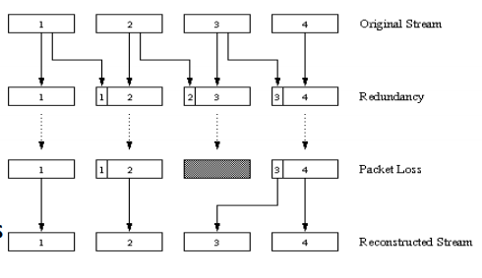
Question 8
a) How much additional bandwidth does each scheme require?
Scheme 1: Every 4 original chunks will have 1 redundant chunk = 25% additional bandwidth;
Scheme 2: Every chunk will have its redundant low-quality chunk “piggyback” on the next transmission = 25% additional bandwidth. Hence, both schemes will require additional 25% bandwidth.

Slide 25
Question 8
b) How do the two schemes perform if the first packet is lost in every group of five packets? Which scheme will have better audio quality?
Scheme 1 will be able to reconstruct the original high-quality audio, while Scheme 2 will get a low-quality audio packet in every 5 packets. Hence, Scheme 1 will have better overall audio quality.

Slide 26
Question 8
c) How do the two schemes perform if the first packet is lost in every group of two packets? Which scheme will have better audio quality?
Scheme 2 will have better audio quality as Scheme 1 is unable to recover from the packet losses while Scheme 2 can (albeit with low-quality). Note, redundancy based FEC (e.g., XOR in Scheme 1) has a fixed loss limit up to which we can recover the data. If the losses exceed that limit, then all data lost in that group cannot be recovered.

Slide 27
End of Tutorial

