Slide 1
Reverse Engineering: Towards Malware Analysis
Lecture – Malware Analysis in Virtual Machines (Safe Environment)
Computer Science Practice
SPRING 2021

Slide 2
Running Malware
Dynamic Analysis
Running the binary
DANGER! DANGER!! DANGER!!!
Physical install or VM?
Air-gapped networks
Notes:
Remember---up to this point we have ONLY discussed “static” malware analysis
We can make some assumptions, get some solid ideas---but it is VERY difficult to be certain what a piece of code is doing until we ACTUALLY run it
Obviously running an unknown binary can be dangerous!
Easy way to get infected, destroy your system, it can spread to other systems---or WORSE---you don’t KNOW you’re infected…
Even so…we need a place to execute our malware if we’re going to continue our investigation…
2 choices == physical or VM
Regardless of what you choose---your VM should be AIR-Gapped (air-gapped networks)
Air-gapped == isolated machines, disconnected from the Internet or any other network to prevent malware from spreading
Physical installs & Air-gapped networks come with their own set of problems…
1) a lot of malware REQUIRES an internet connection (phone home, get additional instructions, etc…
2) using physical machines can also make removing the malware much more difficult (full-reinstall)
The book discusses using “Ghost” (or another tool) to allow for quicker restore after analysis
VM disadvantages:
Some malware actually detects VM and refuses to execute OR changes it’s functionality…
Even so---VMs are used most often---and that’s what we’ll use in this class
2

Slide 3
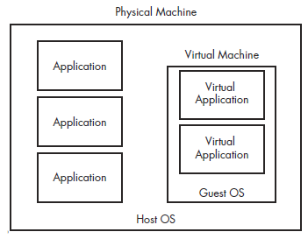
Understanding VMs
Notes:
We’re all familiar with VMs --- they act like a computer inside a computer. Supposedly isolated from the host
With the proper settings you can be “reasonably sure” your VM can’t infect your host
Here we have a figure showing how the traditional apps run in the left column – and the apps contained inside a guest OS of a VM (isolated)
In the past I’ve encouraged everyone to use “VMWare Player” --- because it’s free…
If you’re going to do A LOT of malware analysis---you should invest in a product that allows you to “take snapshots”
Snapshots == allows you to save the current state of a VM and provides you the ability to “rollback”
Again---doesn’t have to be VM---there are lots of alternatives!
Parallels, Virtual PC, VirtualBox, and many others
3

Slide 4
Options
VMware
Parallels
Microsoft Virtual PC
Microsoft Hyper-V
Xen
Others

Slide 5
Creating a Malware Analysis Machine
Give yourself at least 20GB of hard drive space
Careful! Malware may detect small hard drive
Choose an OS
Windows XP and 7 (32-bit and 64-bit)
Linux
8, 2000?
Install any needed / required / desired programs
Notes:
20gb == remember this is dynamic so in most cases the VM won’t allocate all 20gb at once
Choose and OS:
You all know I’m a big Linux fan---but in a lot of cases Malware Analysis is easier on Windows
Many MA tools are designed for Windows
Many pieces of Malware are designed explicitly for Windows (obviously to study it---it will need to be run on Windows
In this class we’ll use both
Once you’ve got your OS chosen---install any software you want / need
Vmware tools is a good thing to install (it makes it easier to move thing in and out --- like copy and paste)
5

Slide 6
Networking Options
No networking
Host-Only Networking
Using Multiple VMs
Multiple VMs setup and linked by a LAN but disconnected from the Internet
Need to install or simulate the required services
Use FakeNet or INetSim
More on these later
Sometimes you just need to go live…
THINK BEFORE YOU DO THIS!!
Bridged Mode and NAT Mode
Notes:
So once you’ve got everything set up---one of the most important things to do is to set up Networking options
This can be a catch 22…remember
A lot of times you need networking set up in a specific way to make the malware execute BUT you don’t want to be connected to the internet incase you start spreading the malware
Disconnecting the network:
It IS possible to set up the VM with NO networking --- but a lot of malware requires networking capabilities (even if it’s not connected / live)
But if needed --- you can actually REMOVE the network adapter from the VM settings
Host-only == this setting creates a separate private LAN between the HOST OS and the GUEST OS.
Very commonly used setting for MA
Host only LAN is NOT connected to the internet BUT is allowed some access to networking functions / connectivity
OBVIOUSLY make sure your host computer is 100% fully patched before setting up a MA VM
Even this will not protect you 100% (in the case of a Zero Day)
Host-Only networking allows the VM and the Host to communicate --- but DOES NOT allow the VM to access (or even see) the physical adapter
Multiple VMs are good---because the malware will see that it IS connected to a network but it ISN’T connect to the actual intenet
So you run mulple VMs on the SAME host in HOST-ONLY mode
Allows us to do all kinds of fun stuff like “fake DNS responses”, capture traffic, etc…
6

Slide 7
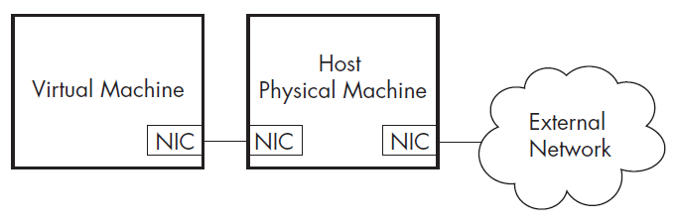
Host-Only Mode

Slide 8
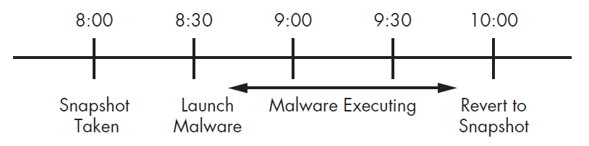
Taking Snapshots
A quick and efficient way to “save the current state” of your VM
Can be restored
Snapshot early. Snapshot often.
Don’t lose your work, take more snapshots
Notes:
Snapshots are a MA’s best friend…they allow you to quickly and easily “backup” or take a complete picture of your VM (all settings / programs / everything)
You can also quickly restore / revert back to the snapshot
So you can run the malware—revert…run it again….revert..
When you revert everything goes back to the way it was when the snapshot was take --- like nothing ever happened
Snapshot early! Take a snapshot as soon as you get your machine all setup---use this as your base.
You’ll always come back to this “ground zero” when starting a new analysis
Snapshot manager allows you to store multiple snapshots…you’re only limited by your physical hard drive space
One OBVIOUS---but important drawback of snapshots is that you will lose any work you have completed when you snapshot…
So if you’ve got something that needs to be saved…be sure to save your work as another snapshot
It may also be possible to transfer your work from a VM to your host through “shared folders”…(if you need to save some portion of your work)
8

Slide 9
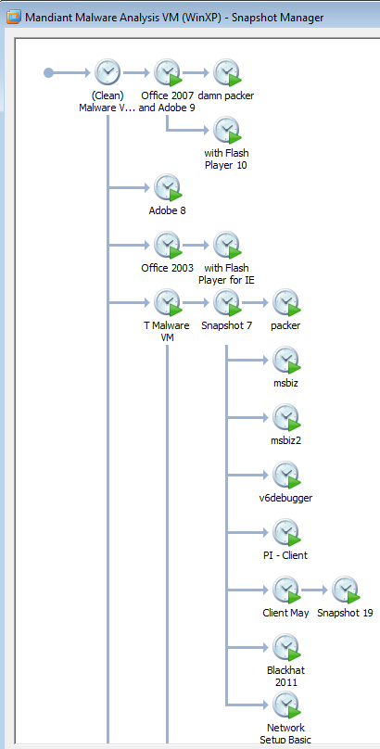
Snapshot Example

Slide 10
Transferring Files
Drag and drop with VMware tools
Shared Folders

Slide 11
Risks
Turn off Auto USB connect in Settings
Malware and VMware don’t always play nice together
Detectable
Escapable
VMware ALWAYS needs to be up-to-date (fully patched)
Be wary of your host
Notes:
Remember SOME malware has the ability to detect it is running in a VM OR that it is being analyzed (for example it is running / executing VERY VERY SLOWLY---cause a person is litterally “stepping-through the code” at run time…
In these cases---the malware can refuse to run or even alter it’s execution…
“Anti-Malware” is discussed in the graduate Malware class
If you’re using VMWare for MA---make sure your CLIENT IS ALWAYS PATCHED AND UP-TO-DATE!
This is very rare (exploits for VM) BUT it does happen!
Even so…it’s probably NOT a good idea to conduct MA (even in a VM) on a machine that contains a lot of sensitive data!
11

Slide 12
VM Workflow
Start with a clean snapshot with no malware running on it.
Transfer the malware to the virtual machine.
Conduct your analysis on the virtual machine.
Take your notes, screenshots, and data from the virtual machine and
transfer it to the physical machine.
5. Revert the virtual machine to the clean snapshot.

Slide 13
Wrap-up
Use VMs
Understand networking options
Use snapshots
Always start clean
Transfer the malware onto the VM
Conduct analysis
Transfer screenshots and other evidence out of the VM to the host
Reset your malware VM to it’s base state and repeat
Notes:
One last note---after resetting your VM to it’s base---you may want to check if there are any updates to the programs you are running (your MA tools)
If so, update your VM and save a new “base”
13

Slide 14
?

