Slide 1

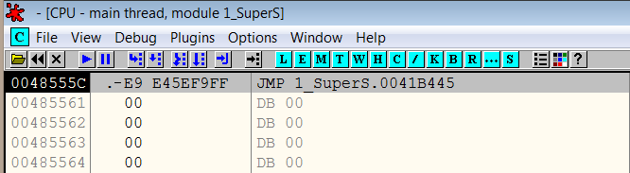
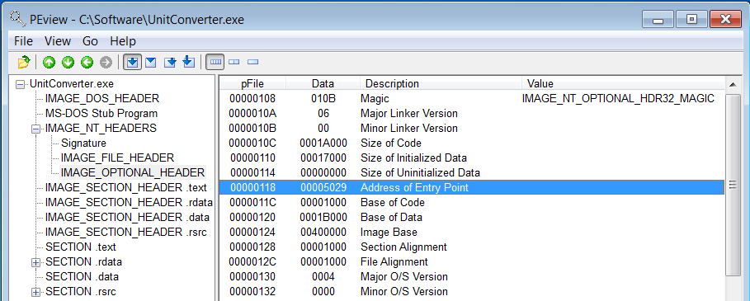
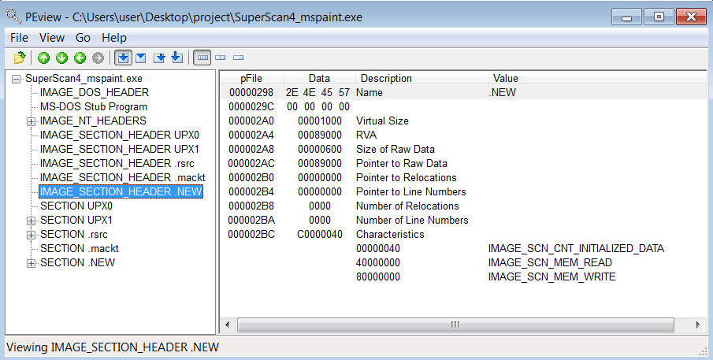
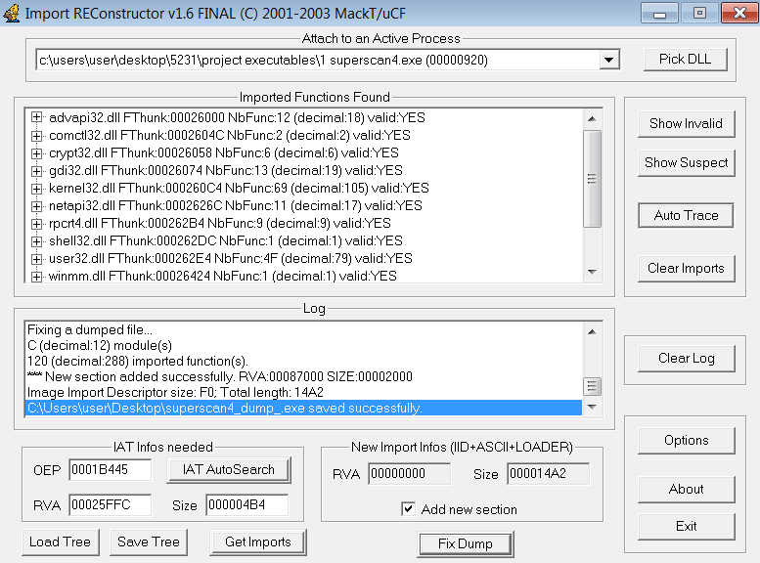
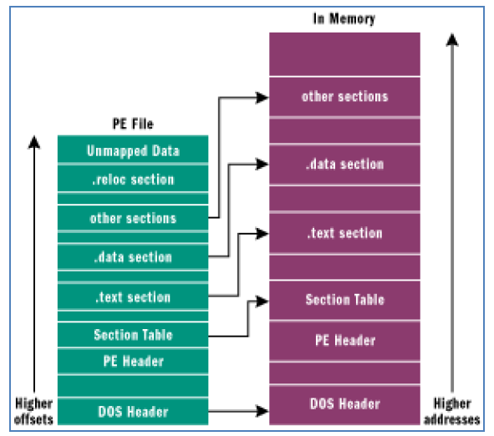
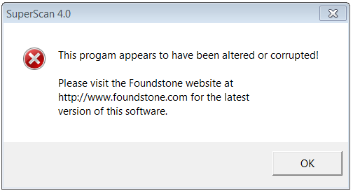
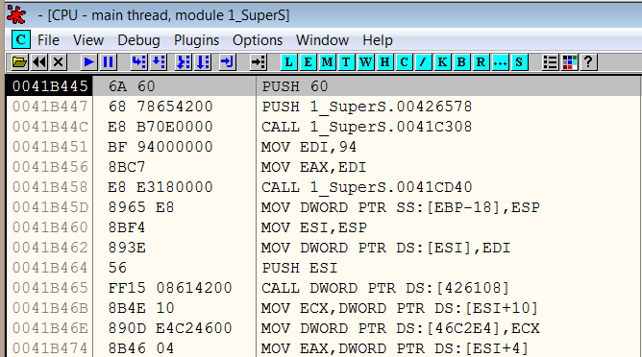
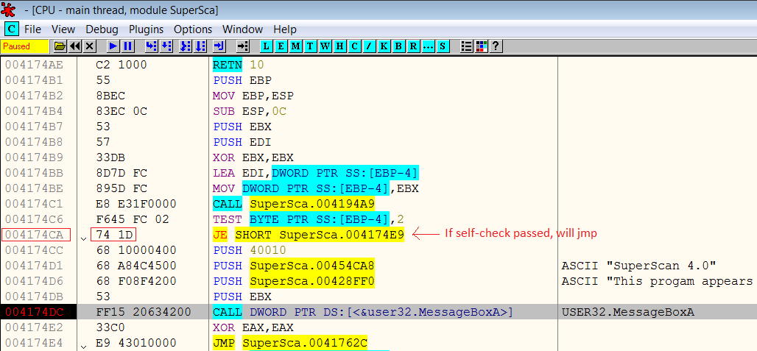
Bypassing Binary Protection on Windows Platform
Group Members
Introduction of Project
How Systems Work
Attack: Break System
After locating the check, patch the program – change opcode from “JE 4174E9” to “JMP 4174E9” using hex editor and it is done
Malware infections are prevalent; they happen even through installation of seemingly useful commercial software
Eg trojan horse in pirated copies of Apple's iWork '09 productivity software
Security articles generally touch on the technical challenges of defending against malware attacks
We want to take on a fresh perspective – get a feel of the technical challenges from malware developers’ angle
Chosen port scanner Superscan4.exe from McAfee as target to explore breaking its defenses and perform code injection
It presents a good challenge:
Executable is obfuscated (UPX packer)
Has sanity check on itself and abort if changes are detected in file content
Defensive features are implemented by a security company – has the wow factor
Gameplan - to inject code into the executable, we must first “de-obfuscate” it to locate the sanity check for disabling
To achieve our objectives for the attack, we must first understand
Structure of the Portable Executable (PE) file format (standard executable file format used in Windows) - to perform code injection
Step 1: Unpacking the executable
Attach the debugger to the executable to find the OEP (Original Entry Point)
Step 3: Inject custom code in executable
Developed an application to create a new section in Superscan4 for injected code
Change the entry point of Superscan4 to execute code in this section first before redirecting to the original code section
Application has modular feature; able to inject chosen payload kept in a binary file
At OEP, dump the fully unpacked program to disk
Fix the Import Table
How packing (code obfuscation) works - in order “de-obfuscate the executable
Know how Attack Works & introduce Defenses
Procedure: Attach debugger during execution
Detect execution within debugger using API calls such as IsDebuggerPresent()
Check for presence of debugger windows during program execution using API such as FindWindow()
Procedure : Trace program execution in debugger
Use more complex code obfuscation engine (eg packers such as Armadillo)
Use Timing based techniques to detect users stepping through code within debugger – Eg GetTickCount() API can detect pause while doing code stepping
Detect for modified code in process as software breakpoints usually change the program to insert the breakpoint
Procedure :Changing the executable as a result of unpacking and code injection
Use code signing - confirm the author and guarantee the code was not altered with the use of a cryptographic hash.
Use commercial solutions like Metaforic, V.i. Labs to ensure integrity of executable
Step 2: Defeat the sanity check
Sanity check will detect changes in the executable after unpacking and abort
Concept of opcode (numeric representation of machine instructions) – to locate and defeat the sanity check
To disable the check, we first need to locate the code – so we attach a debugger for tracing
Hint – the MessageBox offers a good location to apply the breakpoint
System Security Methodology
Our exploration will take us through this methodology - to introduce defenses by learning how attack works

