Slide 1

Stuart Little
E.D.White
Family

Slide 2
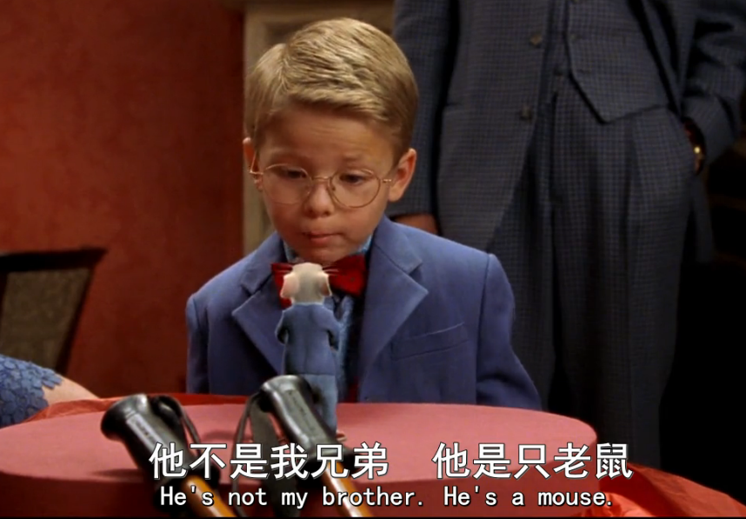
He’s not my brother.
He’s a mouse!

Slide 3
You have to look alike to be family? You don't have to look alike. You don't have to like each other.Like at Snowbell He hates me.And still,he's trying to save me. And we are Family.

Slide 4
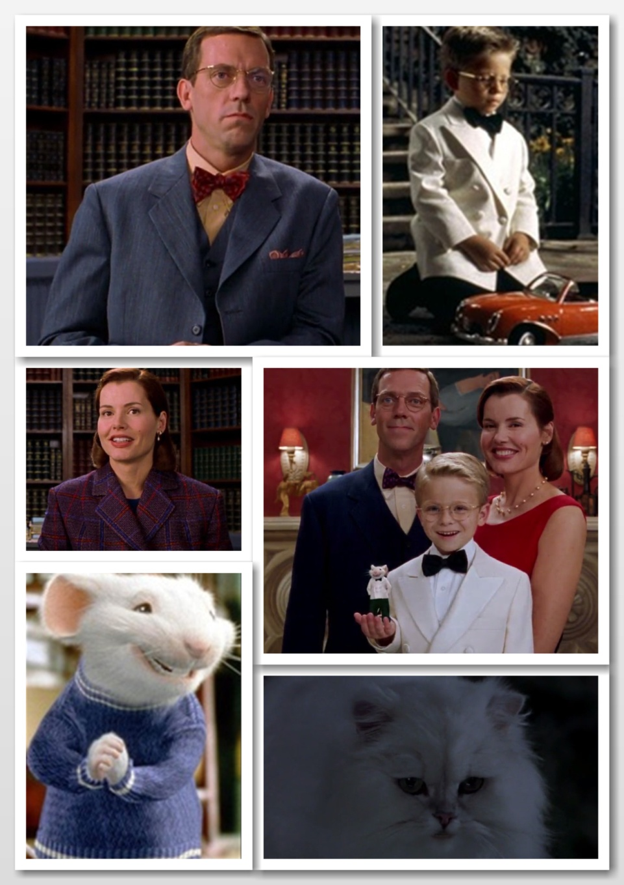
Family

Slide 5
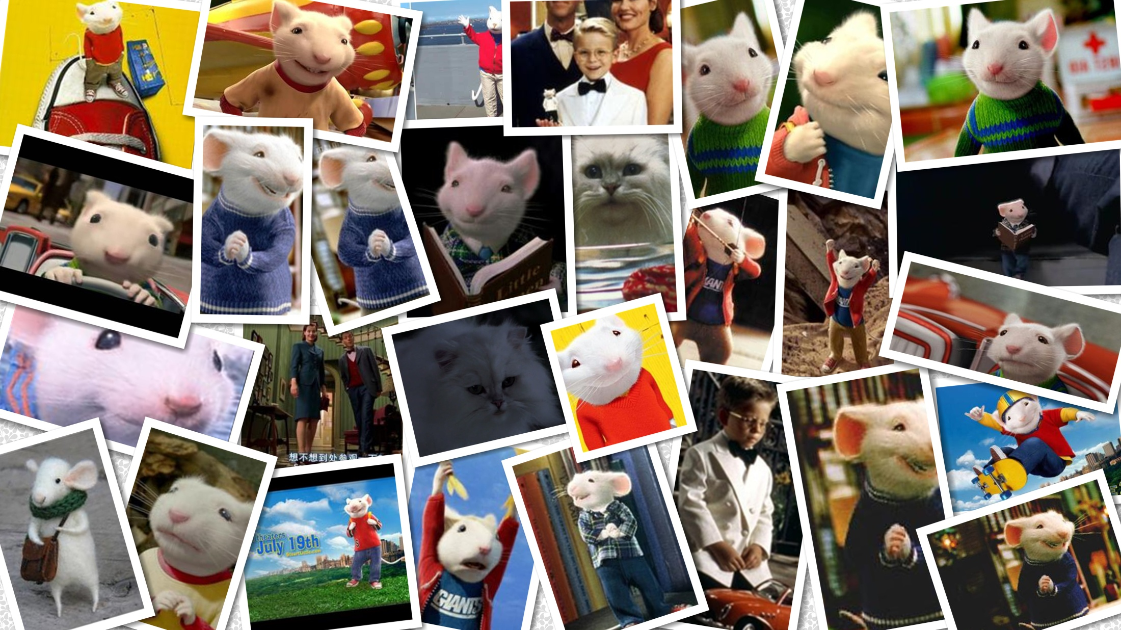
Thank You!
E.D.White
Family

