Slide 1
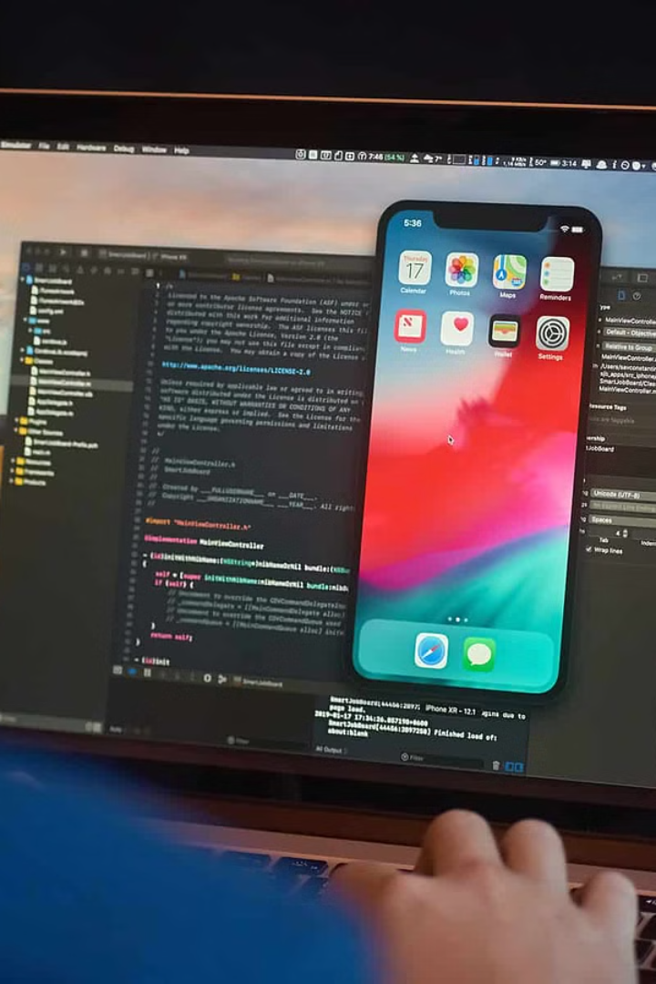


Report on Flutter App Development for Engineering Specialty Guide
This comprehensive report delves into the exciting world of Flutter, a revolutionary open-source mobile app development framework that has captured the attention of the engineering community. Flutter's cross-platform capabilities, robust performance, and rich feature set make it an increasingly popular choice for building high-quality, responsive, and visually stunning mobile applications. Discover how Flutter's innovative approach to app development can streamline your engineering workflows, enhance user experiences, and drive innovation in your organization.
by Abdellah Mjalli

Slide 2
Introduction
This report outlines the development of a comprehensive mobile application built using the Flutter framework, designed to serve as a guide for users interested in an engineering specialty program. The app aims to provide a seamless and informative experience for students, faculty, and prospective applicants, consolidating key details about the specialty's overview, course offerings, faculty expertise, and program curriculum. By leveraging the cross-platform capabilities of Flutter, this application ensures consistent and responsive user interfaces across both iOS and Android devices, catering to the diverse needs of the target audience. The report delves into the app's key features, code structure, and overall development approach, offering insights into the successful implementation of this valuable resource for the engineering specialty community.

Slide 3
App Features
Home Screen: The home screen serves as the main entry point for users, providing a comprehensive overview of the engineering specialty program. This screen features a clean and intuitive design, making it easy for users to navigate and access the key information they need. The home screen includes a captivating hero section that highlights the program's unique features and benefits, drawing users in and piquing their interest. Below the hero section, users will find a neatly organized menu providing quick access to the specialty overview, course catalog, faculty directory, and program curriculum. The home screen is designed to give users a seamless and engaging introduction to the engineering specialty, setting the stage for their exploration of the app's robust functionality.

Slide 4
Specialty Overview
The engineering specialty offers a comprehensive program that provides students with a deep understanding of the fundamental principles and applications of various engineering disciplines. The program's objectives are to equip students with the technical expertise, problem-solving skills, and innovative mindset required to address the complex challenges faced by modern industries and societies. Through a carefully curated curriculum, students will explore topics ranging from structural engineering and materials science to computer systems and renewable energy technologies, gaining a broad and interdisciplinary perspective on the field.
One of the unique features of this engineering specialty is the emphasis on hands-on learning and real-world project experiences. Students will have the opportunity to work on collaborative design projects, participate in industry-sponsored internships, and engage in cutting-edge research initiatives, all of which will help them develop the practical skills and professional acumen needed to thrive in their future careers. Additionally, the program boasts state-of-the-art facilities, including advanced laboratories, prototyping workshops, and computational resources, which provide students with access to the latest tools and technologies in the industry.
The scope of the engineering specialty is designed to be both broad and specialized, catering to the diverse interests and aspirations of our students. Whether they are interested in pursuing careers in energy systems, transportation infrastructure, biomedical devices, or information technology, the program offers a wide range of electives and concentrations that allow students to tailor their educational journey to their individual goals and passions. Through this holistic approach, the engineering specialty aims to cultivate a new generation of engineers who are not only technically proficient but also adaptive, innovative, and socially responsible.

Slide 5

Courses Catalog
The Courses Catalog section of the app offers users a comprehensive overview of the engineering specialty's course offerings. Students can browse through detailed information for each course, including the course code, title, description, and credit hours. This feature empowers users to plan their academic journey by providing a clear understanding of the course requirements and the diversity of subjects available within the specialty.
The Courses Catalog also includes intuitive filtering options, allowing users to sort and search for courses based on criteria such as semester, subject area, or even the professor teaching the course. This functionality enables students to easily identify the courses that align with their interests and academic goals, facilitating more informed decision-making and optimized course scheduling.
By offering a centralized and user-friendly platform to explore the engineering specialty's curricular offerings, the Courses Catalog section of the app serves as a valuable resource for both prospective and current students. The detailed course information and flexible filtering options empower users to navigate the program's academic landscape, ensuring they can make informed choices and maximize their educational experience within the engineering specialty.

Slide 6

Faculty Directory
The Engineering Specialty Guide app features an extensive faculty directory, showcasing the expertise and backgrounds of the accomplished professors who lead the program. Each faculty member's profile includes a brief biography highlighting their areas of specialization, research interests, and notable achievements. Users can explore the diverse backgrounds and wealth of knowledge represented within the engineering faculty, gaining insight into the distinguished instructors who will guide their educational journey.
The faculty directory provides a valuable resource for students, allowing them to learn more about the educators who will be shaping their academic experience. By featuring profiles of the department's leading experts, the app empowers students to make informed decisions about their course selections and forge meaningful connections with the faculty. Through this comprehensive directory, the Engineering Specialty Guide app demonstrates the program's commitment to providing a high-caliber educational experience facilitated by world-class instructors.
Whether a student is interested in exploring the research projects of a particular professor or simply seeking to get to know the individuals who will be mentoring them, the faculty directory serves as an essential tool for navigating the engineering specialty. By highlighting the diverse backgrounds and areas of expertise within the faculty, the app encourages students to engage with their instructors, fostering a dynamic and enriching learning environment.

Slide 7

Program Curriculum
The program curriculum for the Engineering Specialty Guide provides a comprehensive calendar of all specialty-related courses. This section gives students and prospective learners a clear overview of the courses they can expect to take throughout their educational journey in this field. The curriculum is designed to cover a wide range of topics, from foundational engineering principles to advanced, specialized electives, ensuring a well-rounded education that prepares graduates for success in their chosen engineering discipline.
The curriculum is structured to guide students through a logical progression of courses, starting with core classes that establish a strong technical foundation. As students advance, they will have the opportunity to explore various engineering concentrations, such as mechanical, electrical, civil, or computer engineering, by selecting from a diverse array of elective offerings. This flexibility allows students to tailor their education to align with their specific interests and career aspirations.
Each course is meticulously detailed, providing information about the course code, title, description, and credit hours. This level of transparency ensures that students can make informed decisions about their course selection and plan their academic journey accordingly. Additionally, the curriculum incorporates opportunities for hands-on learning, project-based experiences, and industry-relevant internships, further enhancing the practical skills and real-world preparation of students.

Slide 8

Code Structure
The codebase for the Engineering Specialty Guide app is organized in a modular and scalable manner, with separate Dart files for each of the key screens and components. This structure not only makes the code more manageable and easier to maintain, but also enables efficient development and future enhancements.
The home_screen.dart file contains the code for the app's home screen, which serves as the central hub for accessing the various features of the guide. The specialty_overview.dart file houses the code responsible for displaying the detailed overview of the engineering specialty, including its objectives, scope, and unique characteristics.
For the courses catalog, the courses_catalog.dart file is where the user interface and functionality for browsing and filtering the course offerings are implemented. Similarly, the faculty_directory.dart file focuses on the presentation and interaction with the directory of faculty members teaching in the specialty.
Finally, the program_curriculum.dart file is dedicated to the display and organization of the engineering specialty's course calendar and program curriculum, providing users with a comprehensive overview of the academic plan.

Slide 9
Widgets and Functionalities
The development of the Flutter app for the Engineering Specialty Guide has leveraged a wide range of Flutter widgets to create the user interface and implement the required functionalities. Each screen in the app is built using foundational Flutter widgets such as Scaffold, AppBar, Text, Column, Row, ListView, and ListTile. These widgets are combined and customized to construct the visual elements and layout of the various screens, ensuring a cohesive and intuitive user experience.
The app's functionalities, such as navigation between screens, filtering options, and data display, are implemented using Flutter's powerful widget tree and state management techniques. By thoughtfully structuring the widget hierarchy and managing the app's state effectively, the development team has been able to create a smooth and responsive user interface that allows users to seamlessly explore the Engineering Specialty Guide's content. This approach not only enhances the overall user experience but also lays the foundation for future enhancements and maintainability of the app's codebase.

Slide 10
Conclusion
In conclusion, the development of the Flutter app for the Engineering Specialty Guide has been successfully completed. The app provides a user-friendly interface for accessing comprehensive information about the engineering specialty, including details on courses, faculty, and the program curriculum. The organized and modular code structure not only facilitates easy maintenance, but also enables future enhancements and expansions of the app's functionality.
The app's seamless navigation, intuitive UI, and robust data presentation make it a valuable resource for students, faculty, and administrators alike who are interested in the engineering specialty. By serving as a centralized hub for all relevant information, the app fulfills its purpose of being a comprehensive guide that supports the educational and professional development needs of the engineering community.
This detailed report documents the development process and key features of the app, and can be used for evaluation purposes as well as a reference for future improvements and updates. The successful deployment of this app is a testament to the team's technical expertise, design prowess, and commitment to delivering a high-quality, user-centric solution that enhances the overall experience for the engineering specialty program.

