Slide 1
LeanMoE: Large AI. Smaller memory footprint.
HUMAIN Challenge: Deliver AI with Less Compute
Abdullah Ali Alanazi
Notes:
LeanMoE focuses on local execution of Mixture-of-Experts models when device RAM is smaller than model weights. It trades storage access for a smaller RAM footprint rather than reducing arithmetic operations. Built for the HUMAIN Challenge.

Slide 2
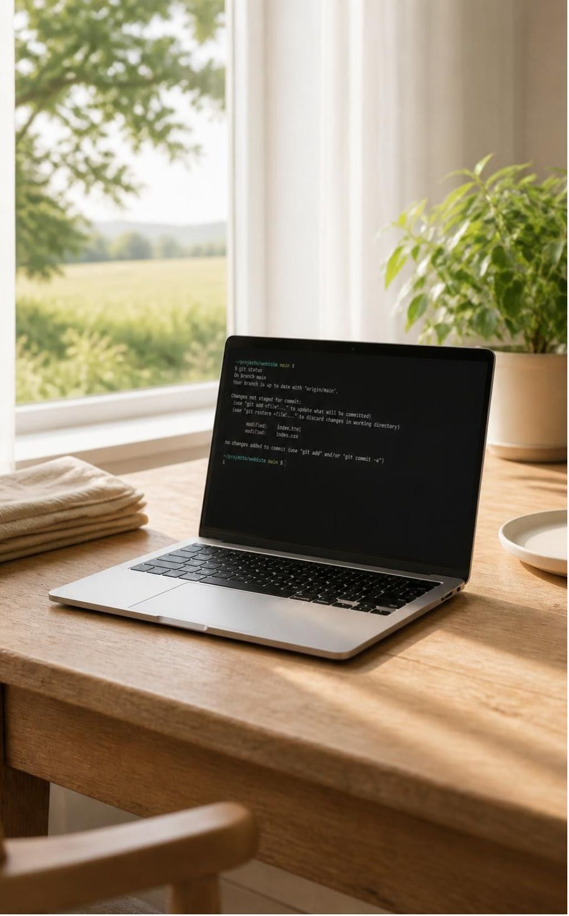
MEMORY CONSTRAINT
A 14.36 GB model store on an 8 GB laptop
14.36 GB
Qwen1.5-MoE-A2.7B-Chat int8 weights on local SSD store
8 GB
Total host RAM on the benchmarked physical laptop
Disk store size is not process RAM. Windows paging can run larger models, but repeated weight reads cost time and other applications compete for memory.
Intel Core i5-12450H · Windows 11 · NVMe SSD store · 48 output tokens evaluated
Notes:
Hardware baseline: Intel Core i5-12450H with 8.30 GB RAM running Windows 11. The model is Qwen1.5-MoE-A2.7B-Chat quantized to int8. The 14.36 GB disk image represents on-disk weights, not process footprint. Windows paging can run models larger than RAM, but repeated reads cost time and other applications compete for memory. Source: https://github.com/No6Name8/LeanMoE/blob/main/results/config_compare_mmap_full_20261030-060448.json

Slide 3
RUNTIME ARCHITECTURE
Stream the experts, not the whole model
SSD model store → RAM expert cache → Qwen computation → generated token
14.36 GB int8 weights stay on disk. LeanMoE reuses selected weights, prefetches likely experts, and adjusts the cache between tokens as the planning budget changes.
Qwen1.5-MoE-A2.7B-Chat int8 produces answers; LeanMoE manages weight access.
Prefetch can miss; the planning budget is not a hard memory ceiling.
Notes:
In MoE architectures, each token activates only a sparse subset of feed-forward experts. The unmapped local SSD model store holds quantized int8 expert weights. LeanMoE streams selected weights into a managed RAM cache, evicting cold experts. A heuristic predictor anticipates routing; cache misses fall back to synchronous SSD reads. Dense attention runs in memory, while MoE layers execute over cached expert slices. LiveBudget adjusts cache capacity between tokens.

Slide 4
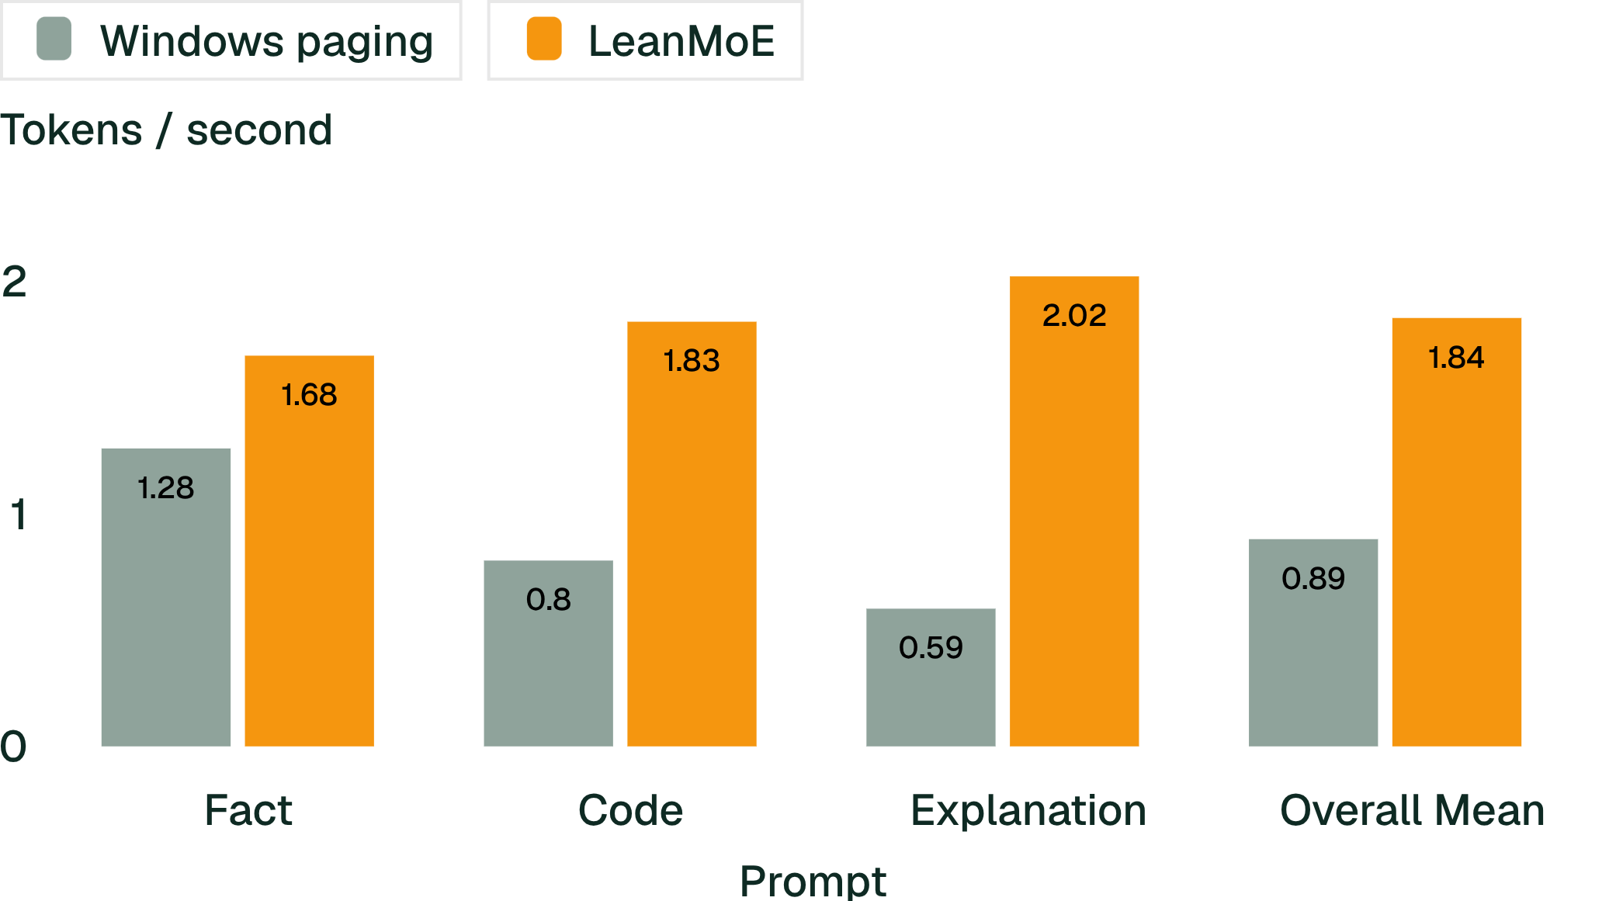
BENCHMARK EVALUATION
2.07× mean decode throughput on the tested laptop
1.842 vs 0.891 tokens/s mean decode throughput across six matched runs.
Five of six matched runs favored LeanMoE. In one warm paging run, OS cache outperformed LeanMoE. All 48 output token IDs matched bit-for-bit.
Excludes load and prefill times. Ratio of means, not mean of ratios.
Notes:
Benchmark details: 3 prompts (fact, code, explanation), 2 runs each alternating order, 48 output tokens generated with greedy decoding. 2.07x is the ratio of overall means (1.842 / 0.891). Source data: https://github.com/No6Name8/LeanMoE/blob/main/results/config_compare_mmap_full_20261030-060448.json

Slide 5
DYNAMIC ADAPTATION
A live budget cut, with 80/80 matching tokens
TOKENS 1 – 20 (INITIAL BUDGET)
TOKENS 21 – 80 (THROTTLED BUDGET)
3.50 GB
2.50 GB
Planning budget allows 124 cached experts in RAM.
Live budget drops to 2.5 GB; cache contracts to 59 experts. Process private memory measures ~2.39 GB after eviction.
One prompt, greedy decoding; all 80 tokens matched the uncut baseline. Token equality does not prove answer correctness. Separate experiment from the throughput benchmark.
Notes:
Adaptive demo: Live budget reduction triggered mid-generation after token 20. Cache resized on-the-fly from 124 down to 59 experts, dropping private memory to ~2.39 GB. Output tokens matched the unthrottled run exactly. Sources: https://github.com/No6Name8/LeanMoE/blob/main/results/adaptive_demo_20261030-060626.json and https://github.com/No6Name8/LeanMoE/blob/main/results/adaptive_demo_20261030-060728.json

Slide 6
ENGINEERING PROVENANCE
Measure, correct, and build on ExpertRelay
ExpertRelay · Abdullah
LeanMoE additions
Engine, store readers, LRU expert cache, predictor, LiveBudget and startup guard.
Integration, accounting fixes, tuning, real-model evaluation, tests, streaming and dashboard.
Import-baseline correction: approximately 2.66 GB before versus 2.47 GB after in an earlier matched 2.5 GB cut experiment, distinct from the final demo.
ExpertRelay · Zenodo DOI: 10.5281/zenodo.22980838
Notes:
LeanMoE builds on Abdullah’s earlier ExpertRelay engine. The baseline correction figures are from an earlier matched 2.5 GB cut experiment, not the final adaptation demo. ExpertRelay: https://doi.org/10.5281/zenodo.22980838

Slide 7
ONE ENGINE. TWO MEMORY ENVIRONMENTS.
LeanMoE sizes its memory to the machine it runs on
LOCAL · WINDOWS LAPTOP
8 GB of RAM
CLOUD · WINDOWS VM
16 GiB of RAM
2.5 GB
10.969 GB
Planning budget in a live mid-run cut
About 2.39 GB private memory measured after the cut. The budget is a planning target, not a hard ceiling. The 14.36 GB model store streams from disk.
Expert cache set automatically
The larger VM's automatic configuration chose this cache size for the same engine.
Separate experiments with different metrics. Not a direct benchmark.
Notes:
One engine, two memory environments. On the 8 GB laptop, the live cut used a 2.5 GB planning budget and measured about 2.39 GB private memory afterward; the budget is not a hard memory ceiling. On the 16 GiB cloud VM, automatic configuration set a 10.969 GB expert cache. These are separate experiments with different metrics, so do not read them as one benchmark.

Slide 8
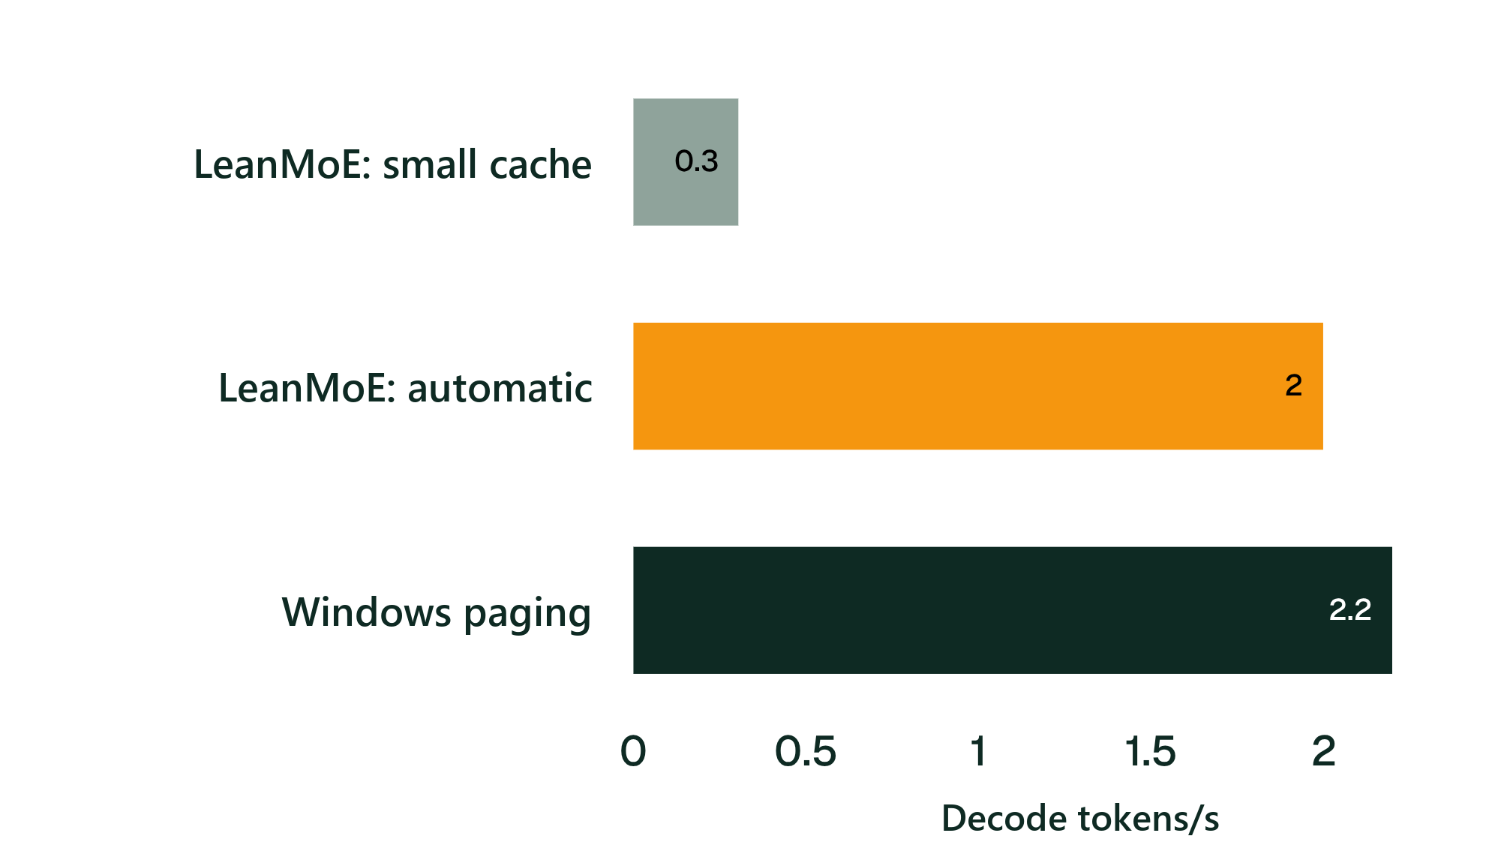
INFRASTRUCTURE COMPARISON
More memory changes the cloud trade-off
Automatic sizing improved LeanMoE decode throughput 6.58× versus its small-cache configuration.
LeanMoE automatic achieved 1.998 tokens/s versus Windows paging’s 2.198 tokens/s: about 9.1% lower throughput in this VM test.
16 GiB VM. One prompt, two main repeats; unequal memory use; OS caches uncontrolled.
Notes:
Cloud demonstration on 16 GiB Windows VM (4 vCPUs). Sizing cache automatically improves throughput 6.58x over small cache, but falls 9.1% behind Windows paging. Cloud memory availability shifts the advantage back toward OS caching. Source: https://github.com/No6Name8/LeanMoE/blob/main/results/resource_profile_comparison.json

Slide 9
RESEARCH HORIZON
Next: test useful answers across more devices
Research priorities
ACCESS & ARTIFACTS
Review resources
Evaluate: Test more models and constrained devices.
Build: Simplify model-store setup and improve memory feedback from measured usage.
Evidence boundary: Full 12-task laptop check: 8/12 correct and within 120 seconds per mode, first and warm. Four tasks wrong; the earlier three-task pilot was a harness check.
GitHub
Code, setup and raw evidence
Live demo
Runs on a protected Windows server
Private credentials required.
HUMAIN Hackathon Submission · October 2026
Notes:
Future work includes task completion, semantic answer validity and token latency; evaluation beyond Qwen1.5-MoE to Mixtral and DBRX across varied edge devices, memory configurations and Linux/macOS unified memory platforms; and improving LiveBudget feedback on system commit pressure and cache limits. These are proposed directions, not completed results. The full 12-task evaluation remained unfinished; the earlier three-task pilot checked the harness only. Repository: https://github.com/No6Name8/LeanMoE | Live demo: https://leanmoe-demo-1.eastus.cloudapp.azure.com/

