Slide 1
LeanMoE: Large AI. Smaller memory footprint.
HUMAIN Challenge: Deliver AI with Less Compute
Abdullah Ali Alanazi
Notes:
I started with a limitation on my own laptop: the model's weights were larger than its RAM. LeanMoE runs Mixture-of-Experts models in that situation by trading storage reads for a smaller RAM footprint. It does not reduce the model's arithmetic. Built for the HUMAIN Challenge: Deliver AI with Less Compute.

Slide 2
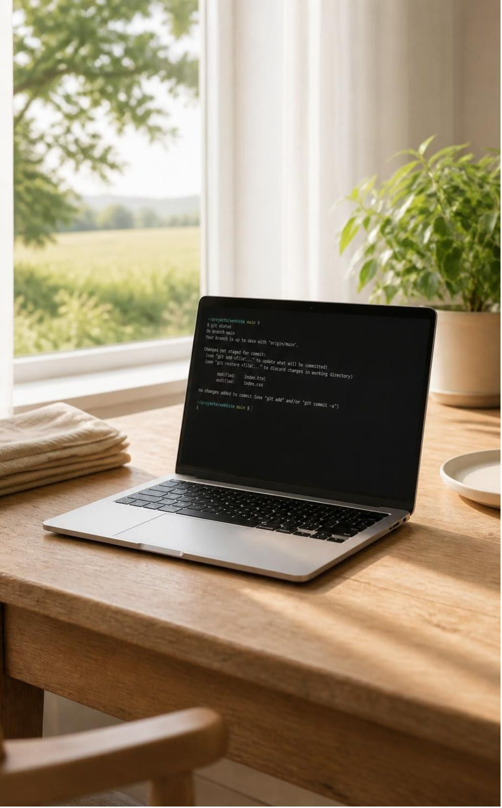
MEMORY CONSTRAINT
My laptop had 8 GB. The disk store was 14.4 GB.
14.36 GB
Qwen1.5-MoE-A2.7B-Chat int8 weights in the local SSD store (disk size, not process RAM)
8.30 GB
Installed physical RAM on the benchmarked laptop
Missing weights must be fetched from SSD, and other applications compete for the same RAM. Windows paging can also run larger models, at a cost in time.
Intel Core i5-12450H · Windows 11 · NVMe SSD store
Notes:
My laptop has 8.30 GB of installed RAM. The Qwen1.5-MoE-A2.7B-Chat int8 store is 14.36 GB on the local SSD. Disk-store size is not process memory: missing weights must be read from SSD, and other applications compete for RAM. Windows paging can also run models larger than RAM, so the question is how each approach behaves on this machine. Hardware: Intel Core i5-12450H, Windows 11, NVMe SSD. Source: https://github.com/No6Name8/LeanMoE/blob/main/results/config_compare_mmap_full_20261030-060448.json
Transition: The model does not need every expert for every token. That gives us a way to manage memory more deliberately.

Slide 3
RUNTIME ARCHITECTURE
Keep useful experts in memory
SSD model store
RAM expert cache
→
→
Qwen
→
Next token
Computes the answers
Output for each step
int8 expert weights stay on disk
Reused experts, resized by budget
Cache: keeps recently used experts in RAM
Prefetch: loads likely experts early; predictions can miss
Budget: a planning target that resizes the cache between tokens, not a hard memory ceiling
Qwen generates the answers; LeanMoE manages expert-weight access.
Engine mechanisms adapted from Abdullah’s earlier ExpertRelay research. Slide 7 explains the contribution.
Notes:
The unmapped SSD store holds quantized int8 expert weights. LeanMoE keeps selected experts in a RAM cache, prefetches likely experts, and resizes the cache when the planning budget changes. Qwen computes the answers; LeanMoE manages expert-weight access. Prefetch predictions can miss, and the memory budget is a planning target, not a hard memory ceiling. The engine mechanisms come from Abdullah’s earlier ExpertRelay research; slide 7 covers that contribution. Avoid implying fewer arithmetic operations.
Transition: First, I tested whether this execution method helped on the same laptop.

Slide 4
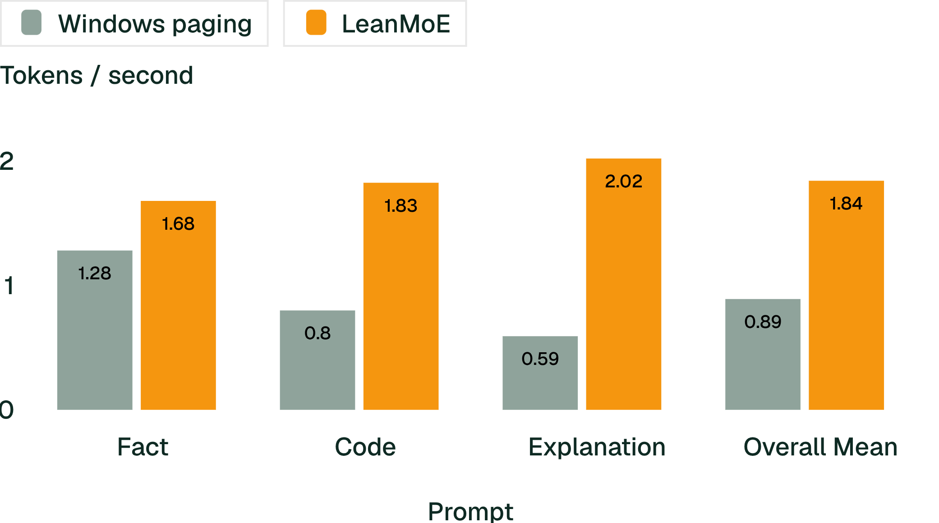
BENCHMARK EVALUATION
2.07× ratio of mean decode throughput on the tested laptop
1.842 vs 0.891 tokens/s overall mean decode throughput. Speedup ratio of means: 2.07×.
Five of six matched runs favored LeanMoE. In one warm paging run, OS cache outperformed LeanMoE. All 48 output token IDs matched bit-for-bit.
Decode only: excludes loading and prefill. Windows file-cache state varied. Ratio of means, not mean of ratios.
Notes:
Method: three prompts (fact, code, explanation), two runs per mode per prompt, 48 output tokens per run. Same laptop, model store, fused kernel and thread settings: OpenBLAS 4 threads, Numba 12. Mode order alternated, one process at a time. Decode excludes loading and prefill. The 2.07× is the ratio of the overall means (1.842 / 0.891), not a mean of per-prompt ratios. LeanMoE was faster in five of six matched comparisons; one warm paging run was faster; all 48 output token IDs matched. Source: https://github.com/No6Name8/LeanMoE/blob/main/results/config_compare_mmap_full_20261030-060448.json
Transition: Faster tokens alone were not enough. I also needed to check useful task results.

Slide 5
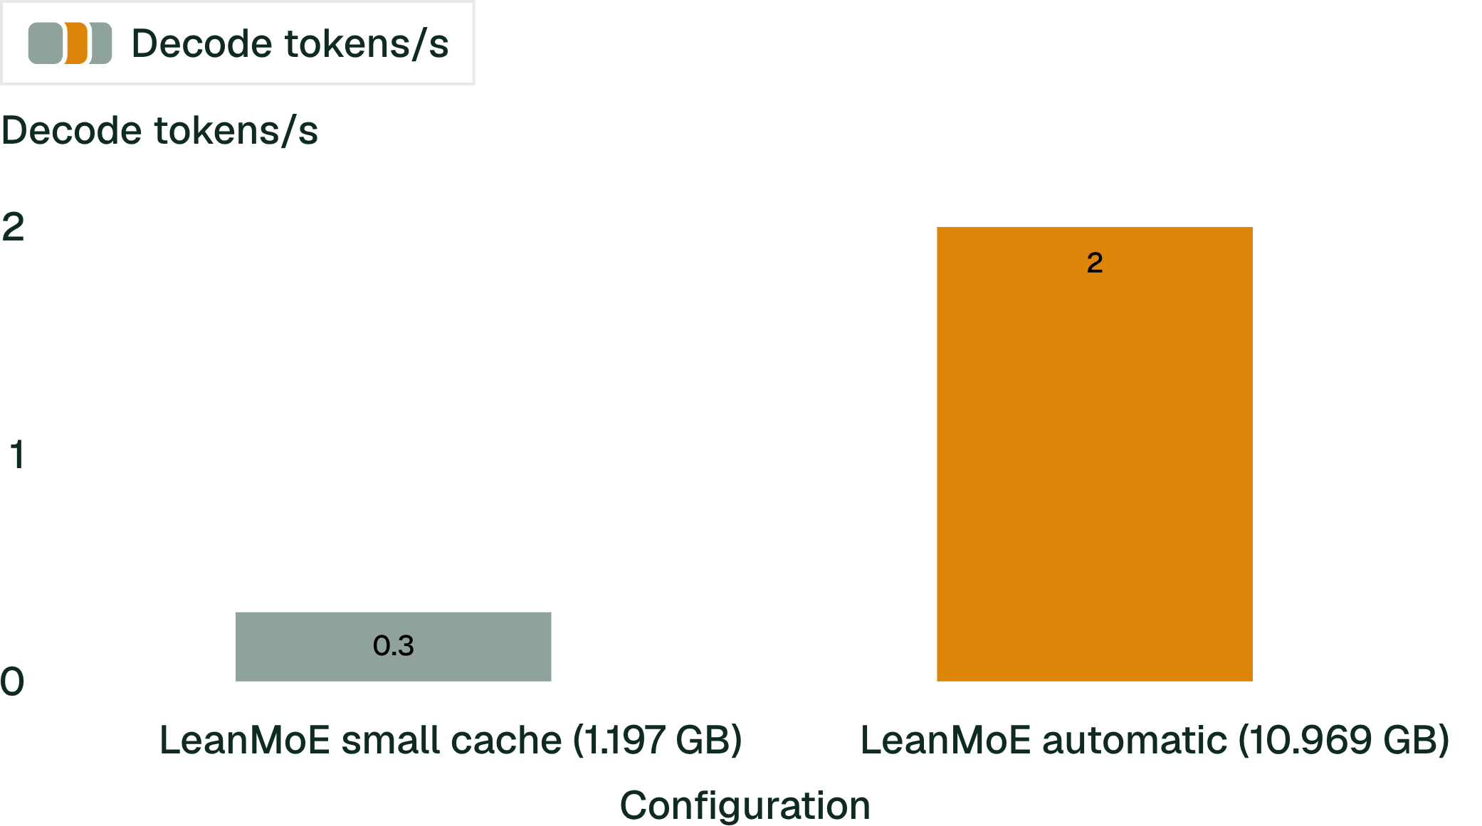
CLOUD VM · SAME-VM CONFIGURATION COMPARISON
Automatic sizing adapts LeanMoE to stronger hardware
6.58×
higher decode throughput vs small-cache LeanMoE, same VM
Automatic sizing picks a larger cache from available RAM, commit headroom and safety reserves.
One prompt, uncontrolled file cache. Not versus Windows paging (2.198 tokens/s).
Mean decode throughput, same 16 GiB Windows VM.
Notes:
Moving to a larger machine did not automatically make the engine faster. The original configuration still used a laptop-sized cache. Measuring the bottleneck led to automatic sizing, which improved LeanMoE’s throughput by 6.58× in this experiment.
Scope: same 16 GiB Windows VM with four vCPUs; same model and store, prompt, fused int8 kernel and four-thread settings. One prompt, two main repeats, uncontrolled Windows file-cache state. The configurations differ in cache capacity and memory use. The 6.58× result compares two LeanMoE configurations, not a speedup over Windows paging (2.198 tokens/s).
Disk reads: guest-wide Windows disk counters across measured decode steps, 24.462 GB to 3.477 GB. These are not host physical media reads, not process-isolated reads, not total task I/O, and not energy savings; async prefetch can cross step boundaries.
Separate task evaluation (earlier slide): 12 fixed tasks, both modes achieved 8/12 manually correct answers, with the same four tasks wrong. This does not mean all answers were correct, and it does not establish broad answer quality.
Sources: https://github.com/No6Name8/LeanMoE/blob/main/results/resource_profile_comparison.json ; https://github.com/No6Name8/LeanMoE/blob/main/deploy/RESOURCE_PROFILE.md

Slide 6
DYNAMIC ADAPTATION · SEPARATE DEMO
The cache resized to the budget, and all 80 tokens completed
PLANNING BUDGET
EXPERT CACHE
3.5 GB
149 → 109
The run started with a 3.5 GB planning budget. Free RAM limited the expert cache at token 1.
Cache slots resized from 149 to 109 experts. Peak sampled private memory during decoding was 2.83 GB.
One prompt, greedy decoding, 80 tokens generated. Token completion shows execution consistency, not answer correctness.
Notes:
Adaptive demo, separate from the throughput benchmark: one prompt, greedy decoding, 80 tokens, starting budget 3.5 GB. The committed run generated all 80 tokens with no error. The expert cache was resized from 149 to 109 experts at token 1, limited by free RAM. Peak sampled private memory during decoding was 2.83 GB. Token completion shows execution consistency, not answer correctness. Historically, a fixed 1.3 GB cache with a 2.5 GB budget was refused at startup, not crashed mid-run. Sources: https://github.com/No6Name8/LeanMoE/blob/main/results/adaptive_demo_20261030-060626.json and https://github.com/No6Name8/LeanMoE/blob/main/results/adaptive_demo_20261030-060728.json
Transition: These experiments also exposed assumptions in the implementation that I needed to correct.

Slide 7
RESEARCH ITERATION
Experiments exposed a memory-accounting error, which I corrected
LEANMOE ADDITIONS
EXPERTRELAY · ABDULLAH
Integration, corrected memory accounting, thread tuning, new evaluations, streaming, dashboard and automatic sizing.
Engine, store readers, LRU expert cache, predictor, LiveBudget and startup guard.
Example: the early estimate missed committed runtime memory at import. In an earlier matched 2.5 GB cut experiment, private memory was about 2.66 GB before the correction and 2.47 GB after. That is a separate accounting experiment from the 2.39 GB adaptation demo.
ExpertRelay · Zenodo DOI 10.5281/zenodo.22980838
Notes:
LeanMoE builds on Abdullah’s earlier ExpertRelay engine, which supplied the engine, store readers, LRU expert cache, predictor, LiveBudget and startup guard. LeanMoE added integration, corrected memory accounting, thread tuning, new evaluations, strict evidence checks, streaming, a dashboard and automatic sizing. Example: the estimate missed committed runtime memory at import. The import-baseline correction is from an earlier matched 2.5 GB cut experiment: about 2.66 GB before and 2.47 GB after. It is not the final adaptation demo. ExpertRelay: https://doi.org/10.5281/zenodo.22980838
Transition: I wanted others to inspect those decisions and test the system themselves.

Slide 8
INSPECTABLE SOFTWARE
A working system others can inspect
Real streaming inference and comparisons
Live budget control
Downloadable run records and recorded evidence
Setup scripts and real-engine synthetic-store tests
GitHub
github.com/No6Name8/LeanMoE
Live demo
Live demo
Private credentials required.
Synthetic weights produce meaningless output; they test the mechanics without the 14.36 GB model store. Full Qwen inference needs the external store and Windows.
Cloud is an optional remote way to try the same engine, not the main performance story.
Notes:
Engineering quality: real streaming inference and comparisons, live budget control, downloadable run records and recorded evidence, setup scripts and real-engine synthetic-store tests. Synthetic weights produce meaningless output and test the mechanics without the large model download. Full Qwen inference needs the external 14.36 GB store and Windows. Cloud detail, kept separate: on a 16 GiB Windows VM with 4 vCPUs (one prompt, two main repeats, uncontrolled OS caches, unequal memory use), LeanMoE with a 1.197 GB cache ran 0.304 tokens/s; automatic sizing set a 10.969 GB cache and ran 1.998 tokens/s, 6.58× the small-cache configuration; Windows paging ran 2.198 tokens/s, about 9.1% faster than automatic LeanMoE. It is not the main performance story. Source: https://github.com/No6Name8/LeanMoE/blob/main/results/resource_profile_comparison.json
Transition: The current evidence answers a narrow question. The next step is to find how widely the result holds.

Slide 9
FUTURE WORK
What we would build next
Smarter expert access
A better cloud experience
Easier adoption
Improve expert prediction and cache policies to reduce unnecessary disk reads.
Investigate safe reuse of loaded model weights while keeping each user’s prompts and state isolated.
Simplify model-store setup and distribution, add more MoE models, and test across more devices.
Validate with controlled comparisons of latency, memory and output consistency.
Tune cache sizing and storage, then measure latency, memory and cost together.
Local inference remains the foundation; cloud extends the same runtime.
GitHub
Live demo
Large models on the hardware people already have.
Demo requires private credentials.
Notes:
Future work, not yet scheduled as results. 1) Smarter expert access: improve expert prediction and cache policies to reduce unnecessary disk reads; validate through controlled comparisons of latency, memory and output consistency. 2) A better cloud experience: investigate safe reuse of loaded model weights between requests while keeping each user’s prompts and generation state isolated; tune cache sizing and storage for the server, then measure latency, memory and cost together. Retaining the engine alone is not expected to solve the observed cloud bottleneck. 3) Easier adoption: simplify model-store setup and distribution, add support for more MoE models, and test across more devices. Local inference stays the foundation; cloud is an extension of the same runtime. We make no claims about speedups, savings, cross-platform support or answer quality. Repository: https://github.com/No6Name8/LeanMoE. Live demo: https://leanmoe-demo-1.eastus.cloudapp.azure.com/ (requires private credentials). Close on: Large models on the hardware people already have.

