Slide 1
LeanMoE
Large AI on a smaller laptop
Adaptive expert memory for local MoE inference
Abdullah Ali Alanazi
LeanMoE
01
Notes:
Opening: I built LeanMoE around the limitations of my own 8 GB Windows laptop. The question was how to run a larger MoE model while controlling memory and preserving execution. Qwen supplies the pretrained model. LeanMoE supplies the runtime and expert access. The next slides distinguish my prior ExpertRelay research from the additions in this project.
Sources: https://github.com/No6Name8/LeanMoE/blob/main/README.md ; https://github.com/No6Name8/LeanMoE/blob/main/results/EVIDENCE.md

Slide 2
More memory comes at a cost
Our starting point
One manufacturer’s DDR5 price increase
14.4 GB model store
8.3 GB laptop RAM
The weights exceed installed memory.
An upgrade is one option, but it
adds hardware cost.
+50% reported · price index, before = 100
Can we use the laptop people already own?
Source: Framework, memory pricing update (original announcement). DIY DDR5 configuration prices; historical example, not market-wide.
LeanMoE
02
Notes:
Hardware cost example from manufacturer primary source: https://frame.work/blog/updates-on-memory-pricing-and-navigating-the-volatile-memory-market . In the Original blog post section, Framework reports a50% increase in DDR5 memory configurable in Laptop DIY Edition orders. Normalize before price to100 and after to150: (150-100)/100=50%. No dollar amount, Saudi retail quote, market-wide time series, or LeanMoE cost saving is asserted. Subsequent updates report both increases and decreases for different parts; the chart is a historical single-vendor announcement, not a current quote or continuing trend. Laptop comparison uses disk-store14.36GB and physicalRAM8.30GB (decimal) from our project. Diskstore size is not process memory. Windows paging can also run oversized models.
Sources: https://github.com/No6Name8/LeanMoE/blob/main/README.md ; https://github.com/No6Name8/LeanMoE/blob/main/results/EVIDENCE.md

Slide 3
A small cache, backed by the SSD
Qwen routes each token through a subset of experts.
SSD model store
RAM expert cache
Qwen computation
All expert weights
remain available
Reuse selected weights
Prefetch likely next experts
Use the selected experts
Generate the next token
Cache capacity follows the memory budget.
LeanMoE changes how weights reach RAM. Qwen still supplies the answers.
LeanMoE
03
Notes:
Cache hits reuse expert weights; misses trigger SSD reads. The predictor reads likely upcoming experts ahead of use. LiveBudget changes cache capacity between tokens. Prediction can miss and reads still cost time. ExpertRelay supplied these underlying mechanisms; LeanMoE integrates, corrects accounting and measures them. This is a conceptual flow, not a claim that all reads overlap computation or that arithmetic work is reduced.
Sources: https://github.com/No6Name8/LeanMoE/blob/main/README.md ; https://github.com/No6Name8/LeanMoE/blob/main/results/EVIDENCE.md

Slide 4
The laptop benchmark: 2.07× mean throughput
Decode tokens per second · higher is faster
5 / 6
matched runs
were faster
Overall: 1.842 vs 0.891 tokens/s
Three prompts, two runs per mode, 48 tokens. Identical token IDs.
OS file-cache state varied; one warm paging run won.
LeanMoE
04
Notes:
The 2.07x headline is the ratio of mean rates, not the mean of six ratios. Cached mean is 1.8422150014592356; mmap mean is 0.8905260956827761. Same laptop/store/fused kernel and OpenBLAS4,Numba12, rotated order, one inference process at a time. Windows cache not cleared. Decode excludes load/prefill. Not a universal speedup or task-correctness claim. Source artifact: https://github.com/No6Name8/LeanMoE/blob/main/results/config_compare_mmap_full_20261030-060448.json
Sources: https://github.com/No6Name8/LeanMoE/blob/main/README.md ; https://github.com/No6Name8/LeanMoE/blob/main/results/EVIDENCE.md

Slide 5
A live budget cut preserves the tested output
3.5 GB to 2.5 GB after token 20
Experts held in RAM
80 / 80
tokens matched the
uncut reference
2.39 GB private memory
after the cut
All 80 tokens completed. One prompt and configuration.
Token equality checks execution consistency; the budget is a planning target.
LeanMoE
05
Notes:
Separate paired experiment, not one of the six speed comparisons. Cache124 to59 experts with final four-thread demo. Artifacts adaptive_demo_20261030-060626.json and adaptive_demo_20261030-060728.json. Strict checker verifies settings, real shrink and full IDs. Same output does not prove answer correct. A startup refusal of an oversized fixed cache does not prove a mid-run crash.
Sources: https://github.com/No6Name8/LeanMoE/blob/main/README.md ; https://github.com/No6Name8/LeanMoE/blob/main/results/EVIDENCE.md

Slide 6
What testing changed
The estimate missed committed runtime memory.
Measured import memory corrected the planning baseline.
2.66 GB
2.47 GB
Before correction
After correction
Foundation: my earlier ExpertRelay engine, cache, predictor and LiveBudget.
LeanMoE adds accounting fixes, tuning, real-model evaluation and the dashboard.
LeanMoE
06
Notes:
Historical matched2.5GB cut under12 BLAS threads:2.660 before and2.468 after correction. This is distinct from final4-thread2.390 demo and must not be mixed. OpenBLAS commits at import were missed by fixed200MiB baseline; fix takes larger of constant and measured import. LeanMoE also adds strict evidence comparisons, streaming, test portability, security and automatic sizing. ExpertRelay prior research attribution: https://doi.org/10.5281/zenodo.22980838
Sources: https://github.com/No6Name8/LeanMoE/blob/main/README.md ; https://github.com/No6Name8/LeanMoE/blob/main/results/EVIDENCE.md

Slide 7
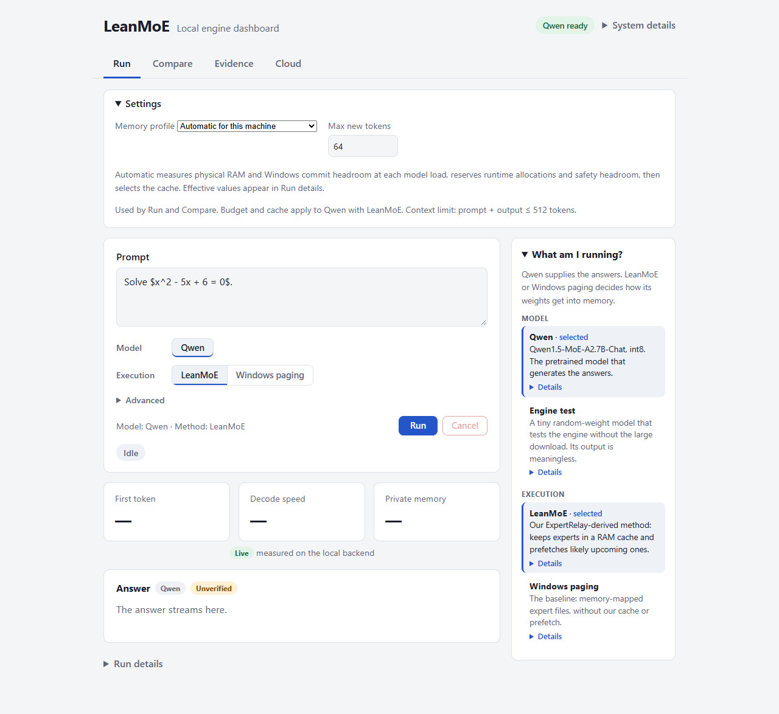
A reviewer can test the engine without the model
Clone. Set up. Run the tests.
Synthetic stores exercise the real cache,
resizing, cancellation and streaming.
Recorded artifacts make the measurements
inspectable. The dashboard exposes run
settings and downloadable results.
Tiny random weights test mechanics.
Their output is meaningless.
LeanMoE
07
Notes:
Screenshot of actual local dashboard. Windows setup script, pytest and dashboard launcher exist in README. No full weights needed for synthetic-store engine tests or saved-artifact checker. These are not a new real-model benchmark. Full Qwen requires14.36GB external store. Do not treat a historical test count as a live result. One owner, streaming cancellation, scoped budget changes and run export are implemented.
Sources: https://github.com/No6Name8/LeanMoE/blob/main/README.md ; https://github.com/No6Name8/LeanMoE/blob/main/results/EVIDENCE.md

Slide 8
More RAM changes the comparison
16 GiB cloud VM · the same engine and Qwen store
Mean decode tokens/s
6.58×
gain from automatic
cache sizing
LeanMoE was about 9%
lower in throughput.
The local-memory problem remains the focus. Cloud provides remote access.
One prompt, two main repeats, unequal memory use and uncontrolled OS caches.
LeanMoE
08
Notes:
Correction to wording on slide: Windows paging2.198 divided by automatic1.998 is1.1001, so paging throughput was10.0% higher; LeanMoE throughput was9.1% lower. The slide will use the latter to avoid denominator ambiguity. Small cache1.197GB vs auto10.969GB; sameVM4vCPU, fusedint8,4threads, two16-token mainrepeats.6.58x is auto versus small-cache LeanMoE, not against paging. Raw outcomes: https://github.com/No6Name8/LeanMoE/blob/main/results/resource_profile_comparison.json
Sources: https://github.com/No6Name8/LeanMoE/blob/main/README.md ; https://github.com/No6Name8/LeanMoE/blob/main/results/EVIDENCE.md

Slide 9
What I would build next
Task success, with a latency requirement
Measure useful answers, rather than token agreement alone.
More devices, more MoE models
Find where the memory and I/O trade-off holds.
Large models on the hardware people have.
github.com/No6Name8/LeanMoE
LeanMoE
09
Notes:
Close with local hardware access and inspectable research. Task success benchmark is unfinished, so no correctness orcost-per-success result is claimed. Qwen has observed math failures despite execution equivalence. Energy and fewer arithmetic operations not measured. Next: task-success/latency evaluation, broader devices/models and easier model-store setup. Real demo requires login: https://leanmoe-demo-1.eastus.cloudapp.azure.com/ . No video URL yet.
Sources: https://github.com/No6Name8/LeanMoE/blob/main/README.md ; https://github.com/No6Name8/LeanMoE/blob/main/results/EVIDENCE.md

