Slide 1
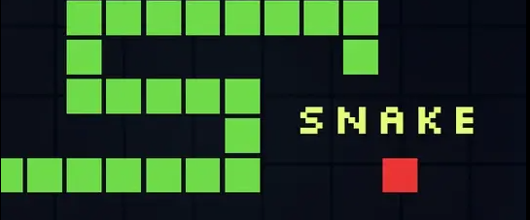
mySnakeGame
Final Project created and presented by Noah Dumas

Slide 2
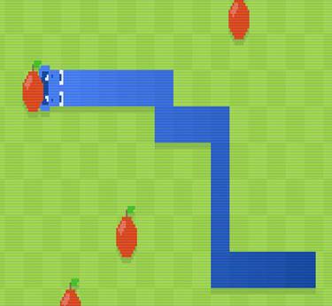
Game Overview
Simple Snake game using pygame
Snake moves on a grid and eats red food blocks
Each food makes the snake longer and increases the score
Game ends if the snake hits a wall or its own body

Slide 3
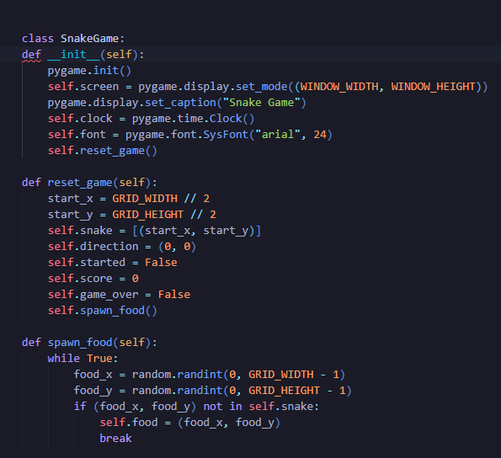
Code Structure and Classes
All logic is inside one main class SnakeGame
Constructor __init__ sets up pygame, window, clock, and font
reset_game initializes snake position, direction, score, and game over flag
Snake body is stored as a list of grid coordinates (x, y)
Food is placed with spawn_food at a random empty cell

Slide 4
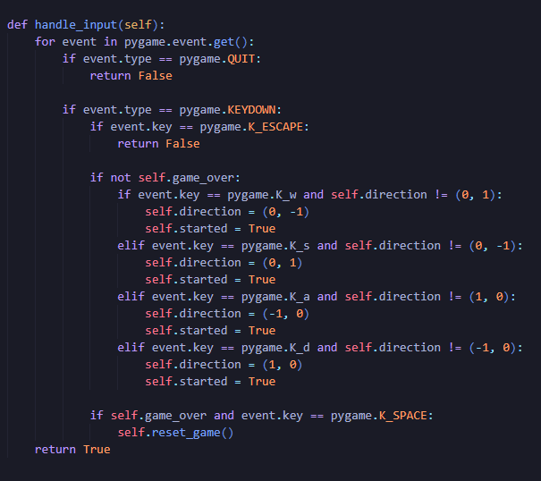
Controls and Player Input
Uses pygame event loop to read keyboard input
WASD control movement on the grid
Direction cannot reverse directly into the opposite direction
ESC closes the window
SPACE resets the game after game over

Slide 5
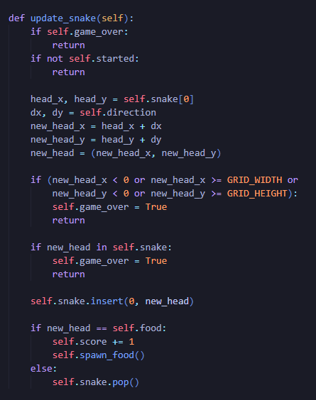
Movement, Collisions, Scoring
update_snake runs every frame to move the snake
Uses the current direction to compute a new head position
Checks collisions with walls and with the snake body
If food is reached, score increases and snake grows
If no food is reached, tail segment is removed so the snake moves forward

Slide 6
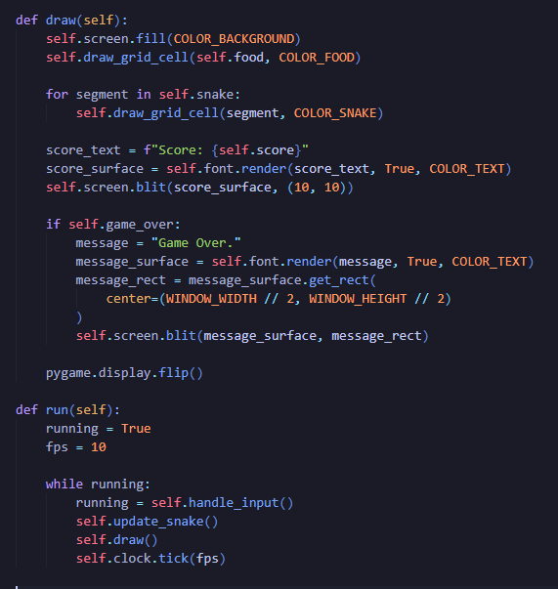
Drawing and Main Loop
draw handles all drawing in one place
clears the screen
draws food, snake, and score
shows game over message
run is the main loop
reads input
updates game state
draws frame
limits speed with clock.tick(fps)

Slide 7
DEMO

