Slide 1
Checkpoint 1
An Nguyen, Mark Araza

Slide 2
Synopsis
A turn based auto battler where users put their teams into a pool and fight against stronger teams each turn, working towards achieving 10 wins to win the game, or 3 losses meaning that their run is out. Players can purchase their units from a randomly generated shop each turn using gold that they earn each turn.

Slide 3
Requirements
Requires an sql database
Minimally this will be a game played in the terminal through text based input
It would be best if this could be played online, but this depends on time constraints

Slide 4
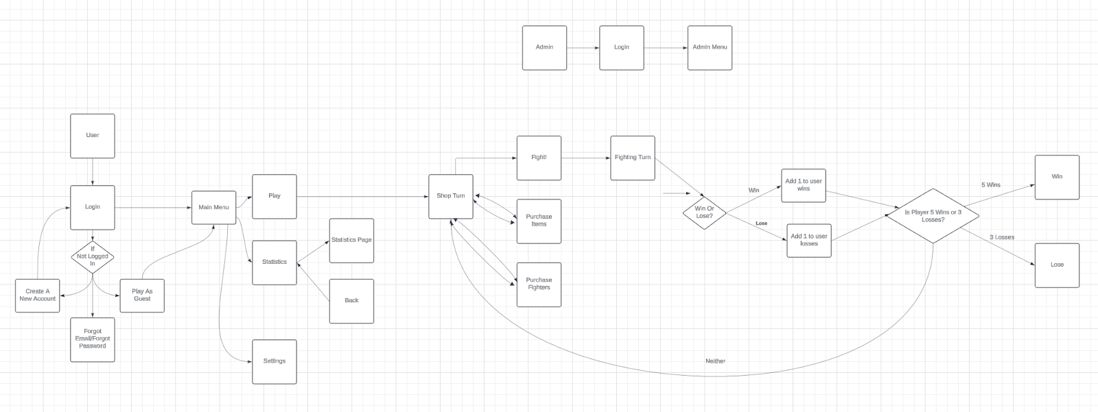
UML Use Case Diagram
In this use case, users login or create an account if they don't have one.
Once playing the game, they can view a settings page, or a statistics page, or join the queue to play a game.
From there the users buy units and unit modifiers, playing until they get 5 wins or 3 losses, at which they win or lose.

Slide 5
UML Use Case Diagram
In this use case, users login or create an account if they don't have one.
Once playing the game, they can view a settings page, or a statistics page, or join the queue to play a game.
From there the users buy units and unit modifiers, playing until they get 5 wins or 3 losses, at which they win or lose.

Slide 6
UML Use Case Diagram
In this use case, users login or create an account if they don't have one.
Once playing the game, they can view a settings page, or a statistics page, or join the queue to play a game.
From there the users buy units and unit modifiers, playing until they get 5 wins or 3 losses, at which they win or lose.

Slide 7
UML Use Case Diagram
In this use case, users login or create an account if they don't have one.
Once playing the game, they can view a settings page, or a statistics page, or join the queue to play a game.
From there the users buy units and unit modifiers, playing until they get 5 wins or 3 losses, at which they win or lose.

Slide 8
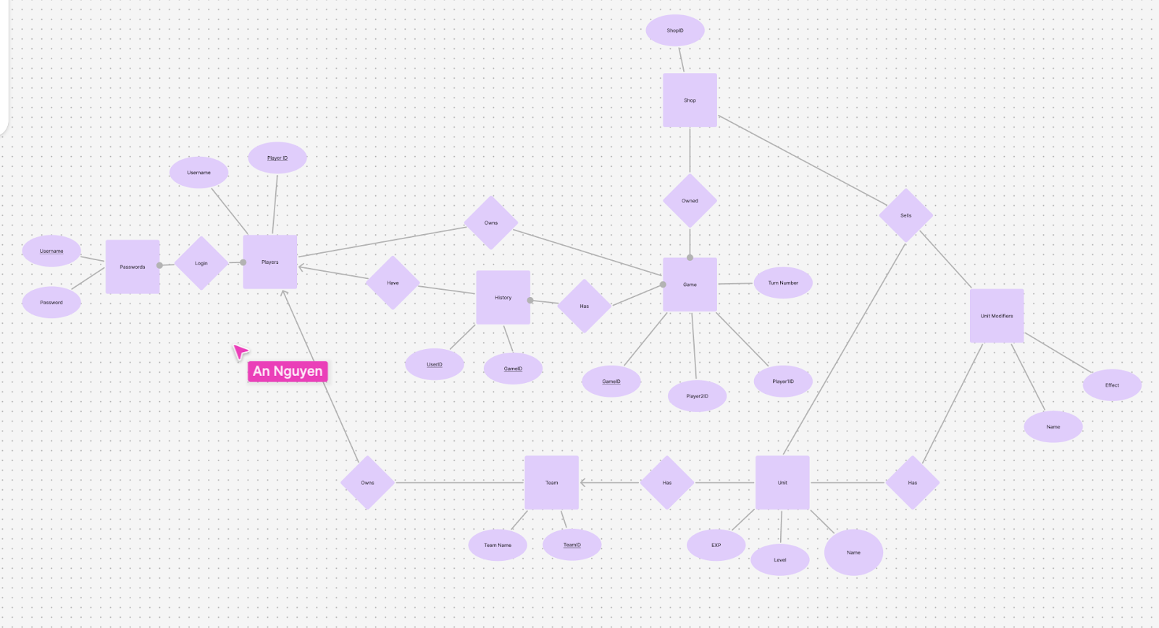
ER Diagram

Slide 9
ER Diagram

Slide 10
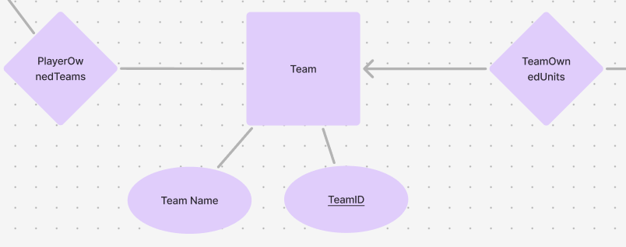
ER Diagram

Slide 11
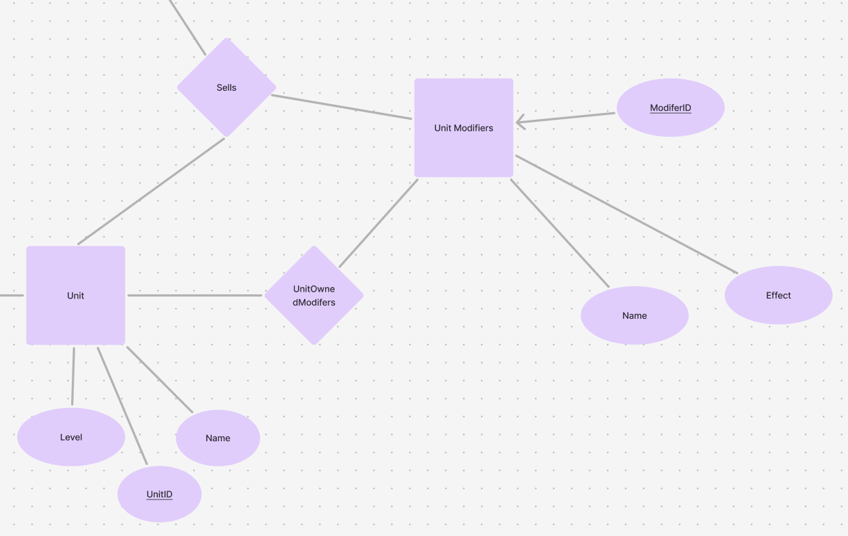
ER Diagram

Slide 12
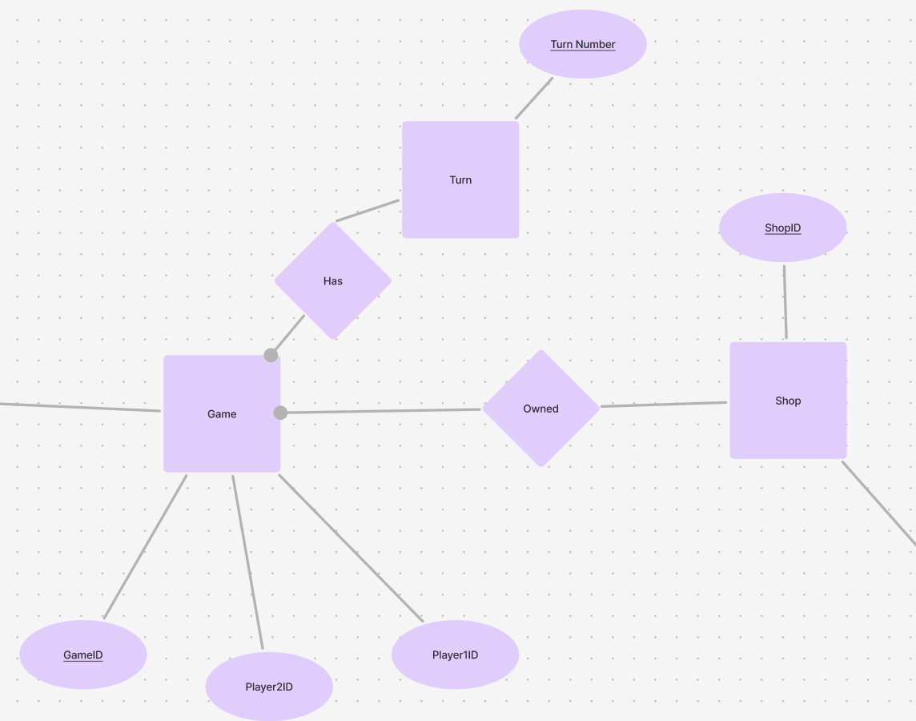
ER Diagram

Slide 13
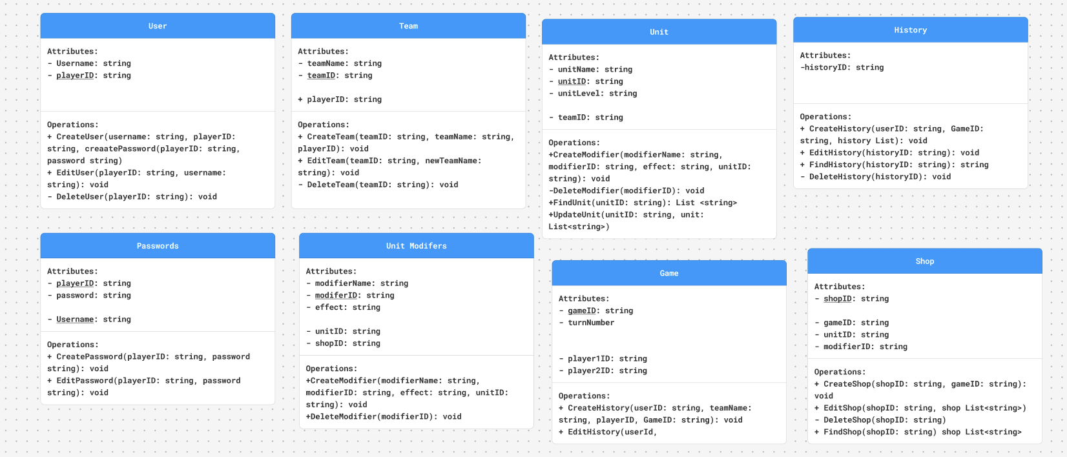
ER to Relations

Slide 14
ER to Relations

Slide 15
ER to Relations

Slide 16
ER to Relations

Slide 17
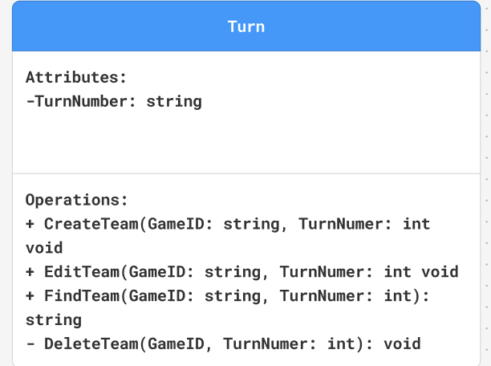
ER to Relations

