Slide 1

Aide Multicritère à la Décision
Noa Foucoux et Ingrid Fondja
2023-2024
Mini-Projet :
Les cafetières avec broyeur

Slide 2
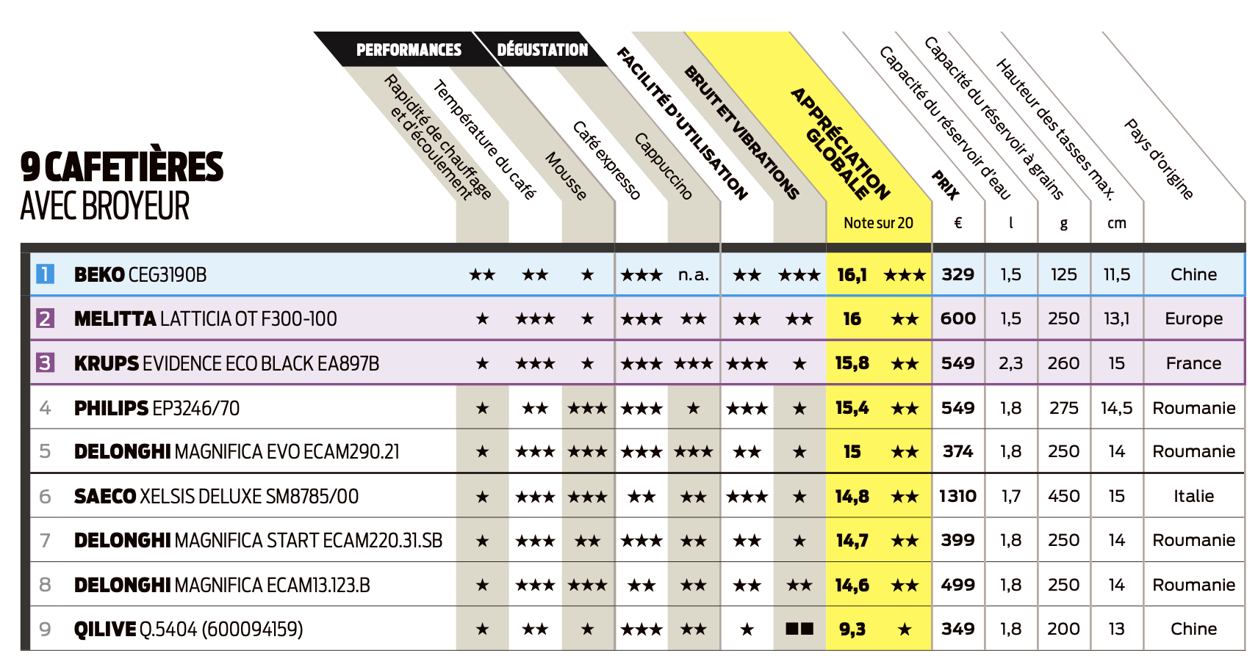
Jeu de données
= 1 = 3 = 4 = 5

Slide 3
Dominance
 | BEKO CEG3190B | MELITTA LATTICIA OT F300-100 | KRUPS EVIDENCE ECO BLACK EA897B | PHILIPS EP3246/70 | DELONGHI MAGNIFICA EVO ECAM290.21 | SAECO XELSIS DELUXE SM8785/00 | DELONGHI MAGNIFICA START ECAM220.31.SB | DELONGHI MAGNIFICA ECAMI3.123.B | QILIVE Q.5404 (600094159)
BEKO CEG3190B | 1 | 0 | 0 | 0 | 0 | 0 | 0 | 0 | 0
MELITTA LATTICIA OT F300-100 | 0 | 1 | 0 | 0 | 0 | 0 | 0 | 0 | 0
KRUPS EVIDENCE ECO BLACK EA897B | 0 | 0 | 1 | 0 | 0 | 0 | 0 | 0 | 0
PHILIPS EP3246/70 | 0 | 0 | 0 | 1 | 0 | 0 | 0 | 0 | 0
DELONGHI MAGNIFICA EVO ECAM290.21 | 0 | 0 | 0 | 1 | 1 | 1 | 1 | 0 | 0
SAECO XELSIS DELUXE SM8785/00 | 0 | 0 | 0 | 0 | 0 | 1 | 0 | 0 | 0
DELONGHI MAGNIFICA START ECAM220.31.SB | 0 | 0 | 0 | 0 | 0 | 0 | 1 | 0 | 0
DELONGHI MAGNIFICA ECAMI3.123.B | 0 | 1 | 0 | 1 | 0 | 1 | 0 | 1 | 0
QILIVE Q.5404 (600094159) | 0 | 0 | 0 | 0 | 0 | 0 | 0 | 0 | 1

Slide 4
Jugements d’indifférence
Jugement d'indifférence pour la capacité
550 | 1,5 | 650 | 1,6 |  | 650 | 2,5 | 550 | 2,3
550 | 1,6 | 650 | 1,65 |  | 650 | 2,3 | 550 | 2,1
550 | 1,65 | 650 | 1,8 |  | 650 | 2,1 | 550 | 2
550 | 1,8 | 650 | 1,9 |  | 650 | 2 | 550 | 1,8
550 | 1,9 | 650 | 2,1 |  | 650 | 1,8 | 550 | 1,7
550 | 2,1 | 650 | 2,3 |  | 650 | 1,7 | 550 | 1,6
550 | 2,3 | 650 | 2,4 |  | 650 | 1,6 | 550 | 1,5
Jugement d'indifférence pour température
1 | 300 | 2 | 400 | 2 | 450 | 1 | 300
2 | 400 | 3 | 600 | 3 | 600 | 2 | 450
3 | 600 | 4 | 900 | 4 | 1000 | 3 | 600
4 | 900 | 5 | 1500 | 5 | 1500 | 4 | 1000
Jugement d'indifférence pour Mousse
1 | 200 | 2 | 300 | 2 | 400 | 1 | 300
2 | 400 | 3 | 500 | 3 | 700 | 2 | 400
3 | 500 | 4 | 600 | 4 | 900 | 3 | 700
4 | 600 | 5 | 1500 | 5 | 1500 | 4 | 900
Jugement d'indifférence pour Bruit et Vibration
1 | 300 | 2 | 400 | 2 | 400 | 1 | 300
2 | 400 | 3 | 500 | 3 | 600 | 2 | 400
3 | 500 | 4 | 1000 | 4 | 900 | 3 | 600
4 | 1000 | 5 | 1500 | 5 | 1500 | 4 | 900

Slide 5
Jugements d’indifférence

Slide 6
Utilité additive
 | Température | Mousse | Bruit et vibration | Capacité eau | Prix | Utilité Additive | Rang
BEKO CEG3190B | 80 | 80 | 100 | -2,842E-14 | 100 | 70,899646 | 1
MELITTA LATTICIA OT F300-100 | 100 | 80 | 60 | -2,842E-14 | 72,3751274 | 50,7398196 | 5
KRUPS EVIDENCE ECO BLACK EA897B | 100 | 80 | 40 | 88,8888889 | 77,5739042 | 55,3488698 | 4
PHILIPS EP3246/70 | 80 | 100 | 40 | 44,4444444 | 77,5739042 | 42,3656349 | 6
DELONGHI MAGNIFICA EVO ECAM290.21 | 100 | 100 | 40 | 44,4444444 | 95,412844 | 41,2463905 | 7
SAECO XELSIS DELUXE SM8785/00 | 100 | 100 | 40 | 33,3333333 | 0 | 63,7029099 | 2
DELONGHI MAGNIFICA START ECAM220.31.SB | 100 | 90 | 40 | 44,4444444 | 92,8644241 | 41,2463905 | 7
DELONGHI MAGNIFICA ECAMI3.123.B | 100 | 100 | 60 | 44,4444444 | 82,6707441 | 60,1146106 | 3
QILIVE Q.5404 (600094159) | 80 | 80 | 0 | 44,4444444 | 97,961264 | 4,62919478 | 9

Slide 7
Concordance
Température | Mousse | Bruit et vibration | Capacité eau | Prix | seuil
0,1 | 0,1 | 0,3 | 0,2 | 0,3 | 0,8
 | BEKO CEG3190B | MELITTA LATTICIA OT F300-100 | KRUPS EVIDENCE ECO BLACK EA897B | PHILIPS EP3246/70 | DELONGHI MAGNIFICA EVO ECAM290.21 | SAECO XELSIS DELUXE SM8785/00 | DELONGHI MAGNIFICA START ECAM220.31.SB | DELONGHI MAGNIFICA ECAMI3.123.B | QILIVE Q.5404 (600094159)
BEKO CEG3190B | 1 | 1 | 0 | 0 | 0 | 0 | 0 | 0 | 1
MELITTA LATTICIA OT F300-100 | 0 | 1 | 0 | 0 | 0 | 0 | 0 | 0 | 0
KRUPS EVIDENCE ECO BLACK EA897B | 0 | 0 | 1 | 1 | 0 | 1 | 0 | 0 | 0
PHILIPS EP3246/70 | 0 | 0 | 0 | 1 | 0 | 1 | 0 | 0 | 0
DELONGHI MAGNIFICA EVO ECAM290.21 | 0 | 0 | 1 | 1 | 1 | 1 | 1 | 0 | 0
SAECO XELSIS DELUXE SM8785/00 | 0 | 0 | 0 | 0 | 0 | 1 | 0 | 0 | 0
DELONGHI MAGNIFICA START ECAM220.31.SB | 0 | 0 | 1 | 1 | 0 | 1 | 1 | 0 | 0
DELONGHI MAGNIFICA ECAMI3.123.B | 0 | 1 | 1 | 1 | 0 | 1 | 0 | 1 | 0
QILIVE Q.5404 (600094159) | 0 | 0 | 0 | 0 | 0 | 0 | 0 | 0 | 1

Slide 8
Discordance
Température | Mousse | Bruit et vibration | Capacité eau | Prix | Nb min de veto
1000 | 1000 | 2 | 0,5 | 300 | 1
 | BEKO CEG3190B | MELITTA LATTICIA OT F300-100 | KRUPS EVIDENCE ECO BLACK EA897B | PHILIPS EP3246/70 | DELONGHI MAGNIFICA EVO ECAM290.21 | SAECO XELSIS DELUXE SM8785/00 | DELONGHI MAGNIFICA START ECAM220.31.SB | DELONGHI MAGNIFICA ECAMI3.123.B | QILIVE Q.5404 (600094159)
BEKO CEG3190B | 0 | 0 | 1 | 0 | 0 | 0 | 0 | 0 | 0
MELITTA LATTICIA OT F300-100 | 0 | 0 | 1 | 0 | 0 | 0 | 0 | 0 | 0
KRUPS EVIDENCE ECO BLACK EA897B | 0 | 0 | 0 | 0 | 0 | 0 | 0 | 0 | 0
PHILIPS EP3246/70 | 0 | 0 | 0 | 0 | 0 | 0 | 0 | 0 | 0
DELONGHI MAGNIFICA EVO ECAM290.21 | 0 | 0 | 0 | 0 | 0 | 0 | 0 | 0 | 0
SAECO XELSIS DELUXE SM8785/00 | 1 | 1 | 1 | 1 | 1 | 0 | 1 | 1 | 1
DELONGHI MAGNIFICA START ECAM220.31.SB | 0 | 0 | 0 | 0 | 0 | 0 | 0 | 0 | 0
DELONGHI MAGNIFICA ECAMI3.123.B | 0 | 0 | 0 | 0 | 0 | 0 | 0 | 0 | 0
QILIVE Q.5404 (600094159) | 1 | 1 | 0 | 0 | 0 | 0 | 0 | 1 | 0

Slide 9
Surclassement
 | BEKO CEG3190B | MELITTA LATTICIA OT F300-100 | KRUPS EVIDENCE ECO BLACK EA897B | PHILIPS EP3246/70 | DELONGHI MAGNIFICA EVO ECAM290.21 | SAECO XELSIS DELUXE SM8785/00 | DELONGHI MAGNIFICA START ECAM220.31.SB | DELONGHI MAGNIFICA ECAMI3.123.B | QILIVE Q.5404 (600094159) |  | OutFlow | Rang | NetFlow | Rang
BEKO CEG3190B | 1 | 1 | 0 | 0 | 0 | 0 | 0 | 0 | 1 |  | 3 | 4 | 2 | 3
MELITTA LATTICIA OT F300-100 | 0 | 1 | 0 | 0 | 0 | 0 | 0 | 0 | 0 |  | 1 | 7 | -2 | 7
KRUPS EVIDENCE ECO BLACK EA897B | 0 | 0 | 1 | 1 | 0 | 1 | 0 | 0 | 0 |  | 3 | 4 | -1 | 5
PHILIPS EP3246/70 | 0 | 0 | 0 | 1 | 0 | 1 | 0 | 0 | 0 |  | 2 | 6 | -3 | 8
DELONGHI MAGNIFICA EVO ECAM290.21 | 0 | 0 | 1 | 1 | 1 | 1 | 1 | 0 | 0 |  | 5 | 1 | 4 | 1
SAECO XELSIS DELUXE SM8785/00 | 0 | 0 | 0 | 0 | 0 | 1 | 0 | 0 | 0 |  | 1 | 7 | -5 | 9
DELONGHI MAGNIFICA START ECAM220.31.SB | 0 | 0 | 1 | 1 | 0 | 1 | 1 | 0 | 0 |  | 4 | 3 | 2 | 3
DELONGHI MAGNIFICA ECAMI3.123.B | 0 | 1 | 1 | 1 | 0 | 1 | 0 | 1 | 0 |  | 5 | 1 | 4 | 1
QILIVE Q.5404 (600094159) | 0 | 0 | 0 | 0 | 0 | 0 | 0 | 0 | 1 |  | 1 | 7 | -1 | 5
InFlow | 1 | 3 | 4 | 5 | 1 | 6 | 2 | 1 | 2
Rang | 1 | 6 | 7 | 8 | 1 | 9 | 4 | 1 | 4

Slide 10
Conclusion
 | Utilité additive | Surclassement
 | Rang | Rang + | Rang - | Rang +-
BEKO CEG3190B | 1 | 4 | 1 | 3
MELITTA LATTICIA OT F300-100 | 5 | 7 | 6 | 7
KRUPS EVIDENCE ECO BLACK EA897B | 4 | 4 | 7 | 5
PHILIPS EP3246/70 | 6 | 6 | 8 | 8
DELONGHI MAGNIFICA EVO ECAM290.21 | 7 | 1 | 1 | 1
SAECO XELSIS DELUXE SM8785/00 | 2 | 7 | 9 | 9
DELONGHI MAGNIFICA START ECAM220.31.SB | 7 | 3 | 4 | 3
DELONGHI MAGNIFICA ECAMI3.123.B | 3 | 1 | 1 | 1
QILIVE Q.5404 (600094159) | 9 | 7 | 4 | 5

