Slide 1
One project from NoHomey
IVAS-TECH Online ordering system

Slide 2
Библиотеки използвани зa Client-а
typescript, react, react-dom, react-scripts, @material-ui/core, @material-ui/styles, @material-ui/icons, @material-ui/pickers, date-fns, @date-io/date-fns, redux, react-redux, reselect, redux-first-router, redux-saga,
validator, localforage and all the neeed @types/*.

Slide 3
Redux-Saga
“redux-saga is a library that aims to make application side effects (i.e. asynchronous things like data fetching and impure things like accessing the browser cache) easier to manage, more efficient to execute, easy to test, and better at handling failures. The mental model is that a saga is like a separate thread in your application that's solely responsible for side effects. redux-saga is a redux middleware, which means this thread can be started, paused and cancelled from the main application with normal redux actions, it has access to the full redux application state and it can dispatch redux actions as well.”

Slide 4
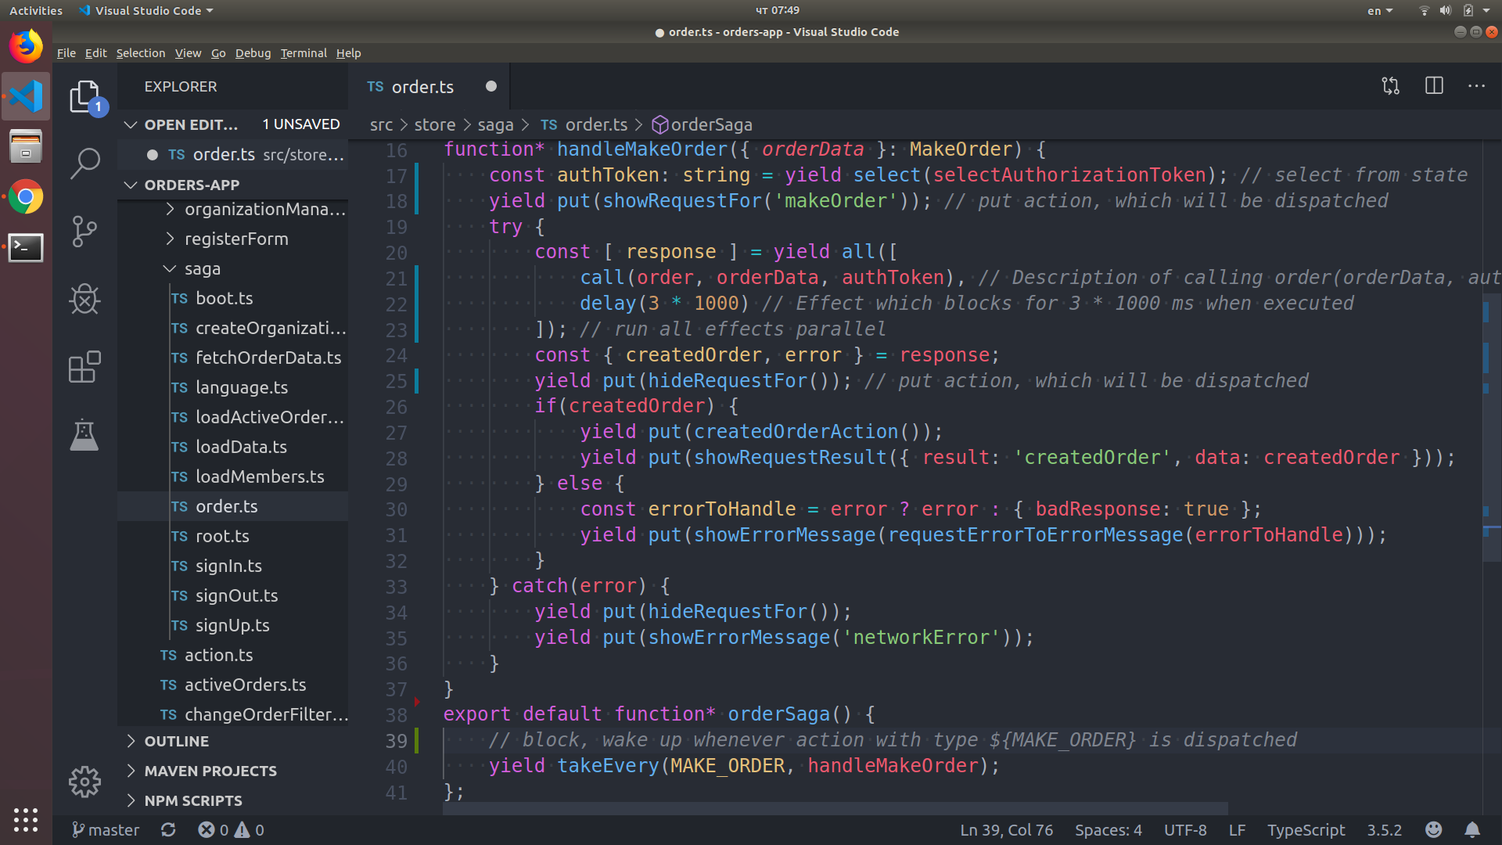

Slide 5
Client е написан на TypeScript
“Because Types matter. They are contract between the implementation and the caller.” - Didn not have time to Google who ...

Slide 6
TypeScript се опитва да бъде по-добър JavaScript … и до някъде успява
Types that match JavaScript (based on structural subtyping)
VS Code (extremely good tooling)
Higher order types: Union (A | B) types, Intersection (A & B) types, Conditional types (T extends U ? V : W), Keys of object (keyof T) and some utility types: Partial<T>, Readonly<T>, Record<K, V>, Pick<T, K>, Omit<T, K>, Exclude<T, U>, Extract<T, U>, NonNullable<T>, ReturnType<F>, InstanceType<T>, Required<T>, ThisType<T> . And many more cool things ...

Slide 7
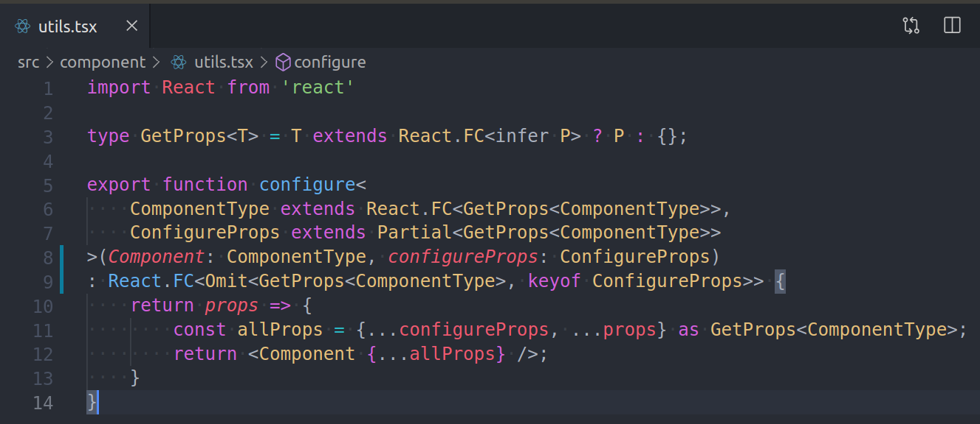
And because of this we can make some cool things

Slide 8
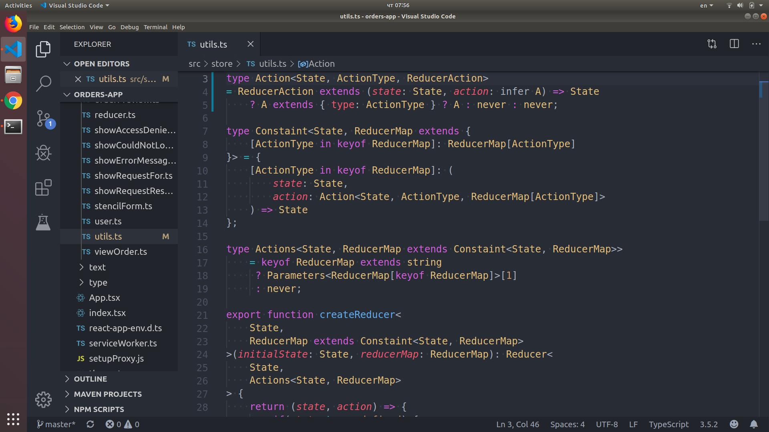

Slide 9
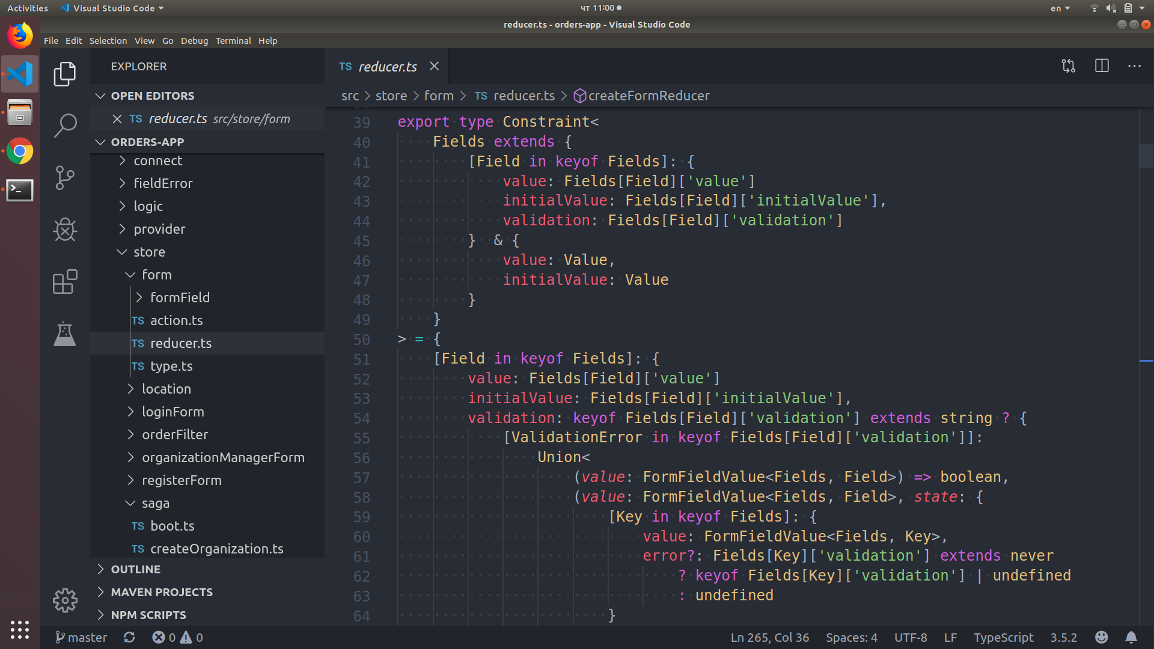

Slide 10
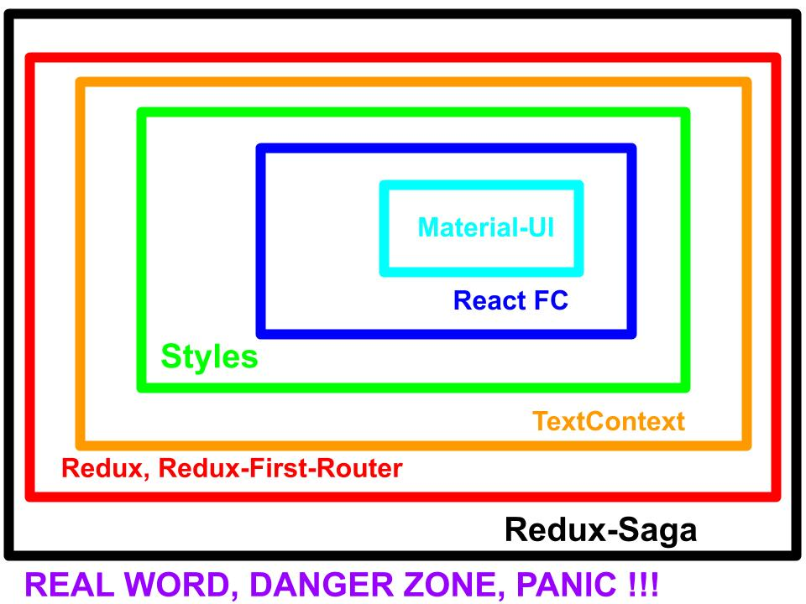
Архитектура на Client-а

Slide 11
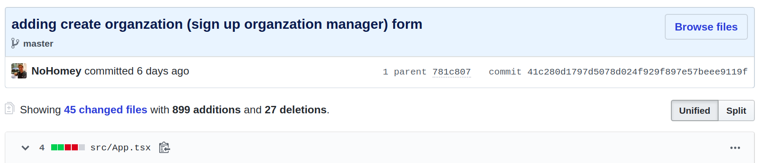
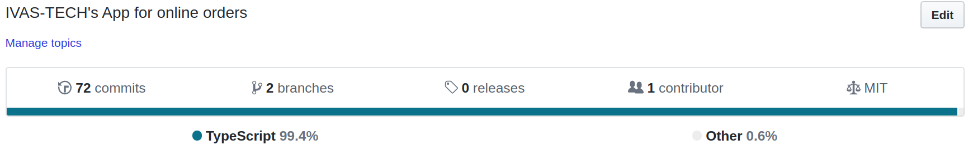
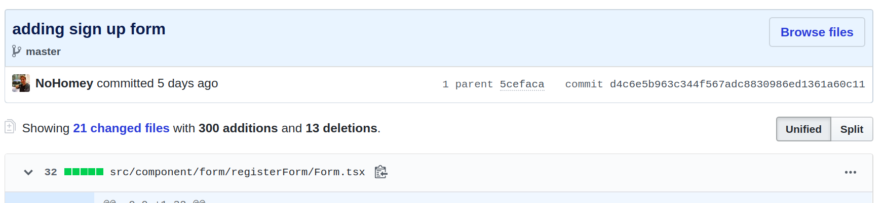
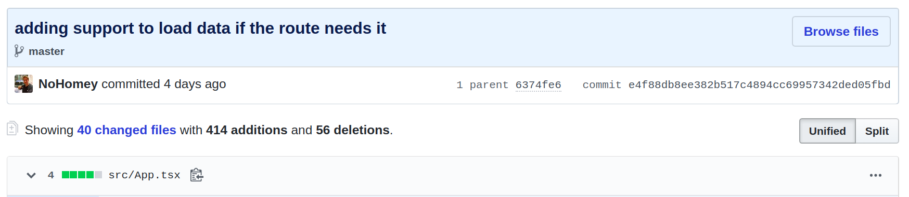
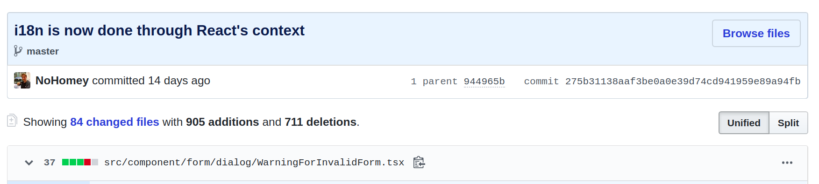
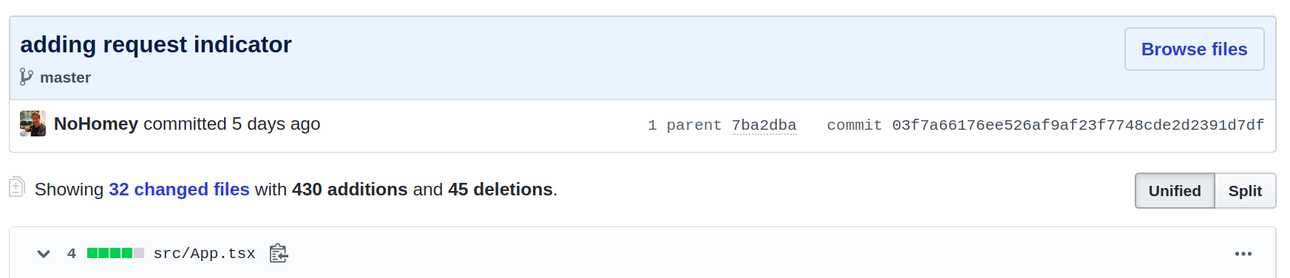
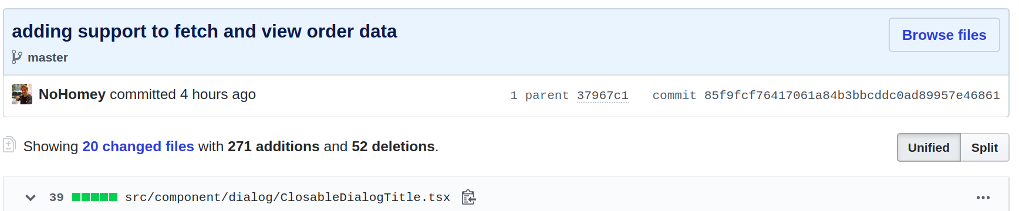
And because of the layered architecture

Slide 12
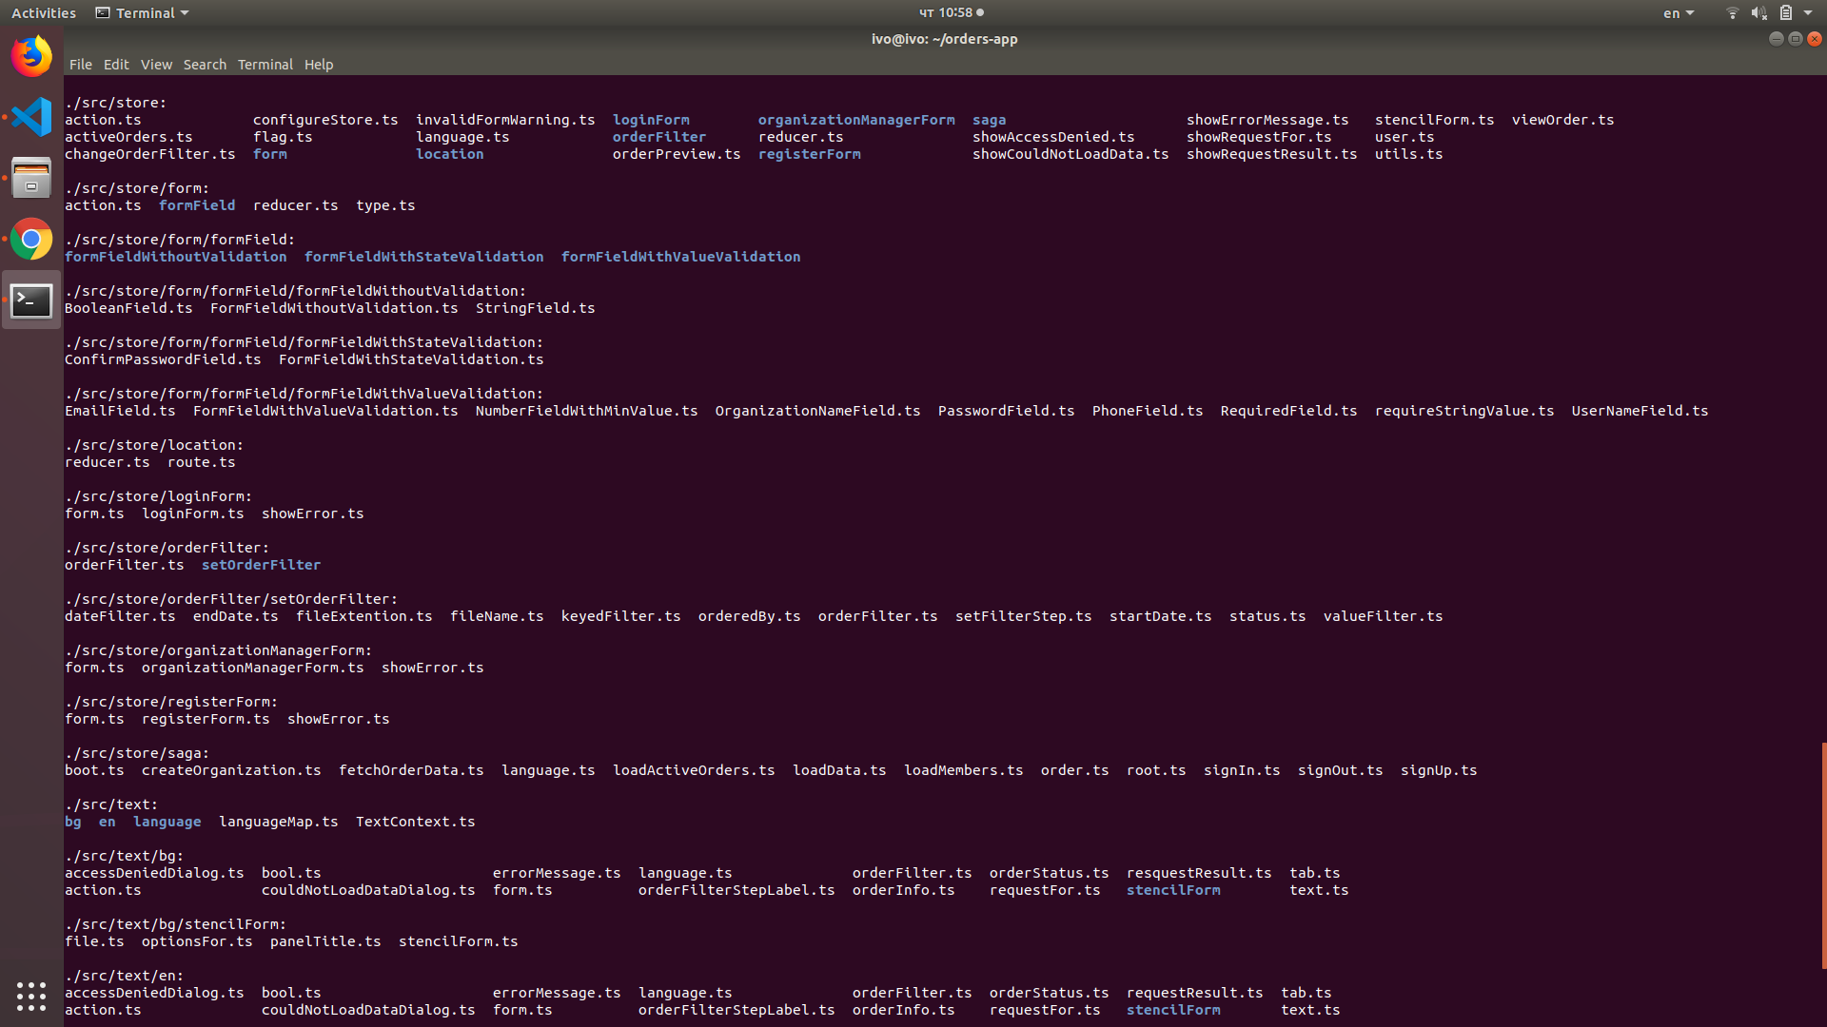

Slide 13
Библиотеки използвани за Server-а
base64url, bcrypt, body-parser, express, jsonwebtoken, mongodb, multer, uuid, validator

Slide 14
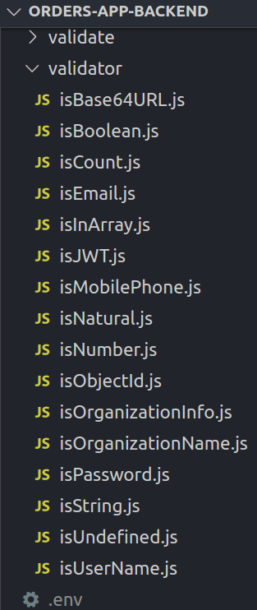
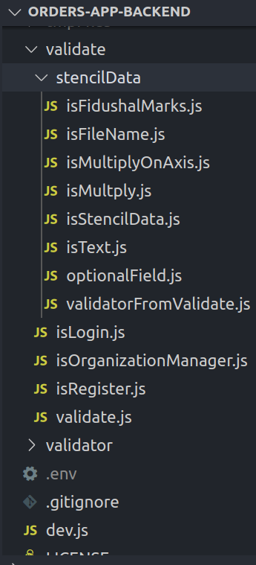
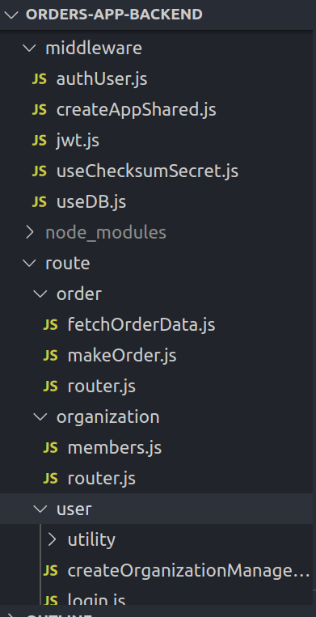
Folder structure

Slide 15
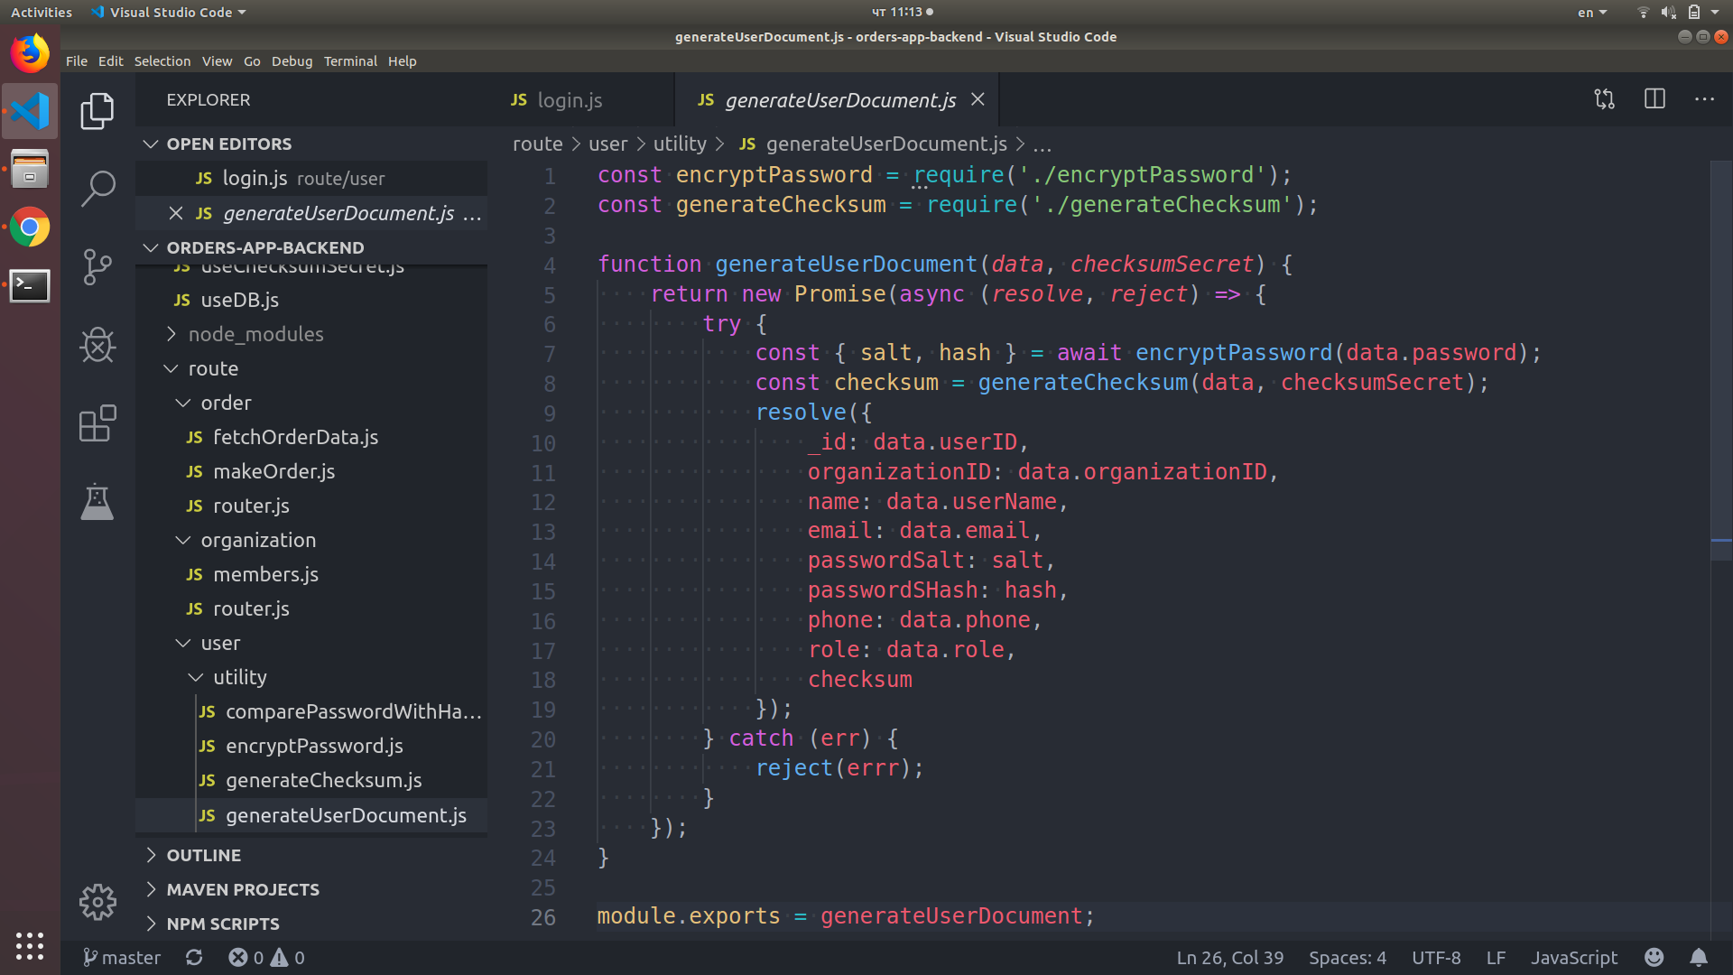
Strong security (User Document to be stored)

Slide 16
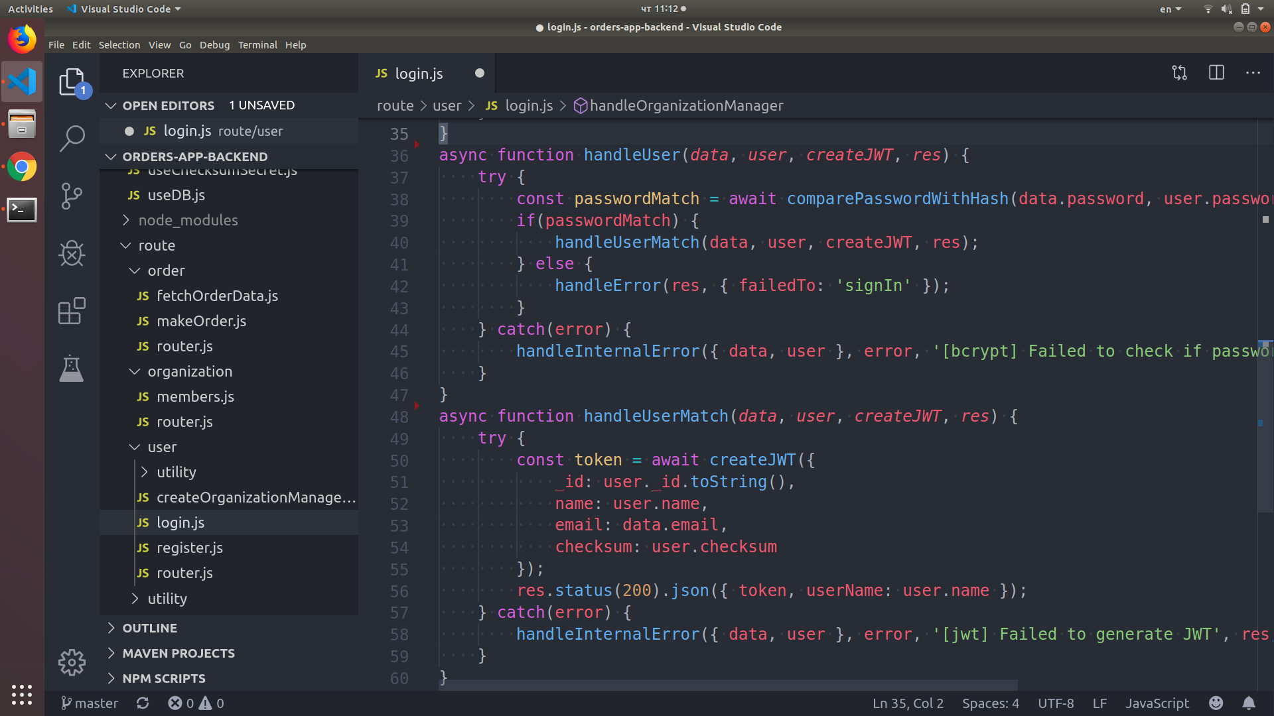
Strong security (login)

Slide 17
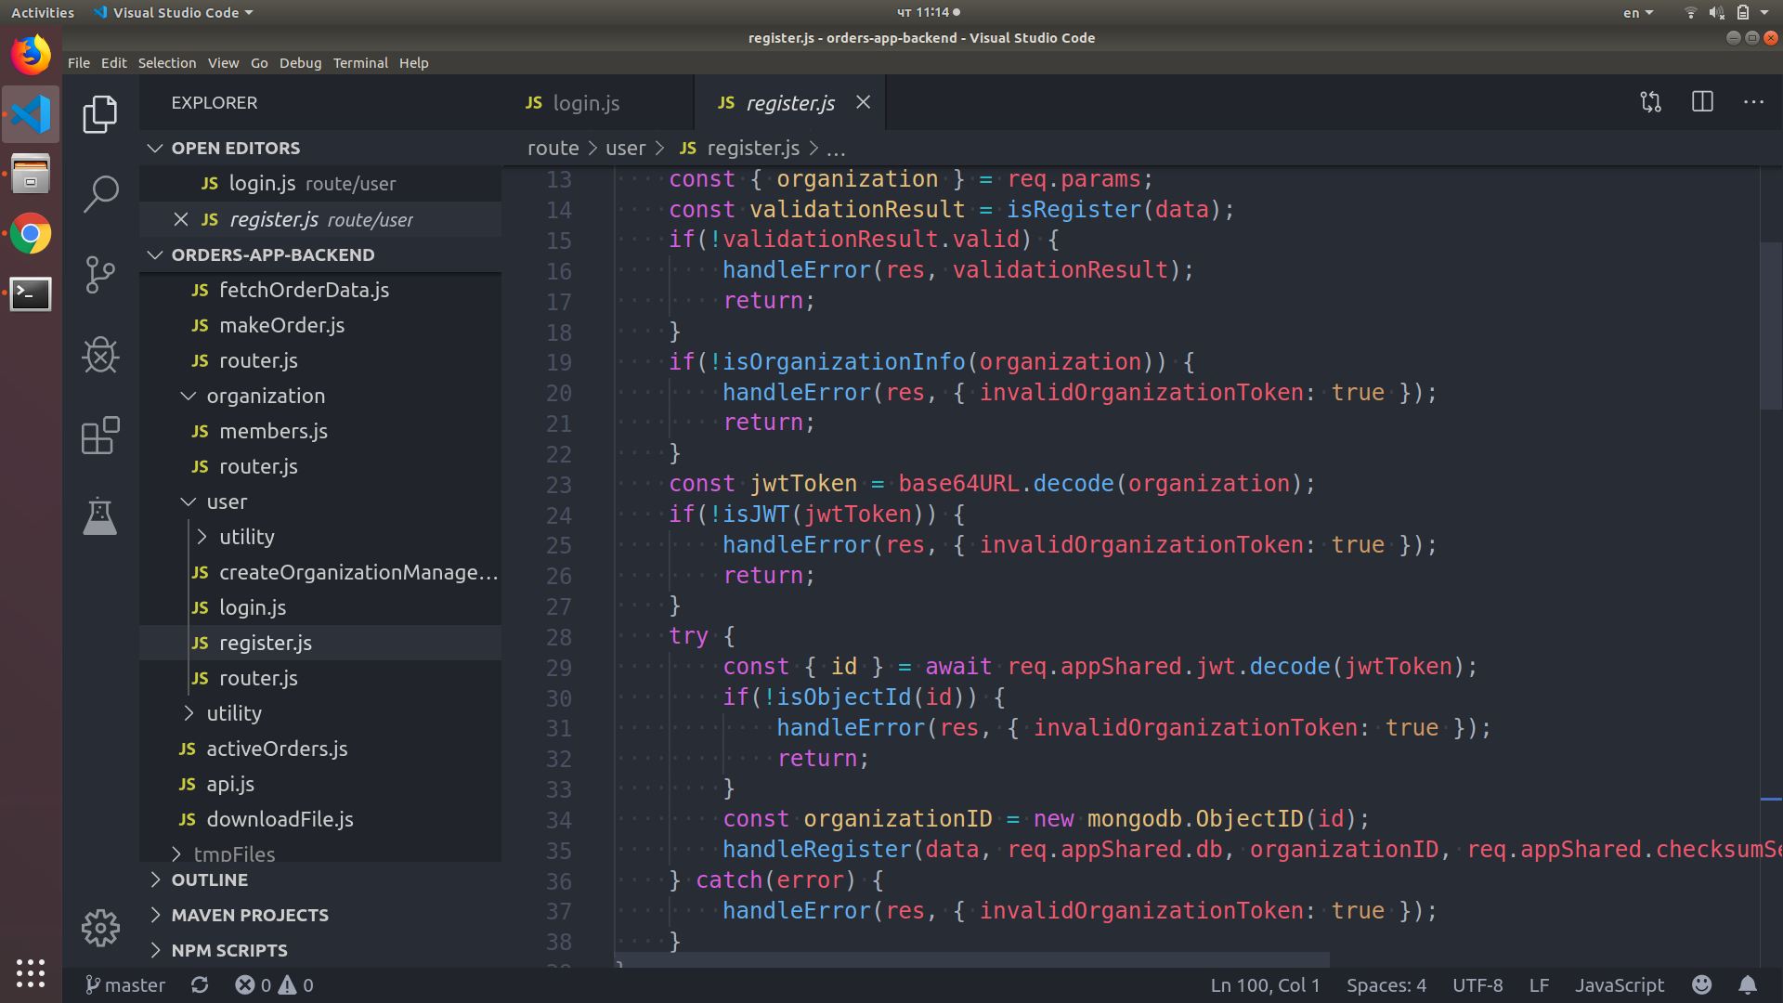
Strong security (register in organization)

Slide 18
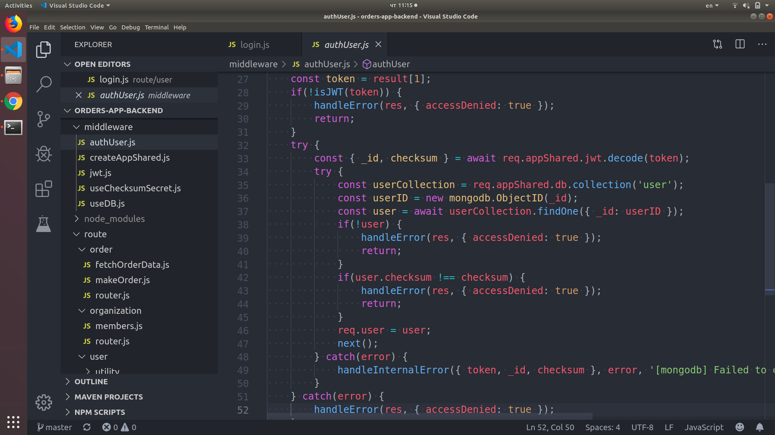
Strong security (authorization as a express middleware)

Slide 19
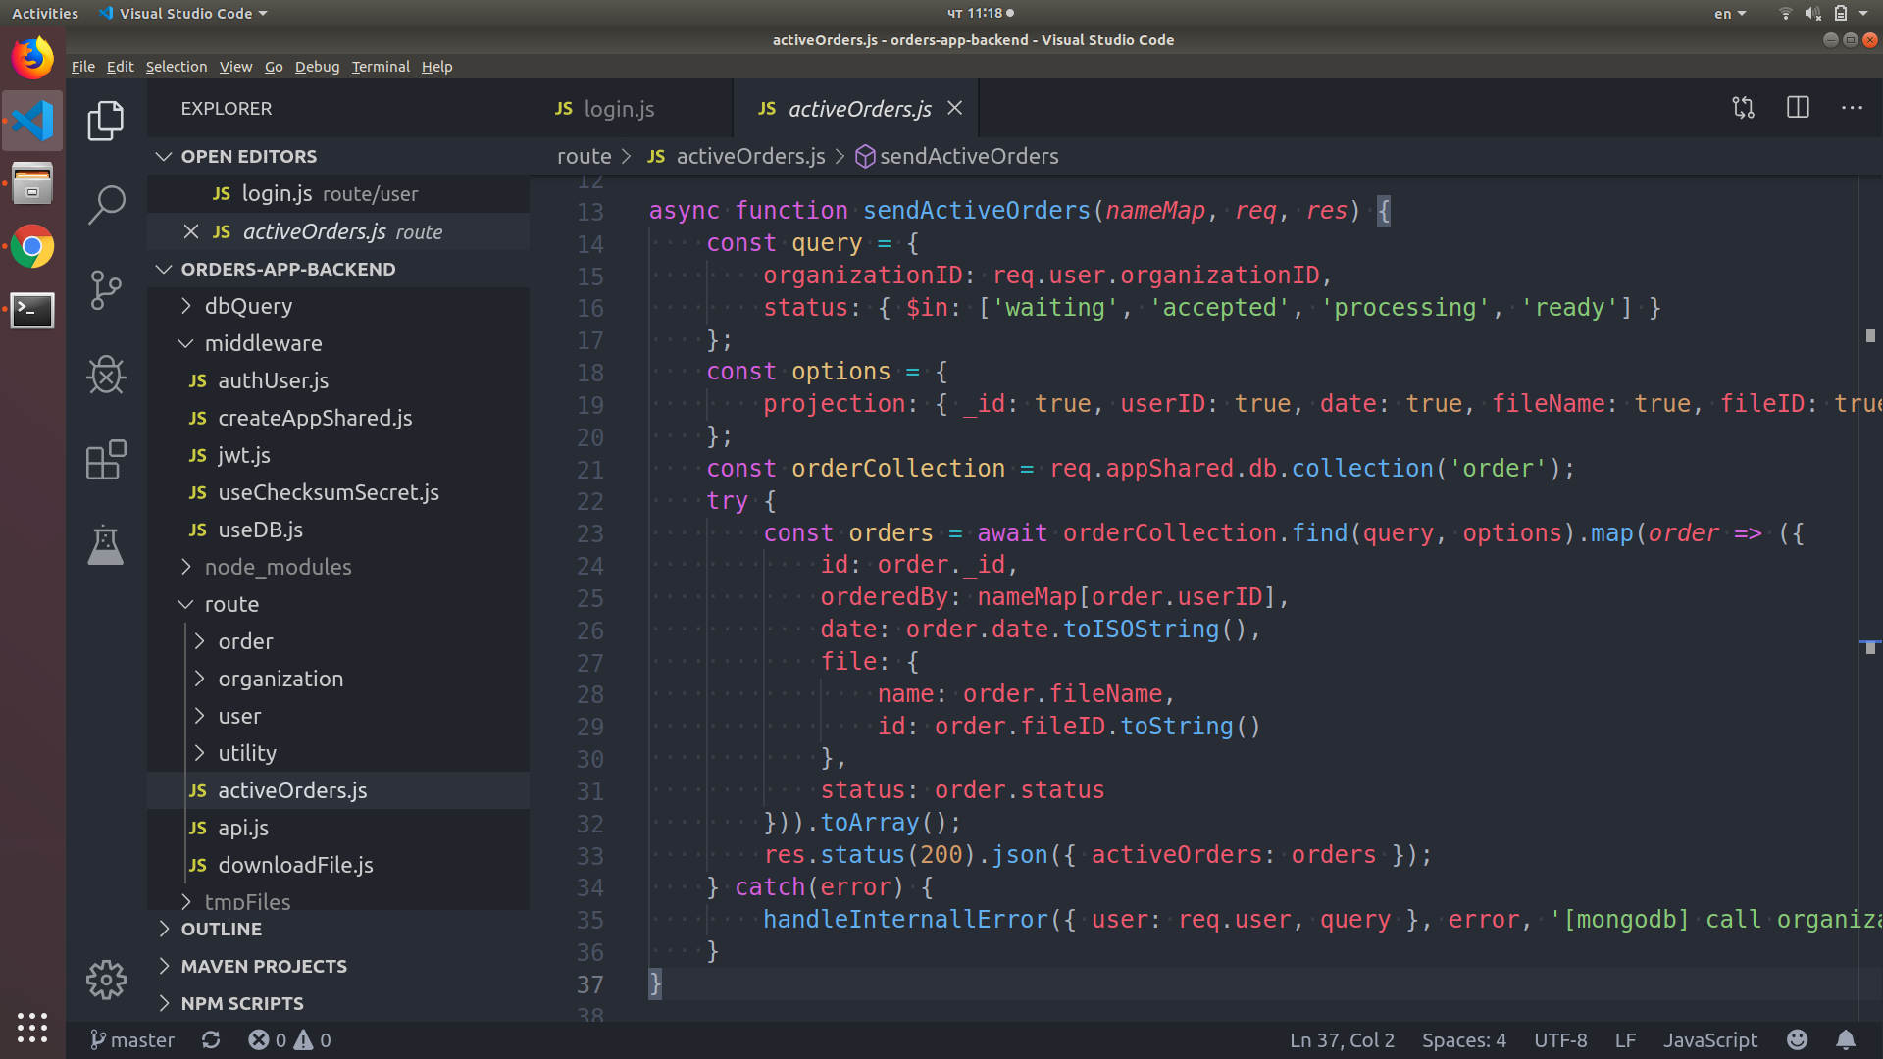
Getting Active orders, gets only orders made in user’s organization

Slide 20
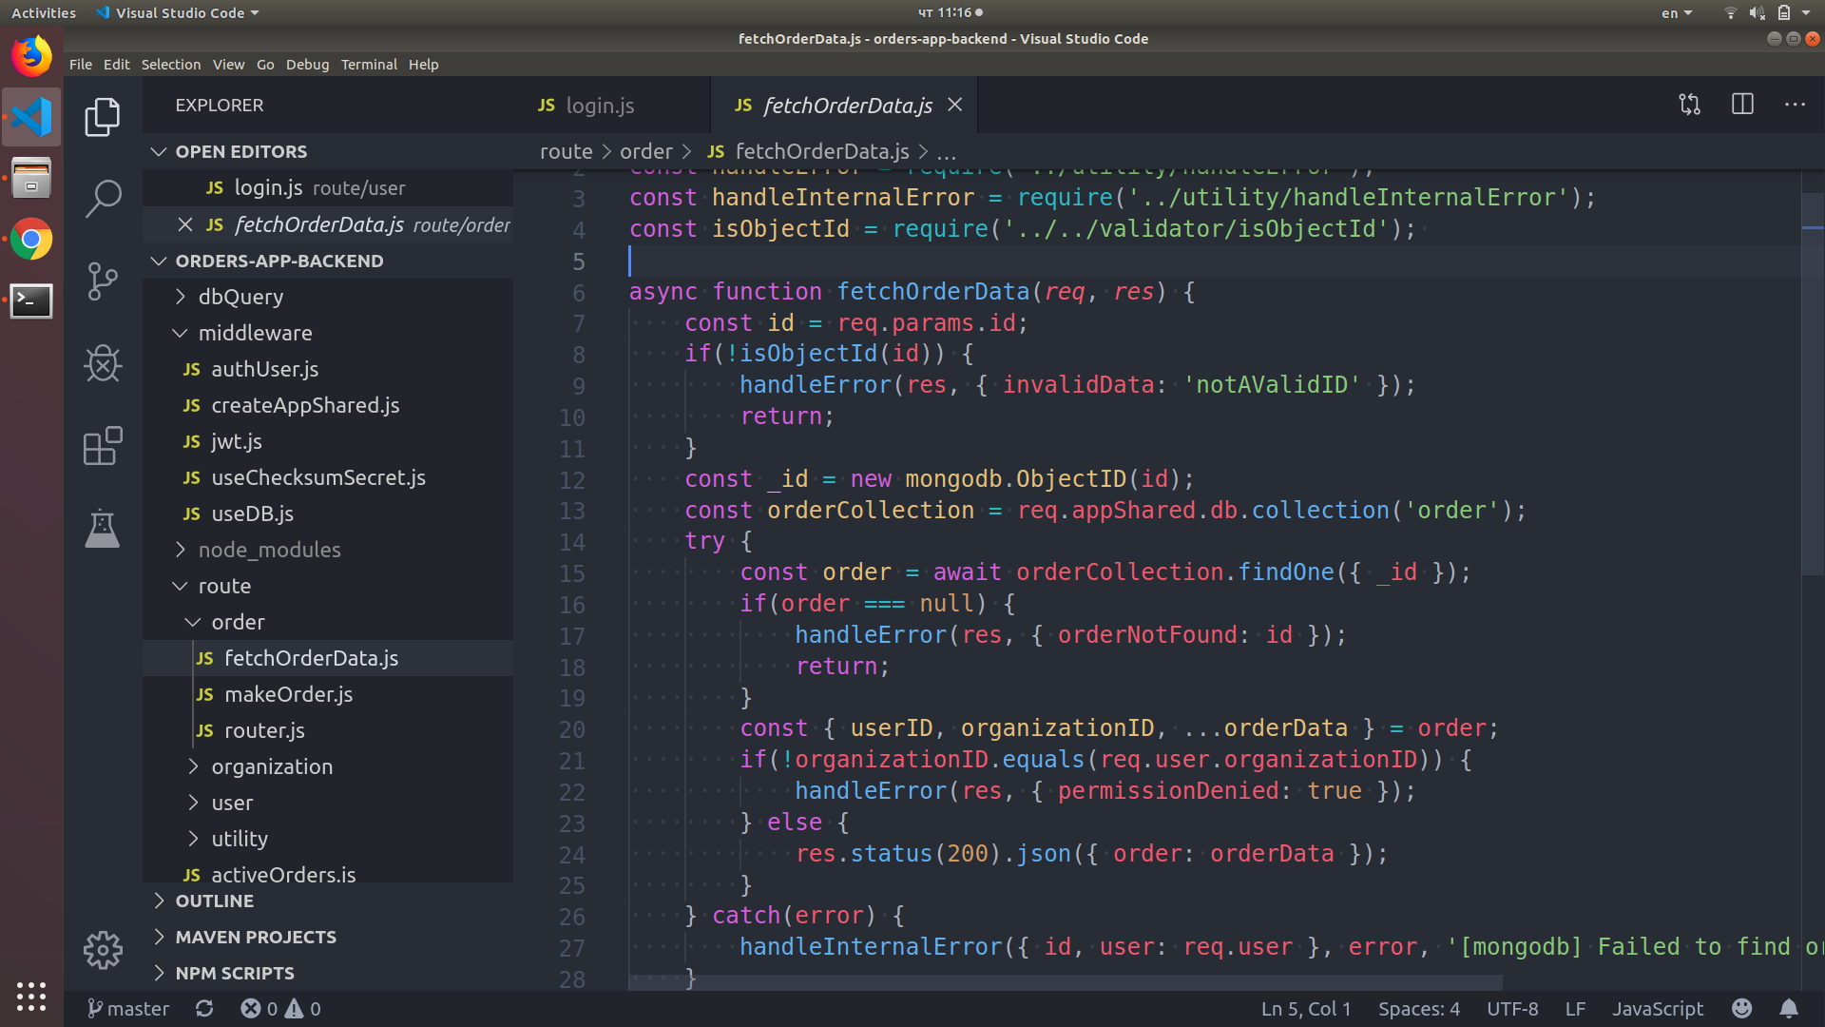
Trying to get order data for order in other organization results in permissionDenied

