Slide 1

Encryption Basic FROM ZERO TO HERO
By Marco Seitz

Slide 2
Basic idea of data structure
Header
Header holds Meta-Data
Destination infromation ( where to send)
Other meta data
Encryption-Information ( Key is held by the recipiant )
Body holds the actual data
The actual message usually as json ( “key“: value)
Body

Slide 3
Basic idea of encryption
Using a scheme,method or process to convert infomation an abnstraction of it
The better the encrpytion the higher the abstraction level

Slide 4
Historical refernces, Ceasar cifre
A common method to encrpt letter applied in the Roman empire was the Ceasar cifre
Method:
It technically refers to letter in the alphabet as number.
A as 0, B as 1, C as 2 and so on.
So in that sense the string(chain of letters): “Ave Caesar“ would have be enyrpted with the key +(+1) to “Bwf Dbftbs“
Decrpytion with the key –(+1) decrypts back to “Ave Caesar“

Slide 5
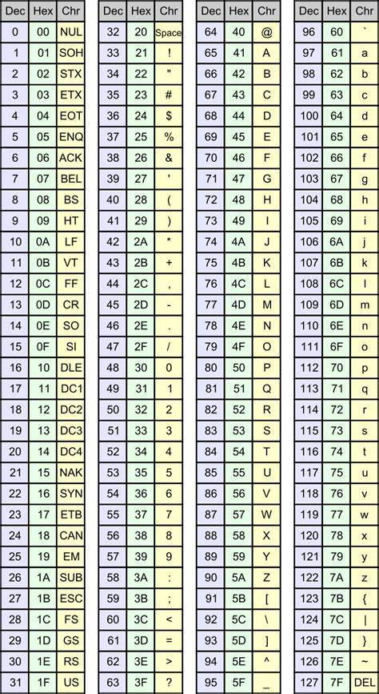
Conceptional Idea (symmetric)
So we have just learned the ceasr cifre to encrypt messages.
We have the alphabet as table of refernce. this usually is known and in modern times extended with a few more symbols. So that the alpahatbet now also covers numbers and symbols same as the ASCII Table
As u can see the letters refer to a number and can be synrchonously en and de crpyted with the ceasar ciffre
Synchrone pretty much means the recpiant and the sender have the same (symertric) key

Slide 6
Conceptional Idea (asymmetric)
Its pretty much the same concept with 1 determined difference:
The key being split into 2 parts ( public and private)
Where each of the 2 participants ( sender and reciever) provide their public key
The Public and The refering Private key are Mathematically related.
Public key chosen is 5 and the context is 20 the resulting prviate key is 15 (20-5)
In reality we have more complex mathematical procedures or algorythms.

Slide 7
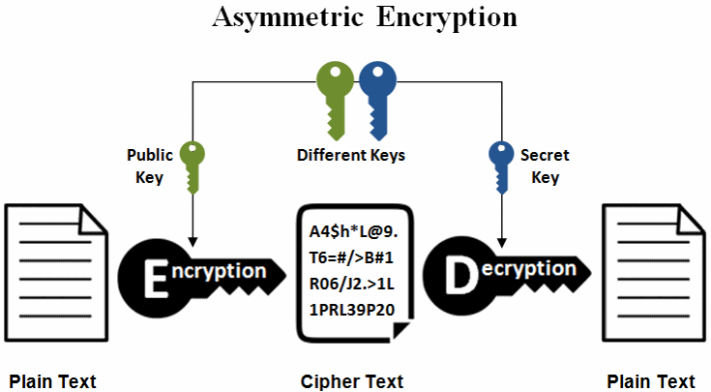
1) ! Generating the key comes with knowing the procedure of doing so meaning knowing the algorythm we can decrpyt the to plain text.
2) ! Public key is sent.
! Each party uses the public key of the other.

Slide 8
Quick Catch up game: 1 point per answer.
What is an encryption?
Whats a key?
Whats a referance table?
What is a symmetric encrption procedure?
What is a asymmetric encrption procedure?
Example for symmetric encryption.
Bonus: Example for asymetric encryption. (not in the mentioned yet)

Slide 9
Diffy Helman Ecnryption
Pretty much waht we saw in the graf earlier.
Asymmetric cryptographic procedure.
Reffering to the 2 mathematician that generated the complex algorythms ealier mentioned.
Fun fact: Algorythms as in symmetric and asymetric proedures can be used in sequences
SymetricEncryption(AysemmetricPublicKeyEncryption(Plainatext))²
Ofc we need an order being agreed on as a reference to be able to decrypt to plaintext again

Slide 10
Catgeories
Encryption Technique | Strengths | Weaknesses
Symmetric Encryption
AES (Advanced Encryption Standard) | Fast and efficient encryption and decryption.<br>- Suitable for encrypting large amounts of data.<br>- Widely adopted and considered secure. | Key distribution: Both parties need to securely exchange the secret key beforehand.<br>- Scalability: Managing a large number of keys can be challenging in large-scale systems.
DES (Data Encryption Standard) | Pioneering encryption algorithm.<br>- Simplicity: Easy to implement and understand. | Security: Vulnerable to brute-force attacks due to its short key length (56 bits).<br>- Deprecated: Considered insecure for modern applications.
3DES (Triple DES) | Improved security over DES by applying the algorithm three times.<br>- Compatibility: Can be used as an upgrade path for systems using DES. | Performance: Slower compared to AES due to multiple encryption rounds.<br>- Key management: Still requires careful key management practices.
Asymmetric Encryption
RSA (Rivest-Shamir-Adleman) | Secure: Strong mathematical foundation and widely studied.<br>- Key distribution: Simplifies key distribution as each party only needs to keep their private key secret.<br>- Digital signatures: Can be used for digital signatures and key exchange protocols. | Performance: Slower compared to symmetric encryption, especially for large datasets.<br>- Key size: Longer key lengths are required for equivalent security compared to symmetric algorithms.<br>- Key management: Requires managing both public and private keys for each user.
ECC (Elliptic Curve Cryptography) | Shorter key lengths for equivalent security compared to RSA.<br>- Performance: Faster encryption and decryption compared to RSA.<br>- Bandwidth efficiency: Suitable for resource-constrained environments like mobile devices and IoT. | Implementation complexity: Requires careful parameter selection and implementation to avoid vulnerabilities.<br>- Standardization: Less standardized compared to RSA, leading to

Slide 11
Performance costs Resources (as in time and electricity)
Genrall spoken we want our data to be safe.
Safety requires:
complex algorythms (GPU CPU)
long chains of keys (data volume)
symmetric encryption (complexity)
Ther are trade offs to be made.

Slide 12
Crypto-Terms to know
“Store now decrypt later“decrypting before saving ( decryption then later)
“Hybrid encryption“ covers symmetric and asymetric encryption in a sequence
“Plaintext“ Data before encrption
…

Slide 13
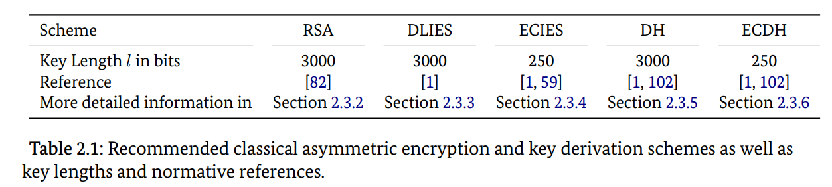
BSI-References: Safe Key-Lengths
Cryptographic Mechanisms: Recommendations and Key Lengths, Version 2024-01 (bund.de)
Page 28

Slide 14
SENSORS AND OTEHR HARDWARE: Now we check what our hardware got
Here u may add a picture of the hardware or a reference text or IFU with encryption data
Identify the encryption given by the product iteslf or by ist context
Check ist classification
And discuss due to kind of encryption and key length the overall securiry of the system Below the BSI-References there is the PDF-File-Link On the further pages u can go hard on the mathematical aspects of encryption. If u feel like it. I hope This reduces some of ur pressure side that. ☺

