Slide 1
Module 4: Physical Layer
Instructor Materials
Introduction to Networks v7.0 (ITN)
Notes:
Cisco Networking Academy Program
Introduction to Networks v7.0 (ITN)
Module 4: Physical Layer

Slide 2
Instructor Materials – Module 4 Planning Guide
This PowerPoint deck is divided in two parts:
Instructor Planning Guide
Information to help you become familiar with the module
Teaching aids
Instructor Class Presentation
Optional slides that you can use in the classroom
Begins on slide # 11
Note: Remove the Planning Guide from this presentation before sharing with anyone.
For additional help and resources go to the Instructor Home Page and Course Resources for this course. You also can visit the professional development site on netacad.com, the official Cisco Networking Academy Facebook page, or Instructor Only FB group.
Notes:
2

Slide 3
What to Expect in this Module
To facilitate learning, the following features within the GUI may be included in this module:
Feature | Description
Animations | Expose learners to new skills and concepts.
Videos | Expose learners to new skills and concepts.
Check Your Understanding(CYU) | Per topic online quiz to help learners gauge content understanding.
Interactive Activities | A variety of formats to help learners gauge content understanding.
Syntax Checker | Small simulations that expose learners to Cisco command line to practice configuration skills.
PT Activity | Simulation and modeling activities designed to explore, acquire, reinforce, and expand skills.

Slide 4
What to Expect in this Module (Cont.)
To facilitate learning, the following features may be included in this module:
Feature | Description
Packet Tracer Physical Mode Activity | These activities are completed using Packet Tracer in Physical Mode.
Hands-On Labs | Labs designed for working with physical equipment.
Class Activities | These are found on the Instructor Resources page. Class Activities are designed to facilitate learning, class discussion, and collaboration.
Module Quizzes | Self-assessments that integrate concepts and skills learned throughout the series of topics presented in the module.
Module Summary | Briefly recaps module content.

Slide 5
Check Your Understanding
Check Your Understanding activities are designed to let students quickly determine if they understand the content and can proceed, or if they need to review.
Check Your Understanding activities do not affect student grades.
There are no separate slides for these activities in the PPT. They are listed in the notes area of the slide that appears before these activities.
Notes:
5

Slide 6
Packet Tracer Physical Mode Activities
These activities are completed using Packet Tracer in Physical Mode.
They are designed to emulate the corresponding Labs.
They can be used instead of the lab when access to physical equipment is not possible.
Packet Tracer Physical Mode activities may not have as much scaffolding as the PT activities that immediately precede them.
Notes:
6

Slide 7
Module 4: Activities
What activities are associated with this module?
Page # | Activity Type | Activity Name | Optional?
4.1.3 | Check Your Understanding | Purpose of the Physical Layer | Recommended
4.2.7 | Check Your Understanding | Physical Layer Characteristics | Recommended
4.3.6 | Check Your Understanding | Copper Cabling | Recommended
4.4.4 | Activity | Cable Pinouts | Recommended
4.5.7 | Check Your Understanding | Fiber-Optic Cabling | Recommended
4.6.4 | Check Your Understanding | Wireless Media | Recommended
4.6.5 | Packet Tracer | Connect a Wired and Wireless LAN | Recommended
4.6.6 | Lab | View Wired and Wireless NIC Information | Recommended
Notes:
7

Slide 8
Module 4: Activities (Cont.)
What activities are associated with this module?
Page # | Activity Type | Activity Name | Optional?
4.7.1 | Packet Tracer Physical Mode | Physical Layer Exploration | Recommneded
4.7.2 | Packet Tracer | Connect the Physical Layer | Recommended
4.7.4 | Module Quiz | Physical Layer | Recommended
Notes:
8

Slide 9
Module 4: Best Practices
Prior to teaching Module 4, the instructor should:
Review the activities and assessments for this module.
Try to include as many questions as possible to keep students engaged during classroom presentation.
Topic 4.1
Ask the students or have a class discussion
What kind of physical connection do they use in their home or work?
Have you ever noticed the variety of physical connections in use in a typical business setting?
Topic 4.2
Ask the students or have a class discussion
Can you think of scenarios outside of networking where physical standards are critical to success?
Describe an occasion where you personally experienced the difference between Throughput and Goodput
Notes:
9

Slide 10
Module 4: Best Practices (Cont.)
Topic 4.3
Ask the students or have a class discussion
What kinds of things do you think will generate EMI or RFI that could have an effect on UTP?
Why do you suppose copper is the conductor of choice?
Topic 4.4
Ask the students or have a class discussion
What would happen if you tried to use a cable that was terminated using different standards at each end?
What is it that makes the higher numbered categories of copper wire better?
Topic 4.5
Ask the students or have a class discussion
Have you ever seen or dealt with a fiber optic connection?
If available, pass around some fiber optic patch cables with different connectors.
Topic 4.6
Ask the students or have a class discussion
Have you ever used a wireless device other than 802.11 Wi-Fi?
Notes:
10

Slide 11
Module 4: Physical Layer
Introduction to Networks v7.0 (ITN)
Notes:
Cisco Networking Academy Program
Introduction to Networks v7.0 (ITN)
Module 4: Physical Layer

Slide 12
Module Objectives
Module Title: Physical Layer
Module Objective: Explain how physical layer protocols, services, and network media support communications across data networks.
Topic Title | Topic Objective
Purpose of the Physical Layer | Describe the purpose and functions of the physical layer in the network.
Physical Layer Characteristics | Describe characteristics of the physical layer.
Copper Cabling | Identify the basic characteristics of copper cabling.
UTP Cabling | Explain how UTP cable is used in Ethernet networks.
Fiber-Optic Cabling | Describe fiber optic cabling and its main advantages over other media.
Wireless Media | Connect devices using wired and wireless media.
Notes:
12
4- Physical Layer
4.0.2- What will I learn to do in this Module.

Slide 13
4.1 Purpose of the Physical Layer
Notes:
4- Physical Layer
4.1- Purpose of the Physical Layer

Slide 14
Purpose of the Physical Layer The Physical Connection
Before any network communications can occur, a physical connection to a local network must be established.
This connection could be wired or wireless, depending on the setup of the network.
This generally applies whether you are considering a corporate office or a home.
A Network Interface Card (NIC) connects a device to the network.
Some devices may have just one NIC, while others may have multiple NICs (Wired and/or Wireless, for example).
Not all physical connections offer the same level of performance.
Notes:
4 – Physical Layer
4.1 – Purpose of the Physical Layer
4.1.1 – The Physical Connection

Slide 15
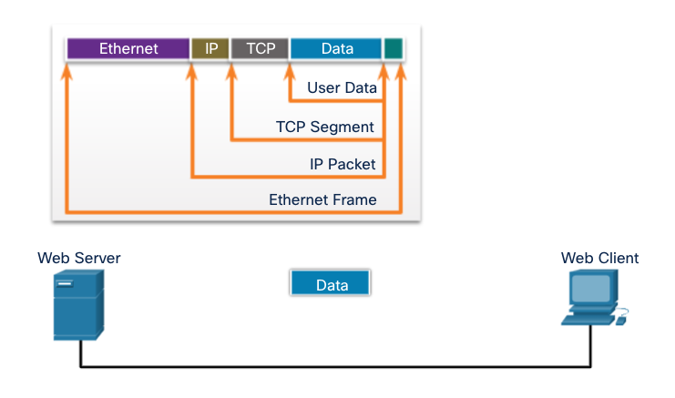
Purpose of the Physical Layer The Physical Layer
Transports bits across the network media
Accepts a complete frame from the Data Link Layer and encodes it as a series of signals that are transmitted to the local media
This is the last step in the encapsulation process.
The next device in the path to the destination receives the bits and re-encapsulates the frame, then decides what to do with it.
Notes:
4 – Physical Layer
4.1 – Purpose of the Physical Layer
4.1.2 – The Physical Layer
4.1.3 – Check Your Understanding – Purpose of the Physical Layer

Slide 16
4.2 Physical Layer Characteristics
Notes:
4 - Physical Layer
4.2 - Physical Layer Characteristics

Slide 17
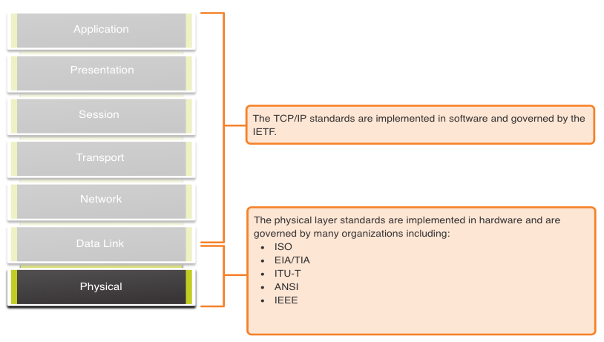
Physical Layer Characteristics Physical Layer Standards
Notes:
4 – Physical Layer
4.2 – Physical Layer Characteristics
4.2.1 – Physical Layer Standards

Slide 18
Physical Layer Characteristics Physical Components
Physical Layer Standards address three functional areas:
Physical Components
Encoding
Signaling
The Physical Components are the hardware devices, media, and other connectors that transmit the signals that represent the bits.
Hardware components like NICs, interfaces and connectors, cable materials, and cable designs are all specified in standards associated with the physical layer.
Notes:
4 – Physical Layer
4.2 – Physical Layer Characteristics
4.2.2 – Physical Components

Slide 19
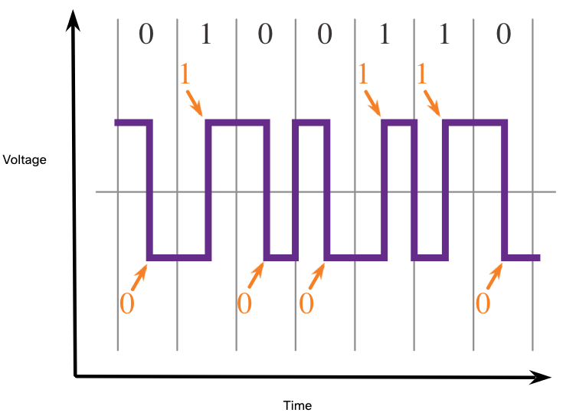
Physical Layer Characteristics Encoding
Encoding converts the stream of bits into a format recognizable by the next device in the network path.
This ‘coding’ provides predictable patterns that can be recognized by the next device.
Examples of encoding methods include Manchester (shown in the figure), 4B/5B, and 8B/10B.
Notes:
4 – Physical Layer
4.2 – Physical Layer Characteristics
4.2.3 – Encoding

Slide 20
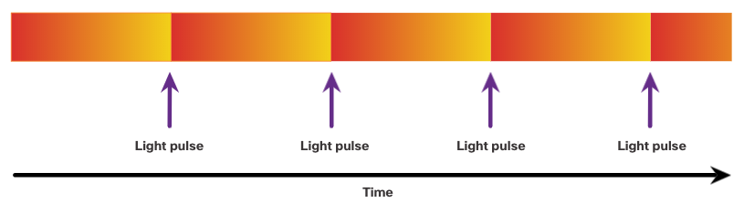
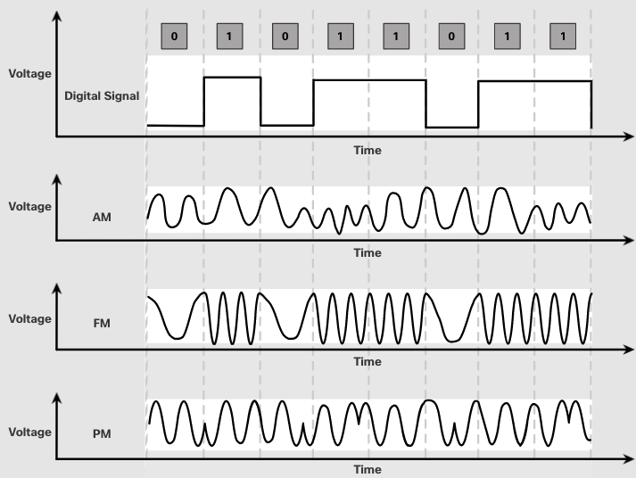
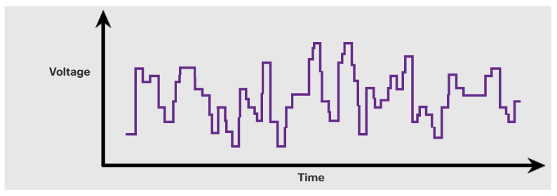
Physical Layer Characteristics Signaling
The signaling method is how the bit values, “1” and “0” are represented on the physical medium.
The method of signaling will vary based on the type of medium being used.
Light Pulses Over Fiber-Optic Cable
Electrical Signals Over Copper Cable
Microwave Signals Over Wireless
Notes:
4 – Physical Layer
4.2 – Physical Layer Characteristics
4.2.4 – Signaling

Slide 21
Physical Layer Characteristics Bandwidth
Bandwidth is the capacity at which a medium can carry data.
Digital bandwidth measures the amount of data that can flow from one place to another in a given amount of time; how many bits can be transmitted in a second.
Physical media properties, current technologies, and the laws of physics play a role in determining available bandwidth.
Unit of Bandwidth | Abbreviation | Equivalence
Bits per second | bps | 1 bps = fundamental unit of bandwidth
Kilobits per second | Kbps | 1 Kbps = 1,000 bps = 10³ bps
Megabits per second | Mbps | 1 Mbps = 1,000,000 bps = 10⁶ bps
Gigabits per second | Gbps | 1 Gbps – 1,000,000,000 bps = 10⁹ bps
Terabits per second | Tbps | 1 Tbps = 1,000,000,000,000 bps = 10¹² bps
Notes:
4 – Physical Layer
4.2 – Physical Layer Characteristics
4.2.5 – Bandwidth

Slide 22
Physical Layer Characteristics Bandwidth Terminology
Latency
Amount of time, including delays, for data to travel from one given point to another
Throughput
The measure of the transfer of bits across the media over a given period of time
Goodput
The measure of usable data transferred over a given period of time
Goodput = Throughput - traffic overhead
Notes:
4 – Physical Layer
4.2 – Physical Layer Characteristics
4.2.6 – Bandwidth Terminology
4.2.7 Check Your Understanding – Physical Layer Characteristics

Slide 23
4.3 Copper Cabling
Notes:
4 - Physical Layer
4.3 - Copper Cabling

Slide 24
Copper Cabling Characteristics of Copper Cabling
Copper cabling is the most common type of cabling used in networks today. It is inexpensive, easy to install, and has low resistance to electrical current flow.
Limitations:
Attenuation – the longer the electrical signals have to travel, the weaker they get.
The electrical signal is susceptible to interference from two sources, which can distort and corrupt the data signals (Electromagnetic Interference (EMI) and Radio Frequency Interference (RFI) and Crosstalk).
Mitigation:
Strict adherence to cable length limits will mitigate attenuation.
Some kinds of copper cable mitigate EMI and RFI by using metallic shielding and grounding.
Some kinds of copper cable mitigate crosstalk by twisting opposing circuit pair wires together.
Notes:
4 – Physical Layer
4.3 – Copper Cabling
4.3.1 – Characteristics of Copper Cabling

Slide 25
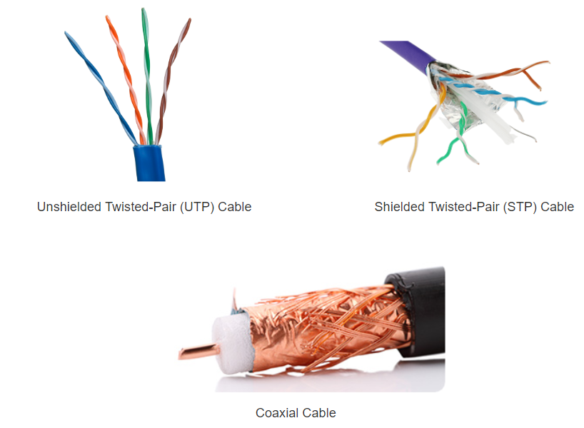
Copper Cabling Types of Copper Cabling
Notes:
4 – Physical Layer
4.3 – Copper Cabling
4.3.2 – Types of Copper Cabling

Slide 26
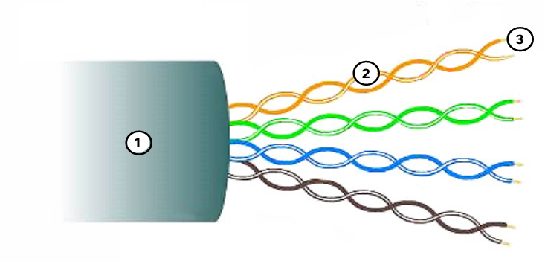
Copper Cabling Unshielded Twisted Pair (UTP)
UTP is the most common networking media.
Terminated with RJ-45 connectors
Interconnects hosts with intermediary network devices.
Key Characteristics of UTP
The outer jacket protects the copper wires from physical damage.
Twisted pairs protect the signal from interference.
Color-coded plastic insulation electrically isolates the wires from each other and identifies each pair.
Notes:
4 – Physical Layer
4.3 – Copper Cabling
4.3.3 – Unshielded Twisted Pair (UTP)

Slide 27
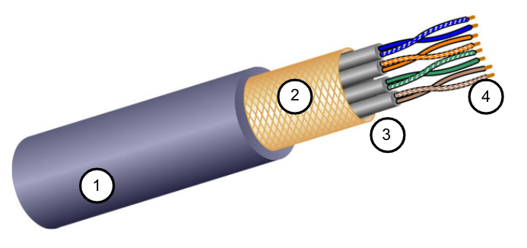
Copper Cabling Shielded Twisted Pair (STP)
Better noise protection than UTP
More expensive than UTP
Harder to install than UTP
Terminated with RJ-45 connectors
Interconnects hosts with intermediary network devices
Key Characteristics of STP
The outer jacket protects the copper wires from physical damage
Braided or foil shield provides EMI/RFI protection
Foil shield for each pair of wires provides EMI/RFI protection
Color-coded plastic insulation electrically isolates the wires from each other and identifies each pair
Notes:
4 – Physical Layer
4.3 – Copper Cabling
4.3.4 – Shielded Twisted Pair (STP)

Slide 28
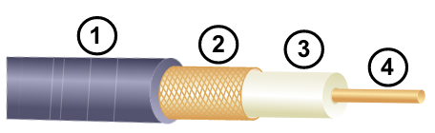
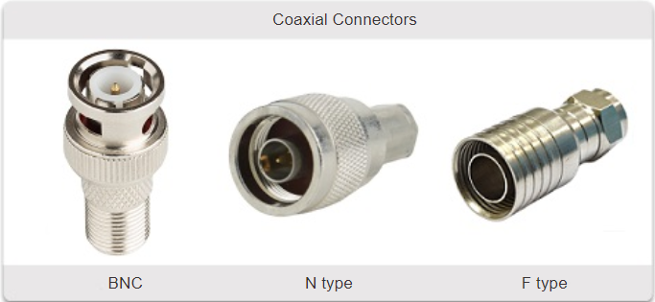
Copper Cabling Coaxial Cable
Consists of the following:
Outer cable jacket to prevent minor physical damage
A woven copper braid, or metallic foil, acts as the second wire in the circuit and as a shield for the inner conductor.
A layer of flexible plastic insulation
A copper conductor is used to transmit the electronic signals.
There are different types of connectors used with coax cable.
Commonly used in the following situations:
Wireless installations - attach antennas to wireless devices
Cable internet installations - customer premises wiring
Notes:
4 – Physical Layer
4.3 – Copper Cabling
4.3.5 – Coaxial Cable
4.3.6 Check Your Understanding – Copper Cabling

Slide 29
4.4 UTP Cabling
Notes:
4 -Physical Layer
4.4 - UTP cabling

Slide 30
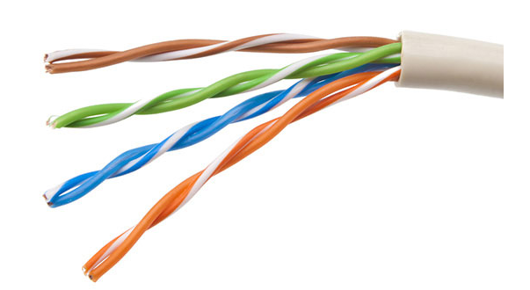
UTP Cabling Properties of UTP Cabling
UTP has four pairs of color-coded copper wires twisted together and encased in a flexible plastic sheath. No shielding is used. UTP relies on the following properties to limit crosstalk:
Cancellation - Each wire in a pair of wires uses opposite polarity. One wire is negative, the other wire is positive. They are twisted together and the magnetic fields effectively cancel each other and outside EMI/RFI.
Variation in twists per foot in each wire - Each wire is twisted a different amount, which helps prevent crosstalk amongst the wires in the cable.
Notes:
4 – Physical Layer
4.4 – UTP Cabling
4.4.1 – Properties of UTP Cabling

Slide 31
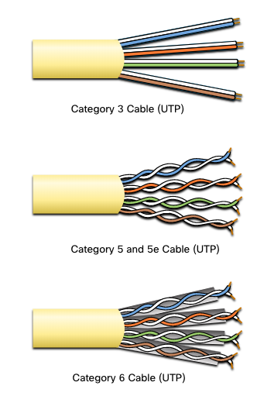
UTP Cabling UTP Cabling Standards and Connectors
Standards for UTP are established by the TIA/EIA. TIA/EIA-568 standardizes elements like:
Cable Types
Cable Lengths
Connectors
Cable Termination
Testing Methods
Electrical standards for copper cabling are established by the IEEE, which rates cable according to its performance. Examples include:
Category 3
Category 5 and 5e
Category 6
Notes:
4 – Physical Layer
4.4 – UTP Cabling
4.4.2 - UTP Cabling Standards and Connectors

Slide 32
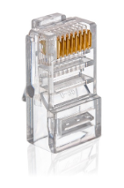
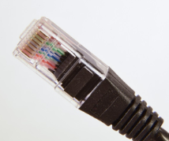
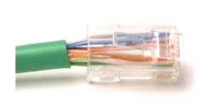
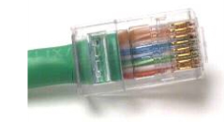
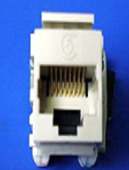
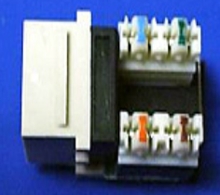
UTP Cabling UTP Cabling Standards and Connectors (Cont.)
RJ-45 Connector
Poorly terminated UTP cable
Properly terminated UTP cable
RJ-45 Socket
Notes:
4 – Physical Layer
4.4 – UTP Cabling
4.4.2 – UTP Cabling Standards and Connectors

Slide 33
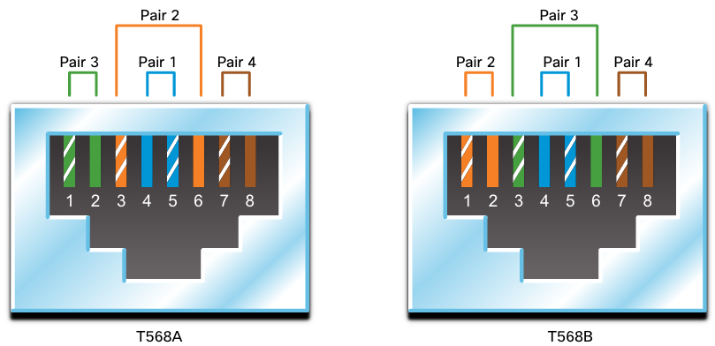
UTP Cabling Straight-through and Crossover UTP Cables
Cable Type | Standard | Application
Ethernet Straight-through | Both ends T568A or T568B | Host to Network Device
Ethernet Crossover * | One end T568A, other end T568B | Host-to-Host, Switch-to-Switch, Router-to-Router
* Considered Legacy due to most NICs using Auto-MDIX to sense cable type and complete connection
Rollover | Cisco Proprietary | Host serial port to Router or Switch Console Port, using an adapter
Notes:
4 – Physical Layer
4.4 – UTP Cabling
4.4.3 – Straight-through and Crossover UTP Cables
4.4.4 – Activity – Cable Pinouts

Slide 34
4.5 Fiber-Optic Cabling
Notes:
4- Physical Layer
4.5 - Fiber-Optic Cabling

Slide 35
Fiber-Optic Cabling Properties of Fiber-Optic Cabling
Not as common as UTP because of the expense involved
Ideal for some networking scenarios
Transmits data over longer distances at higher bandwidth than any other networking media
Less susceptible to attenuation, and completely immune to EMI/RFI
Made of flexible, extremely thin strands of very pure glass
Uses a laser or LED to encode bits as pulses of light
The fiber-optic cable acts as a wave guide to transmit light between the two ends with minimal signal loss
Notes:
4 – Physical Layer
4.5 – Fiber-Optic Cabling
4.5.1 – Properties of Fiber-Optic Cabling

Slide 36
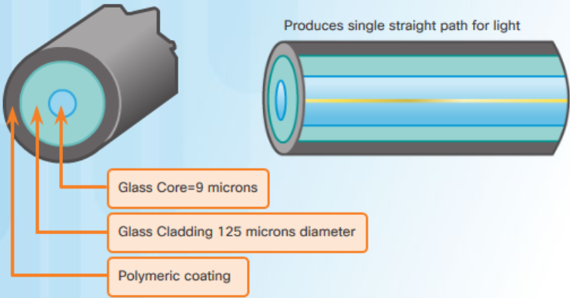
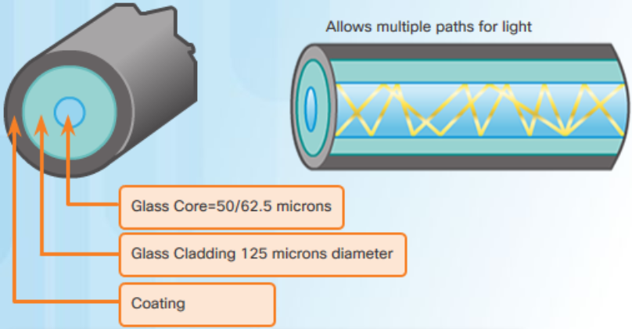
Fiber-Optic Cabling Types of Fiber Media
Single-Mode Fiber
Multimode Fiber
Very small core
Uses expensive lasers
Long-distance applications
Larger core
Uses less expensive LEDs
LEDs transmit at different angles
Up to 10 Gbps over 550 meters
Dispersion refers to the spreading out of a light pulse over time. Increased dispersion means increased loss of signal strength. MMF has greater dispersion than SMF, with a the maximum cable distance for MMF is 550 meters.
Notes:
4 – Physical Layer
4.5 – Fiber-Optic Cabling
4.5.2 – Types of Fiber Media

Slide 37
Fiber-Optic Cabling Fiber-Optic Cabling Usage
Fiber-optic cabling is now being used in four types of industry:
Enterprise Networks - Used for backbone cabling applications and interconnecting infrastructure devices
Fiber-to-the-Home (FTTH) - Used to provide always-on broadband services to homes and small businesses
Long-Haul Networks - Used by service providers to connect countries and cities
Submarine Cable Networks - Used to provide reliable high-speed, high-capacity solutions capable of surviving in harsh undersea environments at up to transoceanic distances.
Our focus in this course is the use of fiber within the enterprise.
Notes:
4 – Physical Layer
4.5 – Fiber-Optic Cabling
4.5.3 – Fiber-Optic Cabling Usage

Slide 38
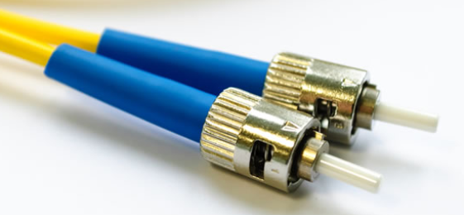
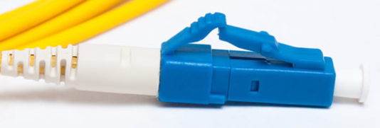
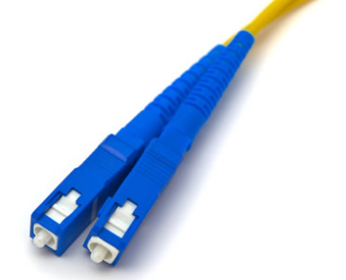
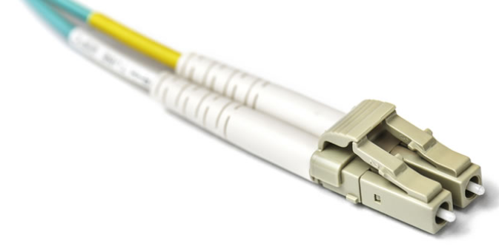
Fiber-Optic Cabling Fiber-Optic Connectors
Straight-Tip (ST) Connectors
Lucent Connector (LC) Simplex Connectors
Subscriber Connector (SC) Connectors
Duplex Multimode LC Connectors
Notes:
4 – Physical Layer
4.5 – Fiber-Optic Cabling
4.5.4 – Fiber-Optic Connectors

Slide 39
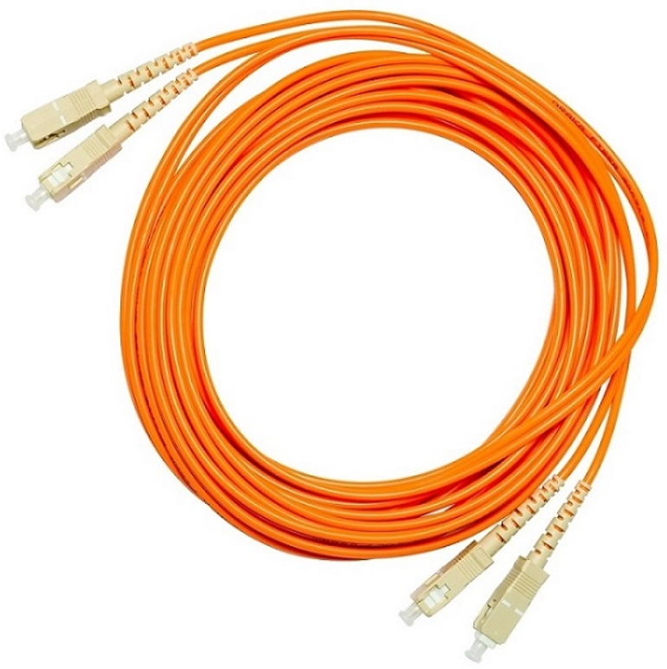
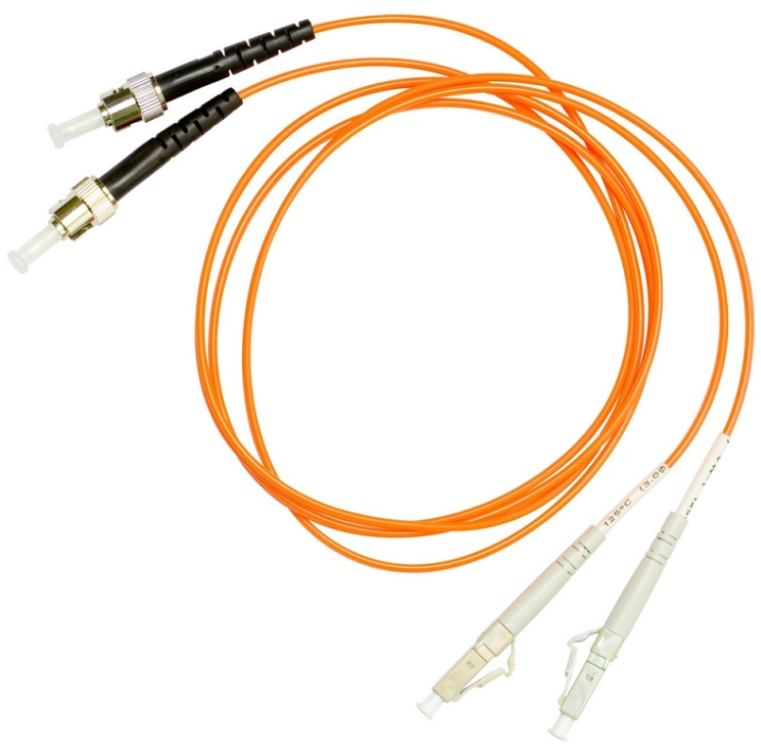
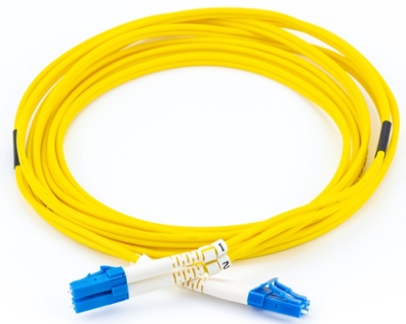
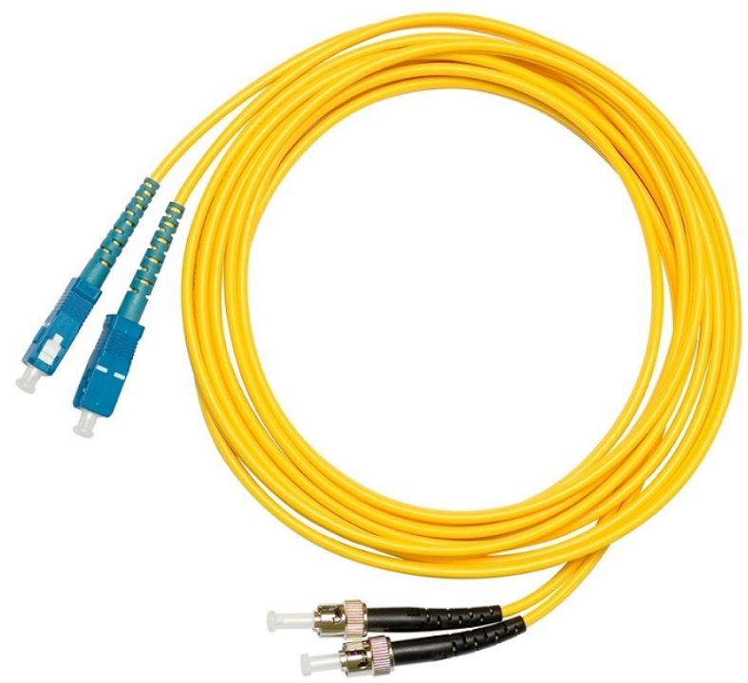
Fiber-Optic Cabling Fiber Patch Cords
SC-SC MM Patch Cord
LC-LC SM Patch Cord
ST-LC MM Patch Cord
ST-SC SM Patch Cord
A yellow jacket is for single-mode fiber cables and orange (or aqua) for multimode fiber cables.
Notes:
4 – Physical Layer
4.5 – Fiber-Optic Cabling
4.5.5 - Fiber Patch Cords

Slide 40
Fiber-Optic Cabling Fiber versus Copper
Optical fiber is primarily used as backbone cabling for high-traffic, point-to-point
connections between data distribution facilities and for the interconnection of buildings
in multi-building campuses.
Implementation Issues | UTP Cabling | Fiber-Optic Cabling
Bandwidth supported | 10 Mb/s - 10 Gb/s | 10 Mb/s - 100 Gb/s
Distance | Relatively short (1 - 100 meters) | Relatively long ( 1 - 100,000 meters)
Immunity to EMI and RFI | Low | High (Completely immune)
Immunity to electrical hazards | Low | High (Completely immune)
Media and connector costs | Lowest | Highest
Installation skills required | Lowest | Highest
Safety precautions | Lowest | Highest
Notes:
4 – Physical Layer
4.5 – Fiber-Optic Cabling
4.5.6 – Fiber versus Copper
4.5.7 – Check Your Understanding – Fiber-Optic Cabling

Slide 41
4.6 Wireless Media
Notes:
4 - Physical Layer
4.6 - Wireless Media

Slide 42
Wireless Media Properties of Wireless Media
It carries electromagnetic signals representing binary digits using radio or microwave frequencies. This provides the greatest mobility option. Wireless connection numbers continue to increase.
Some of the limitations of wireless:
Coverage area - Effective coverage can be significantly impacted by the physical characteristics of the deployment location.
Interference - Wireless is susceptible to interference and can be disrupted by many common devices.
Security - Wireless communication coverage requires no access to a physical strand of media, so anyone can gain access to the transmission.
Shared medium - WLANs operate in half-duplex, which means only one device can send or receive at a time. Many users accessing the WLAN simultaneously results in reduced bandwidth for each user.
Notes:
4 – Physical Layer
4.6 – Wireless Media
4.6.1 – Properties of Wireless Media

Slide 43
Wireless Media Types of Wireless Media
The IEEE and telecommunications industry standards for wireless data communications
cover both the data link and physical layers. In each of these standards, physical layer
specifications dictate:
Data to radio signal encoding methods
Frequency and power of transmission
Signal reception and decoding requirements
Antenna design and construction
Wireless Standards:
Wi-Fi (IEEE 802.11) - Wireless LAN (WLAN) technology
Bluetooth (IEEE 802.15) - Wireless Personal Area network (WPAN) standard
WiMAX (IEEE 802.16) - Uses a point-to-multipoint topology to provide broadband wireless access
Zigbee (IEEE 802.15.4) - Low data-rate, low power-consumption communications, primarily for Internet of Things (IoT) applications
Notes:
4 – Physical Layer
4.6 – Wireless Media
4.6.2 - Types of Wireless Media

Slide 44
Wireless Media Wireless LAN
In general, a Wireless LAN (WLAN) requires the following devices:
Wireless Access Point (AP) - Concentrate wireless signals from users and connect to the existing copper-based network infrastructure
Wireless NIC Adapters - Provide wireless communications capability to network hosts
There are a number of WLAN standards. When purchasing WLAN equipment, ensure compatibility, and interoperability.
Network Administrators must develop and apply stringent security policies and processes to protect WLANs from unauthorized access and damage.
Notes:
4 – Physical Layer
4.6 – Wireless Media
4.6.3 – Wireless LAN
4.6.4 – Check Your Understanding – Wireless Media

Slide 45
Wireless Media Packet Tracer – Connect a Wired and Wireless LAN
In this Packet Tracer, you will do the following:
Connect to the Cloud
Connect a Router
Connect Remaining Devices
Verify Connections
Examine the Physical Topology
Notes:
4 – Physical Layer
4.6 – Wireless Media
4.6.5 – Packet Tracer – Connect a Wired and Wireless LAN

Slide 46
Wireless Media Lab – View Wired and Wireless NIC Information
In this lab, you will complete the following objectives:
Identify and Work with PC NICs
Identify and Use the System Tray Network Icons
Notes:
4 – Physical Layer
4.6 – Wireless Media
4.6.6 – Lab – View Wired and Wireless NIC Information

Slide 47
4.7 Module Practice and Quiz
Notes:
4 - Physical Layer
4.7- Module Practice and Quiz

Slide 48
Module Practice and Quiz Packet Tracer – Physical Layer Exploration– Physical Mode
In this Packet Tracer Physical Mode (PTPM) activity, you will complete the following:
Examine Local IP Addressing Information
Trace the Path Between Source and Destination
Notes:
4 – Physical Layer
4.7 – Module Practice and Quiz
4.7.1 – Packet Tracer Physical Mode

Slide 49
Module Practice and Quiz Packet Tracer – Connect the Physical Layer
In this Packet Tracer, you will do the following:
Identify Physical Characteristics of Internetworking Devices
Select Correct Modules for Connectivity
Connect Devices
Check Connectivity
Notes:
4 – Physical Layer
4.7 – Module Practice and Quiz
4.7.2 – Packet Tracer – Connect the Physical Layer

Slide 50
Module Practice and Quiz What did I learn in this module?
Before any network communications can occur, a physical connection to a local network, either wired or wireless, must be established.
The physical layer consists of electronic circuitry, media, and connectors developed by engineers.
The physical layer standards address three functional areas: physical components, encoding, and signaling.
Three types of copper cabling are: UTP, STP, and coaxial cable (coax).
UTP cabling conforms to the standards established jointly by the TIA/EIA. The electrical characteristics of copper cabling are defined by the Institute of Electrical and Electronics Engineers (IEEE).
The main cable types that are obtained by using specific wiring conventions are Ethernet Straight-through and Ethernet Crossover.
Notes:
4 – Physical Layer
4.7 – Module Practice and Quiz
4.7.3 – What did I learn in this module?

Slide 51
Module Practice and Quiz What did I learn in this module (Cont.)?
Optical fiber cable transmits data over longer distances and at higher bandwidths than any other networking media.
There are four types of fiber-optic connectors: ST, SC, LC, and duplex multimode LC.
Fiber-optic patch cords include SC-SC multimode, LC-LC single-mode, ST-LC multimode, and SC-ST single-mode.
Wireless media carry electromagnetic signals that represent the binary digits of data communications using radio or microwave frequencies. Wireless does have some limitations, including coverage area, interference, security, and the problems that occur with any shared medium.
Wireless standards include the following: Wi-Fi (IEEE 802.11), Bluetooth (IEEE 802.15), WiMAX (IEEE 802.16), and Zigbee (IEEE 802.15.4).
Wireless LAN (WLAN) requires a wireless AP and wireless NIC adapters.
Notes:
4 – Physical Layer
4.7 – Module Practice and Quiz
4.7.3 – What did I learn in this module?

Slide 52
Module 4: Physical Layer New Terms and Commands
Telecommunications Industry Association/Electronic Industries Association (TIA/EIA) latency throughput goodput Electromagnetic interference (EMI) Radio frequency interference (RFI) Crosstalk Unshielded Twisted Pair (UTP) Shielded Twisted Pair (STP) Coaxial cable RJ-45 Cancellation TIA/EIA-568 | Ethernet Straight-through Ethernet crossover Rollover Single-Mode Fiber (SMF) Multimode (MMF) Straight-tip (ST) Connectors Subscriber Connector (SC) Connectors Lucent Connector (LC) Simplex Connectors Duplex Multimode LC Connectors Bluetooth (IEEE 802.15) WiMAX (IEEE 802.16) Zigbee (IEEE 802.15.4) Wireless Access Point (AP)

