Slide 1
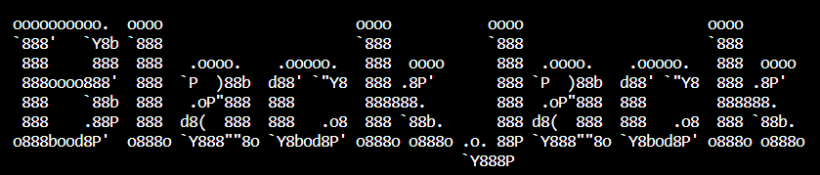
CSC-130-02 Intro to Scripting Fundamentals | SPR ‘23
Dr. Kmir
Group 2: Collin Le, Elkins Berrios-Santos, Rylee Cutter, Gayla Dunphy, Ben Hinz

Slide 2
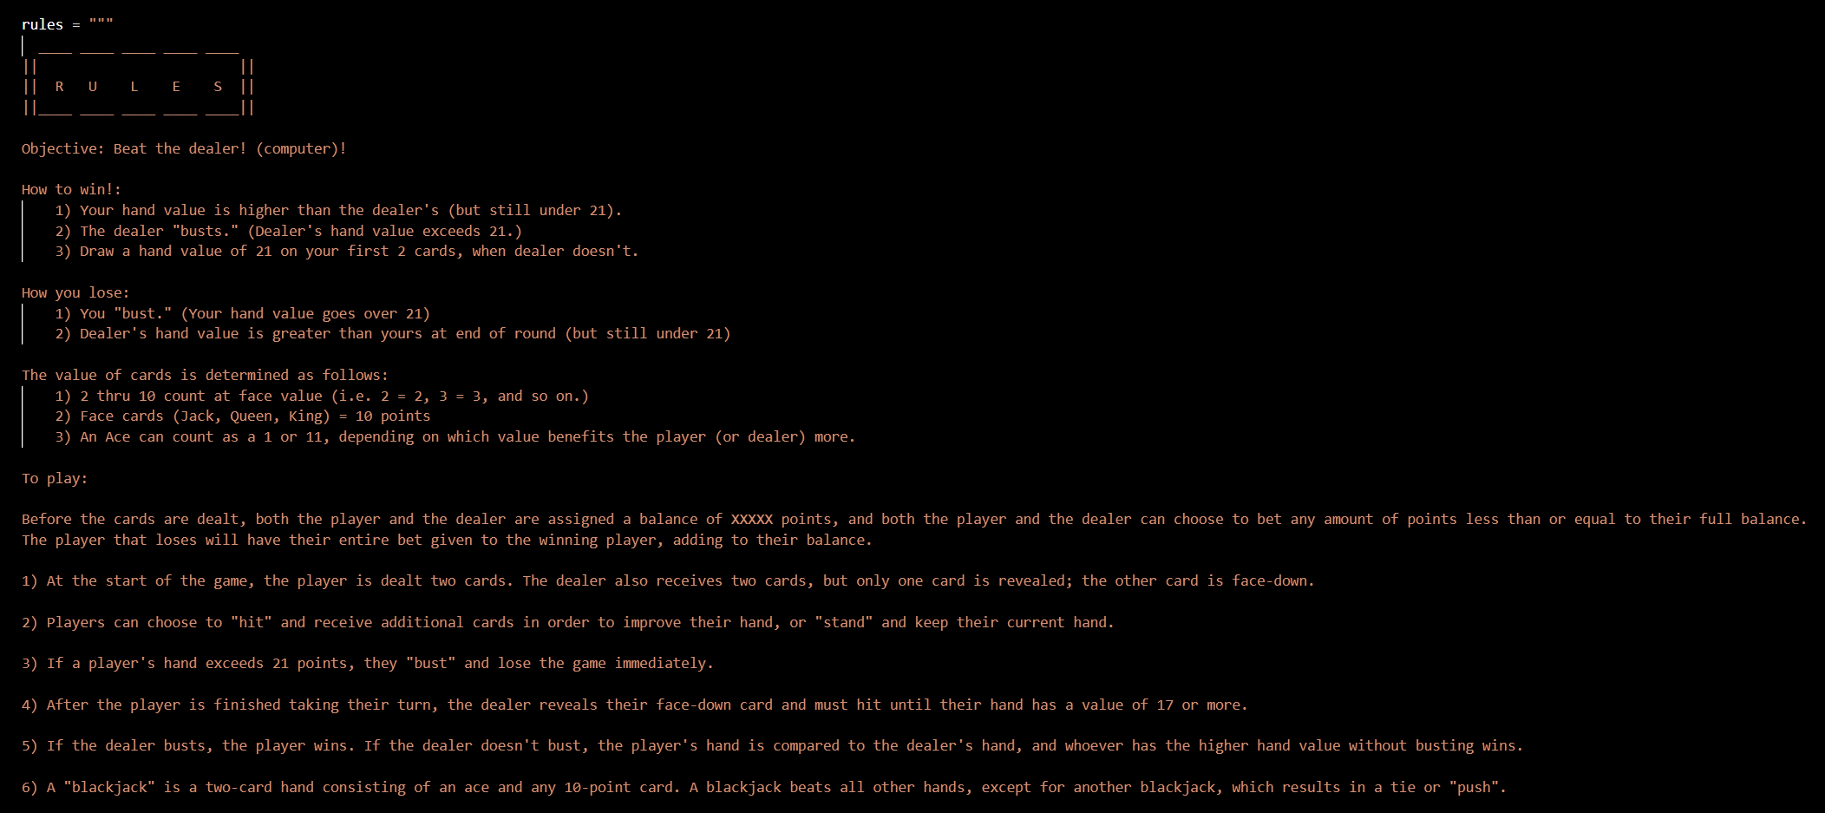
Rules

Slide 3
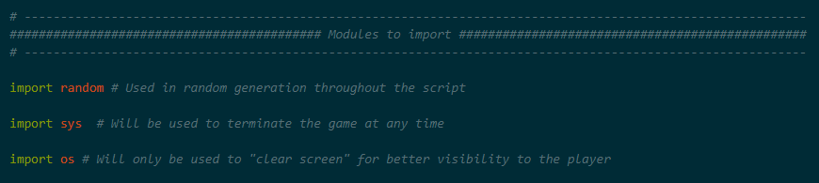
Imported Modules
random: Provides a way to generate random numbers and data.
sys: Provides access to some functions and variables related to the system the Python interpreter is running on. We use it in a few functions to allow the player to quit at any time.
os: Provides a way to interact with the operating system. Used to clear the screen in b/t game segments.

Slide 4
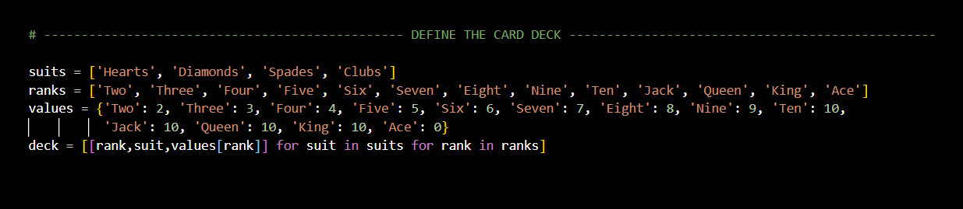
Deck Values
suits: A list that contains the 4 potential suits (♠, ♥, ♦, ♣) for each card.
ranks: A list that contains the potential ranks for each card (2-10, J, Q, K, A).
values: A dictionary that assigns a point value to each rank. (Aces are assigned a value of 1 or 11 in a later function).
deck: A list comprehension that creates a deck of cards by iterating over each combination of suit and rank, totaling to 52 “cards.”

Slide 5
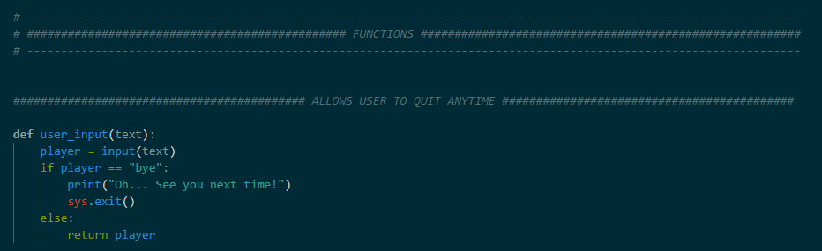
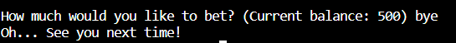
Functions
All functions are listed at the top of the program before the running game for readability.
The player can quit at any time by typing the keyword “bye”.
user_input():
Checks for the keyword “bye” during any input prompt, and will end the program if the keyword is used.

Slide 6
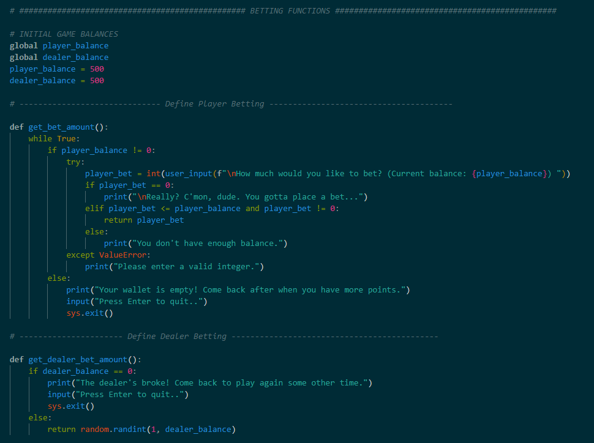
Functions: Place Your Bets!
Initial balances for the player and dealer are both 500 points at beginning of game.
Betting is arranged so that the player bets before the dealer.
The dealer’s betting is automated through randomized integers
Player and Dealer balances update at the end of every round and carry over to the next round of the game.
At the beginning of each round, the betting functions for each (player & dealer) check the balances. If either balance is 0, the game ends.

Slide 7
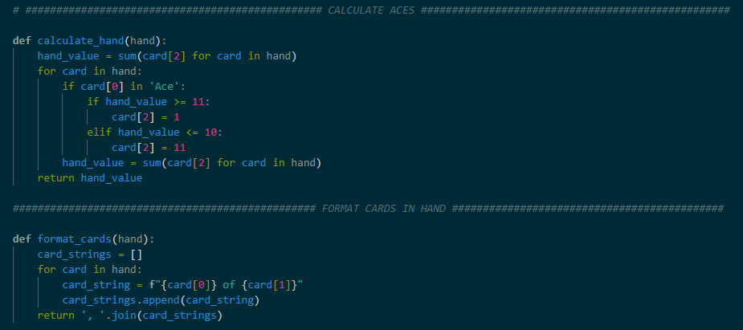
Hand Calculations and Formatting
calculate_hand() function calculates the value of Aces, and updating the total hand.
Aces = 0 at the beginning
Uses player hand size (w/o Aces) to determine whether Ace will be 1 or 11.
Can be used for either the player or the dealer!
format_cards() function assists with displaying the cards in either hand cleanly on the screen.
Turns the raw data from each card into a formatted “string” without altering the actual values of the cards themselves.

Slide 8
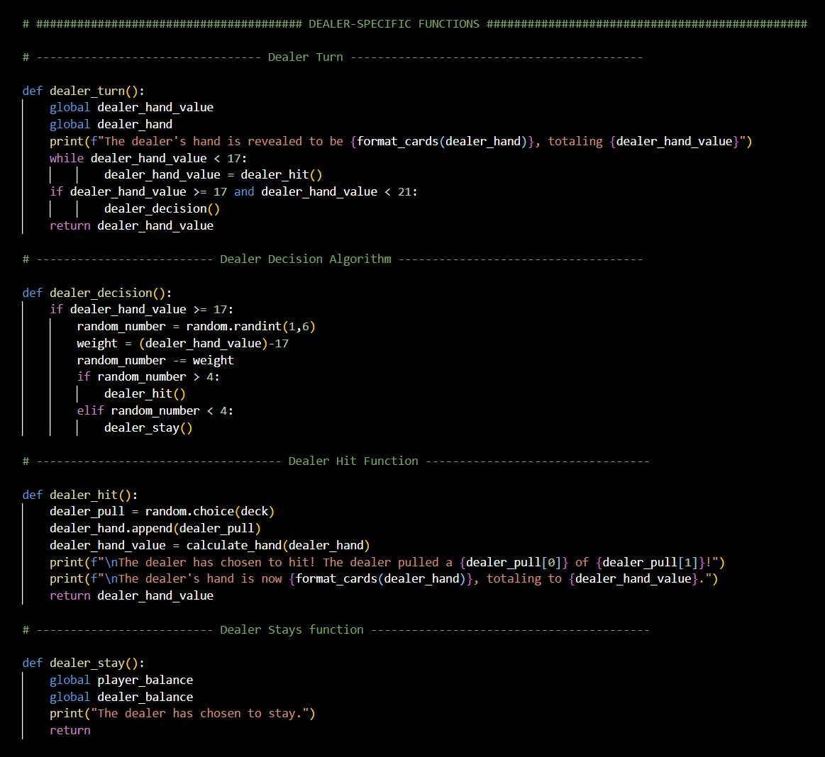
Dealer Functions & Algorithms
Dealer is completely automated through functions that iterate over each other
The functions:
dealer_turn():
Runs after player turn. (If able)
Tells to hit until its hand is >= 17, then make a choice.
dealer_decision(): (“Do I hit or stay?”)
The Dealer’s “brain” (algorithm) decides whether to hit or stand based on a weighted random value.
dealer_hit(): The dealer pulls a card!
dealer_stay(): Dealer does nothing!

Slide 9
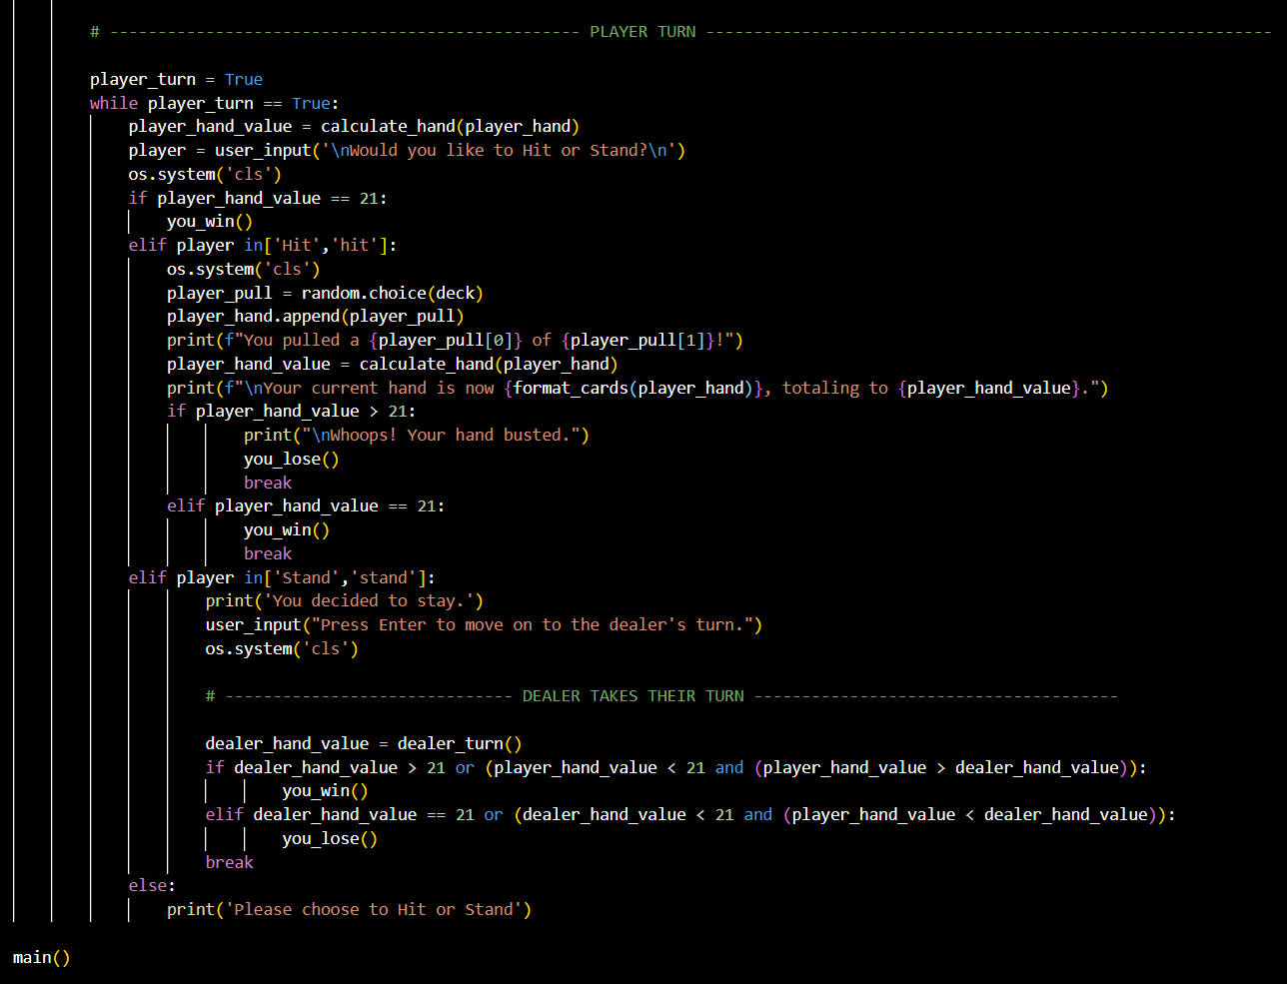
Your Turn!
After the hands are dealt, player can choose to hit or stand!
If hit, a random card is pulled, and the hand is recalculated.
If stay, the player stays where they are, and the turn passes to the dealer.
(Note: The dealer’s turn only happens after the player ends their turn with “stay.”)
The dealer’s algorithm is fully automated through functions.
Their hand is recalculated automatically.

Slide 10
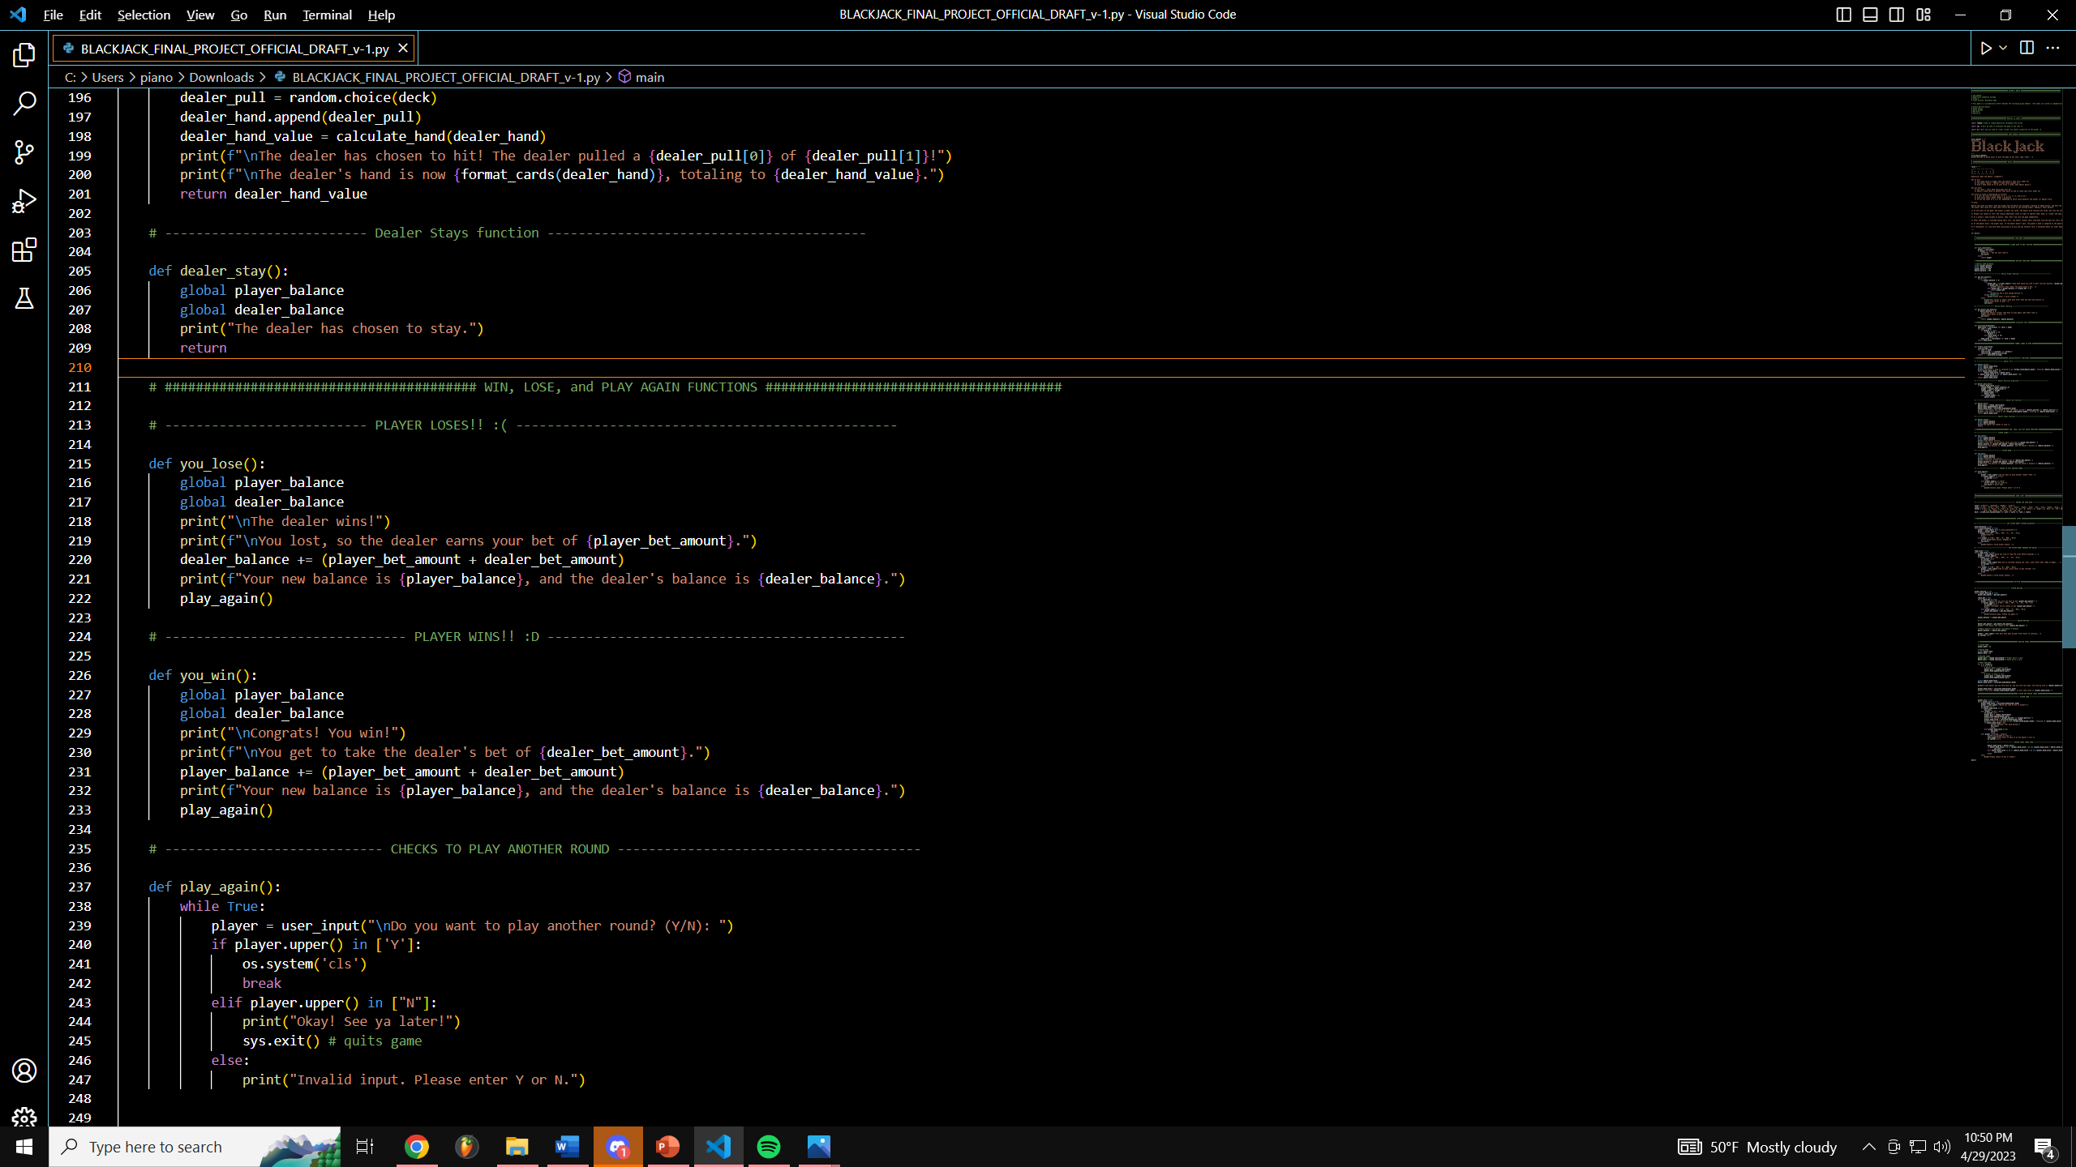
You Win!
On every turn and move, each player’s hand is calculated for the Win/Lose conditions.
You win when :
Your hand = 21
You hand is < 21 but greater than the dealer’s
The dealer busts (Dealer hand > 21)

Slide 11
You Lose! ☹
You lose when :
The dealer’s hand = 21
Dealer’s hand is < 21 but greater than yours
Your hand busts (Your hand > 21)

Slide 12
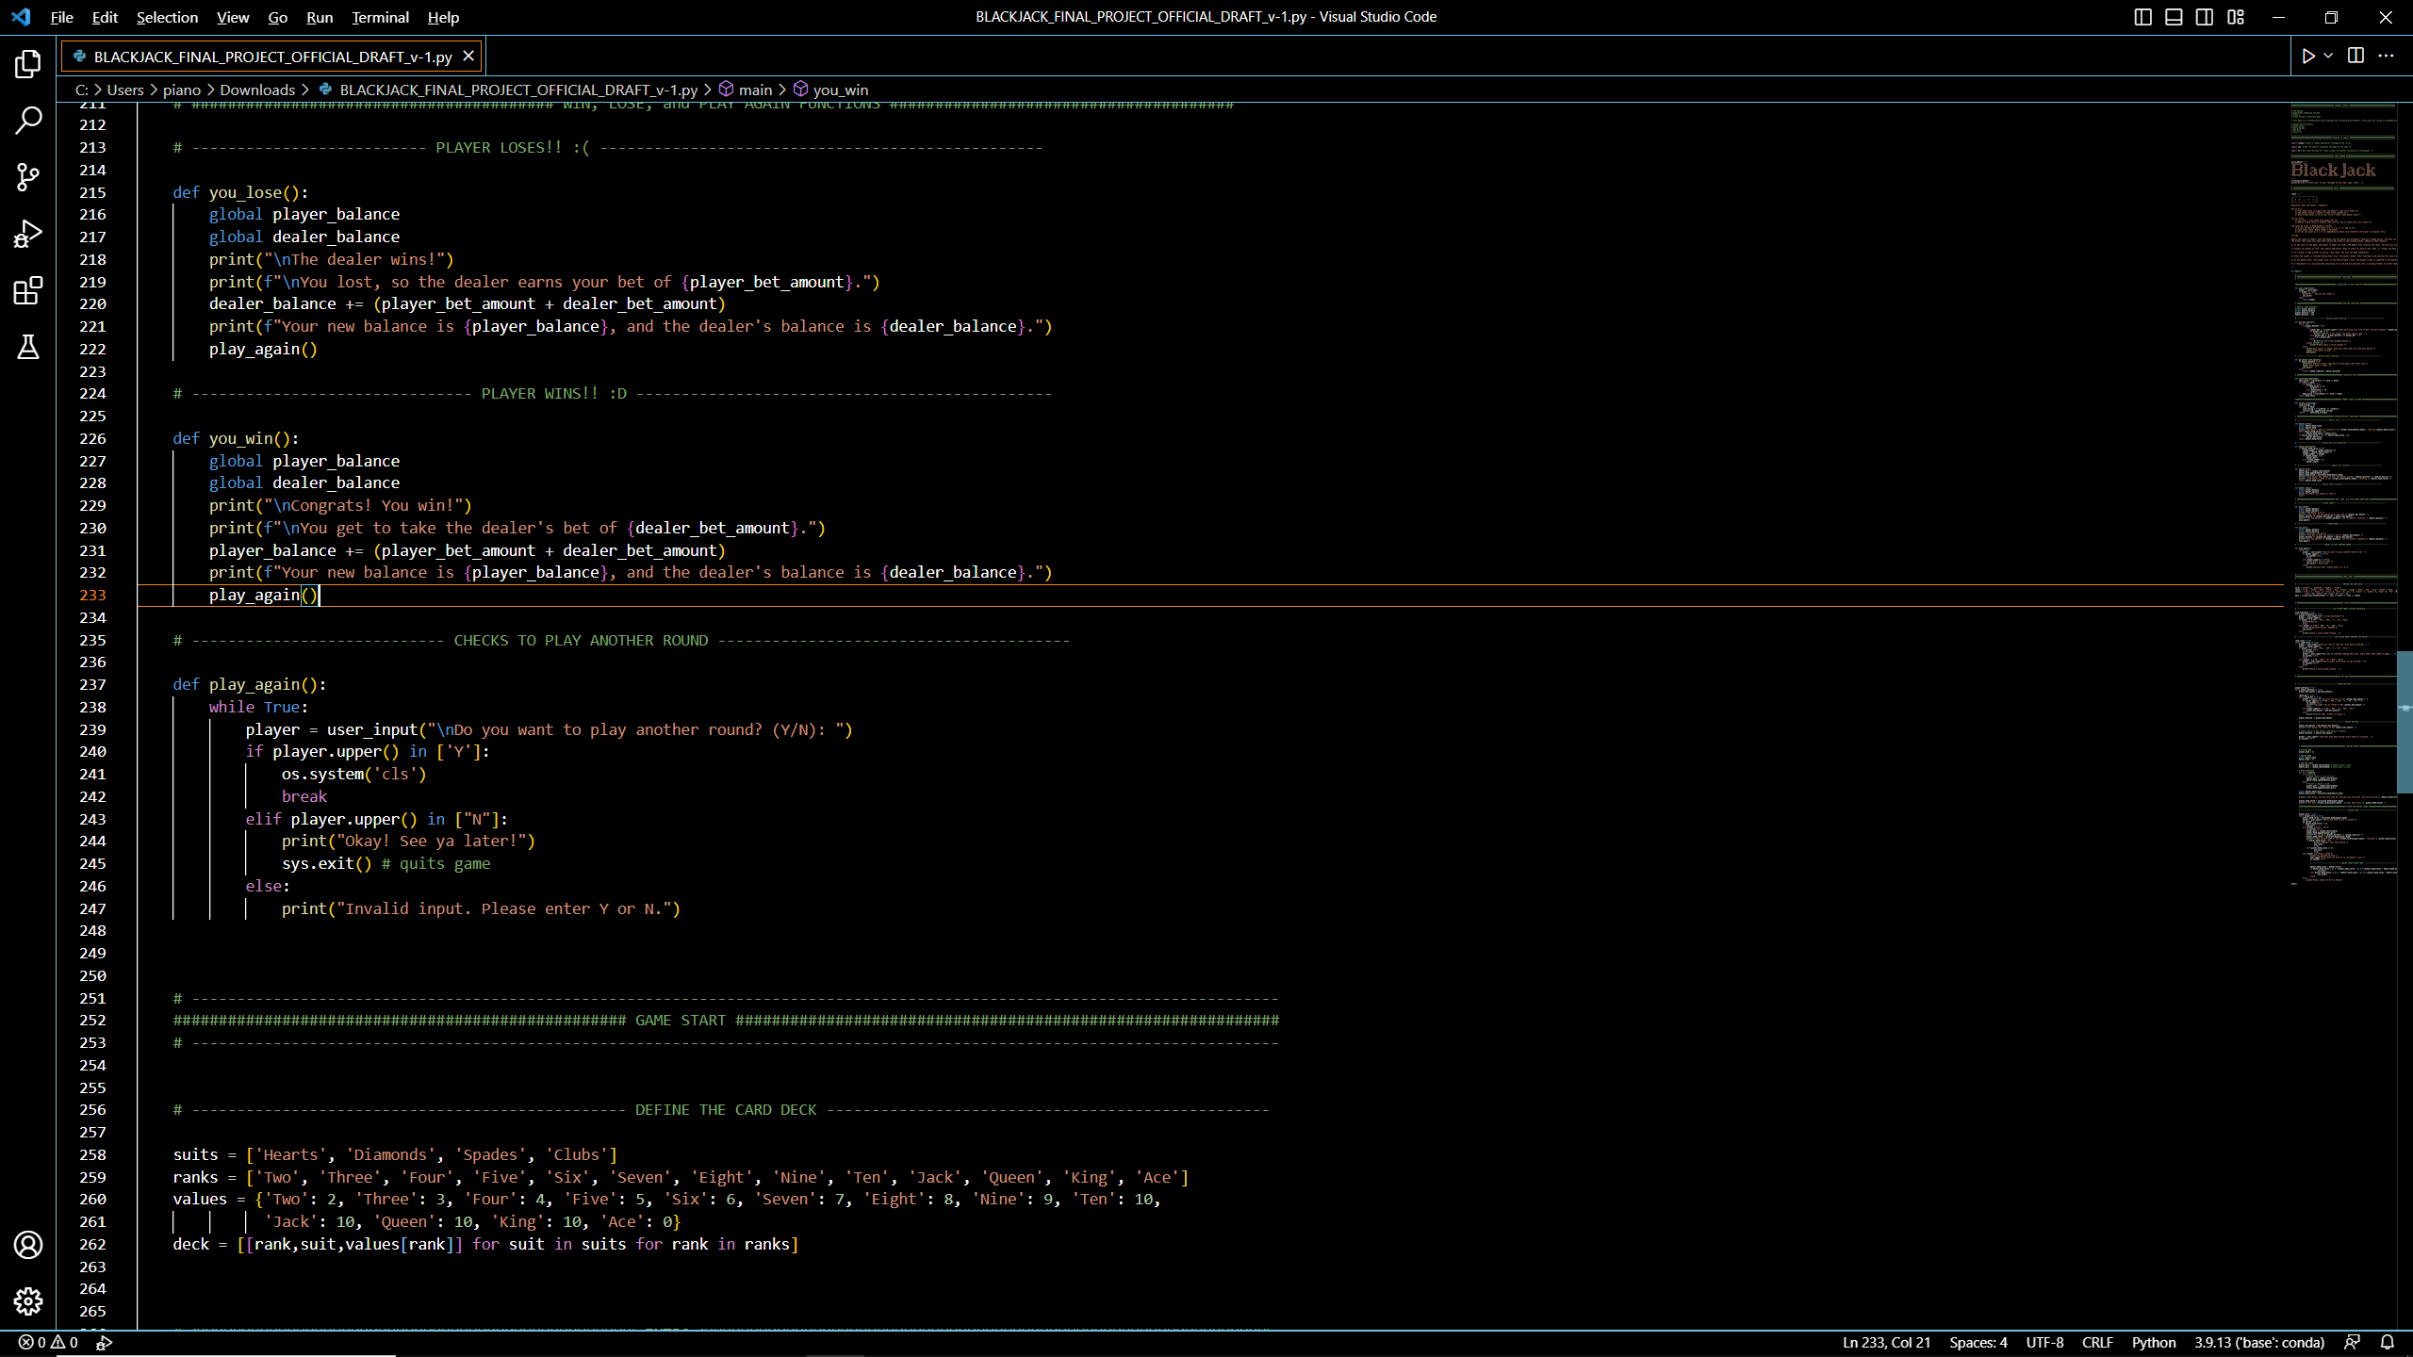
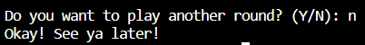
Wanna go again?
At the end of the game, each player’s balance is adjusted.
Winner keeps their bet, and the loser’s bet is added to their balance.
The player can then choose to play another round with the new balances, or end the game!

Slide 13
The End! ☺

