Slide 1
SMART MONEY TRACKER
A CMD-Based Personal Finance Manager
Object-Oriented Programming (OOP) — Project Proposal
Saksham Smith Sunar
King's College Nepal | Bachelor of Science in Computer Science

Slide 2
The Problem
Most people don’t keep an accurate record of their daily income, expenses, and savings — so by the end of the month, it’s hard to know exactly where the money went.
“How much did I actually save this month?”
No record of spending
Money is spent without any log, so overspending is only noticed after it happens.
Savings are an afterthought
— A question most people can’t answer without digging through notes, bank SMS, or memory.
Whatever is “left over” is saved — not a deliberate, tracked goal.
Privacy concerns
Mobile budgeting apps require internet access and store data on remote servers.
Smart Money Tracker
01

Slide 3
Project Objectives
1
Provide a simple and secure login system
2
Record income and expenses with a date
3
Let the user define a custom saving method
4
Generate monthly and yearly financial reports
5
Store all data in CSV files, viewable in Excel
Smart Money Tracker
02

Slide 4
Scope & Limitations
SCOPE
LIMITATIONS
• Single-user personal finance tracking
• Single user account per session
• Records income, expenses & custom savings with dates
• Console (CMD) based — no graphical interface
• Generates monthly and yearly summary reports
• Reports show totals only; no charts or graphs
• Easily extendable due to its OOP structure
• Assumes dates entered in DD-MM-YYYY format
Smart Money Tracker
03

Slide 5
Methodology, Tools & Technologies
Incremental Development Model
Requirement
Analysis
→
Design
→
Coding
→
Testing &
Evaluation
TOOLS
TECHNOLOGIES
• VS Code / Code::Blocks — editing the C++ source
• C++ — primary implementation language
• G++ Compiler — compiling & running the program
• File Handling (fstream) — CSV read/write
• Git & GitHub — version control
• Object Oriented Programming — core design
Smart Money Tracker
04

Slide 6
Object-Oriented Design
The four OOP pillars, applied directly in Smart Money Tracker
1
Encapsulation
2
Inheritance
User’s password and Transaction’s data are kept private, exposed only through controlled methods.
Income, Expense, and Saving all inherit shared fields and behaviour from the Transaction base class.
3
Polymorphism
4
Abstraction
display() and getType() behave differently for each transaction type, called through one base pointer.
Transaction is an abstract class defining a common contract every transaction type must fulfil.
Smart Money Tracker
05

Slide 7
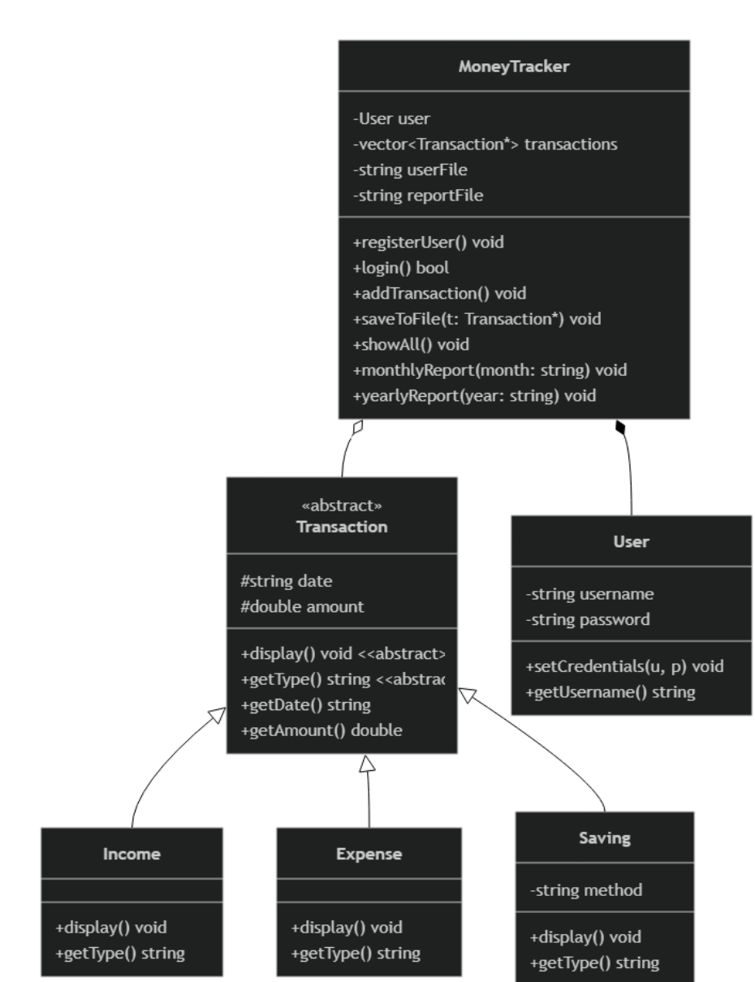
System Design — Class Diagram
Transaction is abstract; Income, Expense, and Saving inherit from it.
MoneyTracker
Central controller — owns User & transactions, drives login, add, save, and report operations.
Transaction (abstract)
Shared date & amount fields; pure virtual display() and getType().
Income / Expense / Saving
Concrete transaction types, each overriding display() and getType().
User
Holds username & password behind private fields with controlled access.
Smart Money Tracker
06

Slide 8
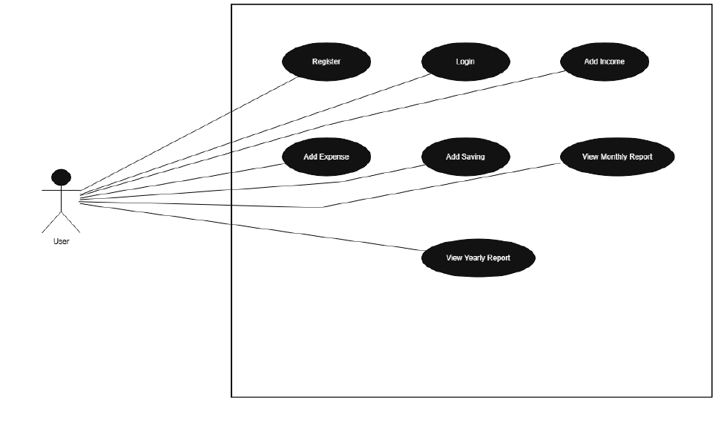
System Design — Use Case Diagram
A single User actor drives all seven core operations of the system
Smart Money Tracker
07

Slide 9
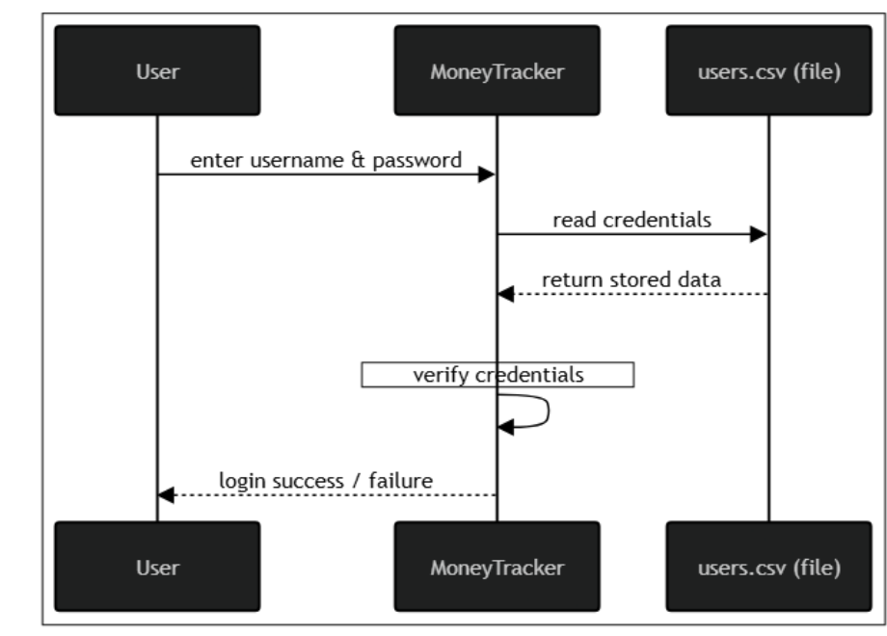
System Design — Sequence Diagram
Message flow for the Login process, between User, MoneyTracker, and users.csv
Smart Money Tracker
08

Slide 10
Proposed Deliverables
1
Login System
2
Transaction Entry
Full registration and secure login before any data can be accessed.
Add income, expense, and custom saving entries with a date.
3
Reports
4
CSV Storage
On-demand monthly and yearly totals for income, expense, and saving.
users.csv and report.csv — both viewable directly in Excel.
Smart Money Tracker
09

Slide 11
Conclusion
Smart Money Tracker replaces scattered notes and manual spreadsheets with a structured, private, and offline C++ console application — built on Encapsulation, Inheritance, Polymorphism, and Abstraction.
Thank You
Questions & Discussion

