Slide 1

DATA 200 Applied Statistical Analysis
Predicting Student
Academic Performance
Exploring real-world student data through statistical and predictive modeling
Team United
Samrat Jung Shahi • Saksham Smith Sunar • Rishav Yadav • Aryan Shrestha
Samrat Jung Shahi
Slides 2–4
Introduction | Problem Statement | Literature Review
Saksham Smith Sunar
Slides 5–7
Dataset Selection | Data Cleaning | EDA Overview
Rishav Yadav
Slides 8–10
Strongest Predictors | Group Comparisons | Context Variables
Aryan Shrestha
Slides 11–13
Modeling | Evaluation Metrics | Streamlit Demo
Dataset: UCI Student Performance | Target: G3 final grade

Slide 2
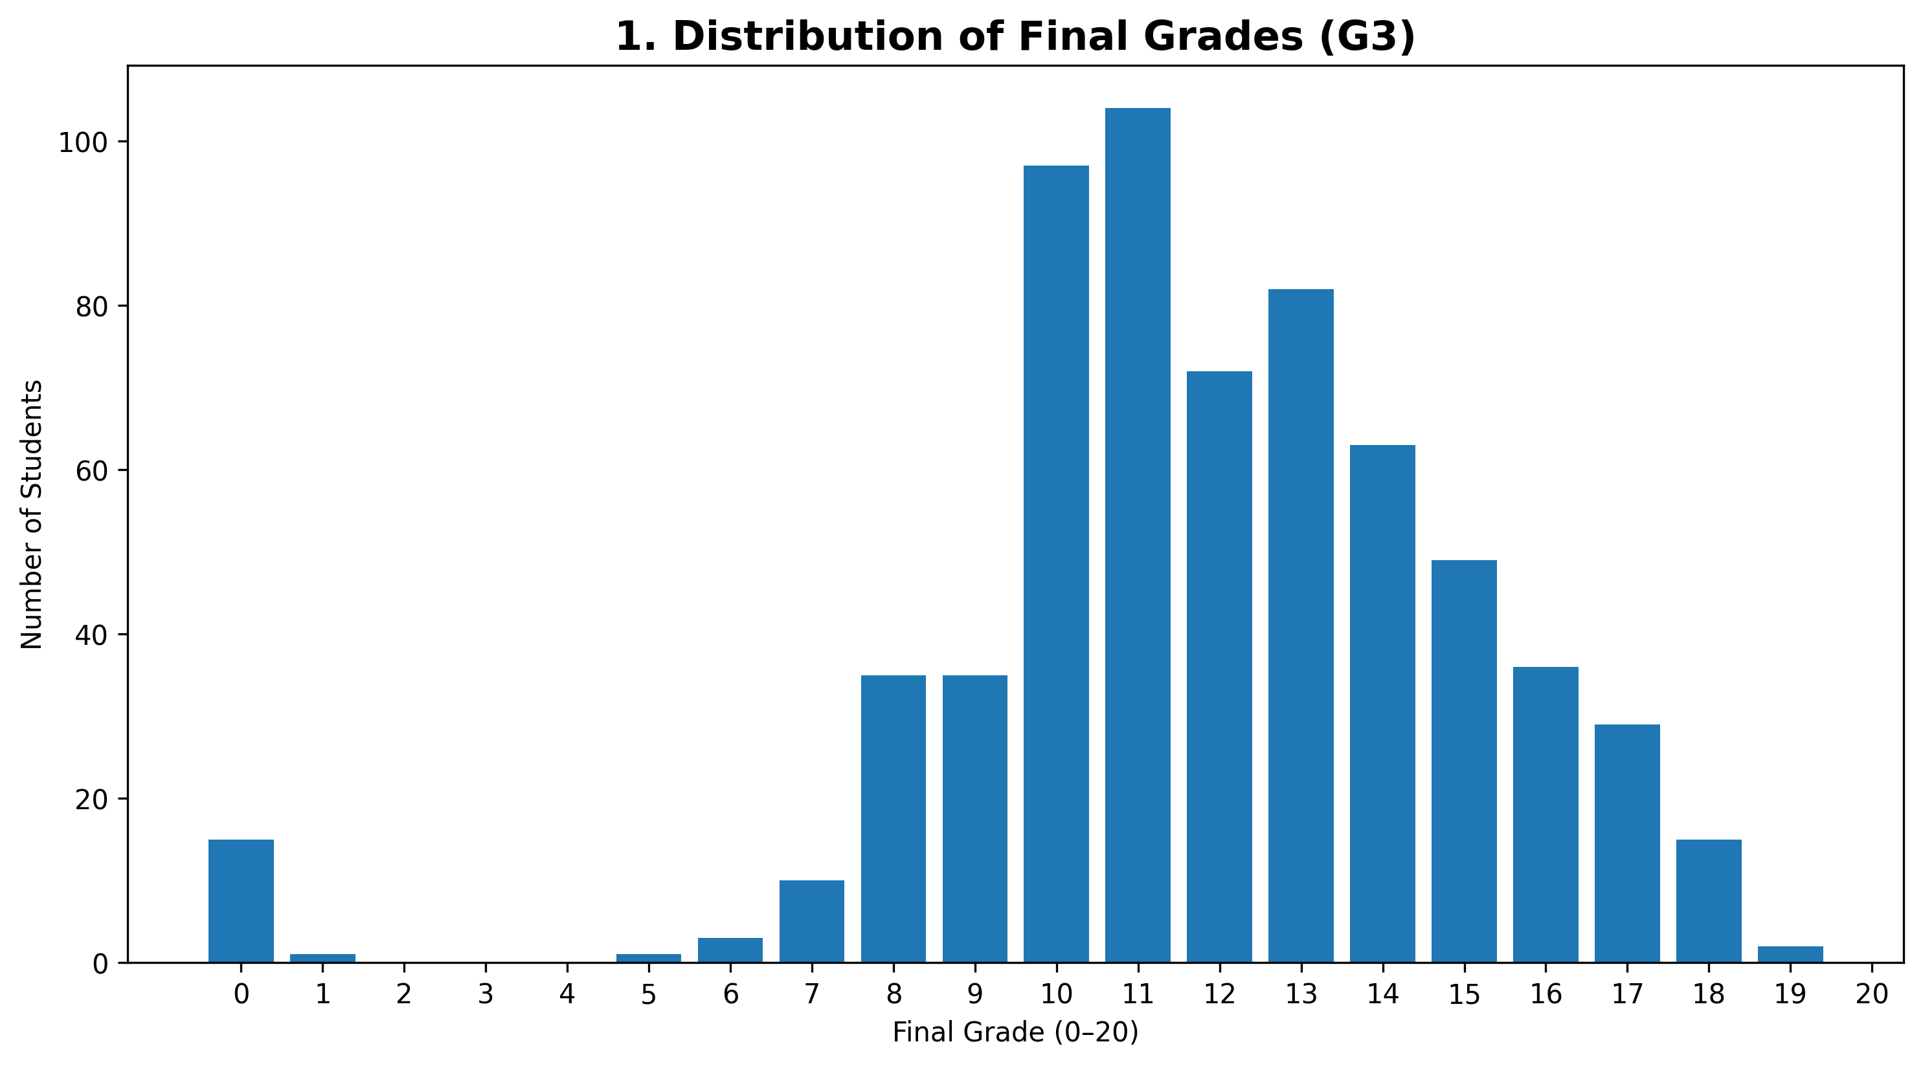
Introduction
Speaker: Samrat
Why academic performance prediction matters
Student performance is affected by academic history, study behavior, family context, and school-related factors.
Statistical modeling helps identify which factors have meaningful associations with final grades.
The goal is not to label students, but to support early awareness and better academic planning.
This project uses a real-world education dataset and keeps the focus on statistical explanation.
Project purpose
Analyze student data, develop hypotheses, build regression models, evaluate prediction quality, and demonstrate results through a simple Streamlit app.
Final grade is measured on a 0–20 scale
Samrat Jung Shahi: Introduction • Problem Statement • Literature Review
DATA 200 Applied Statistical Analysis | Team United
2

Slide 3
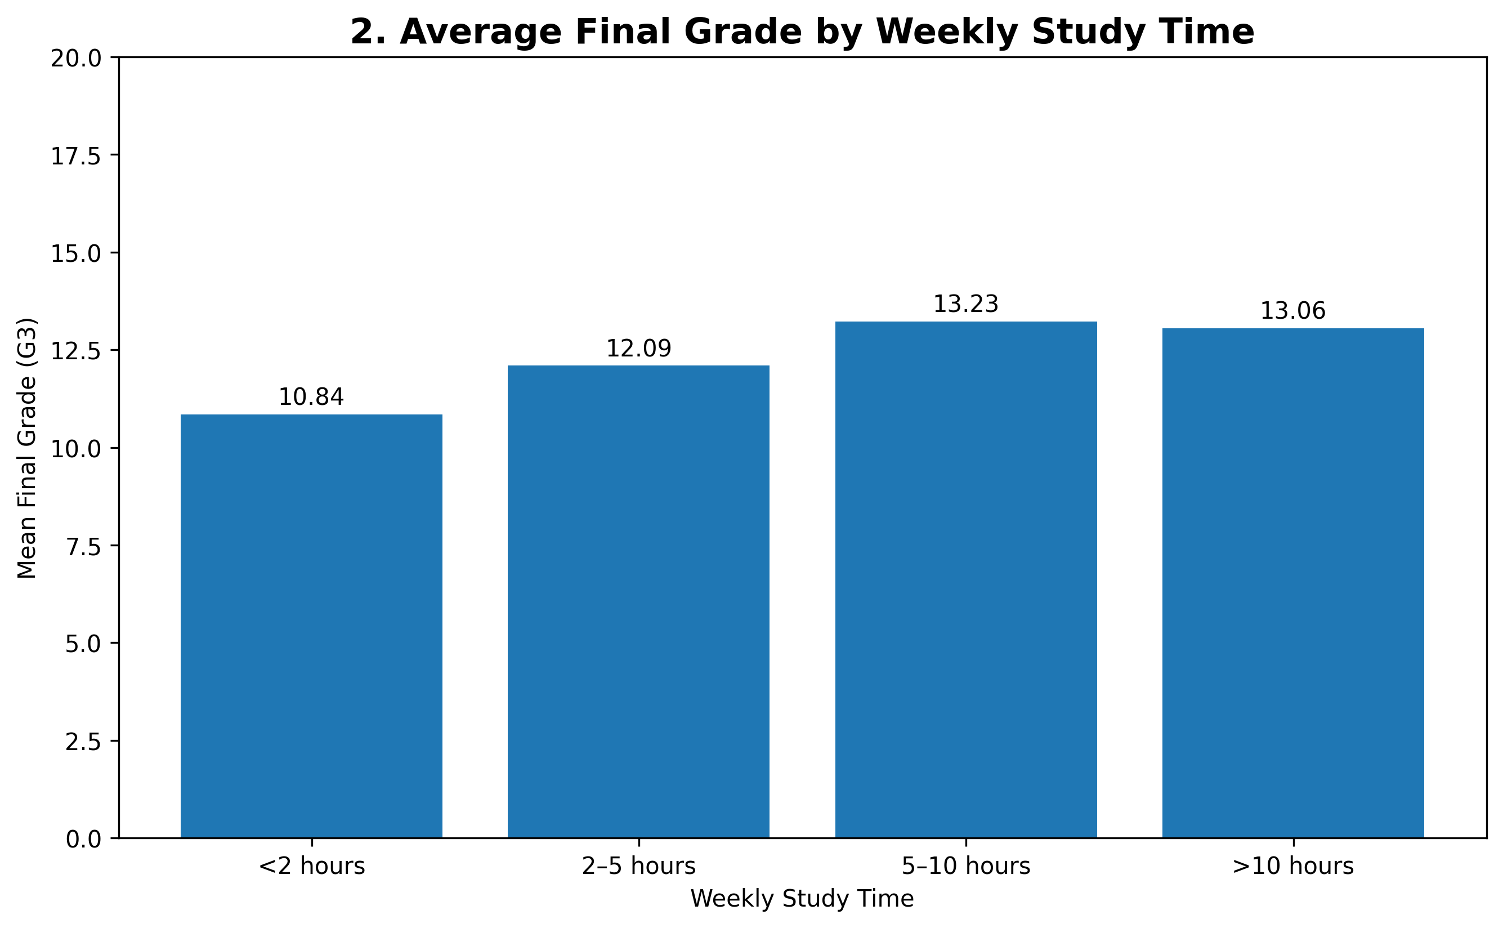
Problem Statement
Speaker: Samrat
Main question and research direction
Main research question
What academic, behavioral, family, and school-related factors are significantly associated with students’ final academic performance, and how accurately can Multiple Linear Regression predict a student’s final grade?
Is study time associated with final grade?
Do previous grades strongly predict final grade?
Are absences, failures, support, and internet access related to performance?
Which factors remain useful after controlling for other variables?
Statistical scope
Association and prediction only. We do not claim causation from this observational dataset.
Samrat Jung Shahi: Introduction • Problem Statement • Literature Review
DATA 200 Applied Statistical Analysis | Team United
3

Slide 4
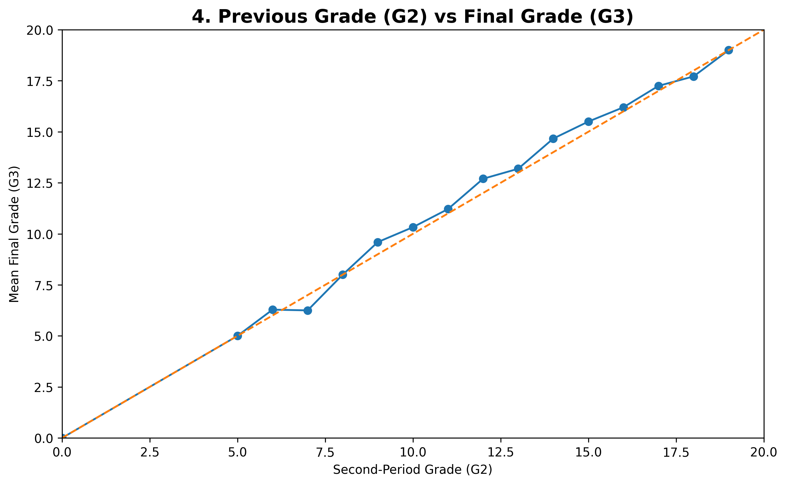
Literature Review
Speaker: Samrat
Related work supports using previous grades, behavior, and school variables
Cortez & Silva (2008)
Adhatrao et al. (2013)
Ramaswami & Bhaskaran (2010)
Predicted secondary school achievement using student demographic, social, school, and prior-grade variables. Their work directly supports our dataset and target variable design.
Used decision-tree methods to predict student performance from prior academic records. It shows why earlier performance can be one of the strongest predictors.
Used CHAID-based educational data mining to identify factors related to school performance, showing the importance of preprocessing and variable selection.
Literature synthesis
Prior studies show academic history is usually highly predictive.
Behavioral and family variables can add explanatory value.
Our project keeps the model interpretable by using regression and statistical tests.
Sources: Cortez & Silva, 2008; Adhatrao et al., 2013; Ramaswami & Bhaskaran, 2010.
Samrat Jung Shahi: Introduction • Problem Statement • Literature Review
DATA 200 Applied Statistical Analysis | Team United
4

Slide 5
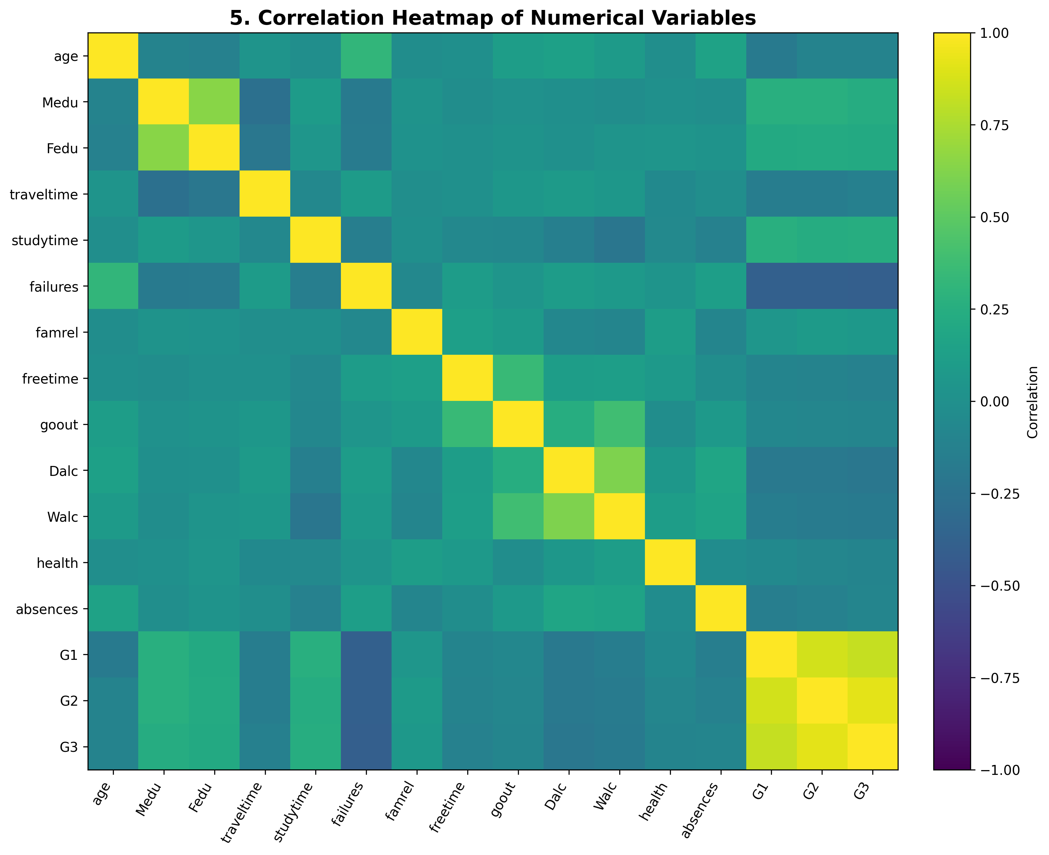
Dataset Selection
Speaker: Saksham
UCI Student Performance dataset: real, documented, and regression-ready
649
33
G3
0
student records
variables
final-grade target
missing values
Source: UCI Machine Learning Repository.
Records are from two Portuguese secondary schools.
Data includes demographic, family, school, behavioral, and grade variables.
The final grade, G3, is numerical, so Multiple Linear Regression is appropriate.
Key limitation
The dataset is observational. It supports statistical association and prediction, but not causal claims.
Source: UCI Machine Learning Repository, Student Performance dataset.
Saksham Smith Sunar: Dataset Selection • Data Cleaning • EDA Overview
DATA 200 Applied Statistical Analysis | Team United
5

Slide 6
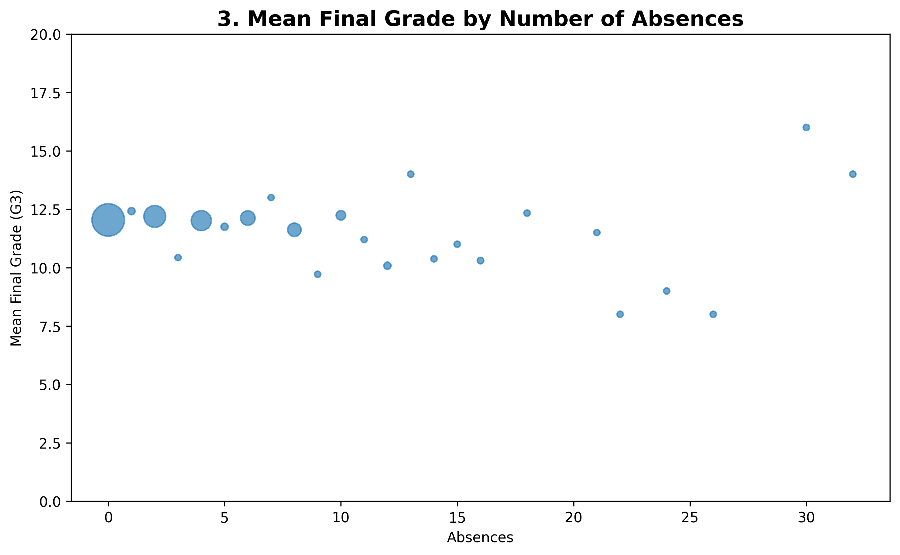
Data Cleaning Process
Speaker: Saksham
Validated quality before modeling
0
0
21
missing values
duplicate rows
absence outliers flagged
Loaded and inspected rows, columns, data types, and valid value ranges.
Checked missing values and exact duplicates before analysis.
Used the IQR method to flag unusual values, especially high absences.
Did not automatically remove outliers because unusual observations can still be valid student records.
Cleaning decision
Keep all valid records for the main analysis. Discuss unusual observations clearly in the limitations section.
Saksham Smith Sunar: Dataset Selection • Data Cleaning • EDA Overview
DATA 200 Applied Statistical Analysis | Team United
6

Slide 7
EDA: Performance Distribution and Study Patterns
Speaker: Saksham
Initial visual evidence from the actual dataset
Most final grades are concentrated around the middle of the 0–20 scale.
Average final grade tends to increase from very low study time to moderate/high study time.
Absences show a weaker and noisier relationship with final grade than previous grades or study time.
EDA caution
These charts show patterns and possible relationships. They do not prove cause-and-effect.
Saksham Smith Sunar: Dataset Selection • Data Cleaning • EDA Overview
DATA 200 Applied Statistical Analysis | Team United
7

Slide 8
EDA: Strongest Predictors
Speaker: Rishav
Previous grades dominate simple relationships with final grade
Main EDA insight
G2 and G1 have the strongest simple correlations with G3. This is why we compare an explanatory model without previous grades against a predictive model with previous grades.
Rishav Yadav: Strongest Predictors • Group Comparisons • Context Variables
DATA 200 Applied Statistical Analysis | Team United
8

Slide 9
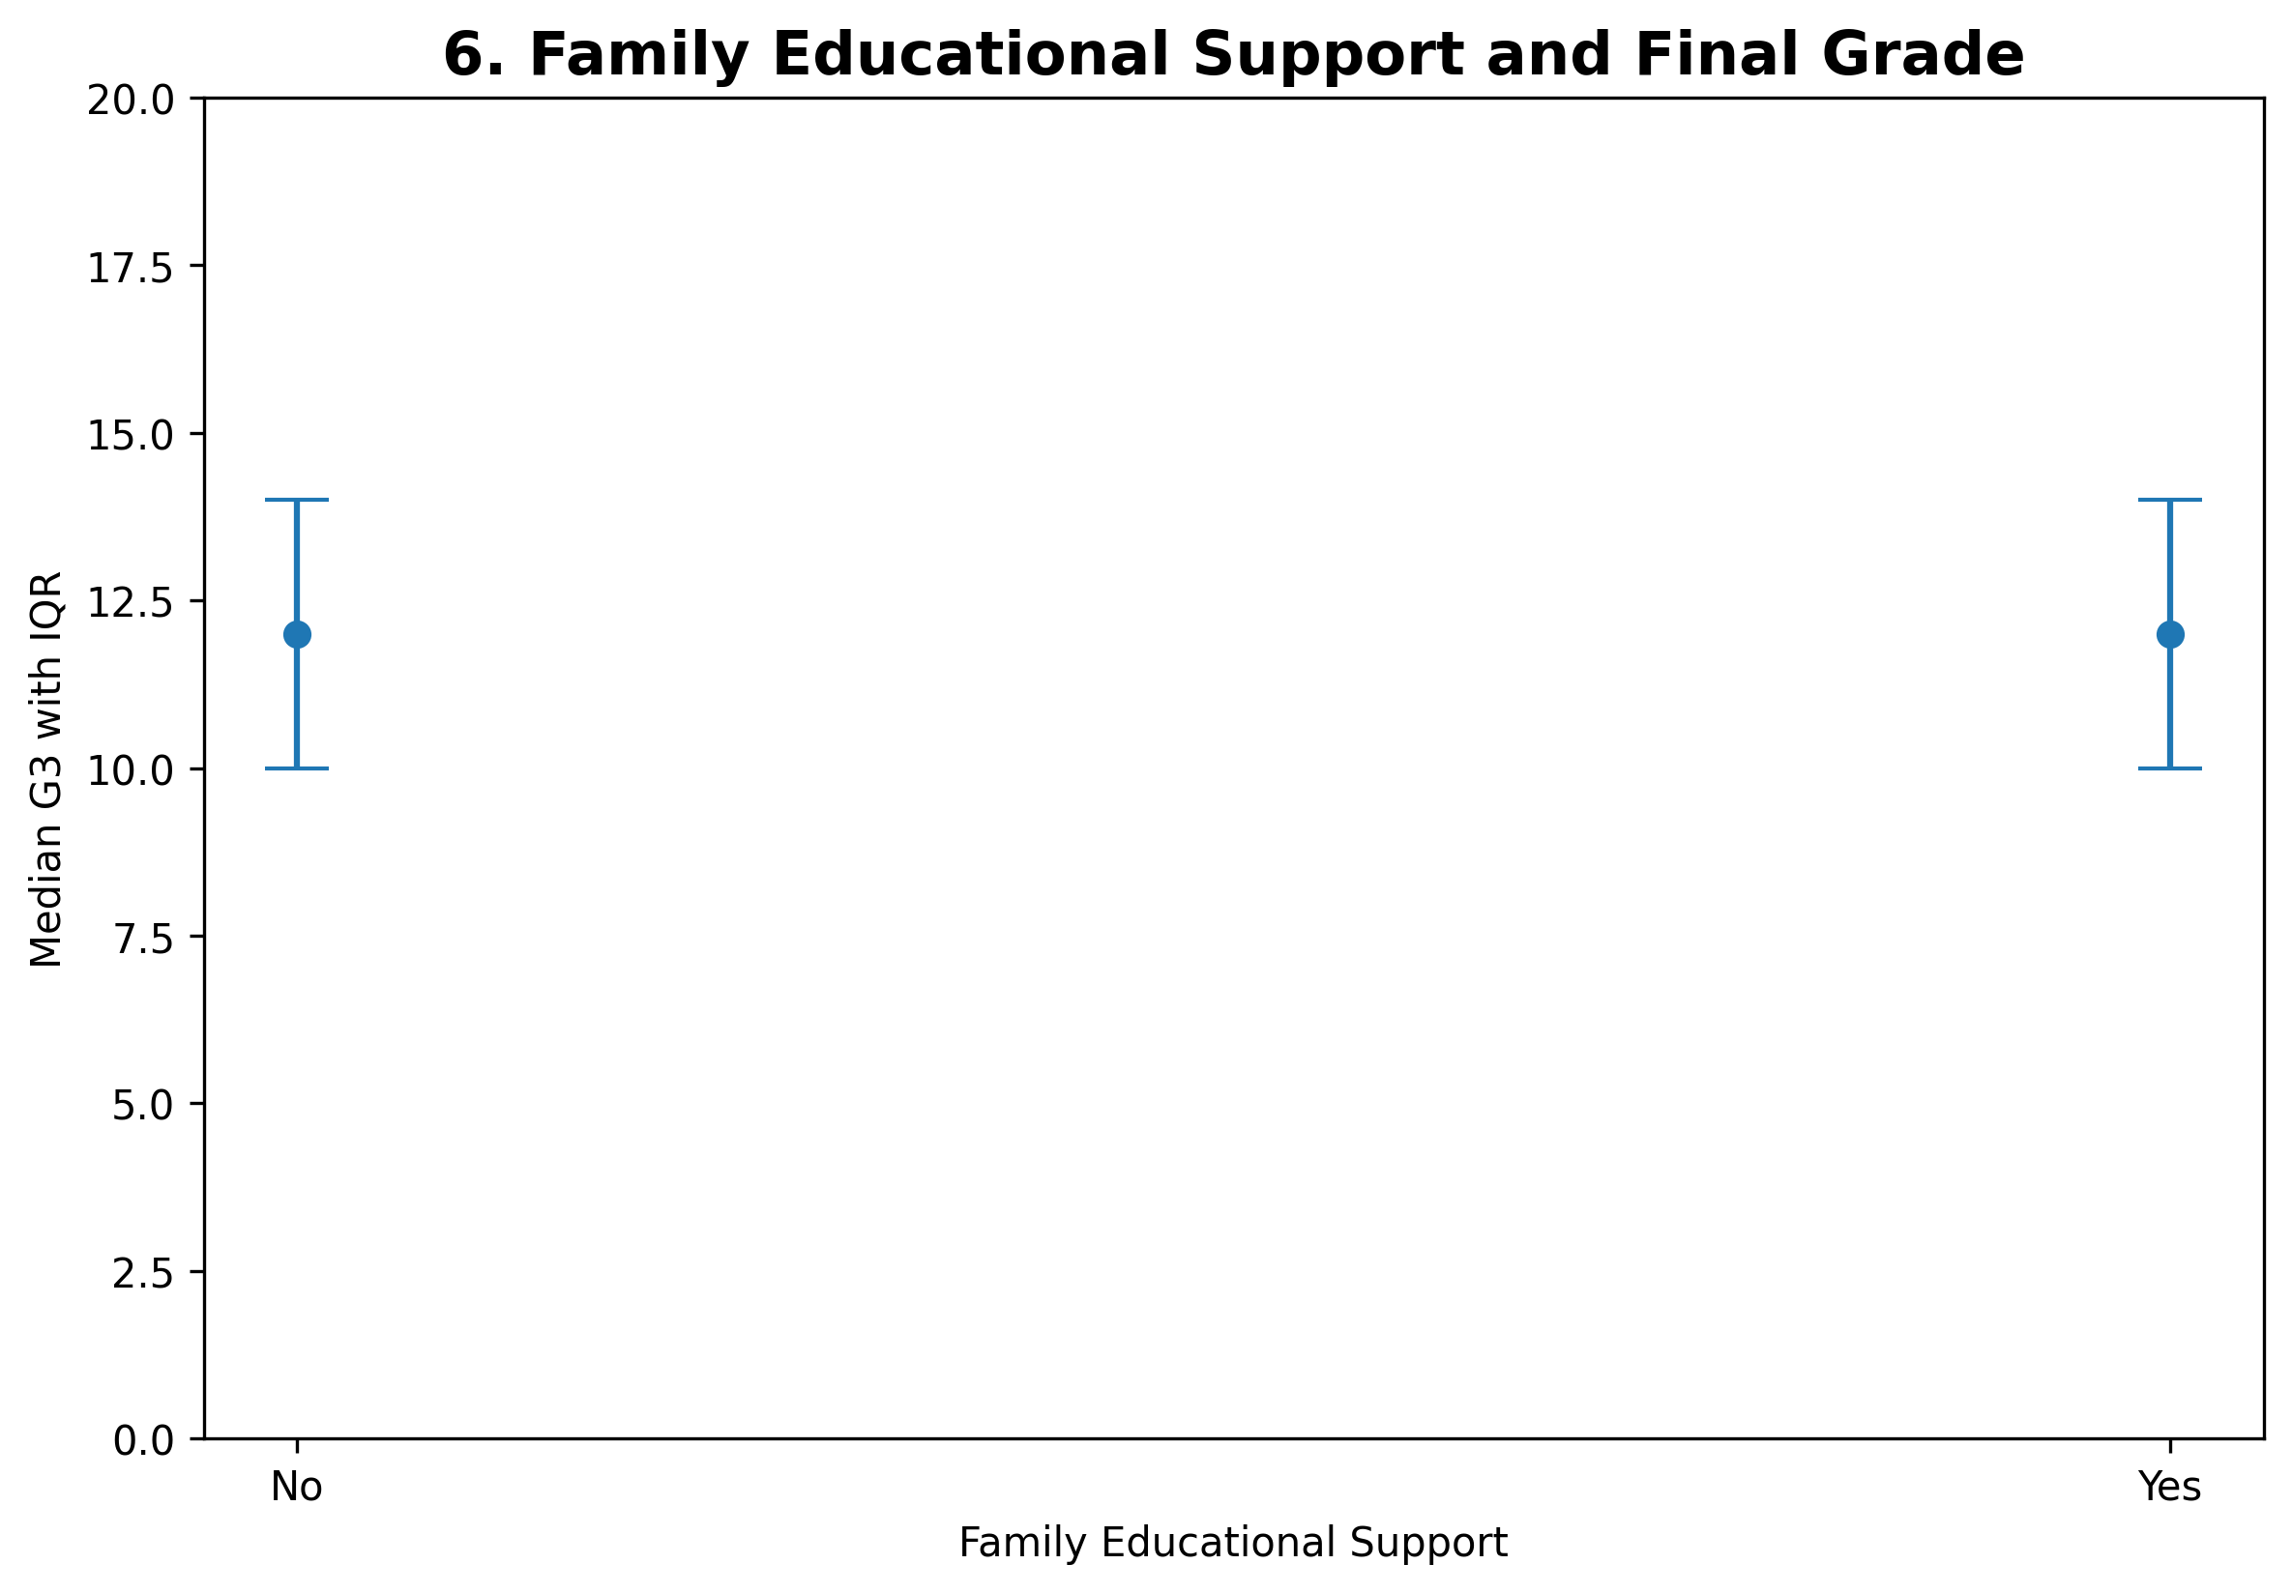
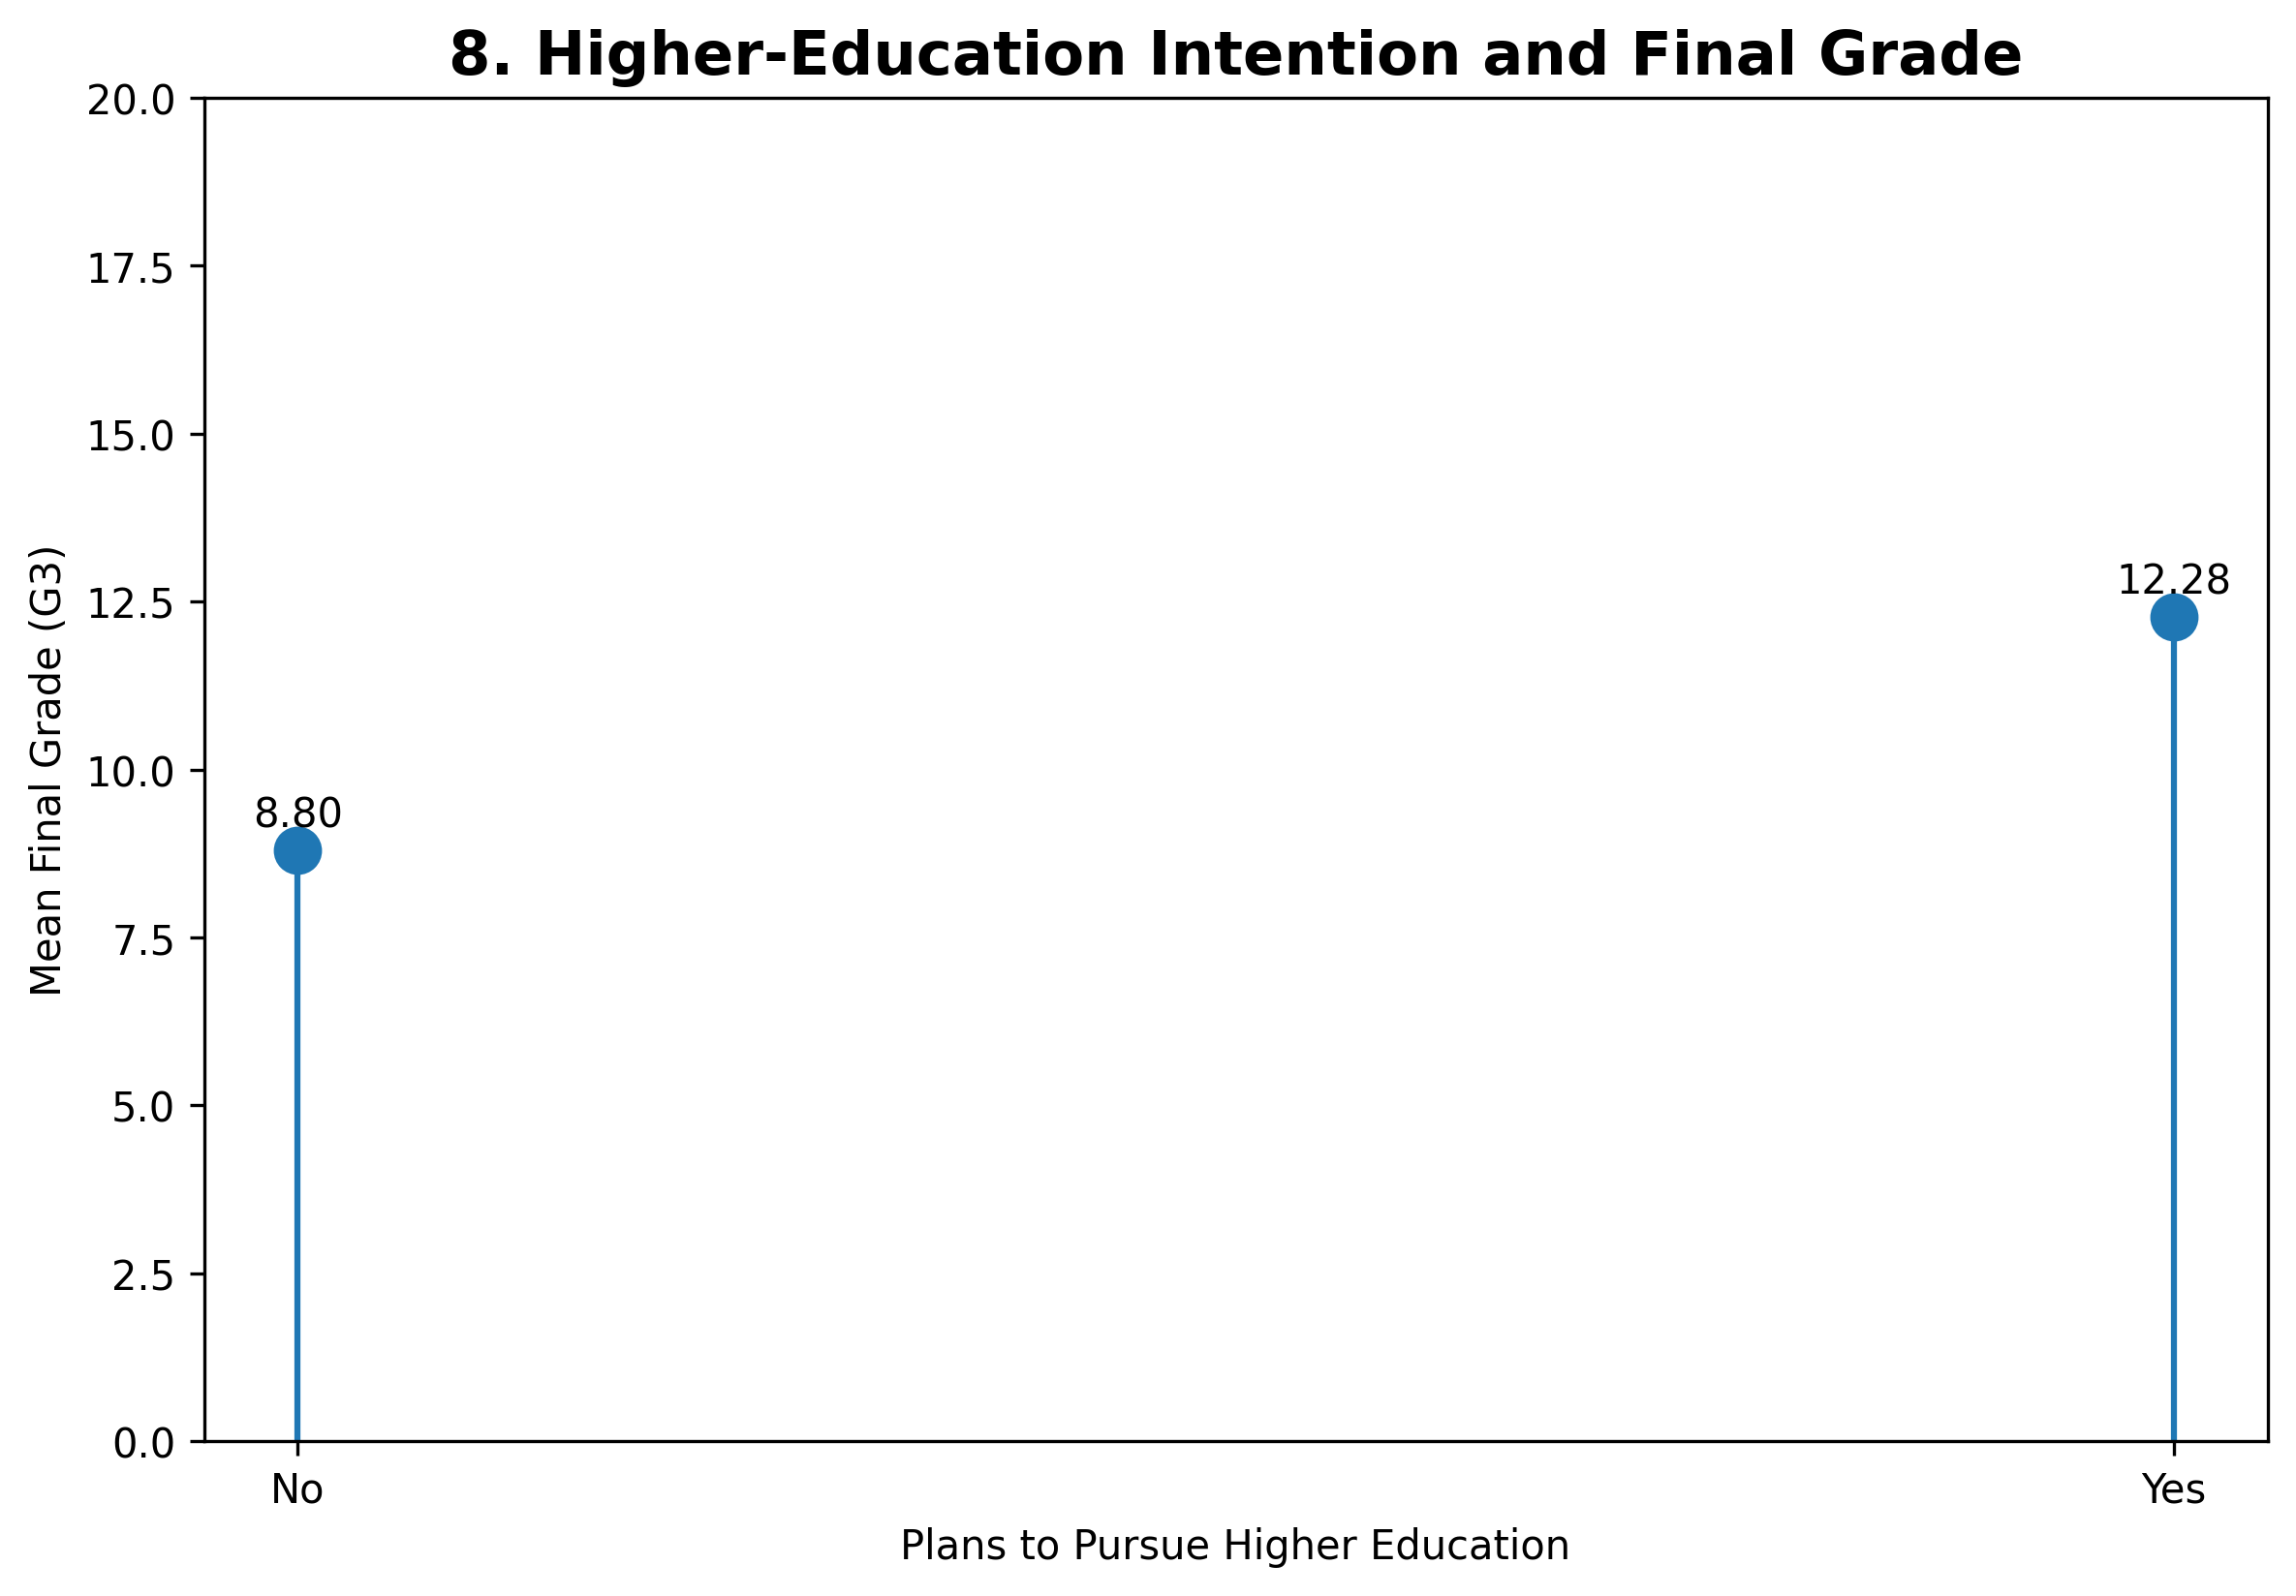
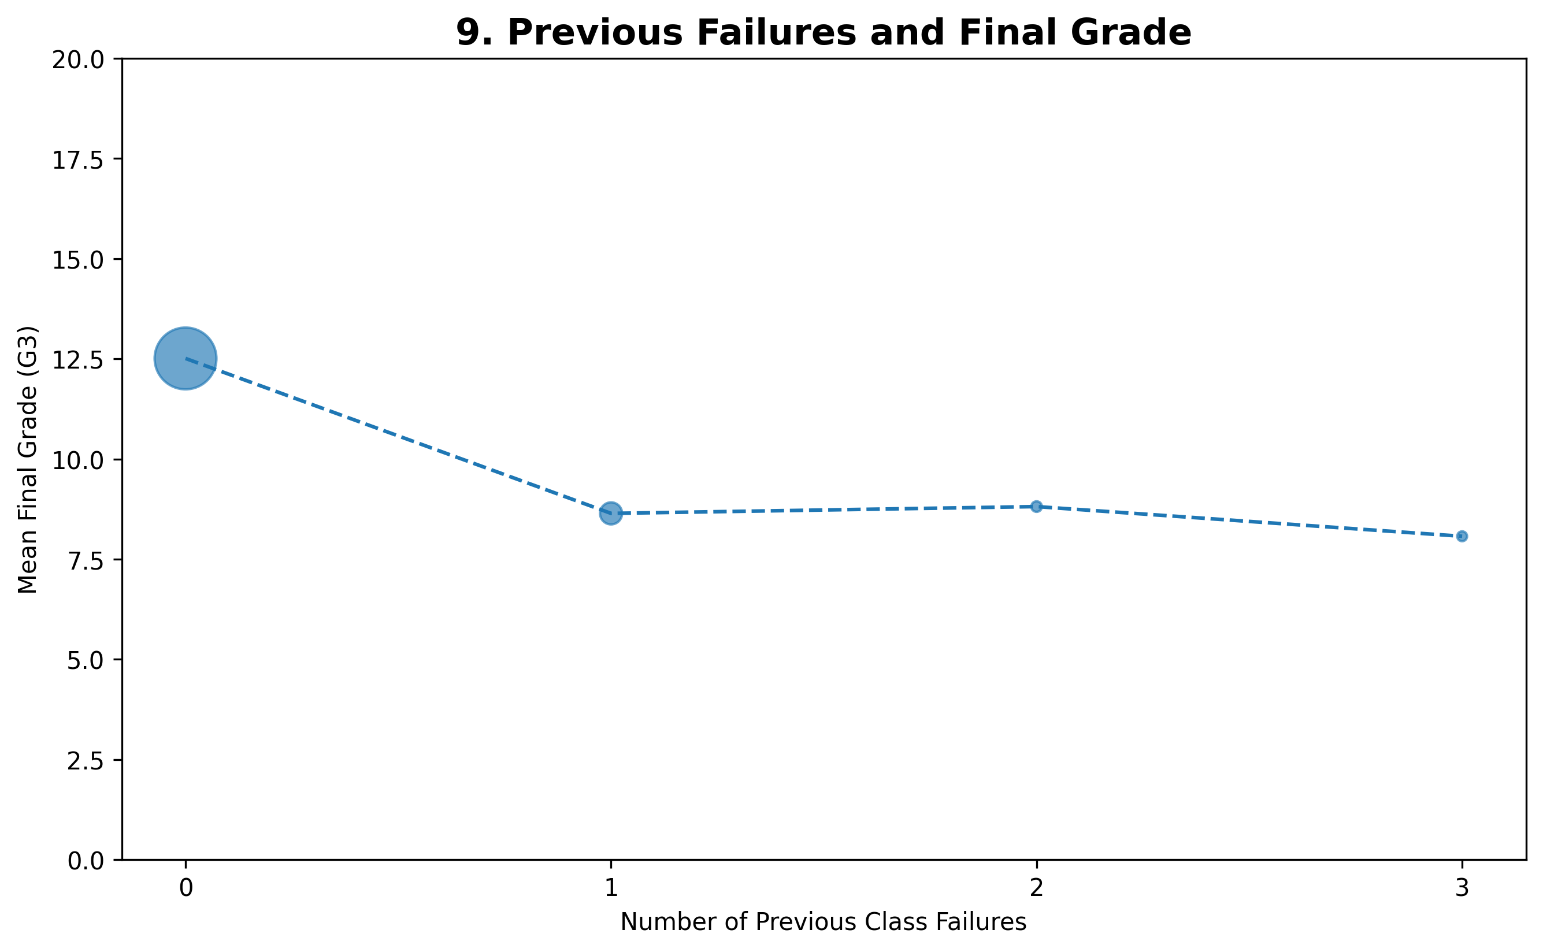
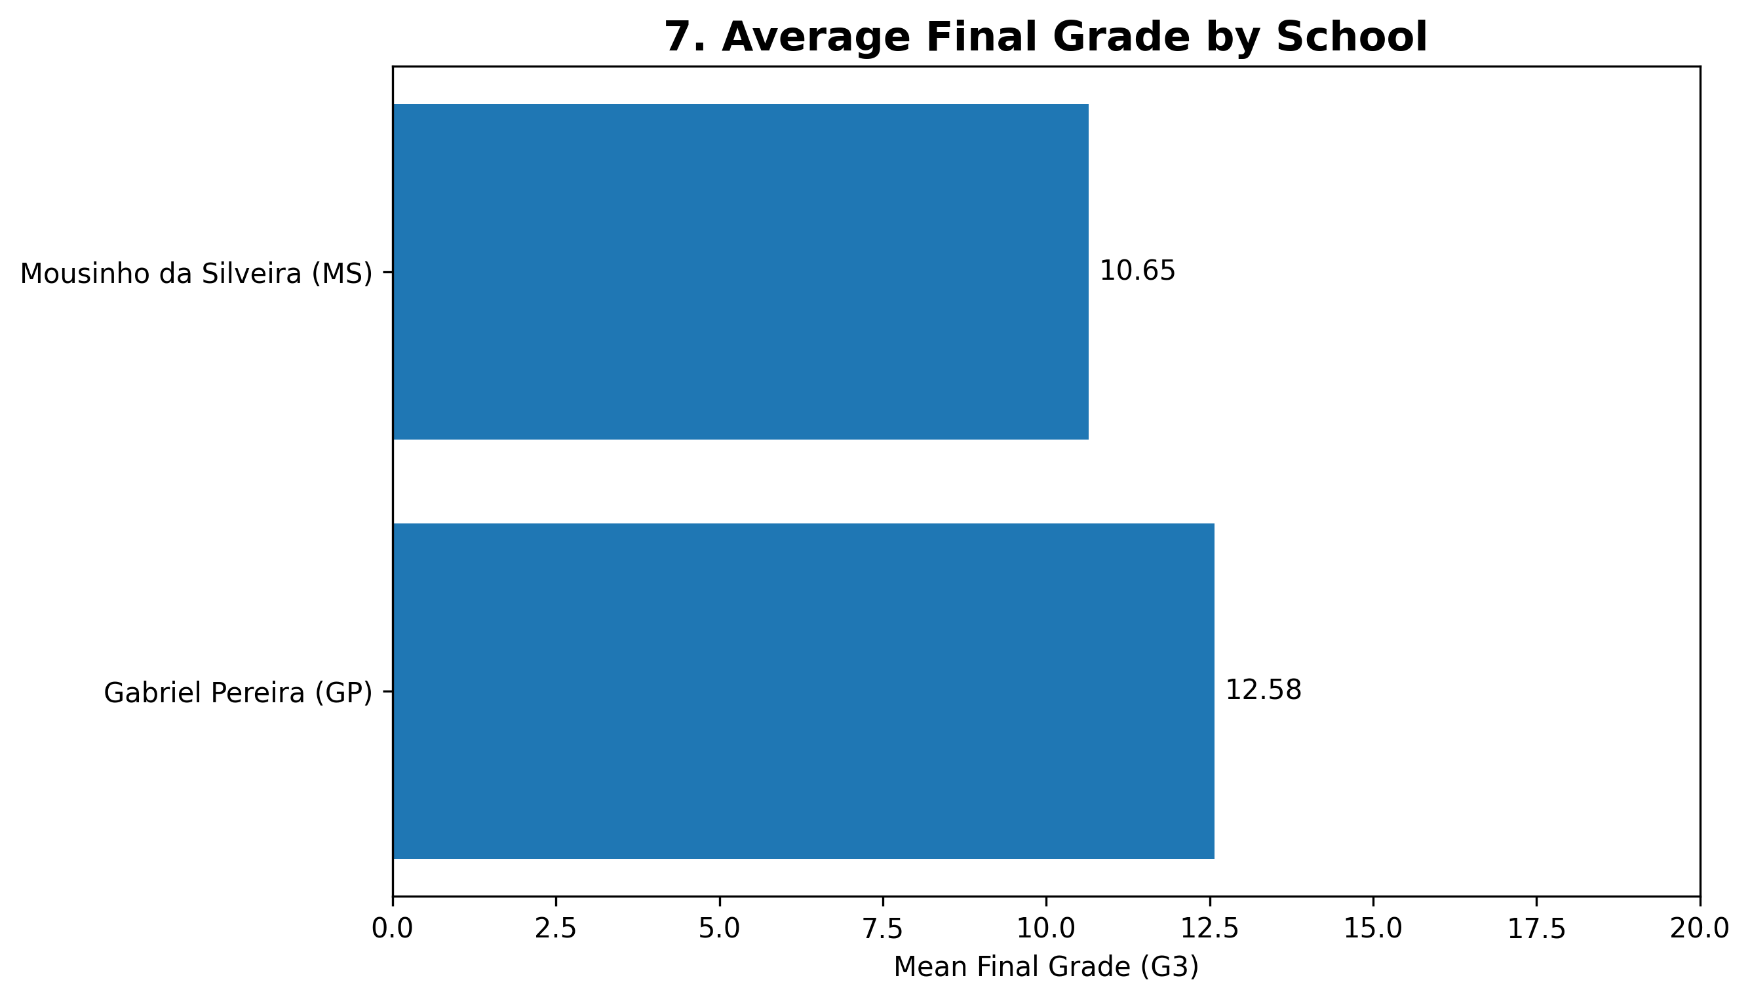
EDA: Group Comparisons
Speaker: Rishav
Differences appear across support, school, future plans, and prior failures
Students planning higher education show a much higher average final grade than those who do not.
Prior failures are associated with lower average final grades.
School and family support can be tested as categorical predictors using dummy variables or group tests.
Method link
These visuals support ANOVA/t-test comparisons and help decide which categorical variables belong in the regression model.
Rishav Yadav: Strongest Predictors • Group Comparisons • Context Variables
DATA 200 Applied Statistical Analysis | Team United
9

Slide 10
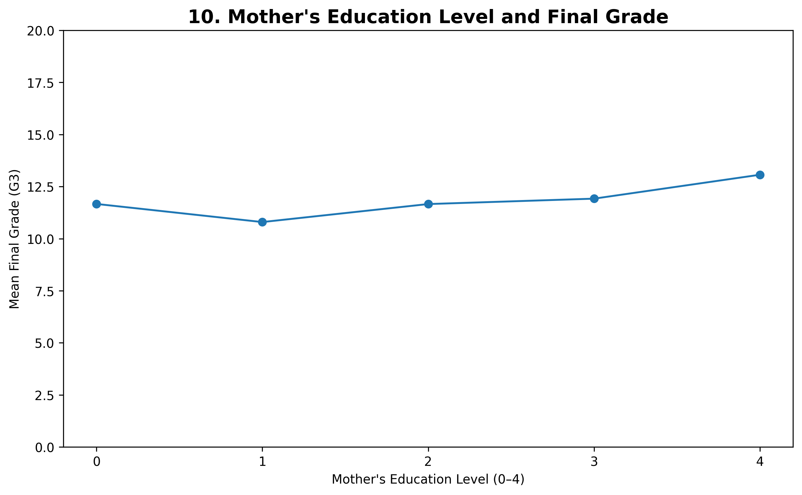
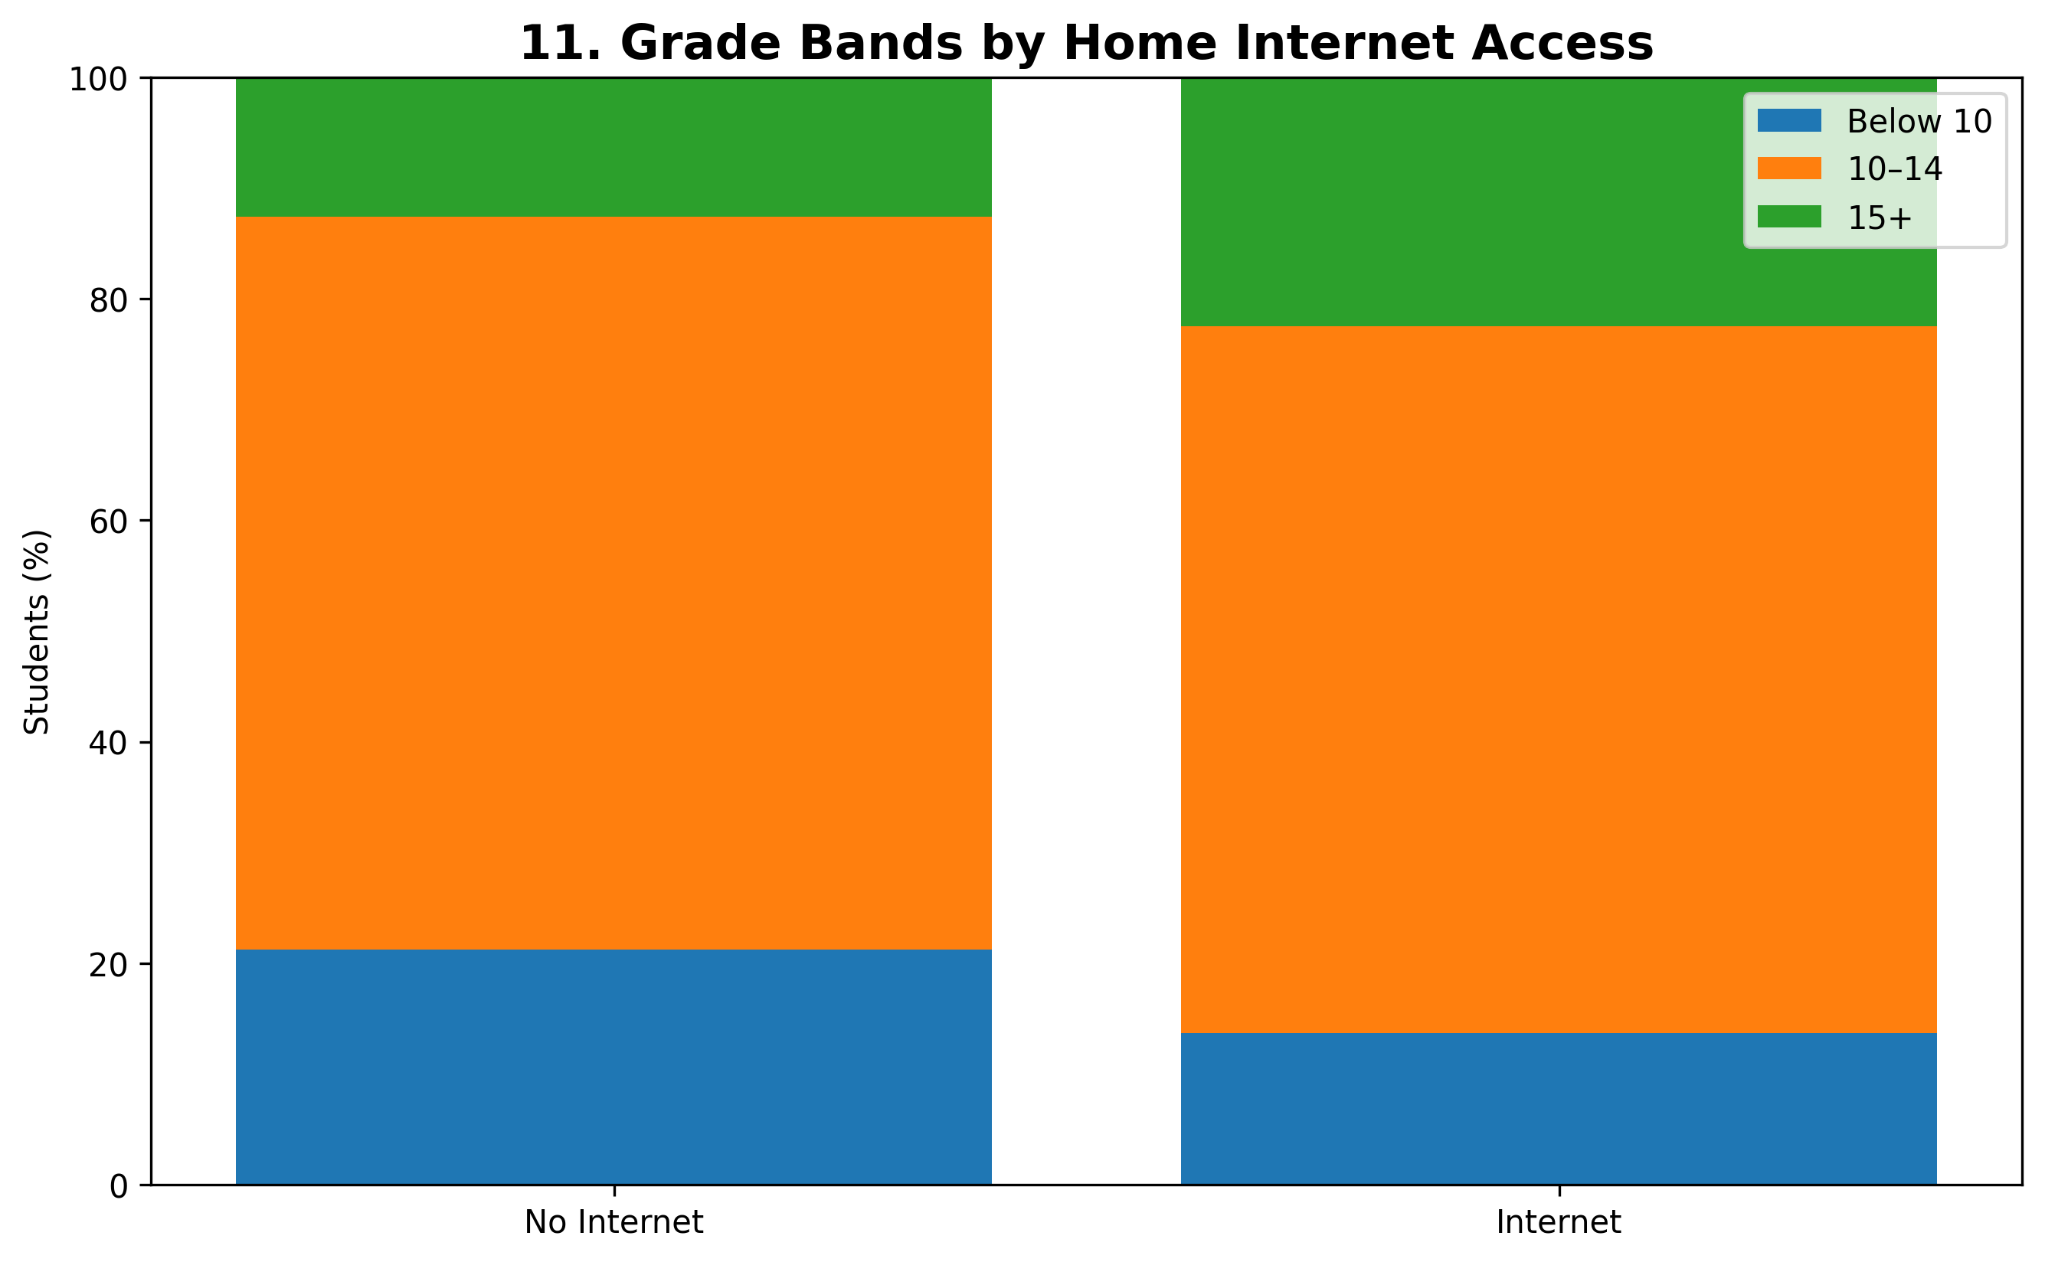
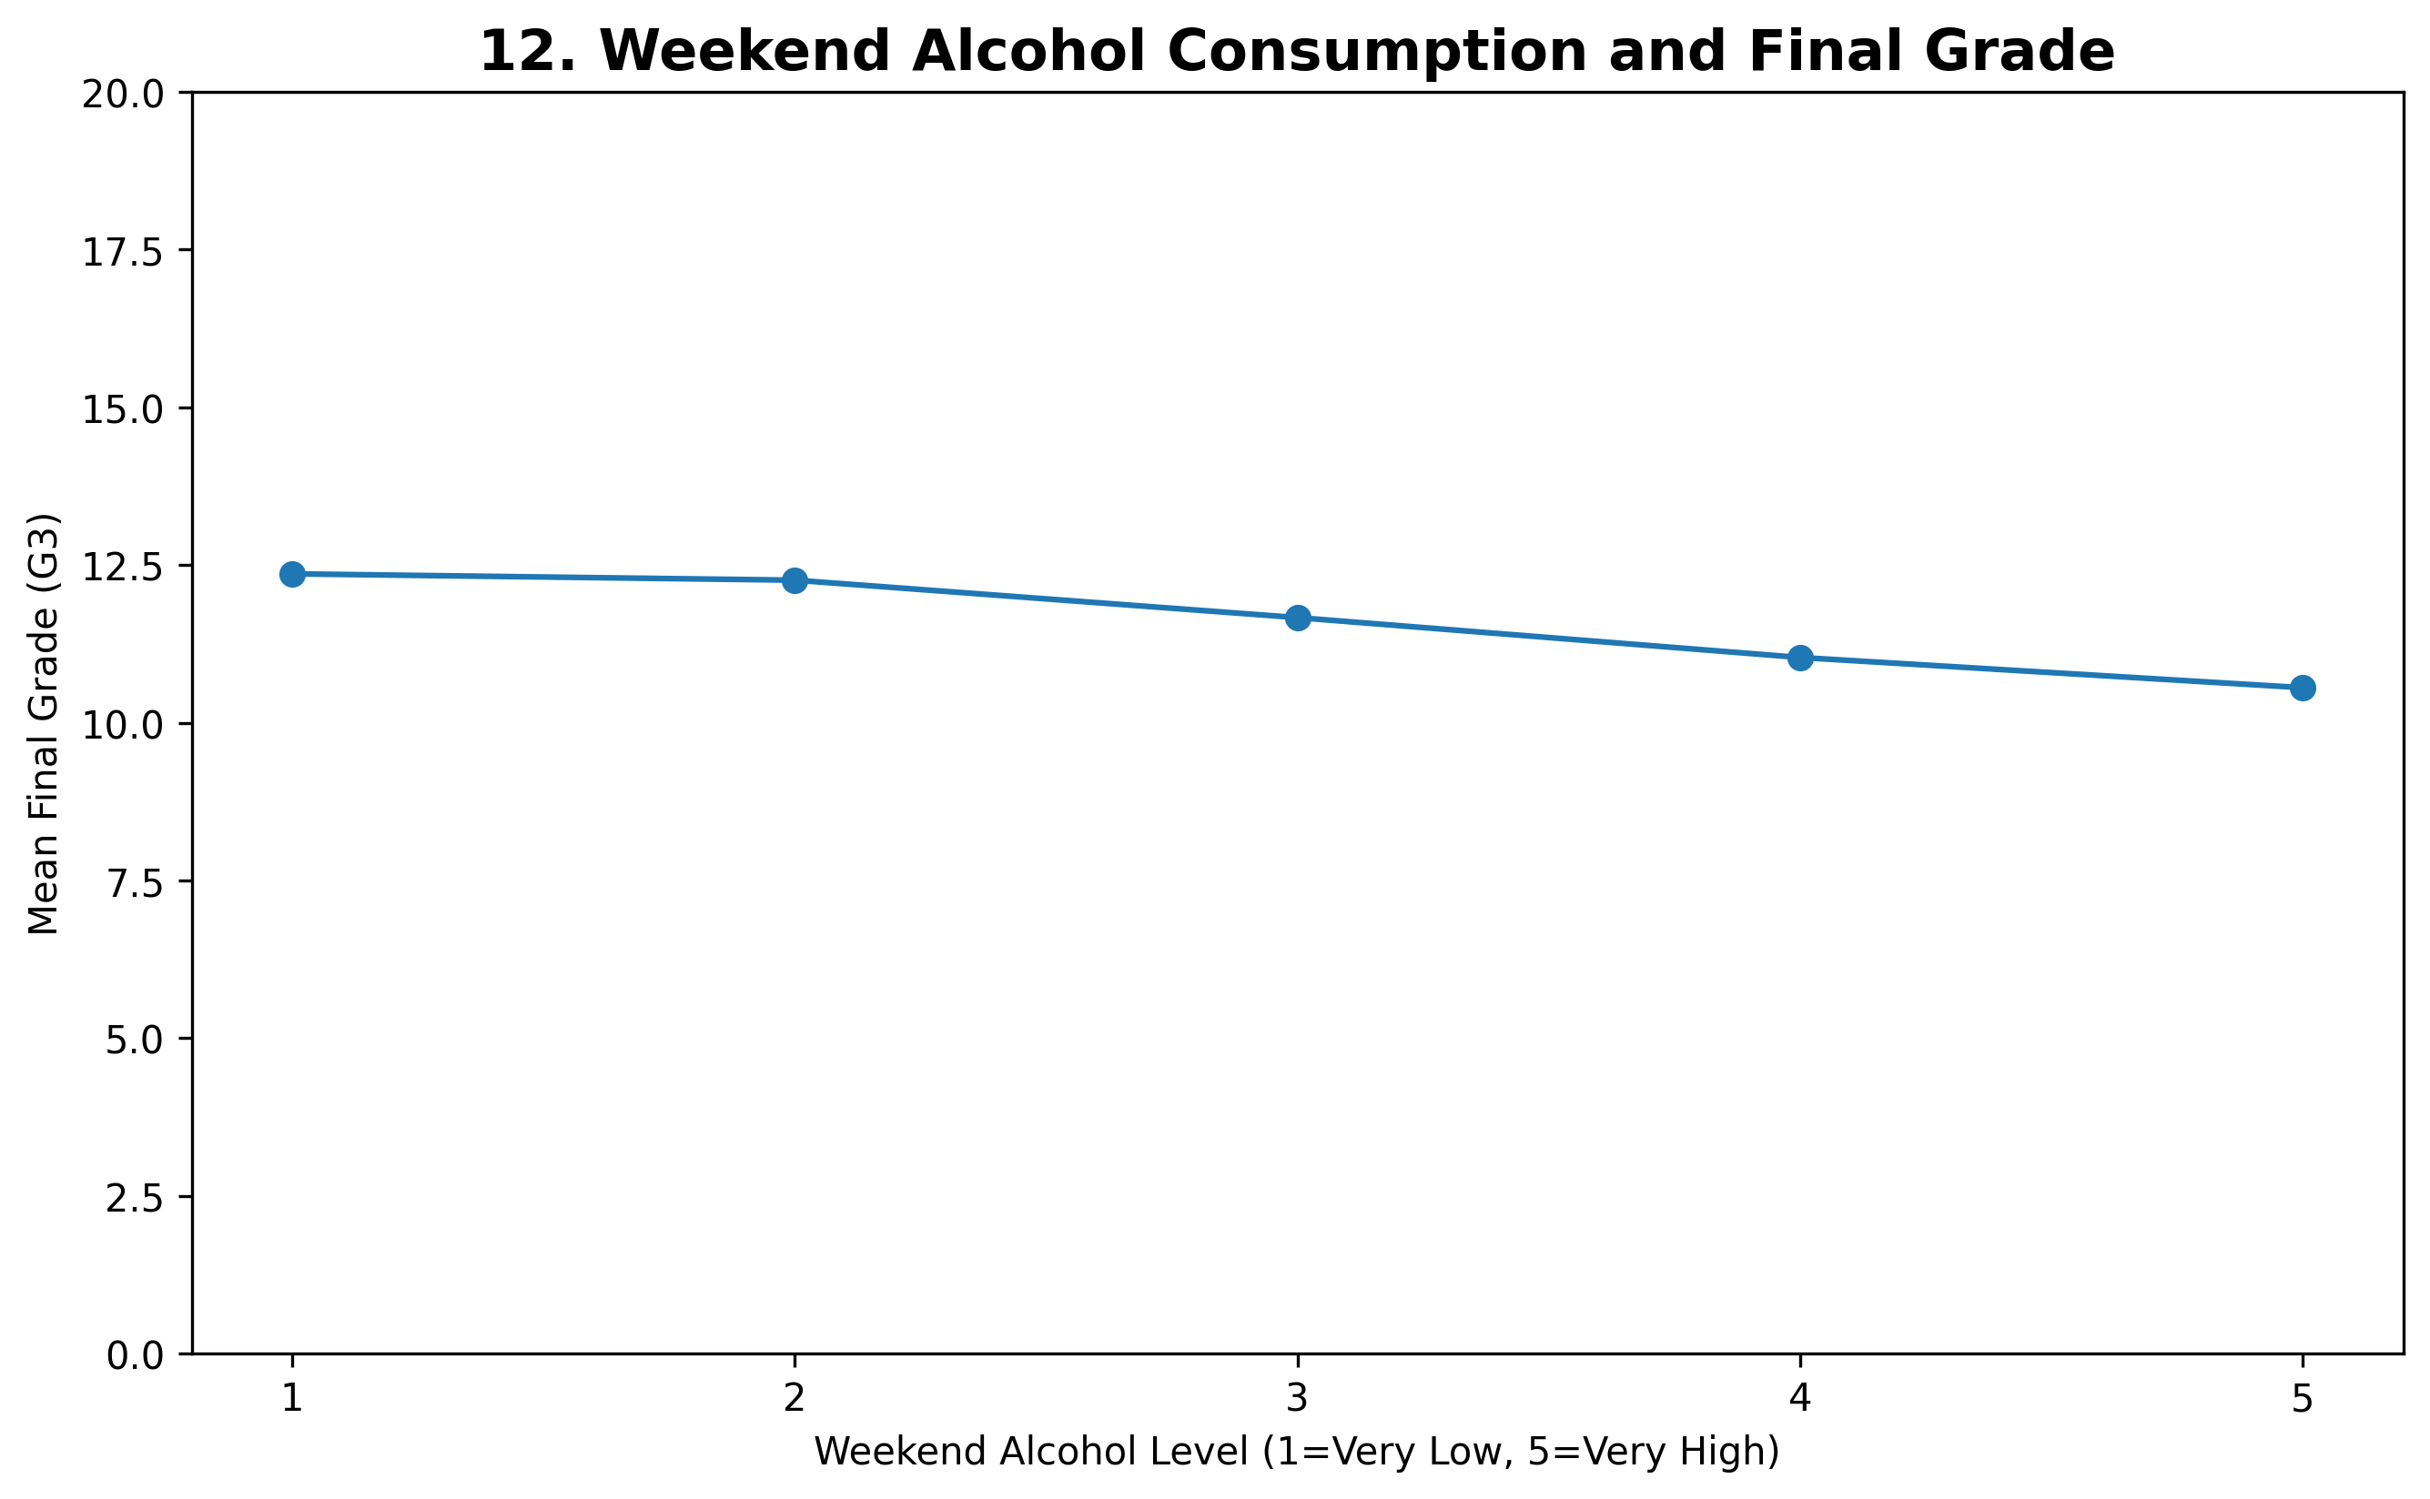
EDA: Family and Lifestyle Context
Speaker: Rishav
Context variables add interpretation beyond test scores
Mother’s education level shows a generally positive pattern with final grade.
Home internet access is associated with different grade-band distributions.
Higher weekend alcohol level shows lower average final grade in the visual trend.
Interpretation
These variables are useful for explanation, but they should be interpreted carefully because they may be connected to other social and academic factors.
Rishav Yadav: Strongest Predictors • Group Comparisons • Context Variables
DATA 200 Applied Statistical Analysis | Team United
10

Slide 11
Modeling: Why Multiple Linear Regression?
Speaker: Aryan
G3 is numerical, so regression fits the project objective
The target variable, G3, is a numeric final grade from 0 to 20.
Multiple Linear Regression estimates how predictors relate to G3 while controlling for other variables.
Statsmodels provides coefficients, standard errors, t-values, p-values, confidence intervals, R², and adjusted R².
Scikit-learn is used separately for train/test prediction evaluation.
Model A: Explanatory
Excludes G1 and G2. Focuses on academic, family, behavioral, and school-related factors.
Model B: Predictive
Includes G1 and G2. Focuses on prediction when previous performance is already known.
Regression equation
G3 = β₀ + β₁(StudyTime) + β₂(Failures) + β₃(Absences) + β₄(Parent Education) + … + ε
Assumptions to check
Linearity, independence, residual normality, homoscedasticity, and multicollinearity using VIF.
Aryan Shrestha: Modeling • Evaluation Metrics • Streamlit Demo
DATA 200 Applied Statistical Analysis | Team United
11

Slide 12
Evaluation Metrics
Speaker: Aryan
How we judge statistical fit and predictive performance
R²
Adj. R²
MAE
RMSE
p-value
VIF
variation explained
penalizes extra predictors
average grade-point error
penalizes larger errors
statistical significance
multicollinearity check
Use p-values and confidence intervals for inference: which predictors are statistically significant?
Use R² and adjusted R² to explain overall model fit.
Use MAE and RMSE on a train/test split to evaluate prediction error in grade points.
Use residual plots and Q-Q plots to check whether model assumptions are reasonable.
Compare Model A and Model B to show the difference between explanatory modeling and predictive modeling.
Reporting rule
We will report only values generated from the actual dataset in Colab. We will not invent coefficients, p-values, or performance scores.
Aryan Shrestha: Modeling • Evaluation Metrics • Streamlit Demo
DATA 200 Applied Statistical Analysis | Team United
12

Slide 13
Streamlit Application Demo
Speaker: Aryan
A simple local app for exploring data and making grade predictions
Student Academic Performance Prediction
App sections
Home • Dataset • EDA • Statistical Analysis • Prediction • Model Performance • About
Study time
2–5 hours
Failures
0
Users can view the dataset and descriptive statistics.
Users can interact with EDA charts and categorical comparisons.
The app displays regression results, p-values, R², MAE, RMSE, and diagnostic plots.
The prediction page estimates G3 from user-selected student characteristics.
The app is designed for a short 1–2 minute final presentation demo.
Absences
4
Internet
Yes
Family support
Yes
G1 / G2
12 / 13
Predicted Final Grade: generated by model
Run locally: pip install -r requirements.txt → streamlit run app.py
References: UCI Student Performance dataset; Cortez & Silva (2008); Adhatrao et al. (2013); Ramaswami & Bhaskaran (2010).
Aryan Shrestha: Modeling • Evaluation Metrics • Streamlit Demo
DATA 200 Applied Statistical Analysis | Team United
13

