Slide 1
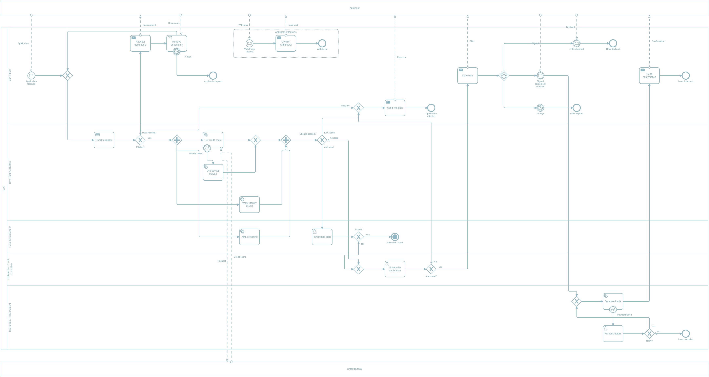



Loan Origination & Approval System
ASSIGNMENT 3
From application to disbursement, with every point where it can stop
Notes:
Introduce the assignment: a bank processes a loan application through checks, underwriting, the offer and disbursement. The question asks us to show every point where an application can stall, be rejected or be cancelled.

Slide 2

The question
01
What happens
A bank checks documents and identity, assesses credit, underwrites, makes an offer and pays out the loan.
Starts
An applicant submits an application with documents
Ends
Disbursed, rejected, withdrawn or lapsed
Failure areas to cover
Documents & identity
Fraud, AML, sanctions
Credit bureau down
Credit outcomes
Timeouts & withdrawal
Disbursement failures
Notes:
The question: a bank handles personal and secured loans through document checks, identity verification, credit assessment, underwriting, the offer and disbursement. It starts when the application arrives and ends when the loan is disbursed, or the application is rejected, withdrawn or lapsed. The pills list the failure areas we had to cover.

Slide 3
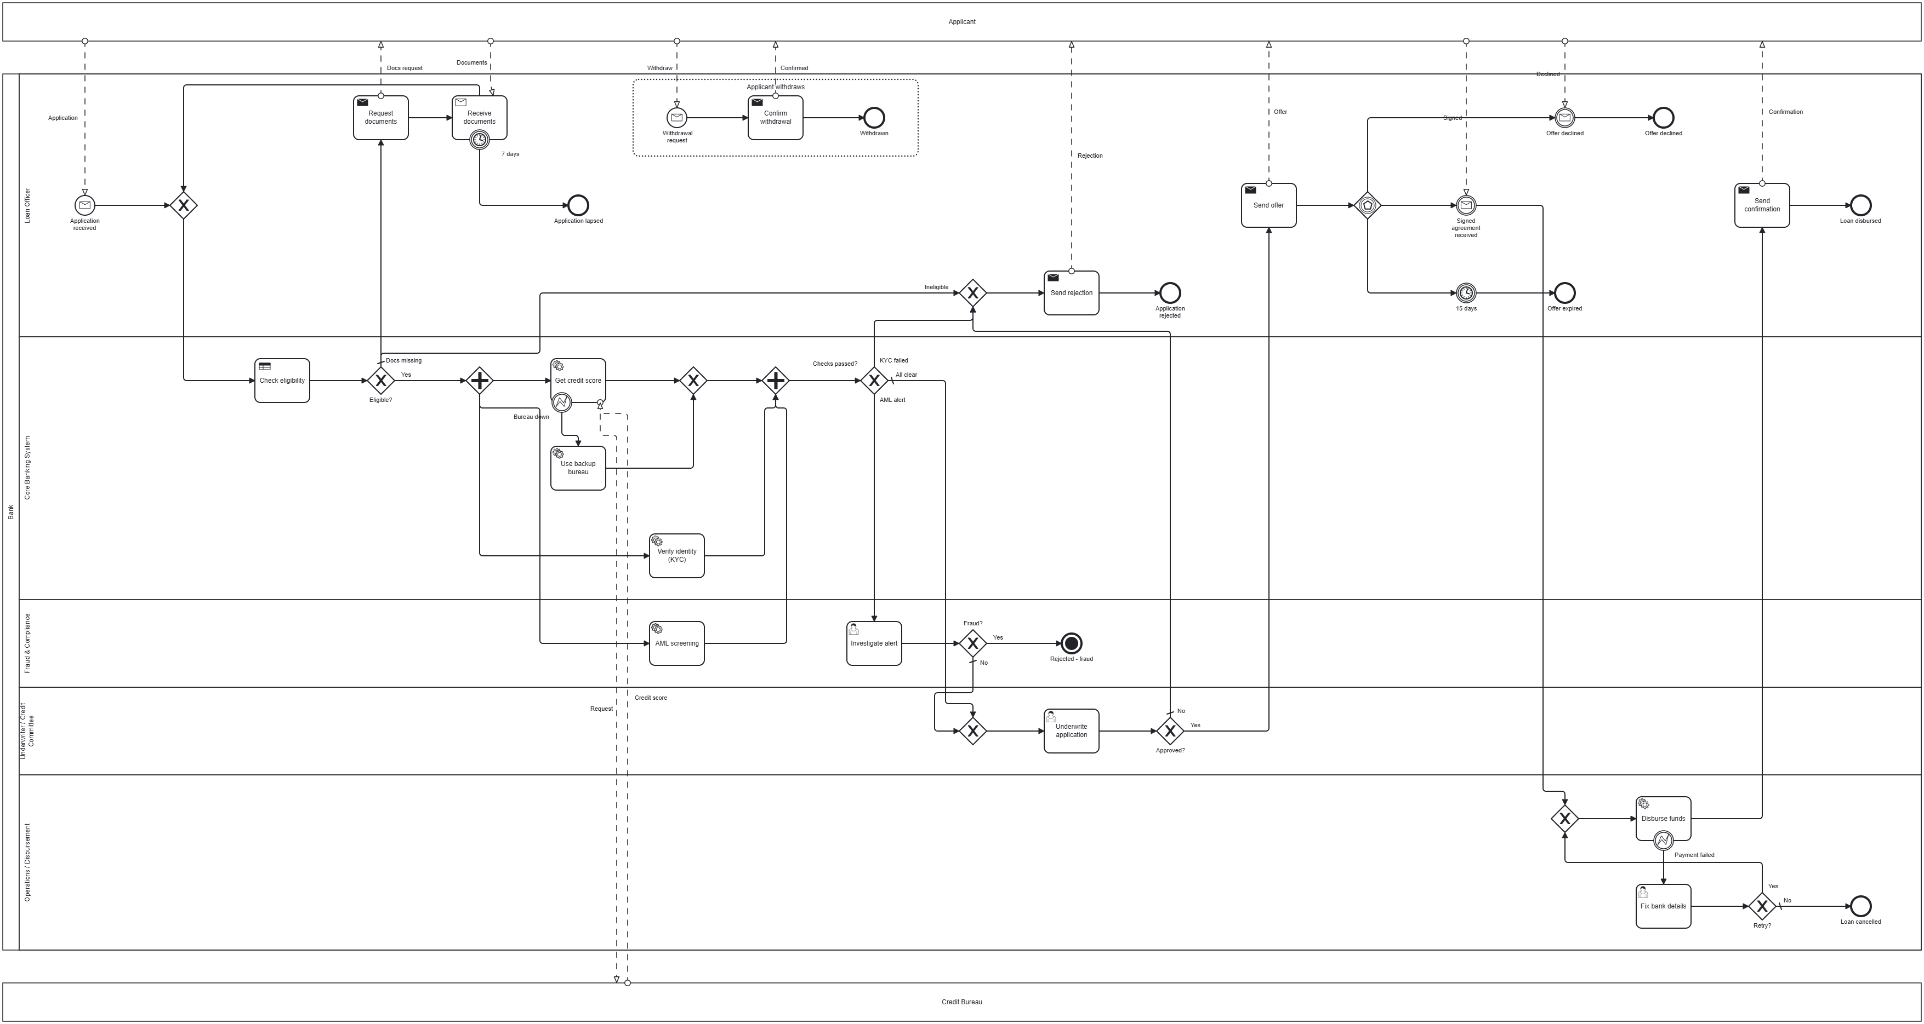
The process
02
Notes:
The full diagram. Applicant and Credit Bureau are external pools; the bank has five lanes. The dotted box at the top is the withdrawal event sub-process.

Slide 4




Task types
03
Business rule
Check eligibility
DMN table decides
User
Investigate alert, Underwrite, Fix bank details
a person decides
Service
Credit score, backup bureau, KYC, AML, Disburse
system / API call
Send
Request documents, offer, rejection, confirmation
message to applicant
Receive
Receive documents
waits, 7-day timer
Notes:
Five task types, each with its BPMN marker. Check eligibility is a business rule task that uses a DMN table. The three user tasks need human judgement and have forms. Service tasks are automated calls: credit score, backup bureau, KYC, AML and disbursement. Send tasks send messages to the applicant, and Receive documents waits for the applicant with a seven-day timer.

Slide 5
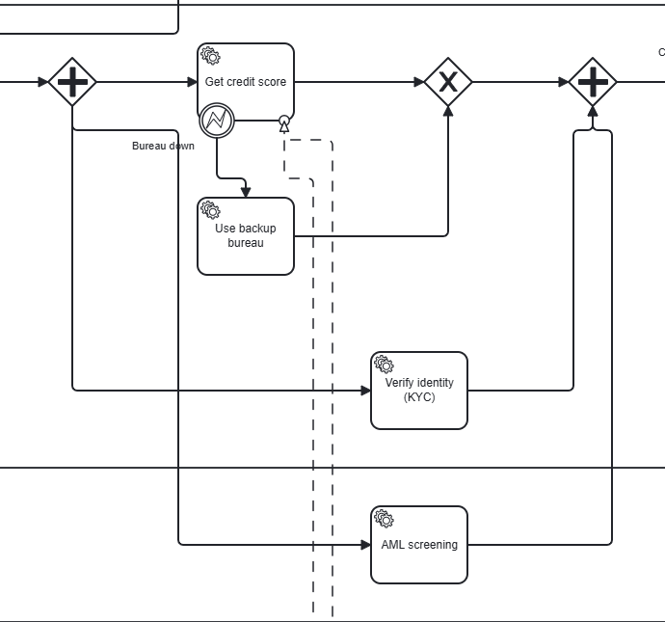
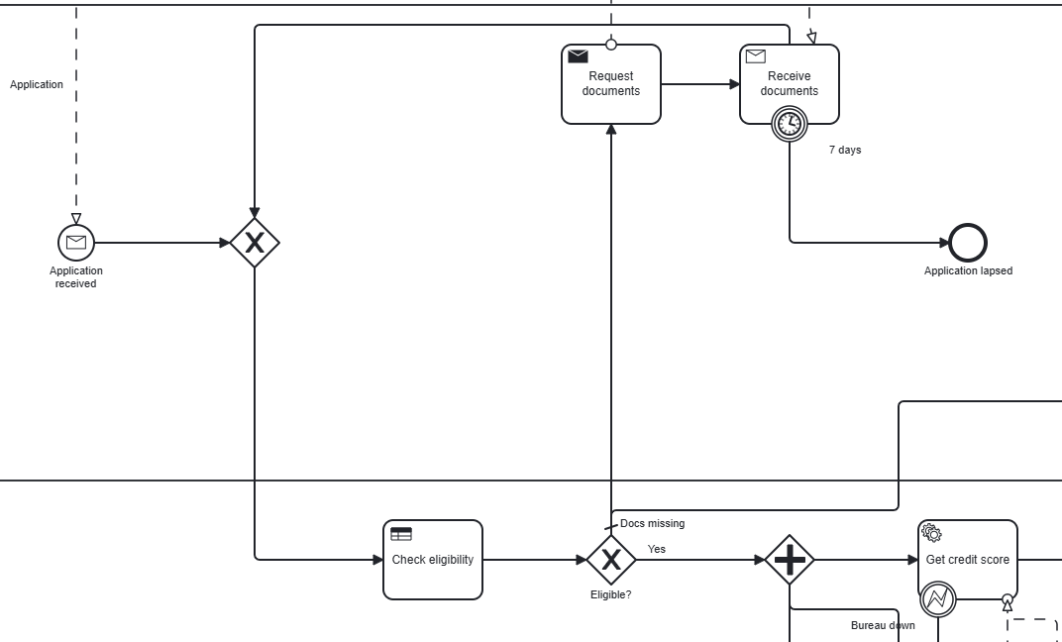
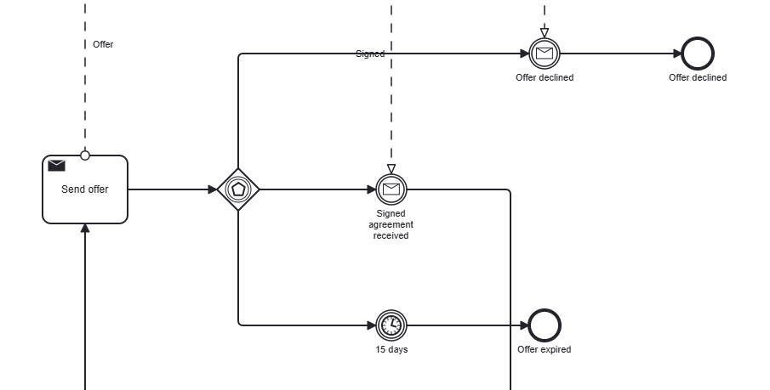


Gateways
04
Exclusive
One path. Eligible? has three: OK, docs missing, ineligible.
Parallel
Credit, KYC and AML at once. The join waits for all three.
Event-based
After the offer, whichever comes first wins: signed, declined or 15 days.
Notes:
Three gateway types. Exclusive gateways choose one path; Eligible? has three outcomes. The parallel gateway runs the credit, KYC and AML checks at the same time; the normal and backup credit paths are merged first so the join gets exactly three tokens. The event-based gateway after the offer waits for whichever happens first: the signed agreement, a decline, or the fifteen-day timer.

Slide 6
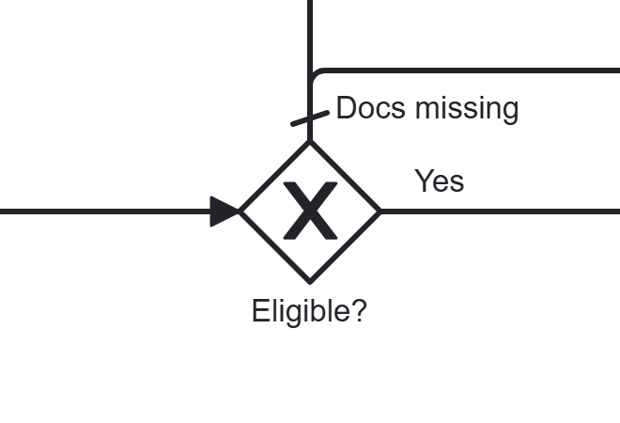
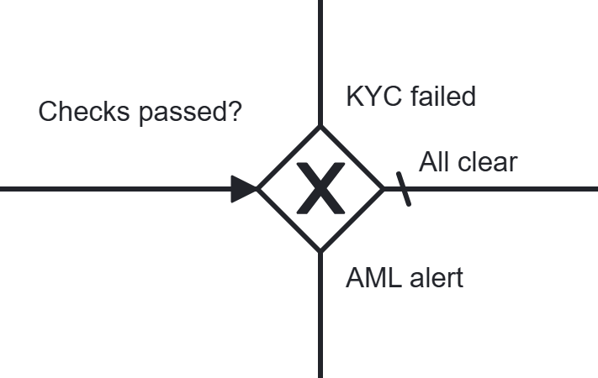
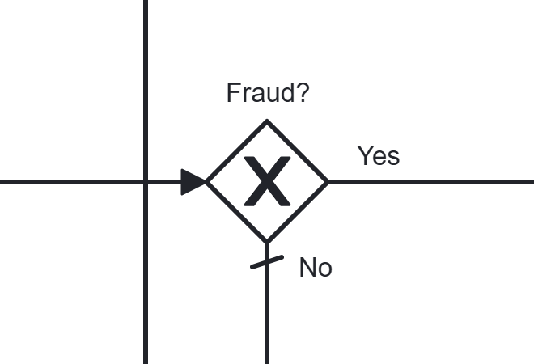
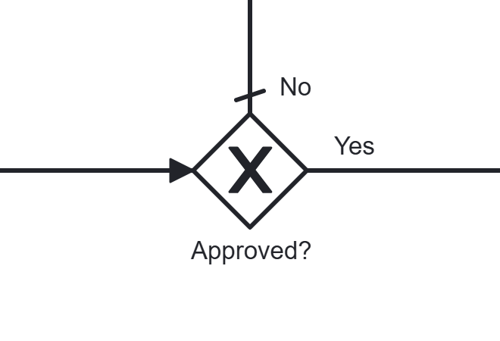
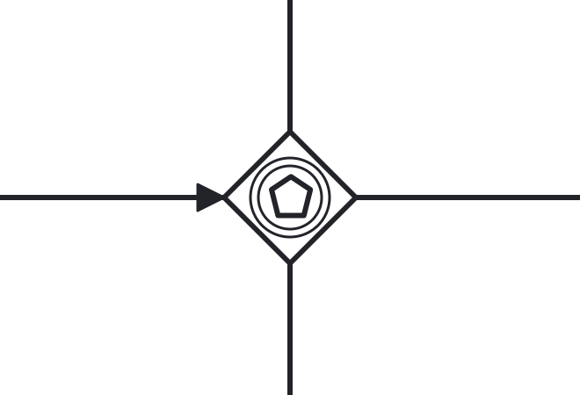
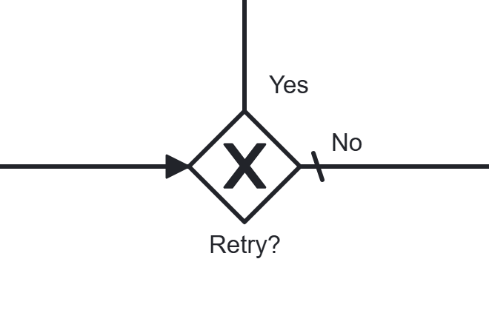
Decision gateways: what each one solves
05
Eligible?
Checks passed?
Fraud?
exclusive · 3 ways
exclusive · 3 ways
exclusive
Sorts the DMN result: continue, ask for documents, or reject.
Acts on all check results at once: clear, KYC failed, or AML alert.
Confirmed fraud stops everything; a false alarm carries on.
Approved?
After the offer
Retry?
exclusive
event-based
exclusive
Carries out the underwriter’s decision: send an offer or reject.
An offer can’t wait forever: first of signed, declined or 15 days wins.
After a failed payment: retry with fixed details or cancel the loan.
Notes:
These are the six decision gateways and the problem each one solves. Eligible? routes the DMN result three ways. Checks passed? looks at all three check results together, after the parallel join. Fraud? stops the process for confirmed fraud. Approved? applies the underwriter decision. The event-based gateway after the offer makes sure we never wait forever: whichever comes first, signed, declined or fifteen days, decides. Retry? decides what happens after a failed payment.

Slide 7
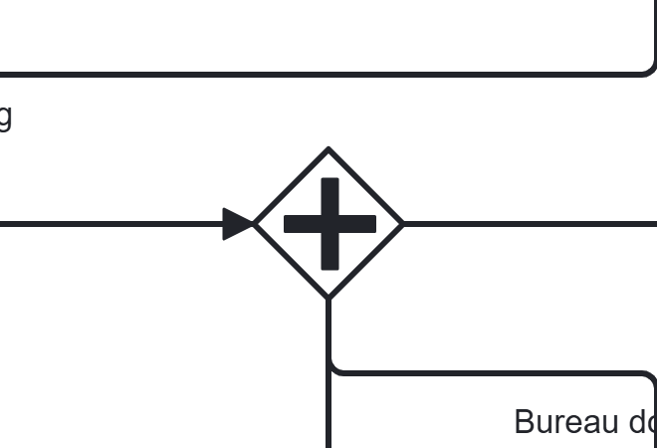
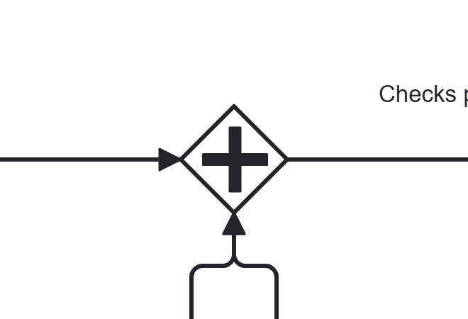
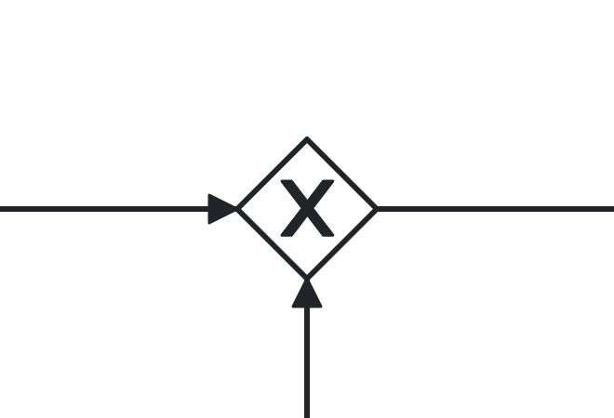
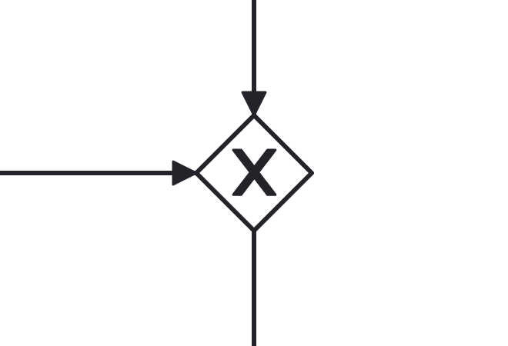
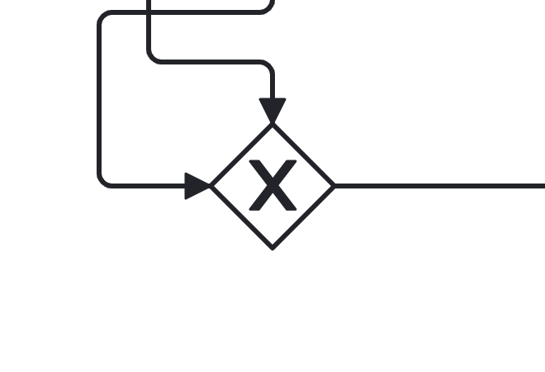
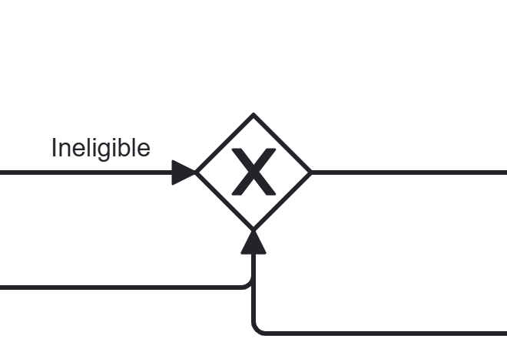
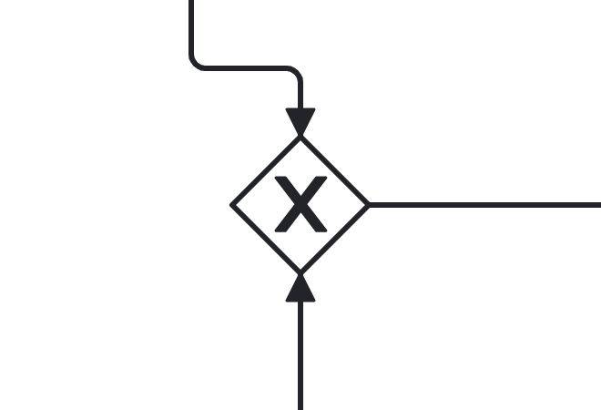
Parallel and merge gateways: what each one solves
06
Split
Join
Credit merge
Documents merge
parallel
parallel
exclusive merge
exclusive merge
Runs credit, KYC and AML at the same time to save time.
Waits until all three checks finish before any decision.
Joins normal and backup credit paths so the join never deadlocks.
Lets resubmitted documents loop back to the eligibility check.
Underwriting merge
Rejection merge
Disbursement merge
exclusive merge
exclusive merge
exclusive merge
A cleared AML alert rejoins the normal path to underwriting.
Three rejection reasons share one Send rejection task.
The payment retry loop re-enters Disburse funds.
Notes:
These gateways shape the flow rather than make decisions. The parallel split runs the three checks at once and the join waits for all of them. The credit merge combines the normal and backup credit paths, so the parallel join always receives exactly three tokens and never deadlocks. The other merges let loops re-enter a step, documents and payment retry, or let several paths share one task, like the single rejection letter and the return to underwriting after a false alarm.

Slide 8

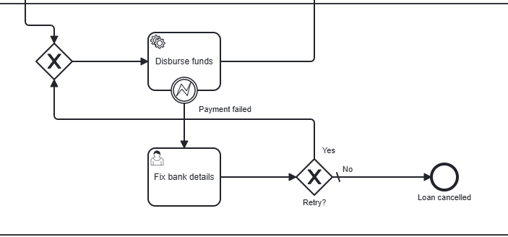


Intermediate events
07
7 days
timer on Receive documents → lapsed
Bureau down
error on Get credit score → backup bureau
Payment failed
error on Disburse funds → fix and retry
Signed / Offer declined
message catches after the offer
15 days
timer catch → offer expired
Notes:
Six intermediate events. Boundary events: a seven-day timer on Receive documents, an error event when the credit bureau is down, and an error event when the payment fails. After the offer, two message catch events and a fifteen-day timer race through the event-based gateway. The crops show the payment retry and the document request.

Slide 9
Critical path
08
Application received
Loan disbursed
1
2
3
4
5
Check eligibility
Credit · KYC · AML
Underwrite
Offer signed
Disburse funds
Every gateway takes its normal branch: Eligible? = OK, Checks passed? = all clear, Approved? = yes, and the signed agreement arrives first.
Notes:
The critical path: application received, eligibility check, the three checks in parallel, underwriting, the signed offer, and disbursement. Every gateway takes its normal branch, and the process ends at Loan disbursed.

Slide 10

Alternate paths
09
Documents missing
request, lapse after 7 days
Not eligible
rejection letter
Bureau down
backup bureau
KYC failed
rejection letter
AML alert
investigate; fraud = terminate
Underwriter declines
rejection letter
Offer declined
offer declined
No reply 15 days
offer expired
Payment fails
fix and retry, or cancel
Applicant withdraws
event sub-process
Notes:
Ten alternate paths, each with the BPMN symbol that handles it. Three end in the same rejection letter. The bureau outage recovers instead of failing. Confirmed fraud uses a terminate end event to stop everything. Withdrawal can happen at any stage, so it is an interrupting event sub-process.

Slide 11
Thank you
5 task types · 3 gateway types · 6 intermediate events · 10 alternate paths
Notes:
To sum up: five task types, three gateway types, six intermediate events, one critical path and ten alternate paths. Thank you.

