Slide 1
Logistics & Shipment Exception Management
Assignment 2 · BPMN 2.0 process model (Camunda 8)
[Your name] · [Roll number] · [Course]
Notes:
Introduce the assignment: a courier moves a parcel from a shipper to a recipient through pickup, hubs and last-mile delivery. The question asks us to focus on how exceptions are detected and resolved. I will cover the four things asked for: task types, gateways, intermediate events, and the critical and alternate paths.

Slide 2
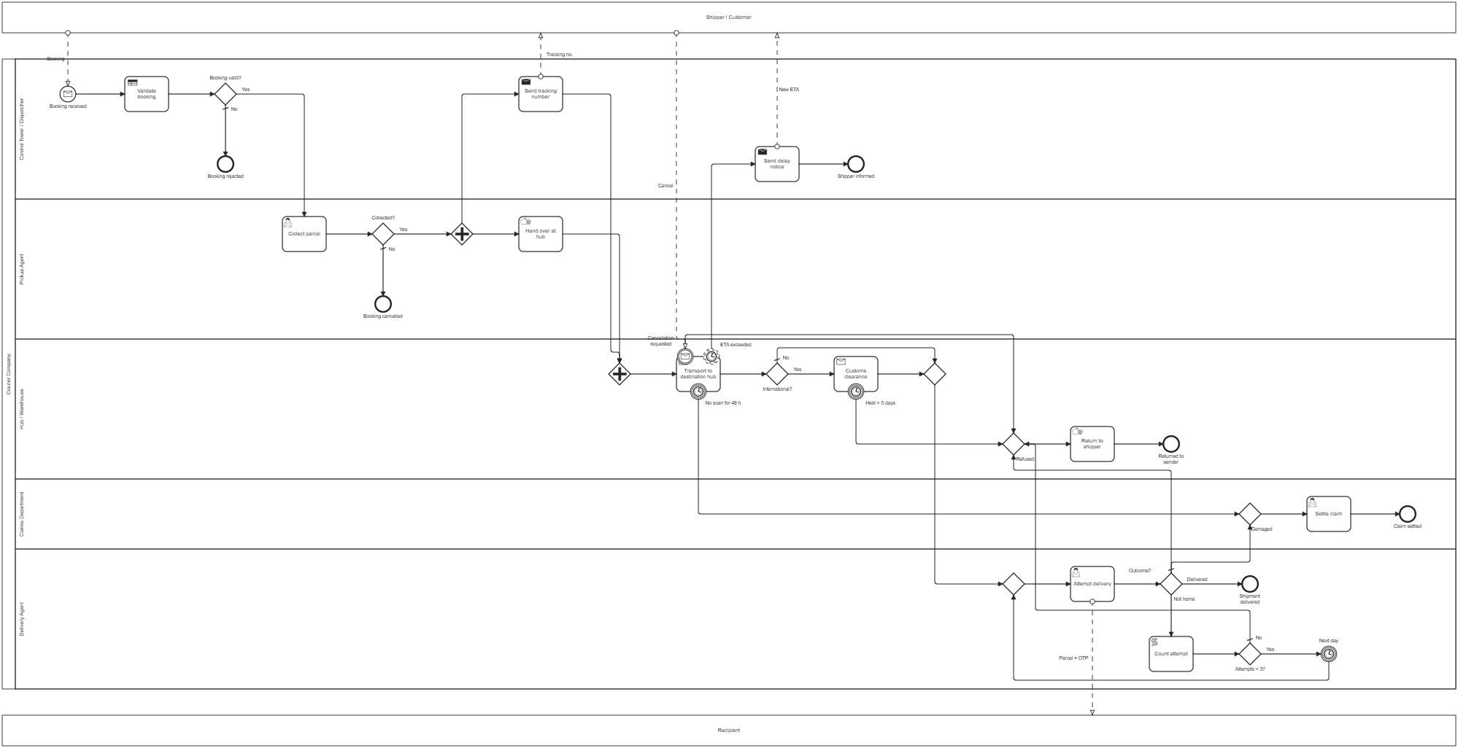
Process overview
Pools: Shipper / Customer, Recipient · Lanes: Control Tower / Dispatcher, Pickup Agent, Hub / Warehouse, Claims Department, Delivery Agent
Notes:
This is the full diagram. The shipper and the recipient are external, so they are separate pools and only exchange messages with us (the dashed lines). Inside the courier pool there is one lane per role: Control Tower, Pickup Agent, Hub, Claims and Delivery Agent. The main flow runs left to right; exceptions branch off near where they happen and end in two shared handlers: Return to sender in the hub lane and Settle claim in the claims lane.

Slide 3
Task types used
Task type | Used for | Why this type
Business rule | Validate booking | Decided by the booking-validation DMN table (prohibited item, address, 70 kg limit)
User | Collect parcel · Attempt delivery · Settle claim | A person decides; the result is entered in a Camunda form
Send | Send tracking number · Send delay notice | One-way message to the shipper
Receive | Transport to destination hub · Customs clearance | The process waits for a message; a timer can be attached
Script | Count attempt | Adds 1 to the attempt counter; no system needed
Manual | Hand over at hub · Return to shipper | Physical work with no system
11
tasks in the model
6
different task types
Notes:
There are eleven tasks of six different types, and each type was chosen for a reason. Validate booking is a business rule task because rules decide the result, in a DMN table. Collect parcel, Attempt delivery and Settle claim are user tasks because a person decides, using a form. Send tasks send one-way messages to the shipper. Transport and Customs are receive tasks because the process waits for a message, the arrival scan or the clearance, and a receive task can carry a timer. Count attempt is a script task: it just adds one to a counter. Hand over and Return are manual tasks: physical work with no system.

Slide 4
Gateways used
X
Exclusive (XOR)
Exactly one outgoing path is taken
+
Parallel (AND)
All outgoing paths run at the same time
Used at
Used at
Booking valid? (Yes / No)
Collected? (Yes / No)
International? (Yes / No)
Outcome? (Delivered / Not home / Refused / Damaged)
Attempts < 3? (limits the retry loop)
Merges: delivery retry loop, after customs, before Return to sender, before Claims
Split after Collected? = Yes
Hand over at hub ∥ Send tracking number
Join before Transport: waits until both are done
Notes:
Two gateway types. Exclusive gateways, the X, are used for every decision: exactly one path is taken. Booking valid, Collected, International, the four-way delivery Outcome, and Attempts less than three, which limits the retry loop. Exclusive gateways are also used as merges where paths join again. The parallel gateway, the plus, is used after pickup: handing the parcel over at the hub and sending the tracking number are independent, so they run at the same time, and the join waits for both before transport starts.

Slide 5
Intermediate events used
Event | Kind | Where it sits | What happens
ETA exceeded | Timer · boundary, non-interrupting | Transport to destination hub | Sends a delay notice; transport carries on
No scan for 48 h | Timer · boundary, interrupting | Transport to destination hub | Parcel treated as lost → Claims
Cancellation requested | Message · boundary, interrupting | Transport to destination hub | Transport stops → Return to sender
Held > 5 days | Timer · boundary, interrupting | Customs clearance | Customs hold too long → Return to sender
Next day | Timer · intermediate catch | Delivery retry loop | Waits one day before the next attempt
Also in the model: a message start event (Booking received) and six end events: Booking rejected, Booking cancelled, Shipper informed, Shipment delivered, Returned to sender, Claim settled.
Notes:
Five intermediate events. Three are attached to the Transport task. ETA exceeded is a non-interrupting timer, drawn dashed: the shipper gets a delay notice but the transport keeps going. No scan for 48 hours is an interrupting timer: the parcel is treated as lost and goes to claims. Cancellation requested is an interrupting message event: the shipper cancels, transport stops, and the parcel goes back. Held more than 5 days is a timer on customs. Next day is an intermediate catch timer inside the delivery retry loop.

Slide 6
Critical path (happy path)
The route a parcel takes when nothing goes wrong: every gateway takes its normal branch.
1
2
3
4
5
6
Booking received
Shipment delivered
Validate booking
Collect parcel
Hand over at hub ∥ Send tracking
Transport to destination hub
Customs clearance (if international)
Attempt delivery
Control Tower
Pickup Agent
Pickup Agent + Control Tower
Hub / Warehouse
Hub / Warehouse
Delivery Agent
Gateway choices on this path: Booking valid? = Yes · Collected? = Yes · Outcome? = Delivered
Step 3 is a parallel split (shaded): both tasks run together and the join waits for both
Every other route through the diagram is an alternate path (next slide)
Notes:
The critical path, or happy path, is what happens when nothing goes wrong. Booking received, validate, collect, then hand over and tracking in parallel, transport, customs only if international, and delivery. Every gateway takes its normal branch: booking valid yes, collected yes, outcome delivered.

Slide 7
Alternate paths (exceptions)
When this happens | Alternate path in the diagram | Ends at
Booking is invalid | Booking valid? = No (DMN result) | Booking rejected
Pickup fails | Collected? = No | Booking cancelled
Transport runs late | Non-interrupting timer → Send delay notice | Shipper informed (parcel keeps moving)
No scan for 48 hours | Interrupting timer → Settle claim | Claim settled
Shipper cancels in transit | Message boundary event → Return to shipper | Returned to sender
Customs hold over 5 days | Timer boundary event → Return to shipper | Returned to sender
Recipient not home | Count attempt → Next day → retry (max 3) | Delivered, or returned after 3 tries
Refused / COD not paid | Outcome? = Refused → Return to shipper | Returned to sender
Parcel damaged | Outcome? = Damaged → Settle claim | Claim settled
Notes:
These are the alternate paths: nine exceptions, each solved inside the diagram. Most end in one of two shared handlers, Return to sender or Settle claim, which keeps the diagram small. The delay path is special because it is non-interrupting: it runs alongside the normal path. The not-home path is a loop with a limit: count the attempt, wait a day, retry, and after three attempts the parcel is returned.

Slide 8
Summary
One critical path and nine alternate paths, each handled inside the diagram.
6
task types
2
gateway types
5
intermediate events
9
alternate paths
Thank you · Questions?
Notes:
To summarise: six task types, two gateway types, five intermediate events, one critical path and nine alternate paths. Every exception the question mentions is detected and resolved inside the model. Thank you, I am happy to take questions.

