Slide 1
7409 Machine Learning in Finance and Trade
Evaluating Impact of Social Media Posts
on Stock Prices
Group number: 3
Group members: Wang Dingrui, Chen Kewen, Wang Yijie, Yang sihan, Cao Jia
汇报时间：2023/05/31

Slide 2
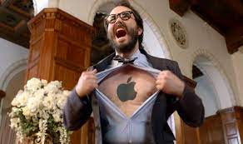
I love Apple!
They build Macs, iPhones and iPads, I can’t breathe without Apple products!
I am going to buy AAPL stocks to support them!
BUT I DO NOT WANT TO LOSE MONEY FOR MY LOVE ☹
A guy who is a crazy apple fan

Slide 3
Today, we are embarking on a journey to build a model that will help him profit from Apple or, at the very least, minimize his losses.

Slide 4
contents
01
Research Overview
02
Data preparation
03
Sentimental Analysis
04
Stock Prediction

Slide 5
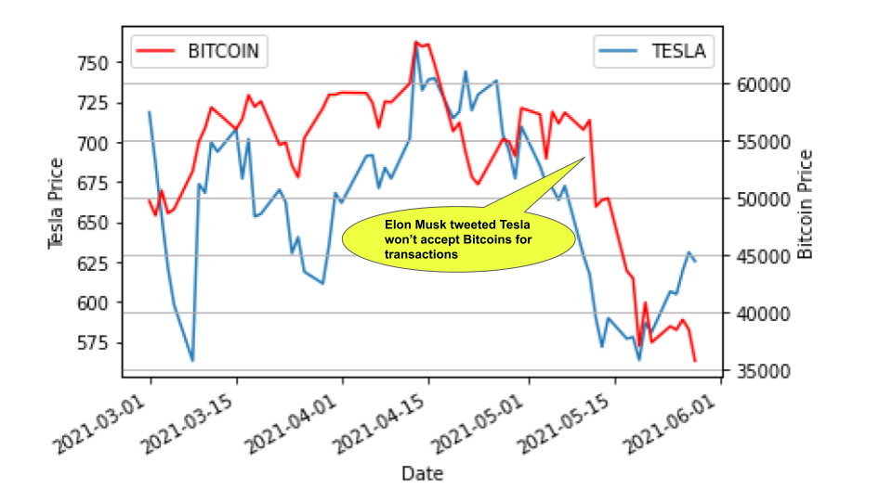
1
Research overview
• Task 1: Examine the effect of social media sentiment on stock closing prices.
• Task 2：The RNN, LSTM, LMP GRU model were used for comparative experiments.
• Task 3：Provide stock prediction results based on different models and explore the returns of different models using the same trading strategy.
Elon Musk’s tweets and its effect on stock prices
Key technology
Financial Texts, Stock Market Prediction, Sentiment Analysis
Main work
Integrate sentiment of social media data with historical stock data and study its effect on closing prices using time series models. Carry out rigorous experiments and deep analysis using multiple deep learning based models.

Slide 6

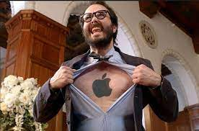

I can’t wait to dive in the market!
Show me your model
Easy dude, before be build the model, we need to prepare the data. Data is to a model what fel magic is to Gul'dan.
Don’t cue me!

Slide 7
2
Data Collection
* Twitter Data. ‘AAPL’ (for Apple)
This dataset contains features like date, username, and tweet of both executive and general people from 1st January 2017 to 6th May 2022.
Data source:https://www.kaggle.com/datasets/omermetinn/tweets-about-the-top-companies-from-2015-to-2020
* Historical Stock Data.
The historical stock data separately for each company stock or decentralised currency from 1st January 2017 to 6th May 2022. This dataset contains the features – ‘open’: the share price of a single stock at the start of the day, ‘high’: the highest price at which the stock was sold on that day, ‘low’: the lowest price the stock was sold on that day, ‘volume’ : total number of shares that were sold or bought on that day, and ‘close’: the closing price of a single stock on that day.
Data source: yahoo finance

Slide 8
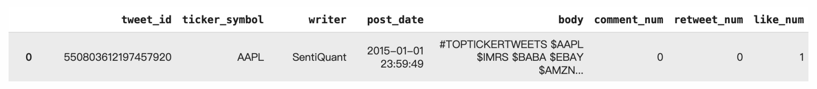
2
Data preprocessing
Tweet Data
Tweet_AAPL: 1424714 pieces of data
Original Dataset: multiple dataset
{tweet_id, ticker_symbol}
{tweet_id, ticker_symbol, writer, post_date, body, comment_num, retweet_num, like_num}
Data processing:
joint: based on tweet_id, where ticker = 'AAPL'
timestamp to datetime:
timestamp = datetime.datetime.fromtimestamp(Date).strftime('%Y-%m-%d %H:%M:%S')

Slide 9
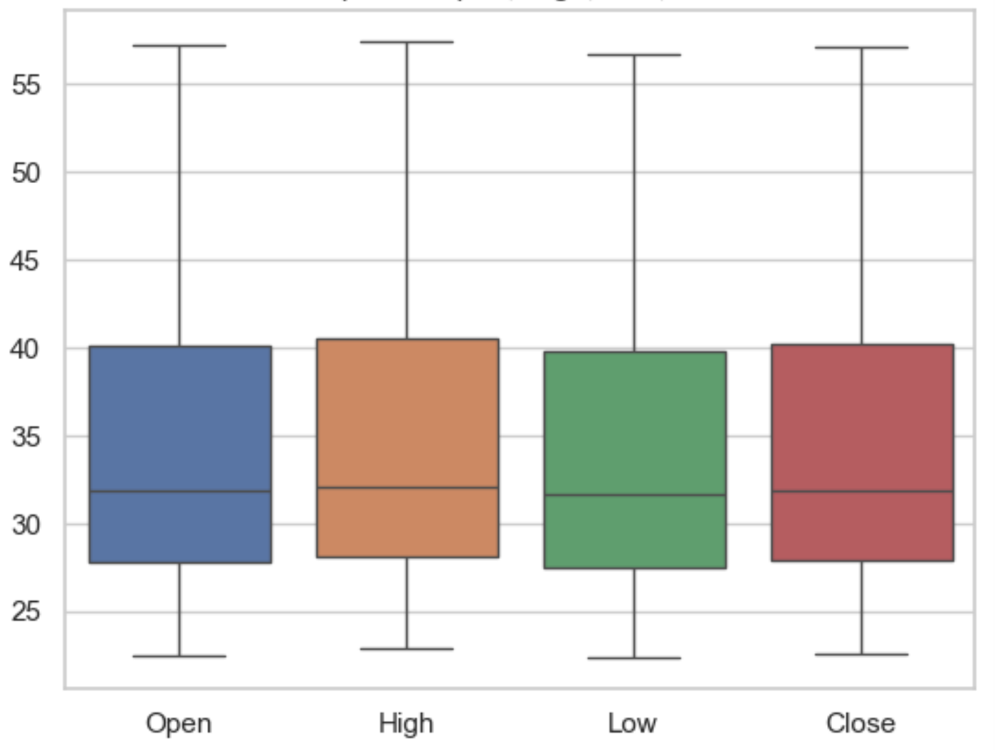
2
Data preprocessing
Stock_price Data
Trading day total: 1258 days
Original Dataset: {Date, Open, High, Low, Close, Adj Close, Volumn}
Outlier detection (boxplot) : No outlier
Boxplot of Open, High, Low, Close

Slide 10
2
Feature Engineering
Feature construction (new features, plus emotions, user comments)
Sentiment Analysis: Vader-sentiment FinBert-sentiment
Feature extraction (calculate mean moving average)
ewma_close_price ：
In order to predict closing prices more accurately, a new variable mean moving average derived from existing variables is introduced. The index weighted moving average takes into account closing prices on 3, 7, 14 and 30 days. The intuition behind the use of four different ewma values is to cover all sudden and long-term changes in stock prices and sentiment.

Slide 11
2
Feature Engineering
Feature selection (remove id, date, number of user followers)
Merge process：
groupby(‘date’).mean()
dropna()
feature selection
Sentiment for each tweet
Sentiment for each day
Drop about 100 data
X,Y
X: ‘Open’, ‘High’, ‘Low’, ‘Close‘, 'Finbert_neutral', 'Finbert_positive', 'Finbert_negative', 'vader_score', 'Volume', 'Close_EWMA3', 'Close_EWMA7', 'Close_EWMA14', 'Close_EWMA30’
Y: 'close_price_shifted'

Slide 12
Now! my wallet is screaming!
Okay, let us construct the model. To be frank, I am not sure if you are a good investor. I will try my best to protect your wallet.

Slide 13
3
Model Construction
AAPL as the stock, twitter as the social media, and VADER and FinBERT tools as the sentiment analysis models
The historical stock data of AAPL from Yahoo, and sentiment scores obtained from VADER and FinBERT on tweets about Tesla from Twitter.

Slide 14
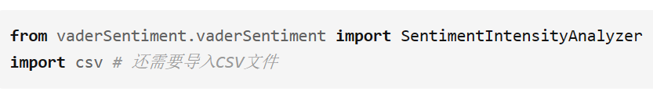
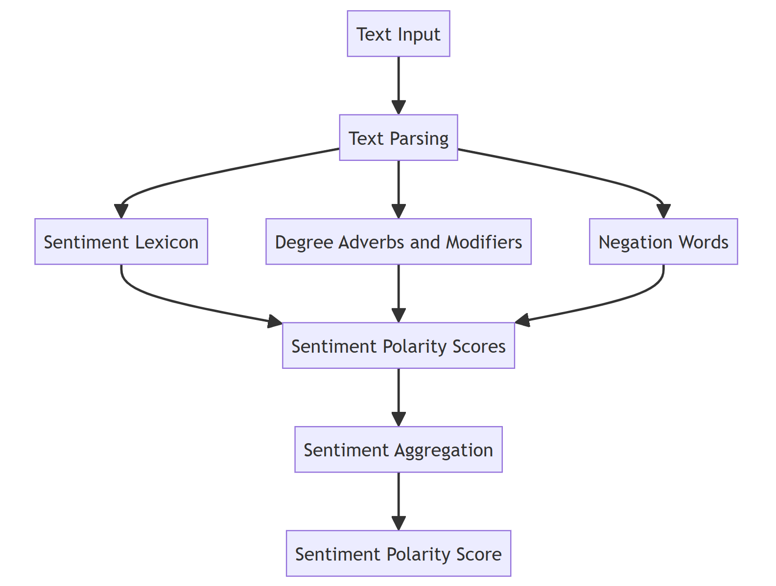
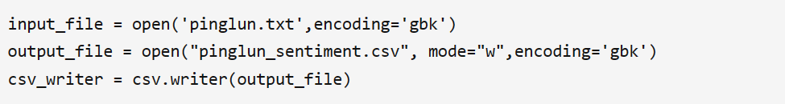
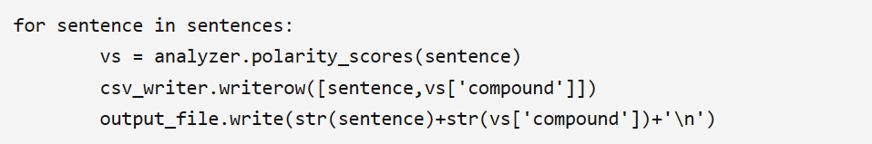

3
VADER
VADER is a text sentiment analysis method based on thesaurus and grammar rules.

Slide 15
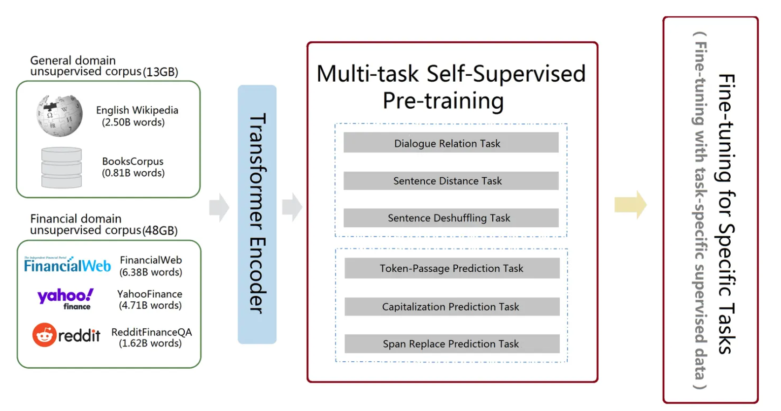
3
FinBERT
Typical "pre-training" + "fine-tuning" architecture

Slide 16
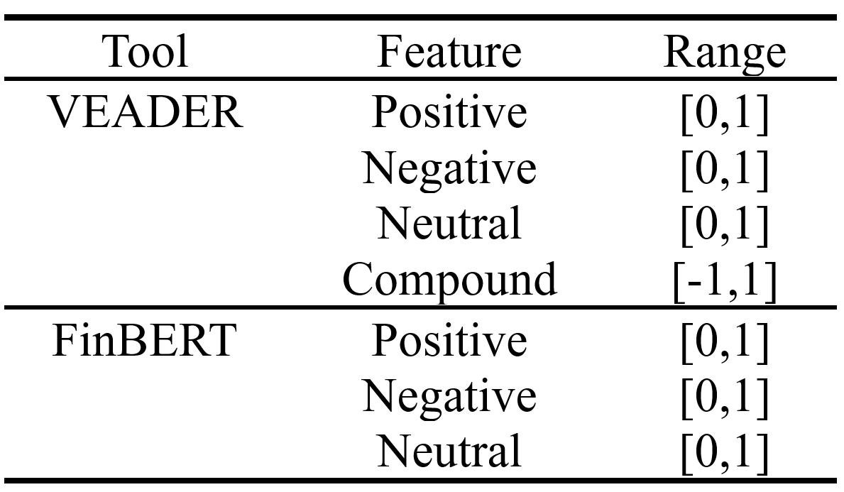
3
Sentiment Analysis
Valence Aware Dictionary for Sentiment Reasoner (VADER):
• NLTK's built-in
• Rule based technique
• Lexical features
• Output: choose 'compound' score
BERT for Financial Text Mining(FinBERT):
• Probability (positive, negative, neutral)
• Control variable

Slide 17
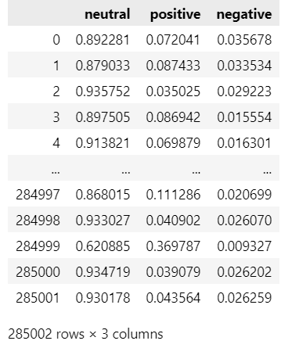
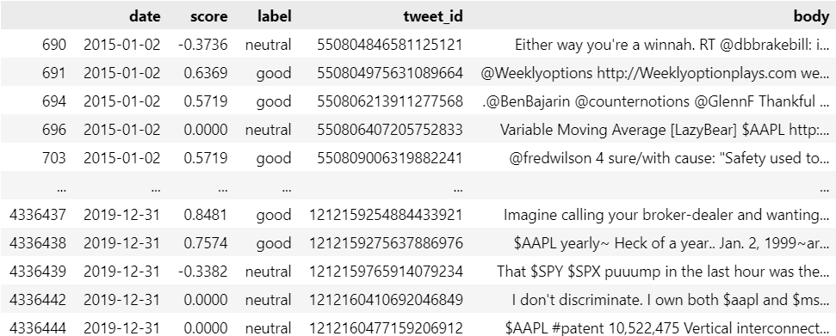
3
Sentiment Analysis
Vader’s Result
FinBERT’s Result

Slide 18
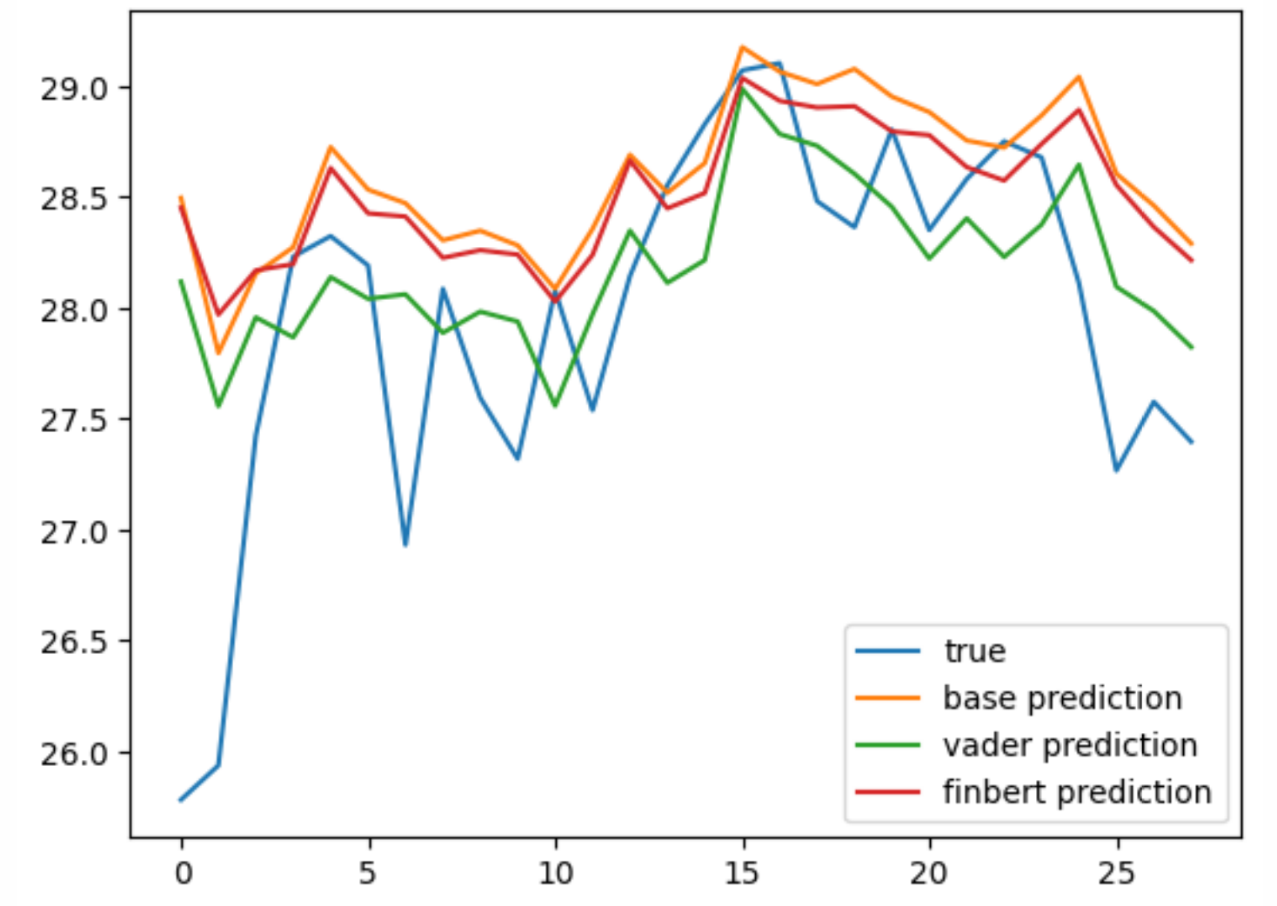
4
Experiments and Result Analysis
E1: Examine the effect of social media sentiment on stock closing prices
AAPL stock data as the base dataset
twitter as the sentimental data source
Use VADER and FinBERT as the sentiment analysis tools
based on simple LSTM

Slide 19
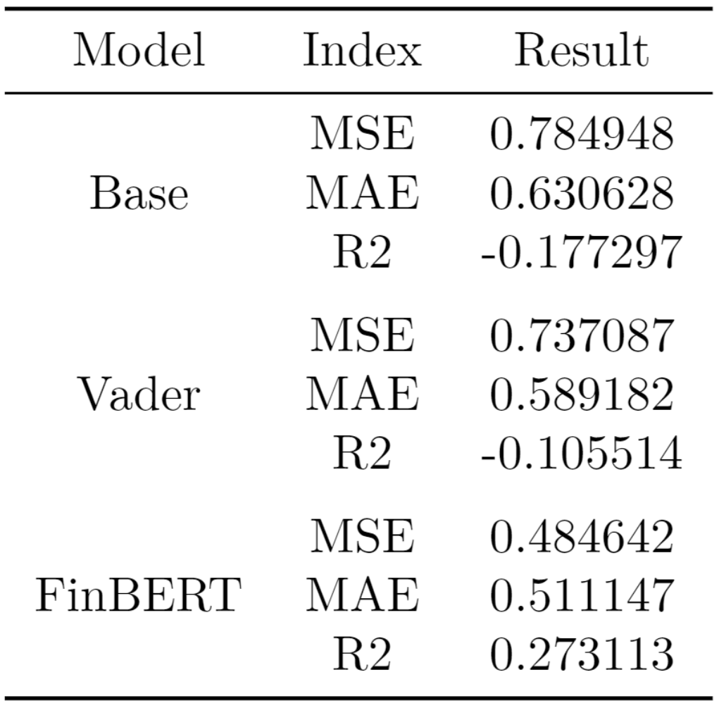
4
Experiments and Result Analysis
E1: Examine the effect of social media sentiment on stock closing prices
Conclusion:
Social media sentiment has an impact on stock closing prices
The prediction effect of sentiment analysis made with FinBERT is the best, and subsequent experiments are based on this data set base + FinBERT

Slide 20

E1: Examine the effect of social media sentiment on stock closing prices
It seems that FinBERT is the

Slide 21
Chosen Networks |  | Discarded Networks
RNN | - Simple recurrent structure - Suitable for modeling and predicting sequence data - Fast training speed - Limited memory capacity for handling long-term dependencies | Bidirectional Networks | Reason: in trading and fiancé, we can’t see the data from the future, so bidirectional networks like Bi-RNN, Bi-LSTM and Bi-GRU are meaningless
GRU | - Gated recurrent structure - Handles long-term dependencies and memory - Moderate training speed - Medium memory capacity
LSTM | - Gated recurrent structure - Handles long-term dependencies and memory - Slower training speed - High memory capacity
MLT | - Feedforward structure - Used for classification, regression, and other machine learning tasks - Fast training speed - Lacks explicit memory capacity - Large number of parameters | CNN | Reason: CNN is usually used in matrix computations, like computer vision. In this experiment, we use serial data, which is not appropriate to use CNN.

Slide 22
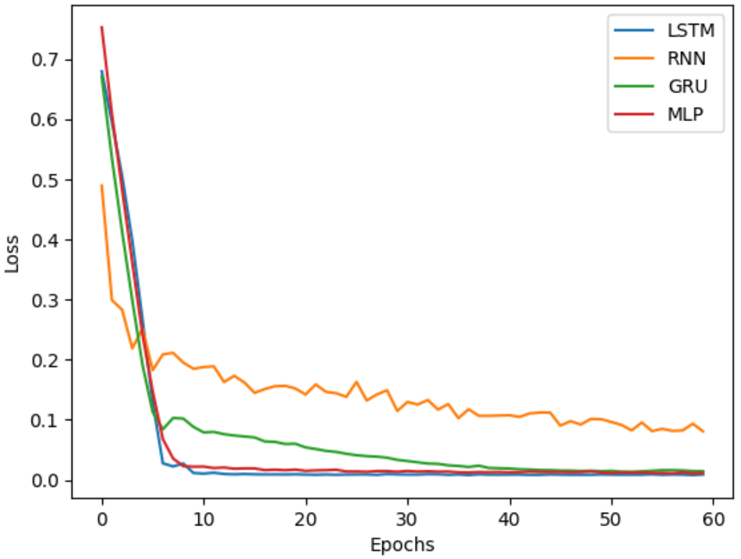
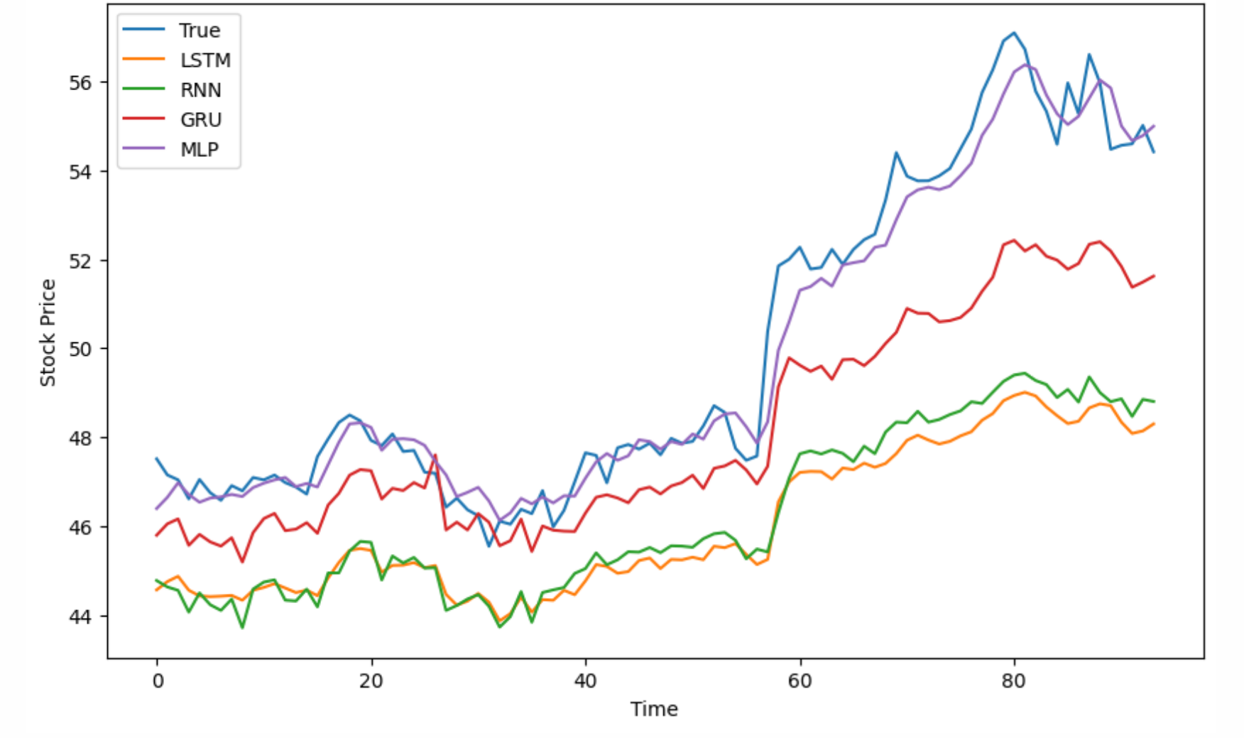
4
Experiments and Result Analysis
E2: Model comparison
Loss of Different Models in Experiment 2
Comparison of Predicted and True Values

Slide 23
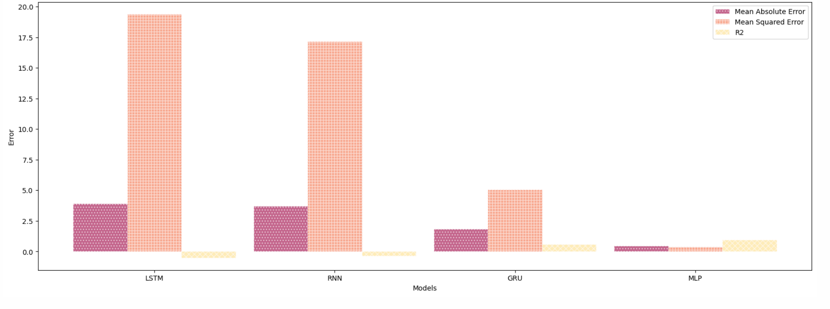
4
Experiments and Result Analysis
E2: Model comparison
Errors of Different Models
Conclusion: MLP model has the best effect on dev set, and the MLP model is used in subsequent experiments

Slide 24
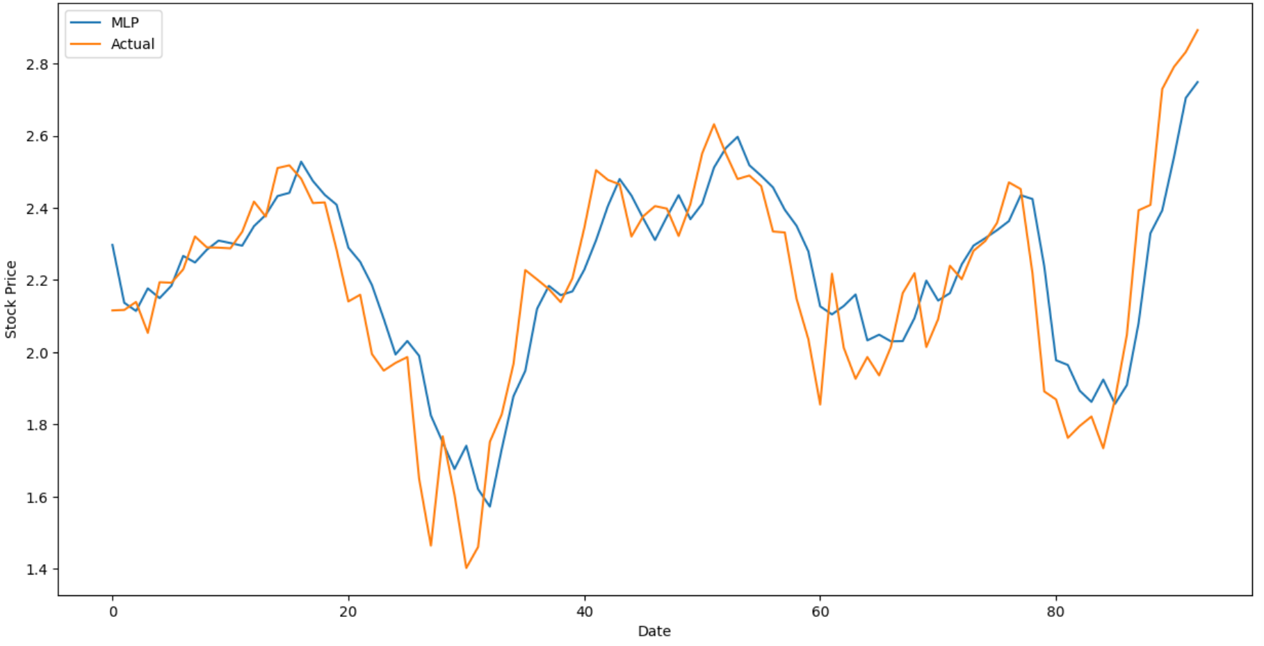
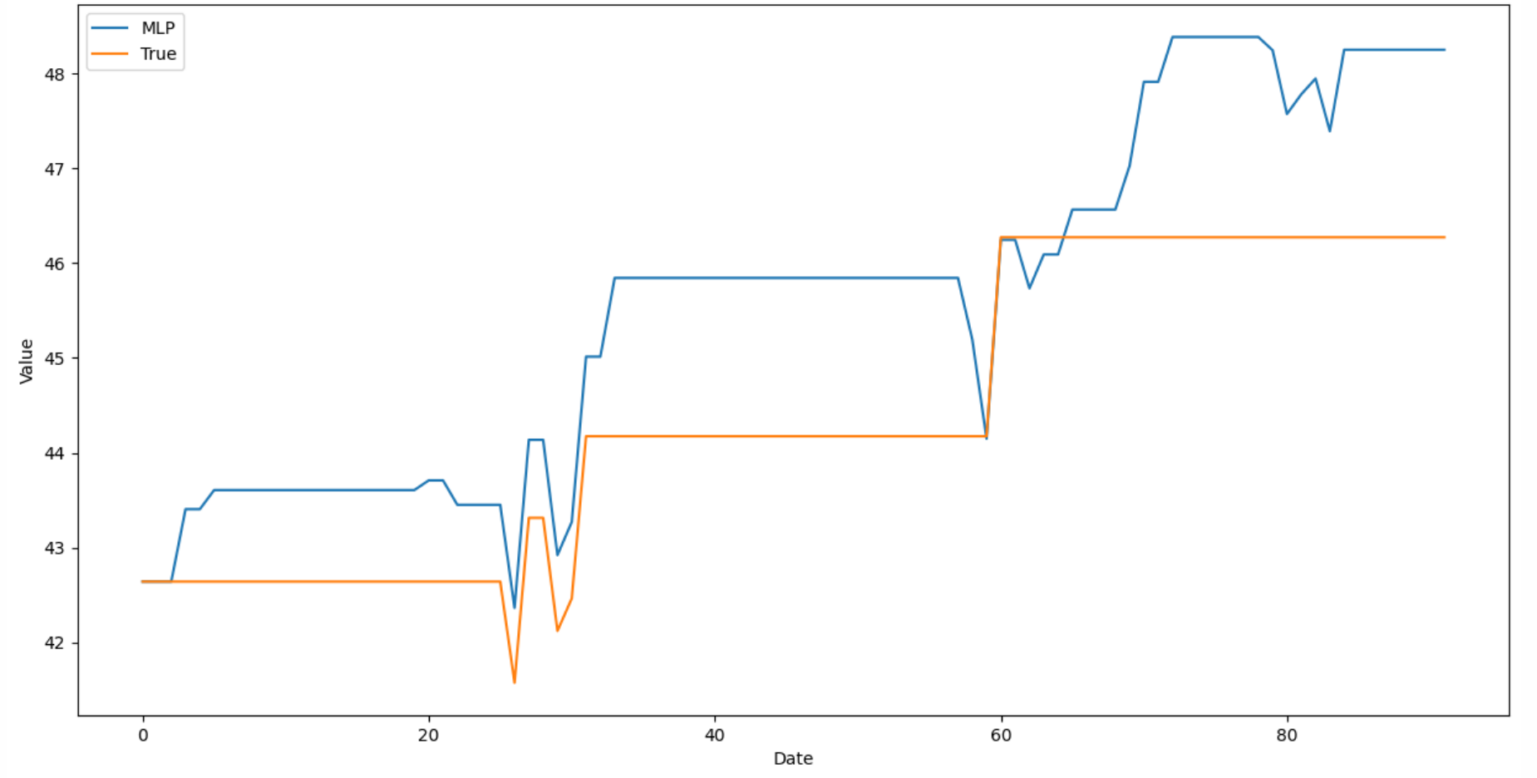
4
Experiments and Result Analysis
E3: Stock Price forecasting and strategy
based on MLP
Stock price prediction using MLP VS Actual
The initial position is 1.
Strategy: Use the model to predict the closing price of t+1 on day t.
If close_predict_{(t+1)} > close_actual_{(t)}, buy short positions, hold no action.
If close_predict_{(t+1) <} close_actual_{(t)}, the position is sold, empty positions do not act.

Slide 25
Money! Apple!
The two greatest things in the world!
Careful, young man. We really hope you can benefit forever, but we know that it is impossible.

Slide 26

You can see all our codes in
https://github.com/NoW0NDER/ML_final

Slide 27
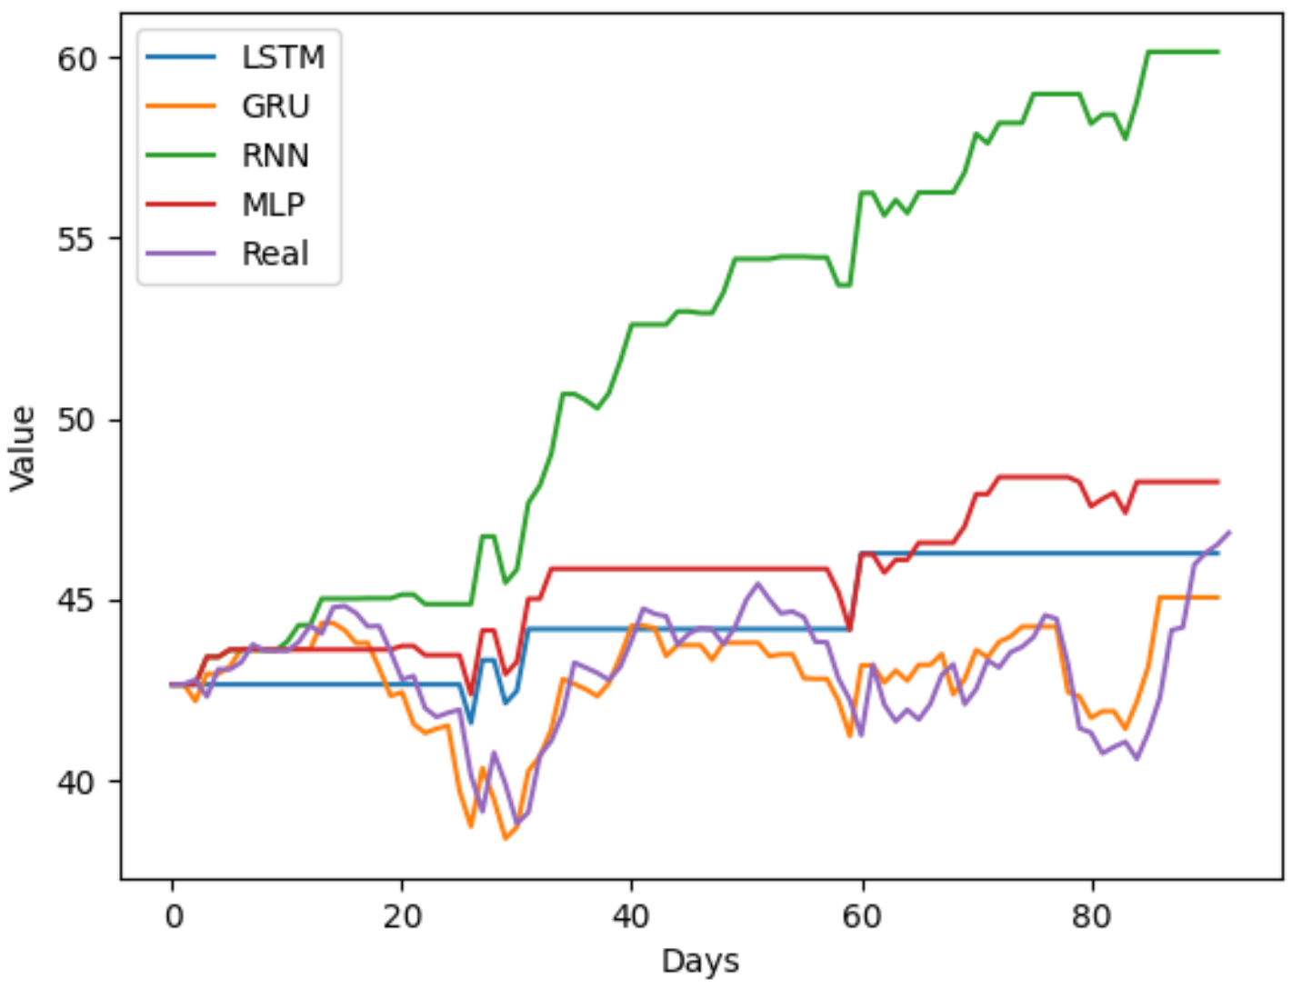
5
Easter Egg
The returns of different models using the same investment strategy

Slide 28
4
Experiments and Result Analysis
Limitations:
Future work:
Finbert API related issues:
The connection is unstable
Can't handle overly long text
The computing time is too long
Problems related to DataSets
NuLL value: null value brought by the Finbert API
Time interval: Limited by the available Twitter data set
Recall the FinBERT model to handle the missing value caused by server disconnection
Compare the effect of social media comments of the general public and executives on stock price prediction
Dive in quantitative strategy research

Slide 29
7409 Machine Learning in Finance and Trade
Thank you !
Group number: 3
Group members: Wang Dingrui, Chen Kewen, Wang Yijie, Yang Sihan, Cao Jia
汇报时间：2023/05/31

