Slide 1



I Can See U.
Indicator-Based Information Operation Detection and Topic-Aware Analysis
08.07.2026
Amit Ner Gaon, Noa Tal, Idan Muallem
Prof. Rami Puzis

Slide 2

Motivation
Social media platforms are central spaces for public discourse.
Information operation (IO) actors exploit the openness of social media to manipulate online discourse threatening democratic processes, public trust, and societal cohesion (Seckin et al., 2024).

Slide 3

IO & Coordination
IOs rely on fleets of coordinated accounts (Pacheco et al., 2021), some of them automated, acting toward a shared political objective. Coordination is what amplifies their influence.
Accounts disseminate the same narrative (e.g., hashtags, account mentions) and posts on the same topics.
Therefore, identifying coordination is a key step toward detecting IO drivers.

Slide 4
Related Work
IO-Driver Detection Methods:
Node-Local: detect suspicious users from their individual content, activity, and behaviour.
Tomaiuolo et al., A Survey on Troll Detection, Future Internet, 2020
Network-Based: detect coordinated groups from graph structure and behavioural similarity.
Pacheco et al., Uncovering Coordinated Networks on Social Media: Methods and Case Studies, ICWSM, 2021
Hybrid: combine user content with network information to detect IO drivers.
Minici et al., IOHunter: Graph Foundation Model to Uncover Online Information Operations, AAAI, 2025
The gap: existing approaches either detect coordinated groups without quantifying each account’s depth of involvement, or implicitly encode structural embeddedness within black-box models. None provides an explicit, interpretable, account-level measure of coordination depth.

Slide 5
Our Contributions
An interpretable, indicator-based approach for account-level IO detection.
The core number in the co-action graph as a single, explainable indicator of coordination, achieving performance comparable to a full feature set (AUC & F1) on a real IO campaign.
Topic-aware analysis of the detected coordinated group (k-core), revealing the campaign’s agenda.

Slide 6

Methods - Co-Action Graph
Nodes: authors in the discourse.
Edges: co-action relations between a pair of authors (e.g., posting the same hashtag). Represents behavioral similarity between the authors.
Purpose: expose coordinated behaviour for IO detection.

Slide 7
Core-Number

Slide 8
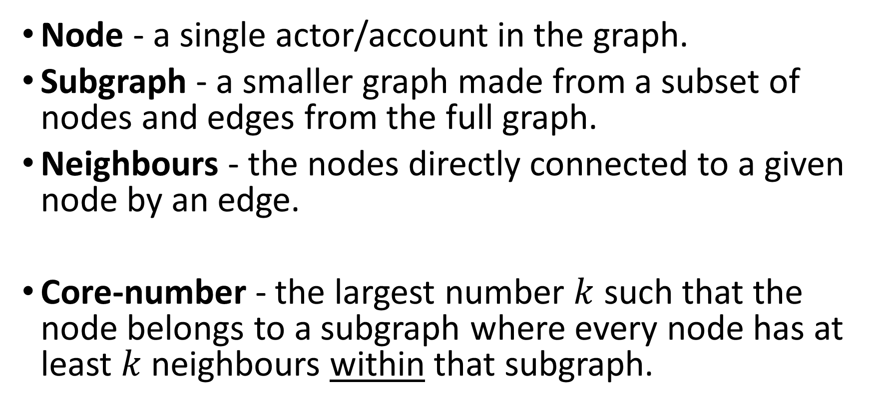
Core Number - Definition
Node - a single actor/account in the graph.
Subgraph - a smaller graph made from a subset of nodes and edges from the full graph.
Neighbours - the nodes directly connected to a given node by an edge.
Core-number - the largest number $k$ such that the node belongs to a subgraph where every node has at least $k$neighbours within that subgraph.

Slide 9
Core Number - Motivation
Account is embedded in a large, tightly coordinated group.
The account is suspected to be an IO driver.
The account gets a high core number.
Similarity with one or two accounts is not enough. Only many accounts coordinating with one another produce a high core number.

Slide 10

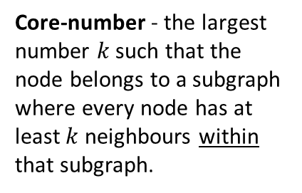
Core Number - Example
Co-Action Graph
IO Drivers
#Music
#DeepState
#True
#Music
#CoverUp
#DeepState
#CoverUp
#DeepState
#CoverUp
#CoverUp
# Media
#Trending
#TruthExposed
#Eurovision
#CoverUp
# Media
#DeepState
#True
Core-number - the largest number $k$ such that the node belongs to a subgraph where every node has at least $k$neighbours within that subgraph.

Slide 11
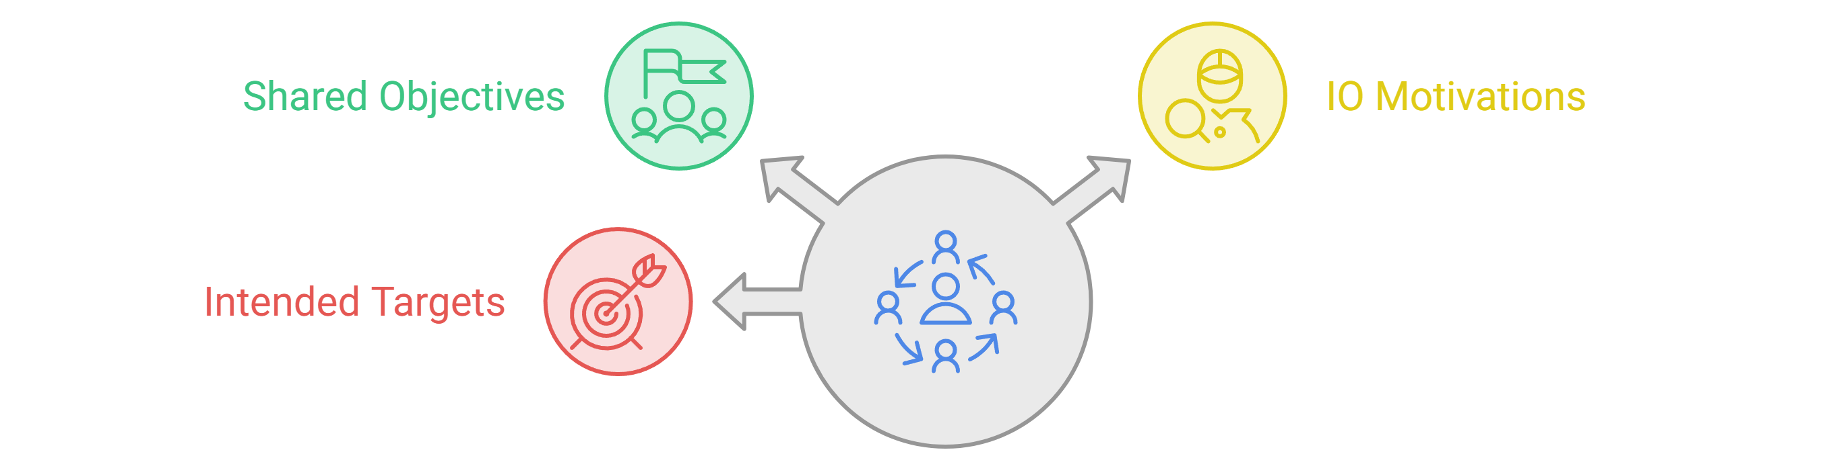
K-Core
An IO driver is part of a network of accounts that coordinate.
This coordinated group can be identified using the node’s k-core in the behavioural-similarity graph.
Investigating this k-core can help reveal the group’s shared objectives, IO motivations, and intended targets.

Slide 12

Additional Indicators
1) Building a co-action graph represents author similarity.
2) IO drivers tend to be embedded in dense communities.
3) Graph-based indicators are used to measure author’s embeddedness.
4) Each user is represented by a human-readable feature vector.
5) The feature vectors are used by a machine-learning model to classify each author as an IO driver or not.
Author feature vector (example)

Slide 13
Experiments

Slide 14
Datasets
Labeled IO Corpus
Collection of 26 information operations (IO).
Campaigns from multiple countries.
Fully labeled (IO vs. Control accounts).
Over 13M control posts from 303K accounts.
zenodo.org/records/14189193
Ecuador Campaign Dataset
787 IO accounts | 21,138 control accounts
700K IO tweets | 770K control tweets
Posts are used to build the co-action graph
Platform labels serve as ground truth
Seckin et al., 2024

Slide 15




Core Number - Results
Ecuador Campaign
Cumulative distribution: proportion of IO drivers by Core Number threshold (≤ / ≥)

Slide 16
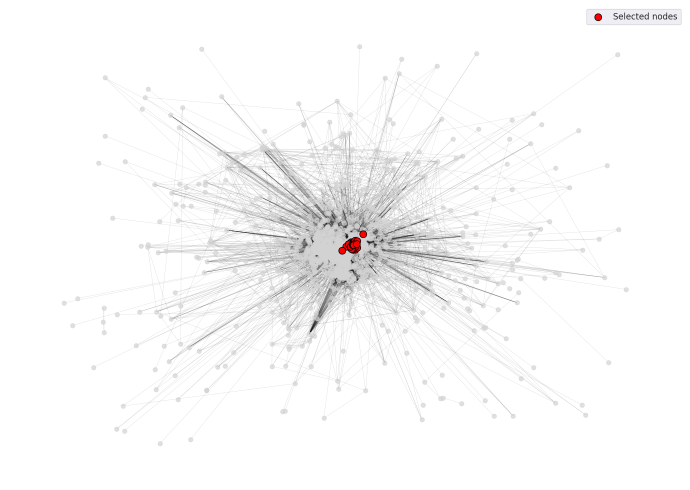
K-Core Example
One of the authors with the highest core number was selected:
  Account ID: 71cc57155d061d447c2c65756c7dfd6873e403a097
  Core number: 106
The corresponding k-core was extracted.
The k-core contains 107 nodes.

Slide 17
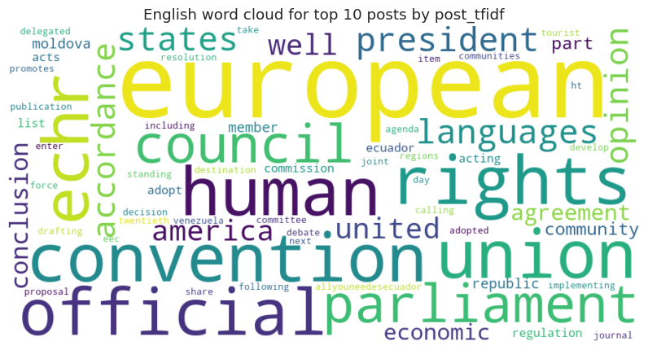
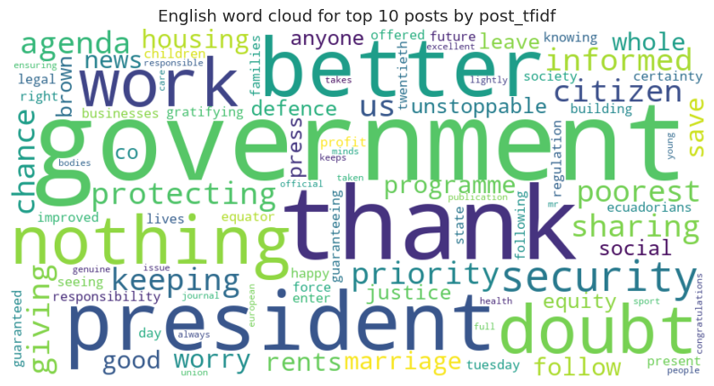
Coordinated Accounts
Two accounts from the same k-core share the same vocabulary and reuse the same texts:
Account: 71cc5715…e403a097
Account: 712125a6…a3f9d0f
Both accounts published the exact same text, word for word:
14.03.2019, 71cc5715…: “Regulation shall enter force twentieth day following publication official journal european union.”
02.05.2019, 712125a6…: “Regulation shall enter force twentieth day following publication official journal european union.”
Both accounts mix pro-government praise with the same off-topic EU legal boilerplate.
Posts shown as stored in the dataset (translated and preprocessed).
Just 2 of the 107 accounts in this k-core. This is the coordination the co-action graph captures.

Slide 18
LLM Analysis of the K-Core
An LLM (OpenAI ChatGPT web interface) was provided with the top 10 posts from each account, ranked by TF-IDF score. The model identified the following patterns:
Promotion of the Ecuadorian president and government policies.
Emphasis on social programs, security, democracy, and government achievements.
Reuse of similar supportive language across accounts.
Unusually repetitive references to EU legal and institutional content.
Shared narratives that may indicate coordinated or automated activity.

Slide 19

Information Gain
On Ecuador Campaign
Information Gain is a statistical method used to measure how much knowledge one variable provides about another.

Slide 20


SHAP Analysis
SHAP analysis on XGBoost model on Ecuador Campaign
SHAP explains how much each feature contributes to a model’s prediction.

Slide 21
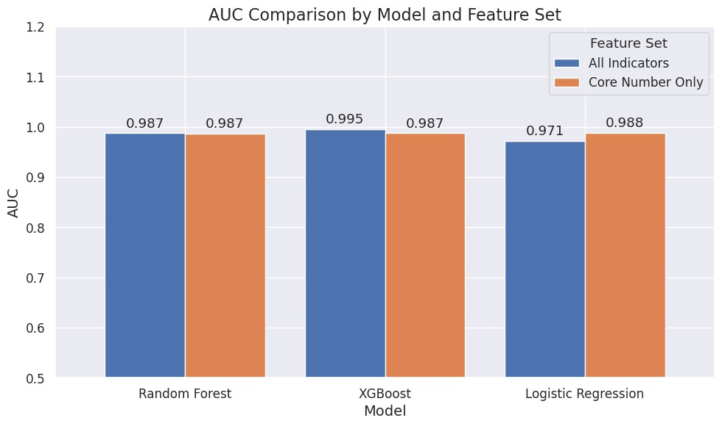
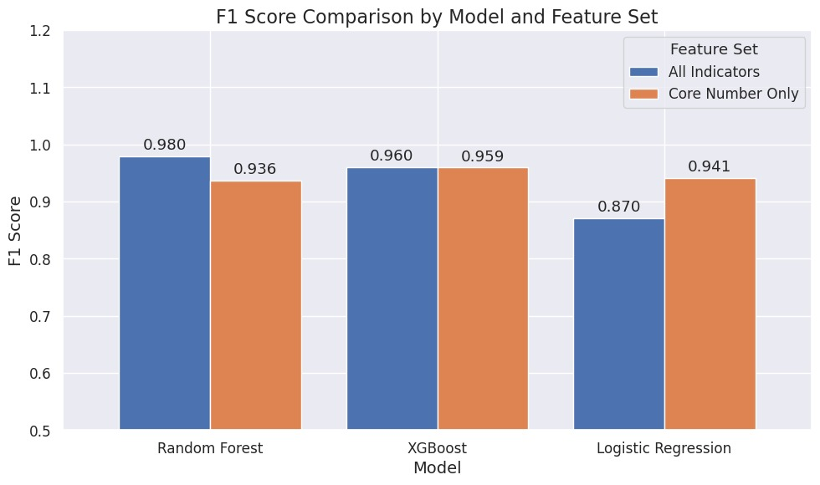
Indicators vs. Core Number
Core number alone achieves high AUC and F1.
Other indicators add little improvement.
Core number captures most of the IO detection signal.
On Ecuador Campaign

Slide 22
Key Takeaways
IO influence relies on fleets of coordinated accounts.
The co-action graph exposes this coordination, and the core number quantifies it.
Core number alone separates IO drivers from legitimate users (high AUC & F1).
Investigating the k-core reveals the campaign’s agenda, making detection both accurate and interpretable.

Slide 23
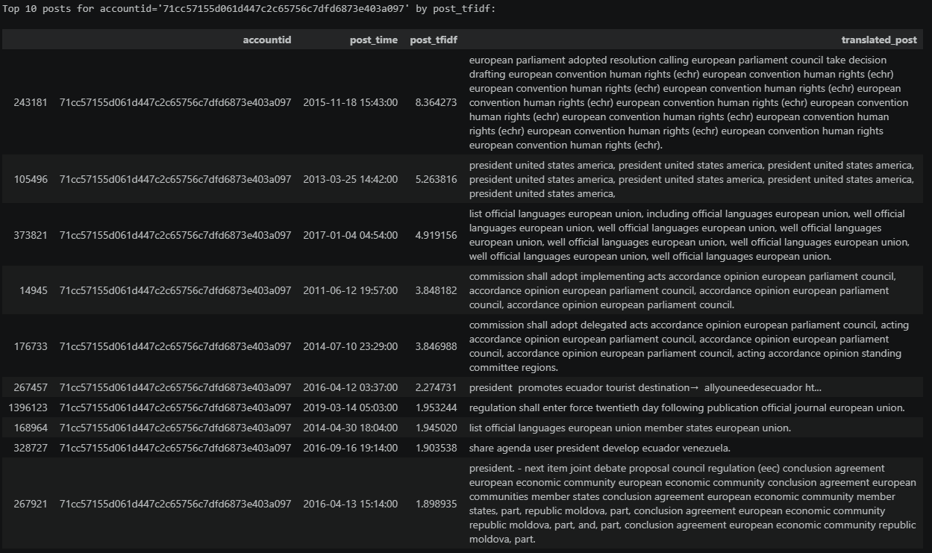
K-Core Example - Top Posts

Slide 24
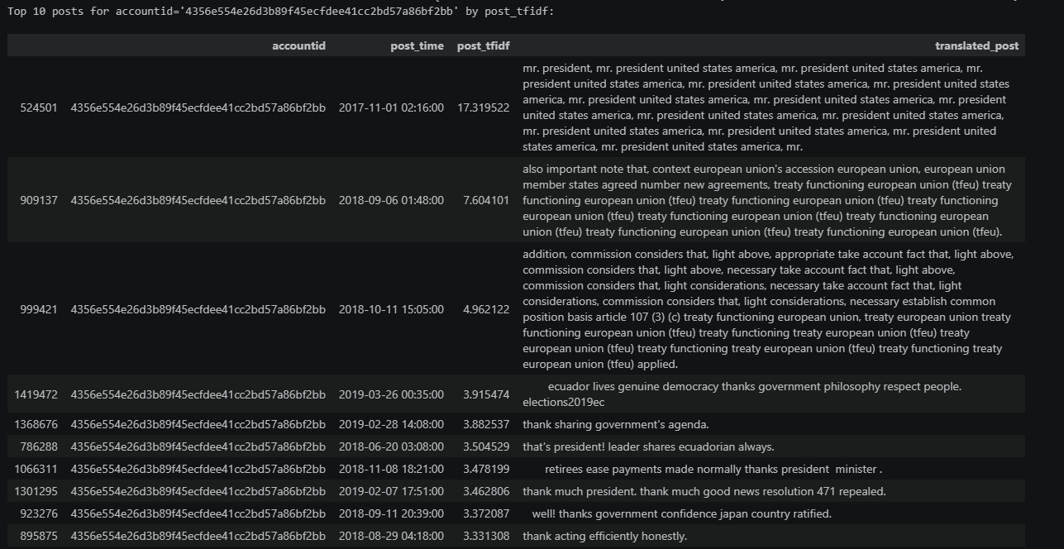
K-Core Example - Top Posts

Slide 25
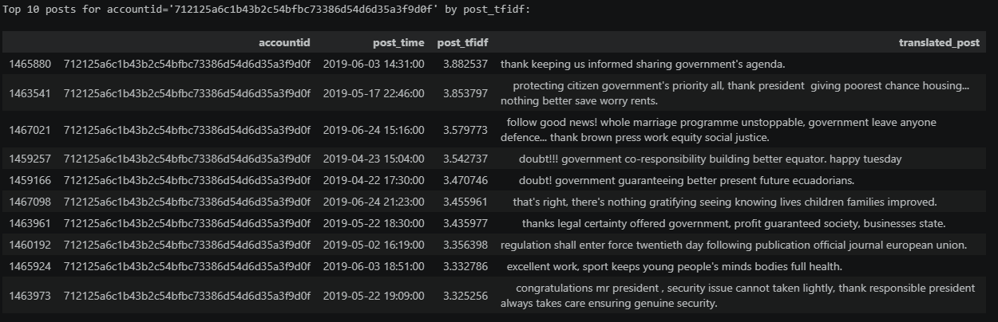
K-Core Example - Top Posts

