Slide 1



Backbone Graph
15.03.2026
Amit Ner Gaon, Noa Tal
Prof. Rami Puzis

Slide 2
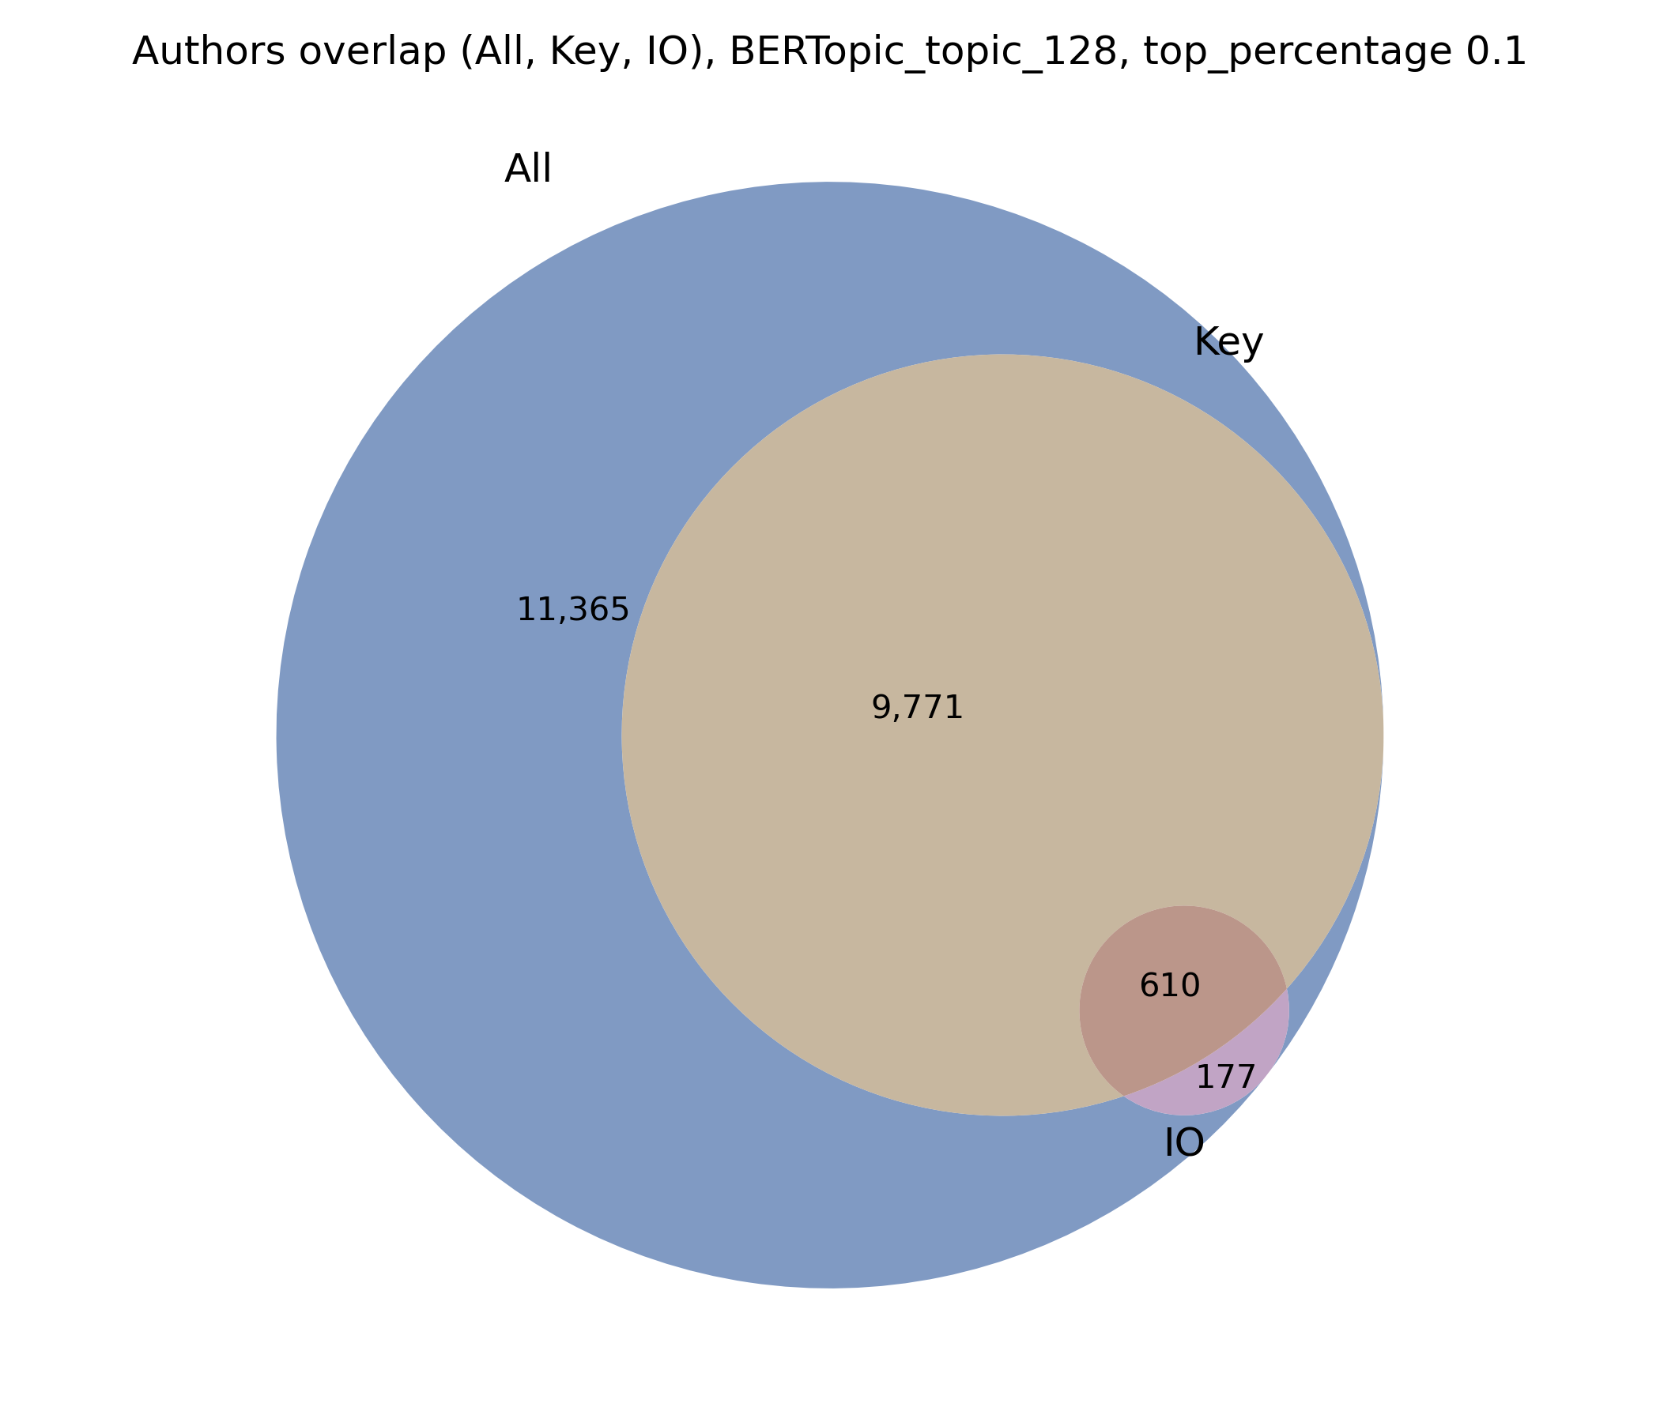
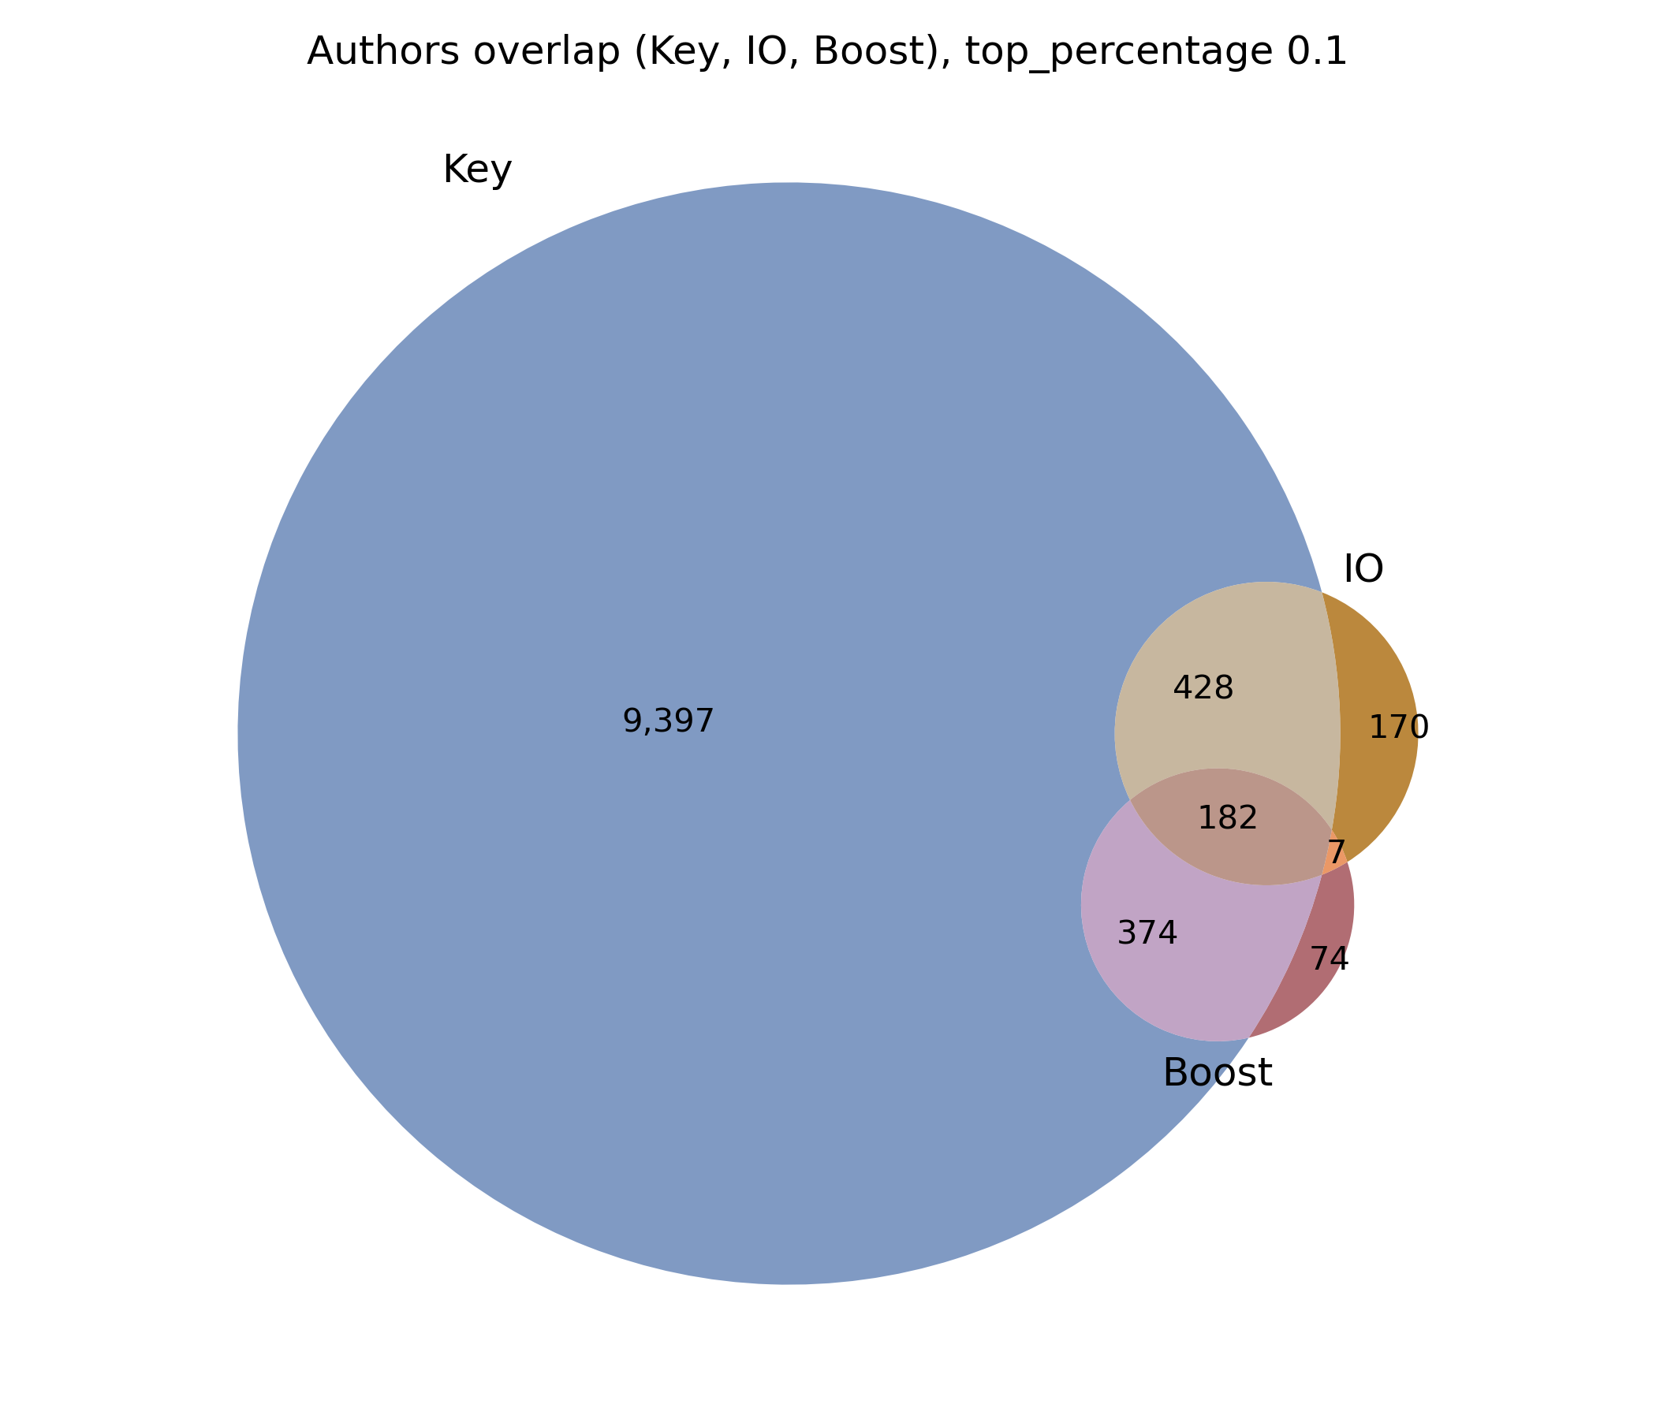
Author Overlap

Slide 3
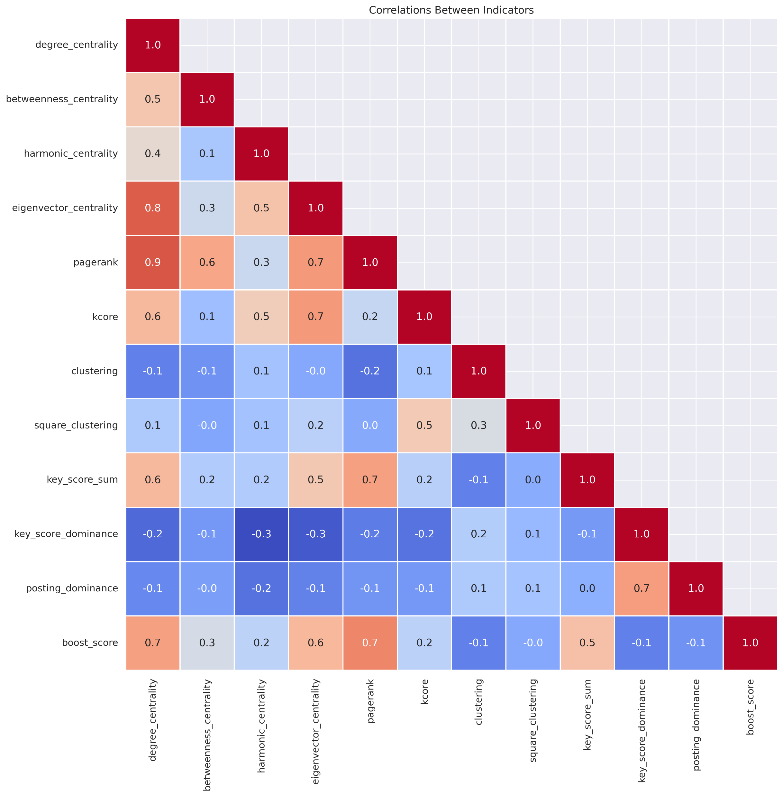
Indicators Correlation

Slide 4
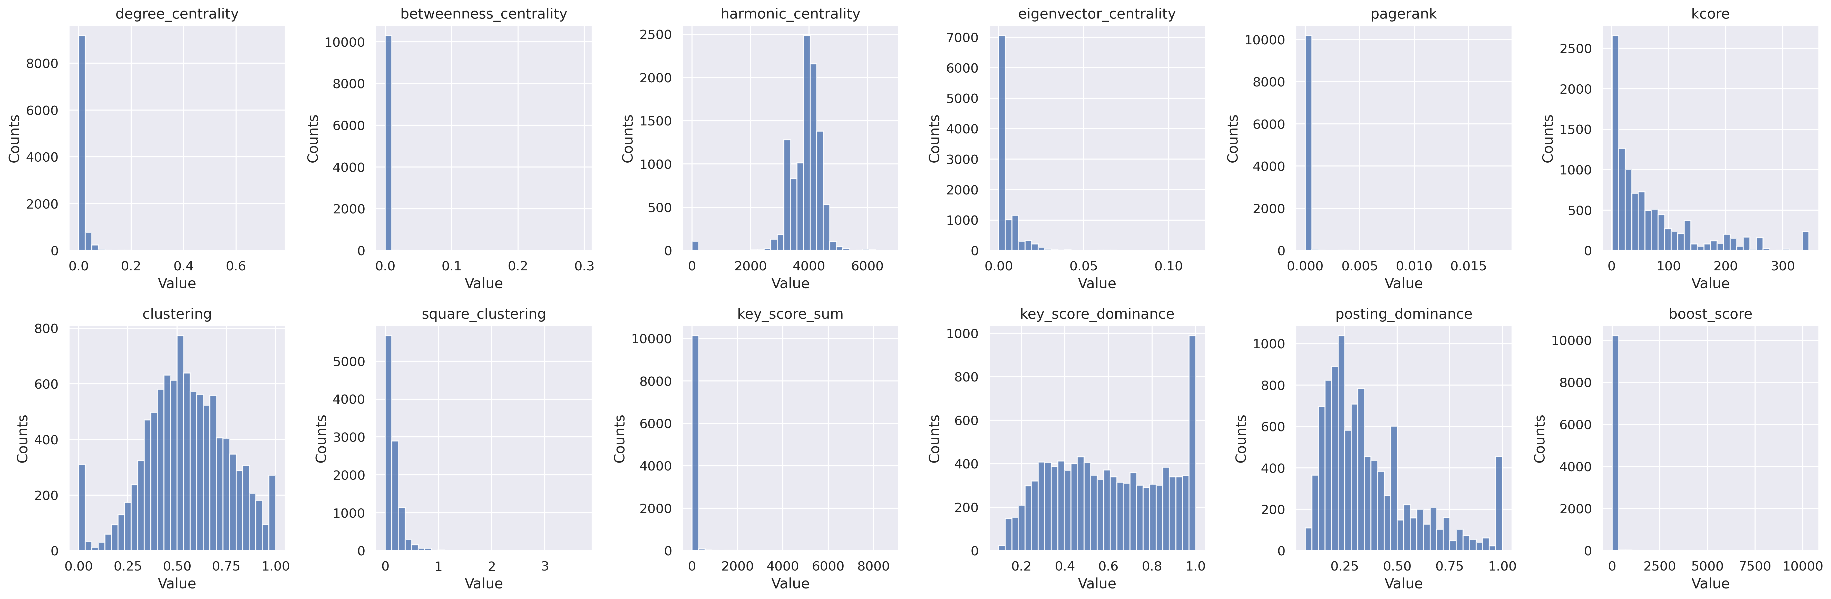
Indicators Distributions

Slide 5
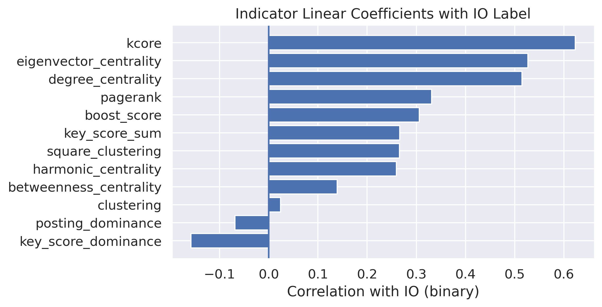
Indicators Io Linear Coefficients

Slide 6
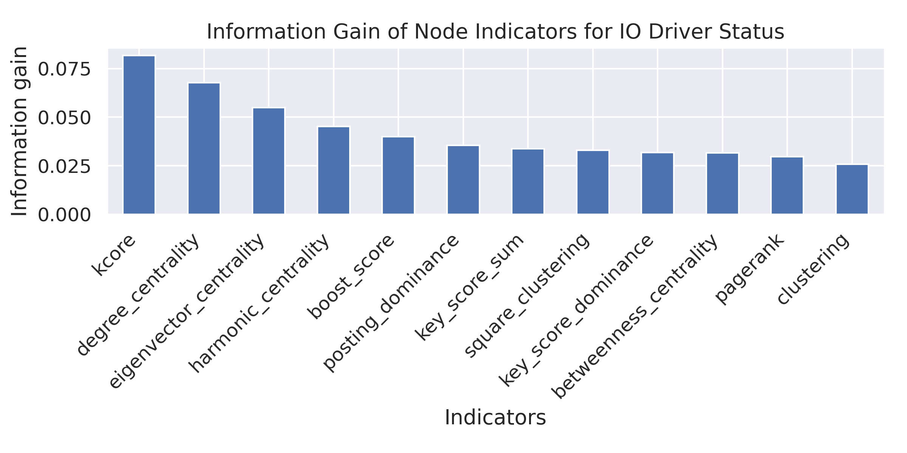
Indicators Information Gain

Slide 7
Classification: Pipeline Parameters
IO and Key Authors Overview (BERTopic_topic_256)
Total authors: 21,923
IO authors: 787 (3.6% of all authors)
Key authors: 4,485 (20.5% of all authors)
Boost authors: 318 (1.5% of all authors)
Overlap between IO and key authors:
  473 authors are both IO and key authors
  60.1% of IO authors are also key authors

Slide 8
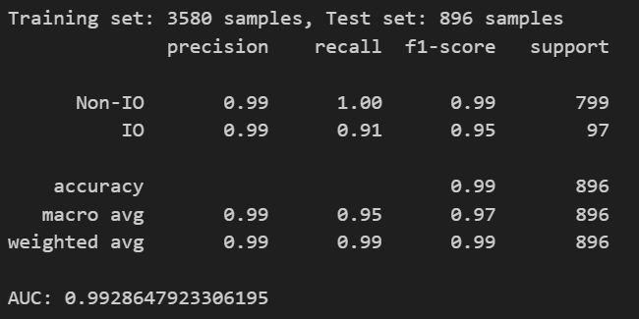
Classification: Random Forest
(key authors only)

