Slide 1



Backbone Graph
06.05.2026
Amit Ner Gaon, Noa Tal, Idan Muallem
Prof. Rami Puzis

Slide 2
Terms & Definitions - IO
Information Operation (IO): A collection of publications by coordinated actors pursuing a shared intent while misleading others.
IO Driver: An account that promotes one or more IO.
Author ‘s IO Label: label = 1 if the author is a IO Driver and label = 0 if not.

Slide 3
Terms & Definitions - Key
Key Author: An author who is a leading participant in one or more topic(s).
Author-Topic Key Score: A measure of how strongly an author is associated with a topic, emphasizing topic-specific content. It is calculated based on the use of topic-related entities (e.g., hashtags, mentions, URLs) in the author’s posts.
Author Key Score: sum of the Author-Topic Key Score across all topics.

Slide 4
Project Core Concepts
Background:
Successful information operation drivers lead topic-level discourse and act in coordination with other drivers.
Objectives:
Author’s key score to quantify topic leadership.
Co-Actions graph to capture behavioral similararty among key authors.
Goal:
Calculation of graph-based indicators (e.g., centralities) to identify information operation (IO) drivers.

Slide 5
Coordinated Behaviour

Slide 6

Co-Actions Graph
Nodes: authors in the discourse.
Edges: co-action relations between author pairs (e.g., co-mention, co-entity, co-topic). Represents behavioral similararty between the authors.
Purpose: expose coordinated behaviour and structural signals for IO detection.

Slide 7

Backbone Graph & IO Indicators
The graph represents behaviour similarity between users.
IO drivers tend to be in Dense Communities.
For each user, we use graph-based indicators to measure how embedded he\she is in the network.
Each user is described by vector of features.

Slide 8
Coordinated Behaviour - Choosing Indicator

Slide 9

Indicators Analysis – Information Gain
Information Gain is used to measure how much knowledge one variable provides about another.

Slide 10


Indicators Analysis – SHAP
SHAP analysis on XGBoost model
SHAP explains how much each feature contributes to a model’s prediction.

Slide 11
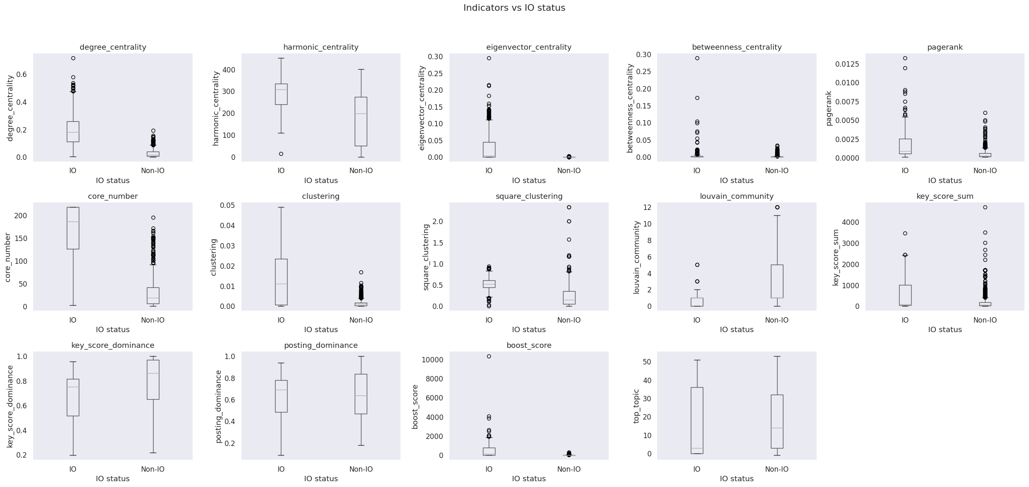
Indicators Analysis – Box Plots
A box plot is a method for demonstrating graphically the distribution of numerical data across different groups.

Slide 12
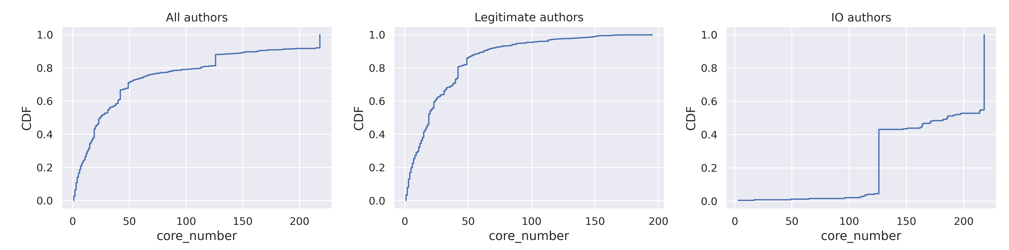
Indicators Analysis – CDF
The Cumulative Distribution Function (CDF) show the probability that the variable will take a value less than or equal to a particular value in X-axis.

Slide 13
Core Number
What k-core measures:
  A k-core is a maximal subgraph that contains nodes of degree k or more. The core number of a node is the largest value k of a k-core containing that node.(NetworkX documentation).
  How deeply a user is embedded inside the dense community in the graph.
  Higher core number → node belongs to tightly connected, cohesive groups.
Why it matters for IO detection:
  IO drivers don’t just connect , they coordinate. In a behaviour similarity graph, this coordination places them inside dense, highly connected community.
  Being in such community is what core number measures.
Coordinated actors → Placed inside dense community → High k-core

Slide 14

Core Number

Slide 15
Hypotheses

Slide 16
Hypotheses
H1 (Dense Community Hypothesis):
  IO drivers are more likely to appear in densely connected regions of the co-action graph.
  Evaluation: Compare IO driver probability across core-number values.
  Statistical test: Binomial Logistic Regression (Wald test on coefficient).
    Dependent variable: IO status (categorical, 0/1).
    Independent variable: k-core values (numeric, discrete non-negative).
H2 (Community Heterogeneity Hypothesis):
  IO drivers are non-uniformly distributed across communities in the co-action graph.
  Evaluation: Compare IO driver probability across different communities. Communities partition by authors’ top topic using the key score.
  Statistical test: permutation-based chi-square test of homogeneity.
    Dependent variable: IO status (categorical, 0/1).
    Independent variable: community membership (categorical).

Slide 17
H1 (Dense Community Hypothesis)
H1 (Dense Community Hypothesis):
  IO drivers are more likely to appear in densely connected regions of the co-action graph.
  Evaluation: Compare IO driver probability across core-number values.
  Statistical test: Binomial Logistic Regression (Wald test on coefficient).
    Dependent variable: IO status (categorical, 0/1).
    Independent variable: nodes’ core-number values (numeric, discrete non-negative).
H1 (Embedding Hypothesis) tests whether users who are more deeply embedded in dense regions of the co-action graph are more likely to be IO drivers.
The intuition is that IO actors often rely on repeated coordination and mutual amplification, which necessarily places them inside tightly connected groups rather than at the network’s periphery.

Slide 18


H1 (Dense Community Hypothesis) group mode: smaller
Ecuador Campaigns
Group mode: smaller - each point represents authors whose indicator value is less than the x-axis value.

Slide 19


H1 (Dense Community Hypothesis) group mode: larger
Ecuador Campaigns
Group mode: larger - each point represents authors whose indicator value is greater than the x-axis value.

Slide 20
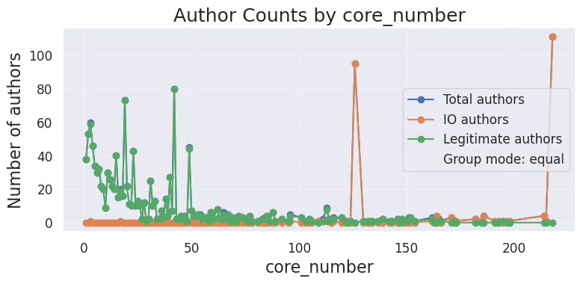
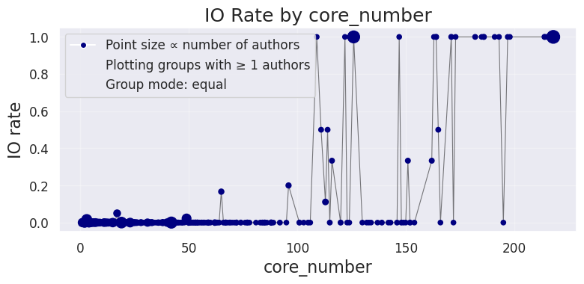
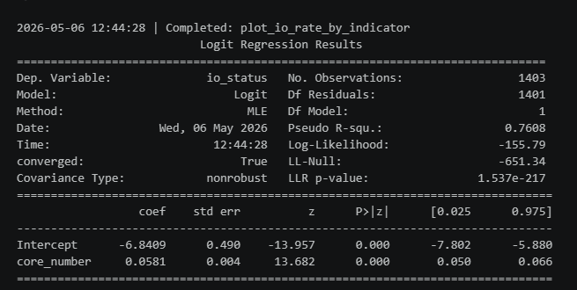
H1 (Dense Community Hypothesis)
Ecuador Campaigns
Using binomial logistic regression with a Wald test on the coefficient

Slide 21
H2 (Community Heterogeneity)
H2 (Community Heterogeneity Hypothesis):
  IO drivers are non-uniformly distributed across communities in the co-action graph.
  Evaluation: Compare IO driver probability across different communities. Communities partition by authors’ top topic and by Louvain algorithm .
  Statistical test: permutation-based chi-square test of homogeneity.
    Dependent variable: IO status (categorical, 0/1).
    Independent variable: community membership (categorical).
H2 (Community Heterogeneity Hypothesis) tests whether IO drivers are concentrated in specific communities\topics rather than being evenly spread across the co-action graph.
The intuition is that IO actors often act around shared narratives, goals, or audiences, which leads them to cluster in particular communities. If this is true, some communities should show a higher probability of containing IO drivers than others.

Slide 22
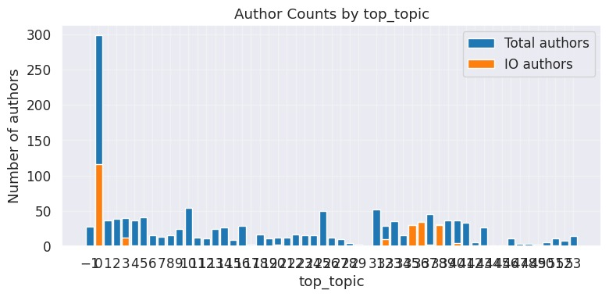
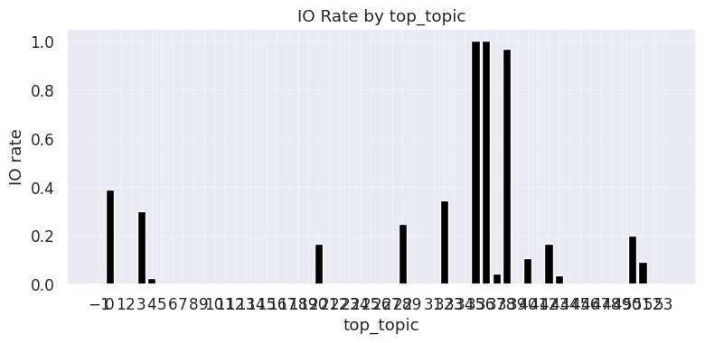
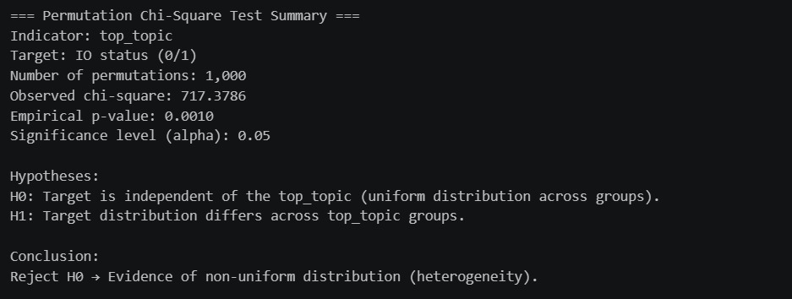
H2 (Community Heterogeneity) top topic
Ecuador Campaigns

Slide 23
Choosing System Configuration

Slide 24
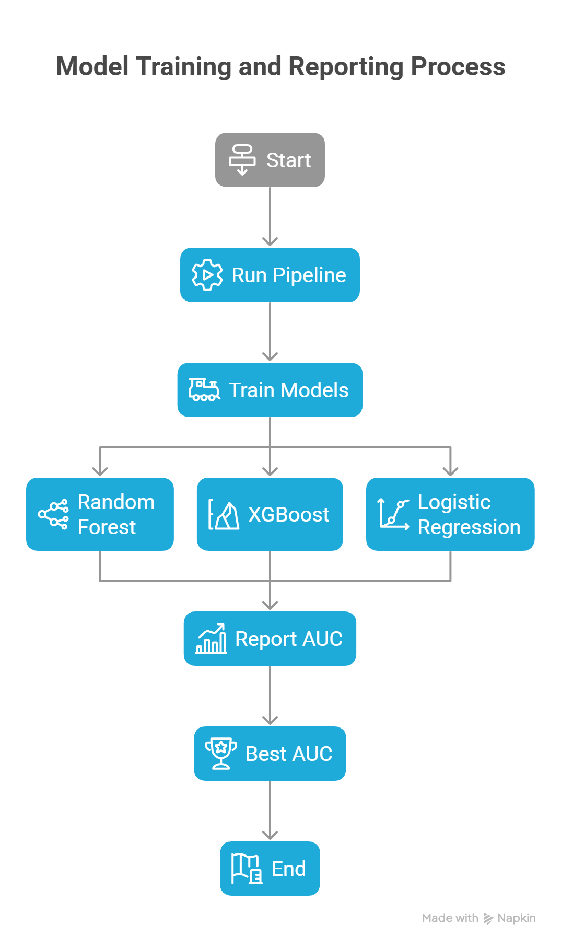
Hyper-Parameter Optimization
Runs the same pipeline across multiple configurations:
  Topic column (model + model’s parameter)
  Top percentage (the percentage of getting the key and boost authors by relevant the score)
  Key authors mode (per-topic / global)
    Note: In per-topic mode, overlap between topics may result selecting more than X% of global authors.
  Graph type: undirected
For each configuration:
  Train models: Random Forest, XGBoost, Logistic Regression
  Report model auc and best AUC.
AUC is evaluated on all accounts, with non-key authors represented by zero-filled features.
(configuration)

Slide 25
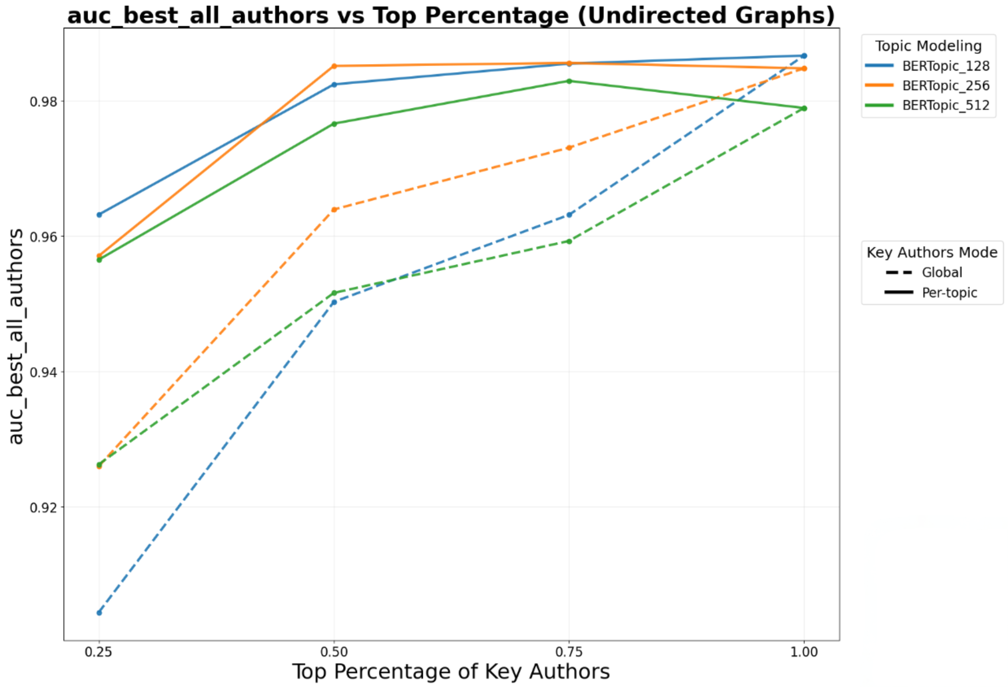
Parameter Sweep AUC Analysis

Slide 26
Data

Slide 27
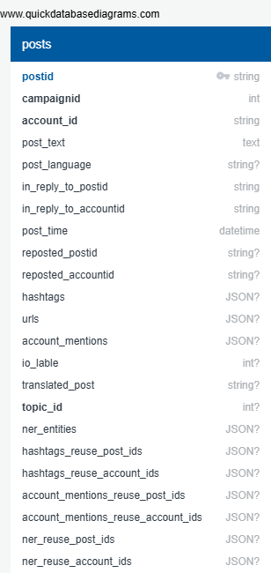
Schema
BGU INPUT
For Evaluation
BGU OUTPUT

Slide 28
Datasets
Labeled IO Corpus Collection of 26 information operation (IO). Campaigns from multiple countries. Fully labeled (IO vs. Control accounts). https://zenodo.org/records/14189193 Ecuador Campaign Subset 787 IO accounts | 21,138 Control accounts 700K IO tweets | 770K Control tweets
Notes:
[1] Seckin, O. C., Pote, M., Nwala, A. C., Yin, L., Luceri, L., Flammini, A., & Menczer, F. (2025, June). Labeled datasets for research on information operations. In Proceedings of the International AAAI Conference on Web and Social Media (Vol. 19, pp. 2567-2574).
[2] Balasubramanian, A., Zou, V., Narayana, H., You, C., Luceri, L., & Ferrara, E. (2024). A public dataset tracking social media discourse about the 2024 us presidential election on twitter/x. arXiv preprint arXiv:2411.00376.

