Slide 1



Backbone Graph
19.02.2026
Amit Ner Gaon, Noa Tal
Prof. Rami Puzis

Slide 2
Core Concepts
The research begins with the hypothesis that successful information operation drivers must lead topic-level discourse and act in coordination with a network of other drivers.
We compute a key score for each author to quantify topic leadership and construct a backbone graph capturing coordination among high-scoring authors.
Thus, enables the computation of graph-based indicators (e.g., centralities) to identify information operation drivers.

Slide 3
Boost workflow to be decided
Boost Author Selection

Slide 4
Terms & Definitions - IO
Information Operation (IO): A collection of publications produced by a set of actors performing similar or complementary actions in pursuit of a shared intent while misleading others.
IO Driver: An account that promotes one or more IO.
Author ‘s IO Label: label = 1 if the author is a IO Driver and label = 0 if not.

Slide 5
Terms & Definitions - Key
Key Author: An author who is a leading participant in one or more topic(s).
Author-Topic Key Score: A measure of how strongly an author is associated with a topic, emphasizing topic-specific content. It is calculated based on the use of topic-related entities (e.g., hashtags, mentions, URLs) in the author’s posts.
Author Key Score: sum of the Author-Topic Key Score across all topics.

Slide 6
Terms & Definitions - Boost
Boost author:
Author`s Boost Score:

Slide 7
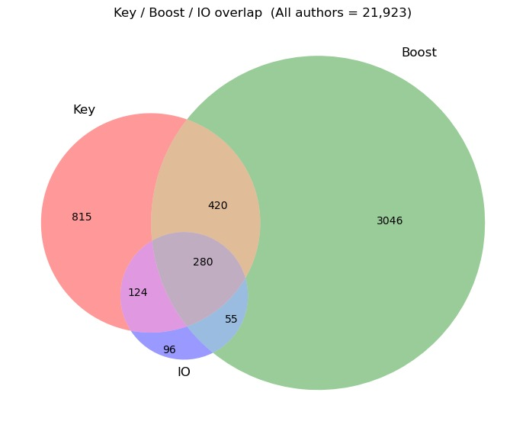

Venn

Slide 8
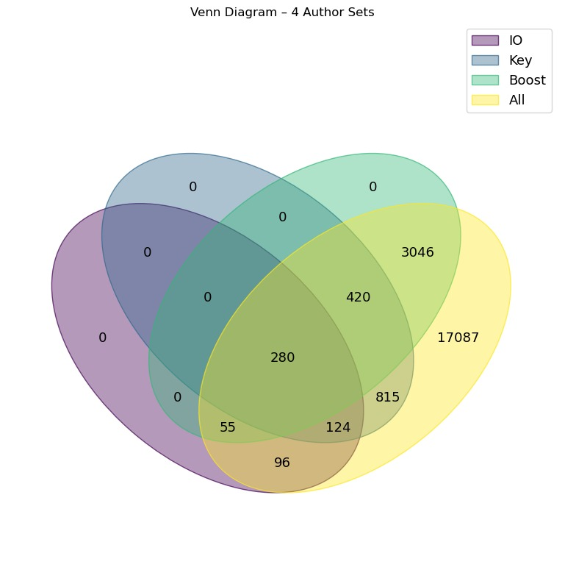
Venn

