Slide 1



Backbone Graph
11.03.2026
Amit Ner Gaon, Noa Tal
Prof. Rami Puzis

Slide 2
Core Concepts
Hypothesis:
Successful information operation drivers lead topic-level discourse and act in coordination with other drivers.
Objectives:
Author’s key score to quantify topic leadership.
Backbone graph to capture coordination among key authors.
Goal:
Calculation of graph-based indicators (e.g., centralities) to identify information operation (IO) drivers.

Slide 3
Boost workflow to be decided
Boost Author Selection

Slide 4
Datasets
Labeled IO Corpus Collection of 26 information operation (IO). Campaigns from multiple countries. Fully labeled (IO vs. Control accounts). https://zenodo.org/records/14189193 Ecuador Campaign Subset 787 IO accounts | 21,138 Control accounts 700K IO tweets | 770K Control tweets | US 2024 Election Dataset Clean dataset. 42,211,159 tweets. January 1 – December 31, 2024. Key Timeline Events Jul 13 – Attempted assassination of Donald Trump Jul 21 – Joe Biden withdrew from presidential race Aug 5 – Kamala Harris formally nominated Nov 5 – Election Day Nov 6 – Election results announced
Notes:
[1] Seckin, O. C., Pote, M., Nwala, A. C., Yin, L., Luceri, L., Flammini, A., & Menczer, F. (2025, June). Labeled datasets for research on information operations. In Proceedings of the International AAAI Conference on Web and Social Media (Vol. 19, pp. 2567-2574).
[2] Balasubramanian, A., Zou, V., Narayana, H., You, C., Luceri, L., & Ferrara, E. (2024). A public dataset tracking social media discourse about the 2024 us presidential election on twitter/x. arXiv preprint arXiv:2411.00376.

Slide 5
Terms & Definitions - IO
Information Operation (IO): A collection of publications by coordinated actors pursuing a shared intent while misleading others.
IO Driver: An account that promotes one or more IO.
Author ‘s IO Label: label = 1 if the author is a IO Driver and label = 0 if not.

Slide 6
Terms & Definitions - Key
Key Author: An author who is a leading participant in one or more topic(s).
Author-Topic Key Score: A measure of how strongly an author is associated with a topic, emphasizing topic-specific content. It is calculated based on the use of topic-related entities (e.g., hashtags, mentions, URLs) in the author’s posts.
Author Key Score: sum of the Author-Topic Key Score across all topics.

Slide 7
Terms & Definitions - Boost
Boost author: An author whose activity is followed by a significant increase in discussion activity.
Author`s Boost Score: A quantitative measure calculated as the cumulative burst weights associated with a user's activity, based on discussion volume increases occurring shortly after the user posts or contributes.

Slide 8
Backbone Graph
Nodes: Key authors.
Edges: Represent behavioural similarity, based on co-actions (e.g. same hashtag usage, repos)
Edges’ Weights: The number of the occurrences of co-actions between the authors.
Purpose: Represent the discussion structure and expose signals of coordinated behaviour for IO detection.

Slide 9
Indicators: Graph Theory
Degree Centrality: Counts how many direct connections a user has.
Betweenness Centrality: measures how frequently a node appears on the shortest path between other.
Harmonic Centrality: Reflects how easily a user can reach many others in the network.
Eigenvector Centrality: Shows whether a user is connected to other high-scoring users.
Pagerank: Estimates a user’s overall importance based on how many important users connect to them.
K-core: Indicates how deeply embedded a user is within the dense group.
Clustering: Measures how tightly connected a user’s neighbors are to each other.
Square Clustering: Measures how often a user participates in tightly connected small group structures.

Slide 10
Indicators: Key Score and Boost
Key Score Sum: The sum of the all the per-topic tdidf score. How much the author is a leading participant in the topics.
Key Score Dominance: Author’s max score in a topic, divided by total score across all topics. Higher values indicate the author is mostly a leading participate in specific(s) topic(s). (in process)
Posting Dominance: Author’s max number of posts in a topic, divided by total number of posts across all topics. Higher values indicate the author is mostly a leading participate in specific(s) topic(s). (in process)
Boost Score : A quantitative measure calculated as the cumulative burst weights associated with a user's activity, based on discussion volume increases occurring shortly after the user posts or contributes. (in process)

Slide 11
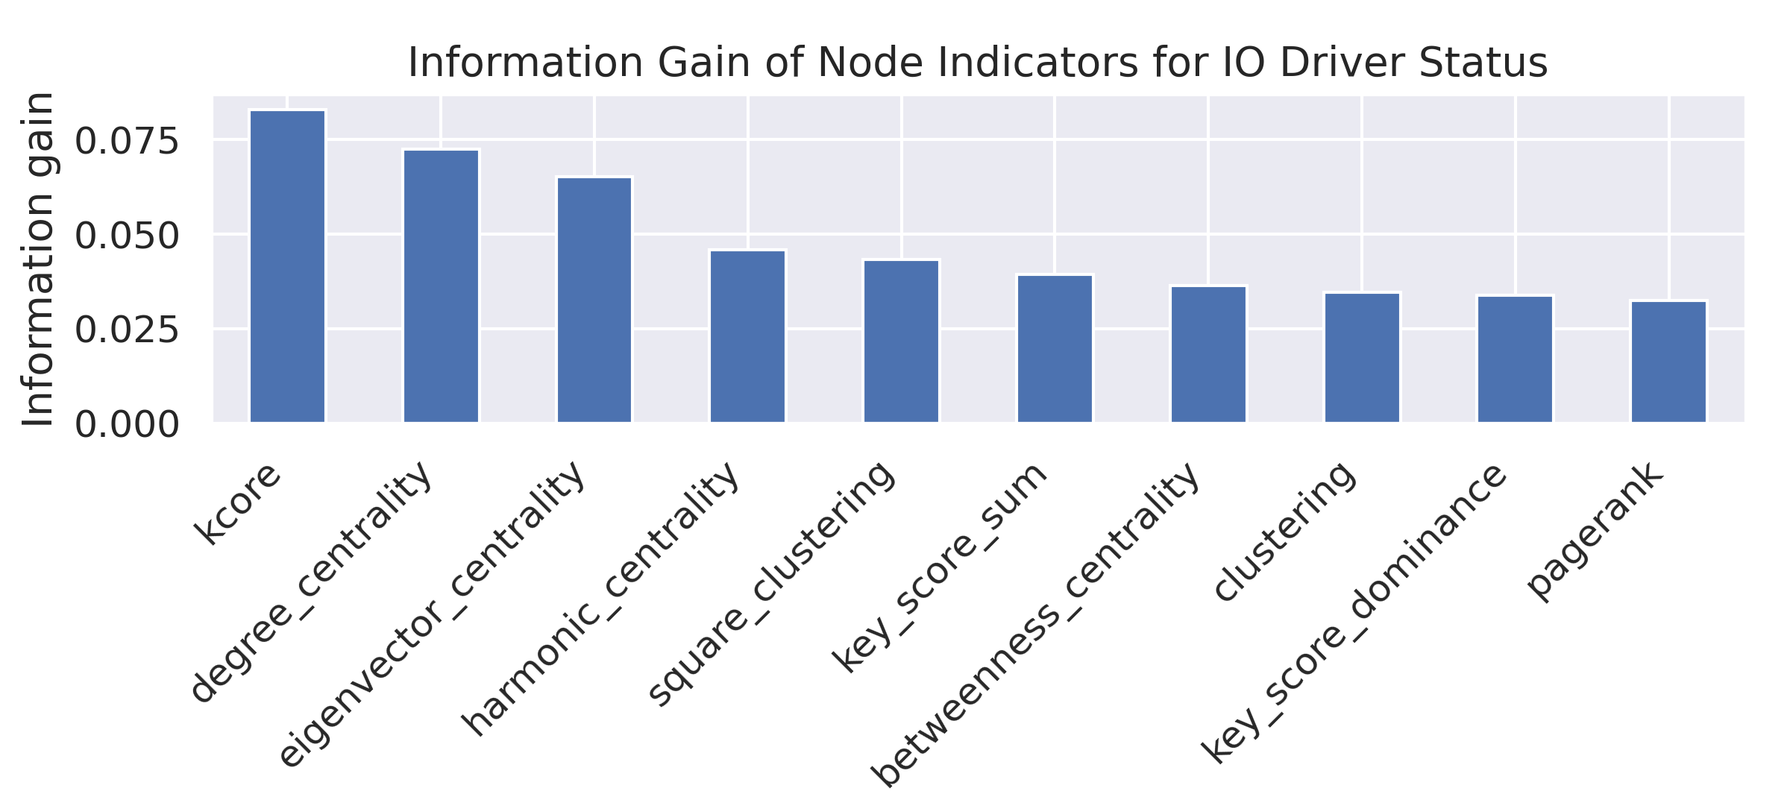
Indicators: Information Gain

Slide 12

Backbone Graph & IO Indicators
high degree centrality
high eigenvector centrality
high k-core
all high

Slide 13
Entities Reuse
Reuse entities are entities (e.g., hashtags, URLs, mentions, keywords) that appear in a post and were previously used by other posts within a defined time window.
Collums in df:
<entity_type>_reuse_<time_window>_postids | list | Earlier posts within a <time_window> that share at least one entity.
<entity_ type >_reuse_<time_window>_accountids | list | Account ids of the authors of the relevant posts.

Slide 14
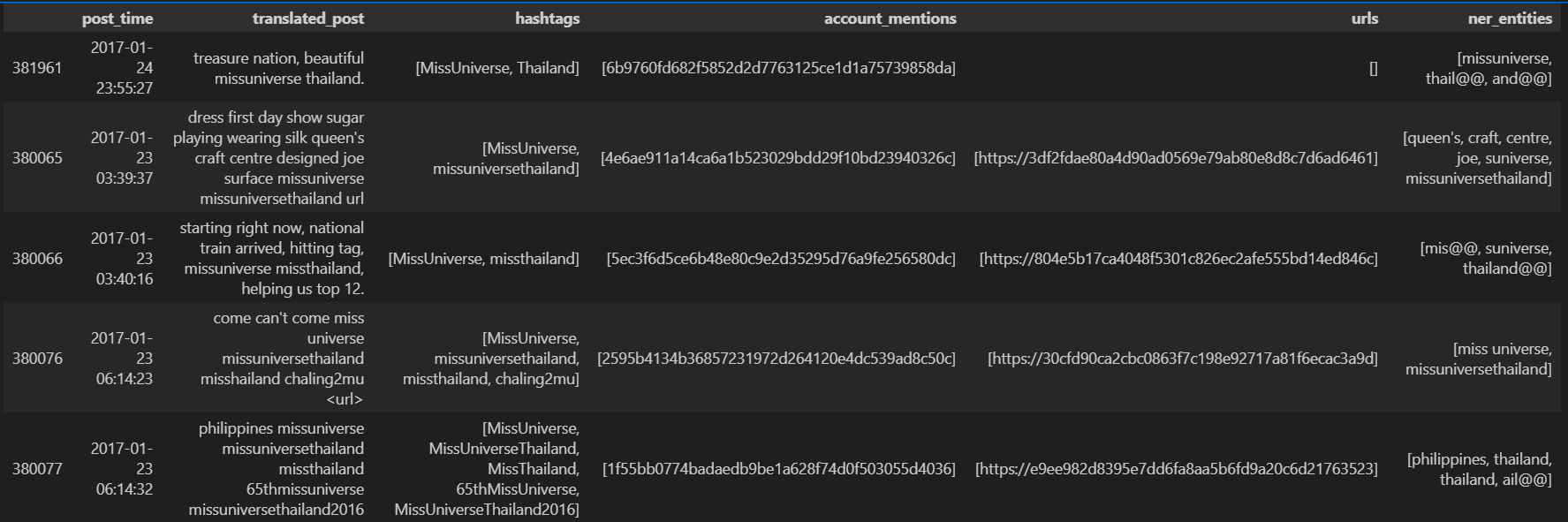
Entities Reuse
The first post is the sampled post with reused hashtags, followed by the posts that the post use their hashtags within the 4D.

Slide 15
Entities Reuse - Account Relations
Account Relations is the edges in the graph.
Direct interactions: Edges are created when an account directly interacts with another account:
  Reply: in_reply_to_accountid → accountid
  Mention: account_mentions → accountid
  Repost: reposted_accountid → accounted
Entity Reuse interactions: Edges are created when accounts reuse the same entity within time_window∈[12H, 3D]:
  hashtags_reuse_<time_window>_accountids → accountid
  urls_reuse _<time_window>_accountids → accountid
  account_mentions_reuse _<time_window>_accountids → accountid
  ner_entities_reuse _<time_window>_accountids → accounted

Slide 16
Parameters: Topic Modelling
Topic modelling identifies main discussion themes in a collection of texts by grouping similar posts.
In this project we use BERTopic, which groups posts using semantic text embeddings.
The minimum topic size parameter defines the minimum number of posts required to create a topic. Small clusters\topics below this size are treated as outliers or merged with other topics.

Slide 17
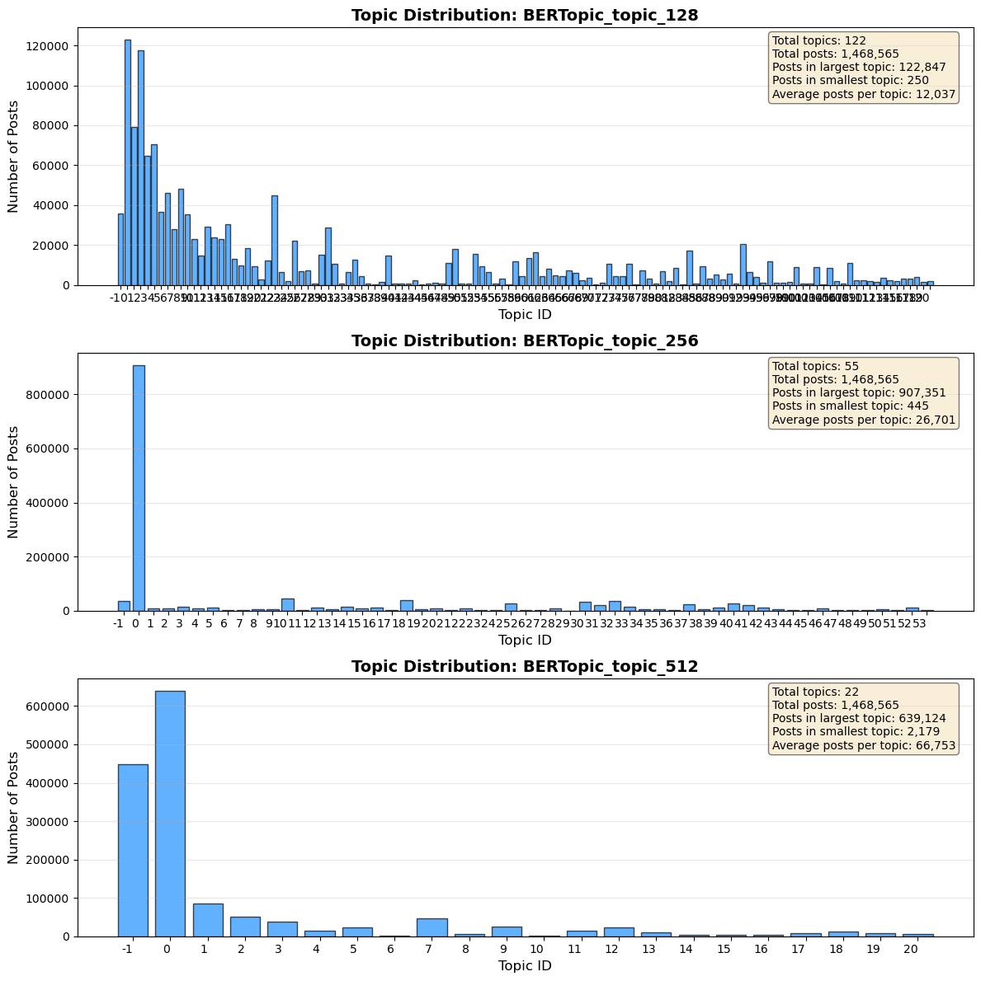
Parameters: Topic Modelling

Slide 18
Parameters: Topic Modelling

Slide 19
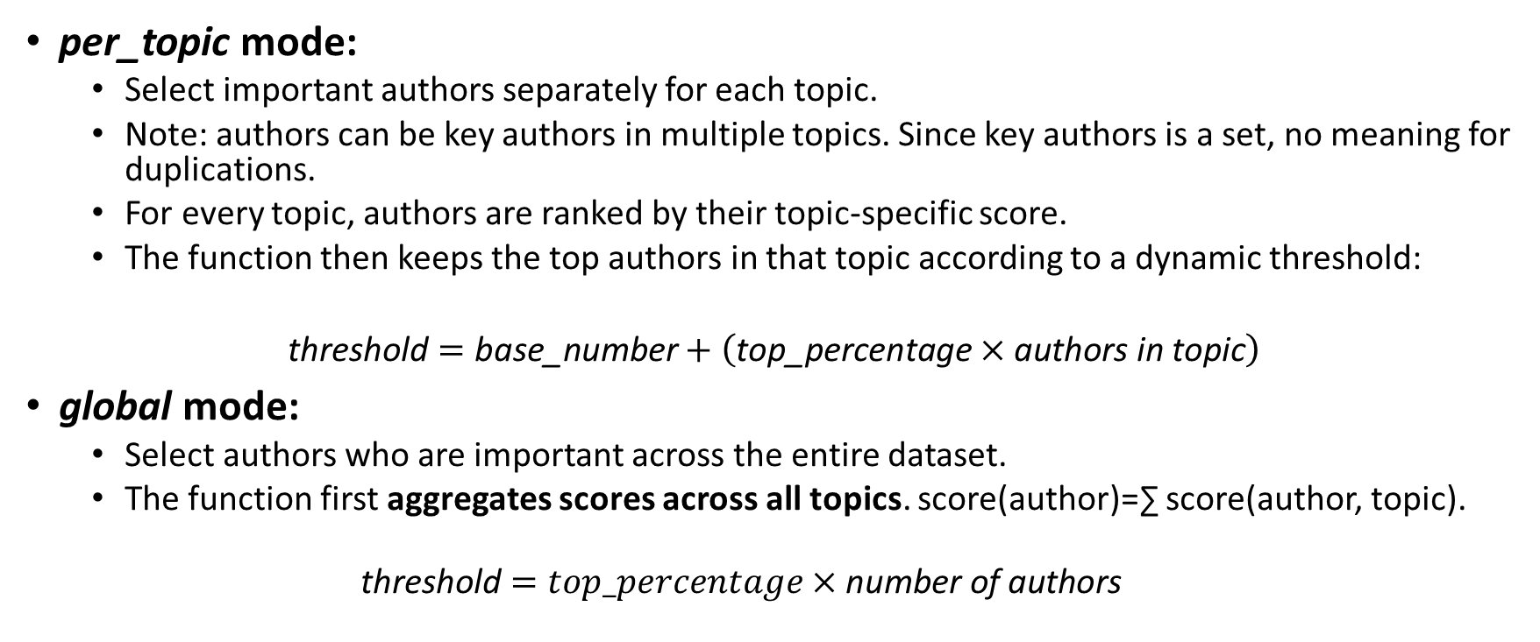
Parameters: Key Authors Mode
per_topic mode:
  Select important authors separately for each topic.
  Note: authors can be key authors in multiple topics. Since key authors is a set, no meaning for duplications.
  For every topic, authors are ranked by their topic-specific score.
  The function then keeps the top authors in that topic according to a dynamic threshold:
$$\text{threshold}=\text{base}\text{_}\text{number}+\left(\text{top}\text{_}\text{percentage}×\text{authors} \text{in} \text{topic}\right)$$
global mode:
  Select authors who are important across the entire dataset.
  The function first aggregates scores across all topics. score(author)=∑​ score(author, topic).
  $$\text{threshold}=top_percentage×\text{number} \text{of} \text{authors}$$

Slide 20
Parameters: Directed and Undirected Graphs
A graph is a structure used to represent relationships between entities. It consists of nodes (e.g., social media accounts) and edges that represent connections between them.
Directed Graph. In a directed graph, edges have a direction (A → B). This means the relationship goes from one node to another.
In this project, directed graphs represent information flow, such as when one account shares content from another account or use entity that was used by the other account.
Undirected Graph. In an undirected graph, edges have no direction (A — B). The connection simply shows that two nodes are related.
In this project, undirected graphs represent coordination, for example when two accounts use the same entity (e.g., hashtags), without considering the timing of their actions.

Slide 21
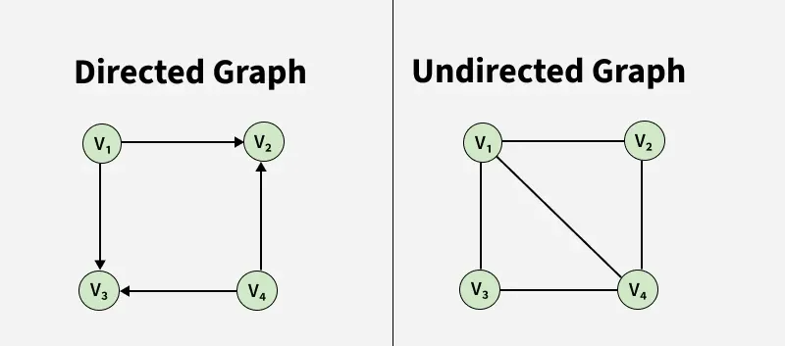
Parameters: Directed and Undirected Graphs
Source: Geeks For Geeks

Slide 22
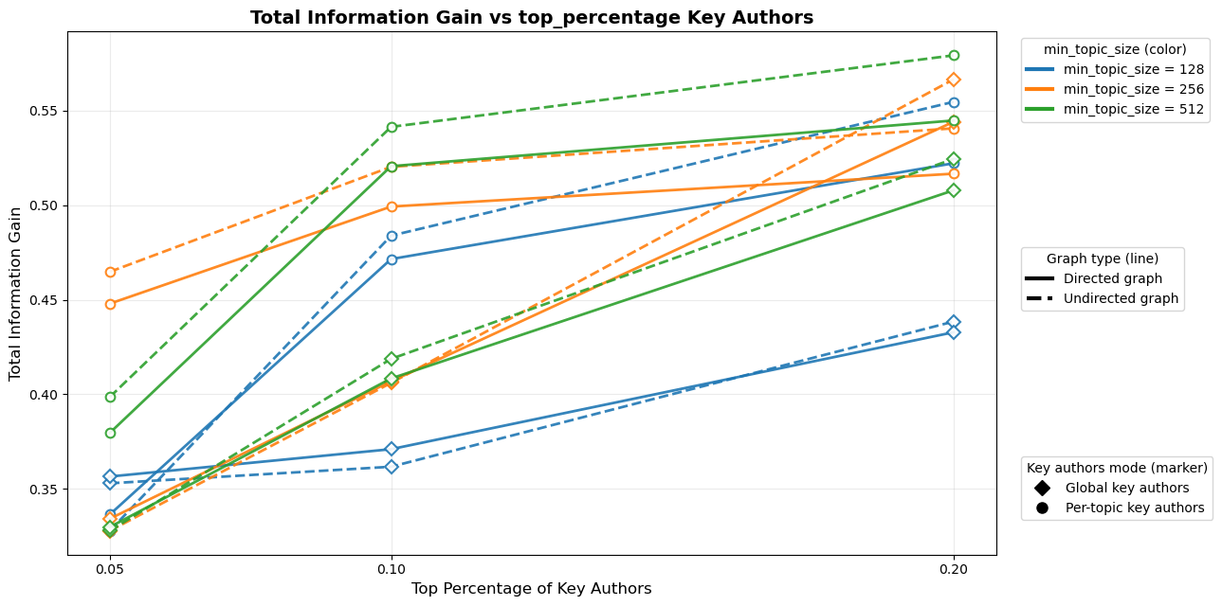
Information Gain Analysis

Slide 23
Terms & Definitions – Boost
(once more)
Boost author: An author whose activity is followed by a significant increase in discussion activity.
Author`s Boost Score: A quantitative measure calculated as the cumulative burst weights associated with a user's activity, based on discussion volume increases occurring shortly after the user posts or contributes.

Slide 24
Boost Authors
Signal Detection Aggregate posts into 5-min bins and compute the growth (delta) between consecutive windows.
Statistical Filtering Apply a Z-score threshold (Z > 3) to isolate statistically significant activity bursts.
Temporal Lookback For each burst, examine the 5-min window immediately preceding the spike.
Boost Attribution Distribute burst intensity evenly among lookback users to form each account's Boost Score.

Slide 25
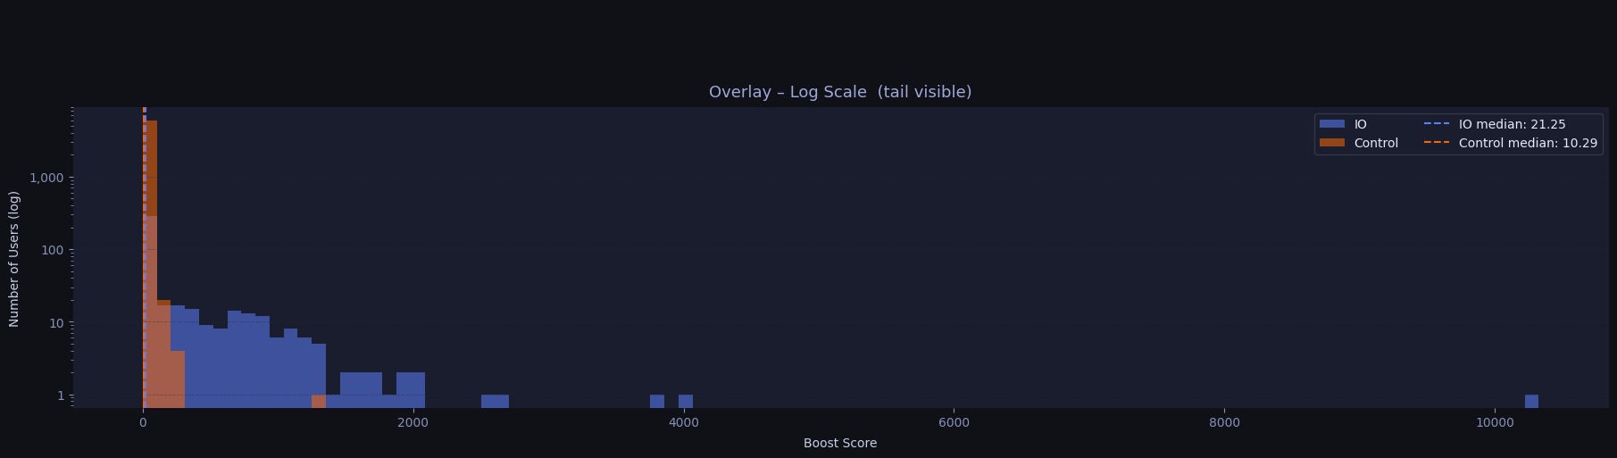
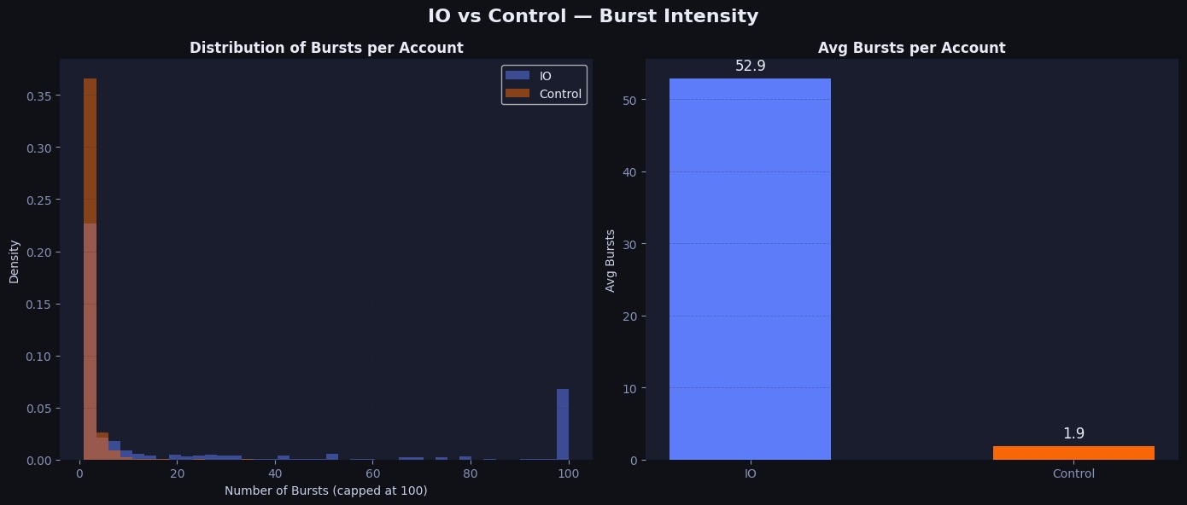
Boost Authors

