Slide 1



Backbone Graph - Terms & Definitions
28.04.2026
Amit Ner Gaon, Noa Tal
Prof. Rami Puzis

Slide 2
Terms & Definitions - IO
Information Operation (IO): A collection of publications by coordinated actors pursuing a shared intent while misleading others.
IO Driver: An account that promotes one or more IO.
Author ‘s IO Label: label = 1 if the author is a IO Driver and label = 0 if not.

Slide 3
Terms & Definitions - Key
Key Author: An author who is a leading participant in one or more topic(s).
Author-Topic Key Score: A measure of how strongly an author is associated with a topic, emphasizing topic-specific content. It is calculated based on the use of topic-related entities (e.g., hashtags, mentions, URLs) in the author’s posts.
Author Key Score: sum of the Author-Topic Key Score across all topics.

Slide 4

Co-Actions Graph
Nodes: authors in the discourse.
Edges: co-action relations between author pairs (e.g., co-mention, co-entity, co-topic). Represents behavioral similararty between the authors.
Purpose: expose coordinated behaviour and structural signals for IO detection.

Slide 5
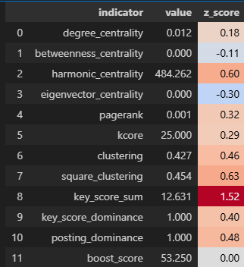
Backbone Graph & IO Indicators
The graph represents behaviour similarity between users.
IO drivers tend to be more central and more connected than legitimate users.
We use indicators to measure, for each user, how embedded they are in the network.
Each user is converted into numeric features.
These features can then be used for different tasks, such as IO classification.
Indicators of an Account
Account ID: `718633c01af2bd9c2435764721d961a6ae113dec92`

Slide 6
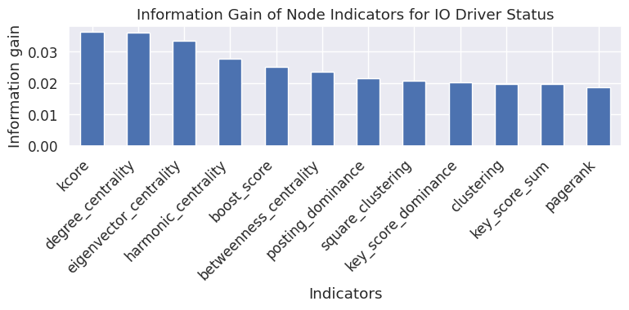
Indicators Analysis – Information Gain
Information Gain is used to measure how much knowledge one variable provides about another.

Slide 7
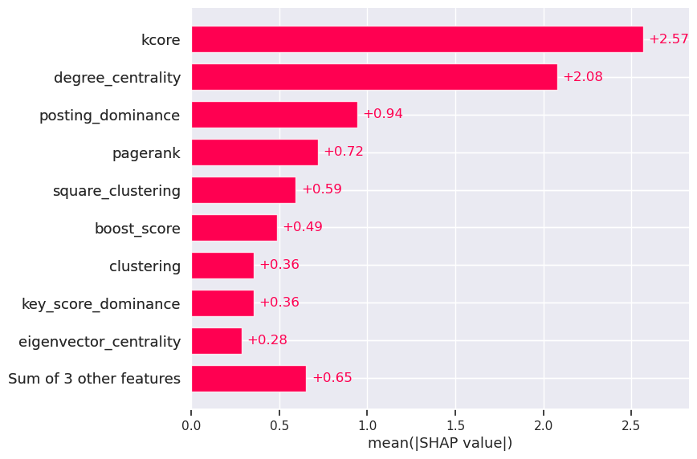
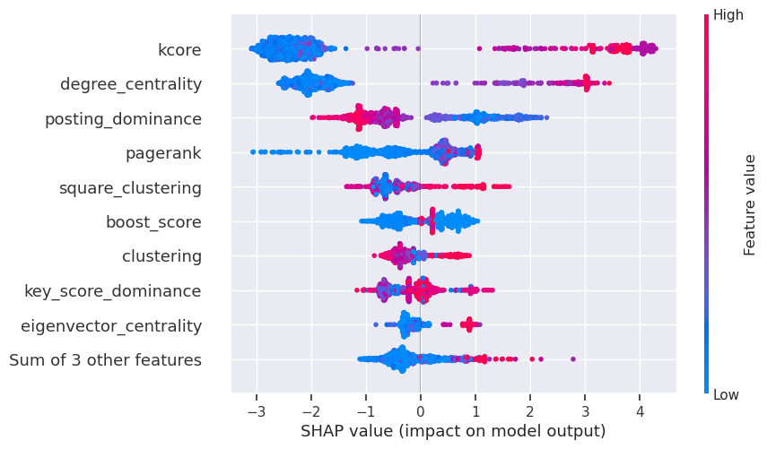
Indicators Analysis – SHAP
SHAP analysis on XGBoost model
SHAP explains how much each feature contributes to a model’s prediction.

Slide 8
Indicators: Graph Theory
Degree Centrality: Counts how many direct connections a user has.
Betweenness Centrality: measures how frequently a node appears on the shortest path between other.
Harmonic Centrality: Reflects how easily a user can reach many others in the network.
Eigenvector Centrality: Shows whether a user is connected to other high-scoring users.
Pagerank: Estimates a user’s overall importance based on how many important users connect to them.
K-core: Indicates how deeply embedded a user is within the dense group.
Clustering: Measures how tightly connected a user’s neighbors are to each other.
Square Clustering: Measures how often a user participates in tightly connected small group structures.

Slide 9
Indicators: Key Score and Boost
Key Score Sum: The sum of the all the per-topic tdidf score. How much the author is a leading participant in the topics.
Key Score Dominance: Author’s max score in a topic, divided by total score across all topics. Higher values indicate the author is mostly a leading participate in specific(s) topic(s).
Posting Dominance: Author’s max number of posts in a topic, divided by total number of posts across all topics. Higher values indicate the author is mostly a leading participate in specific(s) topic(s).
Boost Score : A quantitative measure calculated as the cumulative burst weights associated with a user's activity, based on discussion volume increases occurring shortly after the user posts or contributes.

