Slide 1



Backbone Graph
06.05.2026
Amit Ner Gaon, Noa Tal, Idan Muallem
Prof. Rami Puzis

Slide 2
Terms & Definitions - IO
Information Operation (IO): A collection of publications by coordinated actors pursuing a shared intent while misleading others.
IO Driver: An account that promotes one or more IO.
Author ‘s IO Label: label = 1 if the author is a IO Driver and label = 0 if not.

Slide 3
Terms & Definitions - Key
Key Author: An author who is a leading participant in one or more topic(s).
Author-Topic Key Score: A measure of how strongly an author is associated with a topic, emphasizing topic-specific content. It is calculated based on the use of topic-related entities (e.g., hashtags, mentions, URLs) in the author’s posts.
Author Key Score: sum of the Author-Topic Key Score across all topics.

Slide 4
Project Core Concepts
Background:
Successful information operation drivers lead topic-level discourse and act in coordination with other drivers.
Objectives:
Author’s key score to quantify topic leadership.
Co-Actions graph to capture behavioral similararty among key authors.
Goal:
Calculation of graph-based indicators (e.g., centralities) to identify information operation (IO) drivers.

Slide 5
Coordinated Behaviour

Slide 6

Co-Actions Graph
Nodes: authors in the discourse.
Edges: co-action relations between author pairs (e.g., co-mention, co-entity, co-topic). Represents behavioral similararty between the authors.
Purpose: expose coordinated behaviour and structural signals for IO detection.

Slide 7

Backbone Graph & IO Indicators
high degree centrality
high eigenvector centrality
high core-number
all high

Slide 8

Backbone Graph & IO Indicators
The graph represents behaviour similarity between users.
IO drivers tend to be in Dense Communities.
For each user, we use graph-based indicators to measure how embedded he\she is in the network.
Each user is described by vector of features.

Slide 9
Indicators: Graph Theory
Degree Centrality: Counts how many direct connections a user has.
Betweenness Centrality: measures how frequently a node appears on the shortest path between other.
Harmonic Centrality: Reflects how easily a user can reach many others in the network.
Eigenvector Centrality: Shows whether a user is connected to other high-scoring users.
Pagerank: Estimates a user’s overall importance based on how many important users connect to them.
K-core: Indicates how deeply embedded a user is within the dense group.
Clustering: Measures how tightly connected a user’s neighbors are to each other.
Square Clustering: Measures how often a user participates in tightly connected small group structures.

Slide 10
Indicators: Graph Theory
Degree Centrality: IO drivers tend to coordinate with many accounts, creating many direct connections.
Betweenness Centrality: IO drivers often connect different coordinated groups, acting as bridges between clusters.
Harmonic Centrality: IO drivers are close to many users, enabling fast coordination across the network.
Eigenvector Centrality: IO drivers are connected to other highly coordinated or central actors.
PageRank: IO drivers are reinforced by connections from other important coordinated users.
K-core: IO drivers are deeply embedded in dense, highly coordinated groups.
Clustering: IO drivers are part of tightly connected groups that coordinate actions together.
Square Clustering: IO drivers participate in small, repeated coordination patterns within tightly-knit groups.

Slide 11
Indicators: Key Score and Boost
These indicators quantify user behaviour by measuring the extent to which an individual leads, focuses, and drives activity within discussions.
The indicators capture how strongly a user contributes to topics, whether their activity is concentrated on specific narratives, and how much their actions are associated with increased engagement.
By providing a consistent numeric representation of these behavioural patterns, they enable systematic comparison between users.

Slide 12
Indicators: Key Score and Boost
Key Score Sum: The sum of the all the per-topic tdidf score. How much the author is a leading participant in the topics.
Key Score Dominance: Author’s max score in a topic, divided by total score across all topics. Higher values indicate the author is mostly a leading participate in specific(s) topic(s).
Posting Dominance: Author’s max number of posts in a topic, divided by total number of posts across all topics. Higher values indicate the author is mostly a leading participate in specific(s) topic(s).
Boost Score : A quantitative measure calculated as the cumulative burst weights associated with a user's activity, based on discussion volume increases occurring shortly after the user posts or contributes.

Slide 13
Indicators: Key Score and Boost
Key Score Sum: IO drivers tend to consistently lead discussions across topics, resulting in high overall contribution scores.
Key Score Dominance: IO drivers often focus on specific narratives where they act as main leaders.
Posting Dominance: IO drivers concentrate their activity in particular topics to push targeted messages.
Boost Score: IO drivers’ actions are often followed by increases in activity, indicating coordinated amplification after they post.

Slide 14
Coordinated Behaviour - Choosing Indicator

Slide 15

Indicators Analysis – Information Gain
Information Gain is used to measure how much knowledge one variable provides about another.

Slide 16


Indicators Analysis – SHAP
SHAP analysis on XGBoost model
SHAP explains how much each feature contributes to a model’s prediction.

Slide 17
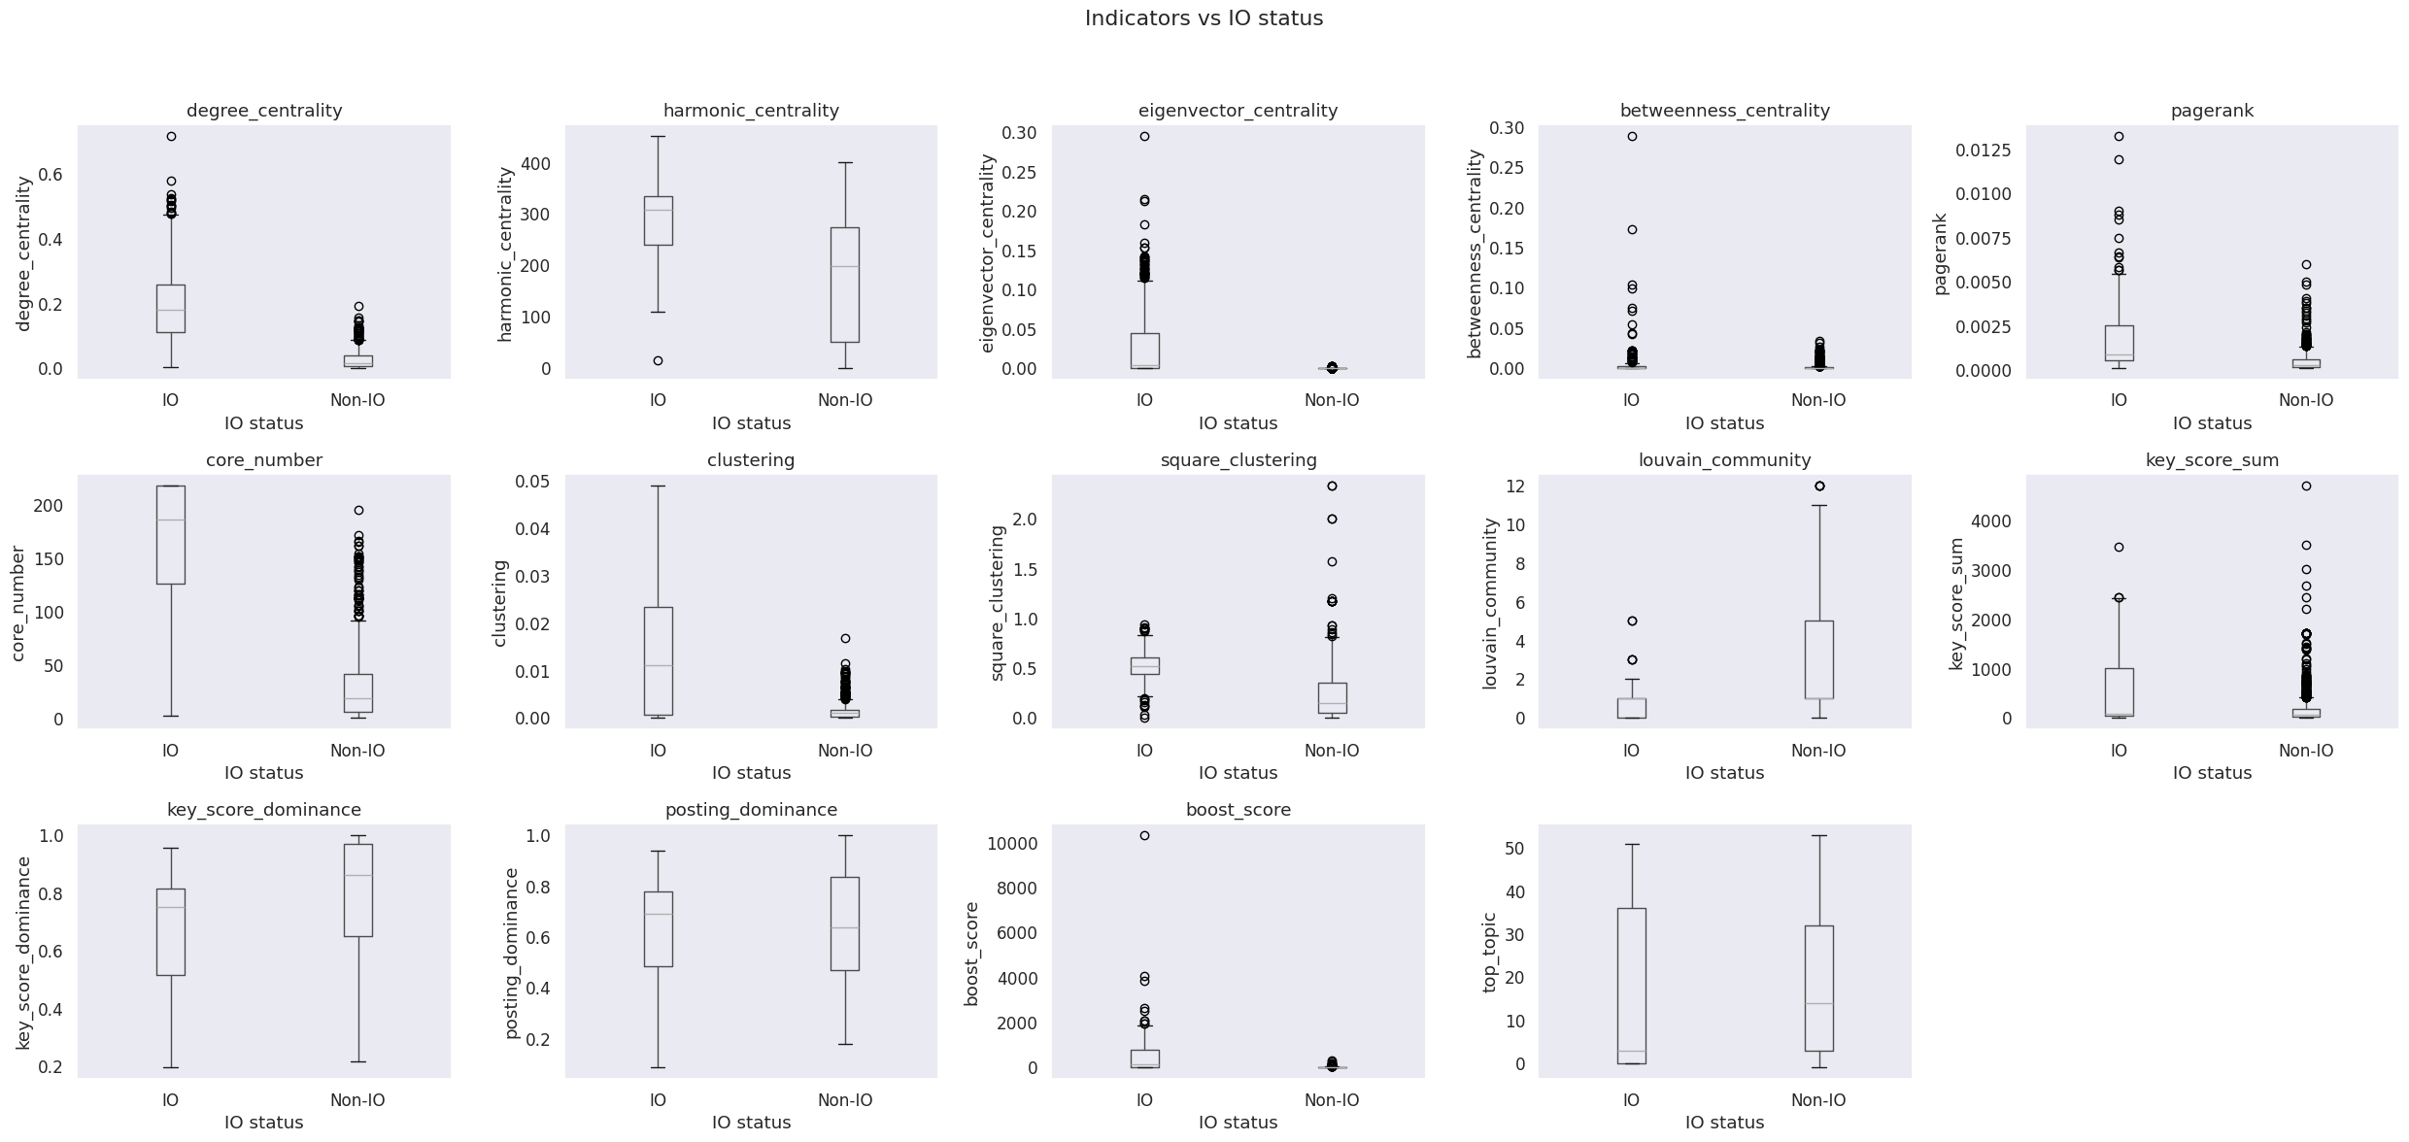
Indicators Analysis – Box Plots
A box plot is a method for demonstrating graphically the distribution of numerical data across different groups.

Slide 18
Core Number
What k-core measures:
  A core-number is the k value of the maximal subgraph that contains nodes of degree k or more. The core number of a node is the largest value k of a k-core containing that node (NetworkX documentation).
  How deeply a user is embedded inside the dense community in the graph.
  Higher core number → node belongs to tightly connected, cohesive groups.
Why it matters for IO detection:
  IO drivers don’t just connect , they coordinate. In a behaviour similarity graph, this coordination places them inside dense, highly connected community.
  Being in such community is what core number measures.
Coordinated actors → Placed inside dense community → High k-core

Slide 19
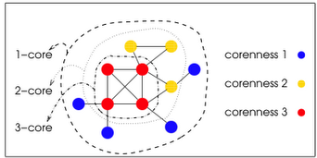
Core Number

Slide 20
Hypotheses

Slide 21
Hypothesis
H1: IO Drivers form clusters on the co action graph. So in dense gpurps this is more likely to find IO drivers. Cheak concectivity. Cheak prescnge of IO driver per level of k-core and k-shell. Prst on k-core and k-shell like in the witheade average in the all users in graph.
H2: When grouping the graph to densce group we want to cheak if in different grpups have more IO driver and in some grpup. The IO driver are not disptrebutied evenaly. Use community detaction and look at the IO driver percentage on each ecommunity.
H3: matching cohort for IO drivers. So in key score is macht to the IO driver when dealing with authors with similar attrivtution (number of posts, degree centralty….).
H3.1 (Narrative Amplification Hypothesis):
  IO drivers tend to lead topic narratives in online discussions.
  Evaluation: Compare the mean key score between IO and non-IO users while controlling for activity and structural factors (e.g., posts, degree in graph).
  Statistical test: paired t-test.
Objective: Run classification model with and withput degree centralty and such. Only k-core. See the different in performance.

Slide 22
Hypotheses
H1 (Dense Community Hypothesis):
  IO drivers are more likely to appear in densely connected regions of the co-action graph.
  Evaluation: Compare IO driver probability across core-number values.
  Statistical test: Binomial Logistic Regression (Wald test on coefficient).
    Dependent variable: IO status (categorical, 0/1).
    Independent variable: k-core values (numeric, discrete non-negative).
H2 (Community Heterogeneity Hypothesis):
  IO drivers are non-uniformly distributed across communities in the co-action graph.
  Evaluation: Compare IO driver probability across different communities. Communities partition by authors’ top topic using the key score.
  Statistical test: permutation-based chi-square test of homogeneity.
    Dependent variable: IO status (categorical, 0/1).
    Independent variable: community membership (categorical).

Slide 23
H1 (Dense Community Hypothesis)
H1 (Dense Community Hypothesis):
  IO drivers are more likely to appear in densely connected regions of the co-action graph.
  Evaluation: Compare IO driver probability across core-number values.
  Statistical test: Binomial Logistic Regression (Wald test on coefficient).
    Dependent variable: IO status (categorical, 0/1).
    Independent variable: k-core values (numeric, discrete non-negative).
H1 (Embedding Hypothesis) tests whether users who are more deeply embedded in dense regions of the co-action graph are more likely to be IO drivers.
The intuition is that IO actors often rely on repeated coordination and mutual amplification, which necessarily places them inside tightly connected groups rather than at the network’s periphery.

Slide 24
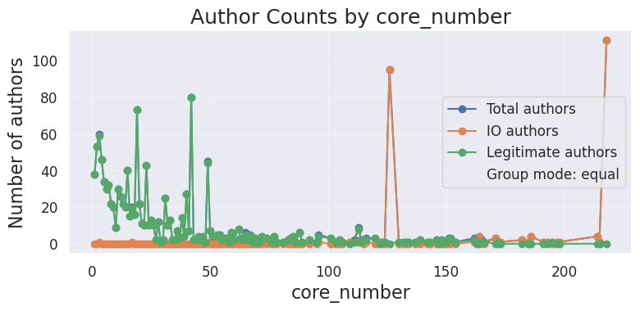
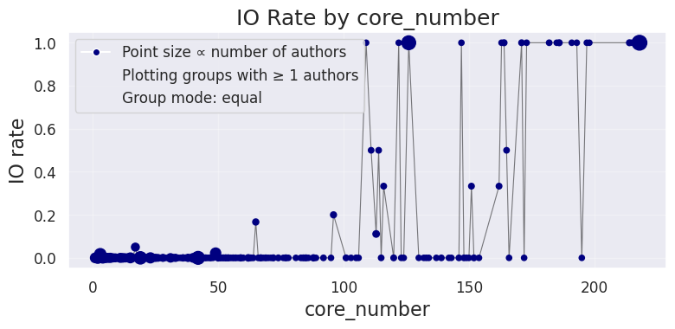
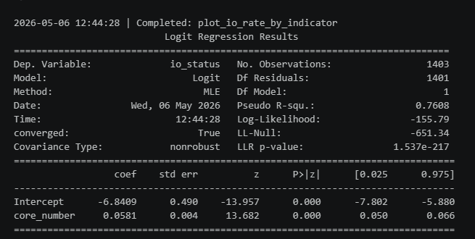
H1 (Dense Community Hypothesis)
Ecuador Campaigns
Using binomial logistic regression with a Wald test on the coefficient

Slide 25


H1 (Dense Community Hypothesis) group mode: smaller
Ecuador Campaigns
Group mode: smaller - each point represents authors whose indicator value is less than the x-axis value.

Slide 26


H1 (Dense Community Hypothesis) group mode: larger
Ecuador Campaigns
Group mode: larger - each point represents authors whose indicator value is greater than the x-axis value.

Slide 27
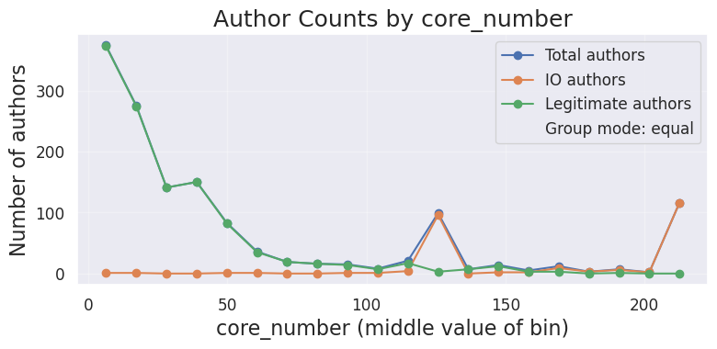
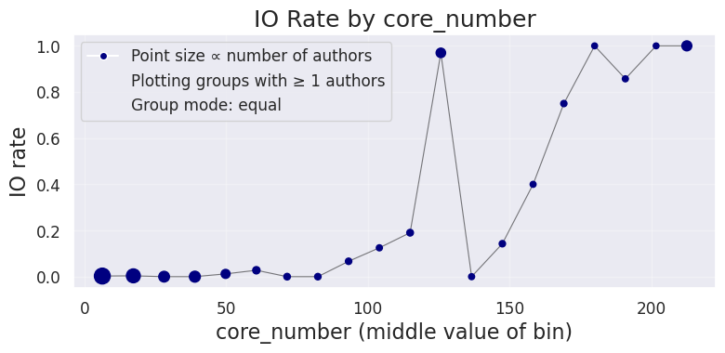
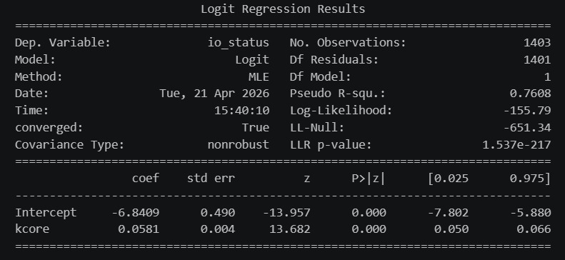
H1 (Dense Community Hypothesis)
20 bins
Using binomial logistic regression with a Wald test on the coefficient

Slide 28
H2 (Community Heterogeneity)
H2 (Community Heterogeneity Hypothesis):
  IO drivers are non-uniformly distributed across communities in the co-action graph.
  Evaluation: Compare IO driver probability across different communities. Communities partition by authors’ top topic and by Louvain algorithm .
  Statistical test: permutation-based chi-square test of homogeneity.
    Dependent variable: IO status (categorical, 0/1).
    Independent variable: community membership (categorical).
H2 (Community Heterogeneity Hypothesis) tests whether IO drivers are concentrated in specific communities\topics rather than being evenly spread across the co-action graph.
The intuition is that IO actors often act around shared narratives, goals, or audiences, which leads them to cluster in particular communities. If this is true, some communities should show a higher probability of containing IO drivers than others.

Slide 29
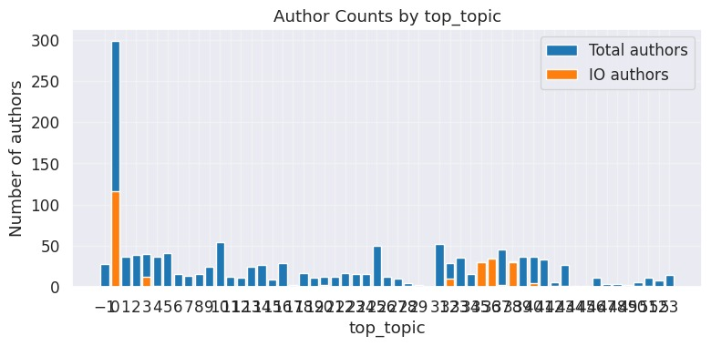
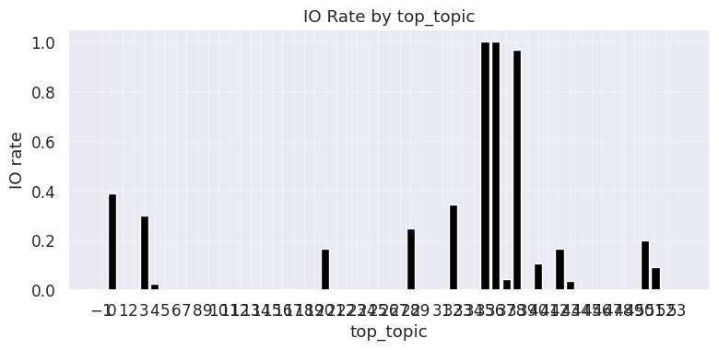
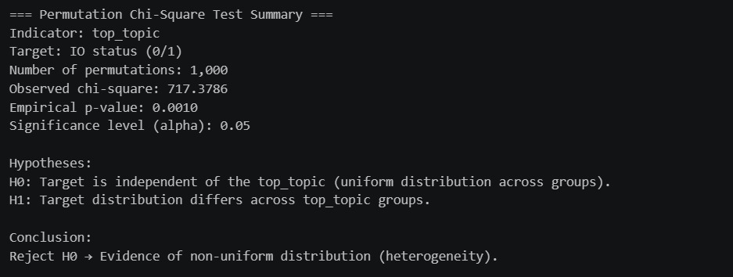
H2 (Community Heterogeneity) for top topic
Ecuador Campaigns

Slide 30
Choosing System Configuration

Slide 31
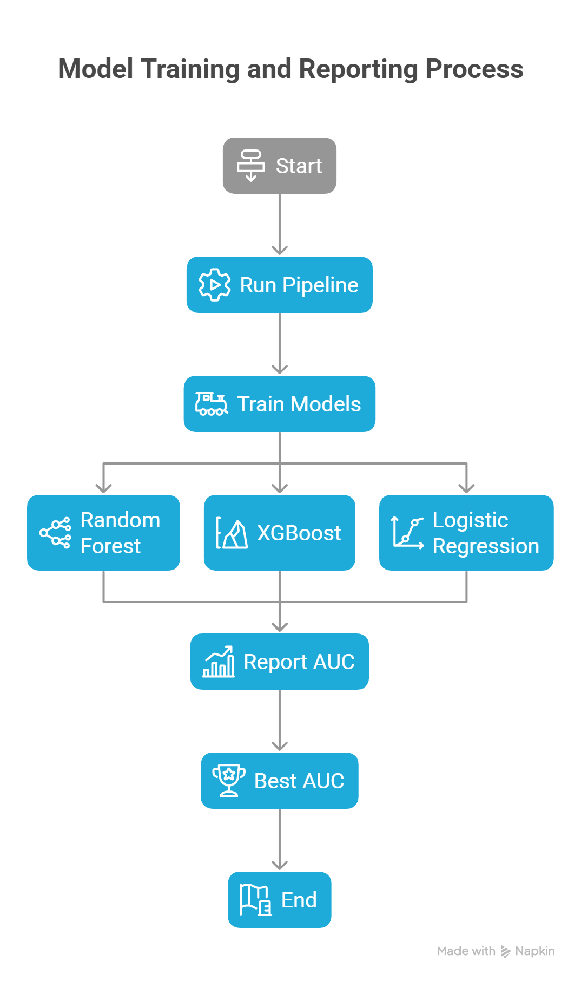
Hyper-Parameter Optimization
Runs the same pipeline across multiple configurations:
  Topic column (model + model’s parameter)
  Top percentage (the percentage of getting the key and boost authors by relevant the score)
  Key authors mode (per-topic / global)
    Note: In per-topic mode, overlap between topics may result selecting more than X% of global authors.
  Graph type (directed / undirected)
For each configuration:
  Train models: Random Forest, XGBoost, Logistic Regression
  Report model auc and best AUC.
AUC is computed for two populations/universe:
  Key authors - accounts in the filtered graph (key authors + boost authors).
  All authors - all accounts in dataset (missing authors filled with zero features).
(configuration)

Slide 32
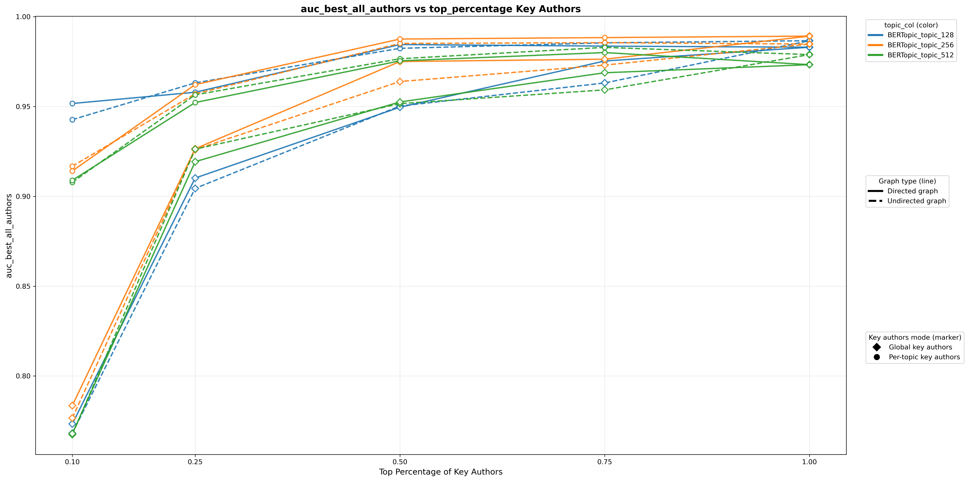
Parameter Sweep AUC Analysis

Slide 33
Final Configuration
BERTopic with min topic size 256
Undirected Graph
Per-topic key authors selection

Slide 34
Data

Slide 35
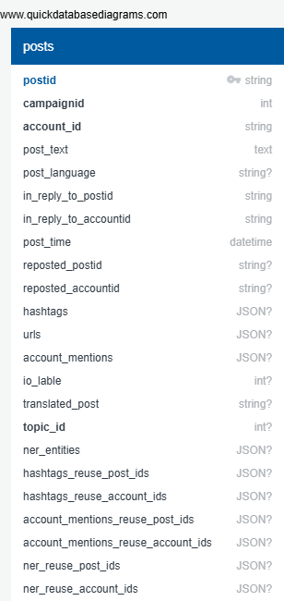
Required Data
BGU INPUT
BGU OUTPUT

Slide 36
Datasets
Labeled IO Corpus Collection of 26 information operation (IO). Campaigns from multiple countries. Fully labeled (IO vs. Control accounts). https://zenodo.org/records/14189193 Ecuador Campaign Subset 787 IO accounts | 21,138 Control accounts 700K IO tweets | 770K Control tweets
Notes:
[1] Seckin, O. C., Pote, M., Nwala, A. C., Yin, L., Luceri, L., Flammini, A., & Menczer, F. (2025, June). Labeled datasets for research on information operations. In Proceedings of the International AAAI Conference on Web and Social Media (Vol. 19, pp. 2567-2574).
[2] Balasubramanian, A., Zou, V., Narayana, H., You, C., Luceri, L., & Ferrara, E. (2024). A public dataset tracking social media discourse about the 2024 us presidential election on twitter/x. arXiv preprint arXiv:2411.00376.

