Slide 1



I Can See U.
Indicator-Based Information Operation Detection and Topic-Aware Group Analysis
23.09.2026
Amit Ner Gaon, Noa Tal, Idan Muallem
Prof. Rami Puzis

Slide 2

Motivation
Social media platforms are central spaces for public discourse.
Seckin et al. (2025). “Sharing without clicking on news in social media.”
Information operations (IOs) exploit the openness of social media to manipulate online discourse, threatening democratic processes, public trust, and societal cohesion.
Weedon et al. (2017), “Information Operations and Facebook”

Slide 3

IO & Coordination
IOs rely on fleets of coordinated accounts acting toward a shared objective. Coordination is what amplifies their influence.
Pacheco et al. “Uncovering Coordinated Networks on Social Media: Methods and Case Studies”
Coordinated activity leaves observable traces of behavioural similarity.
Luceri et al. (2024), “Unmasking the Web of Deceit: Uncovering Coordinated Activity to Expose Information Operations on Twitter”
Therefore, identifying coordination is a key step toward detecting IO drivers.

Slide 4
Related Work
IO-Driver Detection Methods:
Node-Local: detect suspicious users from their individual content, activity, and behaviour.
Tomaiuolo et al., A Survey on Troll Detection, Future Internet, 2020
Network-Based: detect coordinated groups from graph structure and behavioural similarity.
Pacheco et al., Uncovering Coordinated Networks on Social Media: Methods and Case Studies, ICWSM, 2021
Hybrid: combine user content with network information to detect IO drivers.
Minici et al., IOHunter: Graph Foundation Model to Uncover Online Information Operations, AAAI, 2025
The gap: existing approaches either detect coordinated groups without quantifying each account’s depth of involvement, or implicitly encode structural embeddedness within black-box models. None provides an explicit, interpretable, account-level measure of coordination depth.

Slide 5
Our Contributions
An interpretable, indicator-based approach for account-level IO detection.
Topic-aware group analysis revealing the campaign’s agenda.

Slide 6
Interpretable Indicators

Slide 7
Overview
Machine-learning models classify authors using feature vectors. Multiple indicators capture different aspects of author behaviour and may improve classification.
Graph-Based Indicators
  Quantitative: Core number, centralities, and PageRank measure an author’s structural importance.
  Categorical: Community membership shows which neighbourhood the author belongs to.
Topic-Based Indicators
  TF-IDF based: Key score measures how strongly the author uses important entities.
  Posting-based: Posting activity and distribution across topics describe how and what the author posts about.

Slide 8

Co-Action Graph
Nodes: authors in the discourse.
Edges: co-action relations between a pair of authors (e.g., posting the same hashtag). Represents behavioral similarity between the authors.
Purpose: expose coordinated behaviour for IO detection.

Slide 9

Graph Indicators Workflow
1) Building a co-action graph represents author similarity
2) IO drivers tend to be embedded in dense communities.
3) Graph-based indicators are used to measure author’s embeddedness.
4) Each user is represented by a human-readable feature vector.
5) The feature vectors are used by a machine-learning model to classify each author as an IO driver or not.
Author feature vector (example)

Slide 10
Graph-Based Indicators
Using the Co-Action Graph, we calculate well-established graph indicators for each author (node) to characterize their structural role.
  Centrality: Degree, Harmonic, Eigenvector, Betweenness, PageRank
  Cohesion: Core Number, Clustering Coefficient
  Community: Louvain Community
These indicators provide interpretable structural features.

Slide 11
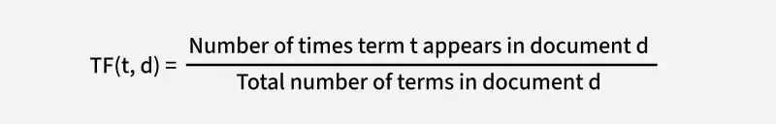
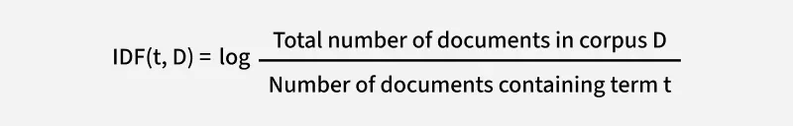
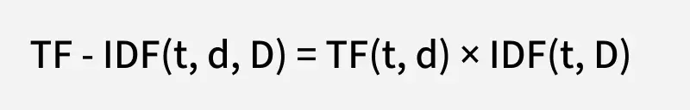
Topic-Based Indicators - TF-IDF
TF-IDF is a statistical method used in natural language processing and information retrieval to evaluate how important a word is to a document (in our project – topic) in relation to a larger collection of documents (topics).
This allows TF-IDF to highlight terms that are both frequent within a specific document (topic) and distinctive across the other documents (topics), making it a useful tool for tasks like search, ranking, text classification, and keyword extraction.
https://www.geeksforgeeks.org/machine-learning/understanding-tf-idf-term-frequency-inverse-document-frequency/

Slide 12
Topic-Based Indicators
Calculated from each author’s posts and hashtags to capture their thematic activity.
Activity-Based Indicators
  Posting Dominance - proportion of an author’s posts assigned to their most frequent topic.
  Top Topic - the author’s dominant topic.
TF-IDF-Based Indicators
  Key Score (Topic) - author’s relevance to a specific topic, calculated by aggregating the TF-IDF scores of the entities used by the author in that topic, with a penalty for activity across multiple topics.
  Key Score Sum - sum of the author’s key scores across all topics.
  Key Score Dominance - proportion of the total key score concentrated in the author’s strongest topic.
Together, these indicators capture the author’s narrative focus and thematic behaviour.

Slide 13
Group Analisys

Slide 14
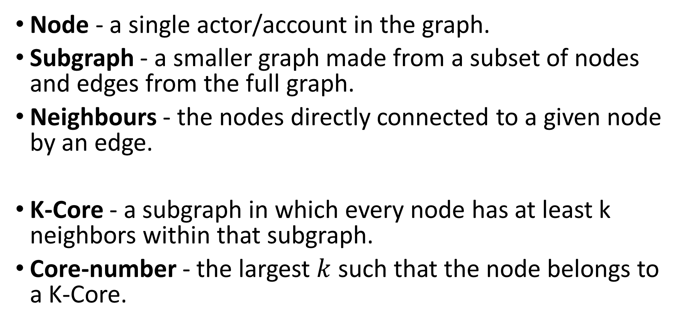
K-Core Definition
Node - a single actor/account in the graph.
Subgraph - a smaller graph made from a subset of nodes and edges from the full graph.
Neighbours - the nodes directly connected to a given node by an edge.
K-Core - a subgraph in which every node has at least k neighbors within that subgraph.
Core-number - the largest $k$ such that the node belongs to a K-Core.

Slide 15

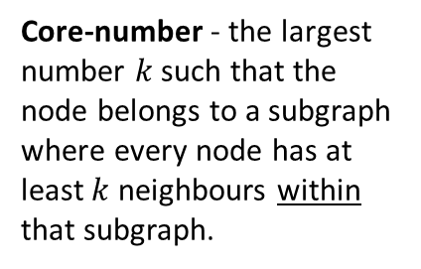
Core Number: Example
Co-Action Graph
IO Drivers
#Music
#DeepState
#True
#Music
#CoverUp
#DeepState
#CoverUp
#DeepState
#CoverUp
#CoverUp
# Media
#Trending
#TruthExposed
#Eurovision
#CoverUp
# Media
#DeepState
#True
Core-number - the largest number $k$ such that the node belongs to a subgraph where every node has at least $k$neighbours within that subgraph.

Slide 16
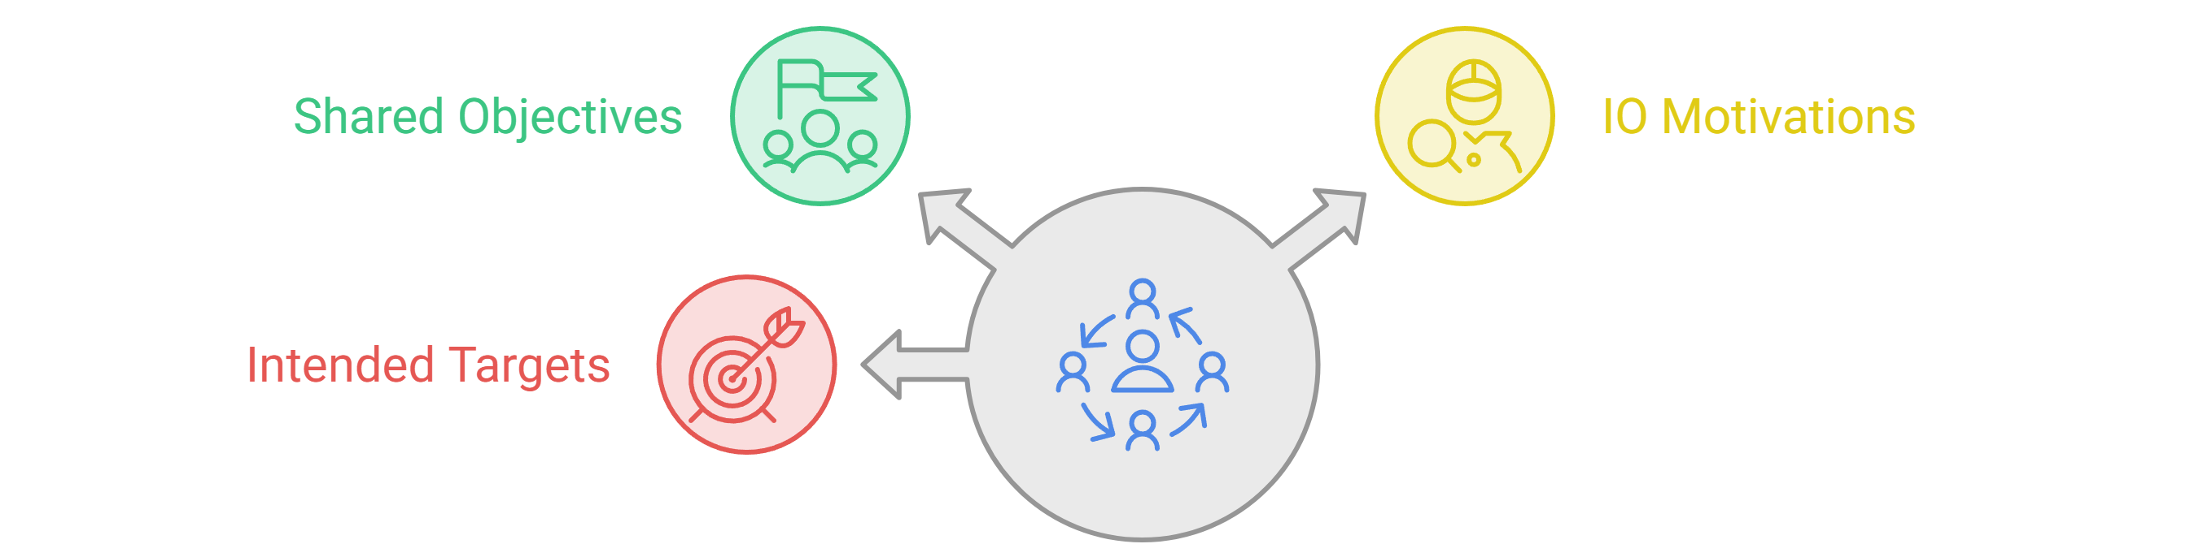
Overview
At the group level, we can reveal shared narratives and thematic patterns that may not be visible when analysing individual accounts.
Goal: Move from “Who participates in an IO?” to “How do coordinated groups operate, and what narratives characterize their activity?”

Slide 17
Overview
We define several groups:
  Maximal k-Core Connected Component - accounts belonging to the same connected component within their maximal k-core.
  Direct Neighbours - accounts directly connected to the focal account.
  Louvain Community - accounts assigned to the same graph community.
  Top Topic - accounts sharing the same dominant topic.
  RF-Predicted IO - accounts classified as IO by Random Forest.
  XGBoost-Predicted IO - accounts classified as IO by XGBoost.
We evaluated each group based on IO concentration (the proportion of authors labeled as IO) and topic alignment among the authors.
K-Core CC were selected because they showed strong performance and a good trade-off between IO concentration and topic alignment.

Slide 18
Maximal K-Core Motivation
Coordinated authors are highly inter-connected in the co-action graph.
IO accounts are in a large k-core.
Since IO requires coordination, IO drivers are expected to appear in the coordinated groups.
The co-action graph represents behavioural similarity between authors.
Similarity with one or two accounts is not enough.
Only many accounts coordinating with one another produce a large k core.

Slide 19
Experiments

Slide 20
Dataset
Labeled IO Dataset
26 verified IO campaigns linked to 16 stats.
Contains IO accounts and matched control accounts discussing similar topics during the same periods.
Includes 303K+ accounts and 13M+ control posts.
Rich activity data: posts, reposts, hashtags, and more.
Each account is labeled IO or non-IO.

Slide 21
Evaluation Settings
Within-Campaign (Transductive)
  Train and test on accounts from the same campaign.
Cross-Campaign (Inductive)
  Train on other campaigns and test on an unseen campaign.
  Uses a leave-one-campaign-out setting.
  Evaluates whether structural patterns generalize to new IO campaigns.

Slide 22
Evaluated Campaigns
Campaign | Period | IO accounts | Controls | Posts
China-1 | 2008–2019 | 699 | 42,120 | 3,670,754
Cuba | 2010–2020 | 503 | 30,099 | 6,155,331
Iran-1 | 2010–2018 | 660 | 5,015 | 1,322,789
Russia-1 | 2009–2018 | 3,293 | 31,299 | 3,650,083
UAE | 2011–2019 | 3,658 | 10,545 | 1,707,792
Venezuela | 2012–2019 | 611 | 9,745 | 1,972,732
18.5 million posts across 138,247 accounts.
Controls matched by hashtag and date.

Slide 23
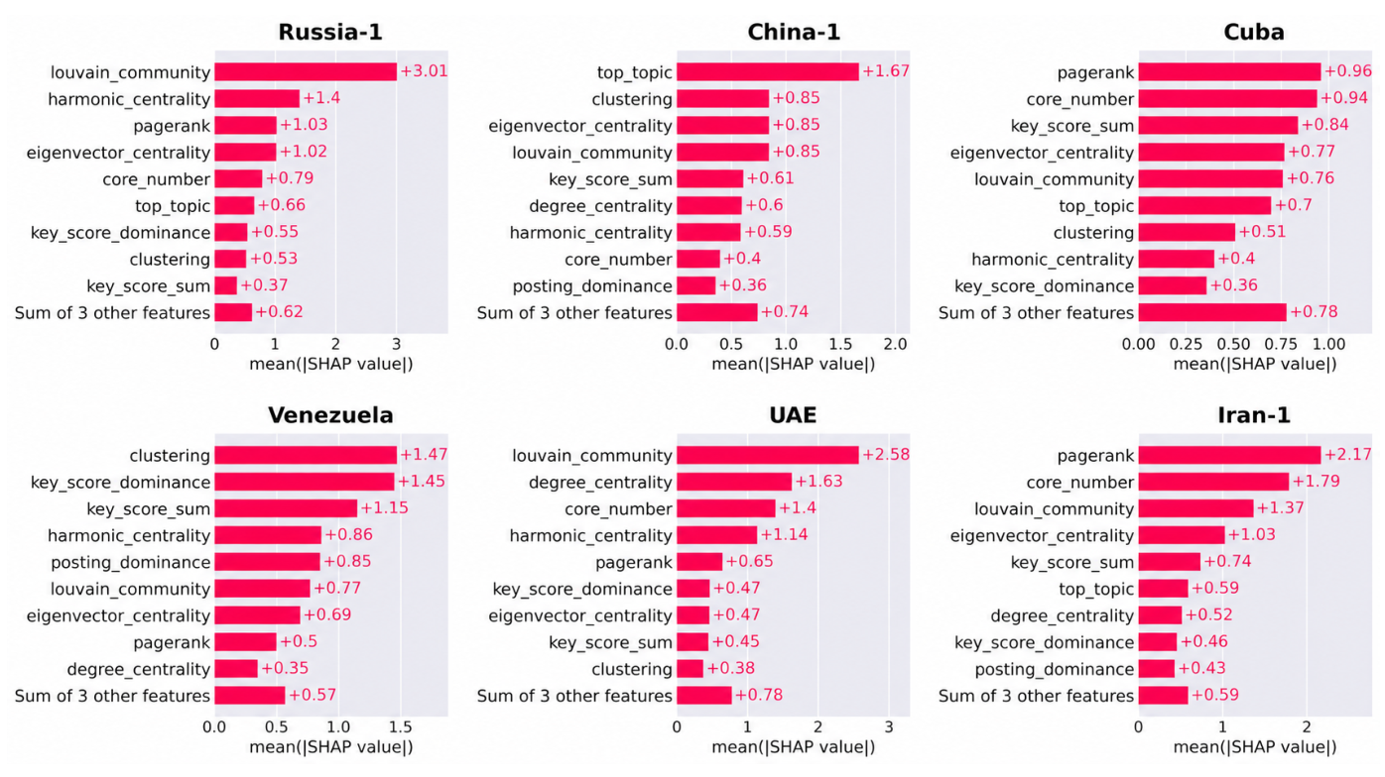
Which Indicators Matter?
XGBoost: indicator importance varies across campaigns (transductive setting).

Slide 24
Detection Across Campaigns
0.990
0.933
Mean within-campaign ROC-AUC
Mean cross-campaign ROC-AUC
Campaign | Within ROC | Within PR | Across ROC | Across PR
Iran-1 | 0.991 | 0.983 | 0.989 | 0.963
UAE | 0.995 | 0.992 | 0.976 | 0.943
Venezuela | 0.984 | 0.964 | 0.889 | 0.649
China-1 | 0.986 | 0.940 | 0.822 | 0.072
Cuba | 0.985 | 0.966 | 0.992 | 0.920
Russia-1 | 0.999 | 0.994 | 0.929 | 0.794
Random Forest AUC. Across: train on five campaigns, test on one.
Mean PR-AUC: 0.973 within campaign / 0.723 across campaigns.
Macro-F1: ICSU 0.804 vs. IOHunter 0.793 (different training coverage).

Slide 25
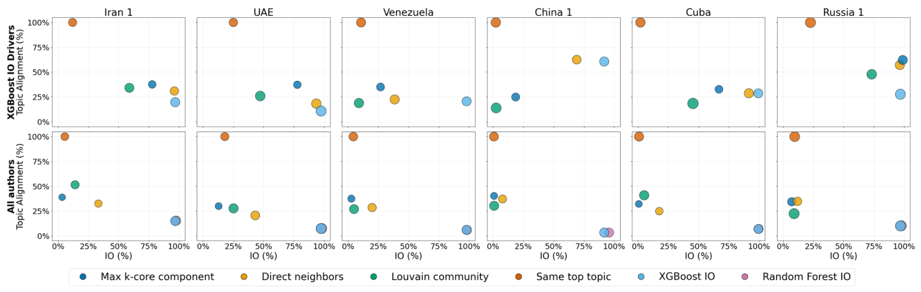
Group Analysis
K-core groups balance IO concentration and topic alignment.
Direct neighbors also perform well.
Top: XGBoost-predicted IO accounts. Bottom: all accounts.

Slide 26
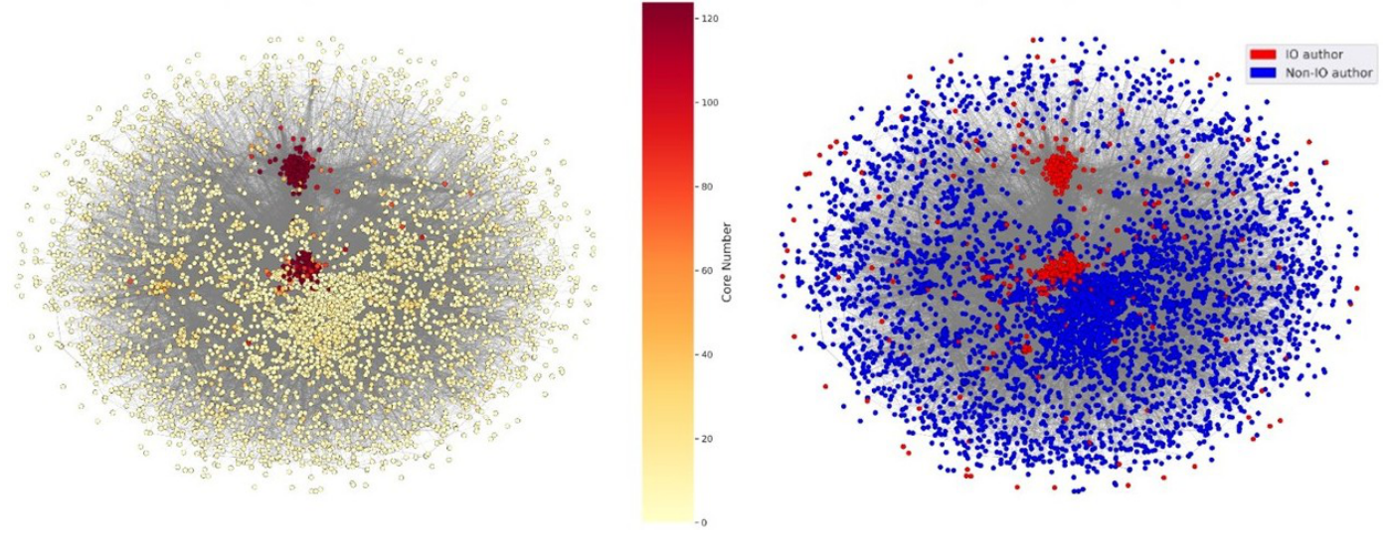
Group Analysis Case Study - Iran 1
Core number
Known IO labels
High-core regions overlap with concentrations of IO accounts.

Slide 27
Group Analysis Case Study - Iran 1
How Was the Group Selected?
Build the Iran-1 co-action graph
Find the maximum k-core
Select a connected component from the k core
Find the peak coordination window: rank 15-minute intervals by the number of account pairs sharing hashtags.

Slide 28
Group Analysis Case Study - Iran 1
In the selected group and during the selected 15-minute interval:
  15 accounts produced 244 posts.
  242 of 244 posts were reposts.
  The activity included 30 shared hashtags.
  16 of 19 reposted source posts focused on U.S. politics.
  The dominant narrative included criticism of Donald Trump and opposition to tax legislation.
Key finding: The analysis revealed a shared narrative amplified through highly coordinated activity.

Slide 29
Summary of Results
Account Detection
  Interpretable Indicators
  Mean ROC–AUC: 0.990 within campaigns and 0.933 across campaigns
Indicator importance varied across campaigns
Group Analysis
  K-core groups showed a strong balance between IO concentration and topic alignment
Iran-1 Case Study
  15 accounts → 244 posts in 15 minutes → 242 reposts
  16 of 19 reposted source posts focused on U.S. politics
  Revealed the shared narrative behind coordinated activity

Slide 30
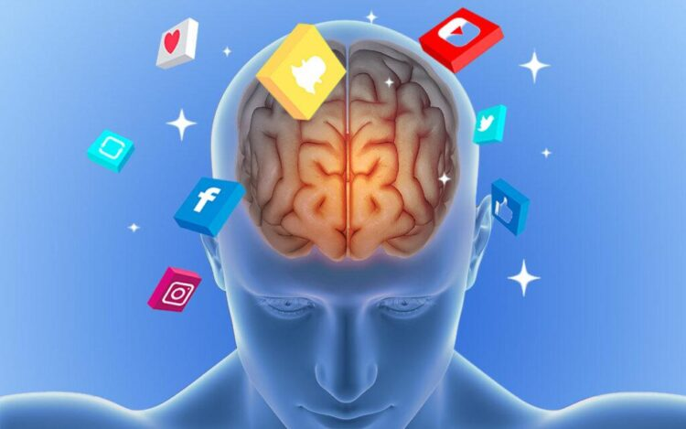
Next Steps
Psychological Characterization
  Use prompt-based psychological questionnaires to explore characteristics that distinguish IO accounts from other accounts.
https://netpsychology.org/social-media-psychology/

