Slide 1



I Can See U.
Indicator-Based Information Operation Detection and Topic-Aware Analysis
08.07.2026
Amit Ner Gaon, Noa Tal, Idan Muallem
Prof. Rami Puzis

Slide 2

Motivation
Social media platforms have become central spaces for public discourse.
The platforms’ openness also enables malicious actors to manipulate online conversations.
These information operations (IO) threaten democratic processes, public trust, and societal cohesion.

Slide 3

IO & Coordination
A single account has limited influence.
IO campaigns rely on groups of accounts acting together.
Accounts coordinate by sharing the same entities (e.g., hashtags, account mentions) and posts on the same topics.
Therefore, identifying coordination is a key step toward detecting IO drivers.

Slide 4
Related Work
IO-Driver Detection Methods:
Node-Local Methods:
  Detect suspicious users based on their individual content, activity, and behaviour (Tomaiuolo et al., “A Survey on Troll Detection,” 2020).
Network-Based Methods:
  Detect coordinated users from graph structure and behavioural similarity (Pacheco et al., “Uncovering Coordinated Networks on Social Media,” 2021).
Hybrid Methods
  Combine user content with network information to detect IO drivers (Minici et al., “IOHunter: Graph Foundation Model to Uncover Online Information Operations,” 2025).
Limitation: Many methods behave as black boxes, providing limited explanations for their predictions.

Slide 5

Methods
1) Building a co-action graph represents author similarity.
2) IO drivers tend to be embedded in dense communities.
3) Graph-based indicators are used to measure author’s embeddedness.
4) Each user is represented by a human-readable feature vector.
5) The feature vectors are used by a machine-learning model to classify each author as an IO driver or not.
Author feature vector (example)

Slide 6

Co-Actions Graph
Nodes: authors in the discourse.
Edges: co-action relations between a pair of authors (e.g., posting the same hashtag). Represents behavioral similarity between the authors.
Purpose: expose coordinated behaviour for IO detection.

Slide 7
Core-Number

Slide 8
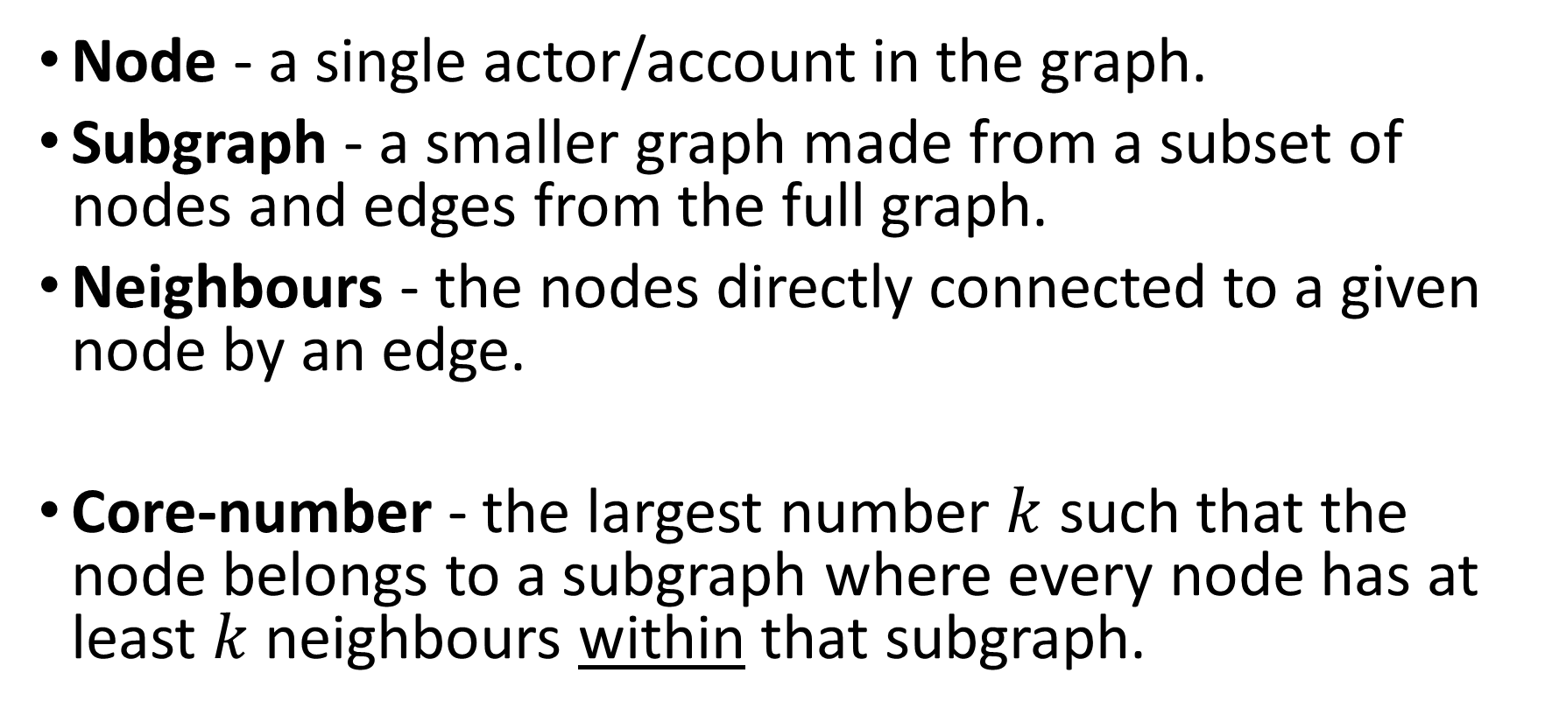
Core Number - Definition
Node - a single actor/account in the graph.
Subgraph - a smaller graph made from a subset of nodes and edges from the full graph.
Neighbours - the nodes directly connected to a given node by an edge.
Core-number - the largest number $k$ such that the node belongs to a subgraph where every node has at least $k$neighbours within that subgraph.

Slide 9
Core Number - Motivation
Core number captures user affiliation to a densely coordinated group.
User’s similarity with only one or two users is insufficient to produce a high core number.
A user embedded in a network where many accounts coordinate with one another will have a high core number.
Therefore, core number enables us to separate IO drivers from legitimate users.

Slide 10
Core Number - Motivation
Node belongs to tightly connected group.
The node/author is suspected to be an IO drive.
Node has higher core-number.

Slide 11

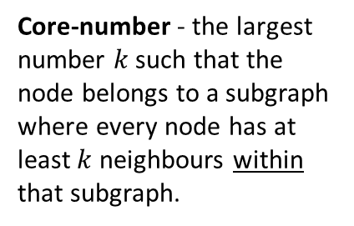
Core Number - Example
Co-Action Graph
IO Drivers
#Music
#DeepState
#True
#Music
#CoverUp
#DeepState
#CoverUp
#DeepState
#CoverUp
#CoverUp
# Media
#Trending
#TruthExposed
#Eurovision
#CoverUp
# Media
#DeepState
#True
Core-number - the largest number $k$ such that the node belongs to a subgraph where every node has at least $k$neighbours within that subgraph.

Slide 12
Experiments

Slide 13
Datasets
Labeled IO Corpus
Collection of 26 information operations (IO).
Campaigns from multiple countries.
Fully labeled (IO vs. Control accounts).
https://zenodo.org/records/14189193
Ecuador Campaign Dataset
787 IO accounts | 21,138 Control accounts
700K IO tweets | 770K Control tweets

Slide 14

Indicators Comparison- Information Gain
On Ecuador Campaign
Information Gain is a statistical method used to measure how much knowledge one variable provides about another.

Slide 15


Indicators Comparison- SHAP
SHAP analysis on XGBoost model on Ecuador Campaign
SHAP explains how much each feature contributes to a model’s prediction.

Slide 16




Core Number
Ecuador Campaign
Cumulative distribution: proportion of IO drivers by Core Number threshold (≤ / ≥)

Slide 17
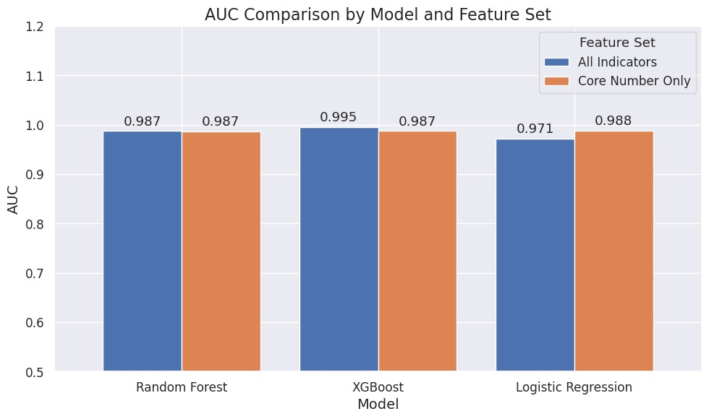
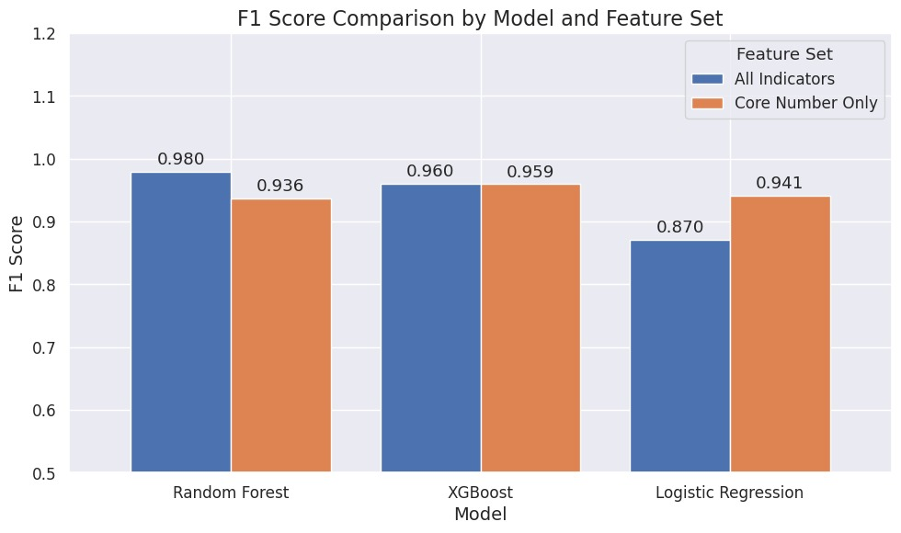
Indicators Comparison &
Core Number
Core number alone achieves high AUC and F1.
Other indicators add little improvement.
Core number captures most of the IO detection signal.
On Ecuador Campaign

