Slide 1



Backbone Graph
25.03.2026
Amit Ner Gaon, Noa Tal
Prof. Rami Puzis

Slide 2
Core Concepts
Hypothesis:
Successful information operation drivers lead topic-level discourse and act in coordination with other drivers.
Objectives:
Author’s key score to quantify topic leadership.
Backbone graph to capture coordination among key authors.
Goal:
Calculation of graph-based indicators (e.g., centralities) to identify information operation (IO) drivers.

Slide 3
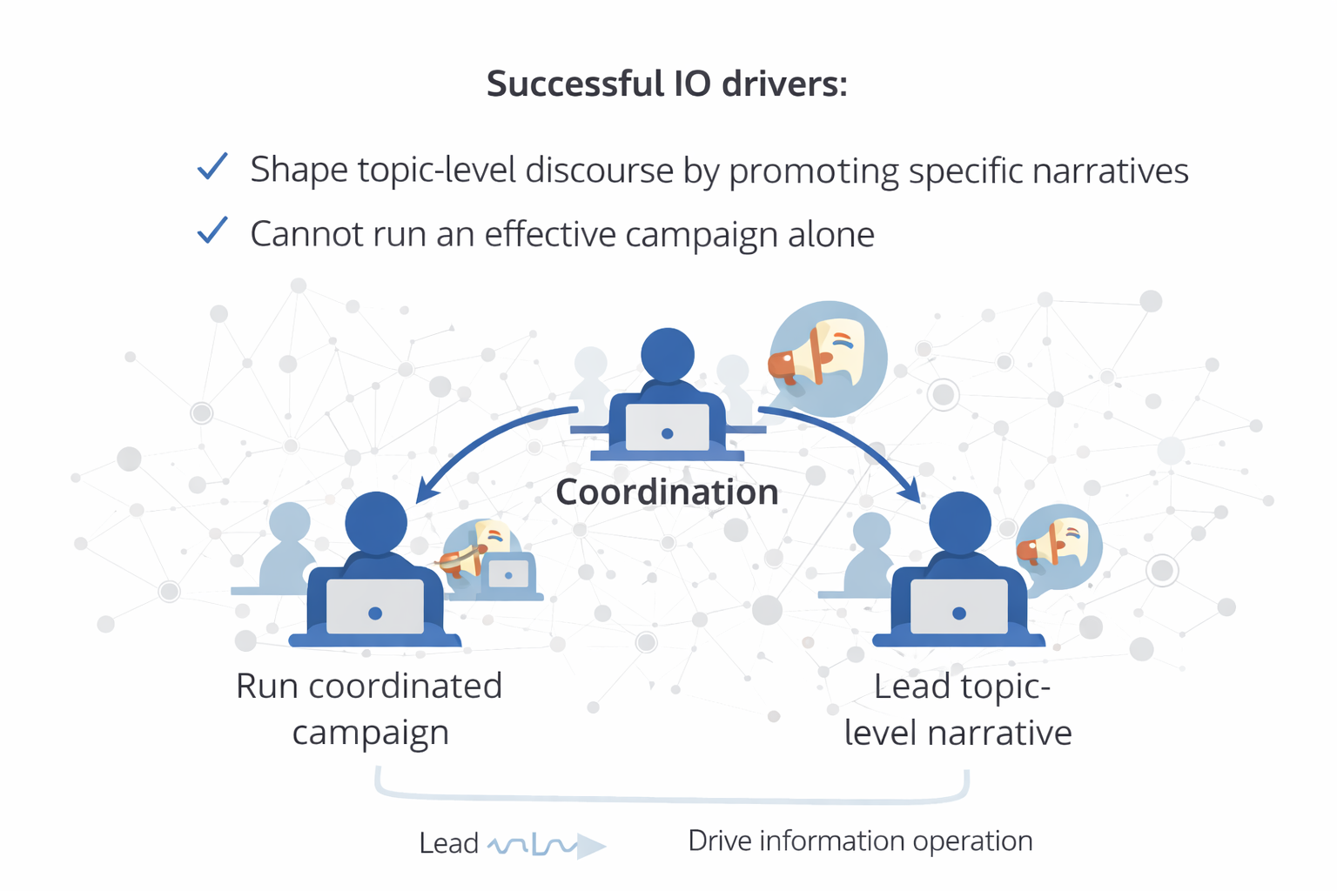
Hypothesis
Successful IO drivers shape the online discourse by promoting and amplifying specific narratives. However, they cannot run an effective campaign alone. Their impact depends on coordination with other drivers, sharing messages, reinforcing each other’s content, and acting as a connected group.
This combination of leading the narrative and coordinated behaviour is what enables a successful information operation.
Academic Papers:
“Identifying Coordinated Activities on Online Social Networks Using Contrast Pattern Mining”
“IOHunter: Graph foundation model to uncover online information operations‏”

Slide 4
Boost Author Selection

Slide 5
Terms & Definitions - IO
Information Operation (IO): A collection of publications by coordinated actors pursuing a shared intent while misleading others.
IO Driver: An account that promotes one or more IO.
Author ‘s IO Label: label = 1 if the author is a IO Driver and label = 0 if not.

Slide 6
Terms & Definitions - Key
Key Author: An author who is a leading participant in one or more topic(s).
Author-Topic Key Score: A measure of how strongly an author is associated with a topic, emphasizing topic-specific content. It is calculated based on the use of topic-related entities (e.g., hashtags, mentions, URLs) in the author’s posts.
Author Key Score: sum of the Author-Topic Key Score across all topics.

Slide 7
Backbone Graph Building
Nodes: authors in the discourse.
Edges: co-action relations between author pairs (e.g., co-mention, co-entity, co-topic). Represents behavioral similararty between the authors.
Edges` Weights: number of co-occurrences.
Filtering: only key and boost authors.
Purpose: expose coordinated behaviour and structural signals for IO detection.

Slide 8

Backbone Graph & IO Indicators
high degree centrality
high eigenvector centrality
high k-core
all high

Slide 9
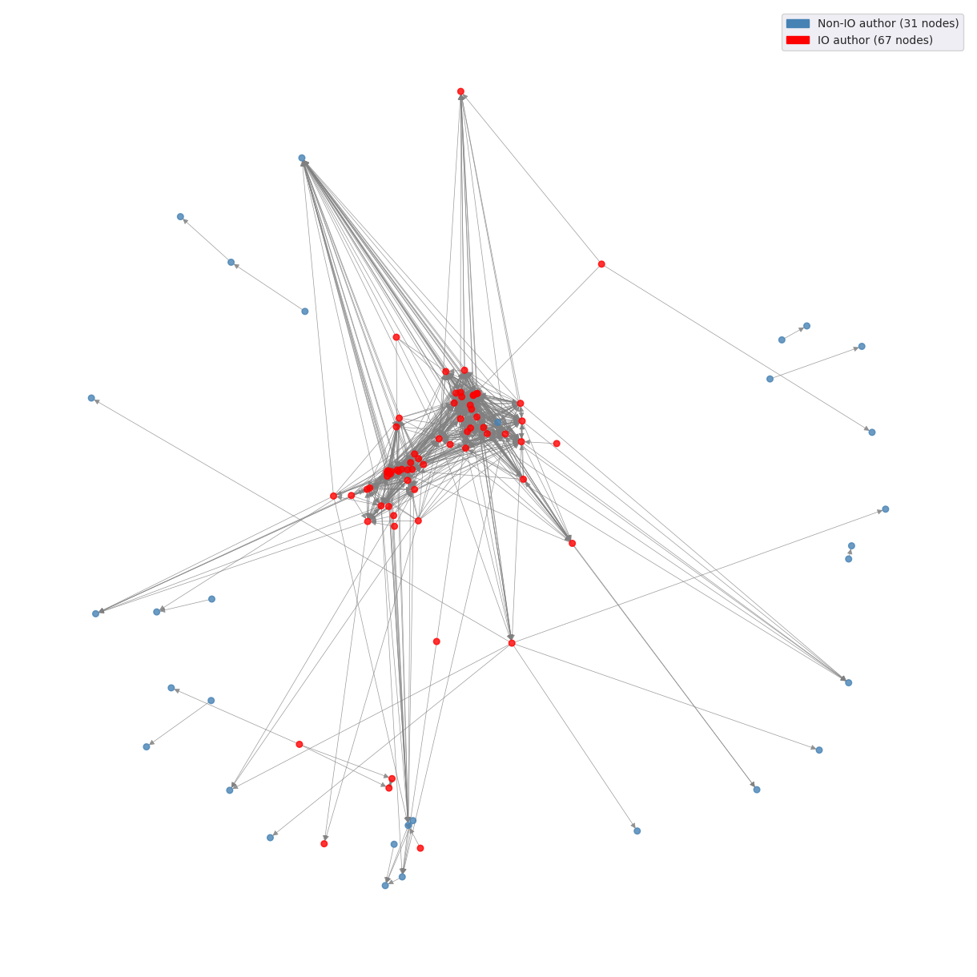
Backbone Graph
Graph built on a sample of 200 posts
IO drivers are mainly located at the center of the graph and highly connected.
Layout: “spring”.
Constructed using `NetworkX`

Slide 10
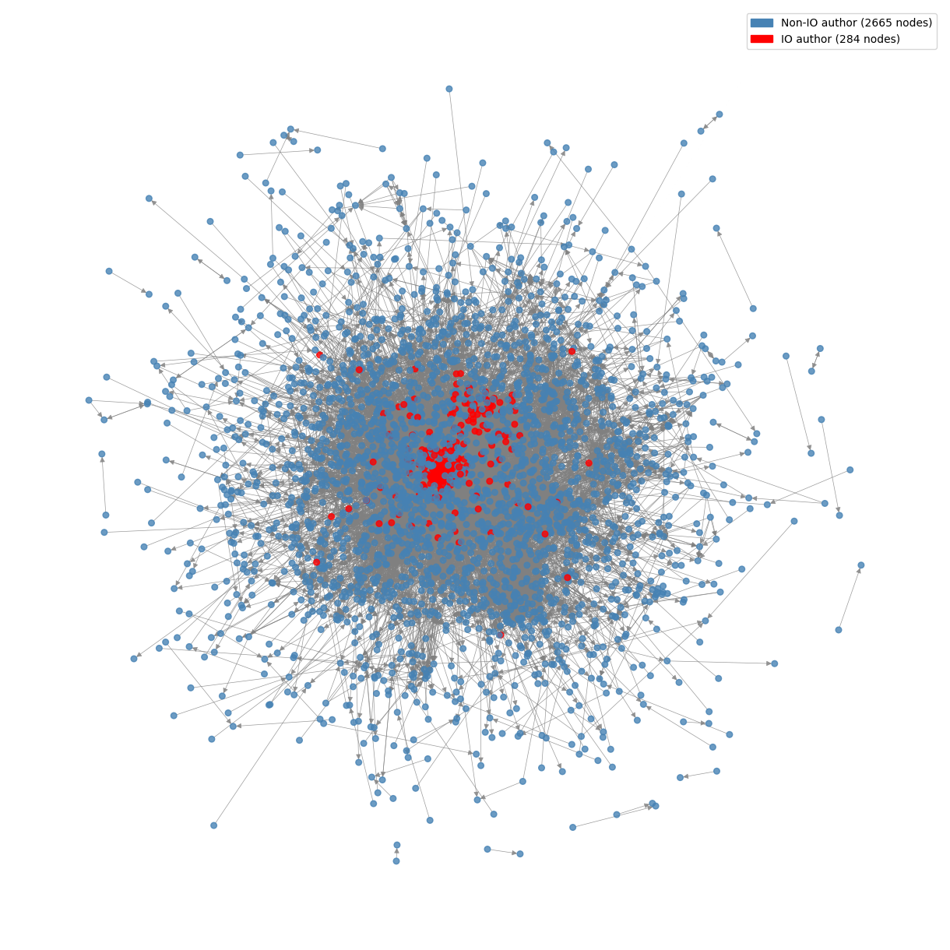
Backbone Graph
Graph built on a sample of 10,000 posts
IO drivers are mainly located at the center of the graph and highly connected.
Layout: “spring”.
Constructed using `NetworkX`

Slide 11
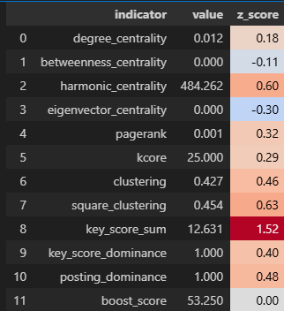
Indicators: Graph Theory
The graph represents behaviour similarity between users.
IO drivers tend to be more central and more connected than legitimate users.
We use indicators to measure, for each user, how embedded they are in the network.
Each user is converted into numeric features.
These features can then be used for different tasks, such as classification models for IO detection.
Indicators of an Account
Account ID: `718633c01af2bd9c2435764721d961a6ae113dec92`

Slide 12
Indicators: Graph Theory
Degree Centrality: Counts how many direct connections a user has.
Betweenness Centrality: measures how frequently a node appears on the shortest path between other.
Harmonic Centrality: Reflects how easily a user can reach many others in the network.
Eigenvector Centrality: Shows whether a user is connected to other high-scoring users.
Pagerank: Estimates a user’s overall importance based on how many important users connect to them.
K-core: Indicates how deeply embedded a user is within the dense group.
Clustering: Measures how tightly connected a user’s neighbors are to each other.
Square Clustering: Measures how often a user participates in tightly connected small group structures.

Slide 13
Indicators: Graph Theory
Degree Centrality: IO drivers tend to coordinate with many accounts, creating many direct connections.
Betweenness Centrality: IO drivers often connect different coordinated groups, acting as bridges between clusters.
Harmonic Centrality: IO drivers are close to many users, enabling fast coordination across the network.
Eigenvector Centrality: IO drivers are connected to other highly coordinated or central actors.
PageRank: IO drivers are reinforced by connections from other important coordinated users.
K-core: IO drivers are deeply embedded in dense, highly coordinated groups.
Clustering: IO drivers are part of tightly connected groups that coordinate actions together.
Square Clustering: IO drivers participate in small, repeated coordination patterns within tightly-knit groups.

Slide 14
Indicators: Key Score and Boost
These indicators quantify user behaviour by measuring the extent to which an individual leads, focuses, and drives activity within discussions.
The indicators capture how strongly a user contributes to topics, whether their activity is concentrated on specific narratives, and how much their actions are associated with increased engagement.
By providing a consistent numeric representation of these behavioural patterns, they enable systematic comparison between users.

Slide 15
Indicators: Key Score and Boost
Key Score Sum: The sum of the all the per-topic tdidf score. How much the author is a leading participant in the topics.
Key Score Dominance: Author’s max score in a topic, divided by total score across all topics. Higher values indicate the author is mostly a leading participate in specific(s) topic(s).
Posting Dominance: Author’s max number of posts in a topic, divided by total number of posts across all topics. Higher values indicate the author is mostly a leading participate in specific(s) topic(s).
Boost Score : A quantitative measure calculated as the cumulative burst weights associated with a user's activity, based on discussion volume increases occurring shortly after the user posts or contributes.

Slide 16
Indicators: Key Score and Boost
Key Score Sum: IO drivers tend to consistently lead discussions across topics, resulting in high overall contribution scores.
Key Score Dominance: IO drivers often focus on specific narratives where they act as main leaders.
Posting Dominance: IO drivers concentrate their activity in particular topics to push targeted messages.
Boost Score: IO drivers’ actions are often followed by increases in activity, indicating coordinated amplification after they post.

Slide 17
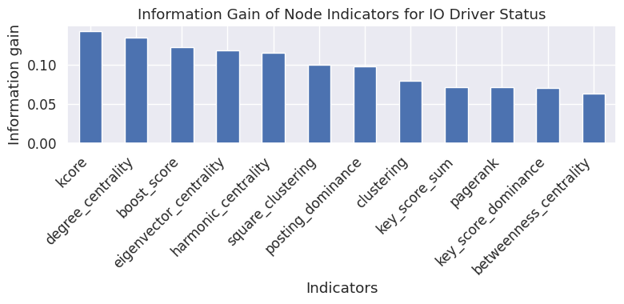
Indicators: Information Gain

