Slide 1

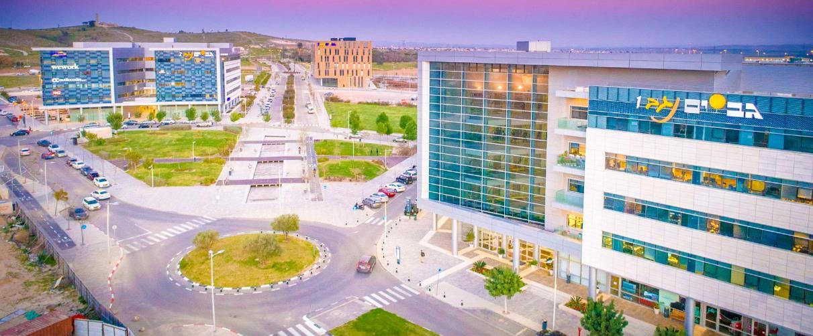
Backbone-Graph
23/07/2025

Slide 2
List of Extracted Topics
topic | post count | title
123 | 2640 | Canadians held without charge in Egypt headed home
924 | 2522 | US ambassador denounces Gaza terrorist tunnels
142 | 2514 | Congress lumbers while threatened default looms
297 | 2504 | Hawkish MKs call to rethink peace talks after Psagot attack
107 | 2498 | Betrayals banks and Bibi
2

Slide 3
Top Posts For Topic 123
topic | author | content | Post topic tf-idf | date
123 | MichaelSerapio | # Canadians John # Greyson and Dr Tarek # Loubani still unable to leave # Egypt Details on # CBCNews Network # CBCNN | 0.5503 | 2013-10-07 15:52:52
123 | MichaelSerapio | # Canadians John # Greyson and Dr Tarek # Loubani still unable to leave # Egypt Details on # CBCNews Network # CBCNN | 0.5503 | 2013-10-07 15:52:52
123 | ayateldewary | Two # Canadians released from prison in # Egypt http://bit.ly/1htsJDh - Wishing them a safe return back home. # cdnpoli # FreeTarekandJohn | 0.4308 | 2013-10-06 07:48:21
123 | SarahVirro | Greyson and Loubani have finally arrived home! # Canadians # Egypt # Toronto # WelcomeBack # Thanksgivingpic.twitter.com/N53Qc2UAbZ | 0.4280 | 2013-10-12 02:24:56
123 | Leftpalm | # Canadians John Greyson & Tarek Loubani held in # Egypt 4more than 50dys without charge on a plane bound for # Toronto http://www.madamasr.com/content/egypt-releases- canadians-held-without-charge … | 0.4150 | 2013-10-06 20:29:38
3

Slide 4
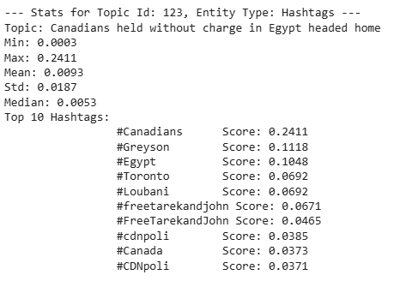
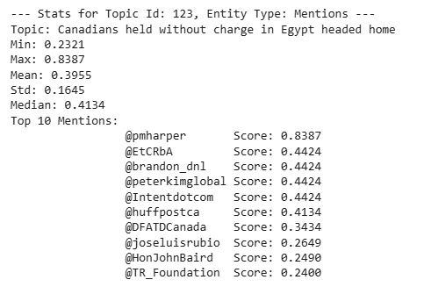
Top Entities For Topic 123
4

Slide 5
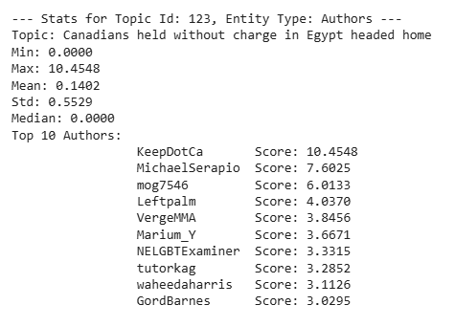
Top Authors For Topic 123
5

Slide 6
Author’s Activity All Topic – Table
Authors | Topic Id | Topic | Number of Posts | Average Posts TF-IDF Score | Hashtags (Counts) | Topic (Frequencies)
KeepDotCa | - | All Topics | 34 | 0.1134 | #Egypt(9), #Greyson(7), #cabinet(5), #Harper(5), #attack(4) | Canadians held without charge in Egypt headed home(11), Senior ministers demand world powers reject Irans cosmetic concessions(7), Nairobi attack shakes sense of security for Kenyas Jews(3), Two freed Canadians unable to leave Egypt(3), Master of mistrust(2)
6

Slide 7
Author’s Activity Topic 123 - Table
Authors | Topic Id | Topic | Number of Posts | Average Posts TF-IDF Score | Hashtags (Counts) | Topic (Frequencies)
KeepDotCa | 123 | Canadians held without charge in Egypt headed home | 11 | 0.206 | #Egypt(8), #Greyson(6), #Canadians(3), #free(2), #charge(1) | Canadians held without charge in Egypt headed home(11)
7

Slide 8
Author’s Activity – Top Posts
topic | title | date | content
123 | Canadians held without charge in Egypt headed home | 2013-10-11 23:15:45 | keep.ca: 2 Canadians jailed in Egypt without charge reportedly heading home - TORONTO - Two... http://bit.ly/1een04y # Canadians # charge
123 | Canadians held without charge in Egypt headed home | 2013-09-30 23:31:11 | keep.ca: Two Canadians held in Egypt have detention extended: family - Two Canadians arrested and held... http://bit.ly/15EFDZG # Canadians
123 | Canadians held without charge in Egypt headed home | 2013-09-30 05:59:35 | keep.ca: Two Canadians held in Egypt have detention extended: family - Two Canadians arrested and held... http://bit.ly/15EFDZG # Canadians
123 | Canadians held without charge in Egypt headed home | 2013-10-08 16:13:08 | keep.ca: John Greyson, Tarek Loubani released in Egypt, not yet heading home - Two Canadians held... http://bit.ly/GCRSzH # Egypt # Greyson
123 | Canadians held without charge in Egypt headed home | 2013-10-06 21:04:44 | keep.ca: John Greyson, Tarek Loubani released in Egypt, not yet heading home - Two Canadians held... http://bit.ly/GCRSzH # Egypt # Greyson
8

Slide 9
Author’s Activity – Lowest Score Posts
topic | title | date | content
84 | As talks kick off Iran calls Western reaction to nuclear proposal good | 2013-09-25 22:50:45 | keep.ca: Deputy warden can't remember talks with teen prisoner who killed herself - TORONTO - A... http://bit.ly/190ueDF # can't # Deputy
84 | As talks kick off Iran calls Western reaction to nuclear proposal good | 2013-09-26 19:48:47 | keep.ca: Deputy warden can't remember talks with teen prisoner who killed herself - TORONTO - A... http://bit.ly/190ueDF # can't # Deputy
272 | Global watchdog approves Syria disarmament plan | 2013-08-08 22:29:57 | keep.ca: IMF review gives former budget watchdog high marks - In a review of global budget... http://bit.ly/12ZBPX8 # budget # Former
272 | Global watchdog approves Syria disarmament plan | 2013-08-07 10:36:58 | keep.ca: IMF review gives former budget watchdog high marks - In a review of global budget... http://bit.ly/12ZBPX8 # budget # Former
853 | Three killed in attack on church wedding in Cairo | 2013-10-20 23:22:29 | keep.ca: Third attack in three weeks at UBC makes investigation top priority:RCMP - VANCOUVER - A third... http://bit.ly/1b4qQuy # attack
9

Slide 10
Author’s Summery
KeepDotCa is Canadian-focused account that shares headlines and updates on major national and international events involving Canada.
Most of the posts are about political developments, government actions, and incidents abroad that affect Canadians.
10

Slide 11
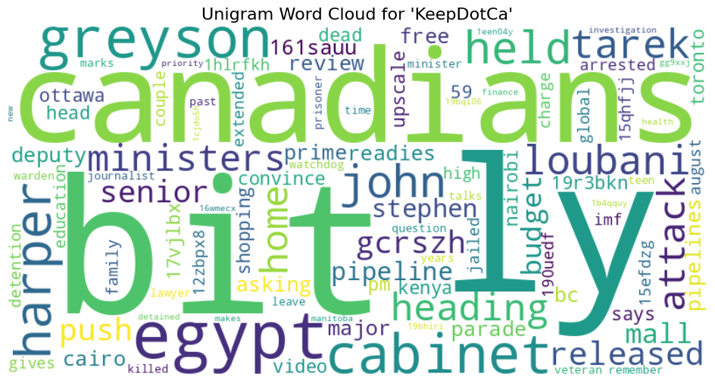
Author’s Activity - Unigram Word Cloud
11

Slide 12
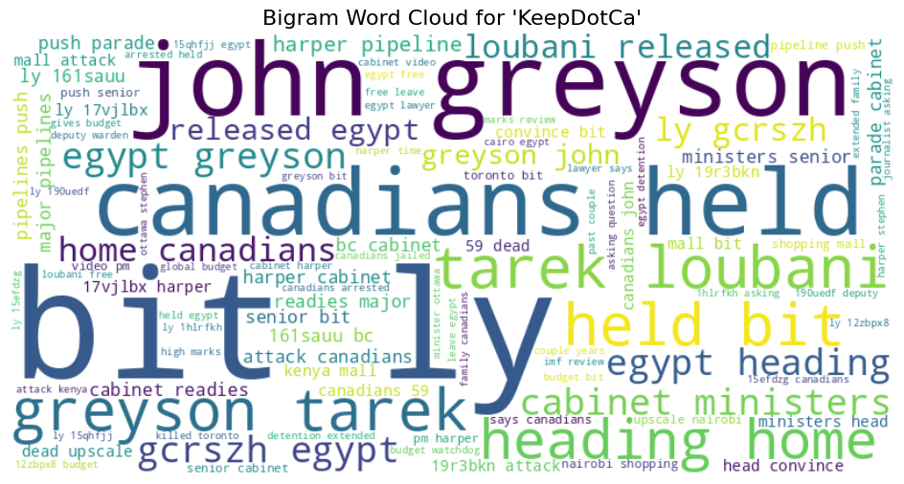
Author’s Activity - Bigram Word Cloud
12

