Slide 1



Backbone Graph
05.01.2026
Amit Ner Gaon, Noa Tal
Prof. Rami Puzis

Slide 2
Introduction
Information Operations (IOs) definition: A set of actors performing similar or complementary actions in pursuit of a common intent, while misleading others.
Social media is the modern public square BUT increasingly exploited by IO.
The Problem:
  LLMs make content detection harder.
  Traditional semantic features are no longer enough.
Our Approach:
  Focus on WHO acts, not WHAT they say
  Structural features + coordination patterns

Slide 3
Introduction
Information Operations (IOs) definition: A set of actors performing similar or complementary actions in pursuit of a common intent, while misleading others.
Social media serves as the modern public square but is increasingly exploited by IOs.
IOs rely on Coordinated Inauthentic Behavior (CIB) to amplify narratives and distort public discourse.
Large language models (LLMs) can generate fluent, human-like content, limiting the discriminative power of semantic features alone.
We therefore aim to identify IO actors using structural features and coordination patterns in online discourse.

Slide 4
Main Ideas
Aim to accurate identification of IO (information operation) authors.
Focus on relationships and interactions between authors.
Narrow analysis to key authors only.
Identify abnormal coordinated behavioural patterns.

Slide 5
Datasets
Labeled IO Corpus [1] Curated collection of 26 Information Operation (IO) campaigns Each campaign fully labeled (IO vs. Control accounts) https://zenodo.org/records/14189193 More details on the next slides… Ecuador Campaign Subset 787 IO accounts | 21,138 Control accounts 700K IO tweets | 770K Control tweets | US 2024 Election Dataset[2] Clean dataset with corrupted/problematic rows removed 42,211,159 tweets | January 1 – December 31, 2024 Key Timeline Events Jul 13 – Attempted assassination of Donald Trump Jul 21 – Joe Biden withdrew from presidential race Aug 5 – Kamala Harris formally nominated Nov 5 – Election Day Nov 6 – Election results announced
Notes:
[1] Seckin, O. C., Pote, M., Nwala, A. C., Yin, L., Luceri, L., Flammini, A., & Menczer, F. (2025, June). Labeled datasets for research on information operations. In Proceedings of the International AAAI Conference on Web and Social Media (Vol. 19, pp. 2567-2574).
[2] Balasubramanian, A., Zou, V., Narayana, H., You, C., Luceri, L., & Ferrara, E. (2024). A public dataset tracking social media discourse about the 2024 us presidential election on twitter/x. arXiv preprint arXiv:2411.00376.

Slide 6
Labeled IO Corpus
Each campaign is a separate dataset.
Contains posts related to the general subject of the campaign.
Includes:
  - Post text
  - Entities: hashtags, URLs (anonymized), account mentions (anonymized)
  - Timestamp
  - Post metadata: account ID, reply-to account ID (anonymized)…
  - Account metadata: creation date, follower count…
Dataset construction:
  - IO accounts identified and released by the social media platform.
  - Control accounts collected from users posting on campaign-related topics and in the same period.
Labels:
  - Labels are provided by the social media platform.
  - Labels are used only for validation.
  - No labels are used in graph construction or classification.

Slide 7
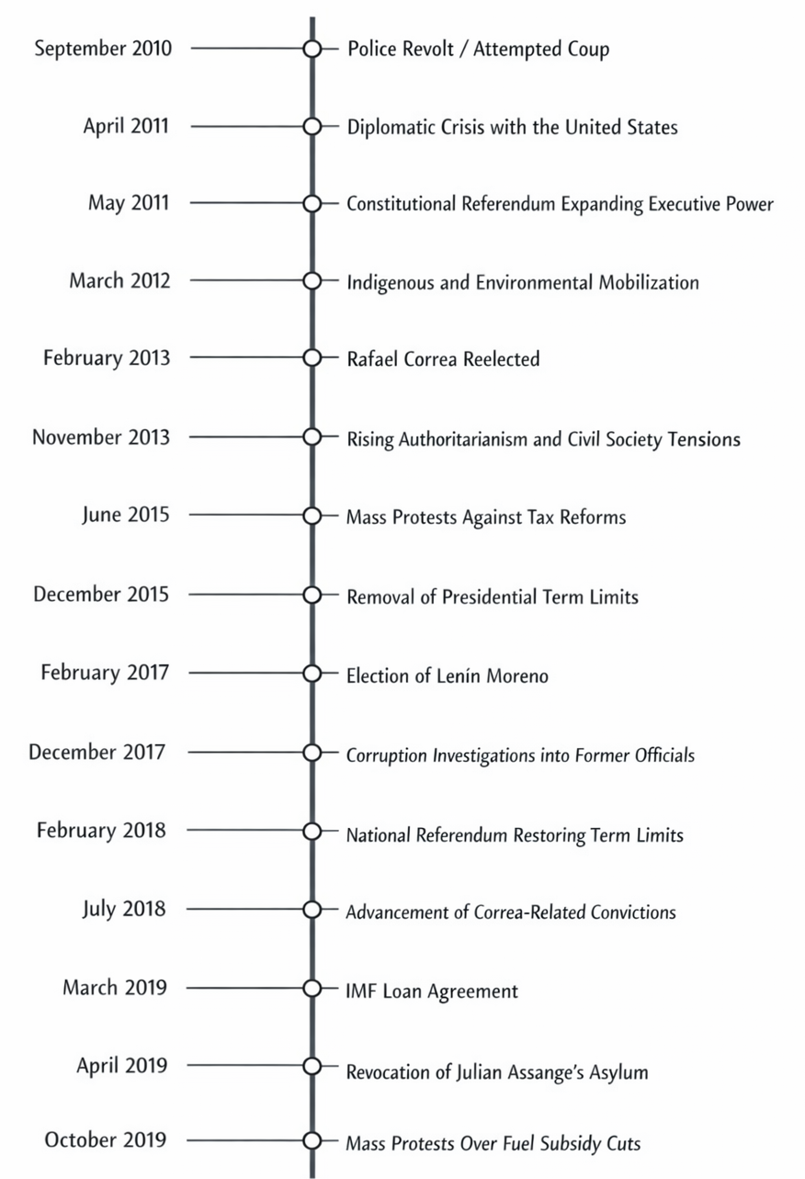
Labeled IO Corpus - Ecuador
787 IO accounts | 21,138 Control accounts
700K IO tweets | 770K Control tweets

Slide 12
Narratives Clustering &
Entities Recognition
Narratives Clustering: group semantically similar posts.
  Will be used for tf-idf score calculation.
Entity Recognition: name entities recognition (NER).
  - Will be use for behavioural similarity.

Slide 14
Entity-Topic TF-IDF Score
TF-IDF: Term Frequency - Inverse Document Frequency
TF-IDF … is a statistical method … to evaluate how important a word is to a document in relation to a larger collection of documents (geeks for geeks).
Notes:
used in natural language processing and information retrieval

Slide 15
Entity-Topic TF-IDF Score
In this project:
  Documents are topics derived from topic clustering.
  Entities are social markers in social media discourse (e.g., hashtags, URLs, mentions, named actors).
Quantify the importance of entities within each topic.
Highlight entities that are distinctive rather than common.

Slide 17
Post & Author Scoring
The TF-IDF score of a post for a topic is computed as the sum of the TF-IDF scores of all entities appearing in that post.
Author score for a topic is:
  TF is the sum of his/her posts’ TF-IDF score.
  IDF is the total number of the topics divide by the topics the author participate in.
  TF-IDF = TF * IDF.

Slide 19
Key Authors Selection
An author is considered a key author independently within each topic and may be a key author in one topic but not in others.
Key authors are defined as authors ranked in the top-N (by TF-IDF score) for at least one topic.
In the graph, all key authors are treated equally, regardless of whether they appear in one or multiple topics.

Slide 21
Backbone Graph Building
Nodes: authors in the discourse.
Edges: co-action relations between author pairs (e.g., co-mention, co-entity, co-topic).
Weights: number of co-occurrences.
Filtering: only key authors.
Purpose: expose coordinated behaviour and structural signals for IO detection.

Slide 22

Backbone Graph

Slide 24
IO Indicators
Assumption: organic users act mostly independently, while IO actors require systematic structural coordination to operate a campaign.
Coordination effect: repeated co-actions produce non-random network structures among the same actors.
Rationale: community identifiers and centralities are measures quantify how embedded, influential, or connective an actor is within the network.

Slide 25
IO Indicators - Examples
Centralities: Measure how structurally important a node is in a network.
  Degree centrality (node): Counts the number of direct connections a node has. Reflects local connectivity.
  Eigenvector centrality (node): the sum of the scores of the node’s neighbours. Reflect connectivity to highly connected nodes.
k-core (node): The largest 𝑘 such that the node belongs to a subgraph where every node has at least 𝑘 neighbours. Reflects embeddedness in dense, mutually connected groups.

Slide 26
IO Indicators
high degree centrality
high eigenvector centrality
high k-core
all high

Slide 27
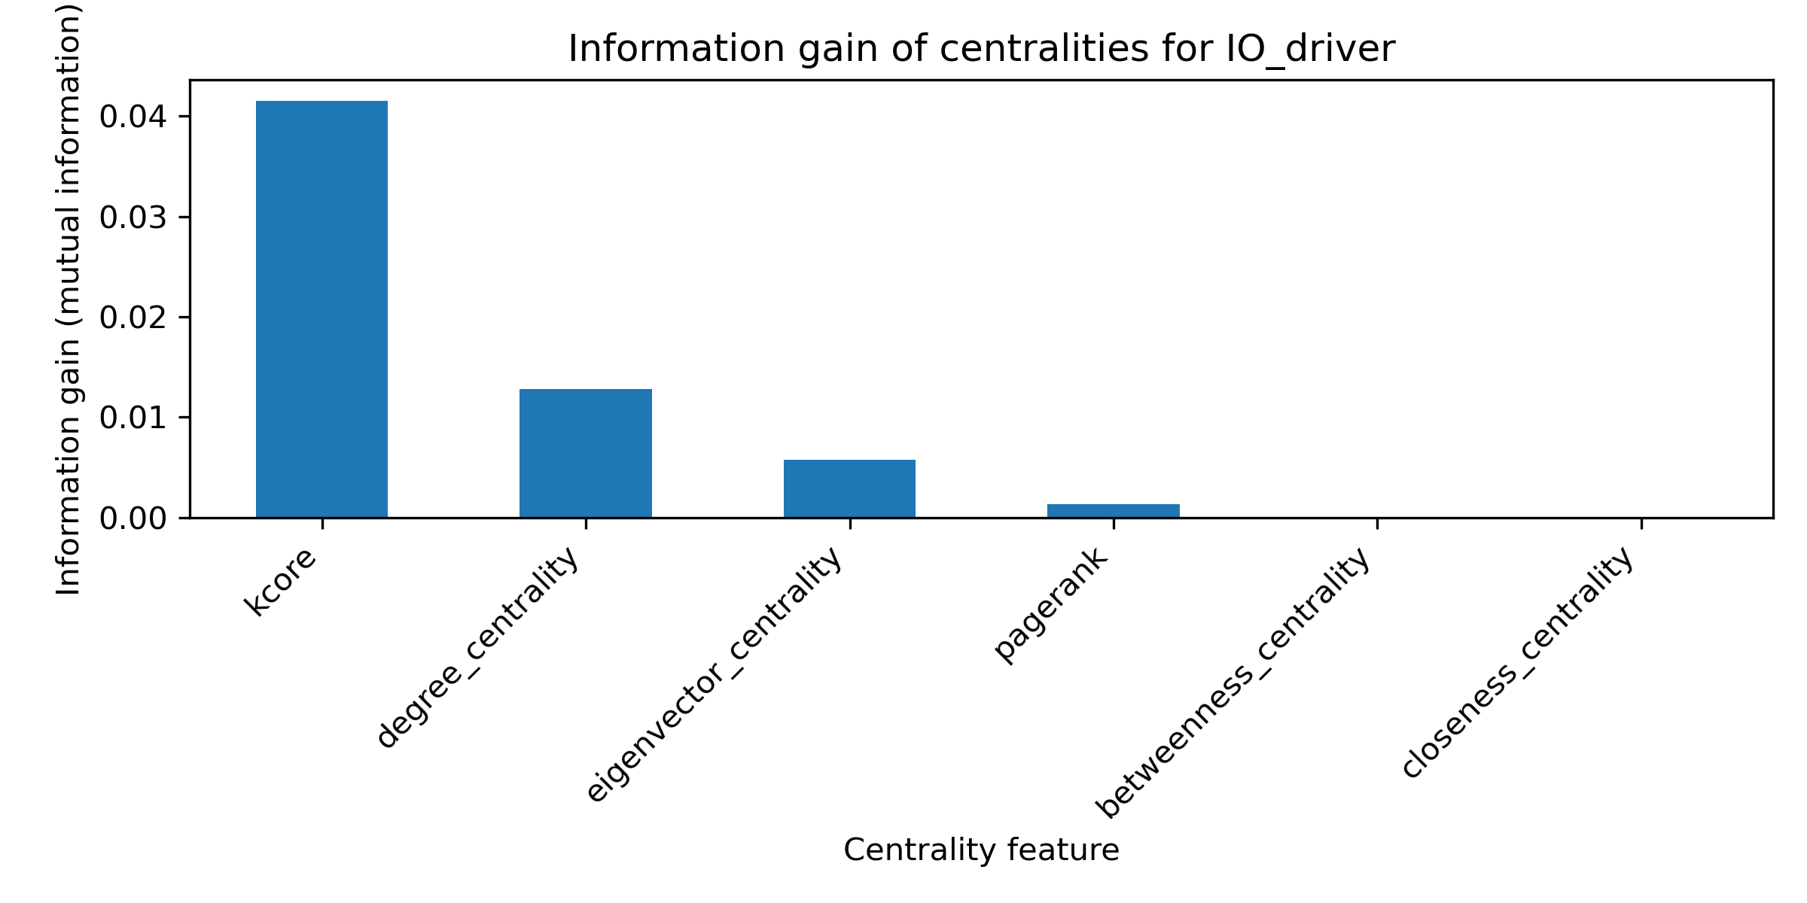
IO Indicators – Information Gain

