Slide 1



Backbone Graph
12.02.2026
Amit Ner Gaon, Noa Tal
Prof. Rami Puzis

Slide 2
Terms
Information Operation (IO): A collection of publications produced by a set of actors performing similar or complementary actions in pursuit of a shared intent, while misleading others.
IO Driver: An account that participates in one or more IO.
Author ‘s IO Label: label = 1 if the author is IO Driver and label = 0 if not.
Key Author: An author who acts as a leading participant in one or more narratives or topics.

Slide 3
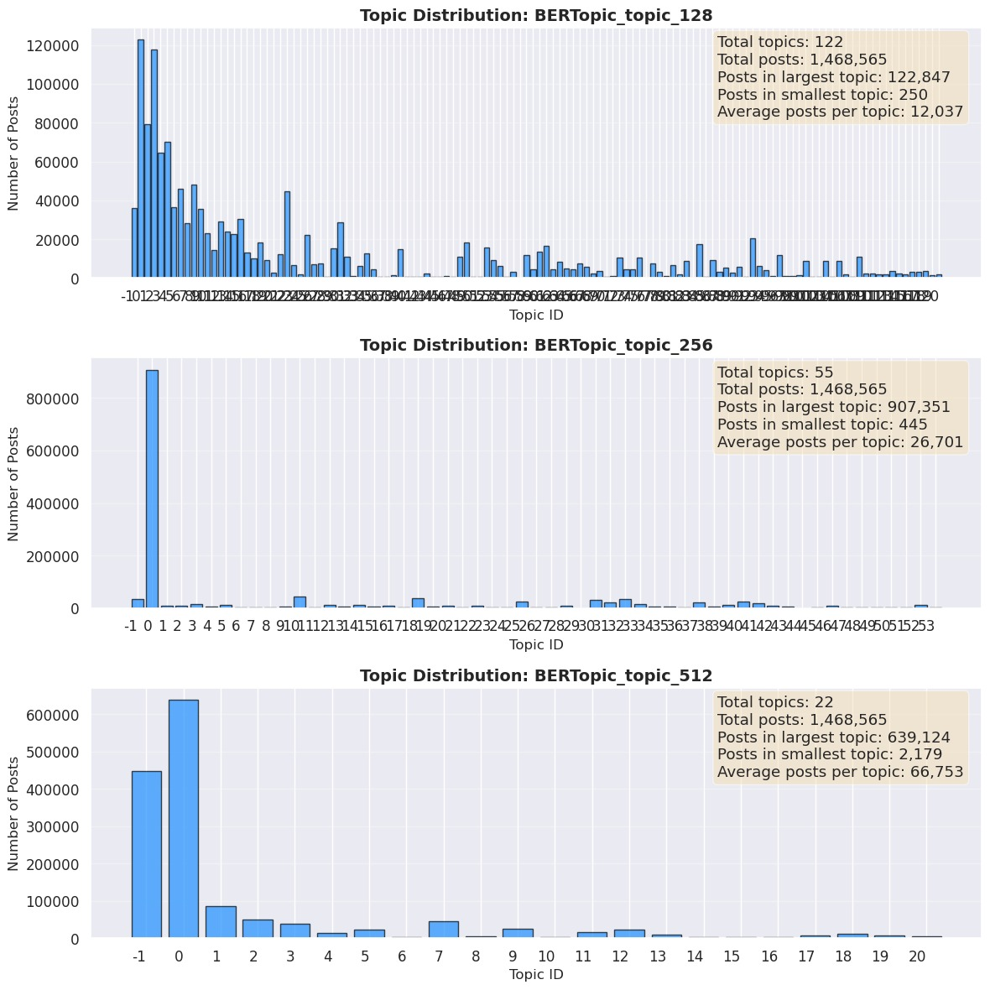
Topic Clustering
min topic size
BERTopic is a topic clustering method that discover semantically coherent topics in text data.
min_topic_size is a parameter that controls the minimum number of documents required to form a topic. Larger the min_topic_size make few topics and each topic larger.

Slide 4
Topic Clustering
min topic size

Slide 5
Backbone Graph Building
Nodes: authors in the discourse.
Edges: co-action relations between author pairs (e.g., co-mention, co-entity, co-topic).
Weights: number of co-occurrences.
Filtering: only key authors.
Purpose: expose coordinated behaviour and structural signals for IO detection.

Slide 6

Backbone Graph

Slide 7
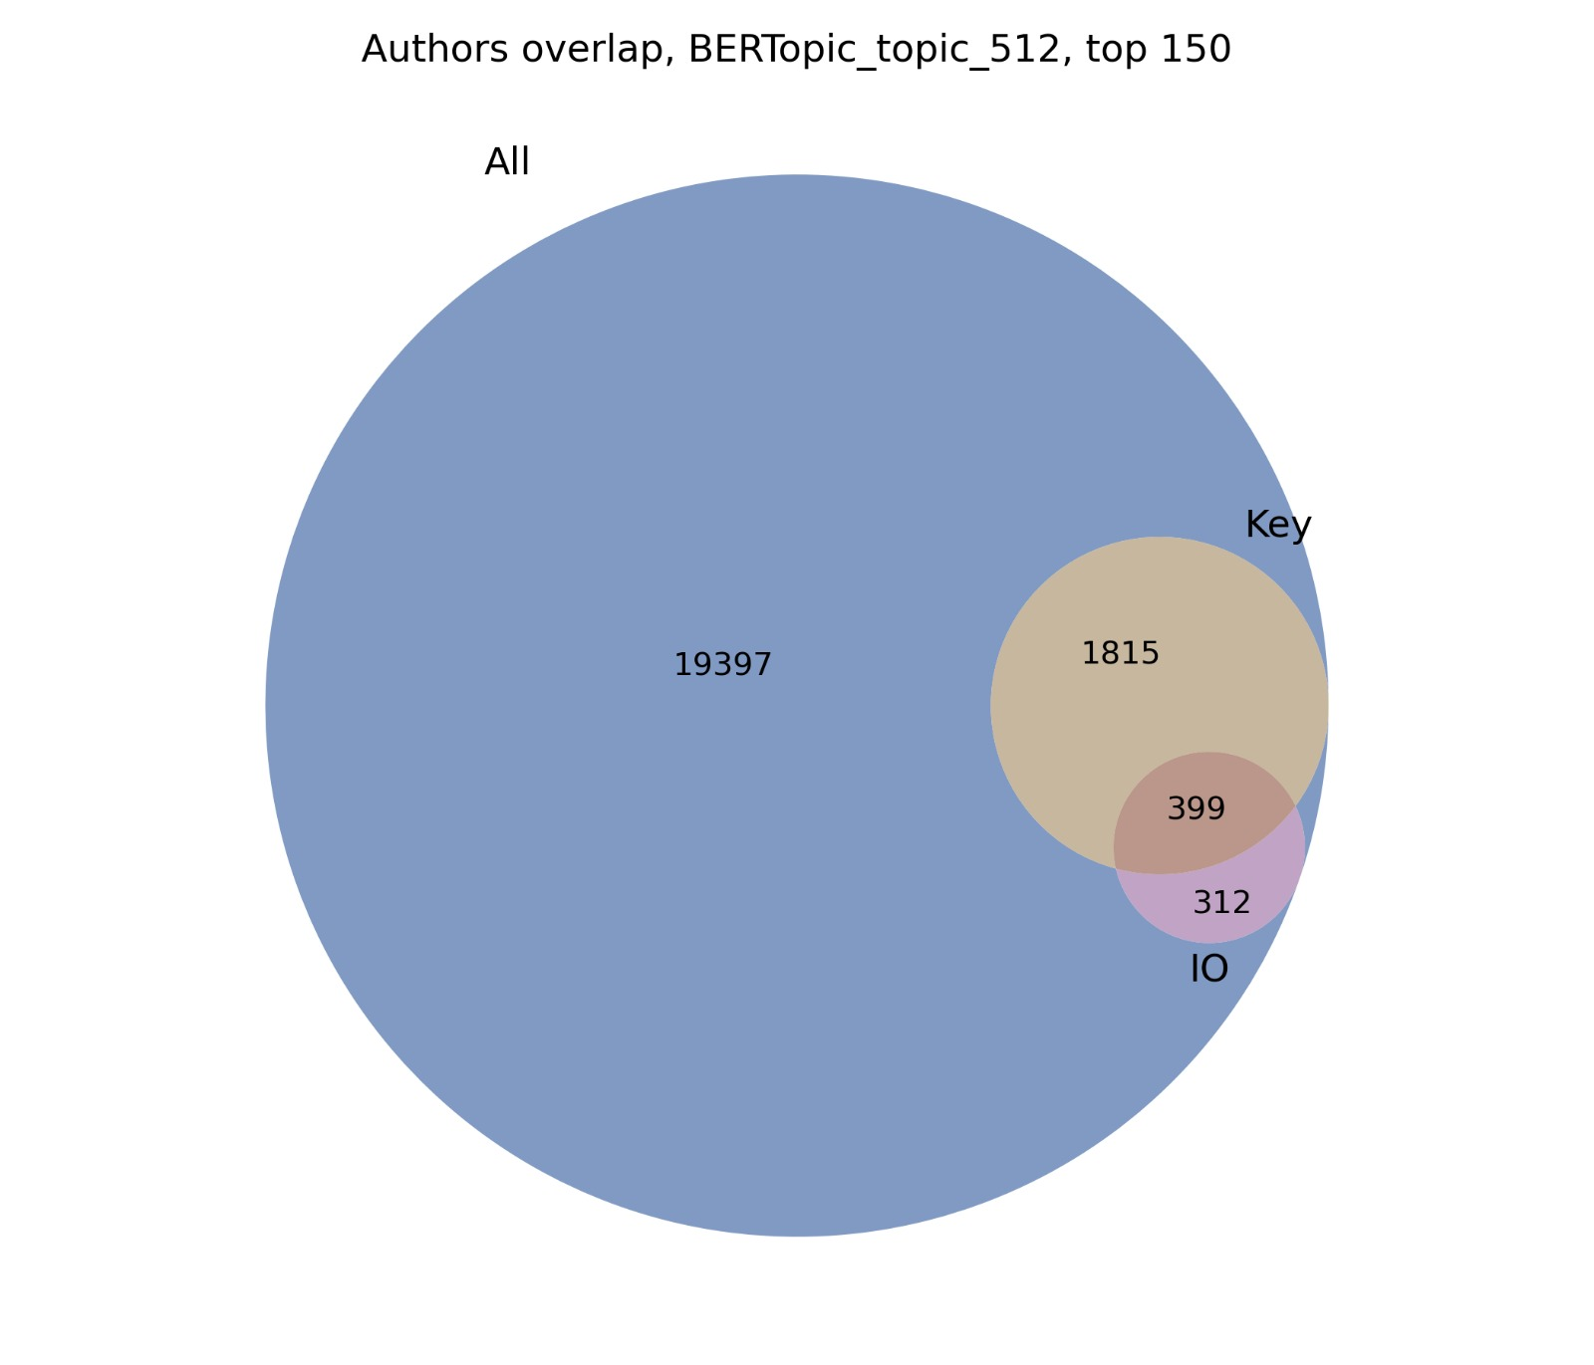
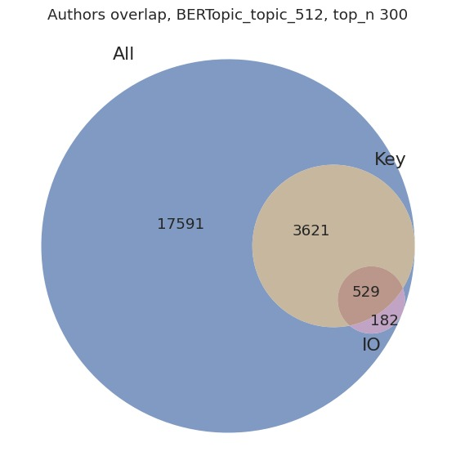
Authors Overlap
IO labels are provided within the dataset
The IO labels were assigned by the social media platforms.

Slide 8
Indicators
Tfidf sum: The sum of the all the per-topic tdidf score. How much the author is a leading participant in the topics.
K-core: Indicates how deeply embedded a user is within the dense group.
Pagerank: Estimates a user’s overall importance based on how many important users connect to them.
Clustering: Measures how tightly connected a user’s neighbors are to each other.
Square clustering: Measures how often a user participates in tightly connected small group structures.
Degree centrality: Counts how many direct connections a user has.
Eigenvector centrality: Shows whether a user is connected to other high-scoring users.
Harmonic centrality: Reflects how easily a user can reach many others in the network.
Betweenness centrality: measures how frequently a node appears on the shortest path between other,

Slide 9
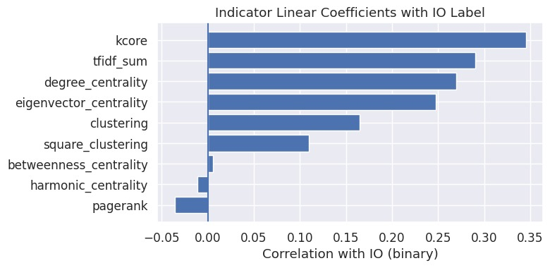
Indicators Coefficients with IO Label

Slide 10
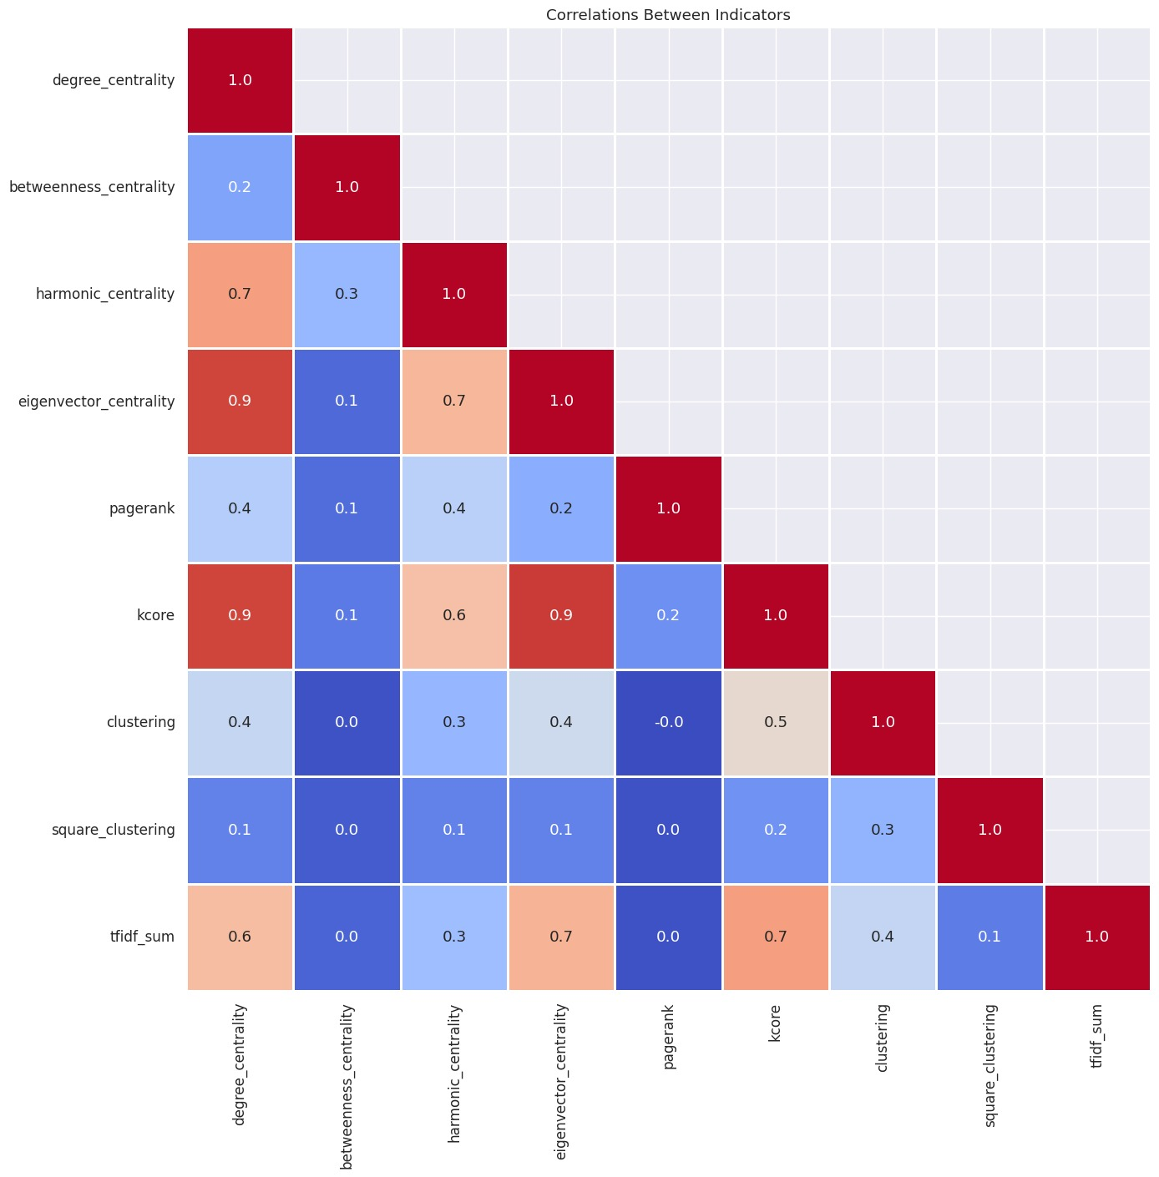
Correlations Among Indicators

Slide 11
Information Gain
Information Gain (Mutual Information) is a measure of how much knowledge one variable provides about another. Higher information gain means the indicator is more useful for making accurate predictions.
https://scikit-learn.org/stable/modules/generated/sklearn.feature_selection.mutual_info_classif.html

Slide 12
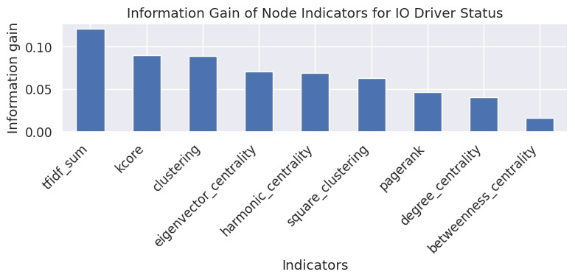
Indicators Information Gain

Slide 13
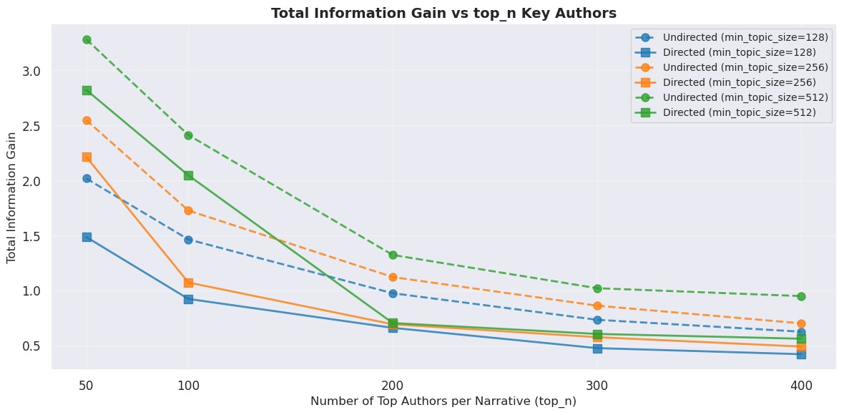
Indicators Information Gain

