Slide 1



Backbone Graph
27.05.2026
Amit Ner Gaon, Noa Tal, Idan Muallem
Prof. Rami Puzis

Slide 2
Core Concepts - IO
Information Operation (IO): A collection of publications by coordinated actors pursuing a shared intent while misleading others.
IO Driver: An account that promotes one or more IO.
Author ‘s IO Label: label = 1 if the author is a IO Driver and label = 0 if not.
Goal:
Calculation of graph-based indicators (e.g., centralities) to identify authors that are IO drivers in social network.

Slide 3

Co-Actions Graph
Nodes: authors in the discourse.
Edges: co-action relations between pair of authors (e.g., posting same hashtag). Represents behavioral similararty between the authors.
Purpose: expose coordinated behaviour for IO detection.

Slide 4

Backbone Graph & IO Indicators
1) Co-actions graph represents author similarity.
2) IO drivers tend to be embedded in dense communities.
3) Graph-based indicators are used to measure author’s embeddedness.
4) Each user is represented by a feature vector.
5) The feature vectors are used to determine if an author is an IO driver.
Author feature vector

Slide 5
Core-Number

Slide 6
Core Number - Intuition
Node belongs to tightly connected group.
The node/author is suspected to be an IO drive.
Node has higher core-number.

Slide 7
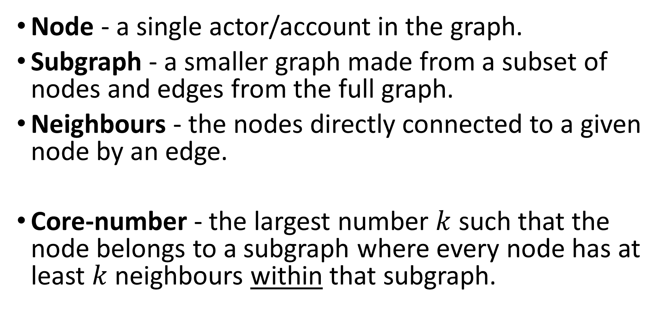
Core Number - Definition
Node - a single actor/account in the graph.
Subgraph - a smaller graph made from a subset of nodes and edges from the full graph.
Neighbours - the nodes directly connected to a given node by an edge.
Core-number - the largest number $k$ such that the node belongs to a subgraph where every node has at least $k$neighbours within that subgraph.

Slide 8

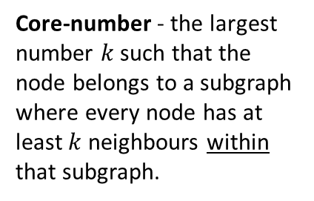
Core Number - Example
Core-number - the largest number $k$ such that the node belongs to a subgraph where every node has at least $k$neighbours within that subgraph.
Because of how core number is calculated, the minimum possible core number for a node is 1.

Slide 9
Core Number - Example
Core-number - the largest number $k$ such that the node belongs to a subgraph where every node has at least $k$neighbours within that subgraph.
Each node in the blue subgraphs has at least 2 neighbours.

Slide 10
Core Number - Example
Core-number - the largest number $k$ such that the node belongs to a subgraph where every node has at least $k$neighbours within that subgraph.
Each node in the red subgraphs has at least 3 neighbours.

Slide 11
Co-Actions Graph
Nodes: authors in the discourse.
Edges: co-action relations between author pairs (e.g., co-mention, co-entity, co-topic). Represents behavioral similararty between the authors.
Purpose: expose coordinated behaviour for IO detection.

Slide 12
Core Number - Example
Co-Action Graph
#DeepState
#Music
#True
#Music
#CoverUp
#DeepState
#CoverUp
#DeepState
#CoverUp
#CoverUp
# Media
#Trending
#TruthExposed
#Eurovision
#CoverUp
# Media
#DeepState
#True
Core-number - the largest number $k$ such that the node belongs to a subgraph where every node has at least $k$neighbours within that subgraph.

Slide 13
Core Number - Example
Co-Action Graph
IO Drivers
#Music
#DeepState
#True
#Music
#CoverUp
#DeepState
#CoverUp
#DeepState
#CoverUp
#CoverUp
# Media
#Trending
#TruthExposed
#Eurovision
#CoverUp
# Media
#DeepState
#True
Core-number - the largest number $k$ such that the node belongs to a subgraph where every node has at least $k$neighbours within that subgraph.

Slide 14




Core Number
Ecuador Campaign
Cumulative distribution: proportion of IO drivers by Core Number threshold (≤ / ≥)

Slide 15
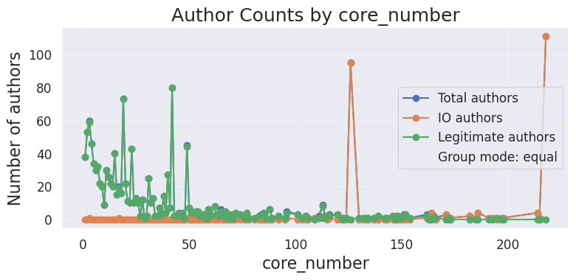
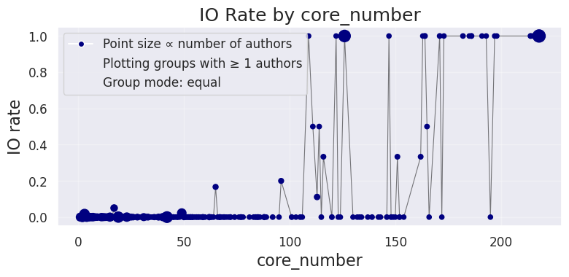
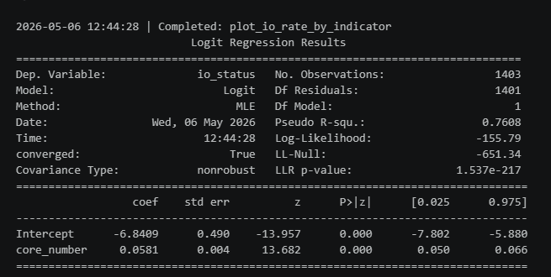
Core Number
Ecuador Campaign
Using binomial logistic regression with a Wald test on the coefficient.
the relationship is highly statistically significant.

Slide 16
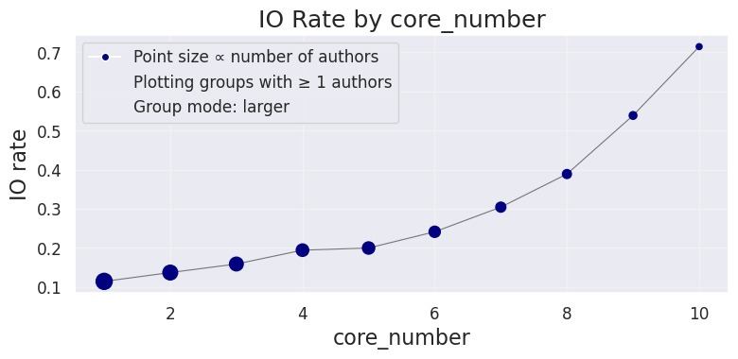
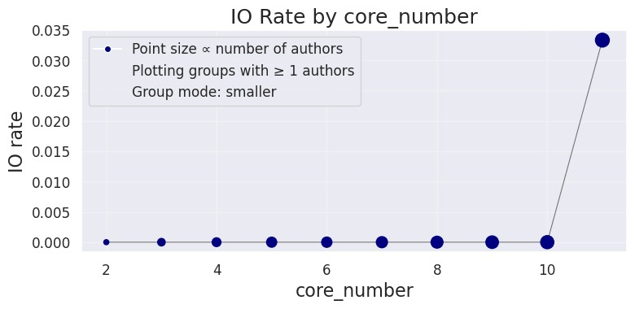
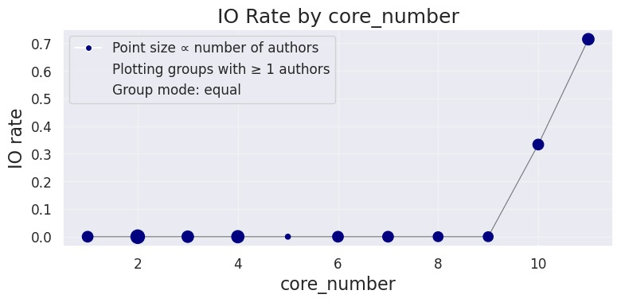
Core Number
Bangladesh Campaign

Slide 17
Indicators Comparison

Slide 18

Indicators Comparison- Information Gain
On Ecuador Campaign
Information Gain is a statistical method used to measure how much knowledge one variable provides about another.

Slide 19


Indicators Comparison- SHAP
SHAP analysis on XGBoost model on Ecuador Campaign
SHAP explains how much each feature contributes to a model’s prediction.

Slide 20
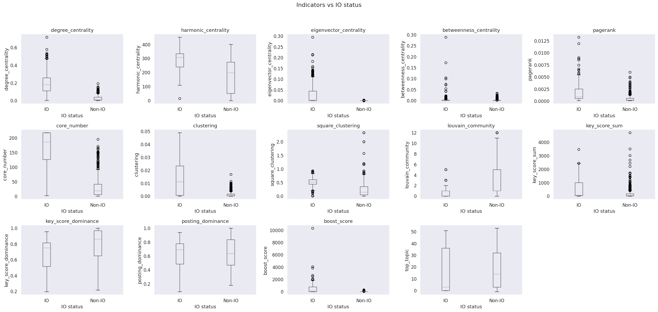
Indicators Comparison- Box Plots
Ecuador Campaign
A box plot is a method for demonstrating graphically the distribution of numerical data across different groups.

Slide 21
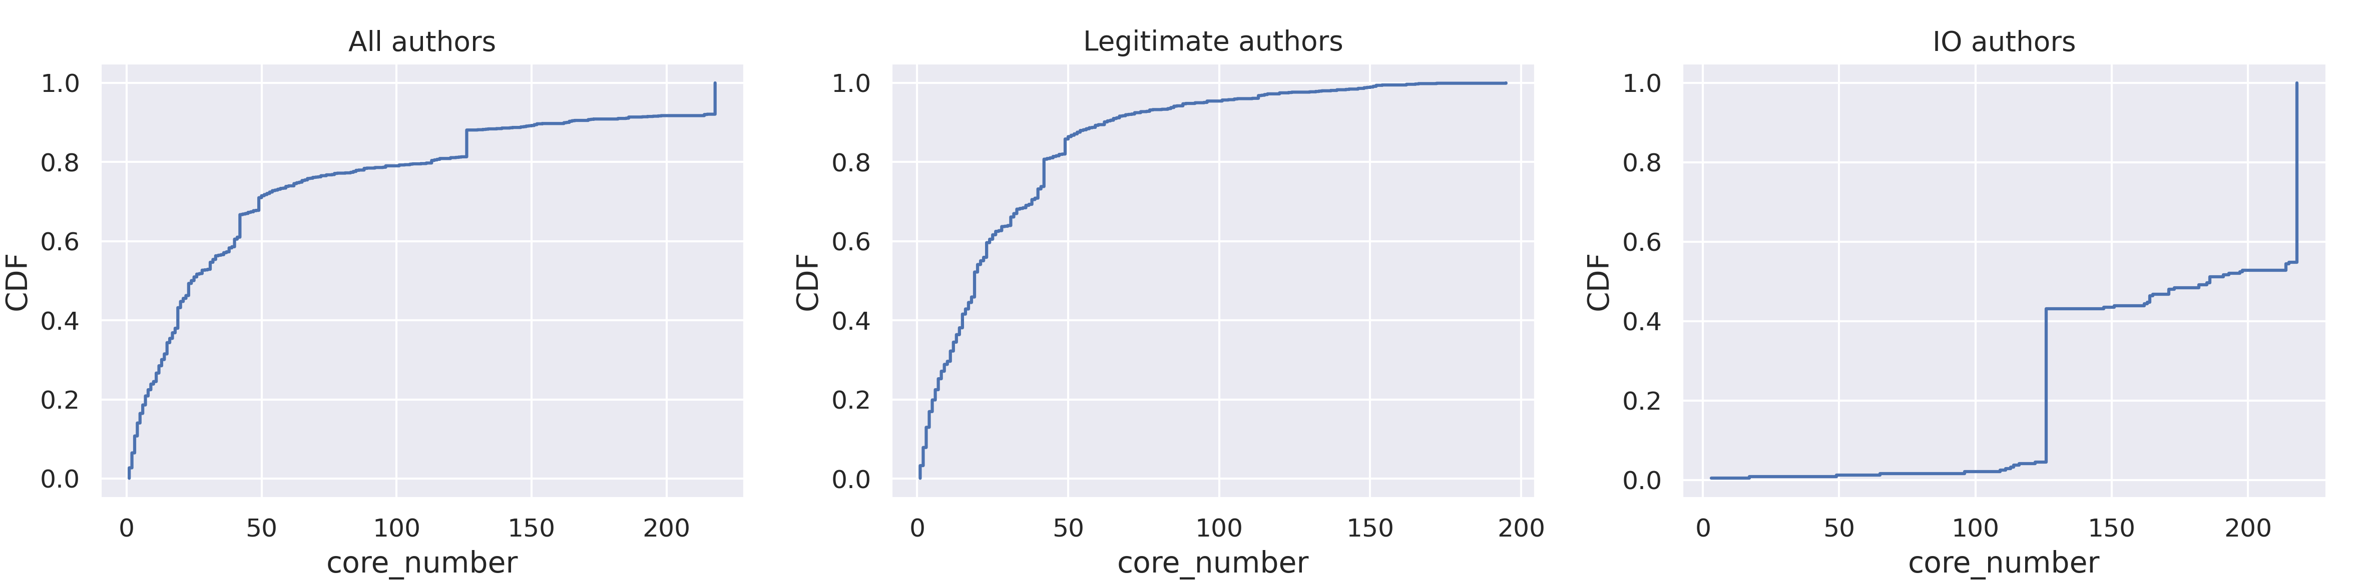
Core Number - CDF
Ecuador Campaign
The Cumulative Distribution Function (CDF) show the probability that the variable will take a value less than or equal to a particular value in X-axis.

