Slide 1
Core Concepts - IO
Information Operation (IO): A collection of publications by coordinated actors pursuing a shared intent while misleading others.
IO Driver: An account that promotes one or more IO.
Author ‘s IO Label: label = 1 if the author is a IO Driver and label = 0 if not.
Goal:
Calculation of graph-based indicators (e.g., centralities) to identify authors that are IO drivers in social network.

Slide 2

Co-Actions Graph
Nodes: authors in the discourse.
Edges: co-action relations between pair of authors (e.g., posting same hashtag). Represents behavioral similararty between the authors.
Purpose: expose coordinated behaviour for IO detection.

Slide 3

Backbone Graph & IO Indicators
1) Co-actions graph represents author similarity.
2) IO drivers tend to be embedded in dense communities.
3) Graph-based indicators are used to measure author’s embeddedness.
4) Each user is represented by a feature vector.
5) The feature vectors are used to determine if an author is an IO driver.
Author feature vector

Slide 4
Core Number - Intuition
Node belongs to tightly connected group.
The node/author is suspected to be an IO drive.
Node has higher core-number.

Slide 5
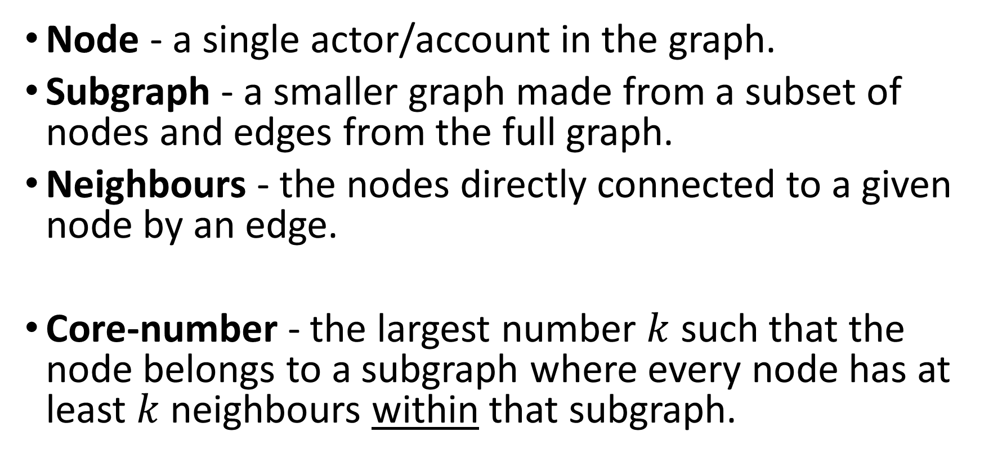
Core Number - Definition
Node - a single actor/account in the graph.
Subgraph - a smaller graph made from a subset of nodes and edges from the full graph.
Neighbours - the nodes directly connected to a given node by an edge.
Core-number - the largest number $k$ such that the node belongs to a subgraph where every node has at least $k$neighbours within that subgraph.

Slide 6

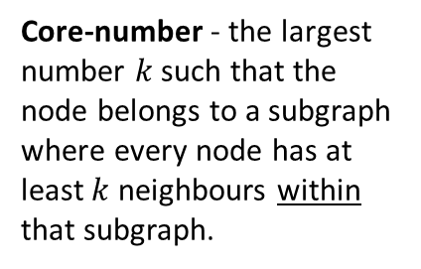
Core Number - Example
Co-Action Graph
IO Drivers
#Music
#DeepState
#True
#Music
#CoverUp
#DeepState
#CoverUp
#DeepState
#CoverUp
#CoverUp
# Media
#Trending
#TruthExposed
#Eurovision
#CoverUp
# Media
#DeepState
#True
Core-number - the largest number $k$ such that the node belongs to a subgraph where every node has at least $k$neighbours within that subgraph.

Slide 7




Core Number
Ecuador Campaign
Cumulative distribution: proportion of IO drivers by Core Number threshold (≤ / ≥)

Slide 8


Indicators Comparison- SHAP
SHAP analysis on XGBoost model on Ecuador Campaign
SHAP explains how much each feature contributes to a model’s prediction.

