Slide 1



I Can See U.
Indicator-Based Information Operation Detection and Topic-Aware Group Analysis
23.09.2026
Amit Ner Gaon, Noa Tal
Prof. Rami Puzis

Slide 2

Motivation
Social media platforms are central spaces for public discourse.
Seckin et al. (2025). “Sharing without clicking on news in social media.”
Information operations (IOs) exploit the openness of social media to manipulate online discourse, threatening democratic processes, public trust, and societal cohesion.
Weedon et al. (2017), “Information Operations and Facebook”

Slide 3

IO & Coordination
IOs rely on fleets of coordinated accounts acting toward a shared objective. Coordination is what amplifies their influence.
Pacheco et al. “Uncovering Coordinated Networks on Social Media: Methods and Case Studies”
Coordinated activity leaves observable traces of behavioural similarity.
Luceri et al. (2024), “Unmasking the Web of Deceit: Uncovering Coordinated Activity to Expose Information Operations on Twitter”
Therefore, identifying coordination is a key step toward detecting IO drivers.

Slide 4
Related Work
IO-Driver Detection Methods:
Node-Local: detect suspicious users from their individual content, activity, and behaviour.
Tomaiuolo et al. (2020), A Survey on Troll Detection
Network-Based: detect coordinated groups from graph structure and behavioural similarity.
Pacheco et al. (2021), Uncovering Coordinated Networks on Social Media: Methods and Case Studies
Hybrid: combine user content with network information to detect IO drivers.
Minici et al. (2025), IOHunter: Graph Foundation Model to Uncover Online Information Operations
The gap: existing approaches either detect coordinated groups without quantifying each account’s depth of involvement, or implicitly encode structural embeddedness within black-box models. None provides an explicit, interpretable, account-level measure of coordination depth.

Slide 5
Our Contributions
An interpretable, indicator-based approach for account-level IO detection.
Topic-aware Group analysis of the detected coordinated group (k-core), revealing the campaign’s agenda.

Slide 6
Interpretable Indicators

Slide 7

Co-Action Graph
Nodes: authors in the discourse.
Edges: co-action relations between a pair of authors (e.g., posting the same hashtag). Represents behavioral similarity between the authors.
Purpose: expose coordinated behaviour for IO detection.

Slide 8
Overview of Indicators
Graph-Based Indicators
  Describe how each account connects to other accounts.
  Capture its position in the network and membership in groups of connected accounts.
Topic-Based Indicators
  Describe which topics each account discusses.
  Capture how its activity is distributed across topics and which terms characterize its posts.

Slide 9
Graph-Based Indicators
Using the Co-Action Graph, we calculate well-established graph indicators for each author (node) to characterize their structural role.
  Centrality: Degree, Harmonic, Eigenvector, Betweenness, PageRank
  Cohesion: Core Number, Clustering Coefficient
  Community: Louvain Community ID
These indicators provide interpretable structural features.

Slide 10
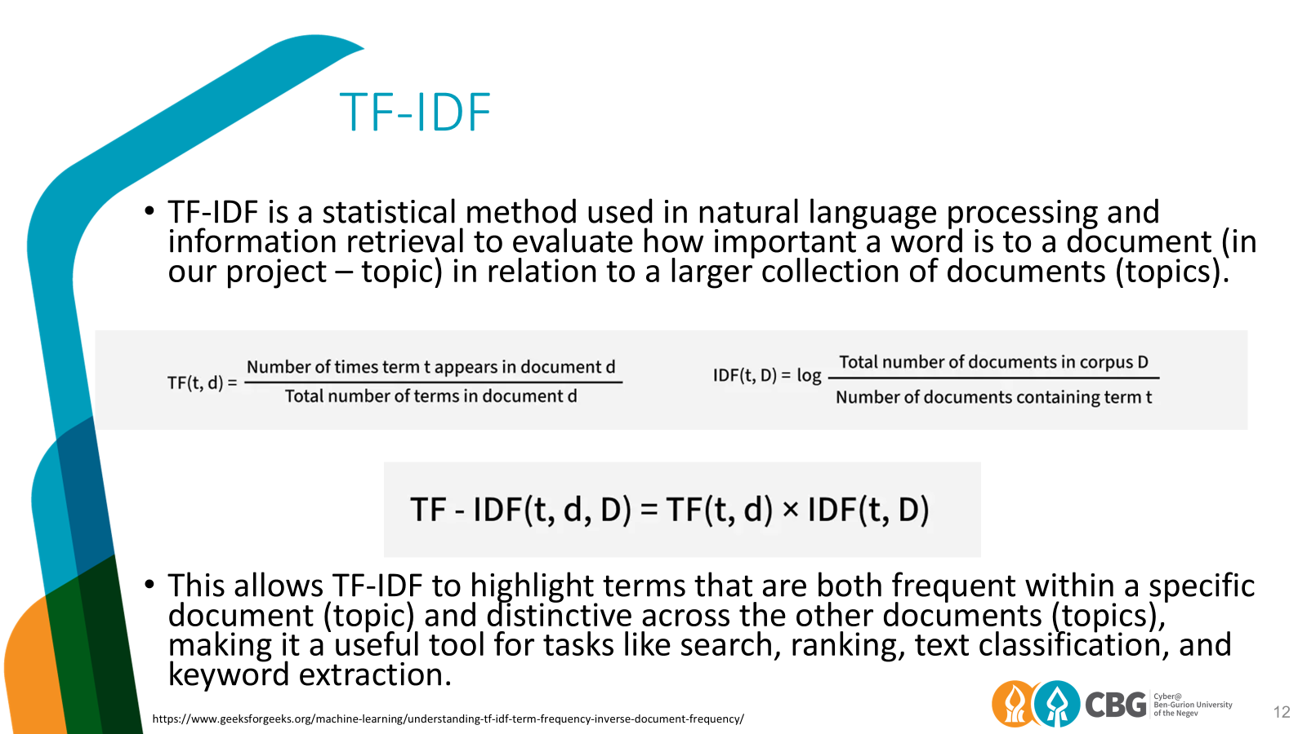

Slide 11
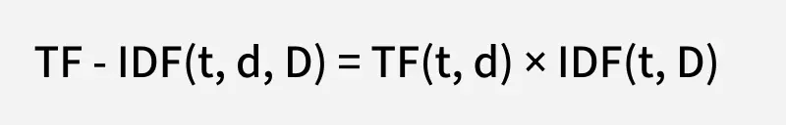
TF-IDF and Account Relevance
TF-IDF measures how characteristic a term is of a topic compared with other topics. We use these term weights to calculate each account’s relevance to a topic based on the entities it uses.
Topic representation: Treat each topic as a collection of its associated posts.
Entity weighting: Use TF-IDF to assign higher weights to entities that are frequent within a topic but uncommon across other topics.
Account relevance: Aggregate the TF-IDF scores of the entities an account uses within a topic to calculate its Key Score, with a penalty for activity across multiple topics.
Account indicators: Summarize these scores using Key Score Sum and Key Score Dominance.
https://www.geeksforgeeks.org/machine-learning/understanding-tf-idf-term-frequency-inverse-document-frequency/

Slide 12
Topic-Based Indicators
Calculated from each author’s posts and hashtags to capture their thematic activity.
Activity-Based Indicators
  Posting Dominance - proportion of an author’s posts assigned to their most frequent topic.
  Top Topic - the author’s dominant topic.
TF-IDF-Based Indicators (see next slide)
  Key Score (Topic) - author’s relevance to a specific topic, calculated by aggregating the TF-IDF scores of the entities used by the author in that topic, with a penalty for activity across multiple topics.
  Key Score Sum - sum of the author’s key scores across all topics.
  Key Score Dominance - proportion of the total key score concentrated in the author’s strongest topic.
Together, these indicators capture the author’s narrative focus and thematic behaviour.

Slide 13

Indicators Workflow
Build a co-action graph connecting accounts with similar activity.
Author Feature Vector (Example)
01
Calculate graph-based indicators and topic-based indicators.
02
Combine the indicator values into a feature vector for each account.
03
Use these feature vectors to classify accounts as IO or non-IO.
04

Slide 14
Group Analysis

Slide 15
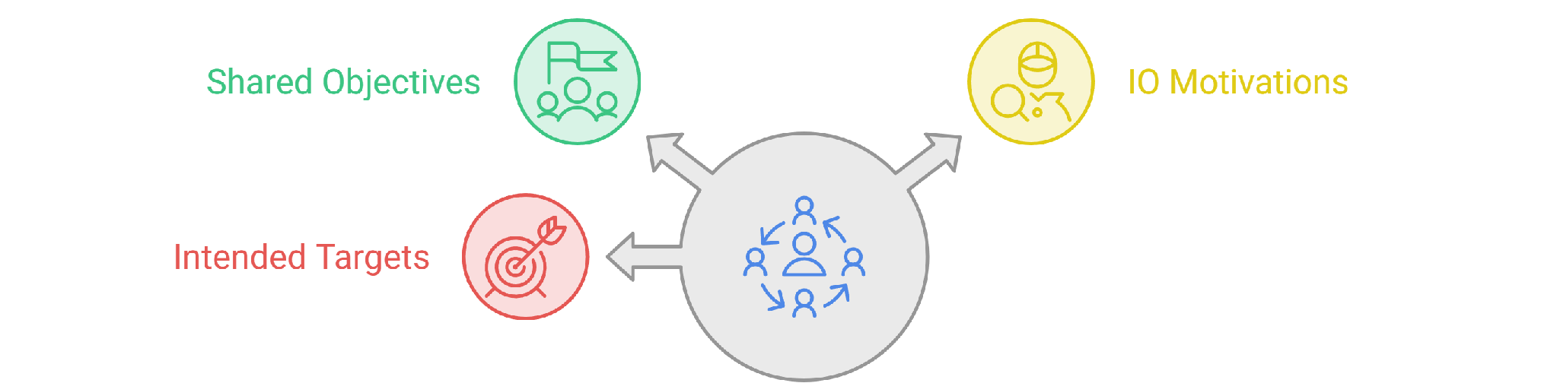
Overview
At the group level, we can reveal shared narratives and thematic patterns that may not be visible when analysing individual accounts.
Goal: Move from “Who participates in an IO?” to “How do coordinated groups operate, and what narratives characterize their activity?”

Slide 16
Group Definitions
We compare groups of accounts defined by graph structure, dominant topic, or model predictions:
  Maximal k-Core Connected Component: Accounts in the same connected component of the highest k-core containing the focal account.
  Direct Neighbours: Accounts directly connected to the focal account.
  Louvain Community Group: Accounts assigned to the same community by the Louvain algorithm. Community membership is an account attribute; here, we analyse the members together as a group.
  Shared Top Topic: Accounts with the same dominant topic.
  RF-Predicted IO: Accounts classified as IO by Random Forest.
  XGBoost-Predicted IO: Accounts classified as IO by XGBoost.

Slide 17
Evaluation
We evaluate each group using IO concentration, the proportion of accounts labelled as IO, and topic alignment, the similarity of members’ topical activity.
We select k-core connected components for further analysis because they provide a good balance between IO concentration and topic alignment.

Slide 18
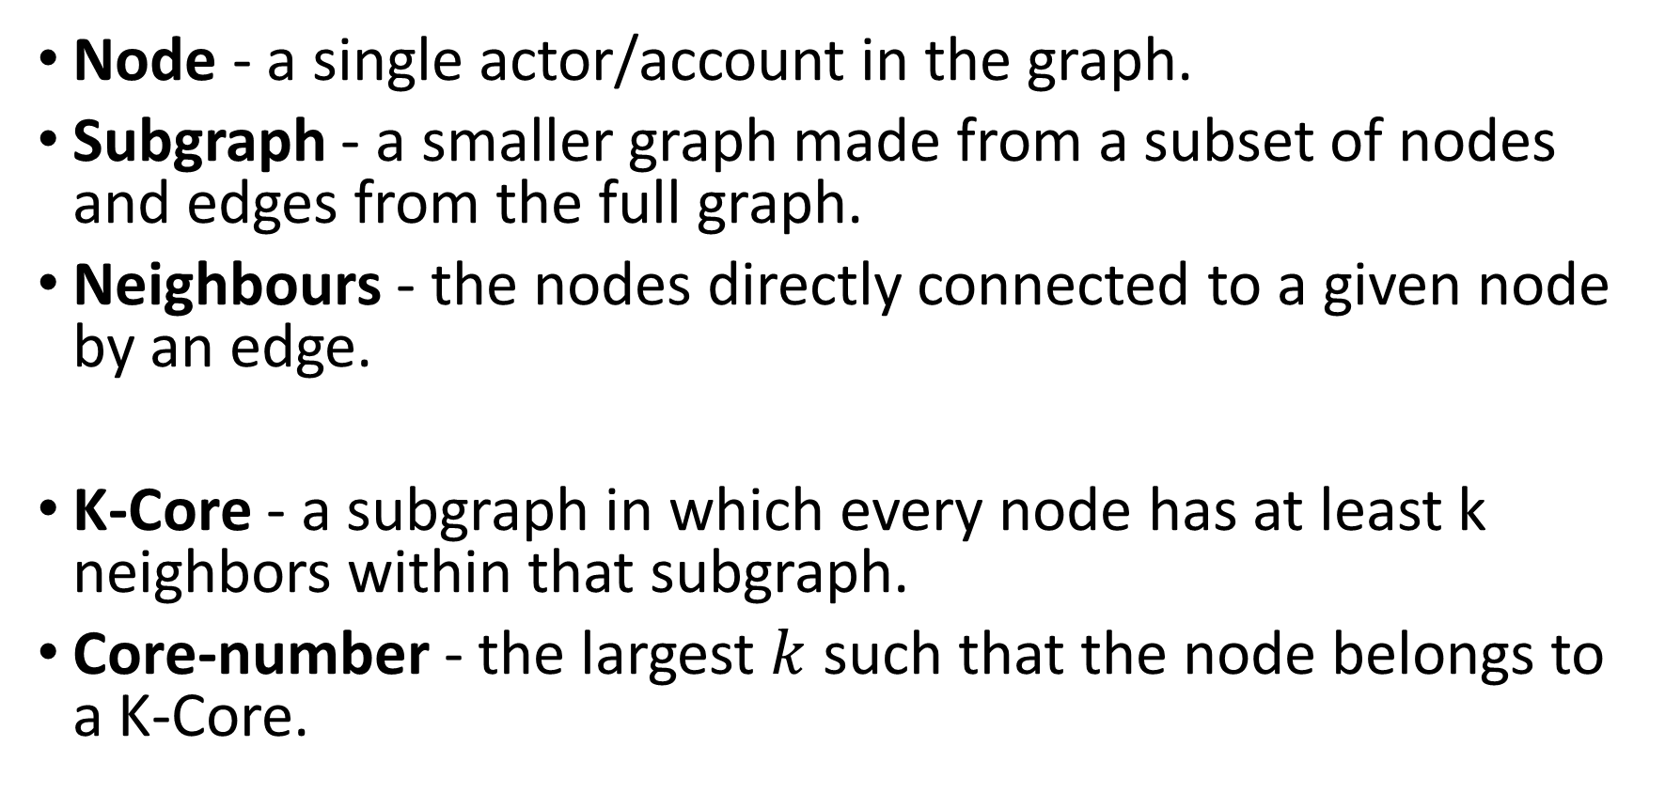
K-Core Definition

Slide 19

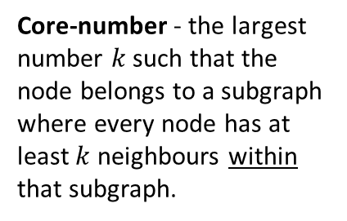
Core Number: Example
Co-Action Graph
IO Drivers
#Music
#DeepState
#True
#Music
#CoverUp
#DeepState
#CoverUp
#DeepState
#CoverUp
#CoverUp
# Media
#Trending
#TruthExposed
#Eurovision
#CoverUp
# Media
#DeepState
#True

Slide 20
Maximal K-Core Motivation
1. The co-action graph represents behavioural similarity between authors.
2. Coordinated authors are highly inter-connected in the co-action graph.
3. Maximal k-cores identify these inter-connected groups, yielding groups of coordinated authors that amplify related narratives.
4. Content and activity analysis identify and characterize the narratives promoted by each group.
Notes:
Key Takeaway: K-core structure guides group selection. Activity and content analysis help explain how the selected group operates and what it amplifies.
Key Takeaway: Similarity with one or two accounts is not enough.
Only many accounts coordinating with one another produce a large k-core.

Slide 21
Experiments

Slide 22
Dataset
Labeled IO Dataset
26 verified IO campaigns linked to 16 stats.
Contains IO accounts and matched control accounts discussing similar topics during the same periods.
Includes 303K+ accounts and 13M+ control posts.
Rich activity data: posts, reposts, hashtags, and more.
Each account is labeled IO or non-IO.

Slide 23
Evaluation Settings
Within-Campaign (Transductive)
  Train and test on accounts from the same campaign.
Cross-Campaign (Inductive)
  Train on other campaigns and test on an unseen campaign.
  Uses a leave-one-campaign-out setting.
  Evaluates whether structural patterns generalize to new IO campaigns.

Slide 24
Evaluated Campaigns
Campaign | Period | IO accounts | Controls | Posts
China-1 | 2008–2019 | 699 | 42,120 | 3,670,754
Cuba | 2010–2020 | 503 | 30,099 | 6,155,331
Iran-1 | 2010–2018 | 660 | 5,015 | 1,322,789
Russia-1 | 2009–2018 | 3,293 | 31,299 | 3,650,083
UAE | 2011–2019 | 3,658 | 10,545 | 1,707,792
Venezuela | 2012–2019 | 611 | 9,745 | 1,972,732
18.5 million posts across 138,247 accounts.
Controls matched by hashtag and date.
7
Notes:
Source: I Can See U: Indicator-Based Detection of Information Operations and Topic-Aware Group Analysis. Uploaded manuscript Backbone_Graph (1).pdf. Table 1, pp. 3–4.

Slide 25
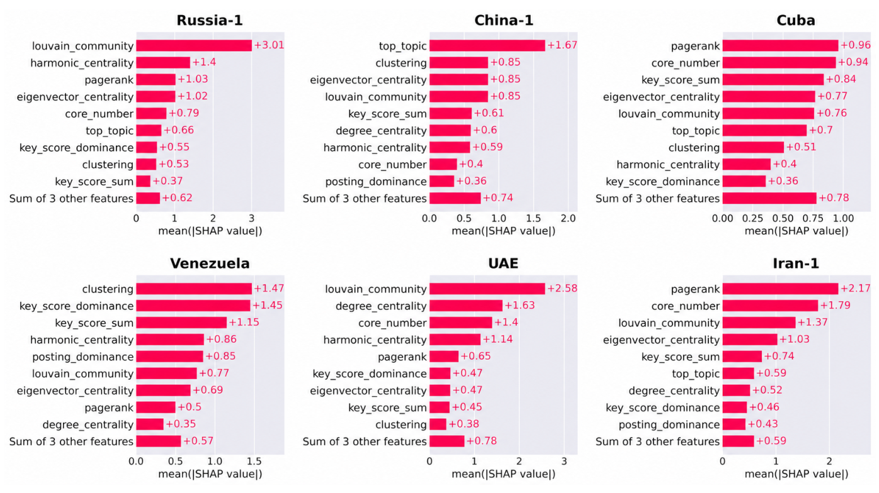
Which Indicators Matter?
XGBoost: indicator importance varies across campaigns (transductive setting).
9
Notes:
האיור מציג את חשיבות המדדים בכל קמפיין עבור מסווג העצים המשופר, לפי ממוצע הערך המוחלט של תרומת כל מדד לתחזיות. עמודה ארוכה יותר משמעה השפעה גדולה יותר על פלט המודל בממוצע, ולא בהכרח השפעה חיובית או הוכחה לסיבתיות.
המדד המוביל משתנה בין קמפיינים. ברוסיה ובאיחוד האמירויות זהו שיוך הקהילה, בסין הנושא המוביל, בוונצואלה מקדם ההתקבצות, ובקובה ובאיראן דירוג הדף. מספר הליבה חשוב בכמה קמפיינים, אך הוא חלק ממכלול מדדים משלימים. המסקנה היא שיש ערך לבחינת כמה היבטים של פעילות החשבון. האיור המקורי מהמאמר נשמר בשלמותו.

Slide 26
Detection Across Campaigns
0.990
0.933
Mean within-campaign ROC-AUC
Mean cross-campaign ROC-AUC
Campaign | Within ROC | Within PR | Across ROC | Across PR
Iran-1 | 0.991 | 0.983 | 0.989 | 0.963
UAE | 0.995 | 0.992 | 0.976 | 0.943
Venezuela | 0.984 | 0.964 | 0.889 | 0.649
China-1 | 0.986 | 0.940 | 0.822 | 0.072
Cuba | 0.985 | 0.966 | 0.992 | 0.920
Russia-1 | 0.999 | 0.994 | 0.929 | 0.794
Random Forest AUC. Across: train on five campaigns, test on one.
Mean PR-AUC: 0.973 within campaign / 0.723 across campaigns.
Macro-F1: ICSU 0.804 vs. IOHunter 0.793 (different training coverage).
10
Notes:
היקף הבדיקה: בחנו שישה קמפיינים, הכוללים כ־18.5 מיליון פרסומים של 138,247 חשבונות.
בדיקה בתוך אותו קמפיין: אימנו את המודל על חלק מהחשבונות ובדקנו אותו על חשבונות אחרים מאותו קמפיין. מדד ההבחנה הממוצע היה 0.990.
בדיקה על קמפיין שלא השתתף באימון: אימנו על חמישה קמפיינים ובדקנו על השישי, וחזרנו על התהליך עבור כל קמפיין. מדד ההבחנה הממוצע היה 0.933.
המשמעות: המדדים מאפשרים הבחנה טובה גם בקמפיינים שלא שימשו לאימון, אך הביצועים משתנים בין הקמפיינים.
ההערה בתחתית מוסיפה שמדד משלים, המתמקד באיכות זיהוי החשבונות החיוביים, הגיע לממוצע של 0.723 בבדיקה בין קמפיינים. היא מסייגת את התמונה ומבהירה שעדיין יש מקום לשיפור.

Slide 27
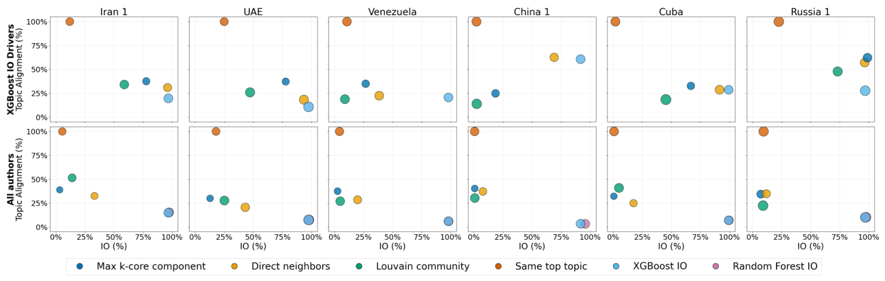
Group Analysis
K-core groups balance IO concentration and topic alignment.
Direct neighbors also perform well.
Top: XGBoost-predicted IO accounts. Bottom: all accounts.
12
Notes:
הסבר להצגה:
שקופית 12 מציגה את התוצאות של ההשוואה שהסברנו בשקופית 11: מה מתקבל כשמגדירים קבוצות בדרכים שונות.
כך קוראים את הגרף:
• כל עמודה היא קמפיין אחר, וכל צבע מייצג שיטה להגדרת קבוצה. כל נקודה מציגה את הממוצע של אותה שיטה.
• ככל שהנקודה ימינה, שיעור החשבונות של מבצע ההשפעה בקבוצות גבוה יותר.
• ככל שהנקודה למעלה, יותר חשבונות בקבוצות חולקים את הנושא המוביל של החשבון שבוחנים.
• לכן מחפשים שילוב של ימינה ולמעלה.
• בשורה התחתונה הניתוח כולל את כלל החשבונות. בשורה העליונה מגבילים את בניית הקבוצות לחשבונות שהמודל סיווג כחשבונות של מבצע השפעה.
מה לומדים?
• קבוצות לפי נושא משותף נמצאות למעלה, כי זו ההגדרה שלהן, אבל הן עשויות לכלול הרבה חשבונות שאינם חלק ממבצע השפעה.
• קבוצות המבוססות על ליבה ושכנים ישירים מציעות שילוב מועיל של ריכוז חשבונות מבצע השפעה והתאמה בנושא. האיזון משתנה בין הקמפיינים.
אפשר לומר בהצגה: בדקנו אילו קבוצות מרכזות גם חשבונות של מבצע השפעה וגם פעילות בנושא משותף. קבוצות המבוססות על ליבה ושכנים ישירים סיפקו בסיס מועיל להמשך החקירה.

Slide 28
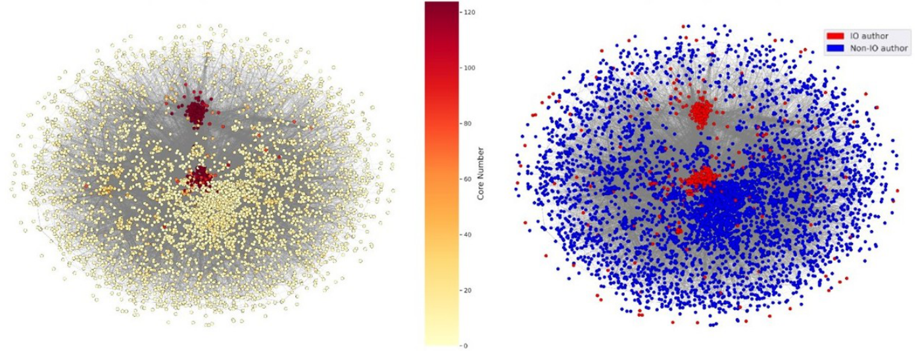
The Iran-1 Network
Core number
Known IO labels
High-core regions overlap with concentrations of IO accounts.
13
Notes:
Source: Backbone_Graph (1).pdf, Figure 4 and Section 4.3, pp. 9–10.
בשני חלקי האיור מוצג אותו גרף, עם אותם חשבונות ובאותם מיקומים. משמאל הצבע מייצג את מספר הליבה. מימין הצבע מייצג את תיוג האמת: אדום לחשבונות של מבצע השפעה וכחול לחשבונות ביקורת. אלה אינם צבעים של תחזיות המודל.
אפשר לראות שאזורים בעלי מספר ליבה גבוה חופפים לריכוזים של חשבונות מבצע השפעה. זו המחשה מבנית לתפקיד האפשרי של המדד, לצד שאר המדדים שהוצגו. האיור אינו מסמן במפורש איזה רכיב נבחר לדוגמה, ואינו מוכיח שכל חשבון בליבה הוא חשבון של מבצע השפעה. בשקופית הבאה נסביר איך נבחר רכיב קשיר של 312 חשבונות מתוך הליבה המרבית, ולאחר מכן נבחן את התוכן שפורסם.

Slide 29
Group Analysis Case Study – Iran 1
How Was the Group Selected?
Build the Iran-1 co-action graph
Find the maximum k-core
Select a connected component from the k core
Find the peak coordination window: rank 15-minute intervals by the number of account pairs sharing hashtags.

Slide 30
Group Analysis: Iran-1 Case Study
01 Group Selection
Select a connected component from the maximum k-core of the Iran-1 co-action graph, comprising 312 accounts.
02 Coordination Window
Score each non-overlapping 15-minute interval by summing the number of distinct account pairs sharing each hashtag. Select the highest-scoring interval.
03 Activity Analysis
Examine posting volume, reposting patterns, and shared hashtags within the selected interval.
04 Content Analysis
Examine the reposted source posts and shared hashtags to characterize the amplified content and recurring political messages.

Slide 31
Group Analysis: Iran-1 Case Study
In the selected group and during the selected 15-minute interval:
  15 accounts produced 244 posts.
  242 of 244 posts were reposts.
  The activity included 30 shared hashtags.
  16 of 19 reposted source posts focused on U.S. politics.
  The dominant narrative included criticism of Donald Trump and opposition to tax legislation.
Key finding: The group amplified U.S. political messages through reposting.

Slide 32
Summary

Slide 33
Summary of Results
Account Detection
  Interpretable Indicators
  Mean ROC–AUC: 0.990 within campaigns and 0.933 across campaigns
Indicator importance varied across campaigns
Group Analysis
  K-core groups showed a strong balance between IO concentration and topic alignment
Iran-1 Case Study
  15 accounts → 244 posts in 15 minutes → 242 reposts
  16 of 19 reposted source posts focused on U.S. politics
  Revealed the shared narrative behind coordinated activity

Slide 34
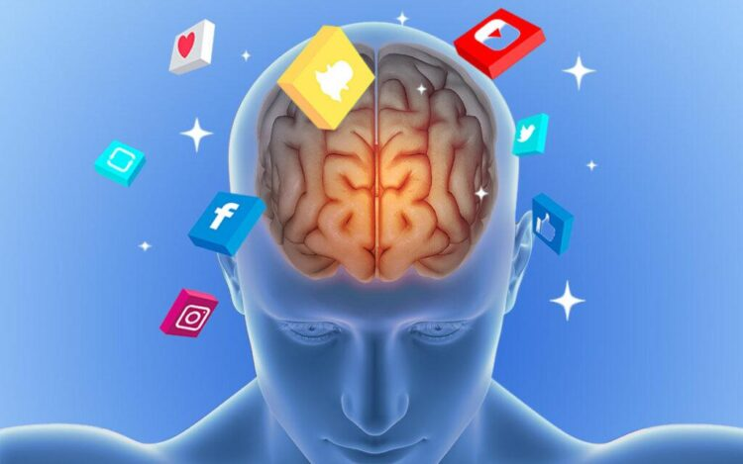
Next Steps
Psychological Characterization
  Use prompt-based psychological questionnaires to explore characteristics that distinguish IO accounts from other accounts.
https://netpsychology.org/social-media-psychology/

