Slide 1



Backbone Graph
10.05.2026
Amit Ner Gaon, Noa Tal, Idan Muallem
Prof. Rami Puzis

Slide 2

Co-Actions Graph
Nodes: authors in the discourse.
Edges: co-action relations between author pairs (e.g., co-mention, co-entity, co-topic). Represents behavioral similararty between the authors.
Purpose: expose coordinated behaviour and structural signals for IO detection.

Slide 3

Choosing Indicator– Information Gain
Information Gain is used to measure how much knowledge one variable provides about another.

Slide 4


Choosing Indicator – SHAP
SHAP analysis on XGBoost model
SHAP explains how much each feature contributes to a model’s prediction.

Slide 5
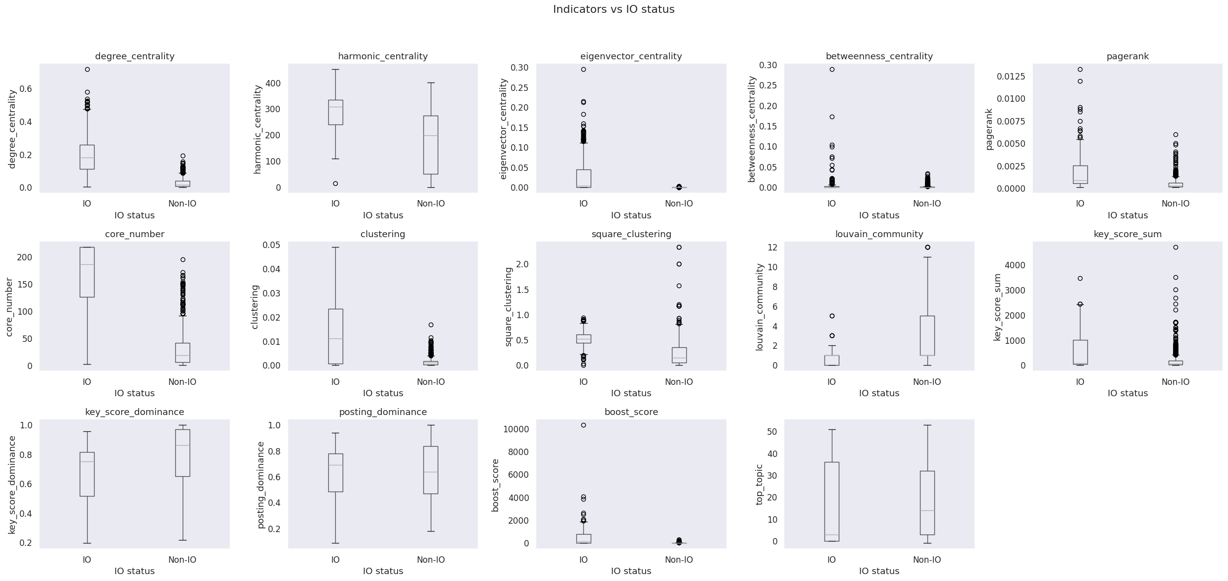
Choosing Indicator – Box Plots
A box plot is a method for demonstrating graphically the distribution of numerical data across different groups.

Slide 6
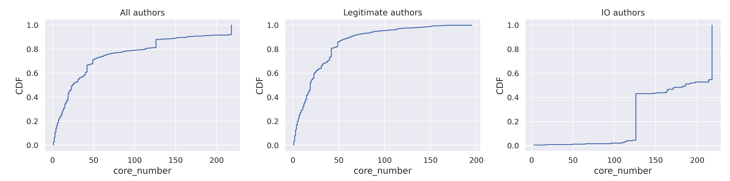
Indicators Analysis – CDF
The Cumulative Distribution Function (CDF) show the probability that the variable will take a value less than or equal to a particular value in X-axis.

Slide 7
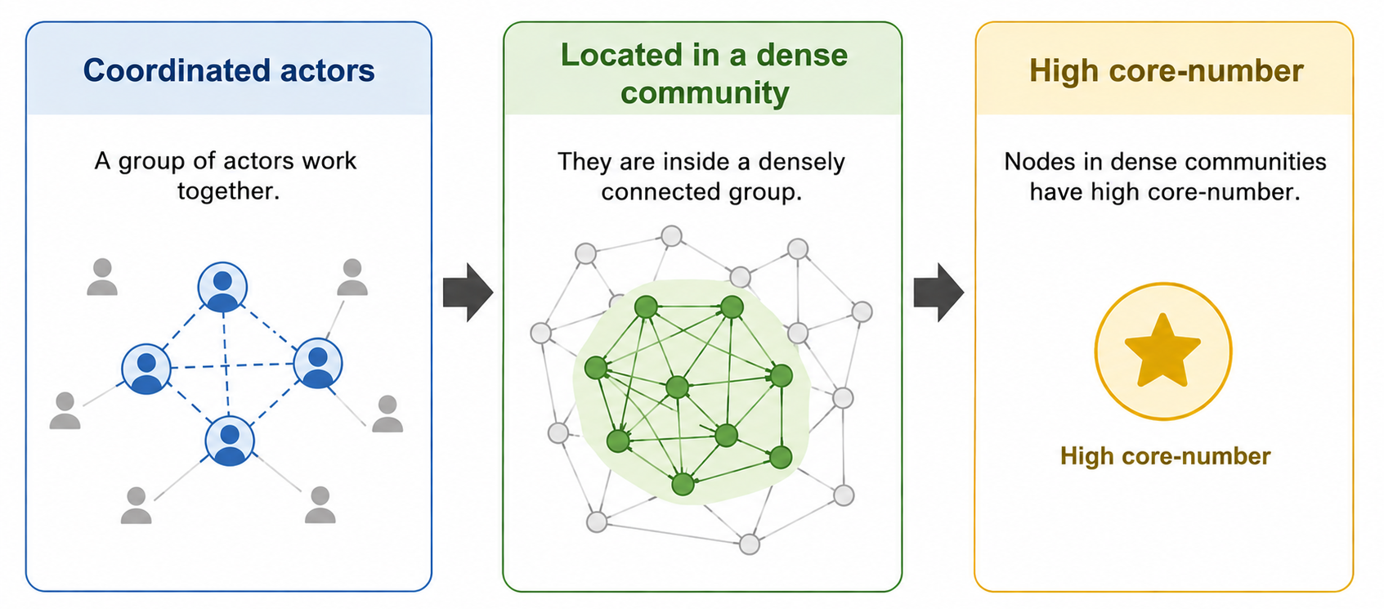
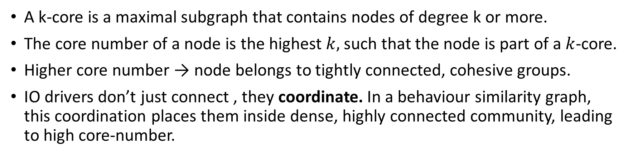
Core Number
A k-core is a maximal subgraph that contains nodes of degree k or more.
The core number of a node is the highest $k,$such that the node is part of a $k$-core.
Higher core number → node belongs to tightly connected, cohesive groups.
IO drivers don’t just connect , they coordinate. In a behaviour similarity graph, this coordination places them inside dense, highly connected community, leading to high core-number.

Slide 8

Core Number - Example

Slide 9
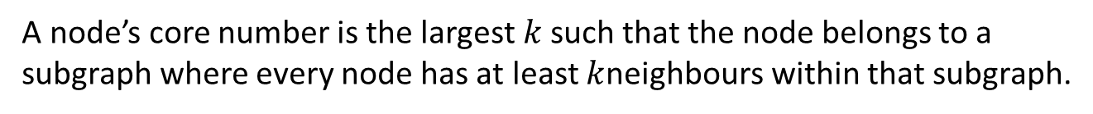
Core Number
#DeepState
#Music
#True
#Music
#CoverUp
#DeepState
#CoverUp
#DeepState
#CoverUp
#CoverUp
# Media
#Trending
#TruthExposed
#CoverUp
# Media
#DeepState
#Eurovision
#True
A node’s core number is the largest $k$such that the node belongs to a subgraph where every node has at least $k$neighbours within that subgraph.

Slide 10


Core Number Analysis group mode: smaller
Ecuador Campaigns
Group mode: smaller - each point represents authors whose indicator value is less than the x-axis value.

Slide 11


Core Number Analysis group mode: larger
Ecuador Campaigns
Group mode: larger - each point represents authors whose indicator value is greater than the x-axis value.

Slide 12
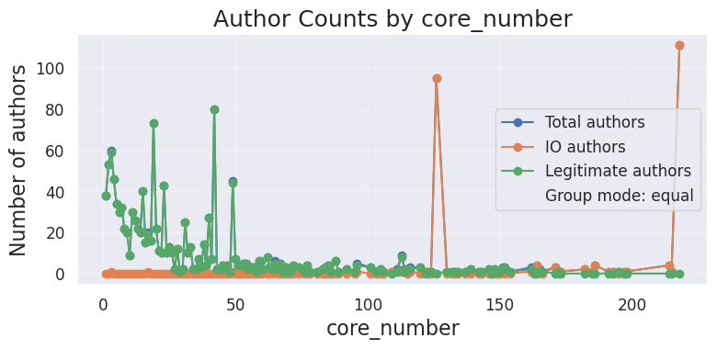
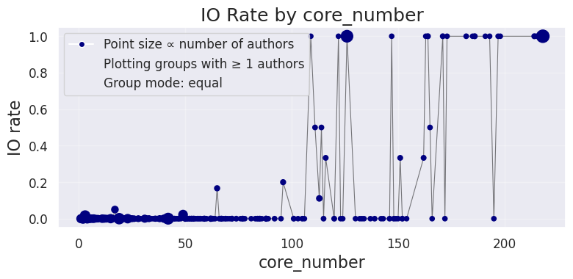
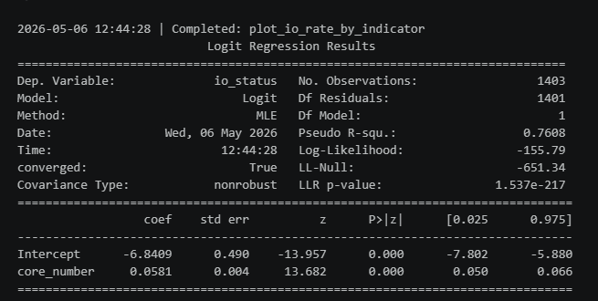
Core Number Analysis
Ecuador Campaigns
Binomial logistic regression & Wald test on coefficient.

