Slide 1



I Can See U.
Indicator-Based Information Operation Detection and Topic-Aware Analysis
17.08.2026
Amit Ner Gaon, Noa Tal, Idan Muallem
Prof. Rami Puzis

Slide 2

Motivation
Social media platforms are central spaces for public discourse.
Information operation (IO) actors exploit the openness of social media to manipulate online discourse threatening democratic processes, public trust, and societal cohesion (Seckin et al., 2024).

Slide 3

IO & Coordination
IOs rely on fleets of coordinated accounts (Pacheco et al., 2021), some of them automated, acting toward a shared political objective. Coordination is what amplifies their influence.
Accounts disseminate the same narrative (e.g., hashtags, account mentions) and posts on the same topics.
Therefore, identifying coordination is a key step toward detecting IO drivers.

Slide 4
Related Work
IO-Driver Detection Methods:
Node-Local: detect suspicious users from their individual content, activity, and behaviour.
Tomaiuolo et al., A Survey on Troll Detection, Future Internet, 2020
Network-Based: detect coordinated groups from graph structure and behavioural similarity.
Pacheco et al., Uncovering Coordinated Networks on Social Media: Methods and Case Studies, ICWSM, 2021
Hybrid: combine user content with network information to detect IO drivers.
Minici et al., IOHunter: Graph Foundation Model to Uncover Online Information Operations, AAAI, 2025
The gap: existing approaches either detect coordinated groups without quantifying each account’s depth of involvement, or implicitly encode structural embeddedness within black-box models. None provides an explicit, interpretable, account-level measure of coordination depth.

Slide 5
Our Contributions
An interpretable, indicator-based approach for account-level IO detection.
The core number in the co-action graph as a single, explainable indicator of coordination, achieving performance comparable to a full feature set (AUC & F1) on a real IO campaign.
Topic-aware analysis of the detected coordinated group (k-core), revealing the campaign’s agenda.

Slide 6

Methods - Co-Action Graph
Nodes: authors in the discourse.
Edges: co-action relations between a pair of authors (e.g., posting the same hashtag). Represents behavioral similarity between the authors.
Purpose: expose coordinated behaviour for IO detection.

Slide 7
Core-Number

Slide 8
Core Number: Motivation
Coordinated authors are highly inter-connected in the co-action graph.
Accounts within these coordinated groups receive a high core number.
Since IO requires coordination, IO drivers are expected to appear in the coordinated groups.
The co-action graph represents behavioural similarity between authors.
Similarity with one or two accounts is not enough. Only many accounts coordinating with one another produce a high core-number.

Slide 9

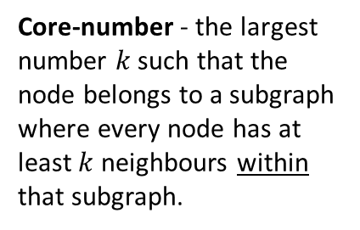
Core Number: Example
Co-Action Graph
IO Drivers
#Music
#DeepState
#True
#Music
#CoverUp
#DeepState
#CoverUp
#DeepState
#CoverUp
#CoverUp
# Media
#Trending
#TruthExposed
#Eurovision
#CoverUp
# Media
#DeepState
#True
Core-number - the largest number $k$ such that the node belongs to a subgraph where every node has at least $k$neighbours within that subgraph.

Slide 10
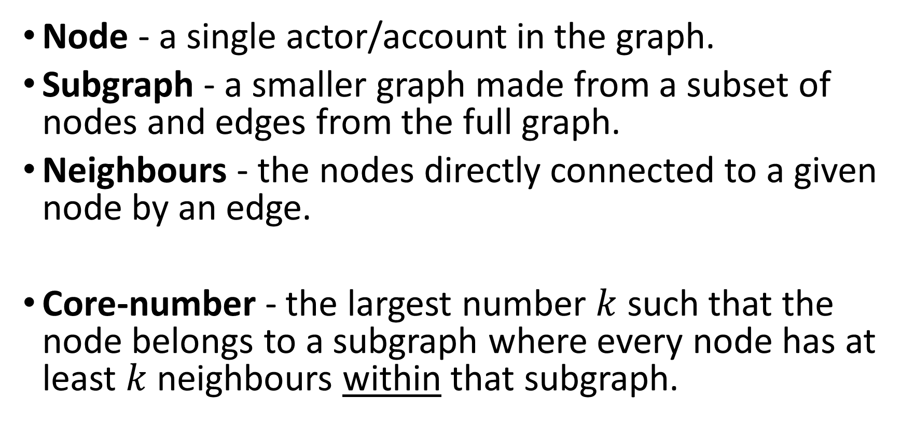
Core Number: Definition
Node - a single actor/account in the graph.
Subgraph - a smaller graph made from a subset of nodes and edges from the full graph.
Neighbours - the nodes directly connected to a given node by an edge.
Core-number - the largest number $k$ such that the node belongs to a subgraph where every node has at least $k$neighbours within that subgraph.

Slide 11
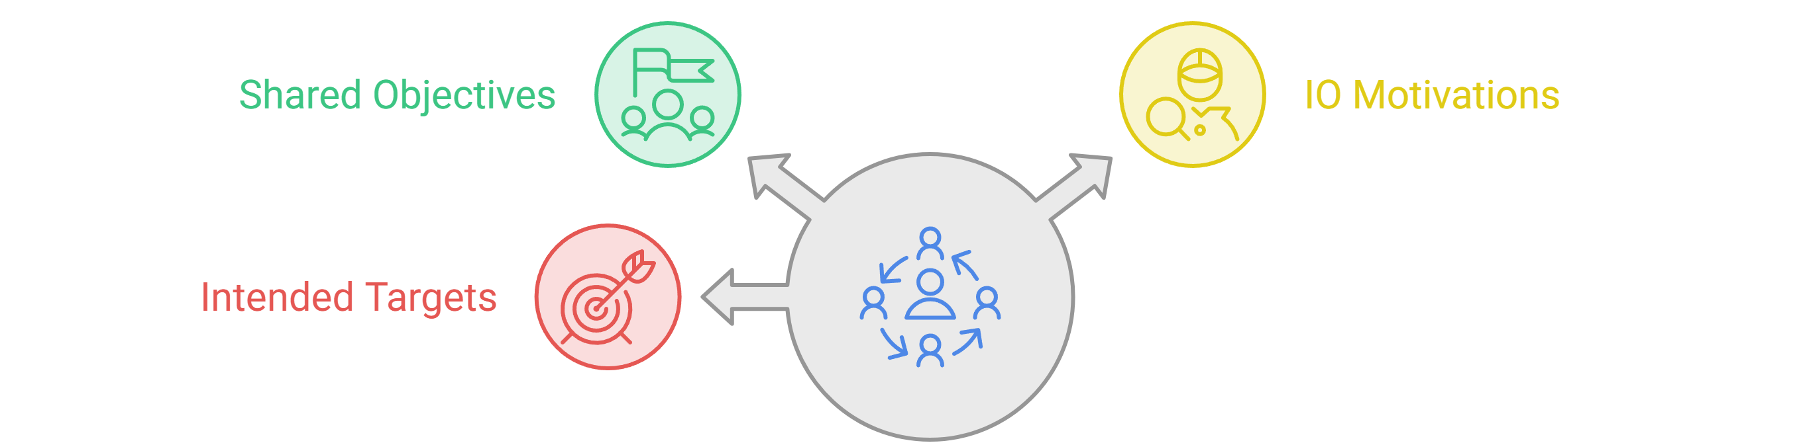
K-Core
An IO driver is part of a network of accounts that coordinate.
This coordinated group can be identified using the node’s k-core in the behavioural-similarity graph.
Investigating this k-core can help reveal the group’s shared objectives, IO motivations, and intended targets.

Slide 12
Additional Indicators & Classification

Slide 13
Motivation
Machine-learning models classify authors using feature vectors. Multiple indicators capture different aspects of author behaviour and may improve classification.
Graph-Based Indicators
  Quantitative: Core number, centralities, and PageRank measure an author’s structural importance.
  Categorical: Community membership shows which neighbourhood the author belongs to.
Topic-Based Indicators
  TF-IDF based: Key score measures how strongly the author uses important entities. (TF IDF is explained in the next slide)
  Posting-based: Posting activity and distribution across topics describe how and what the author posts about.

Slide 14
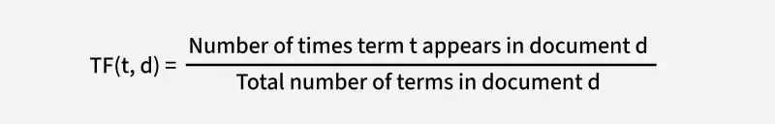
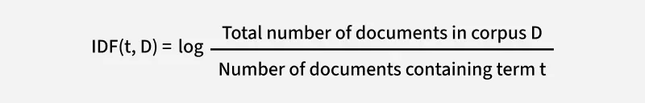
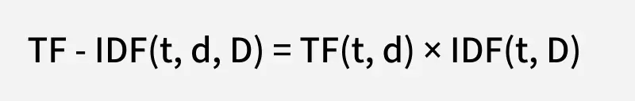
TF-IDF
TF-IDF is a statistical method used in natural language processing and information retrieval to evaluate how important a word is to a document (in our project – topic) in relation to a larger collection of documents (topics).
This allows TF-IDF to highlight terms that are both frequent within a specific document (topic) and distinctive across the other documents (topics), making it a useful tool for tasks like search, ranking, text classification, and keyword extraction.
https://www.geeksforgeeks.org/machine-learning/understanding-tf-idf-term-frequency-inverse-document-frequency/

Slide 15

Additional Indicators & Classification
1) Building a co-action graph represents author similarity.
2) IO drivers tend to be embedded in dense communities.
3) Graph-based indicators are used to measure author’s embeddedness.
4) Each user is represented by a human-readable feature vector.
5) The feature vectors are used by a machine-learning model to classify each author as an IO driver or not.
Author feature vector (example)

Slide 16
Experiments

Slide 17
Datasets
Labeled IO Corpus
Collection of 26 information operations (IO).
Campaigns from multiple countries.
Fully labeled (IO vs. Control accounts).
Over 13M control posts from 303K accounts.
zenodo.org/records/14189193
Ecuador Campaign Dataset
787 IO accounts | 21,138 control accounts
700K IO tweets | 770K control tweets
Posts are used to build the co-action graph
Platform labels serve as ground truth
Seckin et al., 2024

Slide 18
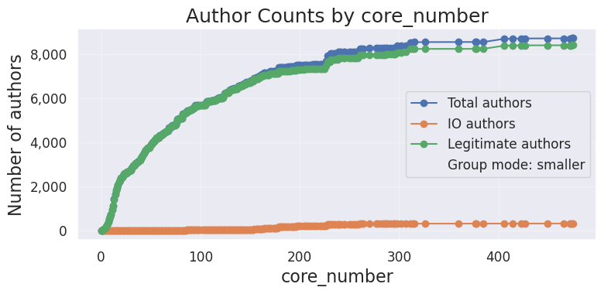
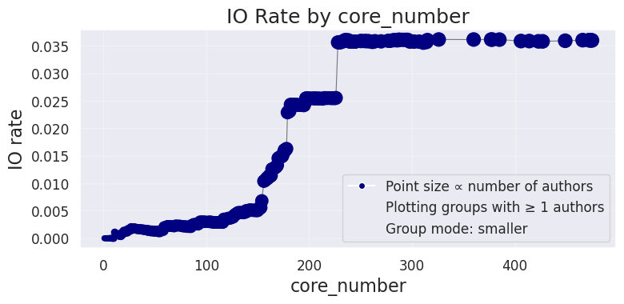
Core Number - Results
Ecuador Campaign
The graph presents the cumulative number of authors with a core number less than or equal to each x-axis threshold.
Few IO drivers have low core numbers, followed by a sharp increase at high core values.
The graph presents the IO rate among authors with a core number less than or equal to each x-axis threshold.
The IO rate remains low at lower core-number values, followed by a sharp increase at higher core-number values.
Cumulative distribution: proportion of IO drivers by Core Number threshold (≤ / ≥)

Slide 19
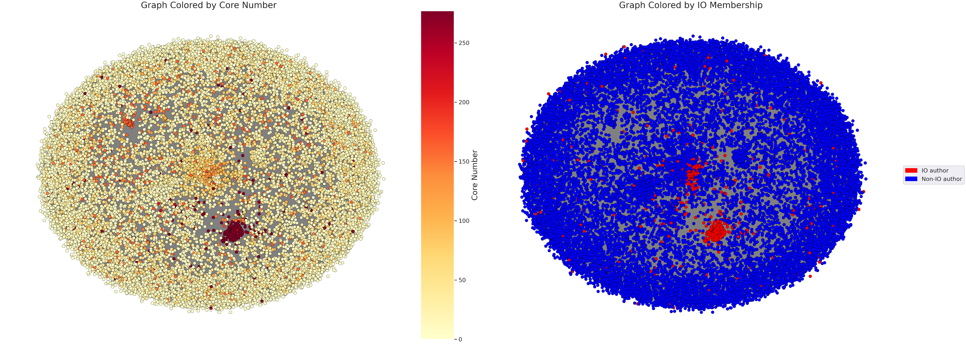
K-Core Plots
Ecuador Campaign

Slide 20
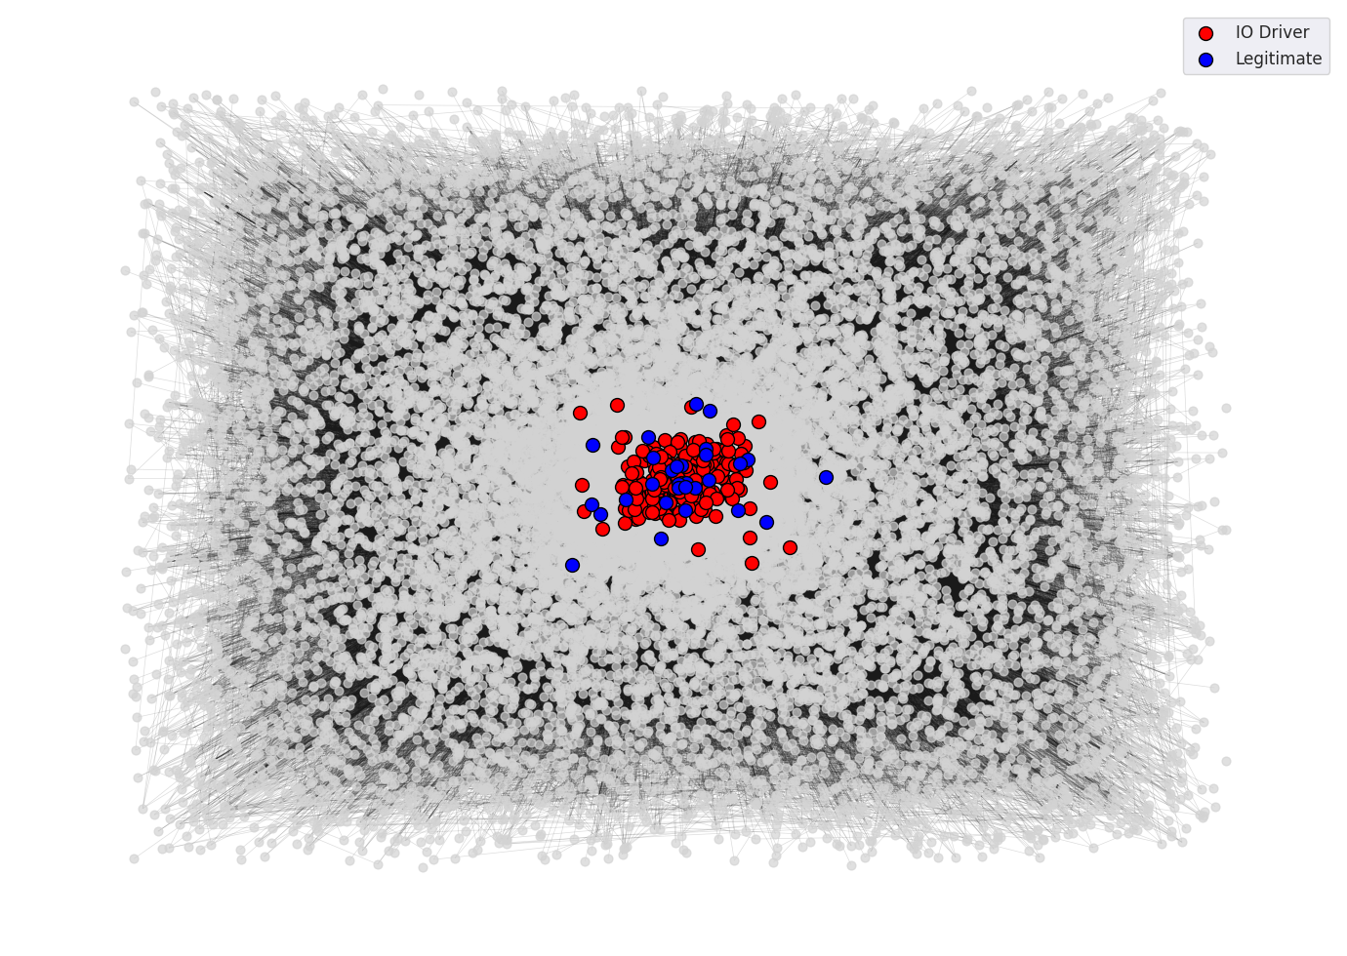
K-Core Example
One of the authors with the highest core number was selected:
  Account ID: 0eff4…224d9
  Core number: 277
The corresponding k-core was extracted.
The k-core contains 278 nodes.

Slide 21
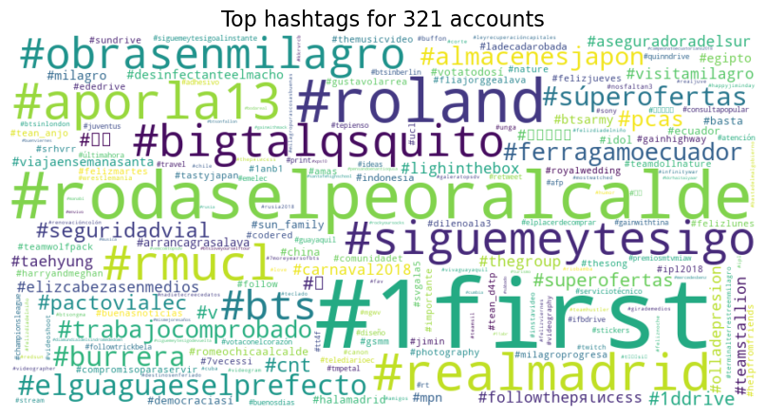
K-Core Accounts - Hashtags

Slide 22
LLM Analysis of the K-Core
An LLM (OpenAI ChatGPT web interface) was provided with the hatags frequencies.
The model identified the following patterns:
The group appears to focus on shaping narratives around Ecuadorian local governance and public services, particularly municipal leadership, infrastructure projects, and transportation-related issues.

Slide 23

Information Gain
On Ecuador Campaign
Information Gain is a statistical method used to measure how much knowledge one variable provides about another.

Slide 24


SHAP Analysis
SHAP analysis on XGBoost model on Ecuador Campaign
SHAP explains how much each feature contributes to a model’s prediction.

Slide 25
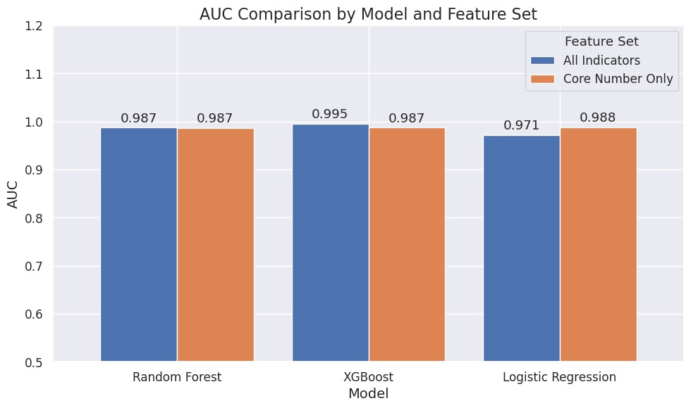
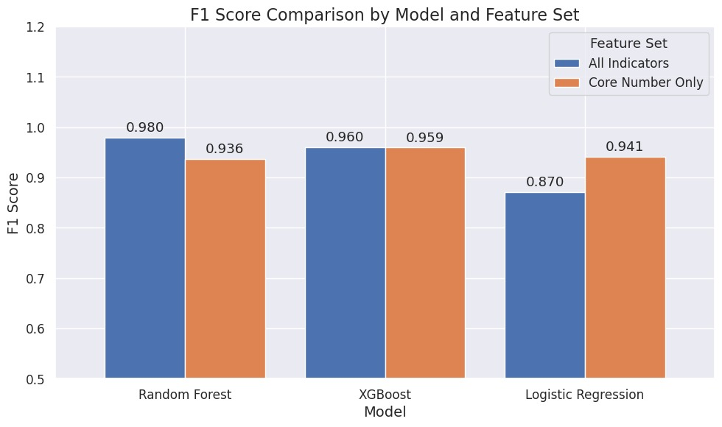
Indicators vs. Core Number
Core number alone achieves high AUC and F1.
Other indicators add little improvement.
Core number captures most of the IO detection signal.
On Ecuador Campaign

Slide 26
Key Takeaways
IO influence relies on fleets of coordinated accounts.
The co-action graph exposes this coordination, and the core number quantifies it.
Core number alone separates IO drivers from legitimate users (high AUC & F1).
Investigating the k-core reveals the campaign’s agenda, making detection both accurate and interpretable.

