Slide 1


Backbone-Graph
21/07/2025

Slide 2
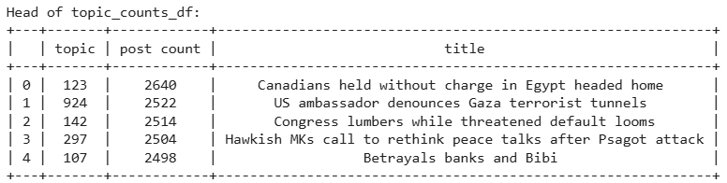
List of Extracted Topics
2

Slide 3
Top Posts For Topic 123
3

Slide 4
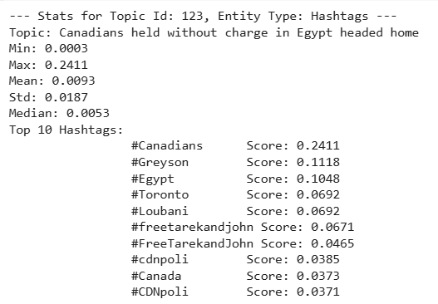
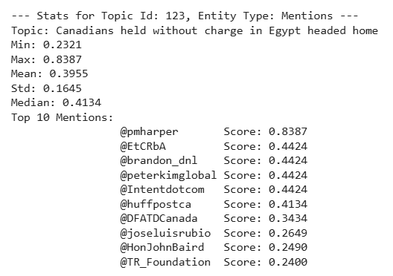
Top Entities For Topic 123
4

Slide 5
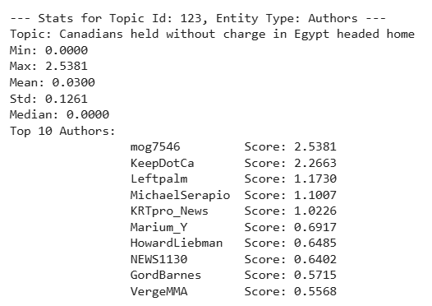
Top Authors For Topic 123
5

Slide 6




Author’s Activity - Table
6

Slide 7
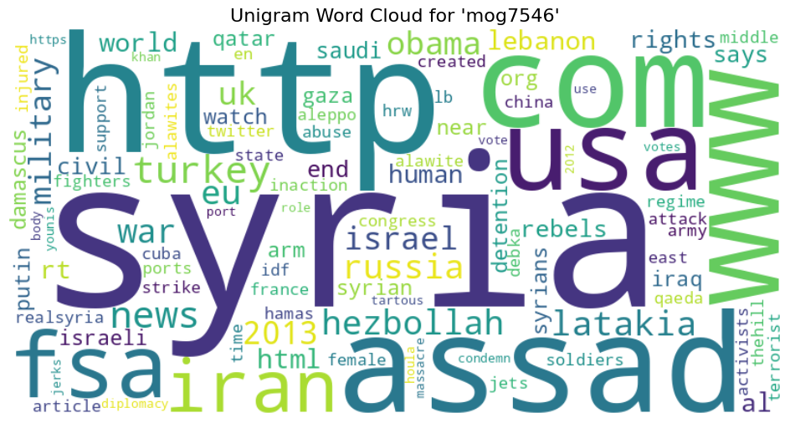
Author’s Activity - Unigram Word Cloud
7

Slide 8
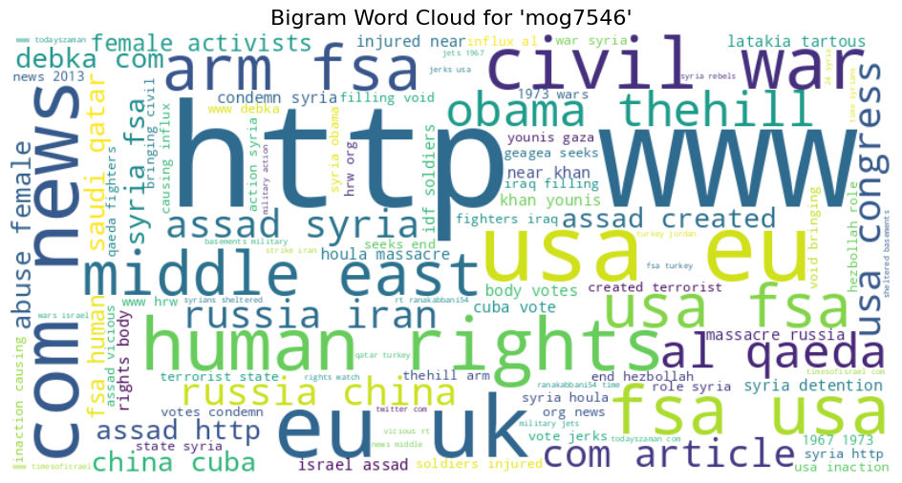
Author’s Activity - Bigram Word Cloud
8

Slide 9
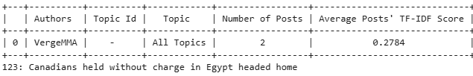

Author’s Activity – All Topic Table
9

Slide 10


Author’s Activity – One Topic Table
10

Slide 11
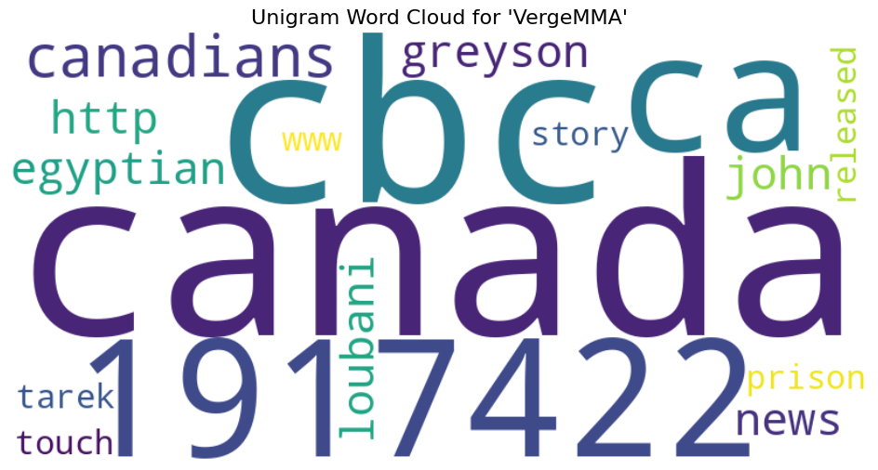
Author’s Activity - Unigram Word Cloud
11

Slide 12
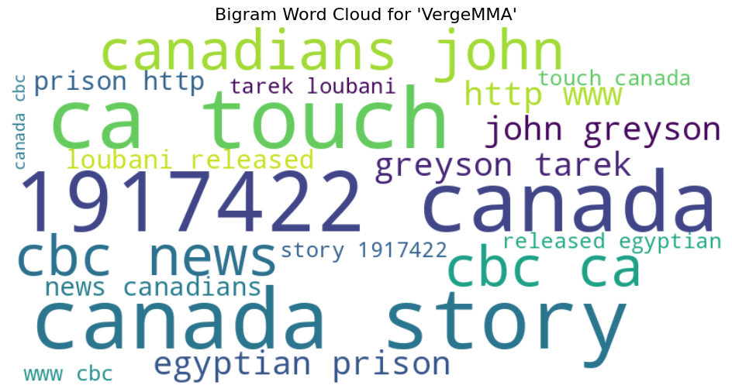
Author’s Activity - Bigram Word Cloud
12

