Slide 1

Flemish script maker
Noach Meged
27th January 2025

Slide 2


There is a BIG workload on the Flemish side with only ONE person
per week.
FL translator
NL translator
NL translator
NL translator
50 recipes
50 recipes

Slide 3
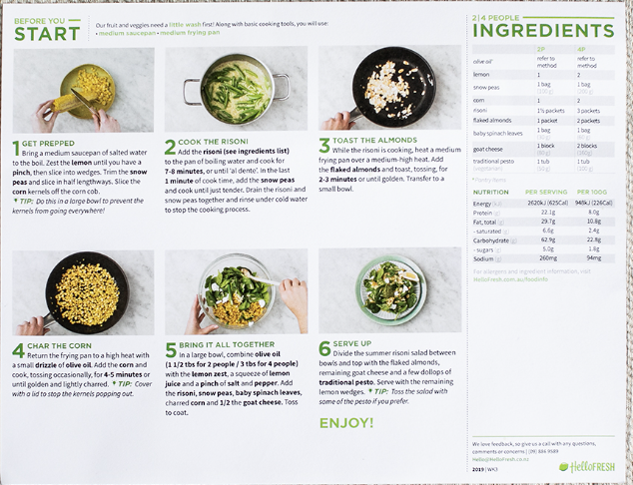
The Flemish translation is done after the Dutch one.
NL translations check
3 translators translate 50 recipes per week for HF BENELUX
FL translations check
Jaro translates 50 recipes per week for HF BENELUX
Recipe card
T-5
T-4

Slide 4


How can we improve this process?

Slide 5

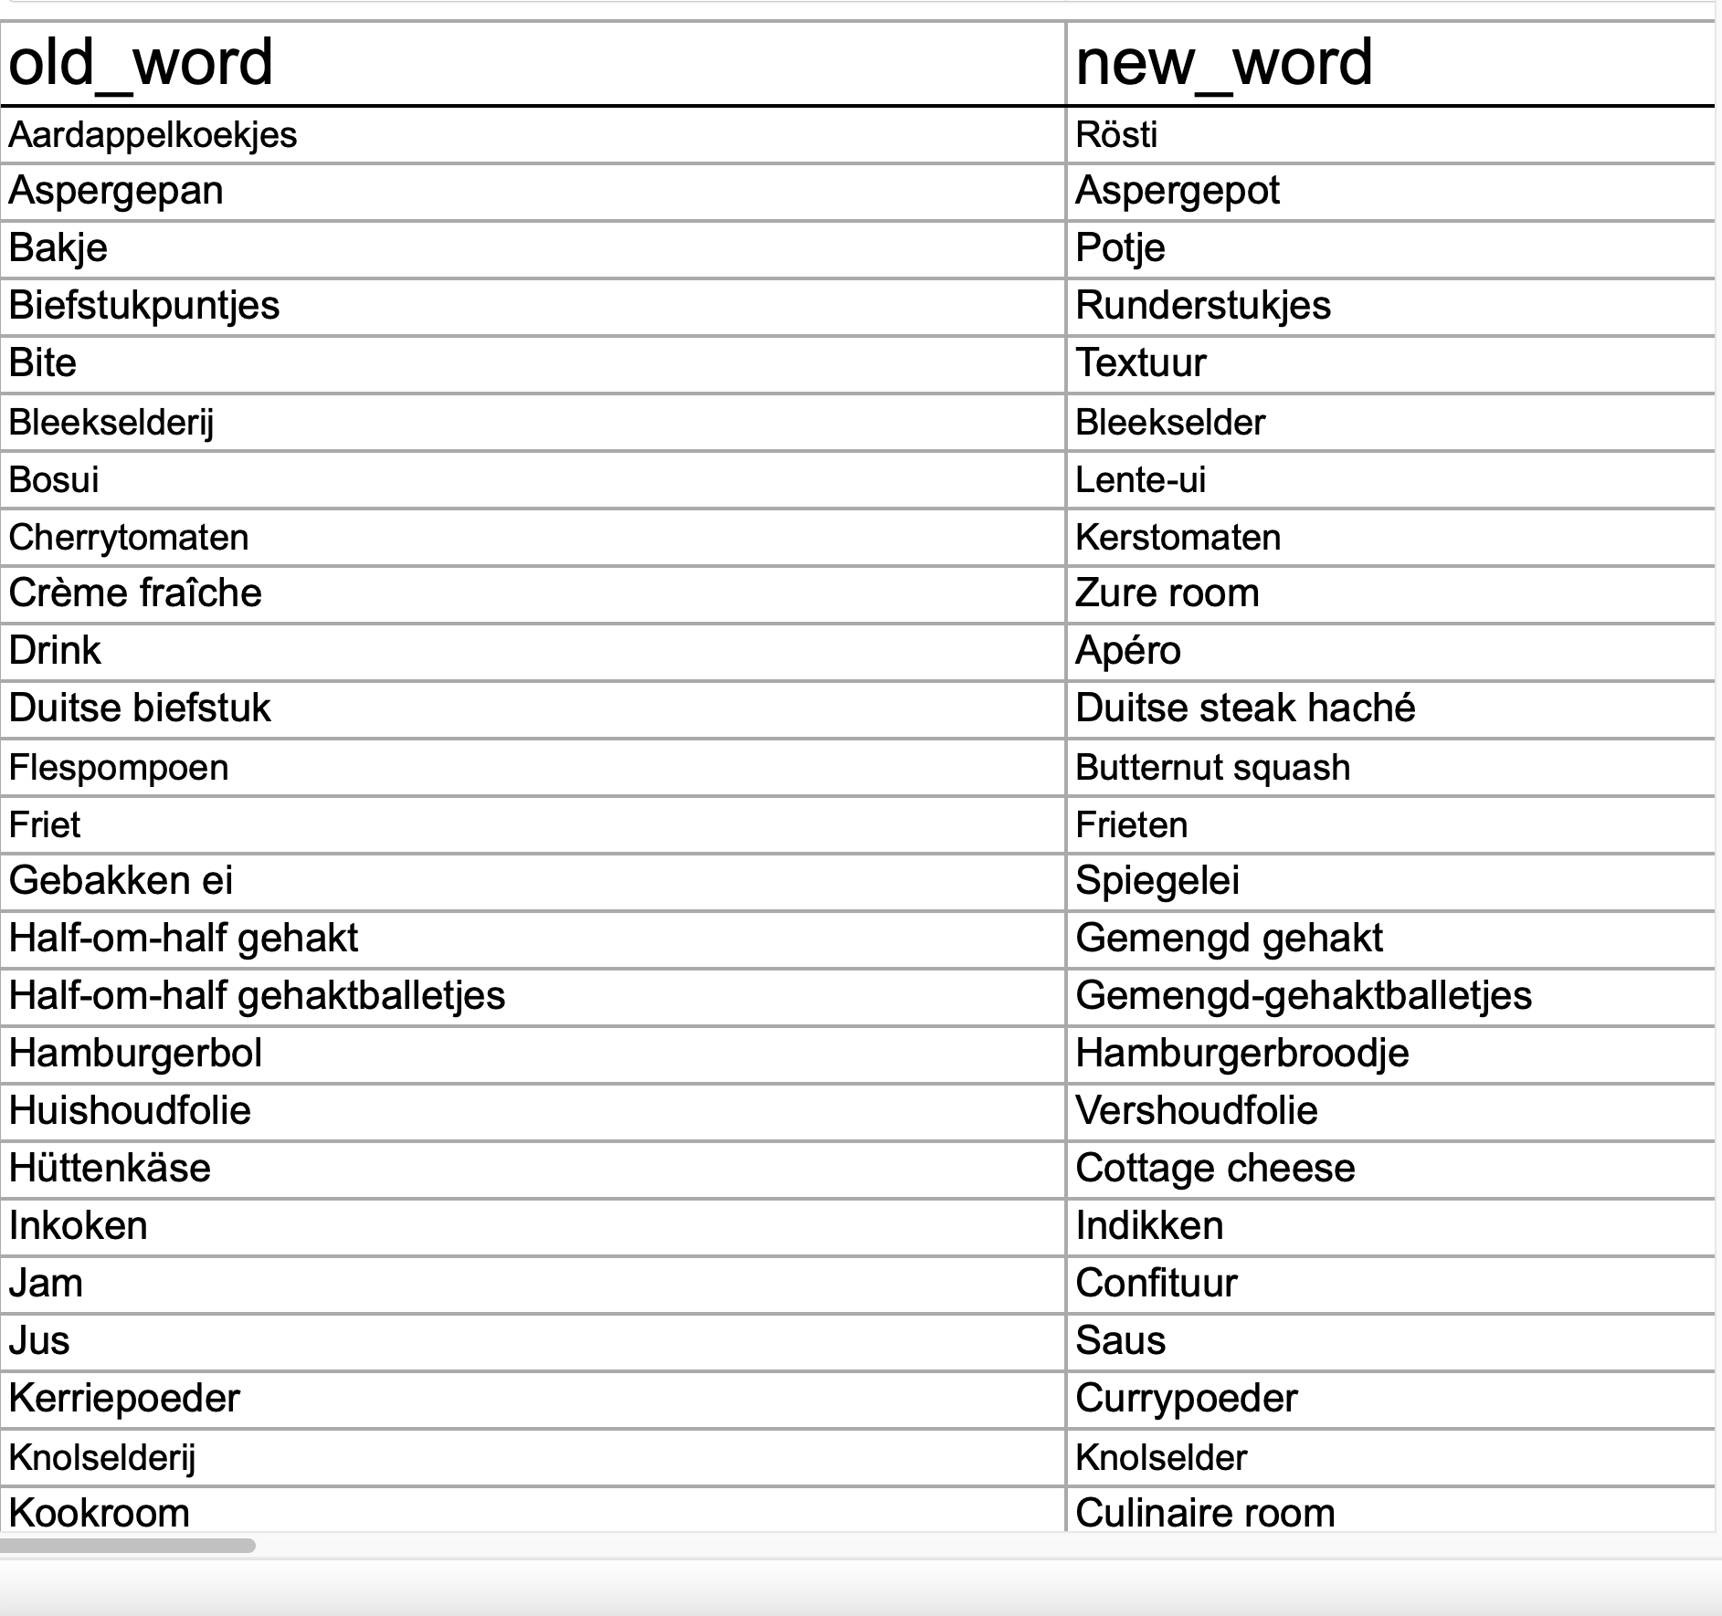
We made a Find & Replace sheet.
Utensils:
Hapjespan
Diepe pan
Title names:
Stamppot
Stoemp
Ingredients:
Sinaasappel
Appelsien

Slide 6





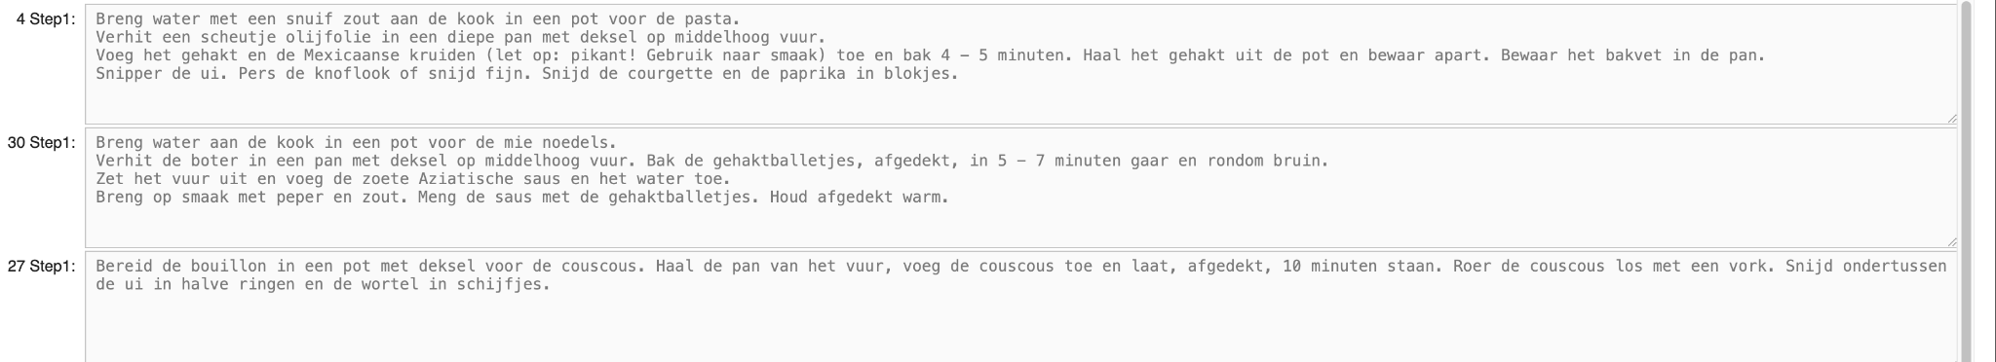


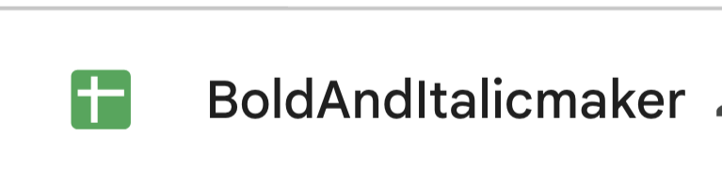
The Script does…
1.
Combines:
Into one file:
=
Find & Replace:
Handling exception:
2.
3.
4.
Bold & Italic:
5.
CPS

Slide 7

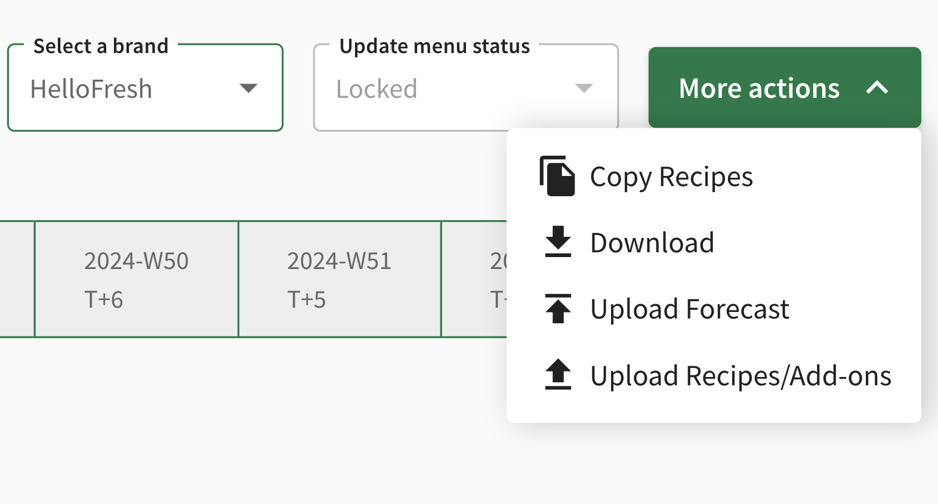
The Final step

Slide 8
Thank You!
27th January 2025

