Slide 1

COS 214 PROJECT
PLANT NURSERY

Slide 2
BRAINS BEHIND THE PROJECT
Noah Dollenberg u24596142
Dillion Koekemoer u23537052
David Potgieter u04579624
Dylan Mcrobbie u24646866
Josh Roberts u23536765

Slide 3
FUNCTIONAL REQUIREMENTS
Greenhouse Management
Staff Management & Actions
Customers & Sales Management

Slide 4
GREENHOUSE MANAGEMENT
PLANT CARE HANDLING
The system manages the care routines for the different plant types, such as management of water amounts, fertilization, and other needs. It is different for every plant type.
PLANT LIFE CYCLE
The system manages the plants from planting seeds to growth to selling of plants. Selling of plants are determined by how far along each plant has grown.
INVENTORY TRACKING
The system maintains an inventory system that keeps track of all plants. Updating the inventory happens when plants have grown, been sold, or require care.
STOCK ADDITION
The system allows for adding new plant stock or plant types to the nursery.

Slide 5
STAFF MANAGEMENT & ACTIONS
PLANT TENDING
Staff does care routines on plants based on plant type.
INVENTORY COORDINATION
Staff keeps track and updates the inventory making sure that the greenhouse and sales are in sync.
CUSTOMER ASSISTANCE
Staff interacts with the customers by showing customer what is available for them to purchase.
ROLE EXTENSIBILITY
The system supports extending roles of staff (eg: delivery staff).

Slide 6
CUSTOMERS & SALES MANAGEMENT
CUSTOMER BROWSING
Customers can view available plants on sale based off of the inventory.
STAFF INTERACTION
Customers receive guidance from staff (available plants), purchasing from the staff, and change the inventory when a purchase is made.
SALES & TRANSACTIONS
The system handles plant purchases, including updating the inventory in real-time and processing the transactions.
CUSTOMER DECISION IMPACT
Customer actions (eg: buying a plant) affects the nursery operations, such as decreasing
the stock of the inventory.

Slide 7
UML DIAGRAMS
State Machine
Sequence
Activity
Object
Communication
Class

Slide 8
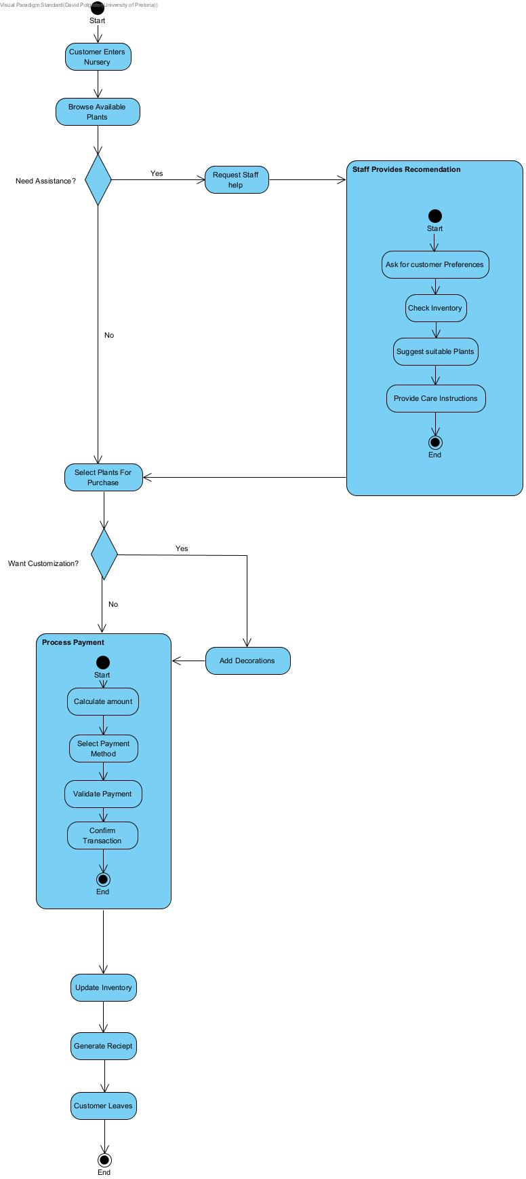
ACTIVITY
DIAGRAM

Slide 9
CLASS DIAGRAMS
Template Method
Iterator
Adapter
Composite
Prototype
Builder
State
Strategy
Factory Method
Decorator
Command

Slide 10
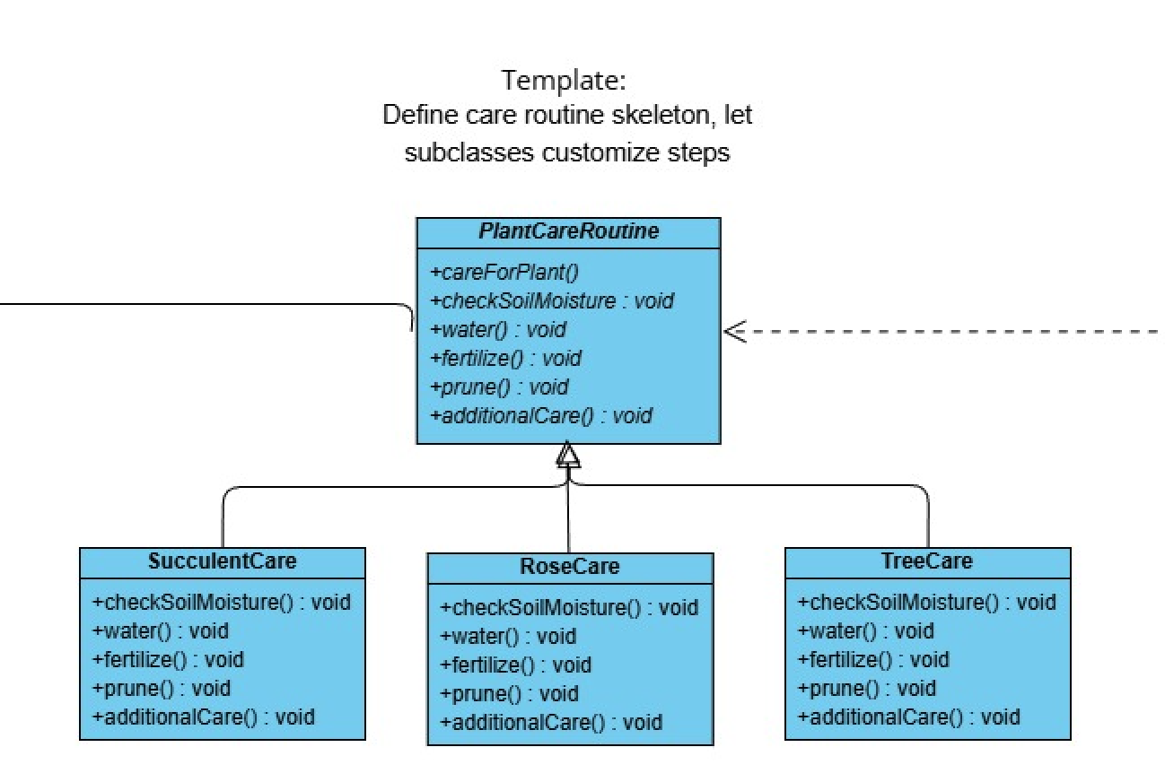
TEMPLATE METHOD

Slide 11
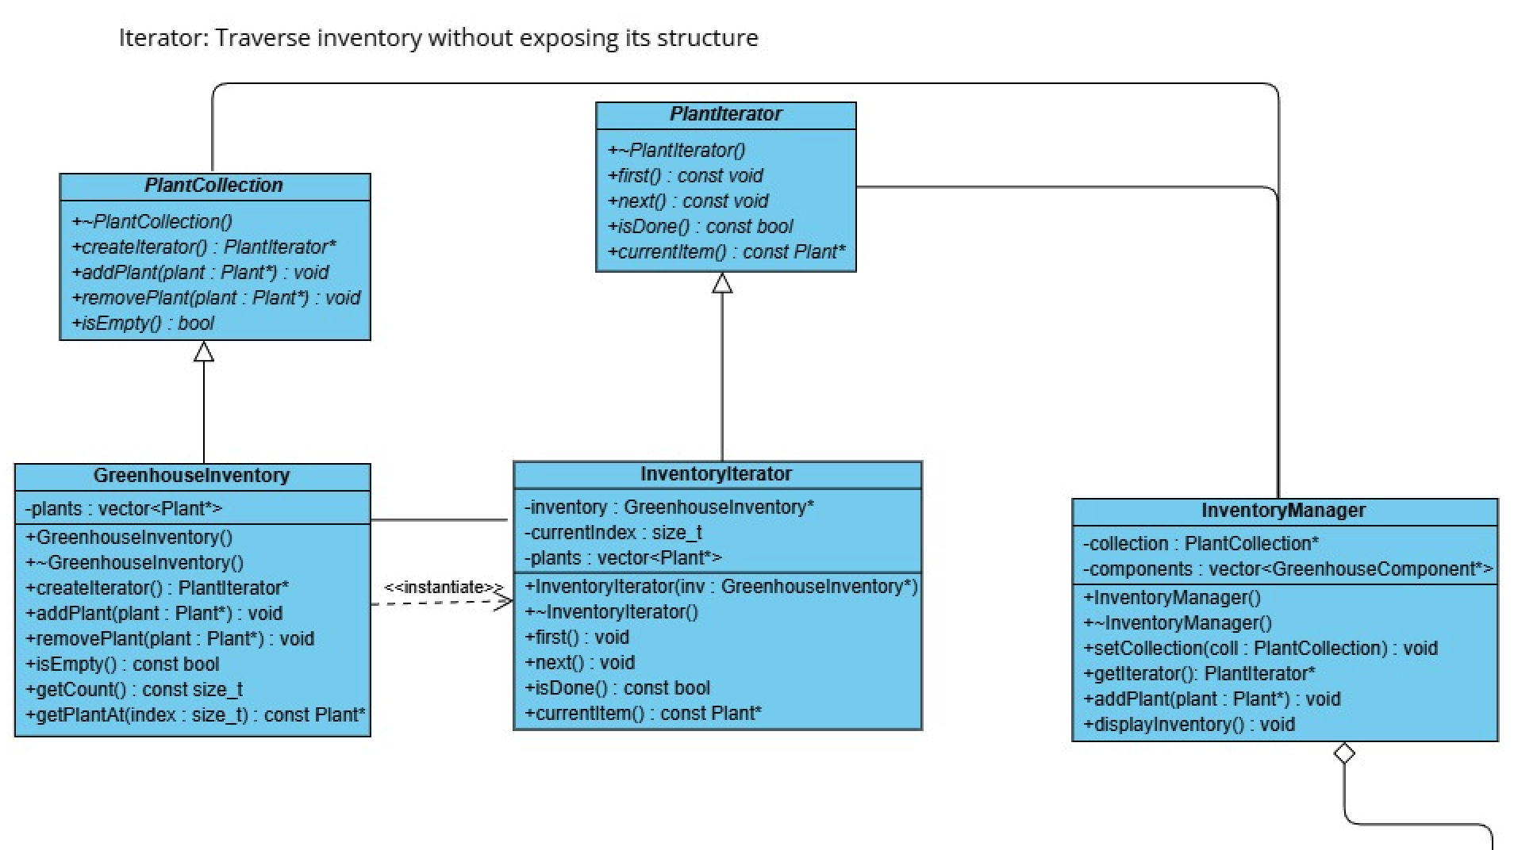
ITERATOR

Slide 12
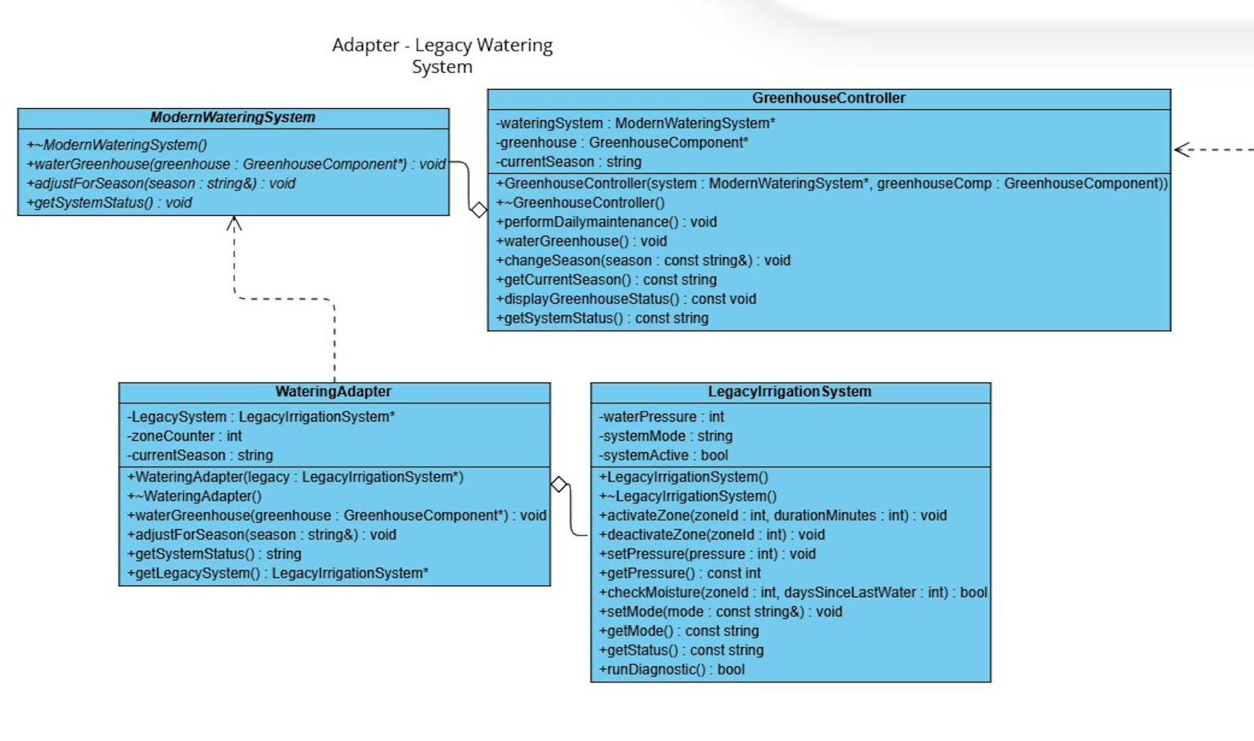
ADAPTER

Slide 13
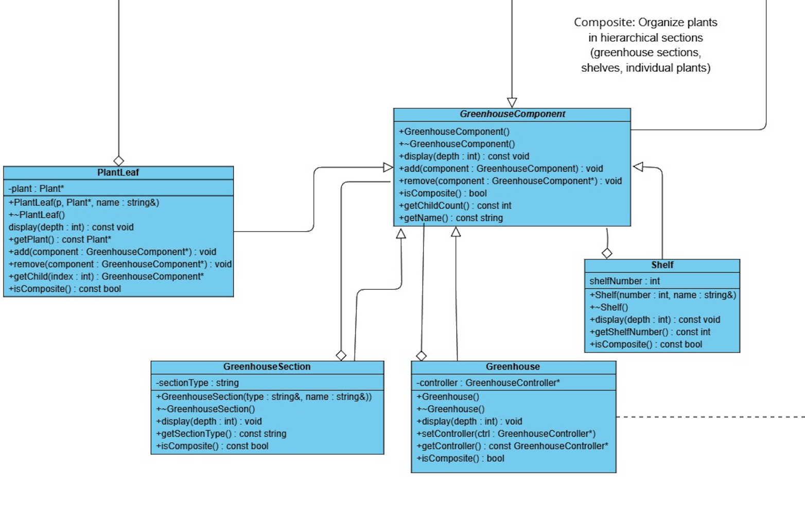
COMPOSITE

Slide 14
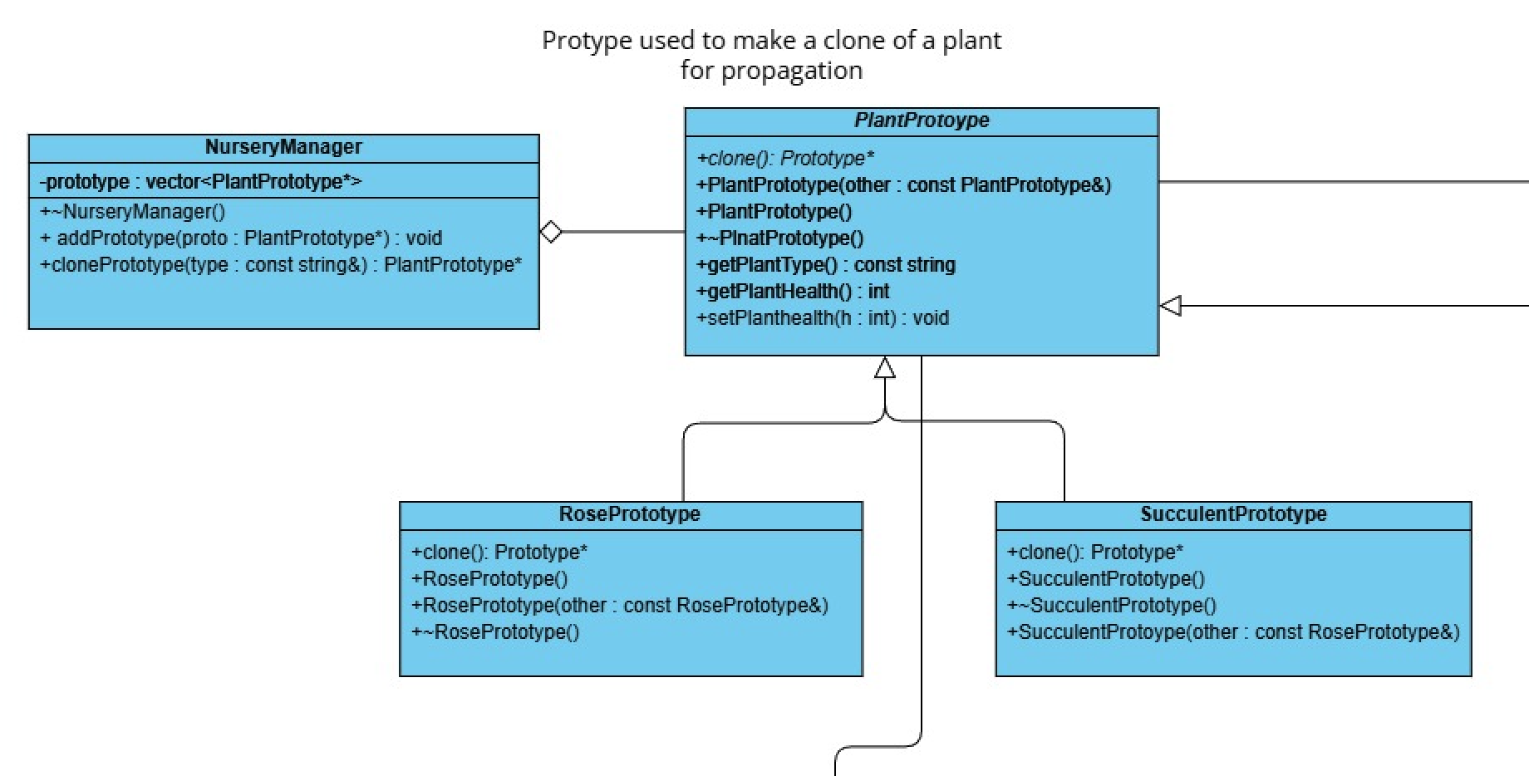
PROTOTYPE

Slide 15
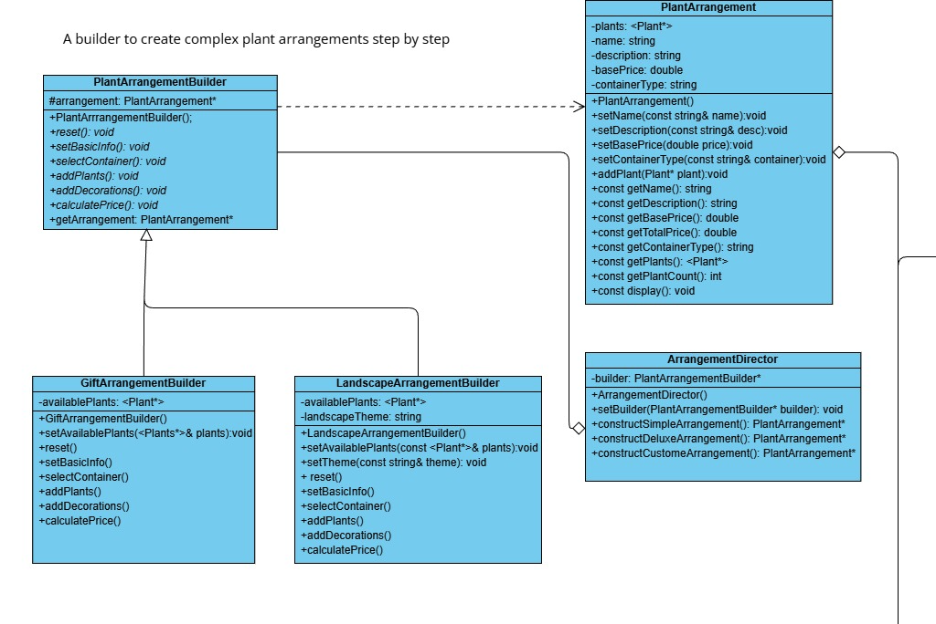
BUILDER

Slide 16
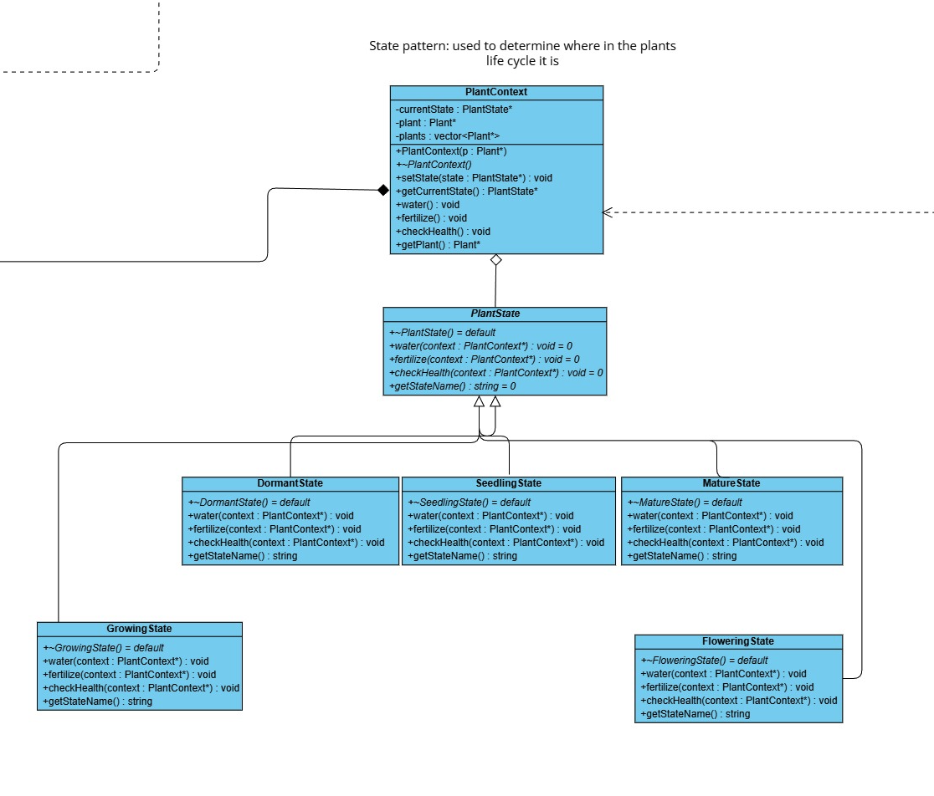
STATE

Slide 17
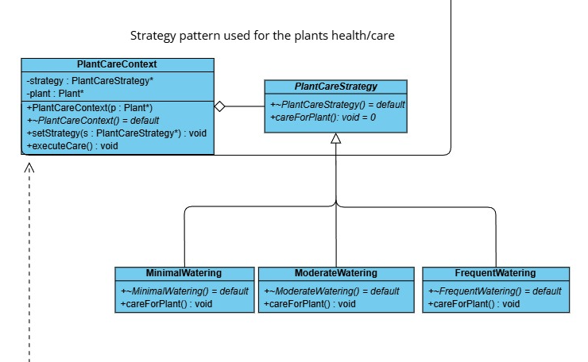
STRATEGY

Slide 18
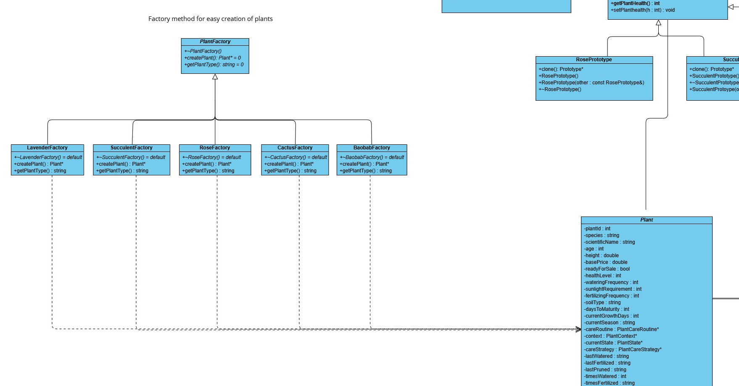
FACTORY METHOD

Slide 19
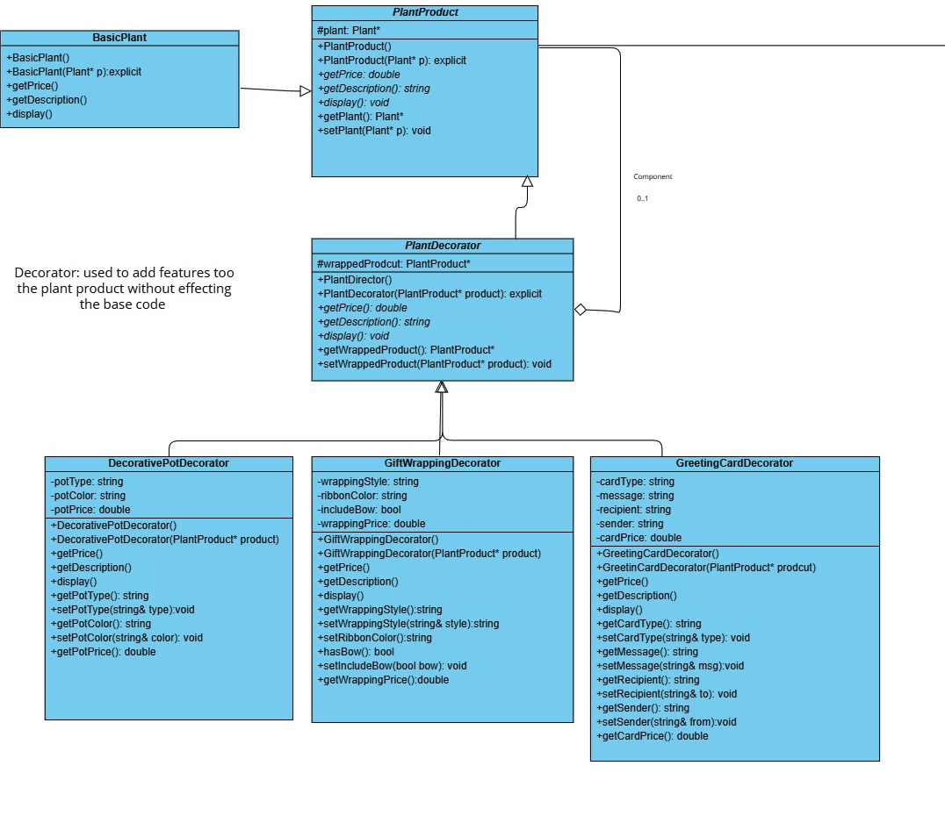
DECORATOR

Slide 20
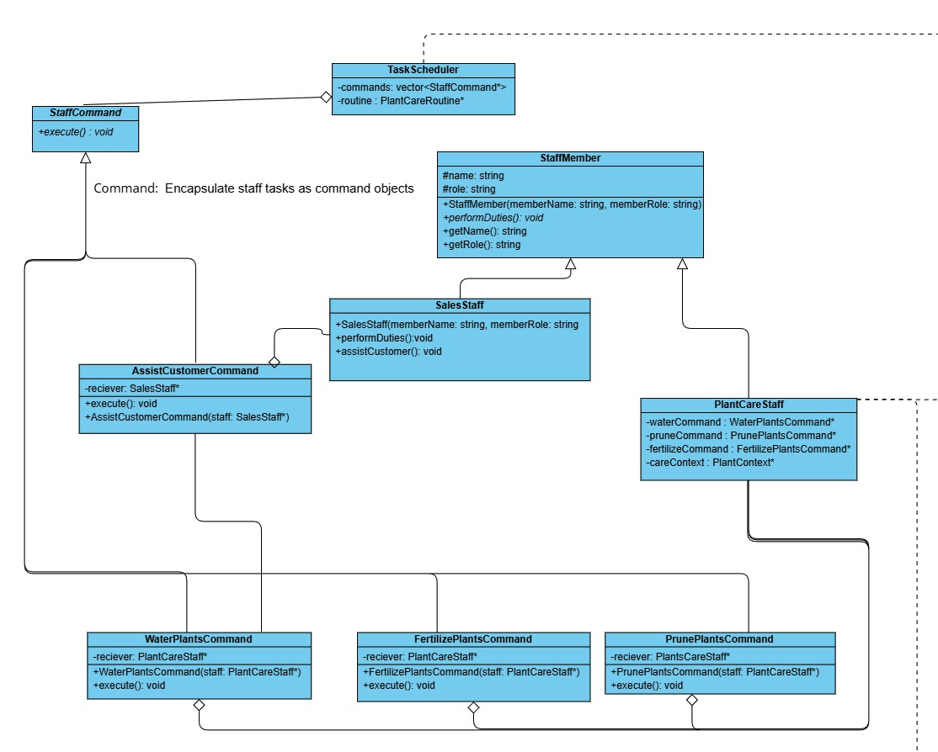
COMMAND

Slide 21
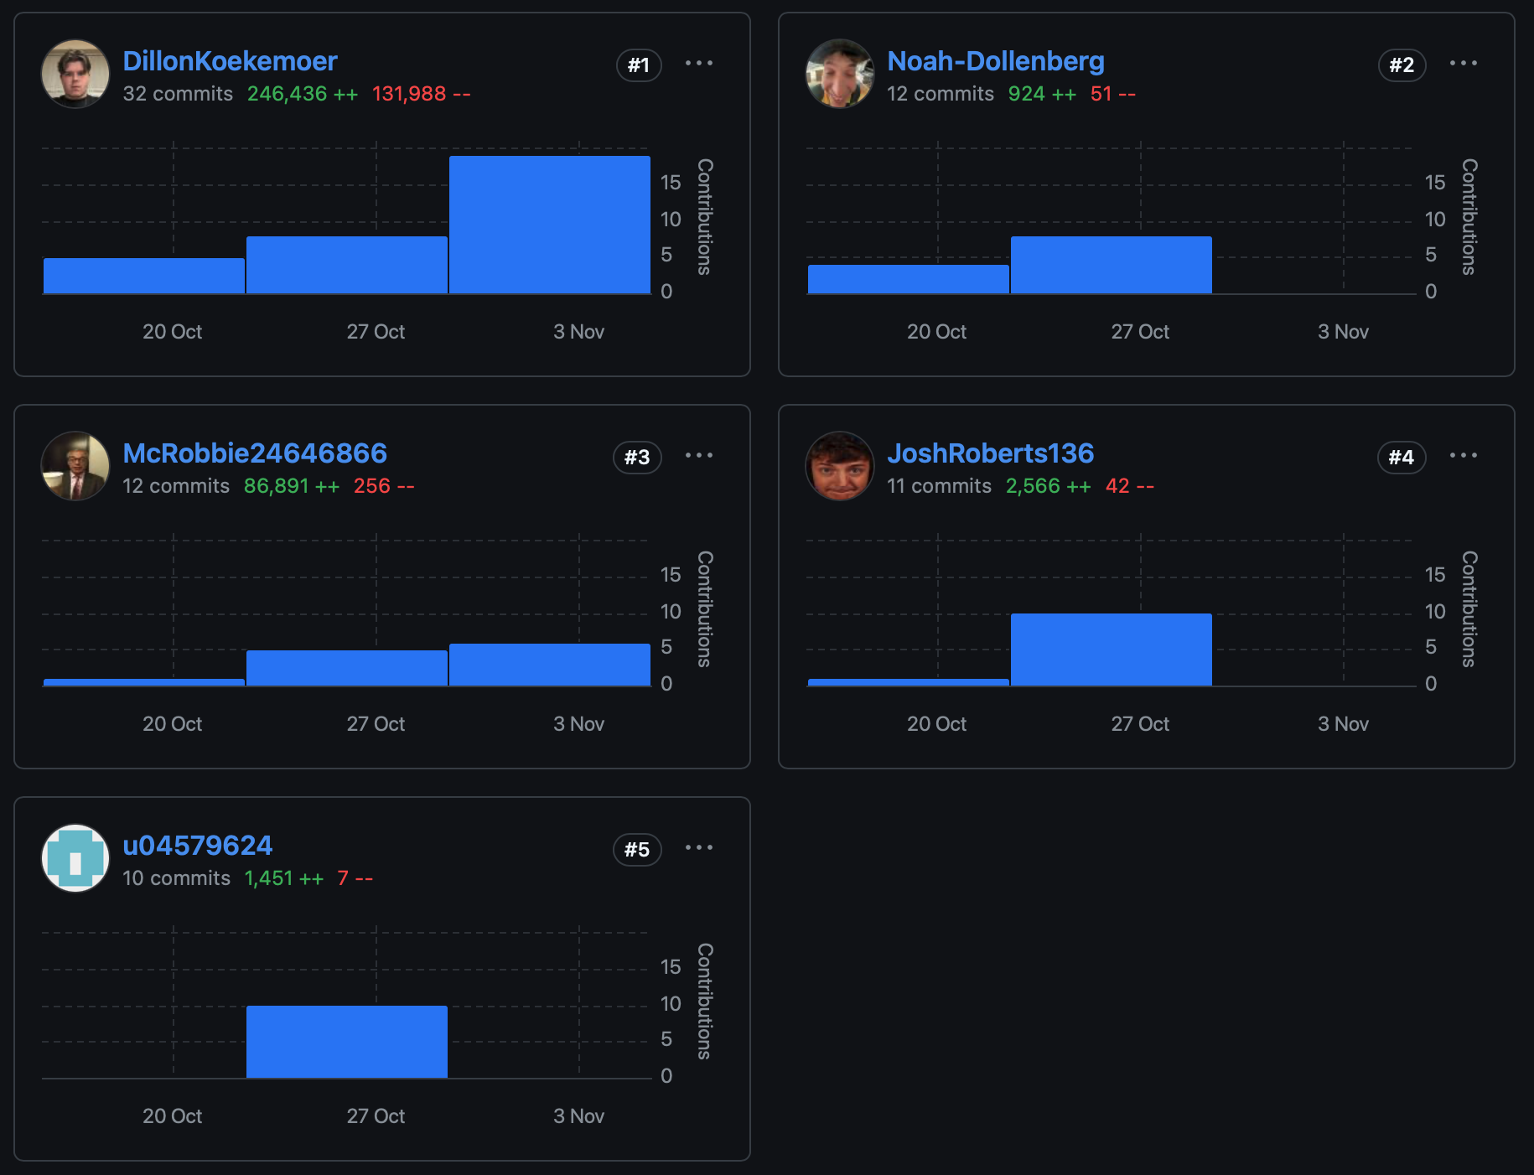
GITHUB
Commits

Slide 22
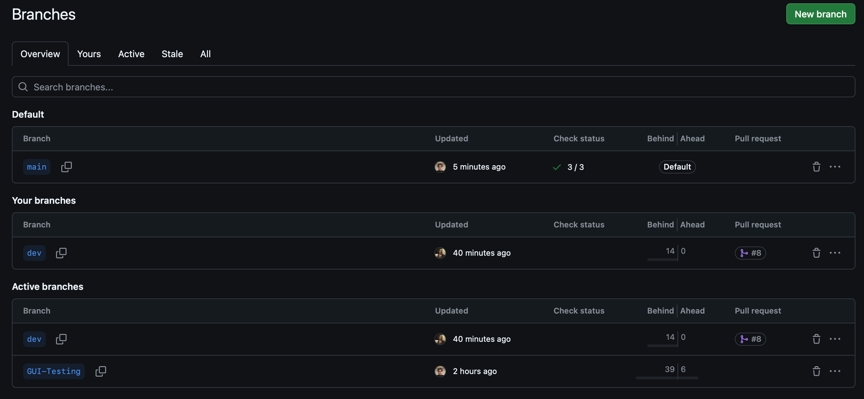
GITHUB
Branches

Slide 23
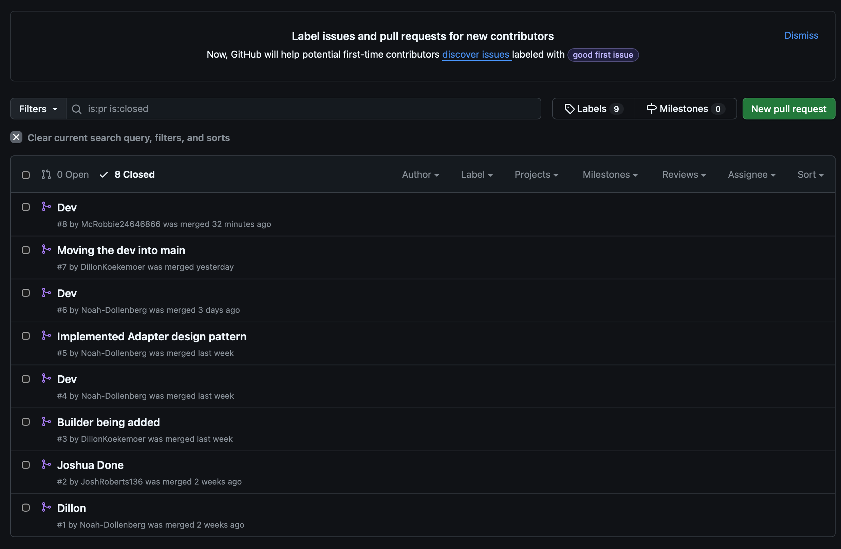
GITHUB
Pull Requests

Slide 24
AND FOR OUR NEXT TRICK…

