Slide 1

COS 214 PROJECT
PLANT NURSERY

Slide 2
BRAINS BEHIND THE PROJECT
Noah Dollenberg u24596142
Dillion Koekemoer u
David Potgieter u04579624
Dylan Mcrobbie u24646866
Josh Roberts u

Slide 3
FUNCTIONAL REQUIREMENTS
Greenhouse Management
Staff Management & Actions
Customers & Sales Management

Slide 4
GREENHOUSE MANAGEMENT
PLANT CARE HANDLING
The system manages the care routines for the different plant types, such as management of water amounts, fertilization, and other needs. It is different for every plant type.
PLANT LIFE CYCLE
The system manages the plants from planting seeds to growth to selling of plants. Selling of plants are determined by how far along each plant has grown.
INVENTORY TRACKING
The system maintains an inventory system that keeps track of all plants. Updating the inventory happens when plants have grown, been sold, or require care.
STOCK ADDITION
The system allows for adding new plant stock or plant types to the nursery.

Slide 5
STAFF MANAGEMENT & ACTIONS
PLANT TENDING
Staff does care routines on plants based on plant type.
INVENTORY COORDINATION
Staff keeps track and updates the inventory making sure that the greenhouse and sales are in sync.
CUSTOMER ASSISTANCE
Staff interacts with the customers by showing customer what is available for them to purchase.
ROLE EXTENSIBILITY
The system supports extending roles of staff (eg: delivery staff).

Slide 6
CUSTOMERS & SALES MANAGEMENT
CUSTOMER BROWSING
Customers can view available plants on sale based off of the inventory.
STAFF INTERACTION
Customers receive guidance from staff (available plants), purchasing from the staff, and change the inventory when a purchase is made.
SALES & TRANSACTIONS
The system handles plant purchases, including updating the inventory in real-time and processing the transactions.
CUSTOMER DECISION IMPACT
Customer actions (eg: buying a plant) affects the nursery operations, such as decreasing
the stock of the inventory.

Slide 7
SIMULATION
How does it work?
Explanation to how it works…
Aahdvsajhdvhasvdavsdhvasdhgvahsdgvhadvhagsvdhgasvdhgavsdhsgavhdgvahgsvdhgavsdhavhdvahsvdhgasvdgsvagvahgsvdhagvsdhavdhgavdgvashgdvagvd v v v vv v v vv v v vv vv v v g gg hg uey guyg uygd uygdydg ydgyu gdygdygd uyg uygdu yg uygd uygduy gduy gdu ygdu ygd
User Input:
Explanation to how it works…
Aahdvsajhdvhasvdavsdhvasdhgvahsdgvhadvhagsvdhgasvdhgavsdhsgavhdgvahgsvdhgavsdhavhdvahsvdhgasvdgsvagvahgsvdhagvsdhavdhgavdgvashgdvagvd v v v vv v v vv v v vv vv v v g gg hg uey guyg uygd uygdydg ydgyu gdygdygd uyg uygdu hbuvtgvggh

Slide 8
UML DIAGRAMS
State Machine
Sequence
Activity
Object
Communication
Class

Slide 9
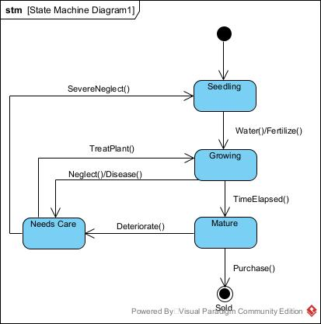
STATE MACHINE
DIAGRAM

Slide 10
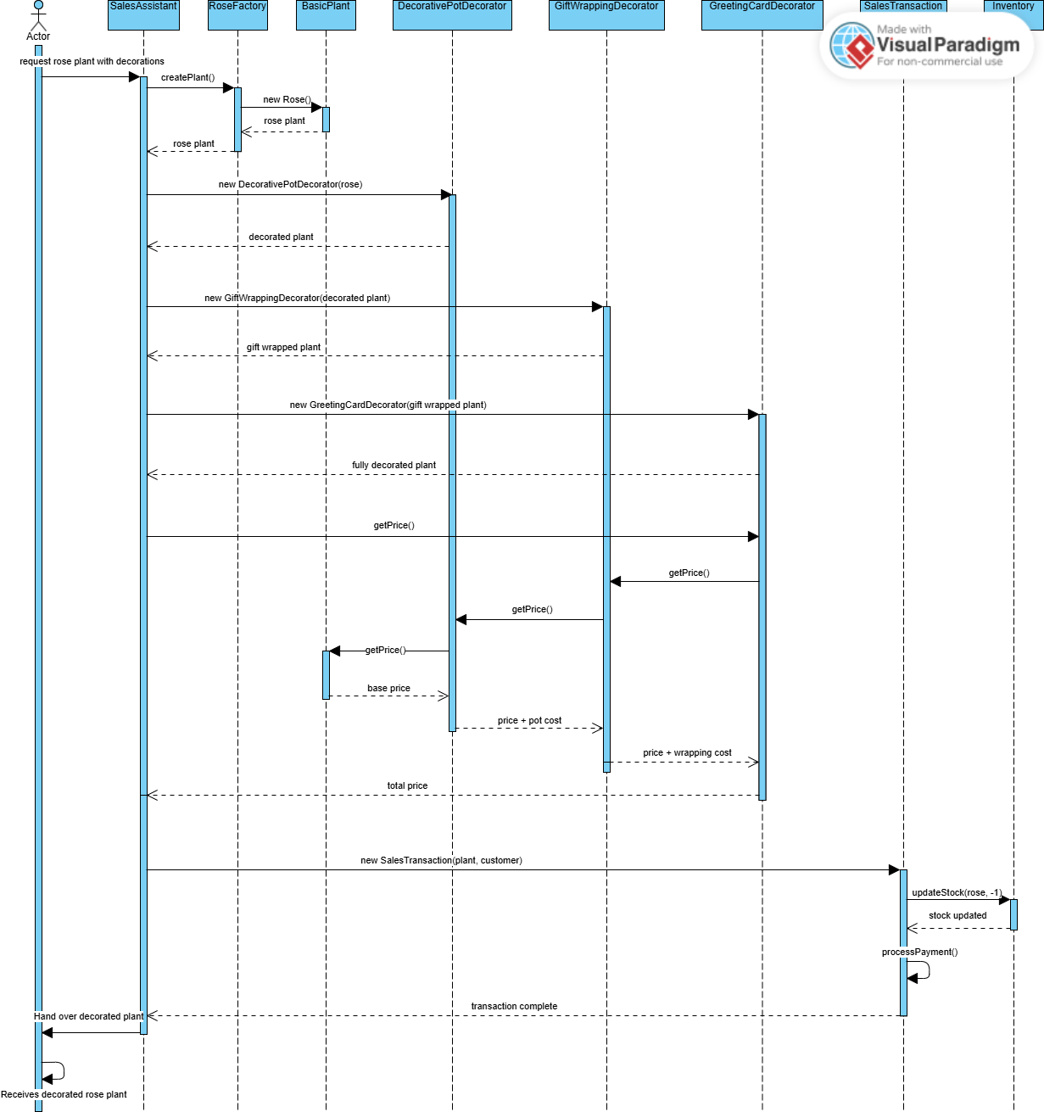
SEQUENCE
DIAGRAM

Slide 11
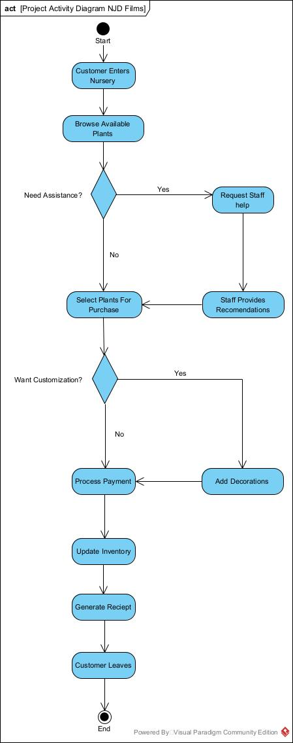
ACTIVITY
DIAGRAM

Slide 12
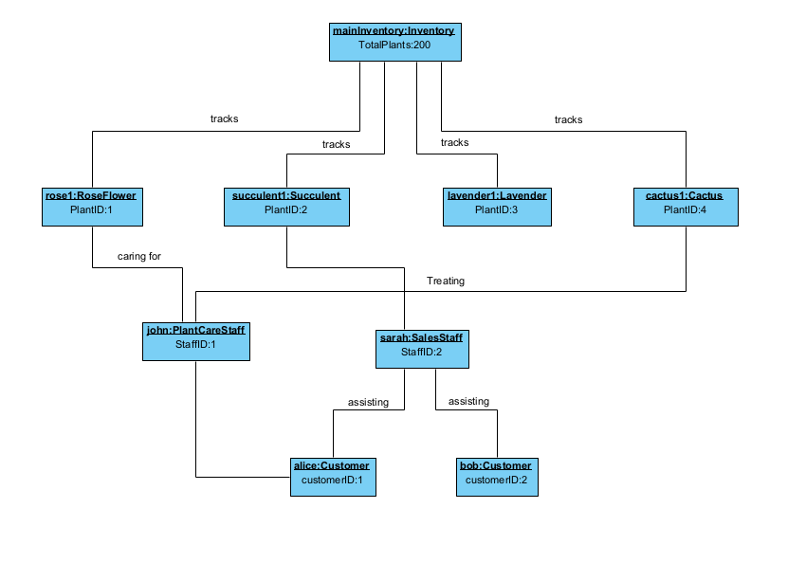
OBJECT
DIAGRAM

Slide 13
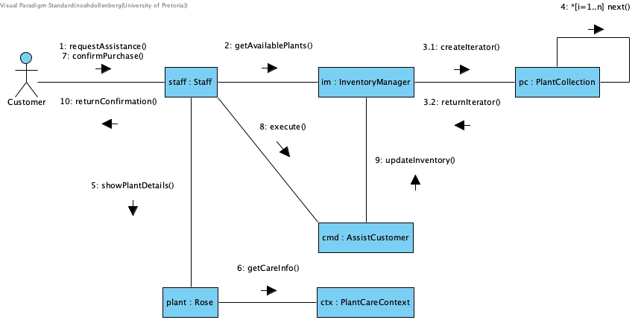
COMMUNICATION
DIAGRAM

Slide 14
CLASS DIAGRAMS
Template Method
Iterator
Adapter
Composite
Prototype
Builder
State
Strategy
Factory Method
Decorator
Command

Slide 15
TEMPLATE METHOD

Slide 16
ITERATOR

Slide 17
ADAPTER

Slide 18
COMPOSITE

Slide 19
PROTOTYPE

Slide 20
BUILDER

Slide 21
STATE

Slide 22
STRATEGY

Slide 23
FACTORY METHOD

Slide 24
DECORATOR

Slide 25
COMMAND

