Slide 1
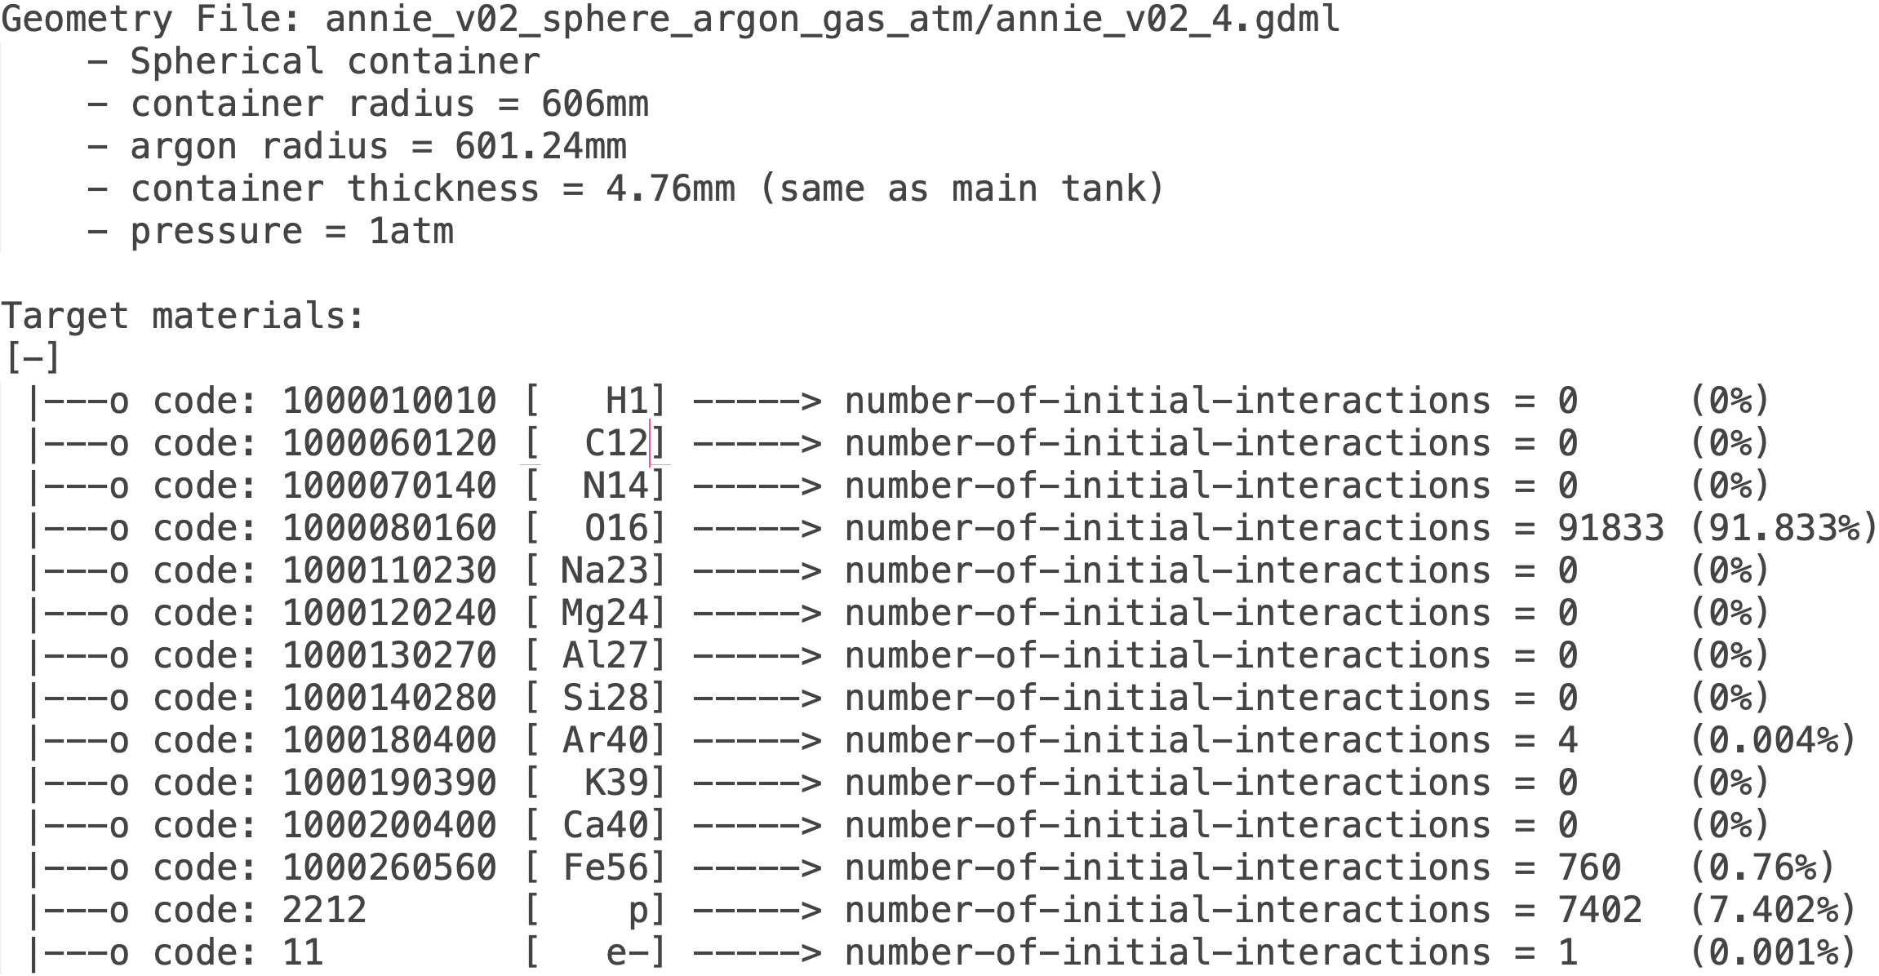
100,000 Events in TWATER_LV with Argon at 1atm
Noah Everett
Noah Everett
South Dakota Mines

Slide 2
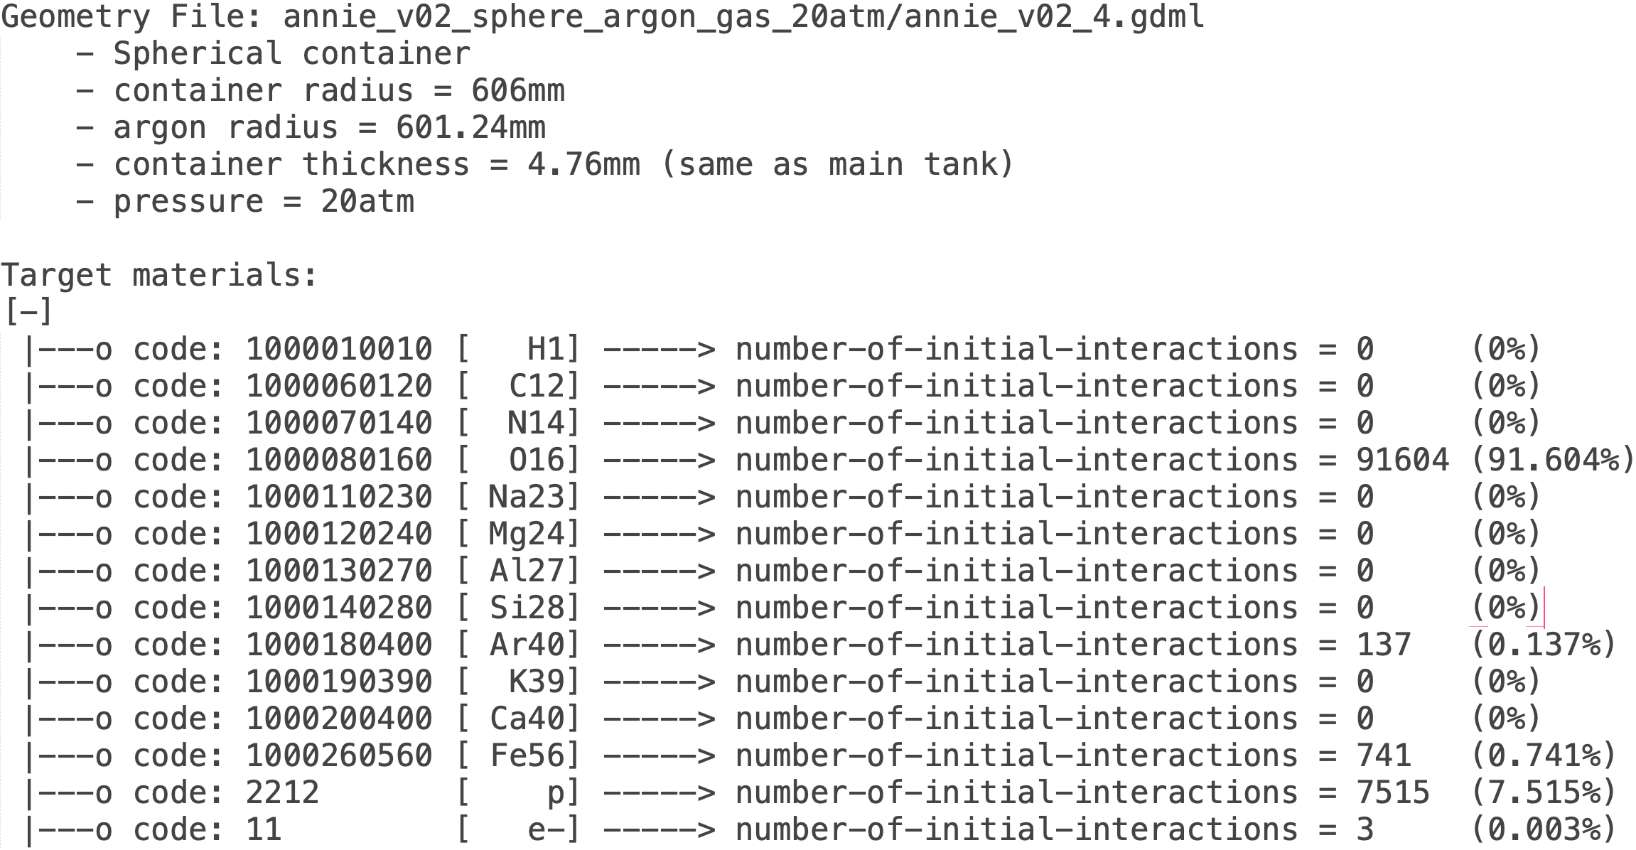
100,000 Events in TWATER_LV with Argon at 20atm
Noah Everett
Noah Everett
South Dakota Mines

Slide 3
100,000 Events in TWATER_LV with Argon at 1atm and 20atm
Rate increase of 34.25x.
Likely an error due to sample statistics.
Side Note: We are now getting interactions with electrons.
Noah Everett
South Dakota Mines

