Slide 1
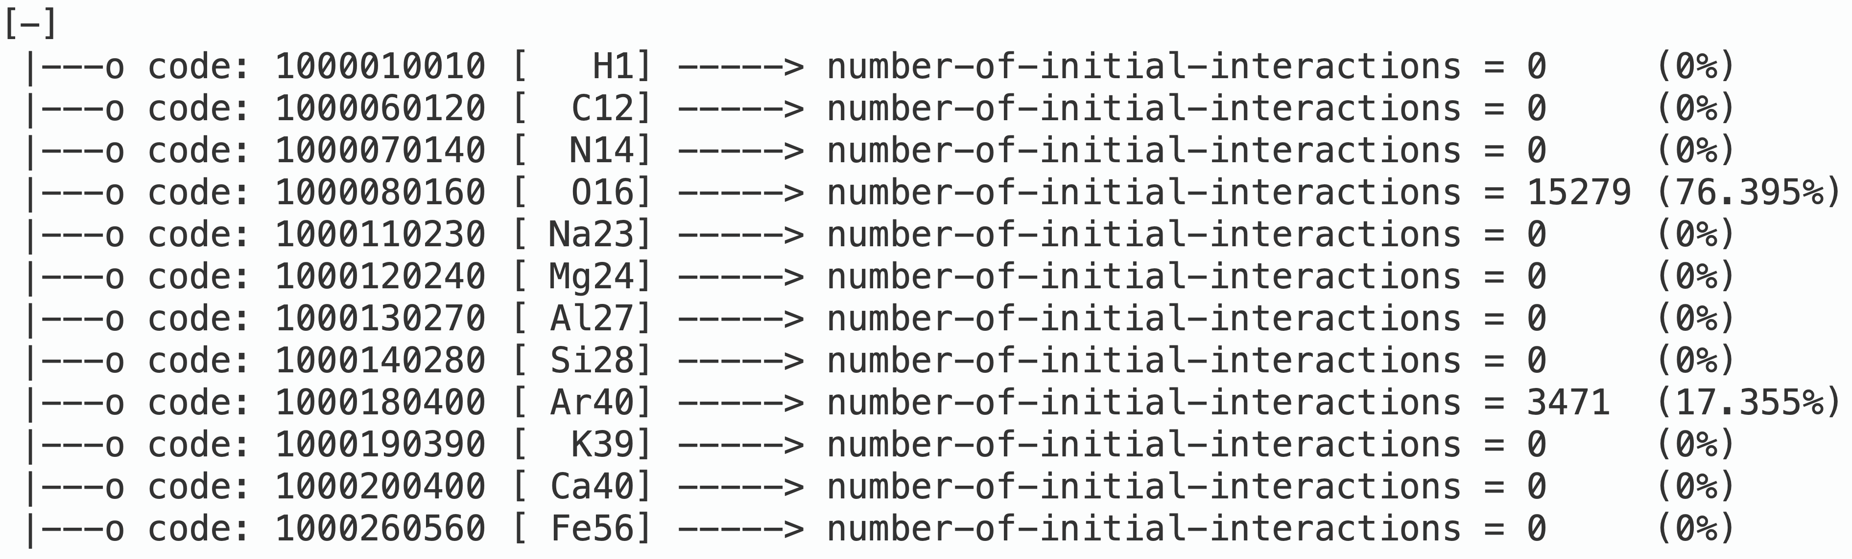
20,000 Events in TWATER_LV
Noah Everett

Slide 2
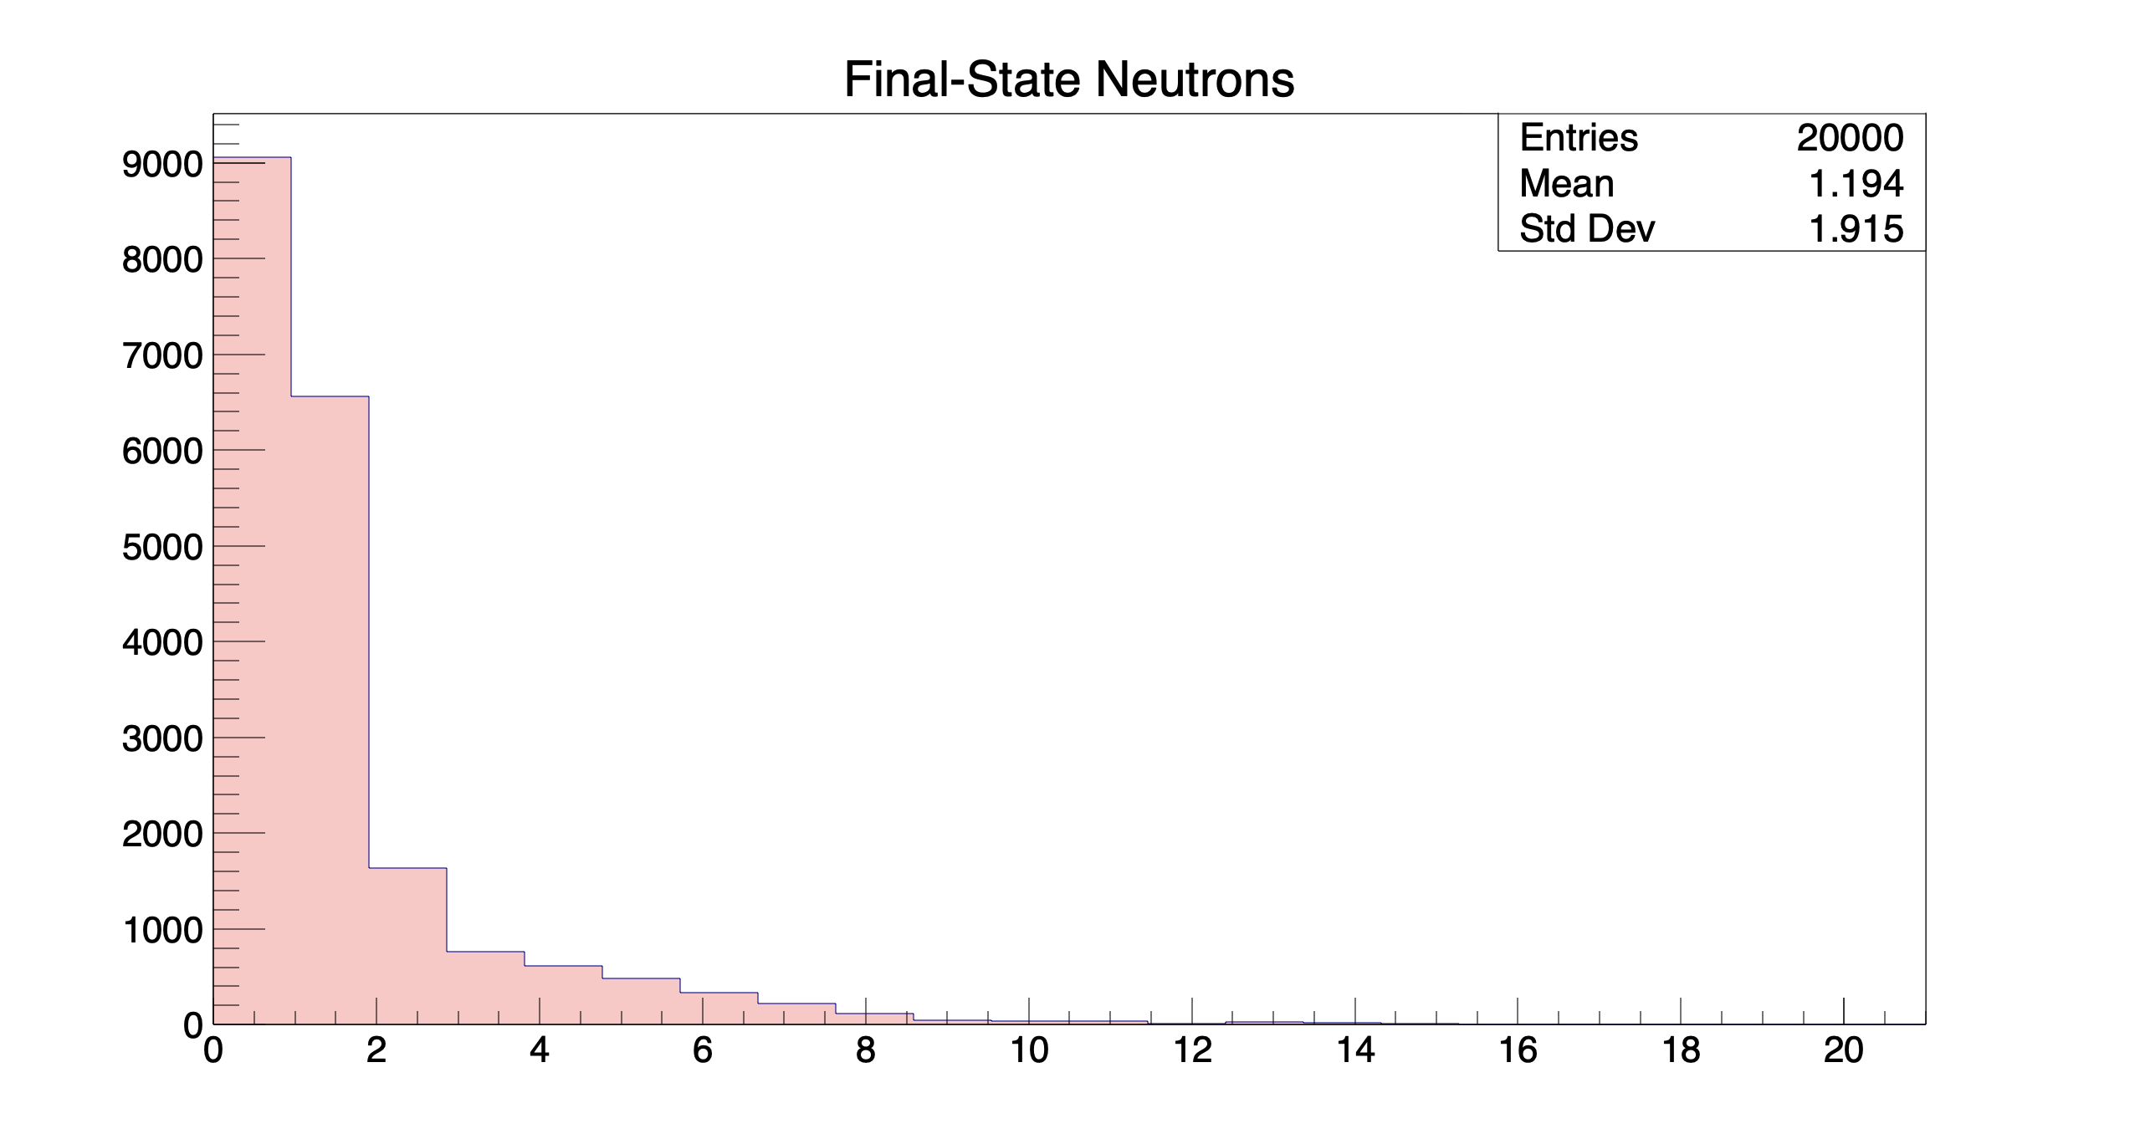
20,000 Events in TWATER_LV
Noah Everett

Slide 3
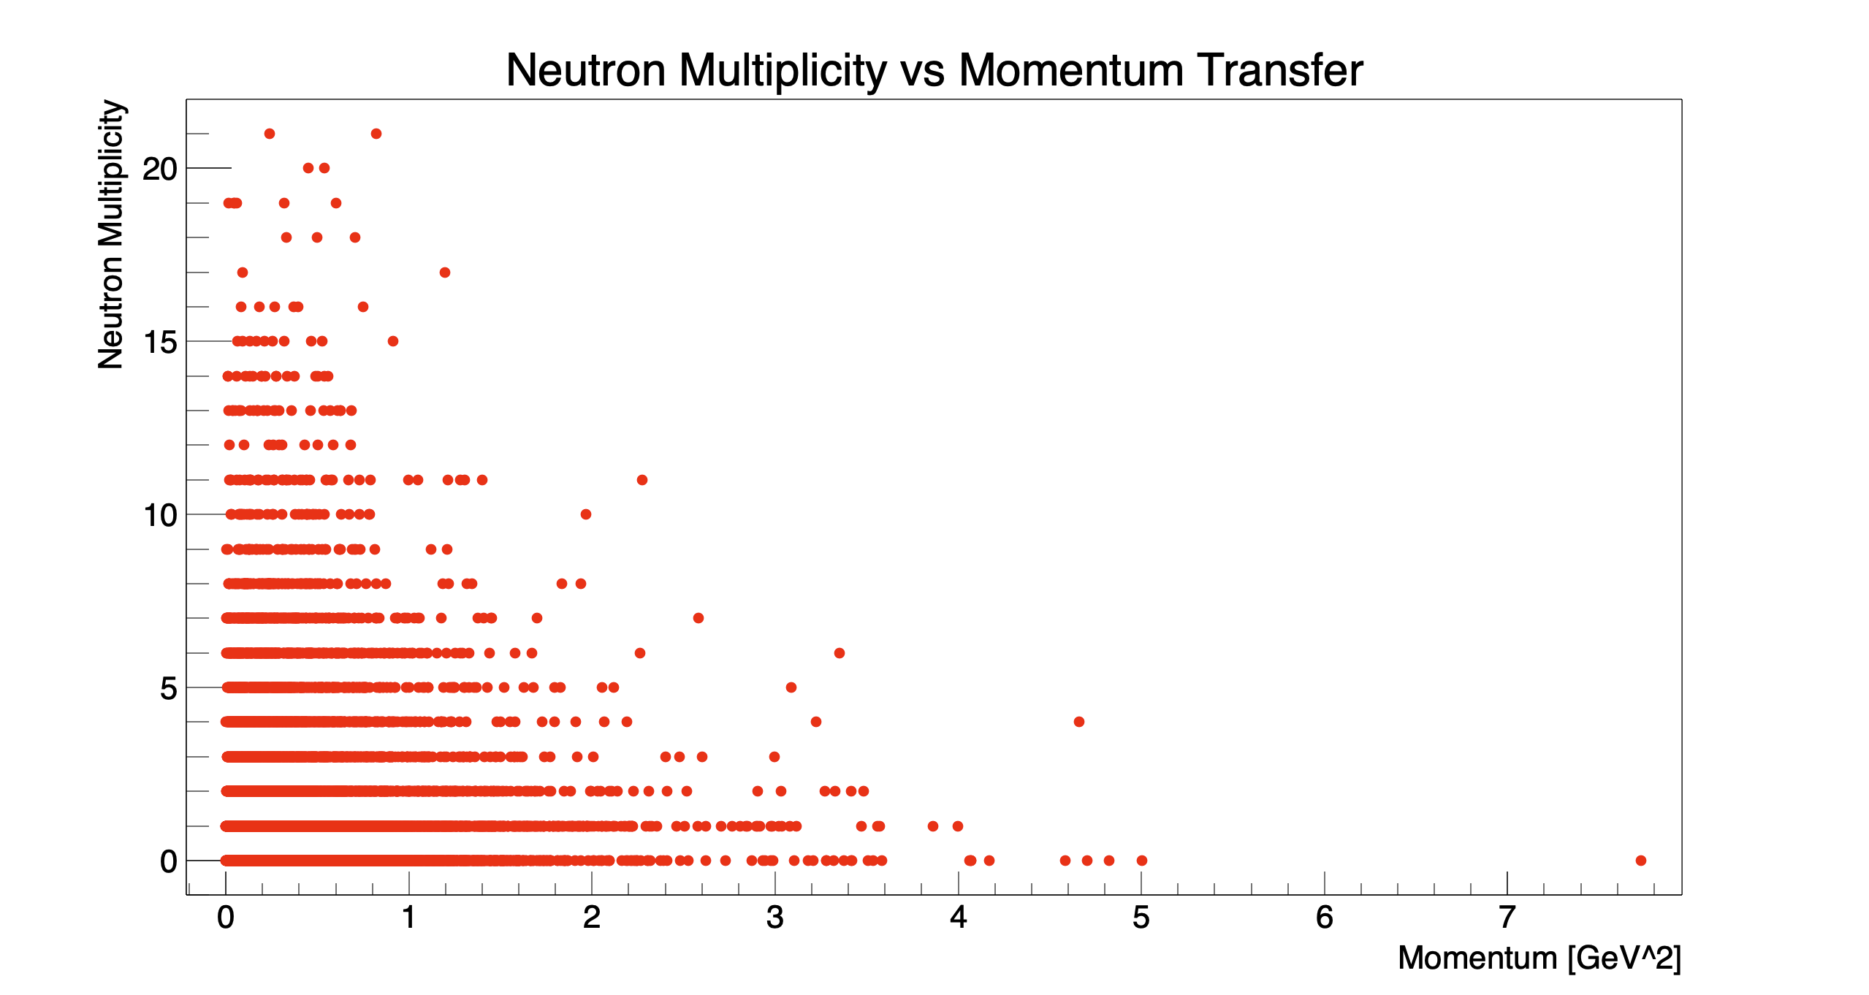
20,000 Events in TWATER_LV
Noah Everett

