Slide 1
House Price Prediction
From Specs and Exterior Photos
CSU Bakersfield, CMPS 4450 Data Mining Final
Noah Gallego, Gerardo Gomez, Justin Lo, Juancarlos Sandoval — Group 4

Slide 2
The Question
Specs Already Get Us Most of the Way. Can the Photo Close the Gap?
What We Know About Each House
Beds, baths, square footage, city, and one exterior photo.
The Experiment
Fit a model on specs alone. Then add features from the photo.
Does the second model beat the first?

Slide 3
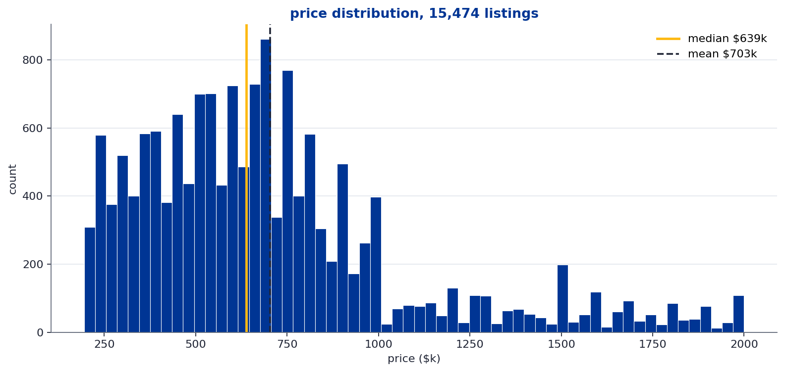
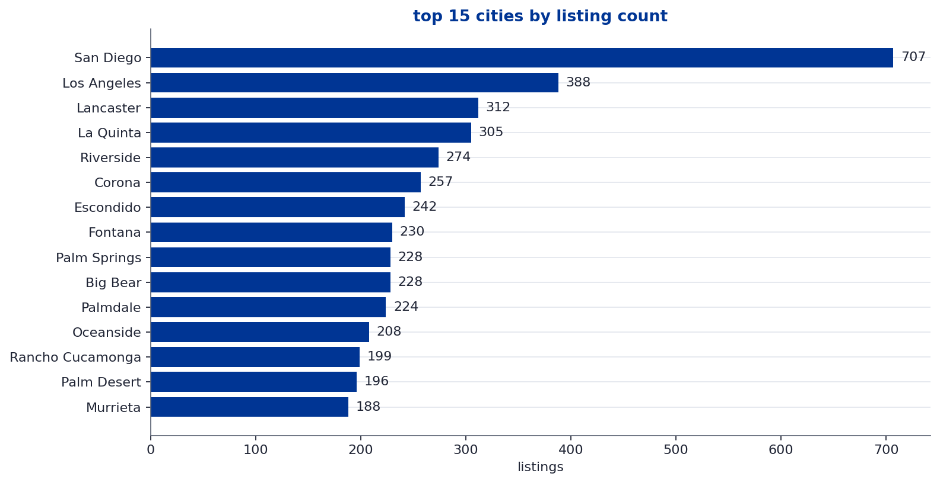
Data
15,474 Southern California Listings, $195k to $2M

Slide 4
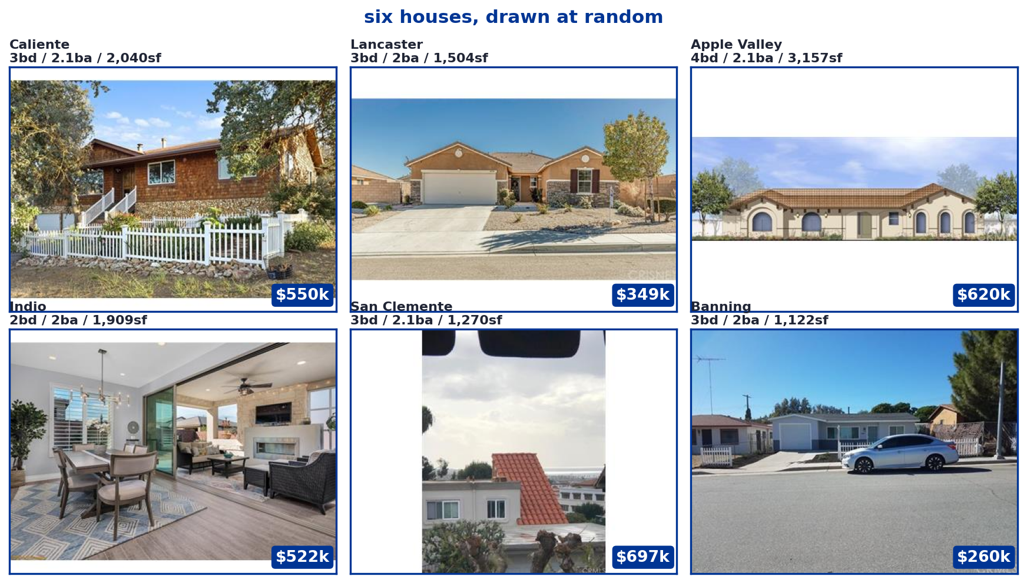
What a Row Looks Like
One Photo Plus a Few Numeric Fields Per House

Slide 5
Train, Validation, Test
How We Use the 15,474 Listings
How We Set It Up
Shuffle the listings and split 65 / 15 / 20 into train, validation, and test
Fit the models on train
Pick the model and its settings (KNN k) by validation error
Re-run the whole comparison on 500 random reshuffles to check stability
Open the test set once, at the end, with every choice already locked
Why This Design
One fixed split swings by several thousand dollars just from luck.
The reshuffles smooth that out, and the test number stays honest because
It never gets to inform a choice.

Slide 6
Eight Columns From Kaggle
What Arrived in the CSV, and What We Do With Each One
Column | Example | Action
image_id | 0 | Drop
street | 1317 Van Buren Avenue | Drop
citi | Salton City, CA | Convert to coordinates
n_citi | 317 | Drop
bed | 3 | Keep
bath | 2.0 | Keep
sqft | 1,560 | Keep
price | $201,900 | Target

Slide 7
City Names Become Coordinates
We Look Each City Up Once With a Geocoding API
The Lookup
City | Latitude | Longitude
Beverly Hills, CA | 34.0736 | -118.4004
San Diego, CA | 32.7157 | -117.1611
Bakersfield, CA | 35.3733 | -119.0187
Salton City, CA | 33.3030 | -115.9486
Why This Works
415 unique cities => 415 API calls, cached once on disk.
Every row gets its city's latitude and longitude.
Now 'nearest neighbor' actually means geographically near, not just same city name.

Slide 8
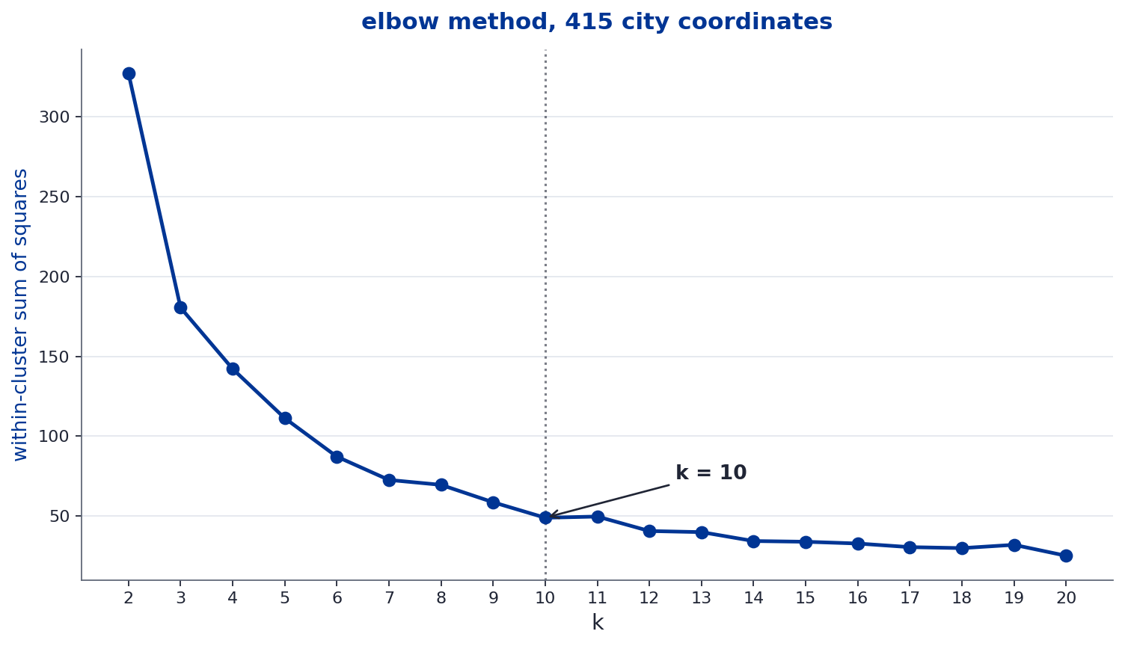
Why k=10?
Elbow Method on 415 City Coordinates

Slide 9
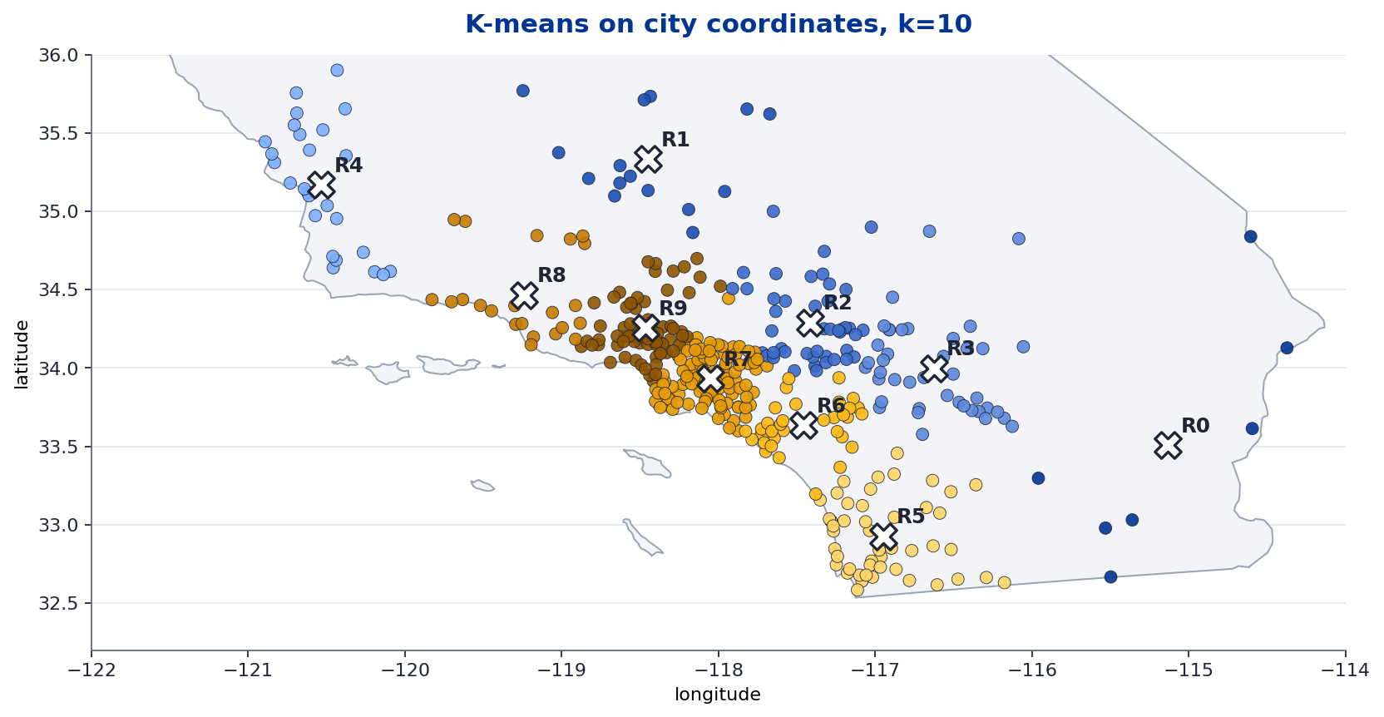
Grouping Cities Into Regions
K-Means on the 415 City Coordinates, k=10
The Idea
K-means takes the
Coordinates and groups
Nearby cities together.
Every row gets one
Extra feature: region_id.

Slide 10
Normalize So No Column Dominates
Rescale Every Feature to the Same Range
Feature | Raw Range | After Min-Max
bed | 1 to 6 | 0 to 1
bath | 1 to 5 | 0 to 1
sqft | 500 to 5,400 | 0 to 1
city_lat | 32.5 to 35.4 | 0 to 1
city_lon | -119.5 to -114.5 | 0 to 1
region_id | 0 to 9 | 0 to 1

Slide 11
Two Models
To Establish a Text-Only Baseline Before We Touch the Photos
Multiple Linear Regression
KNN Regressor
One weight per feature, all summed plus an intercept.
Prediction =
w1*bed + w2*bath + w3*sqft
+ w4*city_lat + w5*city_lon + w6*region.
Fast and transparent. Assumes the relationship
is a straight line.
For a new house, find the k closest houses in
feature space.
Predict by averaging their prices
(regression, not voting).
Needs normalized features. Tuned by k
and by the distance function.

Slide 12
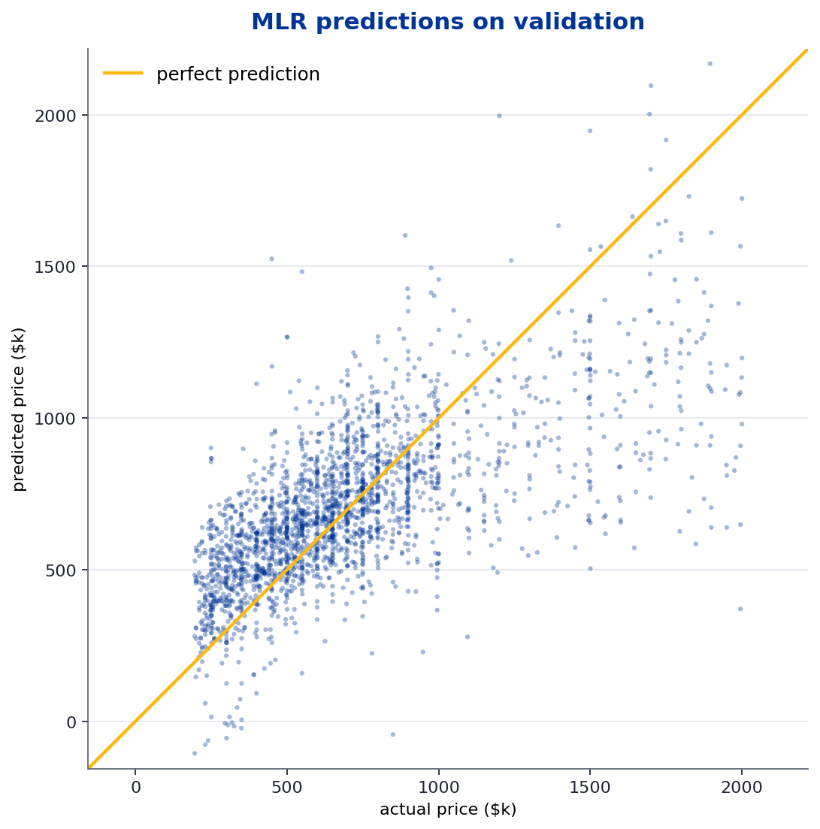
Multiple Linear Regression
Validation Performance, Predicted vs Actual Price
Results
MAE
$200k
RMSE
$280k

Slide 13
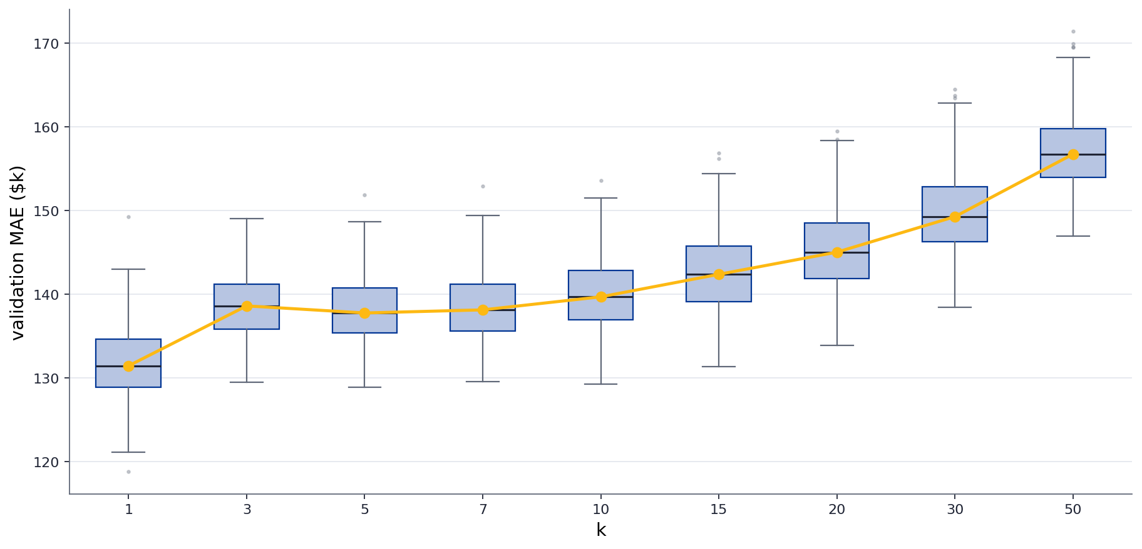
KNN With Euclidean Distance
Each Box Summarizes 500 Random Reshuffles at That k

Slide 14
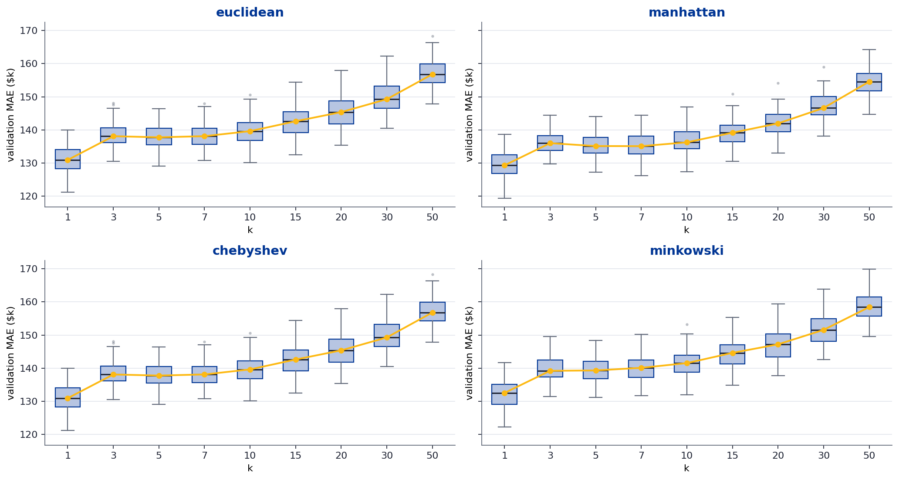
We Repeated This for All Four Distance Functions
Euclidean, Manhattan, Chebyshev, Minkowski

Slide 15
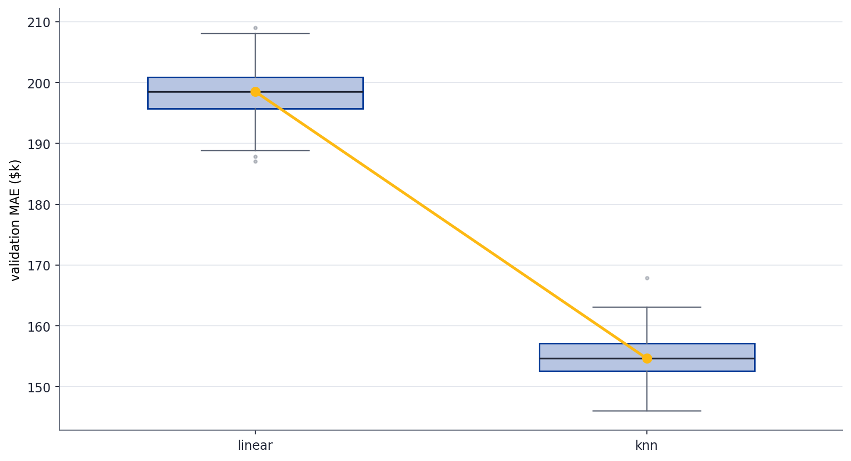
Specs Only Is Already Strong
Error in Dollars, Lower Is Better
Specs-Only Baseline
500 reshuffles,
specs-only models.
KNN around $152k MAE.
Linear around $164k.
Both are well above
the constant predictor
at $280k.

Slide 16
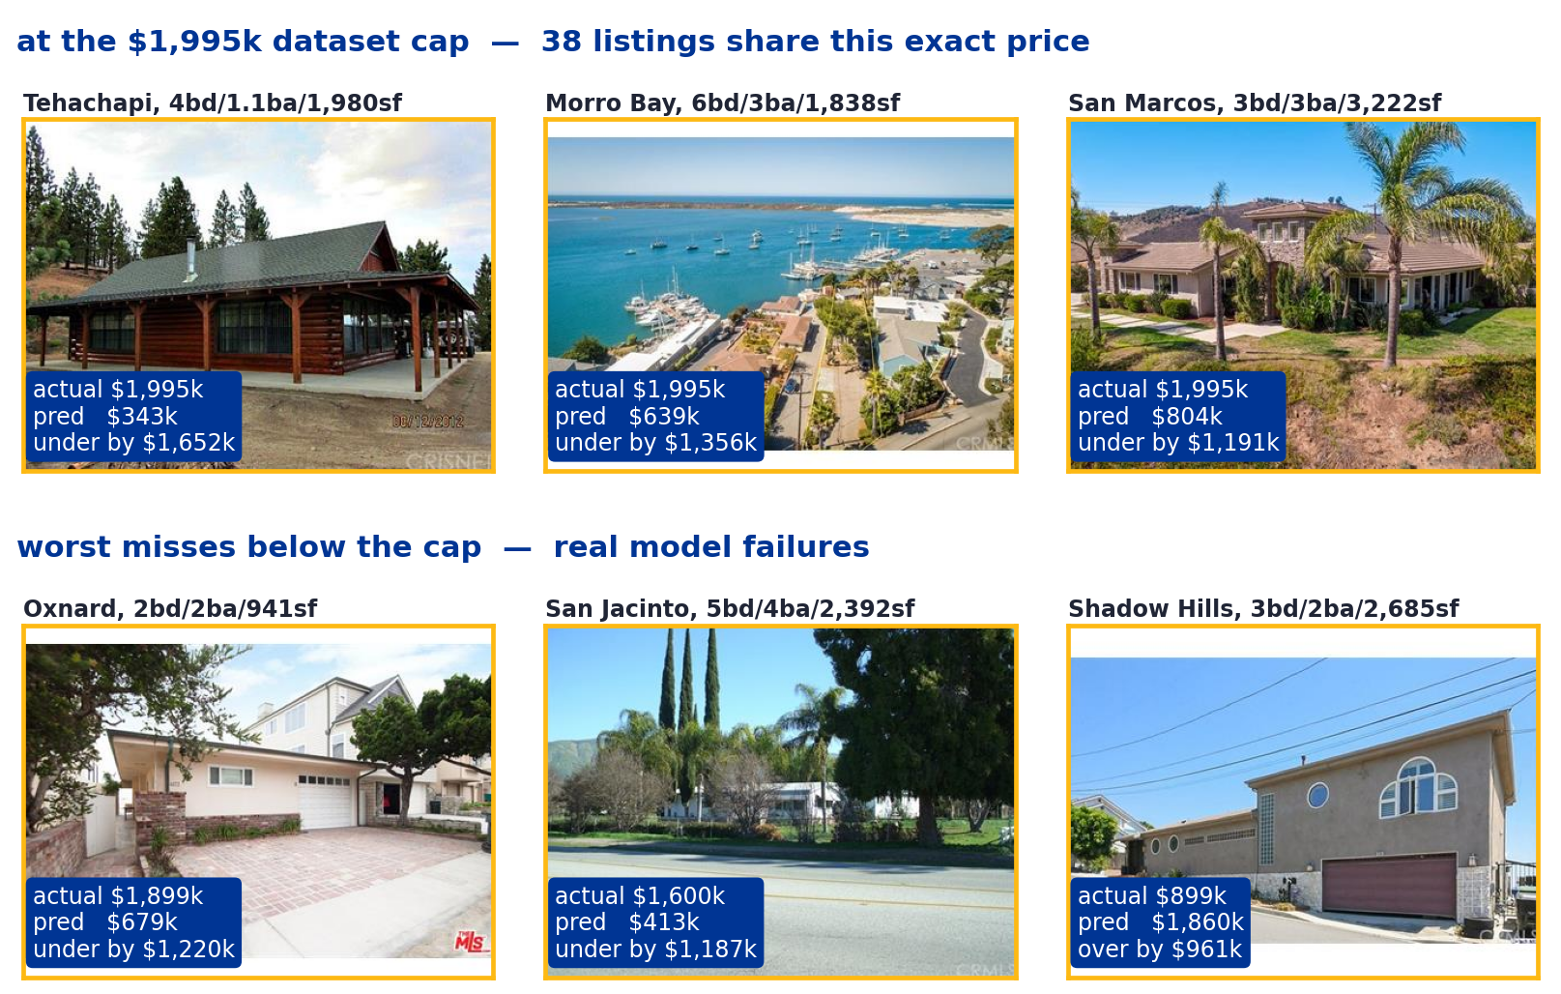
Where the Baseline Misses
The Top Six Errors Split Into Two Kinds

Slide 17
Three Things the Photo Could Fix
The Case for Adding Image Features
Condition
Size Beyond Sqft
Neighborhood Look
Same specs, different
upkeep and landscaping.
That lives in the photo.
Story count, lot size,
yard space. Specs miss
those. The photo doesn't.
Trees, driveway, fencing,
lighting. Signals the
street, not just the city.

Slide 18
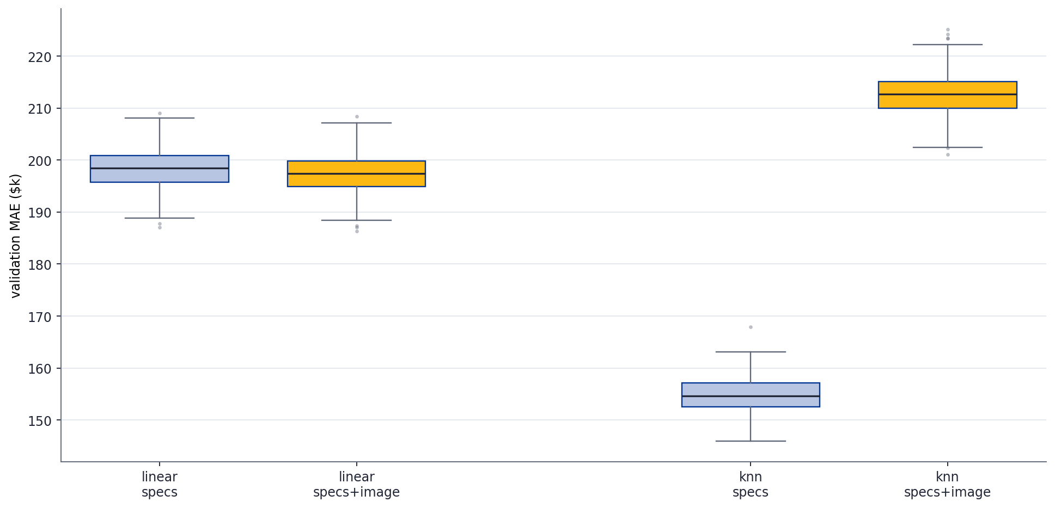
Adding Photo Features
Same Two Models, With and Without the Photo

Slide 19
What We Tried
Three Preprocessing Fixes, Each Motivated by a Problem Above
Center Crop
Throw out the outer 20% on every side, focus on what's in the middle of the frame.
Addresses photos where sky or pavement dominates.
Per-Image Normalize
Rescale each photo so its mean brightness matches every other photo.
Addresses photos shot at different times of day or different exposures.
Add HSV Channels
Compute hue, saturation, and value averages on top of RGB.
Color signal that doesn't change with brightness.

Slide 20
Did Preprocessing Help?
Validation MAE by Feature Variant, Linear and KNN
Feature Variant
Linear MAE
KNN MAE
Best
Specs Only
$165k
$150k
$150k
Specs + Raw Photo
$165k
$181k
$165k
Specs + Center Crop
$165k
$181k
$165k
Specs + Brightness Norm
$165k
$181k
$165k
Specs + Crop + Norm + HSV
$165k
$188k
$165k

Slide 21
Why Not Just Feed in the Pixels?
The Dimensionality Wall
Each Photo Is 128 x 128 x 3 = 49,152 Pixel Values
Training Set Has Roughly 10,000 Houses
More Inputs Than Examples
The model can fit anything in training and learn nothing useful.
Linear regression is underdetermined.
KNN sees pixel positions as unrelated columns — shift the house
Ten pixels left and every input value changes.

Slide 22
A Filter Is a 3x3 Window That Slides Across the Photo
The Kernel Is Fixed, the Output Is a Smaller Summary

Slide 23
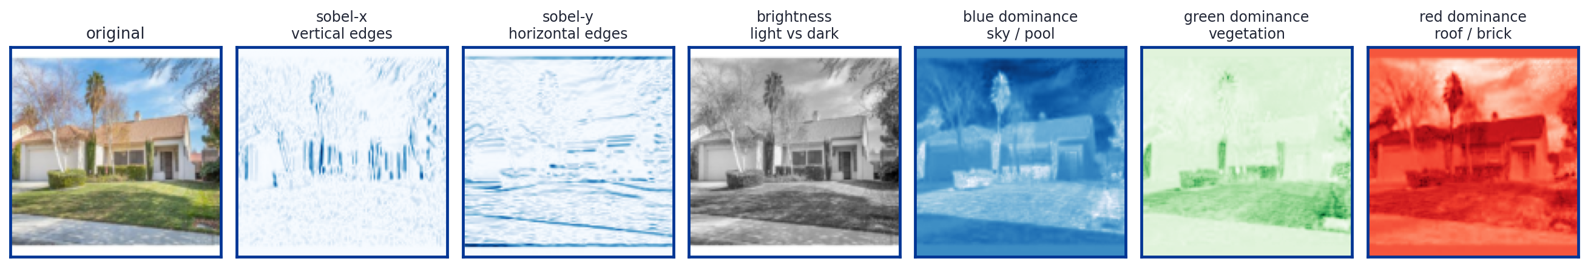
Our Six Filters
One Photo, Six Response Maps

Slide 24
What the Model Sees, End to End
100 Numbers Per House
From the Listing
From the Photo
Beds
Baths
Square footage
Typical price in that city
6 filters, each pooled to 4 x 4
= 96 numbers describing
What's where in the photo

Slide 25
Did Spatial Features Help?
Validation MAE, by Feature Set and Model
Feature Set
Linear
KNN
Best
Specs Only
$165k
$150k
$150k
Specs + Spatial (96)
$164k
$218k
$164k
Spatial Only
$269k
$265k
$265k

Slide 26
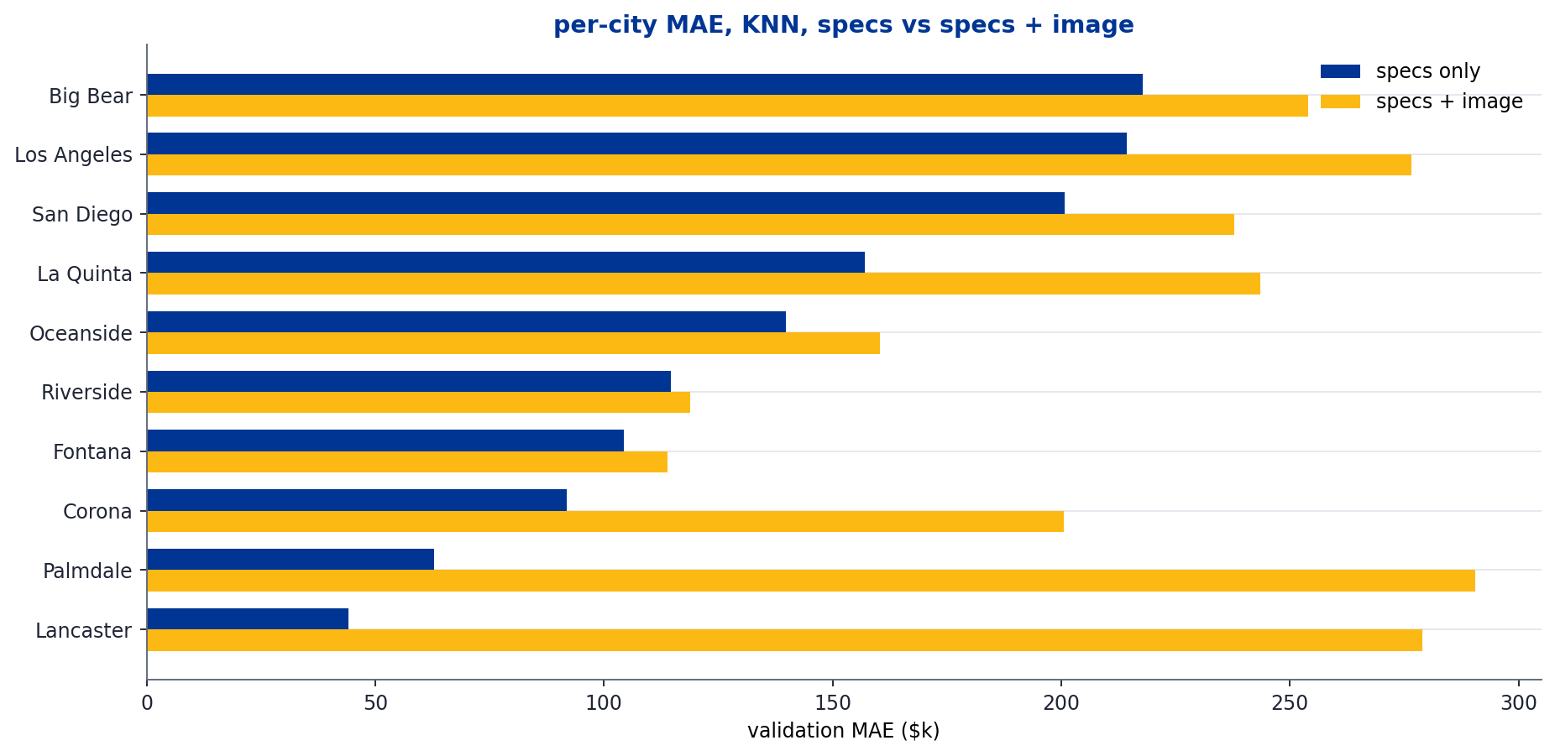
Per-City, With and Without the Photo
KNN, Specs Only vs Specs + Image. Two Cities Benefit a Little. The Rest Get Worse.

Slide 27
Final Test Results
Trained on Train + Val, Evaluated Once on the 3,095 Held-Out Test Rows
Model
Features
MAE
RMSE
% Within $50k
% Within $100k
Constant
None
$270k
$366k
13.9%
27.1%
Linear Regression
Specs
$164k
$233k
23.2%
44.5%
Linear Regression
Specs + Spatial
$163k
$233k
23.1%
44.8%
KNN, k=15
Specs
$150k
$224k
29.4%
51.0%
KNN, k=15
Specs + Spatial
$208k
$291k
15.8%
33.9%

Slide 28
Conclusion
Specs already carry the price signal.
The photo, hand-summarized in numpy, does not add anything on top.
What We Tried
27 simple image features and 96 spatial filter features.
Preprocessing (crop, normalize, HSV) didn't help.
Neither linear nor KNN improved with photo features added.

